Slide 1
Radiometry Updates

Slide 2
WISP DAY 1, Wavelength (nm) v. Ed
O
O
O
O
O
Down-welling Irradiance, 0 to 2 Watts/m²·nm
O = “Open Ocean Stations”

Slide 3
WISP DAY 1, Wavelength (nm) v. Lu
O
O
O
O
O
0 to 0.01 Watts/m²·nm·sr

Slide 4
WISP DAY 1, Wavelength (nm) v. Ld
O
O
O
O
O
0 to 0.4 Watts/m²·nm·sr

Slide 5
WISP DAY 1, Wavelength (nm) v. MEDIAN Ed (Blue) Ld (Green)
O
O
O
O
O

Slide 6
WISP DAY 1, Wavelength (nm) v. MEDIAN Ed (Blue) Lu (Green)
O
O
O
O
O

Slide 7
795/740 Analysis…What Causes +750 Kick Up?
Characteristic | Minimum Ratio (least kick) | Maximum Ratio (most kick)
Rrs | -36.1 | 11.0
Lu | 1.06 | 1.07
Ld | 0.87 | 0.90
Ed | 0.92 | 0.94
Numerator (Lu-0.028Ld) | -33.4 | 10.4

Slide 8
WISP/SAS/PRO Comparison

Slide 9
Hyper-Pro Profiles…Still In Progress Monday: No dark detector data files??? Wednesday: Cast 1/6 no dark file, rest of profiles ‘processed’

Slide 10
Example E_{d} profile for Wednesday (Cast 6):
Different colors represent different wavelengths

Slide 11
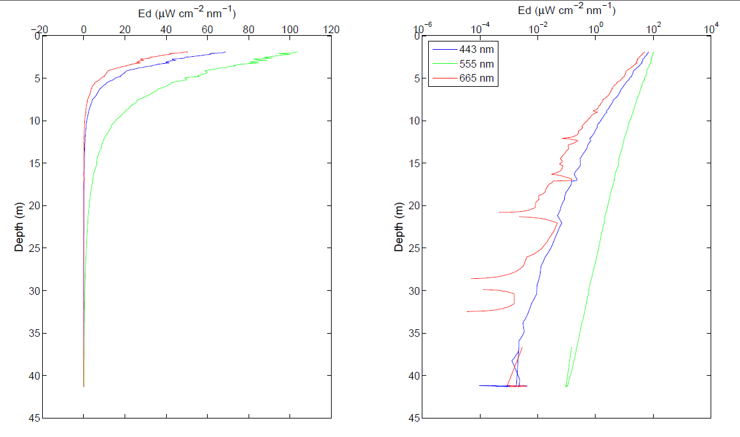
Example Ed profile on Wednesday. Different colors represent different wavelengths.

Slide 12
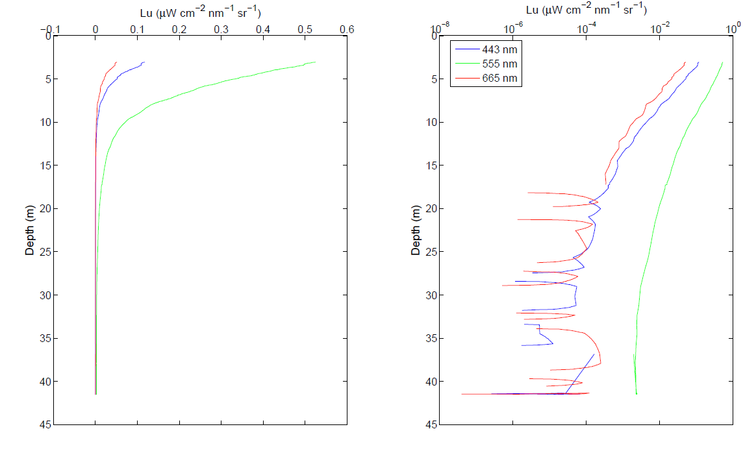
Example Lu profile on Wednesday. Different colors represent different wavelengths.

