Slide 1
Backscattering sensors
BB9
&
ECO VSF

Slide 2
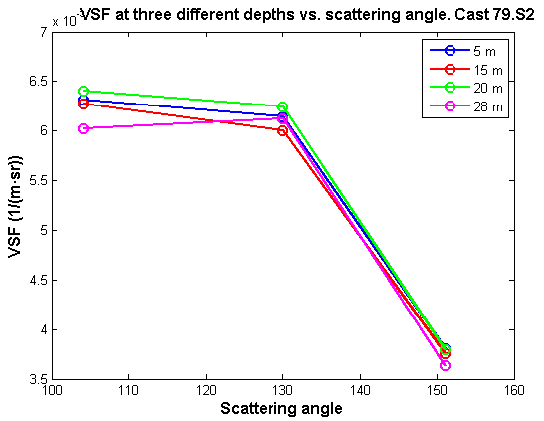
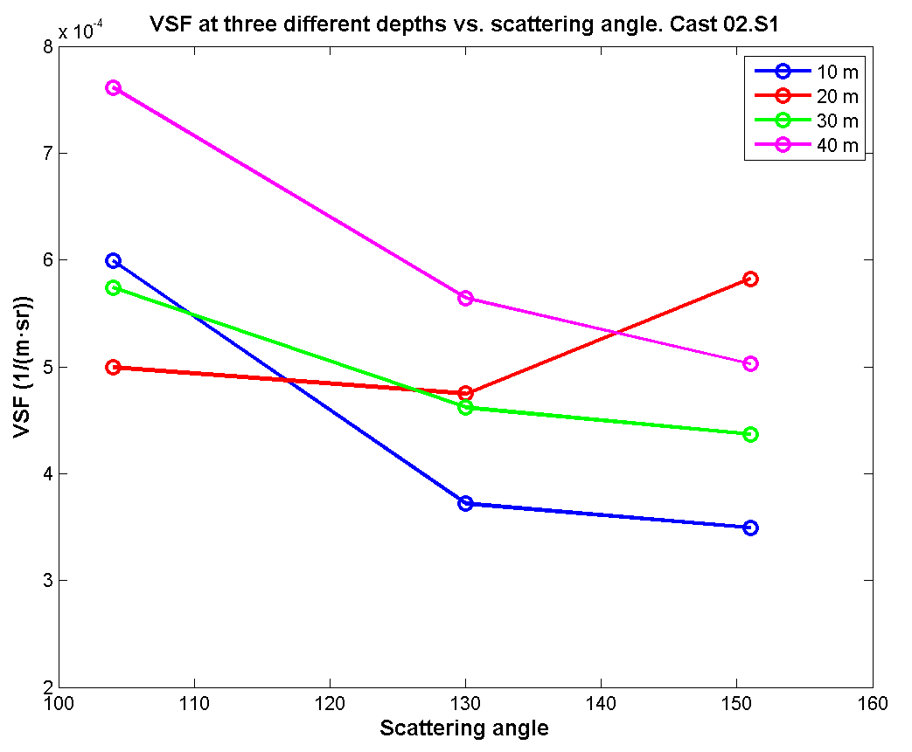
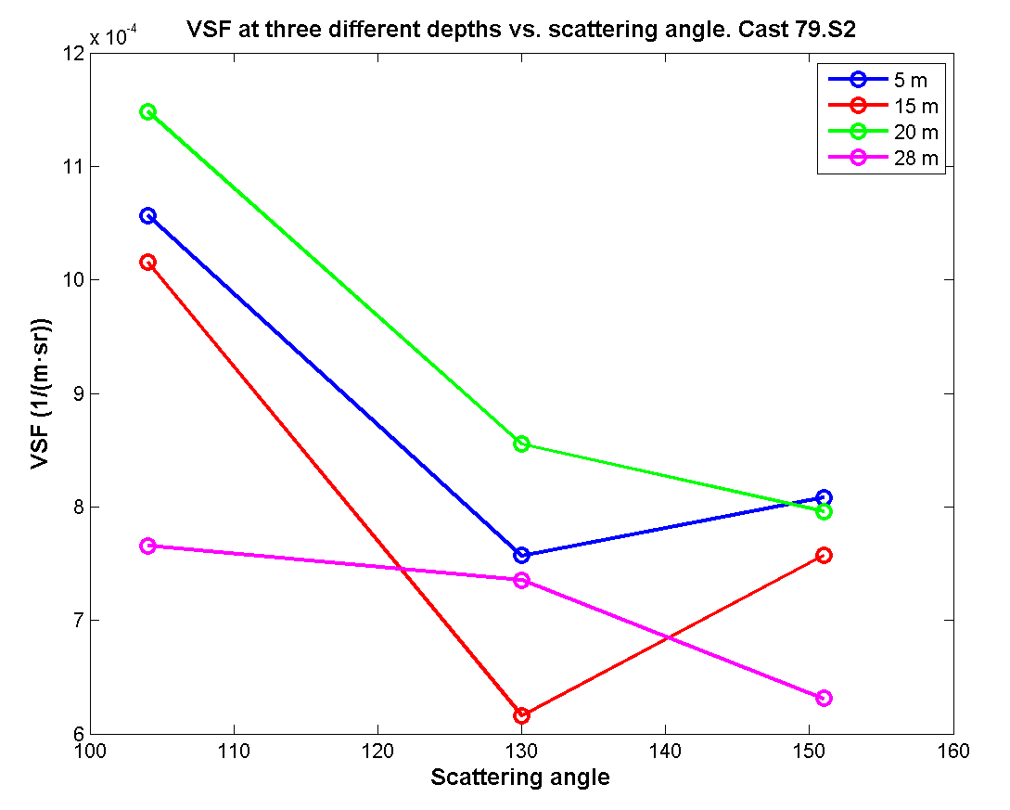
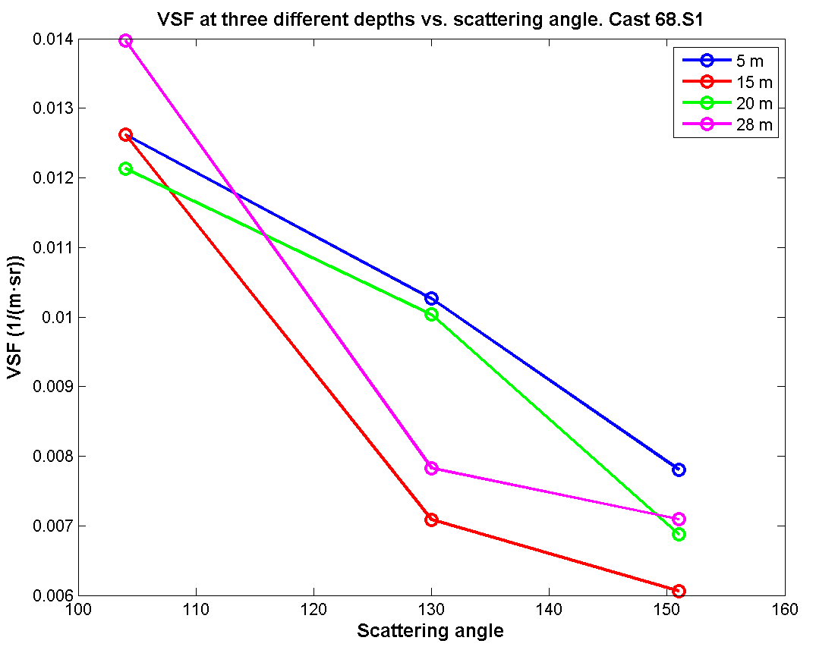
ECO VSF
Last week…
After checking the code...

Slide 3
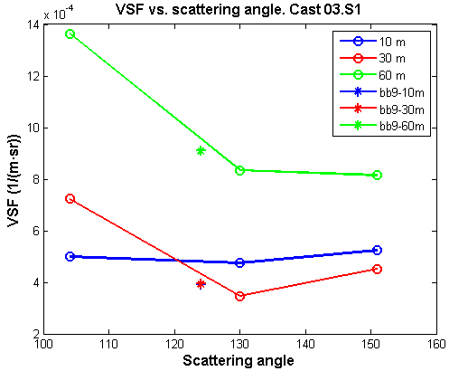
Comparison VSF vs scattering angles for both instruments

Slide 4
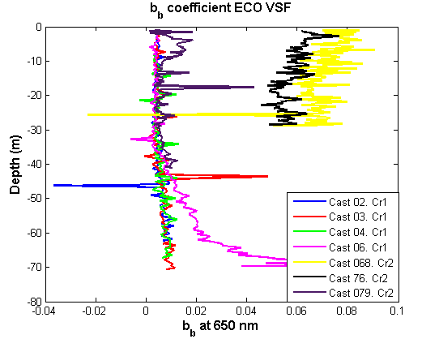
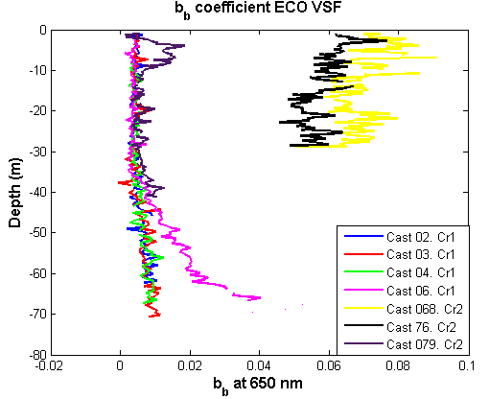
b_{b} coefficient (all the casts)
Before removing the spikes
After removing the spikes
River station (black and yellow lines) value of b_{b} coefficient much higher

Slide 5
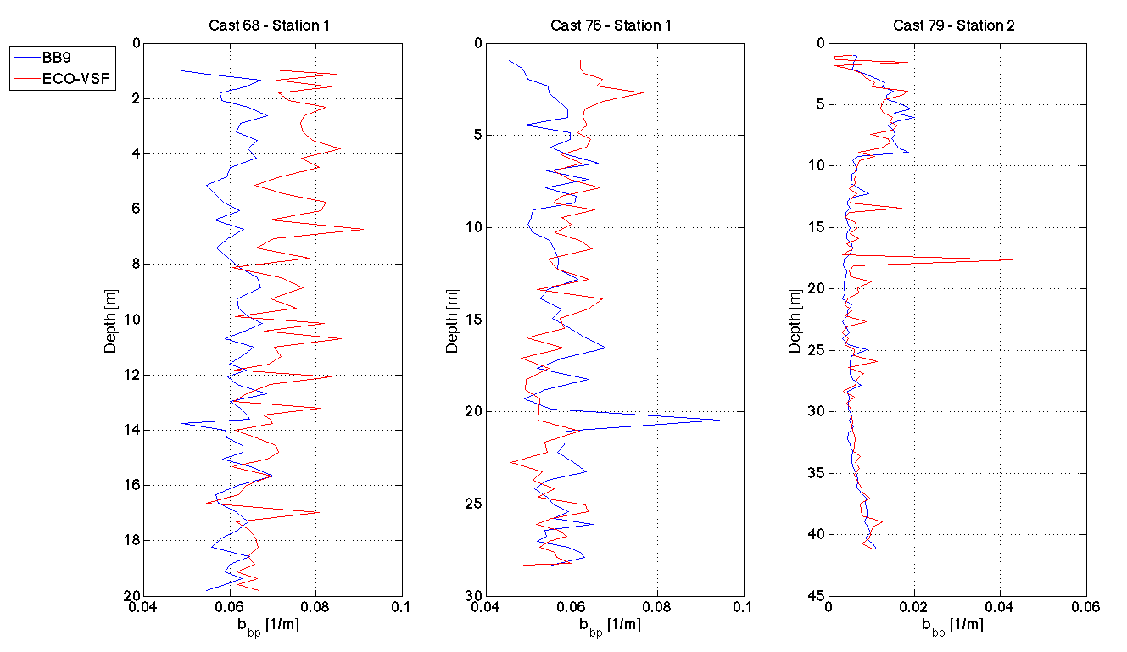
b_{b} comparison between ECO VSF & BB9 for the Cruise 2
CLOSURE
More differences on the river station. Check again after absorption corrections

Slide 6
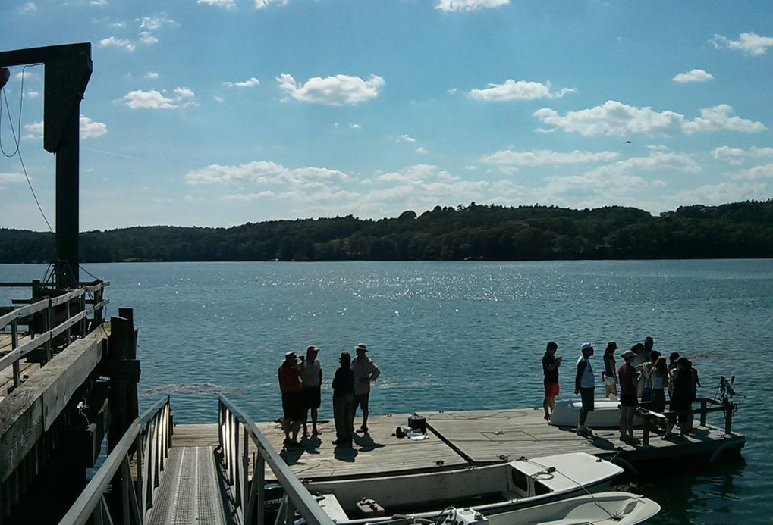
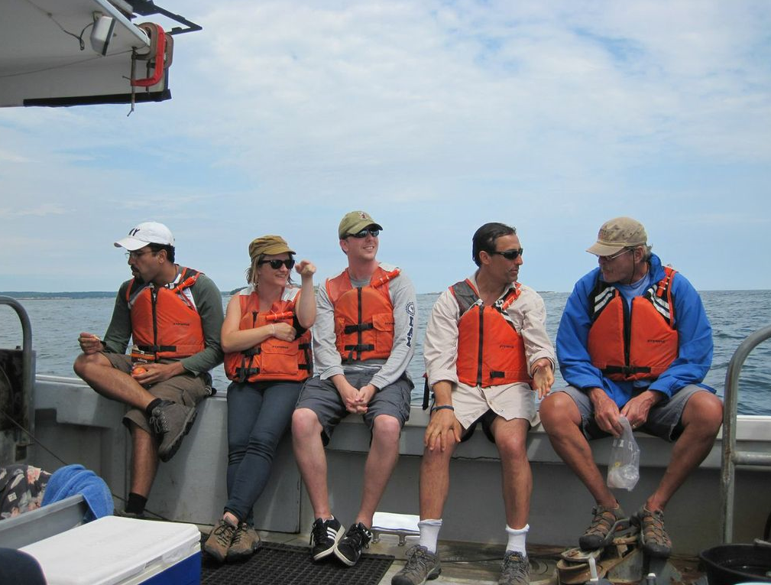
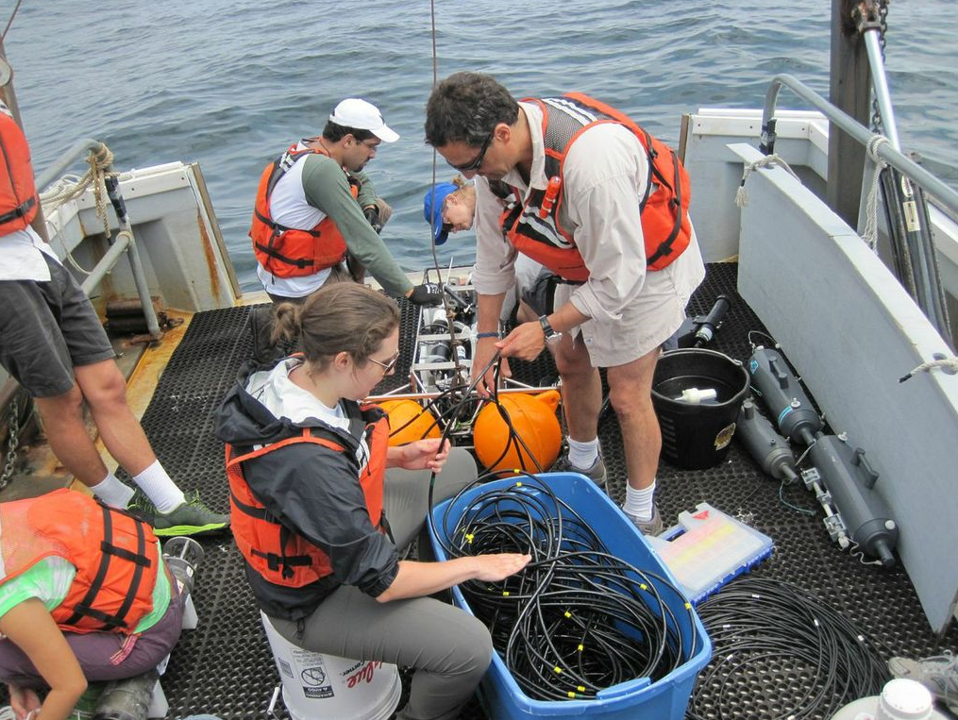
Next steep:
absorption corrections based on AC-S data

