Slide 3
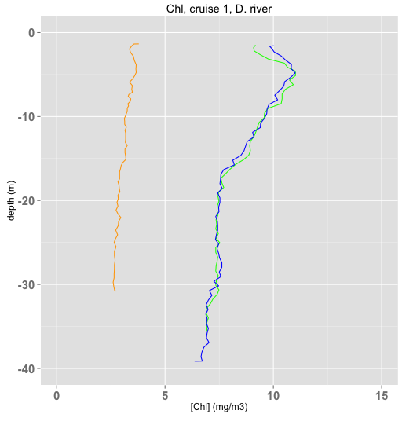
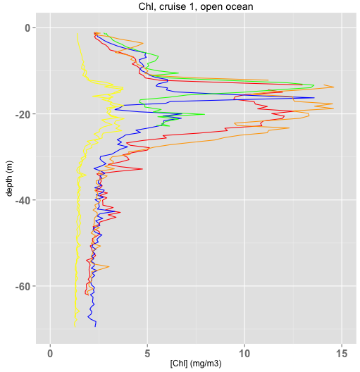
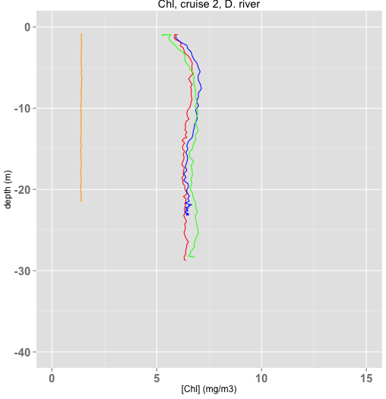
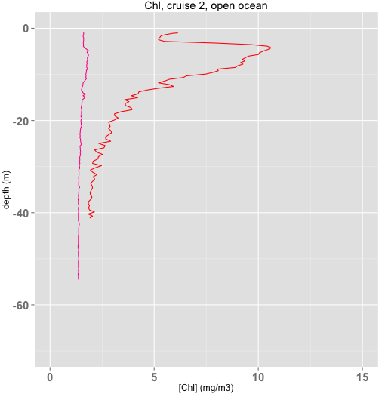
0m = 2.90 mg/m3
4m = 2.44 mg/m3
0m = 0.54 mg/m3
4m = 0.65 mg/m3
0m = 2.05 mg/m3
5m = 1.19 mg/m3
0m = 1.41 mg/m3
4m = 3.12 mg/m3
Notes:
Cruise1 DR: cast 2 belonging to the open ocean?
Cruise1 open ocean: BT seems abnormal. Maybe the BT was removed during the downcast.
Open ocean: DCM at 20m (cruise1) and 10m (cruise2) at the thermocline and pycnocline.

