Slide 1
DATA PROCESSING & ANALYSIS

Slide 2
HyperSAS and HyperPro
Raw Data
Convert from counts to physical units
Level 2
Processed Data
SOFTWARE: SatView/SatCon
ADDITIONAL DATA PROCESSING
Dark
Corrections
Interpolate to
bins of wavelengths
Quality Control (tilting corrections, etc)
Align data
in time
DATA ANALYSIS
Determine AOPs
Closure Analysis
Comparison with
other radiometric
sensors
Calculate
median and std
K
PAR
R
Rrs
Notes:
After returning from the field, there are many steps to transform the raw data into a useable product. Here we show a general schematic for processing HyperSAS and HyperPro data.

Slide 3
WISP
Raw Data
Send raw data directly to the WISP manufacturer
Level 2
Processed Data
DATA PROCESSING
Dark
corrections
Interpolate to bins of wavelengths
Quality Control
Align data
in time
DATA ANALYSIS
Determine AOPs
Closure analysis
Comparison with
other radiometric
sensors
Calculate
median and std
K
PAR
R
Rrs
Notes:
The analysis for the WISP data is similar but you will need to send out the raw data to the manufacturer and there is also no dark correction.

Slide 4
HyperSAS and HyperPro
Raw Data
Convert from counts to physical units
Level 2
Processed Data
SOFTWARE: SatView/SatCon
ADDITIONAL DATA PROCESSING
Dark
Corrections
Interpolate to
bins of wavelengths
Quality Control (tilting corrections, etc)
Align data
in time
DATA ANALYSIS
Determine AOPs
Closure Analysis
Comparison with
other radiometric
sensors
Calculate
median and std
K
PAR
R
Rrs
Notes:
Now we will go through the data processing and analysis step by step. First, the raw data processing.

Slide 5
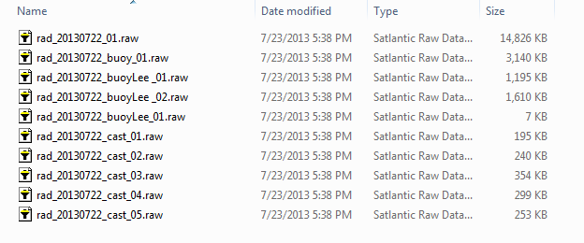
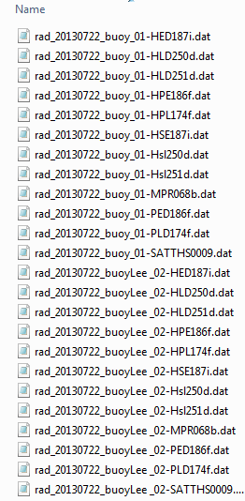
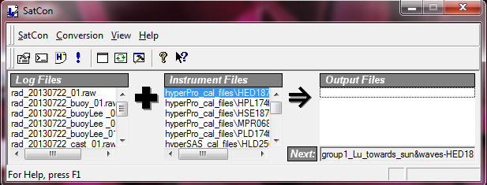
Level 2
Processed Data
Raw Data
SOFTWARE
Processed data in physical unit
Raw data in digital counts
Instrument calibration files
Notes:
Using SatCon you will convert the raw data from counts to physical units.

Slide 6
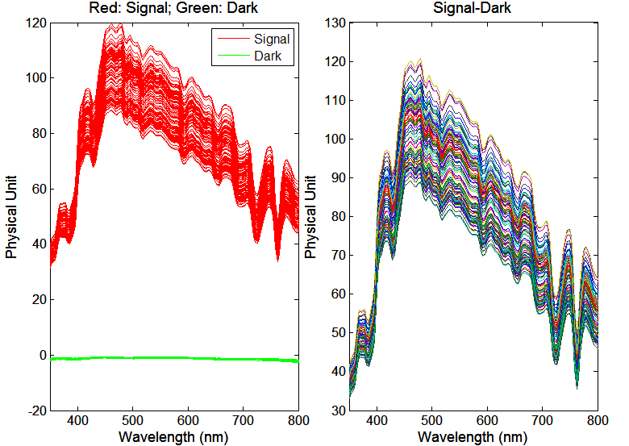
DATA PROCESSING
Dark
Corrections
Interpolate to bins of wavelengths
Quality Control
Align data
in time
Two files are created for each sensor, one containing all dark measurements and the other, the light measurements
The dark measurement is used as baseline. Subtract these values from the light spectrum.

Slide 7
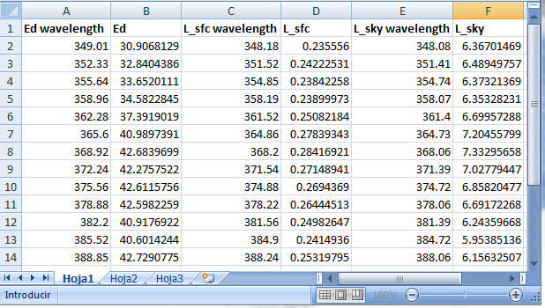
DATA PROCESSING
Dark
Corrections
Interpolate to
bins of wavelengths
Quality Control
Align data
in time
Linear interpolation to the wavelength of one of the sensors

Slide 8
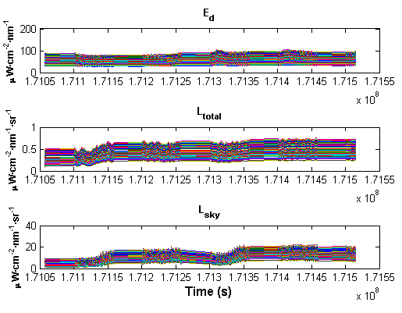
DATA PROCESSING
Dark
Corrections
Interpolate to bins of wavelengths
Quality Control
Align data
in time
Plot data over time to identify inconsistent data that should be deleted

Slide 9
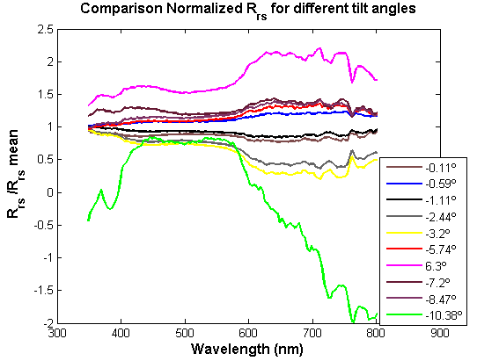
DATA PROCESSING
Dark
Corrections
Interpolate to
bins of wavelengths
Quality Control
Align data
in time
Example of the effect of the tilt angle on Rrs

Slide 10
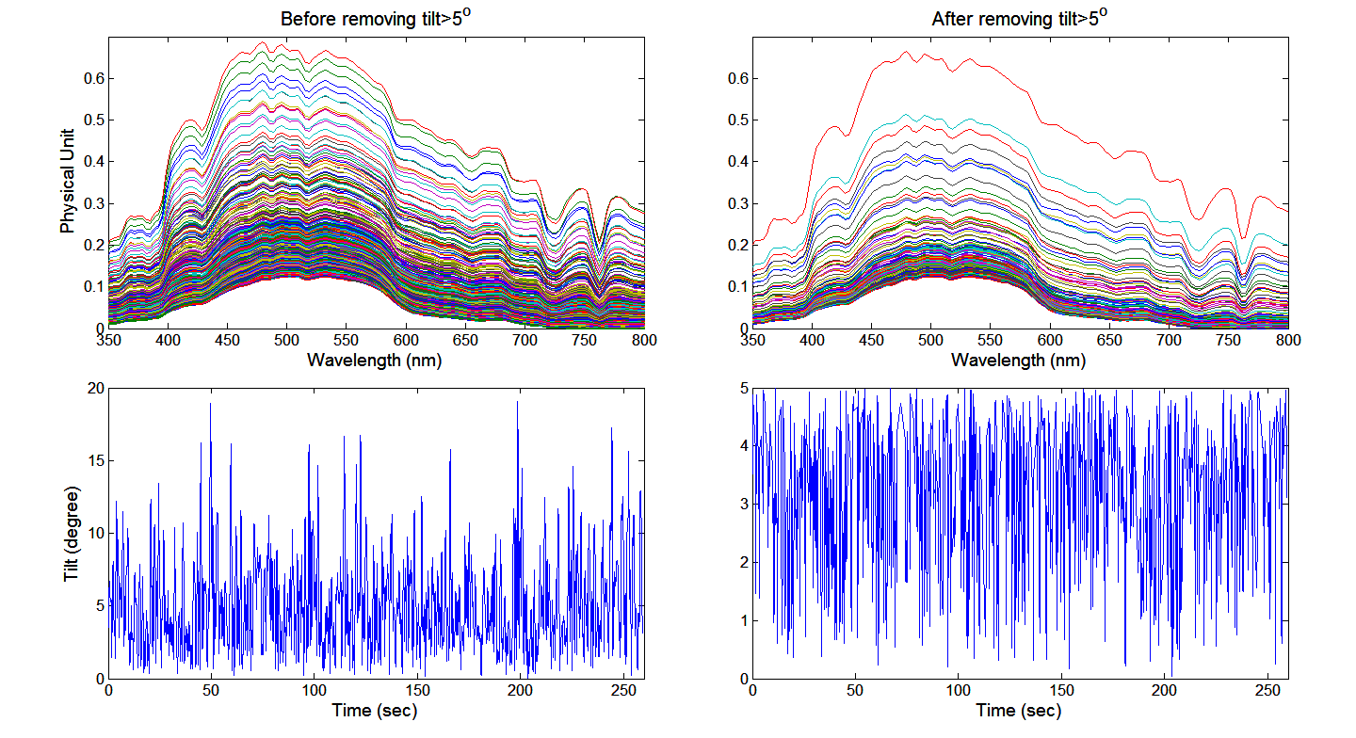
DATA PROCESSING
Dark
Corrections
Interpolate to
bins of wavelengths
Quality Control
Align data
in time
Remove the data with tilt angles > 5º

Slide 11
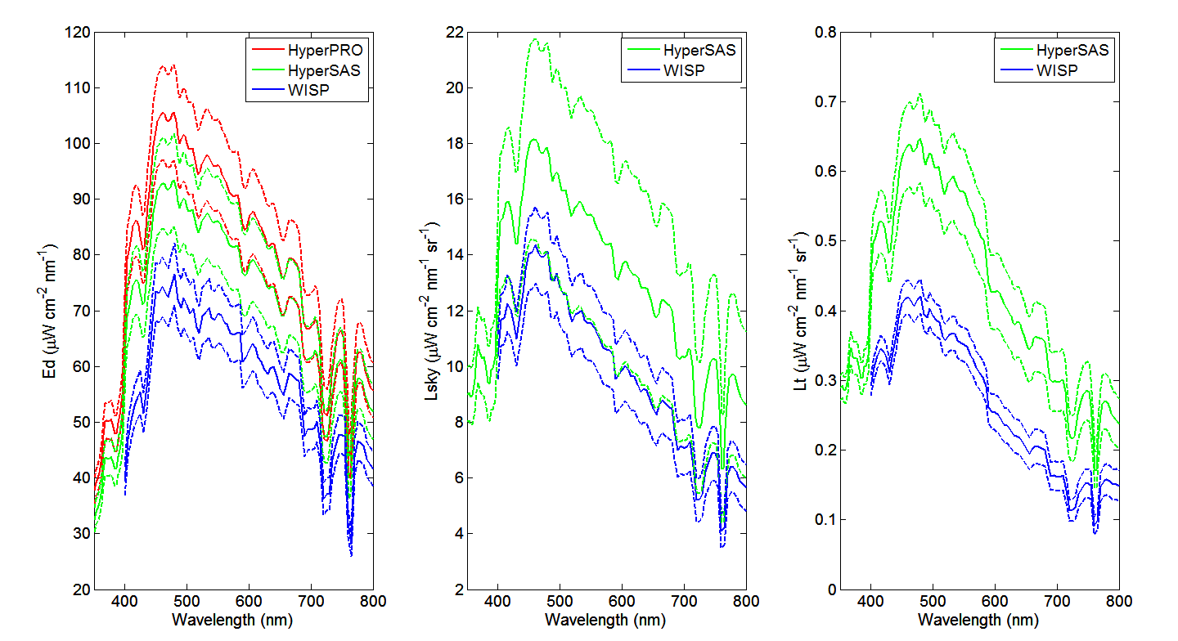
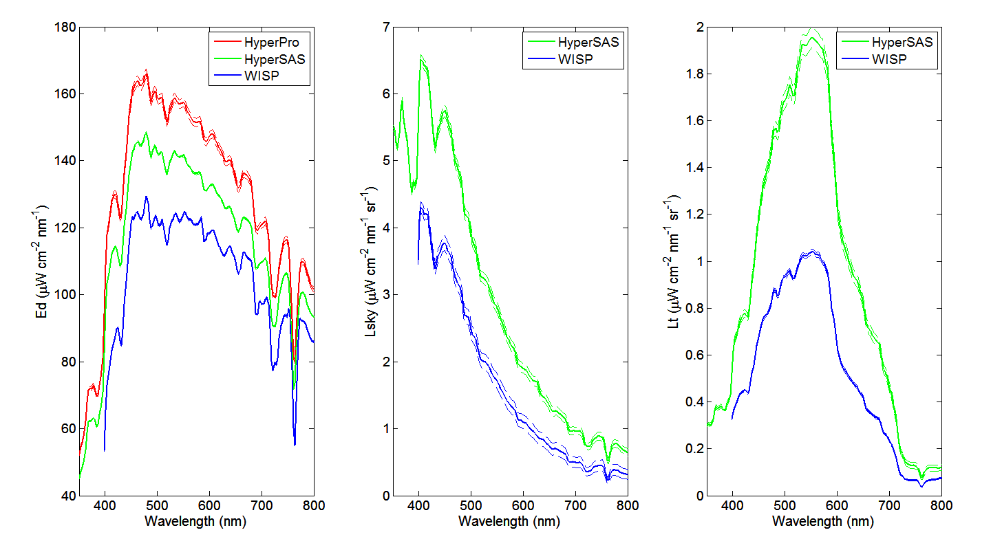
DATA ANALYSIS
Comparison with
other radiometric
sensors
Ed
Lsky
Lsfc
This figure shows an example of disagreeing sensor measurements. These may be due to strong wave conditions at the time of measurement, operator error, etc.
This figure shows an example of more consistent and stable measurements.
It is important to determine the offset between the different instruments, if any. To do this, take measurements under controlled light conditions (for example, in a laboratory with a known light source).

Slide 12
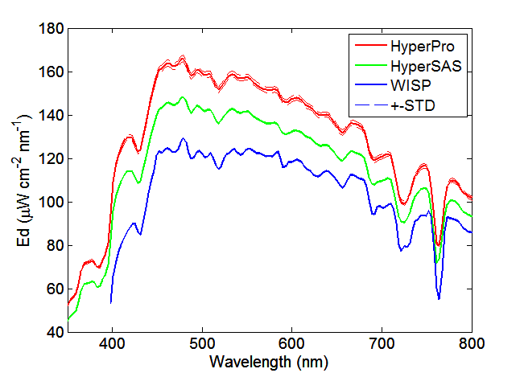
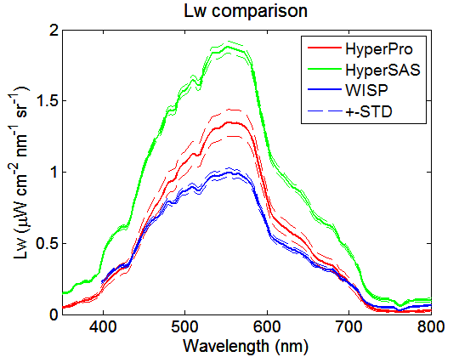
DATA ANALYSIS
Calculate
median and std
Ed
Lw
This example shows the median results for Lw and Rrs spectra taken over a 10 minute period and the standard deviation for the three different data sets.

Slide 13
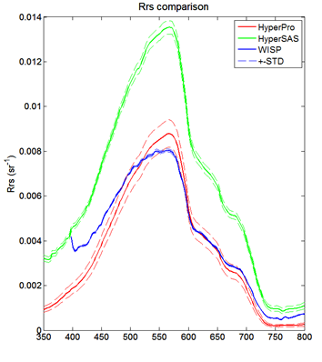
DATA ANALYSIS
Determine AOPs
Remote Sensing Reflectance:
HyperSAS & WISP:
Rrs =
HyperPRO: Lee Method
Rrs=
An example of Rrs spectra for the three different instruments is shown.

Slide 14
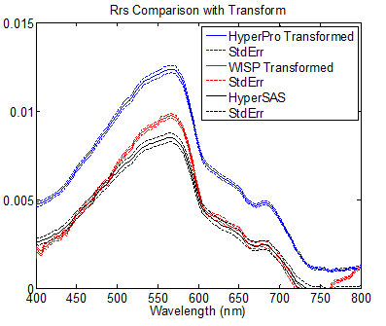
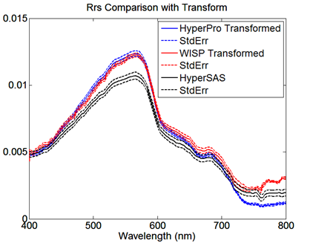
DATA ANALYSIS
Closure Analysis
Normalized Rrs
Normalized Rrs
The differences found between the three instruments, could be due to several factors: initial calibration, the limitations of each instruments’ measurement capabilities, variable field conditions, operator error during set-up/measurement/deployment, etc.

Slide 15
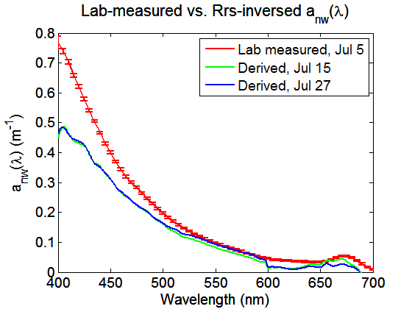
DATA ANALYSIS
Inversion Application
Chlorophyll (mg/m³)
Date | Lab | Inversed
Jul 15 | ~2.1 | 2.47
Jul 27 | ~2.2 | 1.88
Interesting fact is that inversed results are always better when using WISP-measured R_{rs}(λ). The estimated non-water absorption a_{nw}(λ) and Chl concentration with WISP R_{rs}(λ) is shown above for dock test on Jul 15 and Jul 27.

