Slide 1

DATA PROCESSING
&
ANALYSIS

Slide 2
HyperSAS and HyperPro
Raw Data
Convert from counts to physical units
Level 2
Processed Data
SOFTWARE: SatView/SatCon
ADDITIONAL DATA PROCESSING
Dark
Corrections
Interpolate to
bins of wavelengths
Quality Control (tilting corrections, etc)
Align data
in time
DATA ANALYSIS
Determine AOPs
Closure Analysis
Comparison with
other radiometric
sensors
Calculate
median and std
K
PAR
R
Rrs
Notes:
After returning from the field, there are many steps to transform the raw data into a useable product. Here we show a general schematic for processing HyperSAS and HyperPro data.

Slide 3
WISP
Raw Data
Send raw data directly to the WISP manufacturer
Level 2
Processed Data
DATA PROCESSING
Dark
corrections
Interpolate to bins of wavelengths
Quality Control
Align data
in time
DATA ANALYSIS
Determine AOPs
Closure analysis
Comparison with
other radiometric
sensors
Calculate
median and std
K
PAR
R
Rrs
Notes:
The analysis for the WISP data is similar but you will need to send out the raw data to the manufacturer and there is also no dark correction.

Slide 4
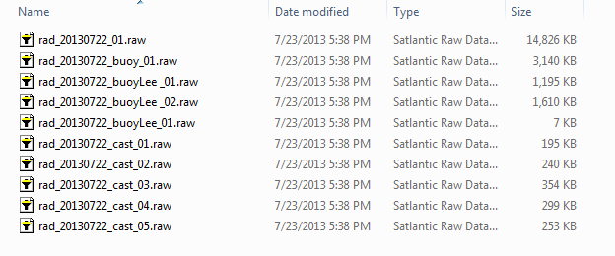
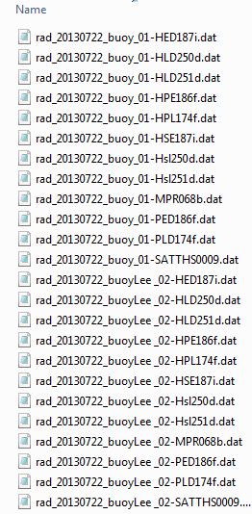
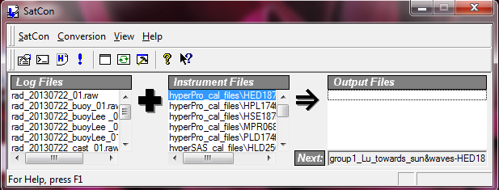
Level 2
Processed Data
Raw Data
SOFTWARE
Processed data in physical unit
Raw data in digital counts
Instrument calibration files
Notes:
Using SatCon you will convert the raw data from counts to physical units.

Slide 5
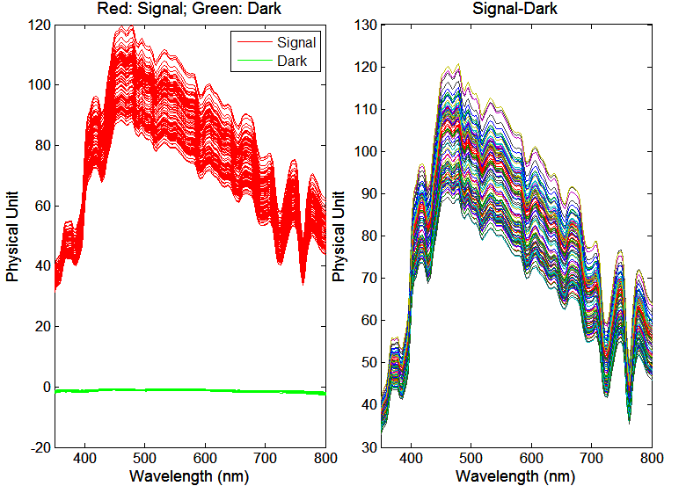
DATA PROCESSING
Dark
Corrections
Interpolate to bins of wavelengths
Quality Control
Align data
in time
Two files are created for each sensor, one containing all dark measurements and the other, the light measurements
The dark measurement is used as baseline. Subtract these values from the light spectrum.

Slide 6
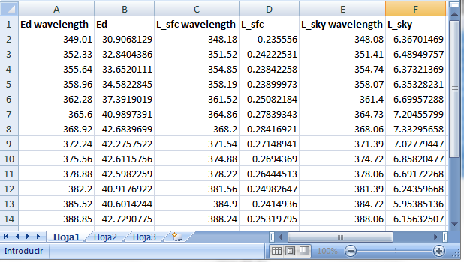
DATA PROCESSING
Dark
Corrections
Interpolate to
bins of wavelengths
Quality Control
Align data
in time
Linear interpolation to the wavelength of one of the sensors

Slide 7
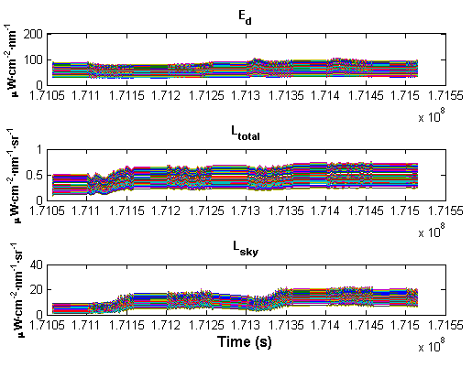
DATA PROCESSING
Dark
Corrections
Interpolate to bins of wavelengths
Quality Control
Align data
in time
Plot data over time to identify inconsistent data that should be deleted

Slide 8
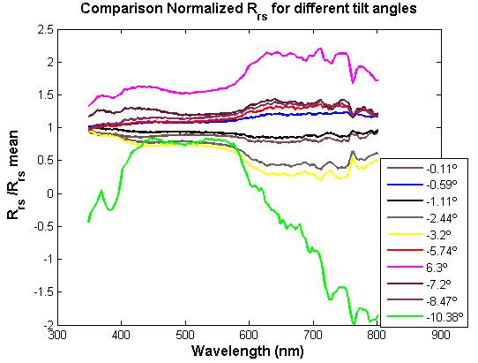
DATA PROCESSING
Dark
Corrections
Interpolate to
bins of wavelengths
Quality Control
Align data
in time
Example of the effect of the tilt angle on Rrs

Slide 9
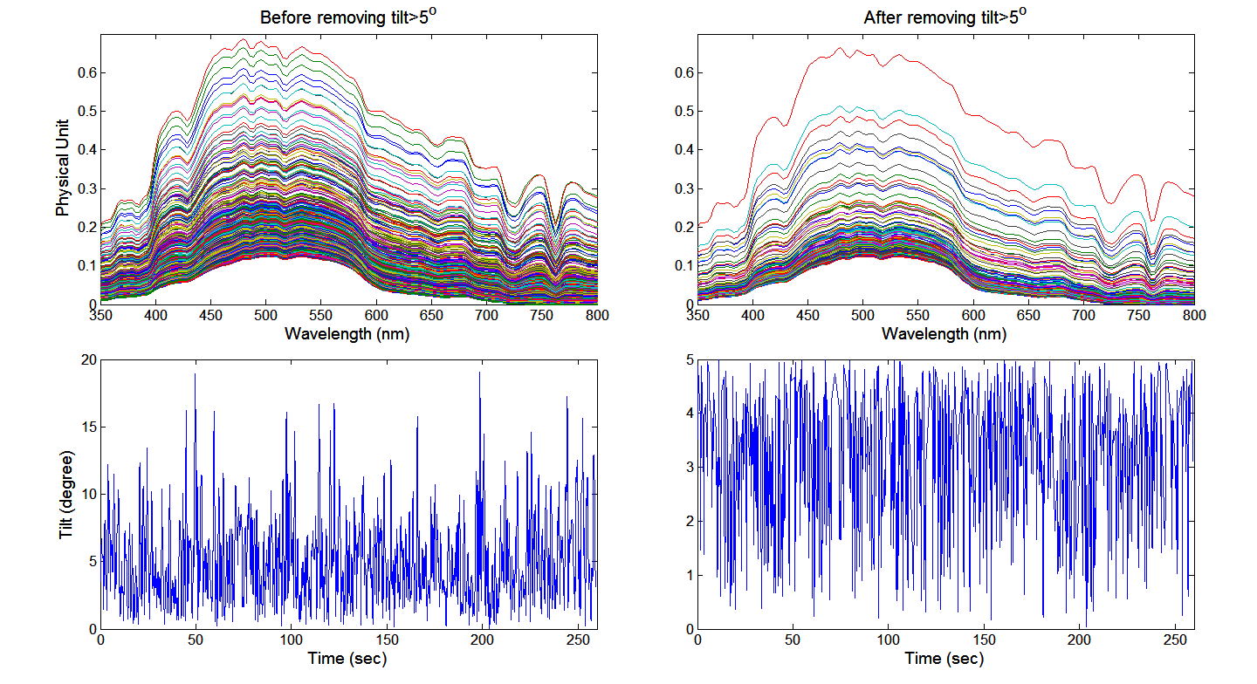
DATA PROCESSING
Dark
Corrections
Interpolate to
bins of wavelengths
Quality Control
Align data
in time
Remove the data with tilt angles > 5º

Slide 10
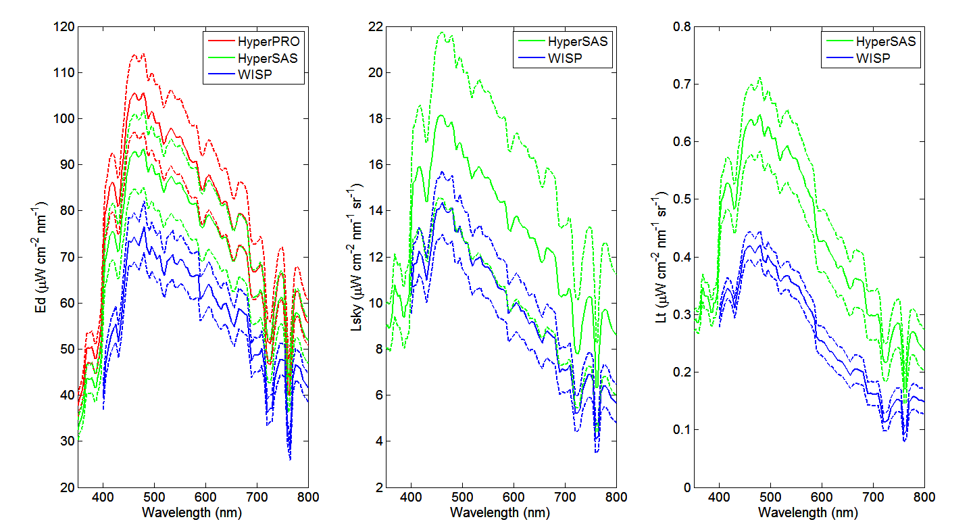
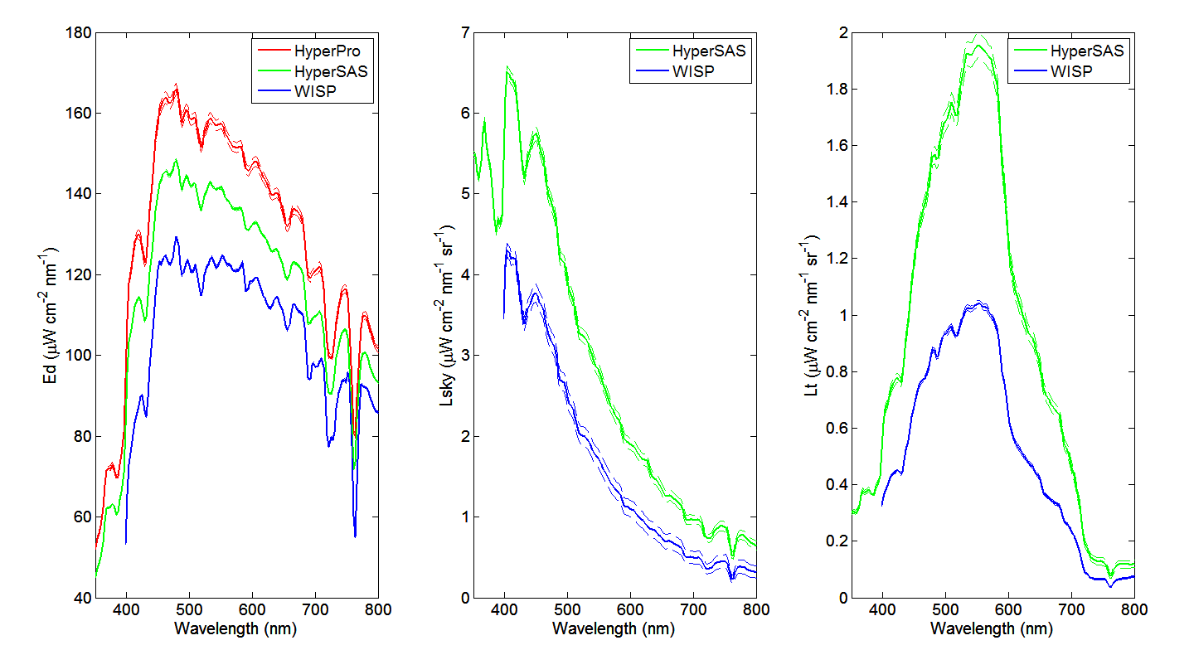
DATA ANALYSIS
Comparison with
other radiometric
sensors
Ed
Lsky
Lsfc
This figure shows an example of disagreeing sensor measurements. These may be due to strong wave conditions at the time of measurement, operator error, etc.
This figure shows an example of more consistent and stable measurements.
It is important to determine the offset between the different instruments, if any. To do this, take measurements under controlled light conditions (for example, in a laboratory with a known light source).

Slide 11
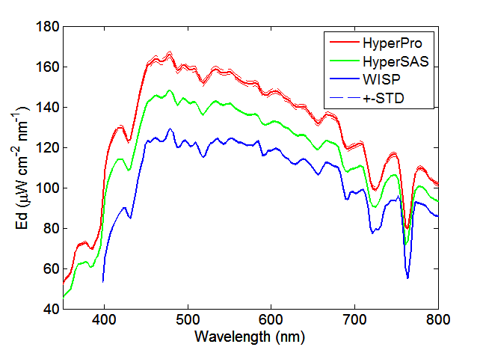
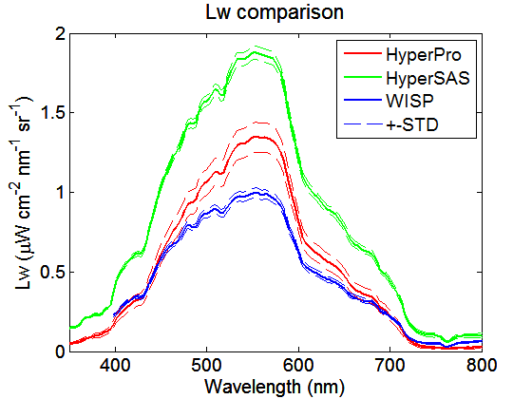
DATA ANALYSIS
Calculate
median and std
Ed
Lw
This example shows the median results for Ed and Lw spectra taken over a 10 minute period and the standard deviation for the three different data sets.

Slide 12
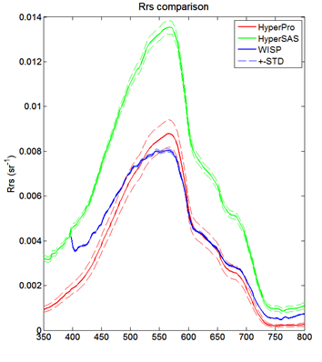


DATA ANALYSIS
Determine AOPs
Remote Sensing Reflectance:
HyperSAS & WISP:
Rrs =
HyperPRO: Lee Method
Rrs=
ρ= f(sky conditions, wind speed, solar zenith angle, and viewing geometry).
For ϴ =40º, Ф= 135º from the Sun and wind speed < 5m/s → ρ≈0.028 (Mobley, 1999).

Slide 13
Differences between instruments’ response could be explained by:
DATA ANALYSIS
Closure Analysis
Offsets between sensors,
Spatial variations during deployment,
Not accurate information about atmospheric conditions and sea level state,
Inappropriate angle corrections,
Handling errors (especially for WISP),
…
Incorrect values of sea-surface reflectance factor, ρ

Slide 14
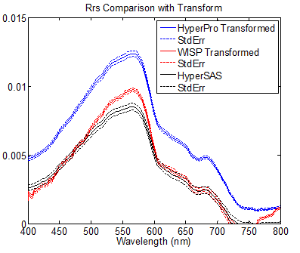
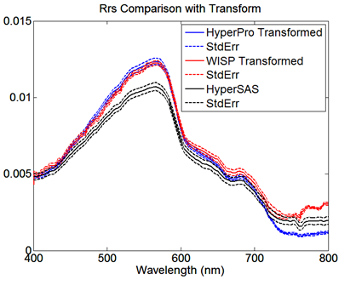
DATA ANALYSIS
Closure Analysis
Normalized Rrs
Normalized Rrs
The left panel shows the Rrs spectra after the offset corrections between the Ed sensors.
On the right panel, a value of ρ=0.021 was used for determining Rrs for WISP and HyperSAS sensors (corresponding to 0 m/s wind speed and <40º zenith angle).

