Slide 1
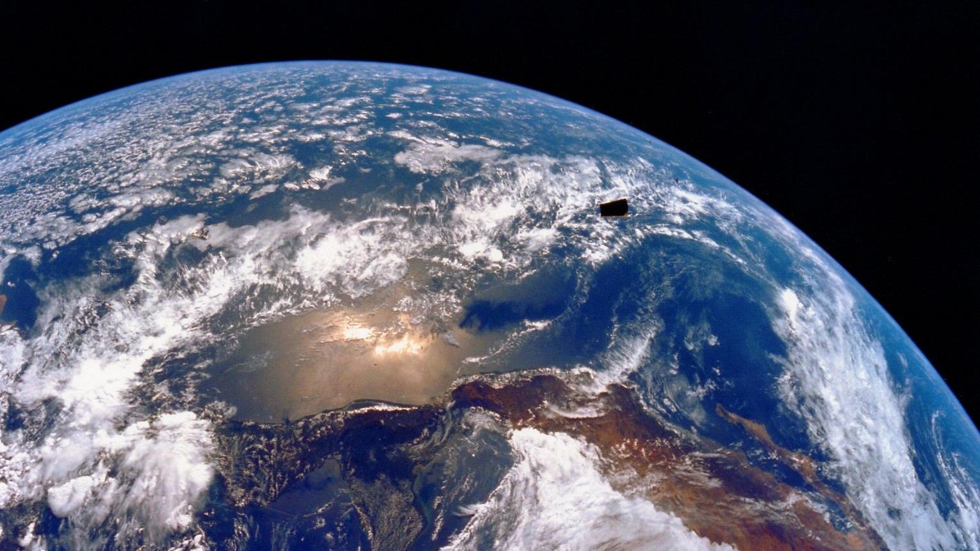

Slide 2
An Unofficial Guide to Radiometric Measurement

Slide 3
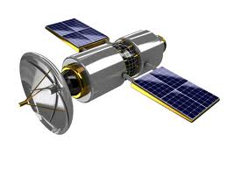
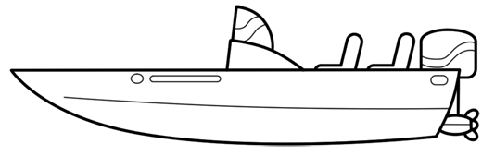
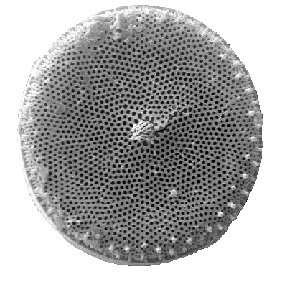
Atmospheric effects
Satellite
Skylight
L_{w}
In situ
E_{d}
L_{r}
Absorption
Downwelling irradiance E_{d}
Reflected radiance L_{r}
Water-leaving radiance L_{w}
Scattering
Transmission

Slide 4
R=E_{u} /E_{d}
Air
Water
Downwelling irradiance E_{d}
Upwelling irradiance E_{u}

Slide 5
R_{rs}=L_{u} /E_{d}
dΩ
Air
Water
Upwelling radiance L_{u}

Slide 6
Radiometers

Slide 7
Above water
Skylight L_{i} ~ L_{r}
L_{w}
E_{d}
E_{d}
Air
Water
Air
L_{t} = L_{r} + L_{w}
Water

Slide 8
φ =135 °
θ = 40 °

Slide 9
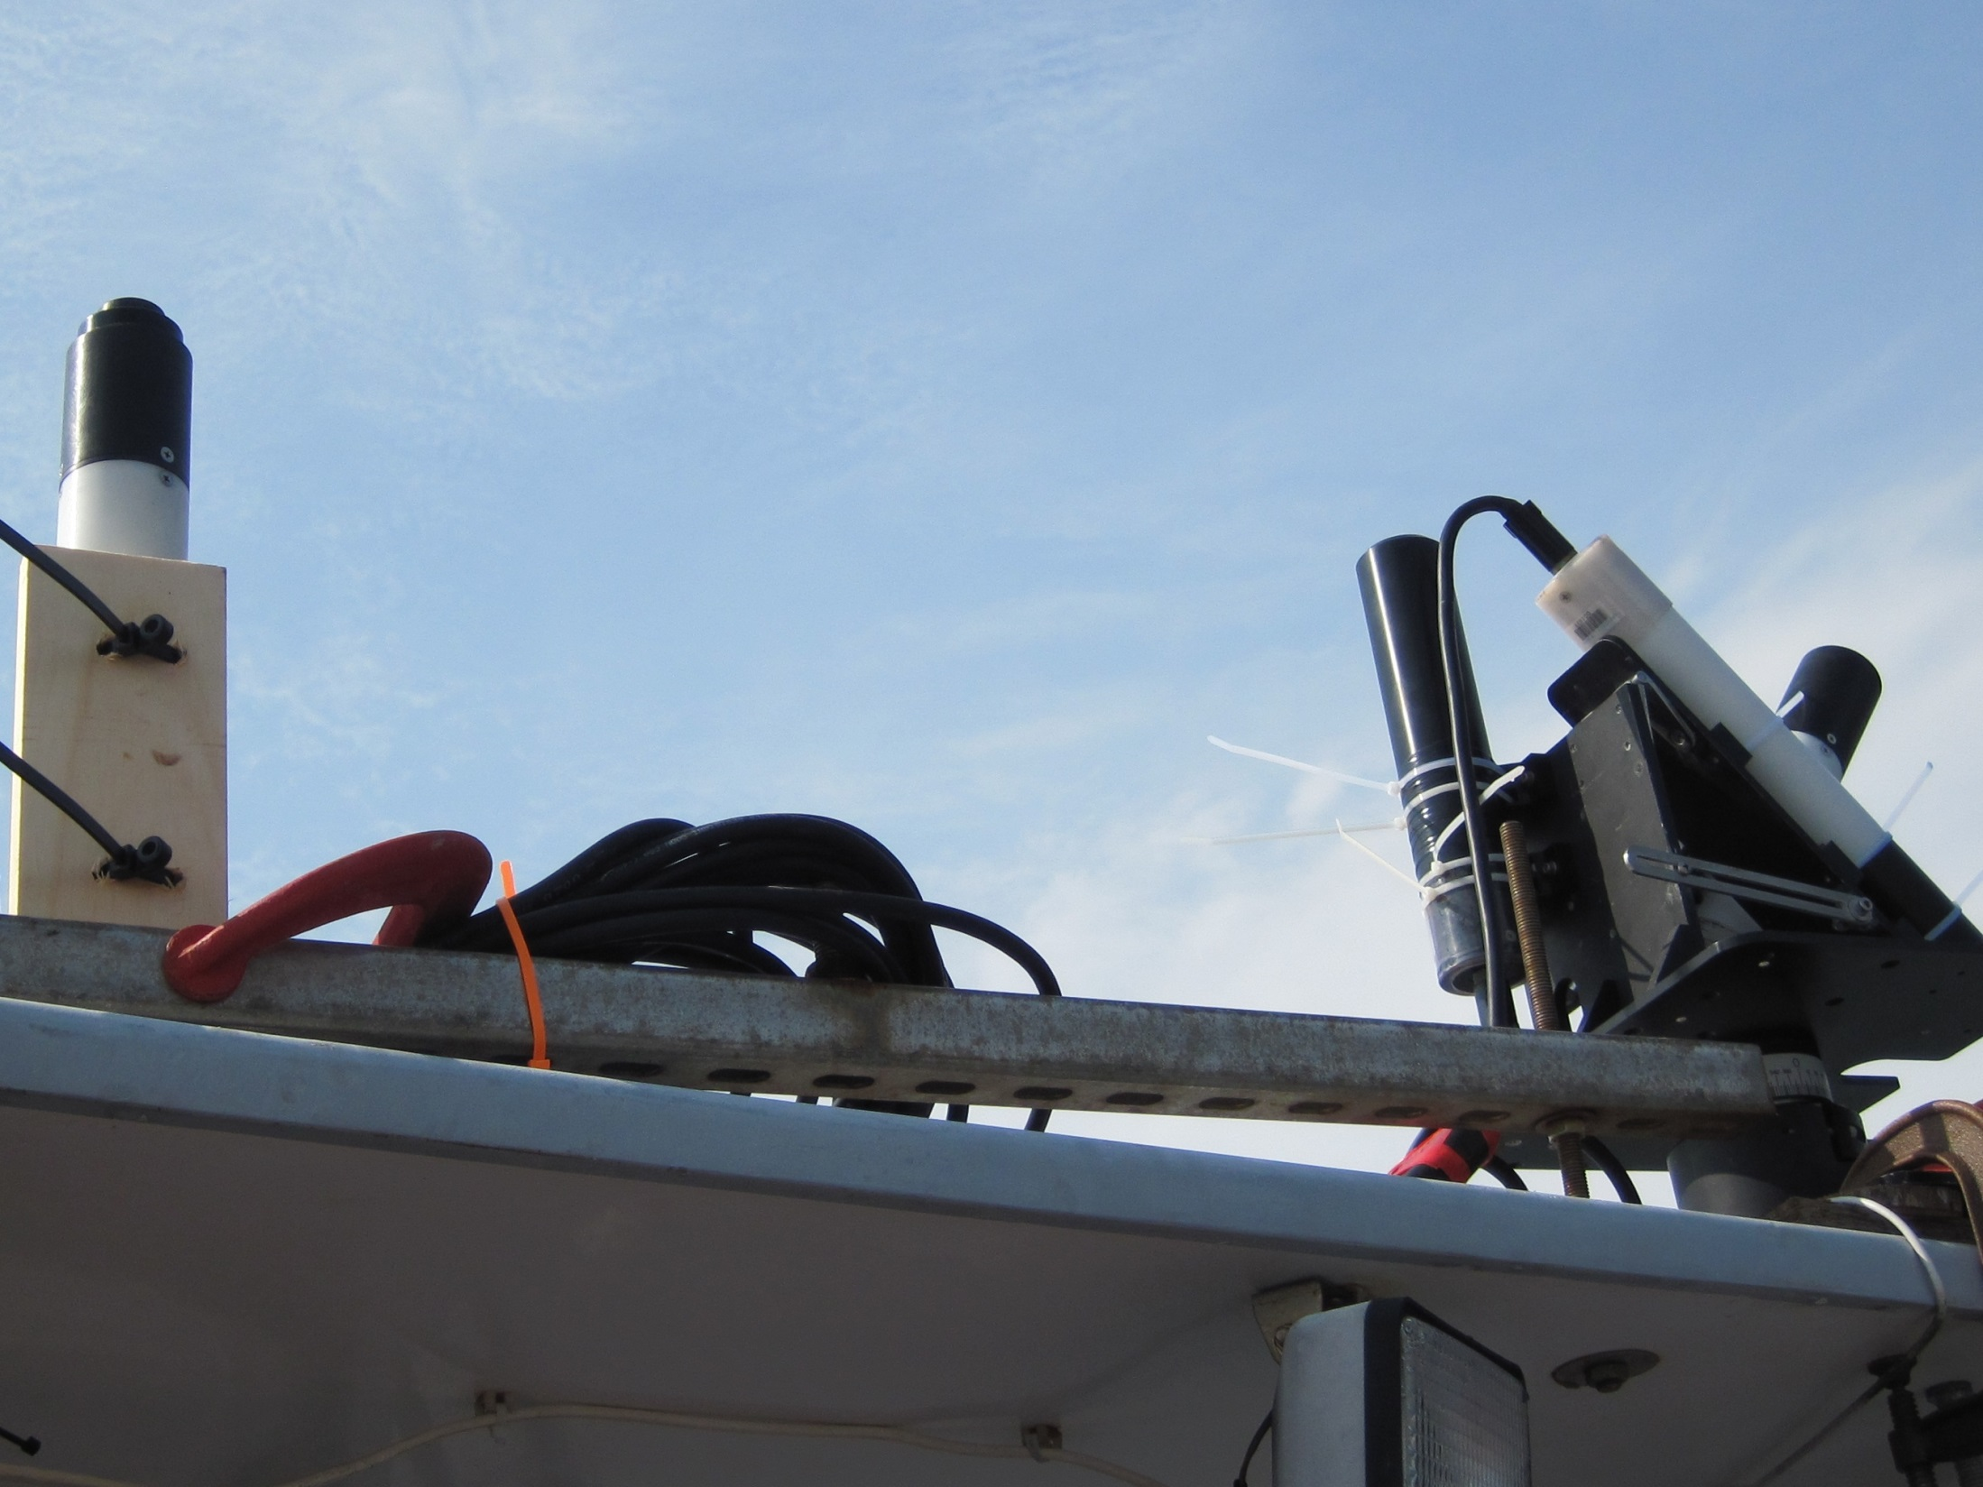
E_{d} Sensor
Tilt Heading
Sensor
L_{i} Sensor
L_{t} Sensor
SECURE MOUNT

Slide 10
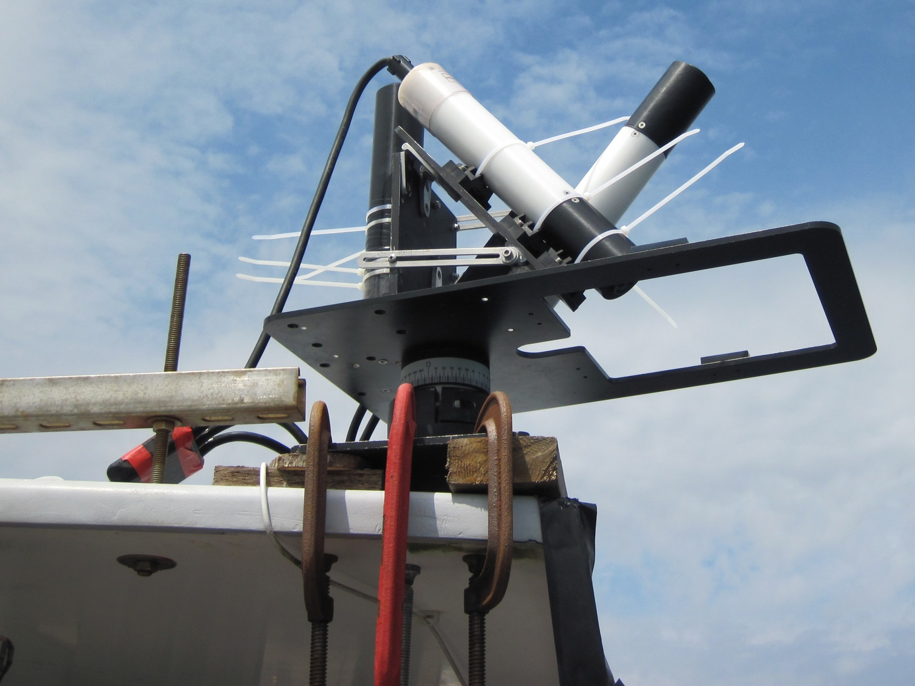
L_{i} Sensor
Tilt Heading Sensor
L_{t} Sensor
SECURE MOUNT

Slide 11
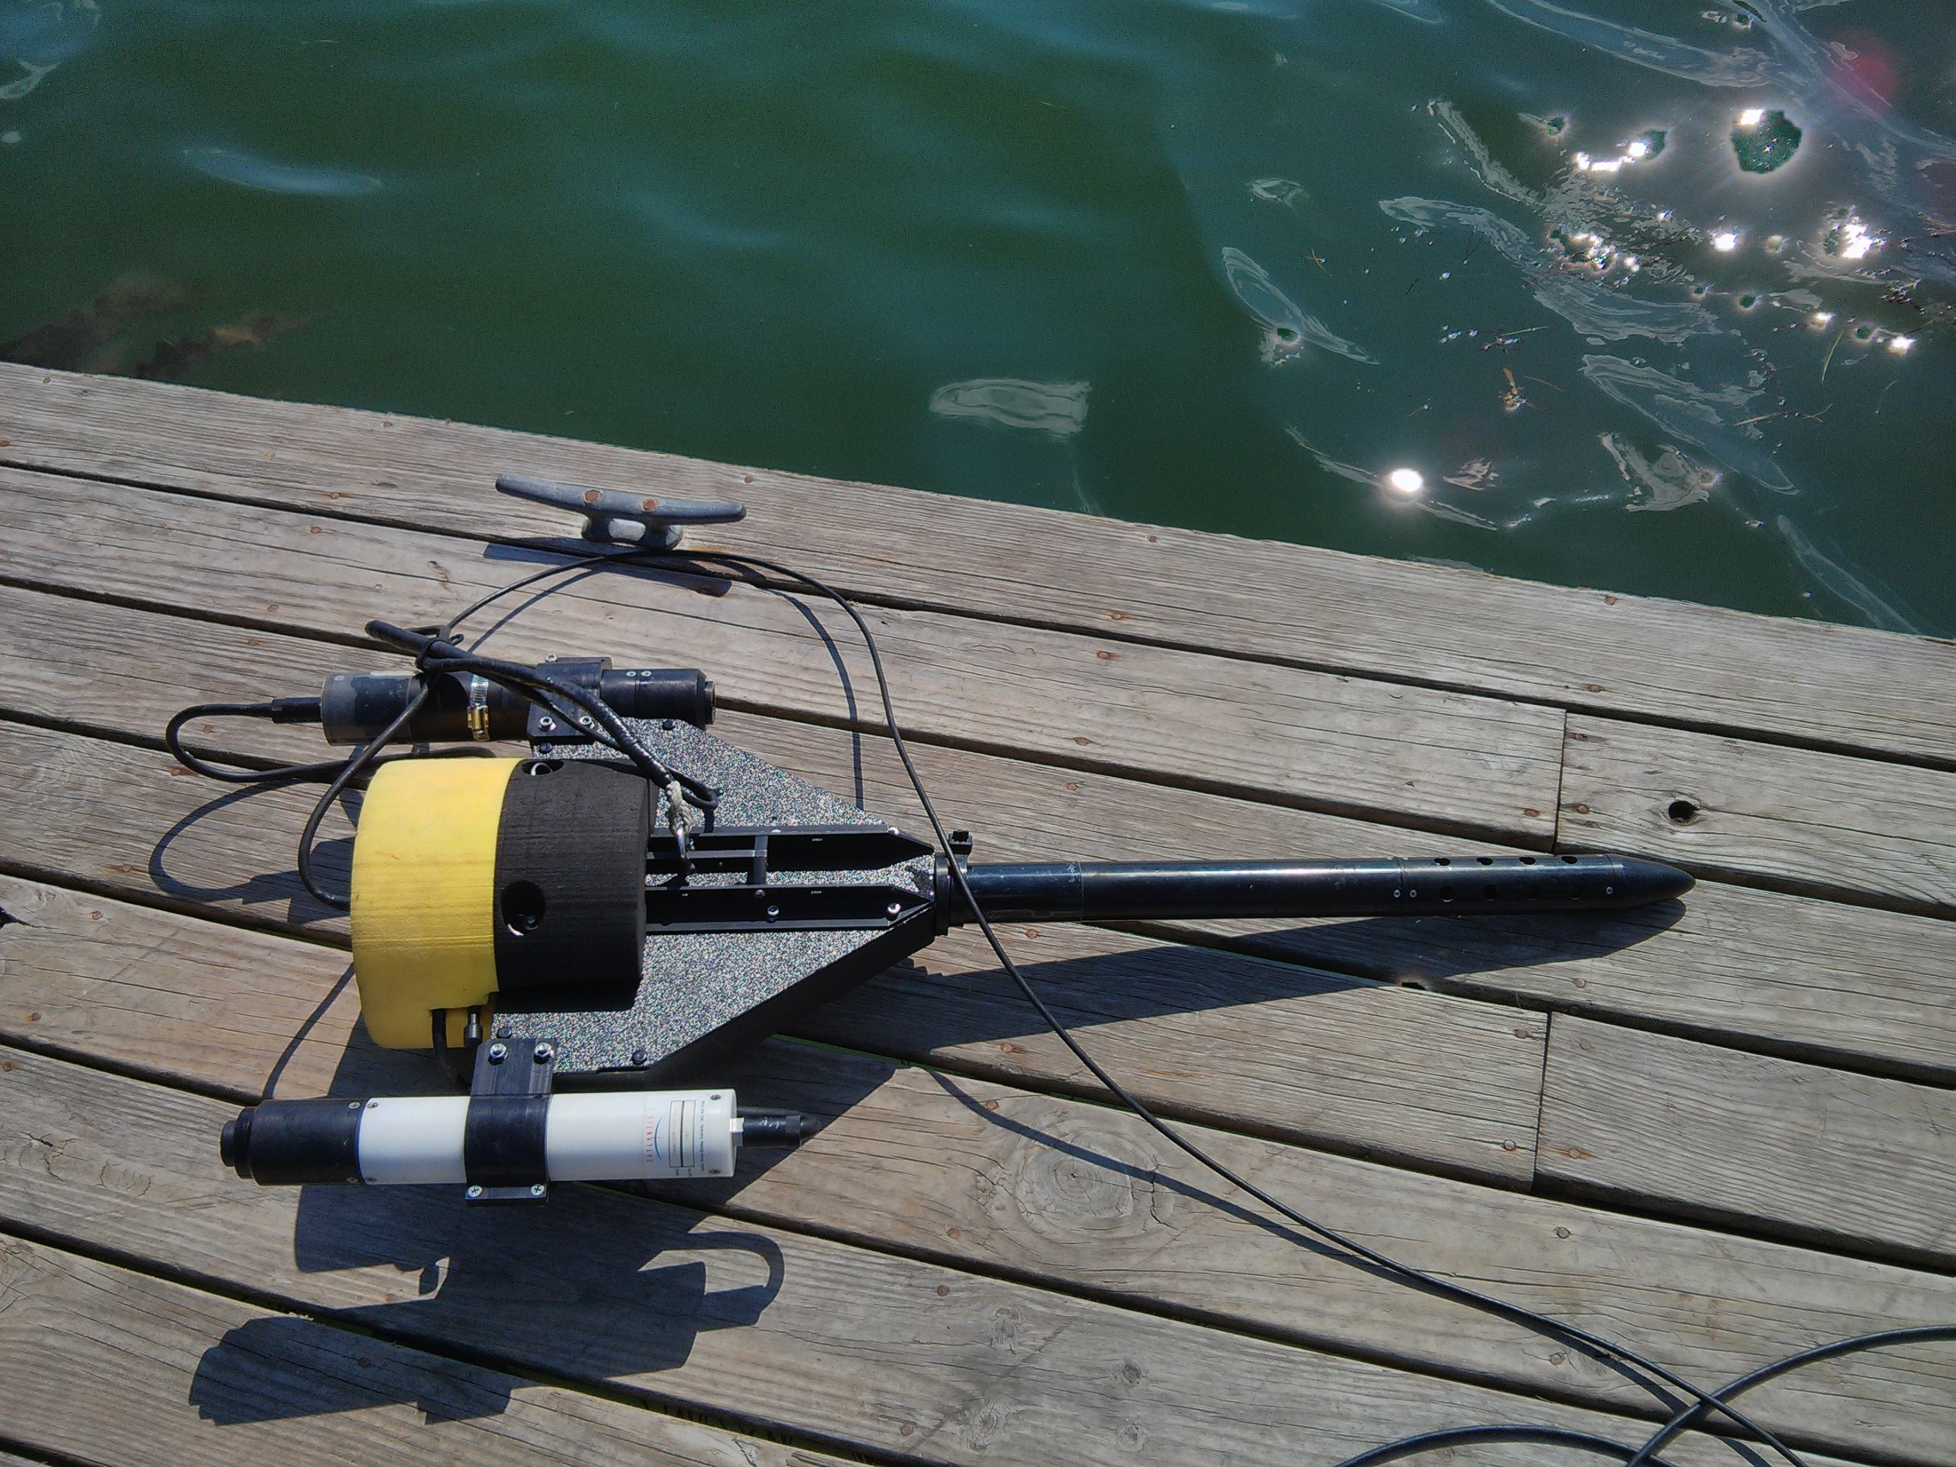
Upwelling Radiance Sensor L_{u}
Tilt sensor
Pressure sensor
Downwelling Irradiance Sensor E_{d}

Slide 12
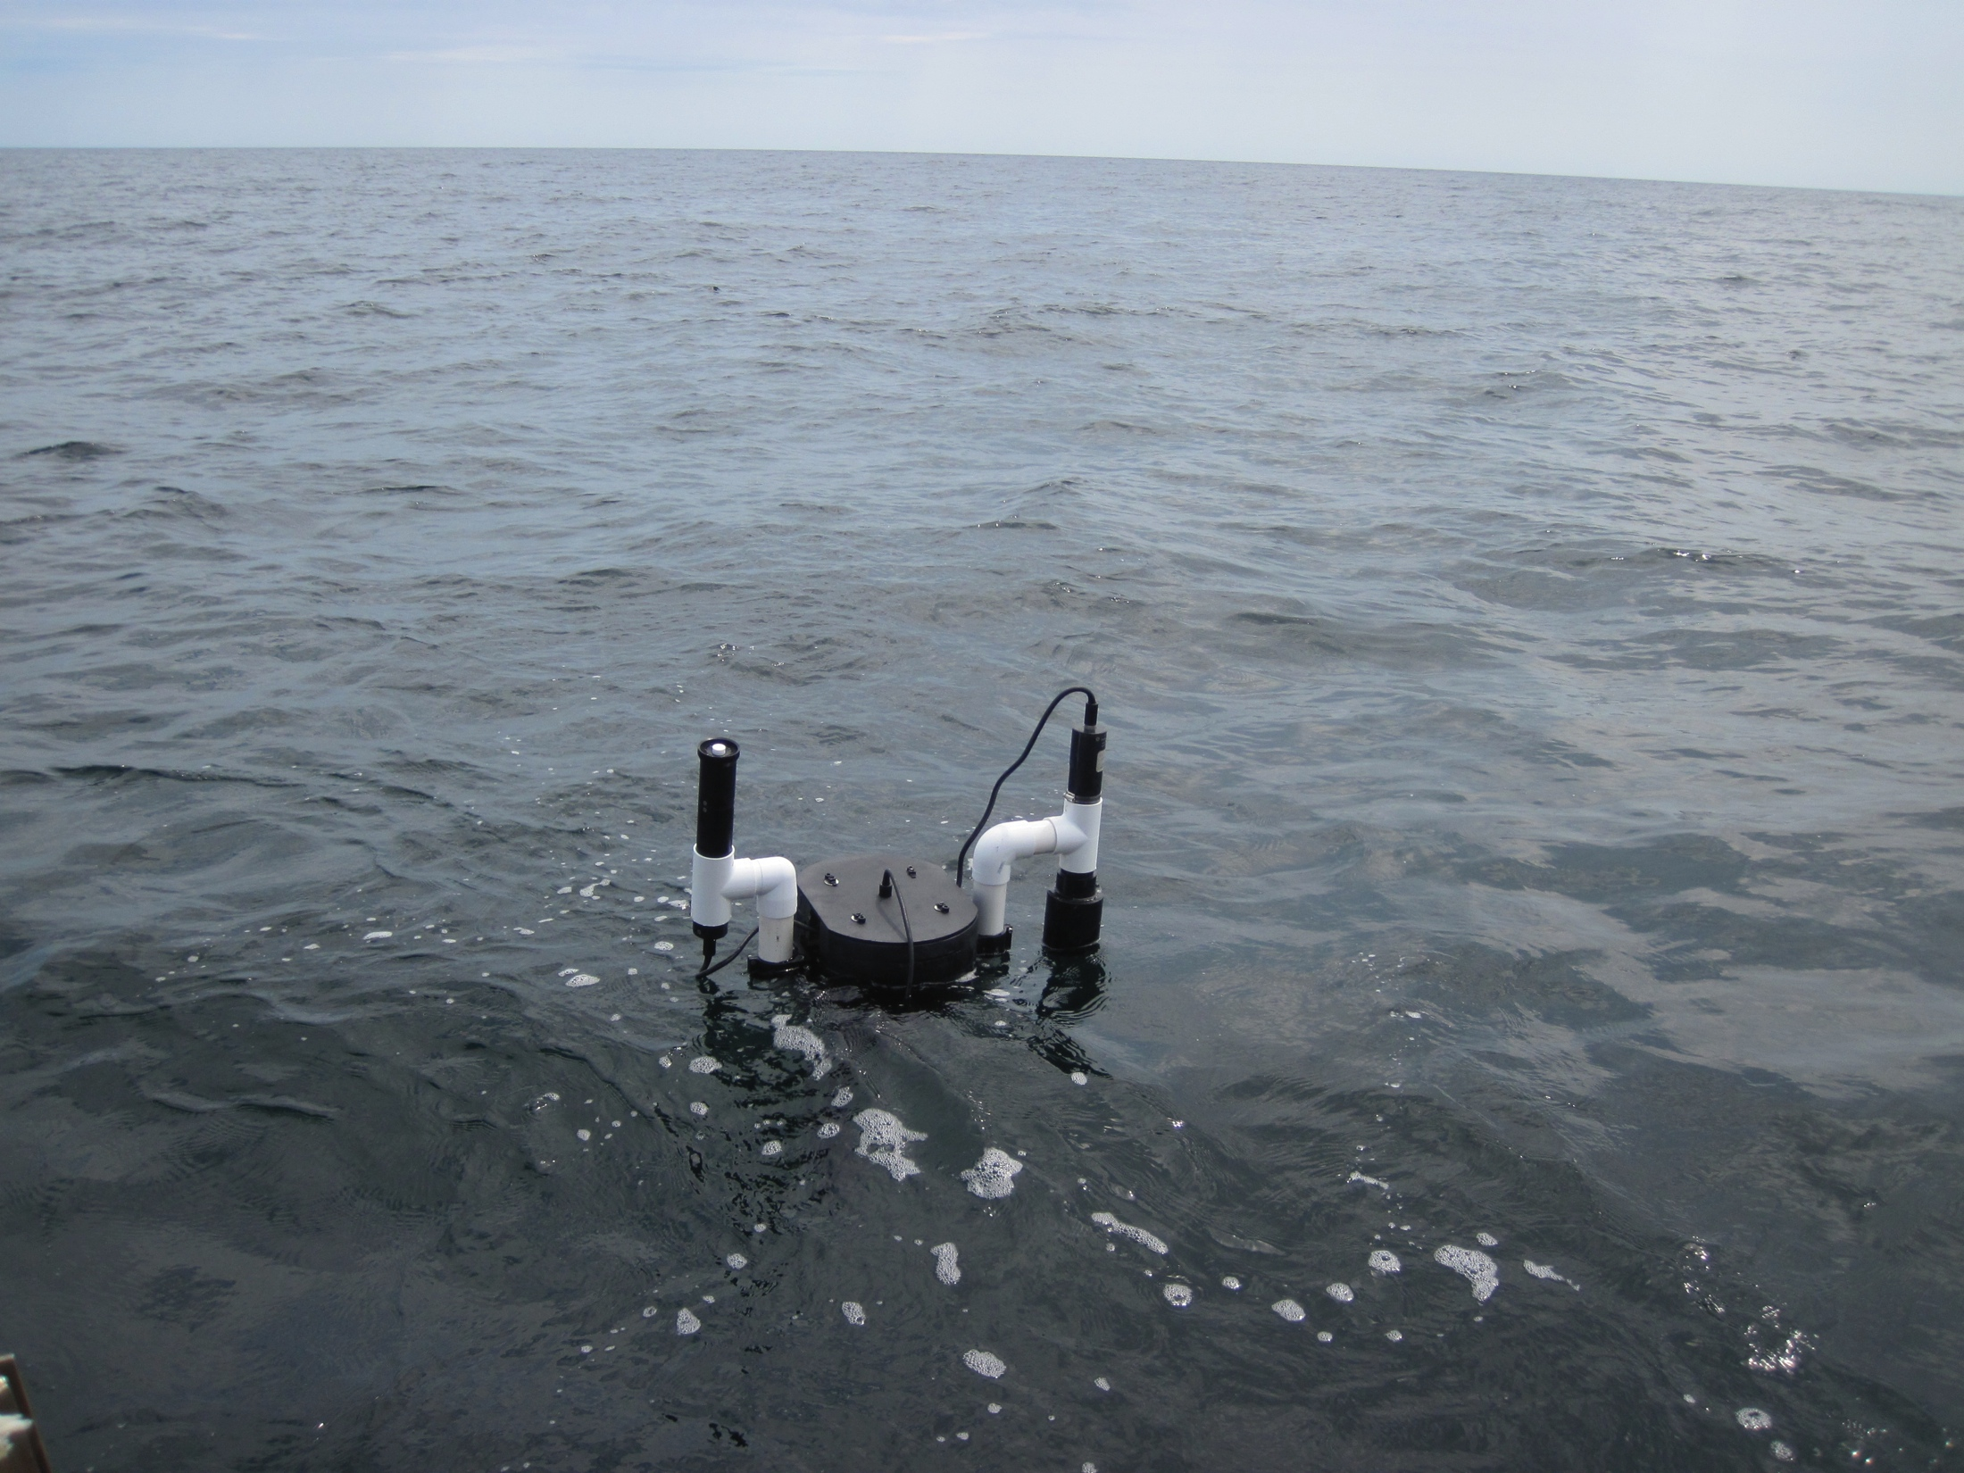
Buoy
E_{d}
L_{u}

