Slide 1
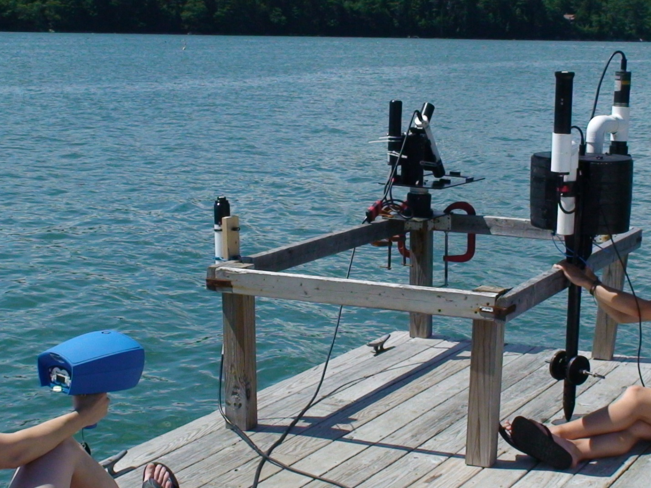
Radiometry Updates 7/29

Slide 2
Dock Test 7/27
Test 1: All Sensor Test
  ‘Same’ dock location for WISP, SAS base, and buoyed HyperPro
  SAS Ed sensor located on upper dock
Test 2: Ed Sensor Test
  Same dock location for all sensors
Test 3: Water Splash Test on HyperPro
  Ran HyperPro for 1-2 minutes normal
  Ran HyperPro for 1-2 minutes after splashing water on the upwelling radiance sensor

Slide 3
WISP Test 1: Every 30 seconds for 5-6 minutes
Good Agreement with Time
(Some boat wakes and waves)
‘Kick’ in 750-800 Smaller

Slide 4
Test 2: Ed
Test 1: All Sensors
Good Agreement of Ed values with Time
Used Median Values To Compare with SAS/Pro

Slide 5
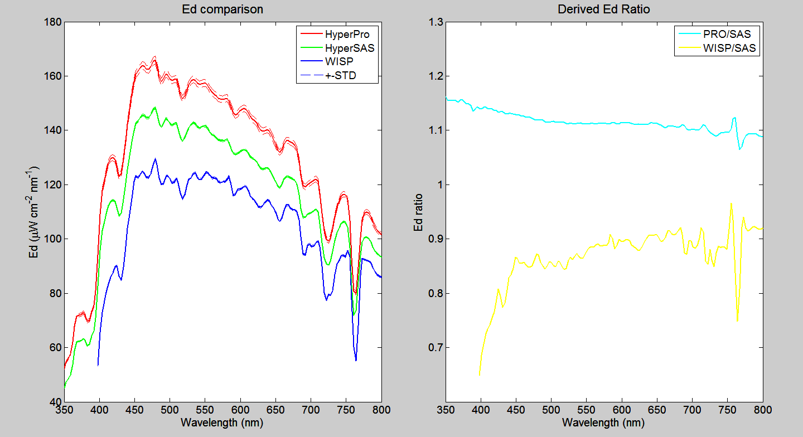
Test 1: SAS Ed Sensor On Upper Dock
Difference Can Be +10%

Slide 6
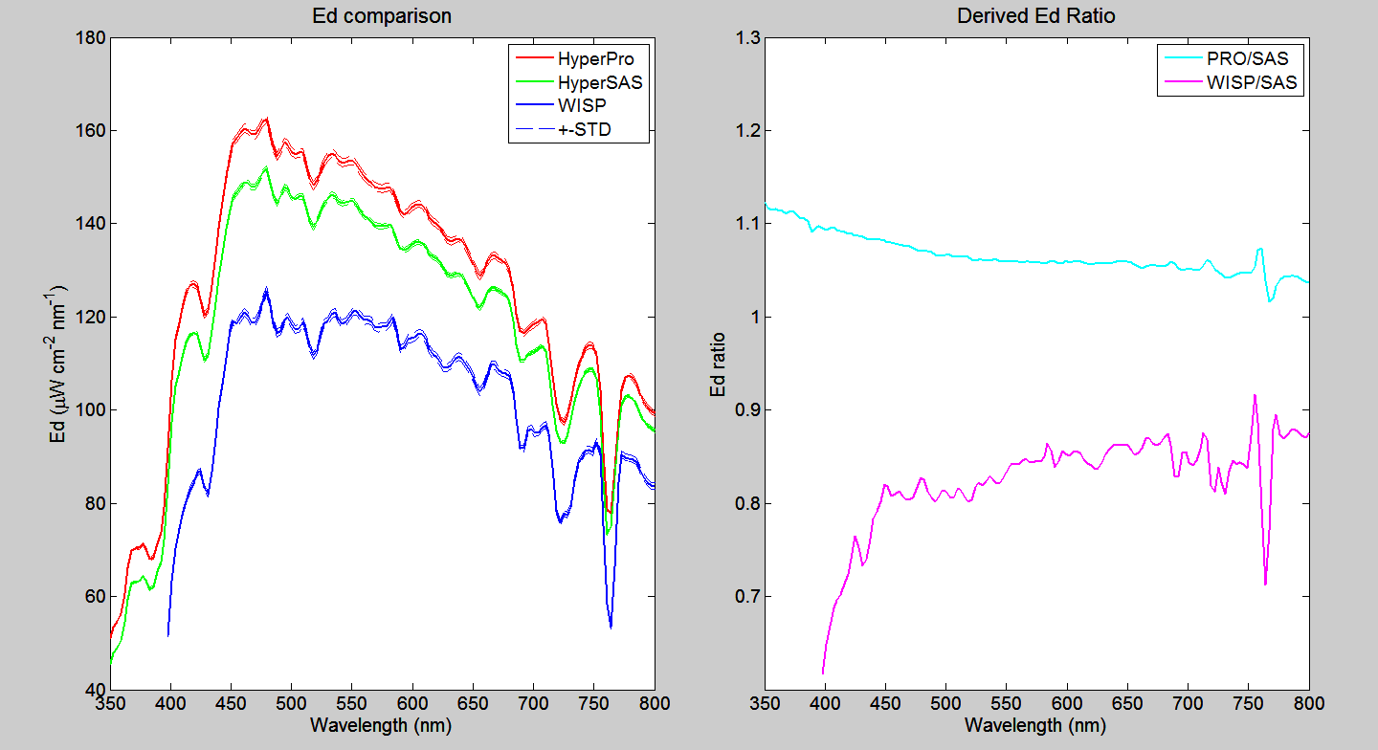
Test 2: SAS Ed Sensor On Lower Dock
Difference ½ As Big

Slide 7
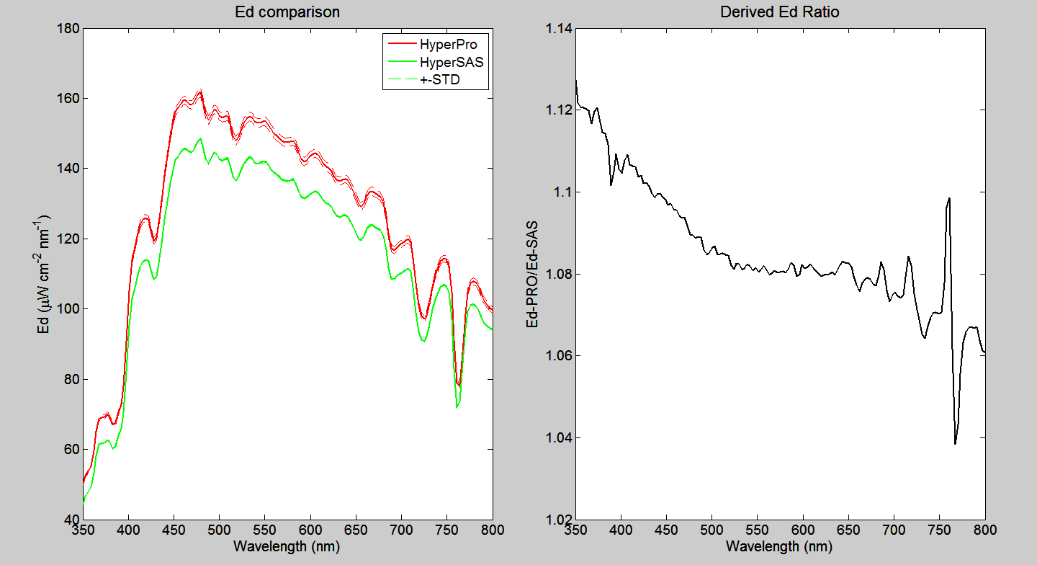
Test 3: Ed Pre-Splash Test (Some Waves)

Slide 8
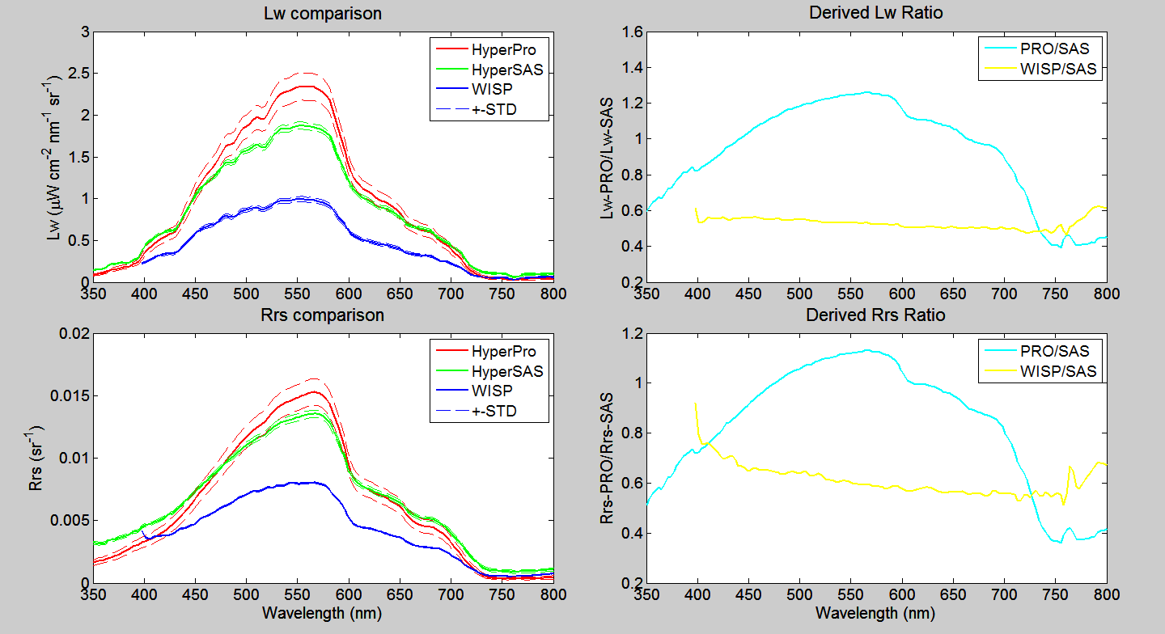
Test 1: Variability in Lw and Rrs

Slide 9
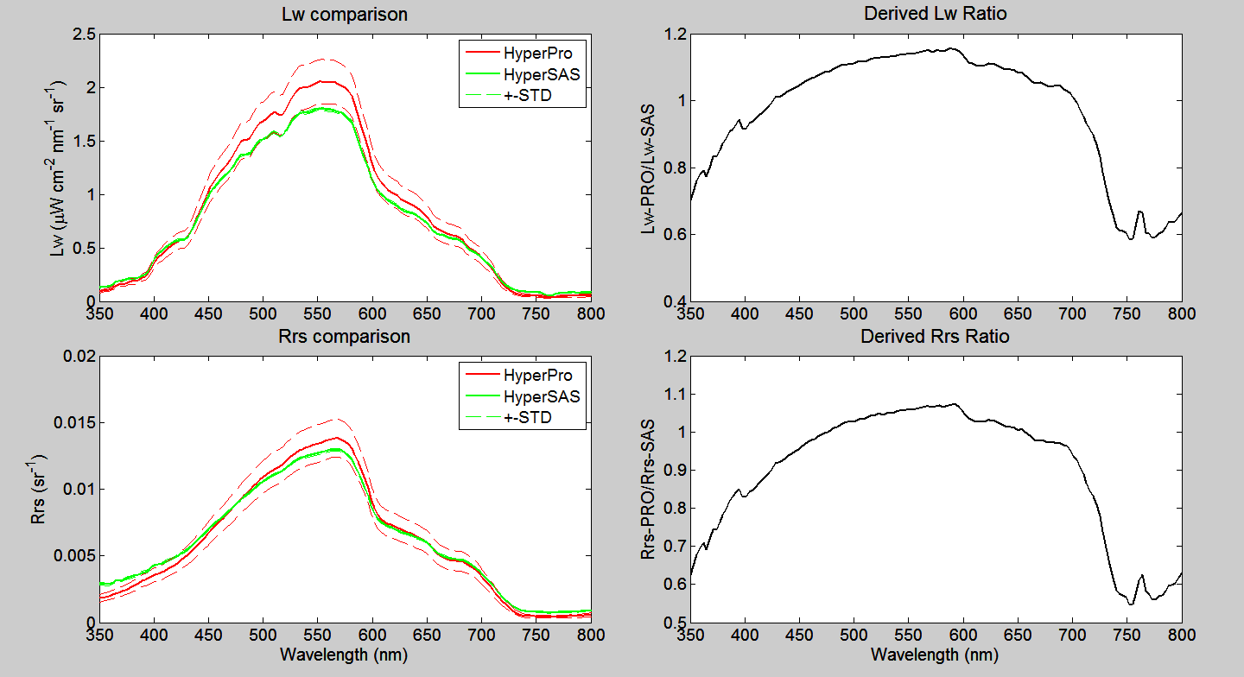
Test 3: Variability in Lw and Rrs
Slightly Better with Ed Sensor Closer

Slide 10
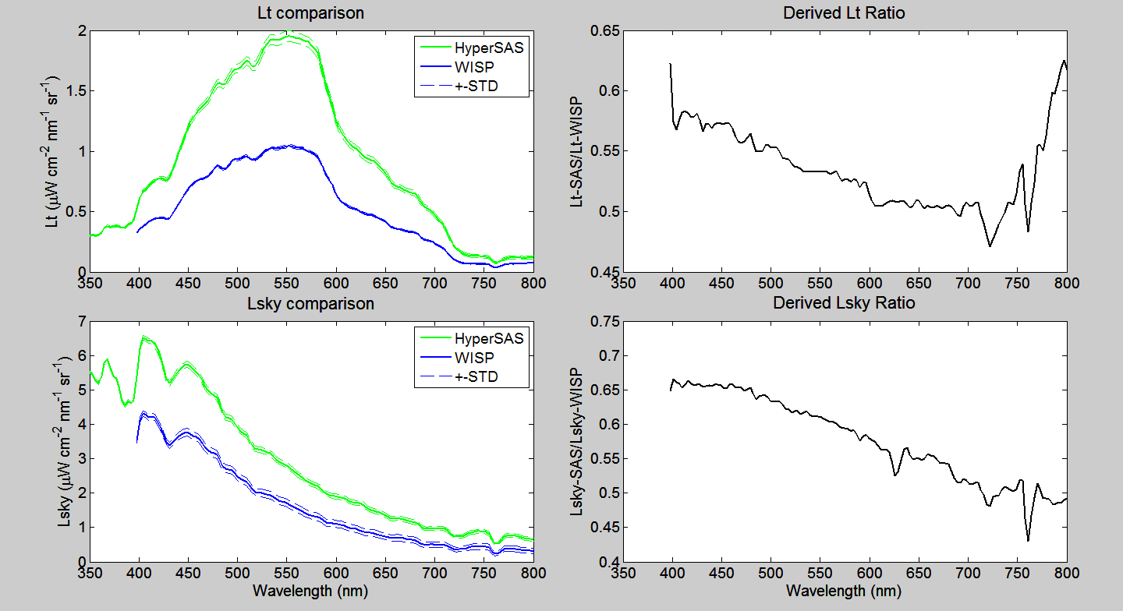
Test 1: Variability in Lt and Lsky

Slide 11
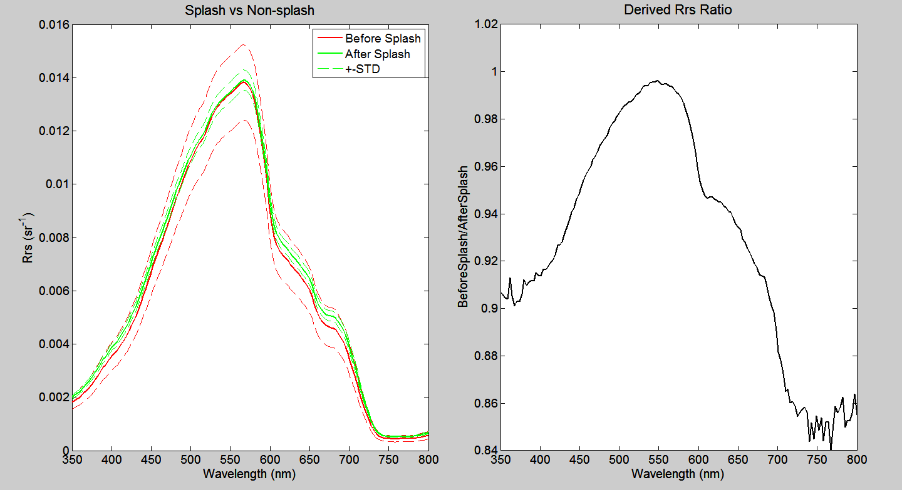
Test 3: HyperPro Splash Test

Slide 12
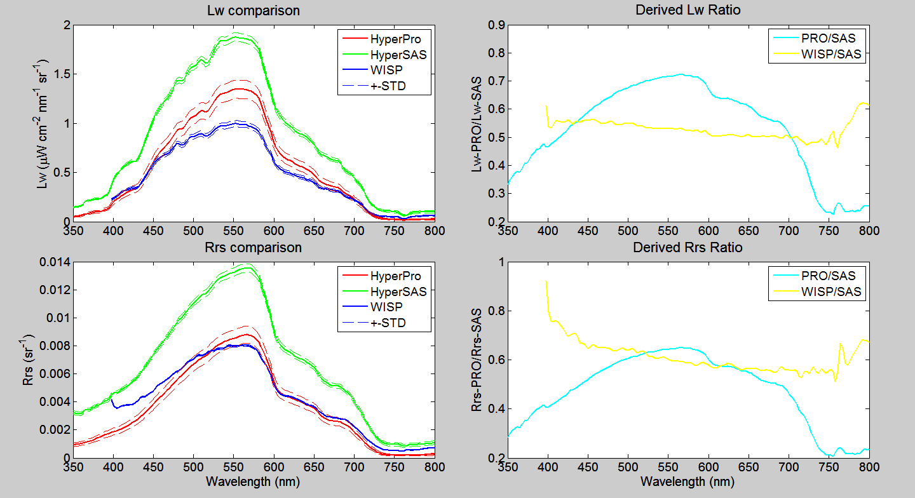
Let’s Make It More Complicated-Immersion

Slide 13
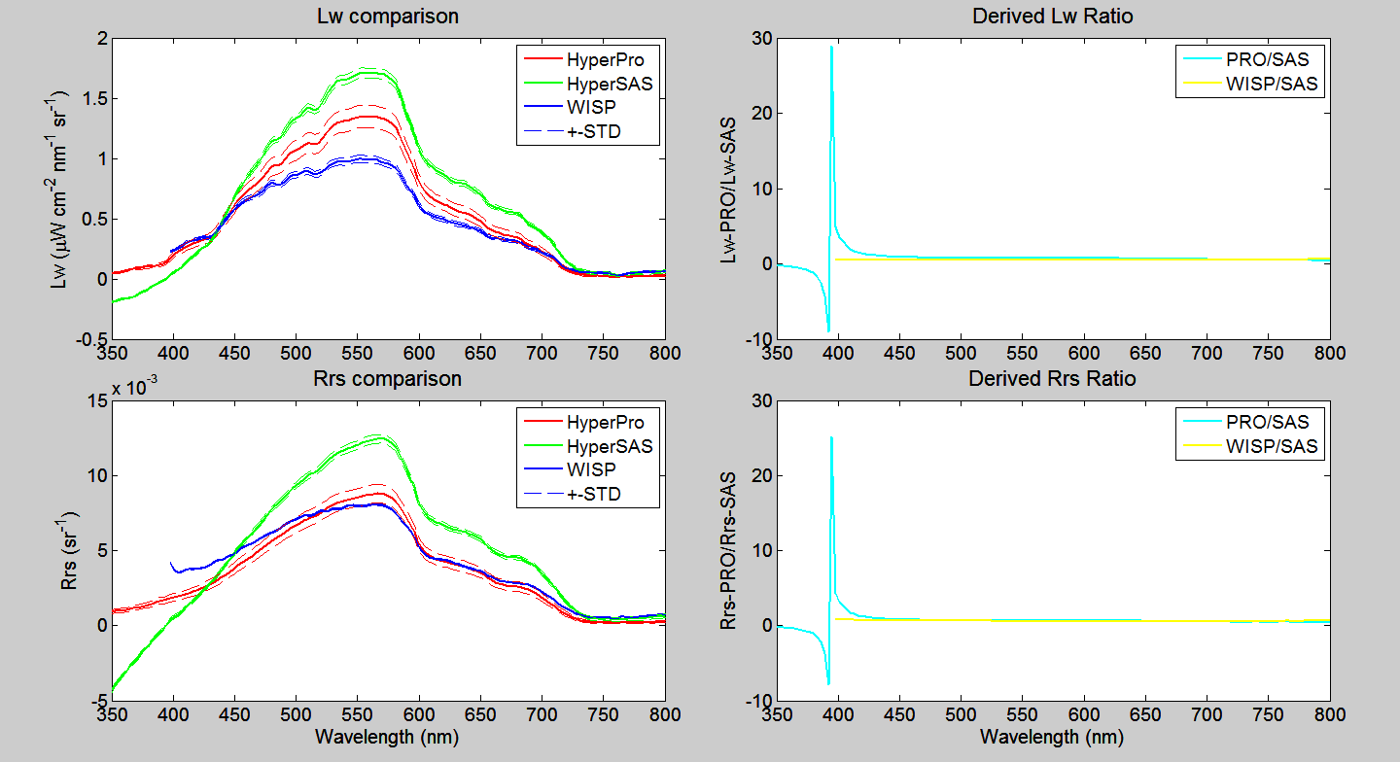
Let’s Make It More Complicated-ρ_{sky}=0.09

Slide 14
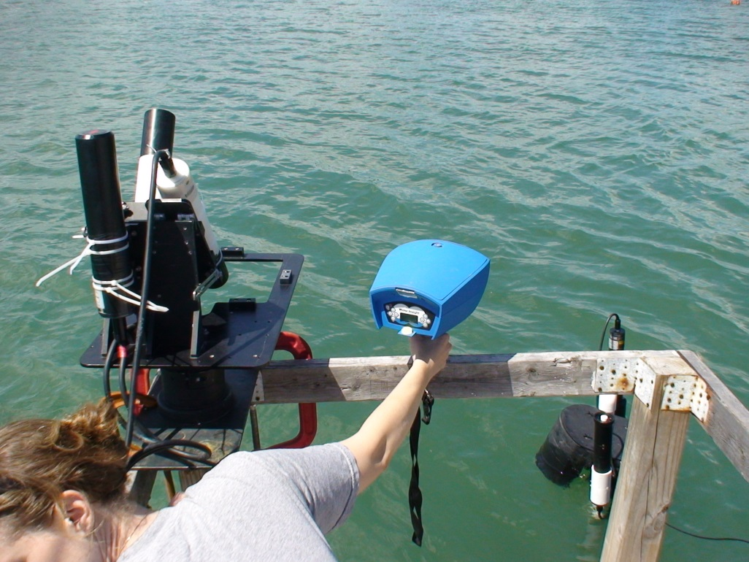
Recommendations?
Keeping in mind that the SAS and/or Pro may have calibration issues, using WISP in open water doesn’t look promising ‘as is’*
Gimbal the WISP
Put a level bubble on the under side of the WISP
Add automatic sampler feature (every x seconds)

Slide 15
EXTRA FIGURES:WISP

