Slide 1
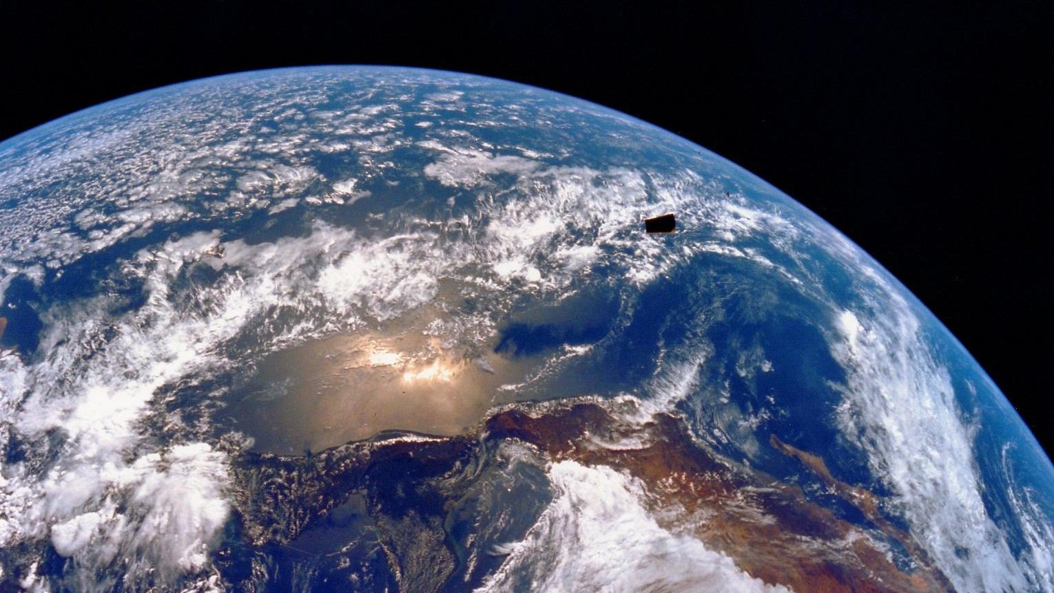

Slide 2
An Unofficial Guide to Radiometric Measurement
Notes:
The field of ocean optics focuses on the use of light’s inherent optical properties and how sunlight changes in earth’s atmosphere and oceans. From the characteristics of these light interactions, we can learn about ocean properties, such as chlorophyll levels and particle size trends. Satellites provide essential measurements of various optical properties that can tell us about productivity, climate change and the carbon cycle on large spatial and temporal scales. One important part of remote sensing is collecting comparable field radiometry measurements and calibrating these satellite products. It is therefore crucial to follow certain protocols and learn how to collect accurate radiometry data in the field. In this video we will explain the general theory behind optical measurements, how optical oceanographers study light interactions, and the common instruments used. We’ll also show you the best practices for set-up and field measurements, as well as what common result spectra could look like.

Slide 3
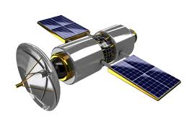
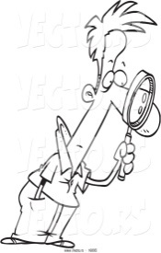
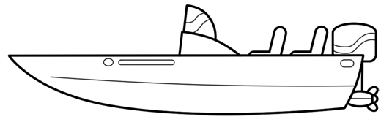
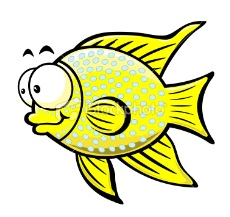
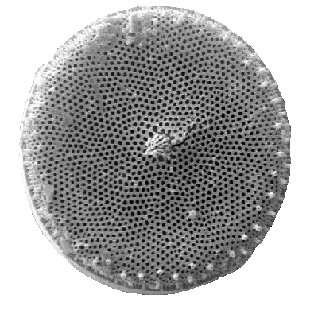
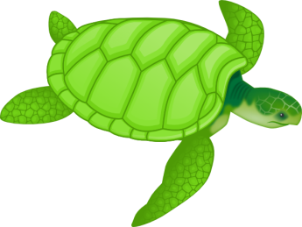
Atmospheric effects
Satellite
Skylight
L_{w}
In situ
E_{d}
L_{r}
Absorption
Downwelling irradiance E_{d}
Reflected radiance L_{r}
Water-leaving radiance L_{w}
Scattering
Transmission
Notes:
When light hits the ocean’s surface, the total amount of energy per unit area received is referred to as the down-welling irradiance or Ed. Part of this light can be reflected back into air and is called reflected radiance or Lr when viewed at a specific direction and angle. The rest of the light may travel into the water column. Within the water column, some light will be absorbed by water molecules, particles, CDOM and other substances like minerals, and some could be scattered into different directions by these same components. The scattered light can then be absorbed or scattered again. Ultimately, only a small part of the light will be transmitted to depth. A part of light can also be reflected back into air and when measured at a given solid angle and a specific direction it is referred to as the water-leaving radiance or Lw. Scientists are interested in Lw because it carries information from a particular parcel of water and its optical properties. Lw can either be collected by in-situ field work or via satellites. However, in addition to the water-leaving radiance, reflected radiance and skylight radiance also contribute to the signals collected by satellites or field instruments. Especially for satellite data, measurement corrections can be complicated by clouds, atmospheric particles, and water molecules, which can also absorb or scatter sunlight and contribute to the signal received by satellites.

Slide 4
R=E_{u} /E_{d}
Air
Water
Downwelling irradiance E_{d}
Upwelling irradiance E_{u}
Notes:
When using in-situ sensors, it is important to understand the difference between radiance and irradiance. Imagine you are standing on a water surface. The total energy brought by light hitting you from all directions over a given unit area is the down-welling energy or irradiance (Ed). The upwelling irradiance is the same as down-welling, simply picture the light coming at you from below the water surface. Reflectance can be viewed as the ratio of Eu over Ed, or how much light ‘bounces’ off the water surface.

Slide 5
R_{rs}=L_{u} /E_{d}
Air
dΩ
Water
Upwelling radiance L_{u}
Notes:
The reflectance measured by satellites is slightly difference since satellites will measure radiance instead of irradiance. Imagine that you are viewing a water surface from a specific direction. The total energy per solid angle you receive is referred to as the radiance. Therefore, radiance will be viewing direction and solid angle dependent. Only if the water surface is Lambertian in nature will the upwelling radiance be identical at all directions. Remote sensing reflectance is defined as the ratio of the upwelling radiance over the down-welling irradiance.

Slide 6
Hyperspectral Radiometers

Slide 7
Above water
Skylight L_{i} ~ L_{r}
L_{w}
E_{d}
E_{d}
Air
Air
L_{t} = L_{r} + L_{w}
Water
Water
Notes:
There are two main types of radiometric configurations, those suited for above water measurements and those for below the water surface. This video focuses on above water radiometers which have two main set-ups: above water and in water systems. Above water systems generally consist of a sensor measuring down-welling irradiance (Ed), a sensor pointing downward to measure the total upwelling radiance including the reflected radiance and the water-leaving radiance (Lt), and a third sensor measuring sky radiance (Li). This third sensor is used to correct for reflected radiance, allowing for conversion between total radiance and water-leaving radiance. When measuring using in-water systems, there are generally only two radiometers. This includes a sensor for down-welling irradiance (Ed). Instead of using a third sensor for sky radiance, the water-leaving radiance is measured directly by attaching a cone to the end of the radiance sensor pointing downward. Some radiometers do not have the cone and instead they take measurements at different water depths. This profiling method will not be discussed in this video but below surface measurements can provide an additional source of data for comparison.

Slide 8
Optimal Measurement Geometry
φ =135 °
θ = 40 °
Notes:
For above-water measurements it is important to follow the recommendations for optimum sampling positions and geometries in order to reduce the sun glinting and variability of field measurements. If we imagine that the sun direction falls in the grey plane in this diagram, the recommended location for taking measurements will be approximately 135 degrees away in either direction. In addition, if using a fixed system one should set up the instrument so that the two radiance sensors are pointed at 40 degrees from the zenith and 140 degrees from the zenith. This is equivalent to plus or minus 50 degrees from the horizon. If using a handheld instrument the angle may not be adjustable.

