Slide 1
AC-9/AC-S data analysis from CDOM Lab
July 10, 2013

Slide 2
Blanks: AC-9/AC-S
Agreement between blanks, except when bubbles are present in the tube
Notes:
– is the Milli-Q blank stable (e.g. when comparing between groups)?
Both blue and red are examples of bubbles being present in the tube

Slide 3
Blanks: AC-9/AC-S
Instabilities come from bubbles in the tube
Notes:
what might cause instability?
Effect of bubbles in the tube

Slide 4
Blanks: AC-9/AC-S
  Device file represents calibration at 25.48˚C (AC-9) but blanks were measured at 23˚C.
  Absorption increases with temperature, especially around 700 nm
  Standard deviation was similar to factory, however
  Reasons for discrepancy between blank and device file
    This is largely because our sample is colder than the factory calibration temperature.
    Moving, using, and reusing the instrument will affect the measurement.
Notes:
– how does your blank compare to the device file?
– why could your blank be different from device file (factory blank)?

Slide 5
Blanks: AC-9/AC-S
What are the symptoms of a bad Milli-Q calibration?
  Bad Milli-Q calibrations will have several spikes and will not be repeatable.
How do you insure that the tubes and windows are clean?
  To make sure that the tubes and windows are clean the instrument should be cleaned, air calibrated, and Milli-Q calibrated.
Notes:
– –

Slide 6
Data Processing
CDOM Absorption Coefficients at 440nm
(after temperature and salinity corrections)
Device | DRE | Biscay Pond
AC-9 | 0.3552 | N/A
AC-S (25) | N/A | 2.901
AC-S (16) | 0.3372 | N/A
Notes:
3. For the ac-9/ac-s, calculate the spectral absorption coefficient, aCDOM(λ), for the field samples. First use data from only the absorption flow tube (a tube), then repeat the calculations for the attenuation flow tube (c tube). Apply:
– Milli-Q pure water calibration x
– correct temperature and salinity corrections (Biscay Pond is freshwater and
DRE had a salinity of 28 on 2 July) x

Slide 7
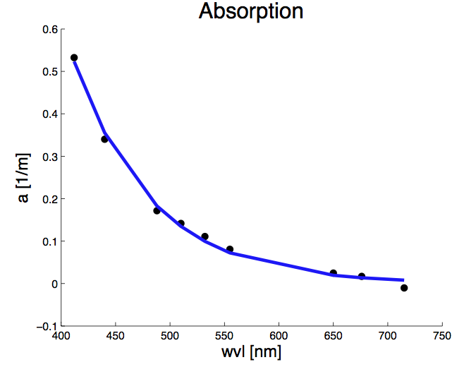
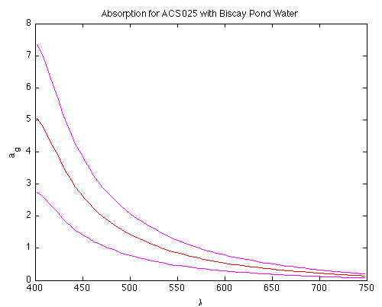
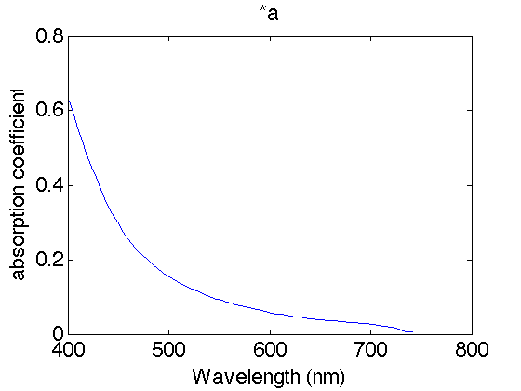
a_{CDOM} for field samples
DRE AC-9
BP AC-S (25)
DRE AC-S (16)
Notes:
3. For the ac-9/ac-s, calculate the spectral absorption coefficient, aCDOM(λ), for the field samples. First use data from only the absorption flow tube (a tube), then repeat the calculations for the attenuation flow tube (c tube). Apply:
– Milli-Q pure water calibration x
– correct temperature and salinity corrections (Biscay Pond is freshwater and
DRE had a salinity of 28 on 2 July) x

Slide 8
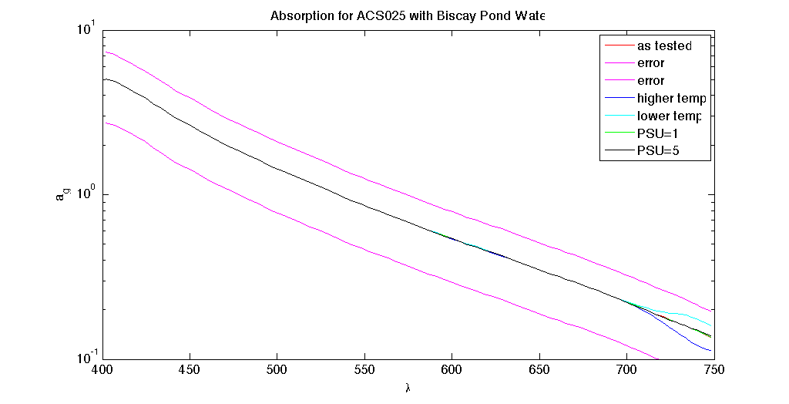
Data Processing
Sensitivity of results to differences in temp correction and salinity correction
Notes:
– how would your results change if you used a temperature correction that was 2o C too high or too low?
– how would your results change if you used a salinity correction that was 1 unit too high or too low? 5 units too high or too low?

Slide 9
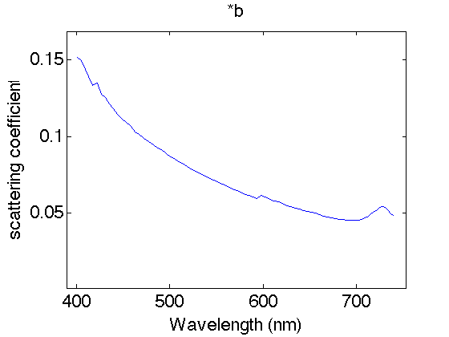
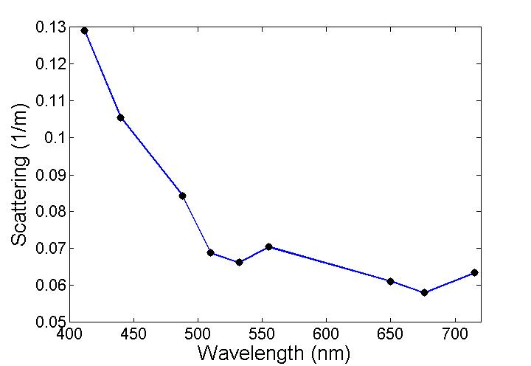
Data Processing
Differences in absorption and attenuation (median scattering for AC-9 data from DRE)
Consistency between samples?
AC-9
AC-S (16)
Notes:
– is there any difference between the aCDOM(λ) for the a tube vs. the c tube? Are these consistently different between or among samples?
In other words, are a and c the same, and is this consistent between samples

Slide 10
Data Processing
CDOM absorption coefficient
at ~705-725 nm (ac-s) or 715nm (ac-9)
Device | DRE | Biscay Pond
AC-9 | -0.010 | N/A
AC-S (25) | N/A | 0.18
AC-S (16) | 0.016 | N/A
Notes:
4) For the ac-9/ac-s, what is the CDOM absorption coefficient at ~705-725 nm (ac-s) or 715nm (ac-9) for the three field samples??
– are these values equal to zero?

Slide 11
Data Processing
Justification for forcing these values to zero and subtracting from other wavelengths:
  CDOM absorption should be zero in the NIR
  Should be removed from all values
Slopes sensitive to NIR value?
  Yes 0.0138 to 0.0131 for AC-9
Notes:
– is there justification for forcing these values to zero, and subtracting the
average from all other wavelengths?
– use Excel or Matlab to fit an exponential function to the data. Are the slopes
sensitive to the removal of the NIR value?

Slide 12
Comparison of Field Samples
Does the magnitude of CDOM absorption vary as a function of its source?
Wavelength (nm) | AC-9 : DRE | AC-S(25) : BP
412 | 0.5324 | 4.652
440 | 0.3401 | 3.11
488 | 0.1716 | 1.659
510 | 0.1416 | 1.262
532 | 0.1110 | 1.019
555 | 0.0808 | 0.7954
650 | 0.0246 | 0.3443
676 | 0.0168 | 0.272
Notes:
BEFORE NIR CORRECTION
Does the magnitude of CDOM absorption vary as a function of its source?
Use 300 and 350 nm (spectrophotometers only) and ac-9 wavelengths (412, 440, 488, 510, 532, 555, 650, 676 nm) to compare aCDOM for:
– coastal waterDRE water (dock)
– Biscay Pond (freshwater)

Slide 13
Comparison of Field Samples
Spectral Slope with ref wavelength = 440nm, using least squares
Device | DRE | Biscay Pond
AC-9 | 0.0138 | N/A
AC-S (25) | N/A | 0.0121
AC-S (16) | 0.0131 | N/A
Spectral slopes can vary between water sources
Notes:
Does the spectral slope of CDOM vary as a function of its source AND/OR method to compute the slope?
SCDOM is the spectral slope of CDOM:
aCDOM(λ) = aCDOM (λREF) e - SCDOM (λ – λREF) ,
where aCDOM(λ) is the amplitude of the absorption coefficient at any wavelength λ (Jerlov, 1976) or at the reference wavelength, λREF (usually 412 or 440 nm). See Carder et al. (1989) and Blough and Del Vecchio (2002) for a discussion of the interpretation of the spectral slope.
The best method to calculate the slope is to minimize the square difference between the exponential model and the data (possibly weighed by a different error in each
wavelength if the uncertainty varies as function of wavelength, e.g. due to variability in source intensity as function of wavelength). The relative (percent) error is not constant spectrally; in the red the absorption is low and the signal-to-noise high. Slope measurements often exclude red wavelengths due to its sensitivity to temperature (e.g. the 715 nm channel in the ac-9).
You may write your own code to determine the slope by non-linear exponential regression (we will also supply code: http://misclab.umeoce.maine.edu/software.php); OR,
less rigorously, you may determine the spectral slope for a CDOM(λ) by plotting the ln- transformed values of aCDOM vs. wavelength using Excel and adding a trend line (this is the same as if you fit an exponential curve in Excel, try it). If you use the latter method, is the slope linear?
– what is the spectral slope, SCDOM, for the range 412 nm – 676 nm?
– is the slope constant over all wavelength regions?
o what is the slope for 300 – 350 nm (spectrophotometer)?
o what is the slope for for 350 – 450 nm (all instruments)?
– do spectral slopes vary between the water types?

