Slide 1
Lab 2 - Spectro
Blanks - Question 1
Data Processing - Questions 1, 2, 5, 6

Slide 2
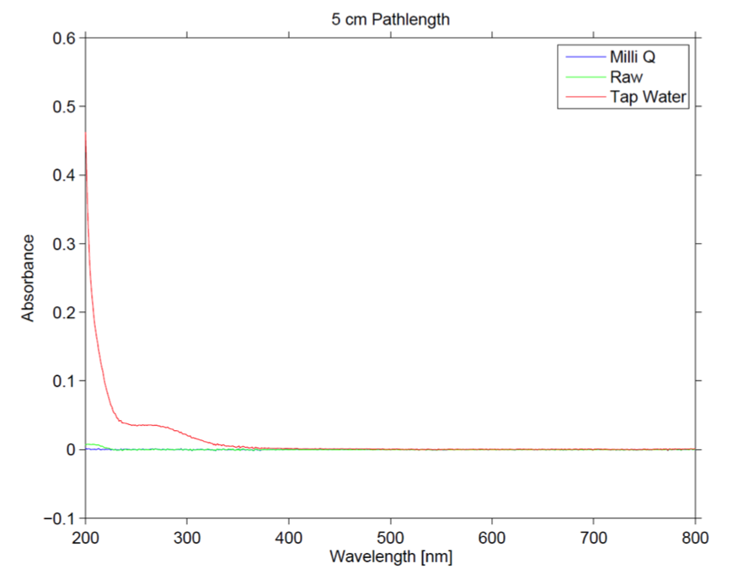
Blanks - 1
-RO has a similar spectral signature to Milli-Q except near 200nm
-Tap water has a different spectral signature at wavelengths less than 400nm because there are different components in tap water.
-Keep cuvette clean and properly placed by rinsing the cuvette 3x, using a lens wipe to clean the optical lens, placing the cuvette closest to the detector and orienting it in the same direction each time.
-Milli-Q water gives the lowest reading

Slide 3
1cm Pathlength

Slide 4
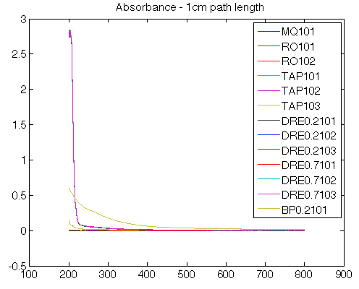
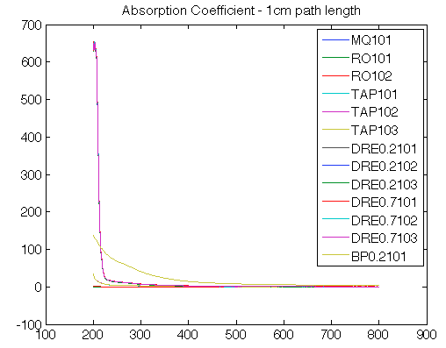
Absorbance and Absorption Coefficient 1cm pathlength

Slide 5
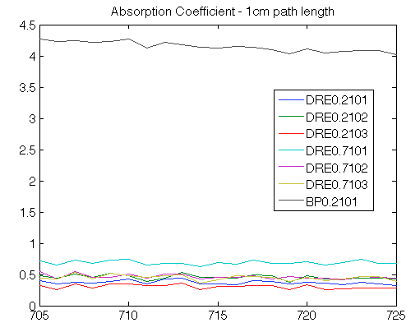
Absorption Coefficient, 1cm pathlength, Field Samples Wavelength 705-725nm

Slide 6
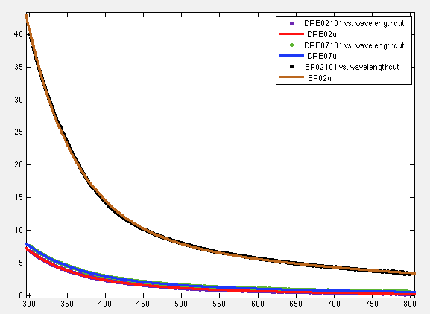
Exponential Fit - 1cm pathlength

Slide 7
DRE02u
General model Exp2:
f(x) = a*exp(b*x) + c*exp(d*x)
Coefficients (with 95% confidence bounds):
a = 779 (695.2, 862.9)
b = -0.01726 (-0.01769, -0.01684)
c = 9.727 (8.934, 10.52)
d = -0.00457 (-0.004698, -0.004443)
Goodness of fit:
SSE: 0.7182
R-square: 0.9993
Adjusted R-square: 0.9993
RMSE: 0.03805

Slide 8
DRE07u
General model Exp2:
f(x) = a*exp(b*x) + c*exp(d*x)
Coefficients (with 95% confidence bounds):
a = 438.8 (408.9, 468.7)
b = -0.0147 (-0.01497, -0.01444)
c = 5.441 (5.092, 5.789)
d = -0.002897 (-0.002991, -0.002803)
Goodness of fit:
SSE: 0.7661
R-square: 0.9994
Adjusted R-square: 0.9994
RMSE: 0.0393

Slide 9
BP02u
General model Exp2:
f(x) = a*exp(b*x) + c*exp(d*x)
Coefficients (with 95% confidence bounds):
a = 3449 (3310, 3588)
b = -0.01574 (-0.01589, -0.01559)
c = 19.62 (18.95, 20.29)
d = -0.002182 (-0.002233, -0.00213)
Goodness of fit:
SSE: 9.883
R-square: 0.9997
Adjusted R-square: 0.9997
RMSE: 0.1412

Slide 10
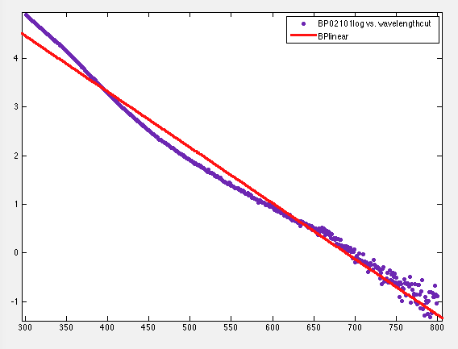
Linear model Poly1:
f(x) = p1*x + p2
Coefficients (with 95% confidence bounds):
p1 = -0.01149 (-0.01162, -0.01137)
p2 = 7.918 (7.848, 7.988)
Goodness of fit:
SSE: 20.38
R-square: 0.9854
Adjusted R-square: 0.9854
RMSE: 0.2023

Slide 11
5cm Pathlength

Slide 12
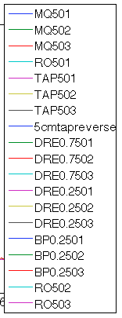
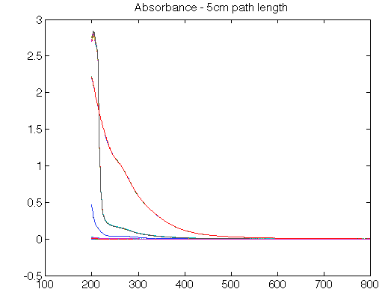
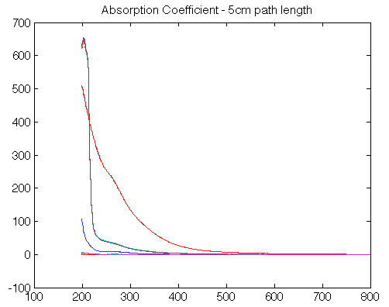
Absorbance and Absorption Coefficient 5cm pathlength

Slide 13
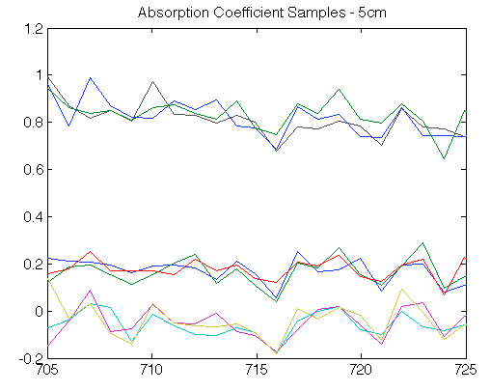
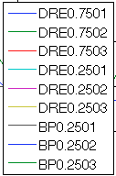
Absorption Coefficient, 5cm pathlength, Field Samples Wavelength 705-725nm

Slide 14
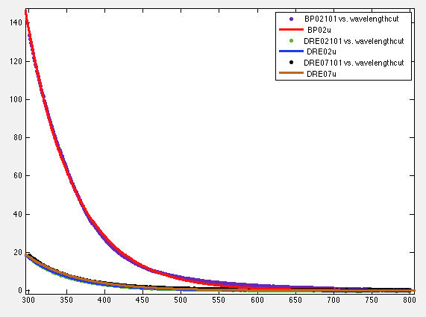
Exponential Fit - 5cm pathlength

Slide 15
BP02u
General model Exp1:
f(x) = a*exp(b*x)
Coefficients (with 95% confidence bounds):
a = 1.555e+04 (1.513e+04, 1.597e+04)
b = -0.01576 (-0.01584, -0.01568)
Goodness of fit:
SSE: 509.5
R-square: 0.9988
Adjusted R-square: 0.9988
RMSE: 1.011

Slide 16
DRE02u
General model Exp1:
f(x) = a*exp(b*x)
Coefficients (with 95% confidence bounds):
a = 2941 (2870, 3012)
b = -0.01713 (-0.0172, -0.01706)
Goodness of fit:
SSE: 4.977
R-square: 0.9992
Adjusted R-square: 0.9992
RMSE: 0.09997

Slide 17
DRE07u
General model Exp1:
f(x) = a*exp(b*x)
Coefficients (with 95% confidence bounds):
a = 1722 (1638, 1805)
b = -0.01523 (-0.01538, -0.01509)
Goodness of fit:
SSE: 29.93
R-square: 0.9959
Adjusted R-square: 0.9959
RMSE: 0.2452

Slide 18
Bias removal
General model Exp1:
f(x) = a*exp(b*x)
Coefficients (with 95% confidence bounds):
a = 1.555e+04 (1.513e+04, 1.597e+04)
b = -0.01576 (-0.01584, -0.01568)
Goodness of fit:
SSE: 509.5
R-square: 0.9988
Adjusted R-square: 0.9988
RMSE: 1.011
General model Exp1:
f(x) = a*exp(b*x)
Coefficients (with 95% confidence bounds):
a = 1722
(1638, 1805)
b = -0.01523 (-0.01538, -0.01509)
Goodness of fit:
SSE: 29.93
R-square: 0.9959
Adjusted R-square: 0.9959
RMSE: 0.2452

Slide 19
10cm Pathlength

Slide 20
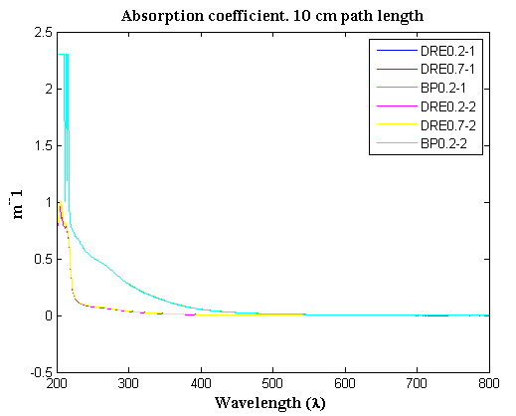
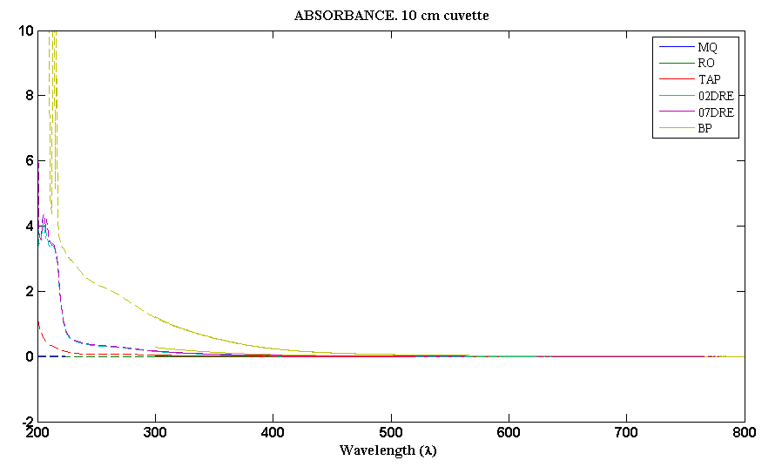
Absorbance and Absorption Coefficient 10cm pathlength

Slide 21
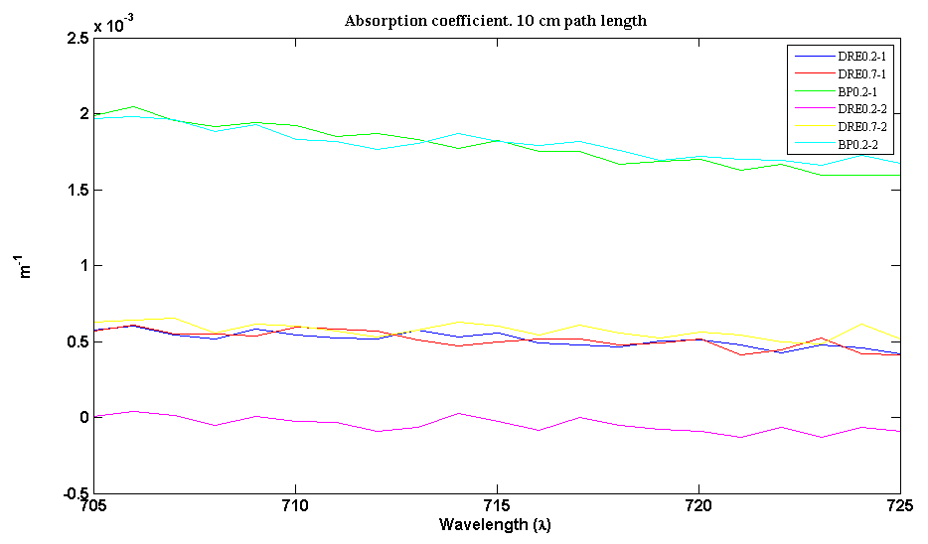
Absorption Coefficient, 10cm pathlength, Field Samples Wavelength 705-725nm

Slide 22
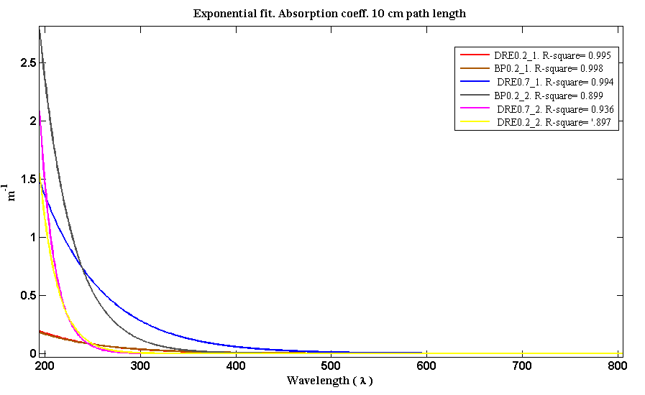
Exponential Fit - 10cm pathlength

Slide 23
Data Processing - 2
- Yes
- Yes because CDOM only absorbs in the blue so the residual scattering is due to air bubbles or colloids and therefore should have value 0 in the NIR.
- Yes, see Bias Removal
5
- There doesn't appear to be anything in the water smaller than 1 micron , therefore the 0.2 vs 0.7 filter pore size does not have an impact.

Slide 24
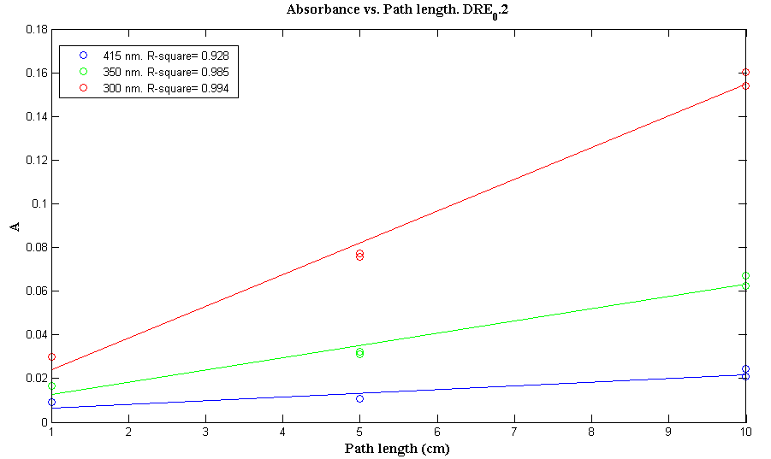
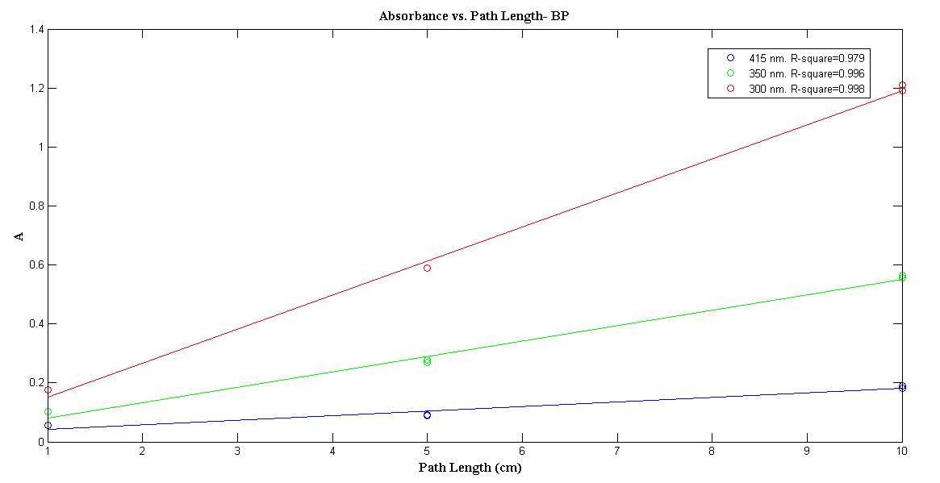
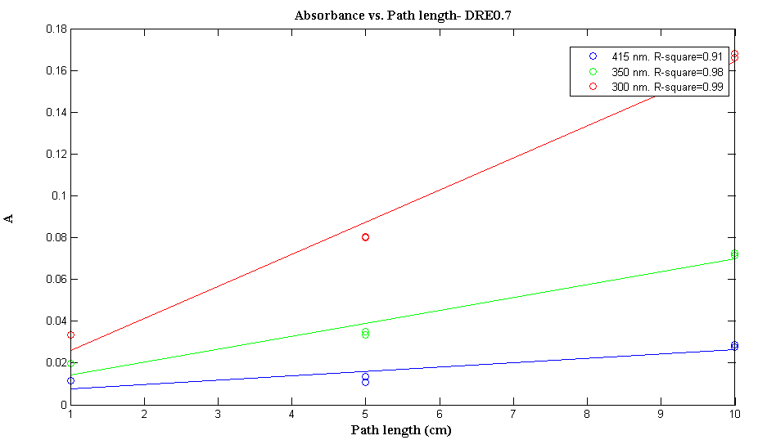
Data Processing - 6
- Absorption increases linearly with pathlength.

