Slide 1
ac-9/ac-s
Data and Discussion

Slide 2
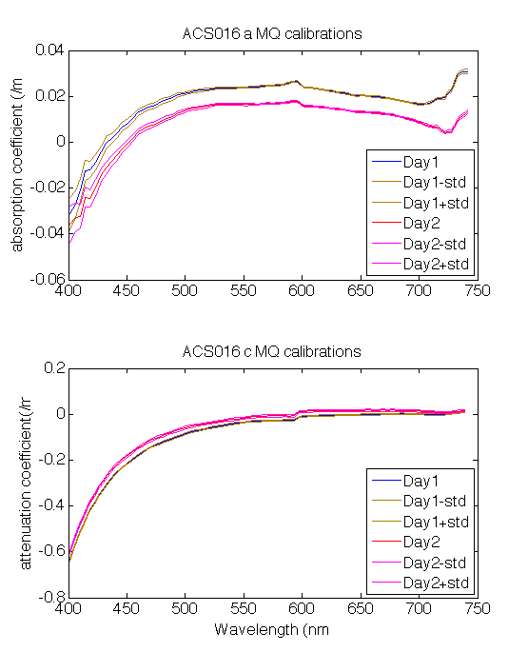
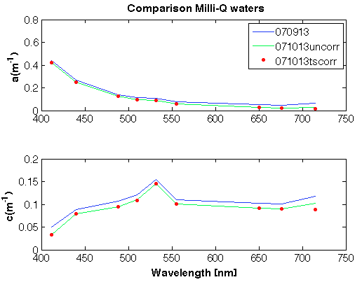
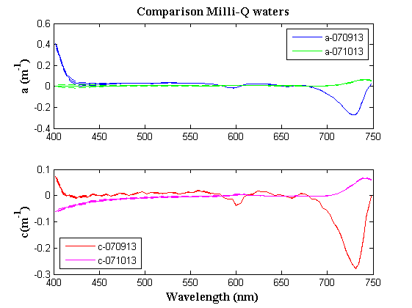
MilliQ Calibration Comparison ac-9/s
7. How did the pure water calibration compare between days?
AC-S (25)
AC-9
AC-S(16)

Slide 3
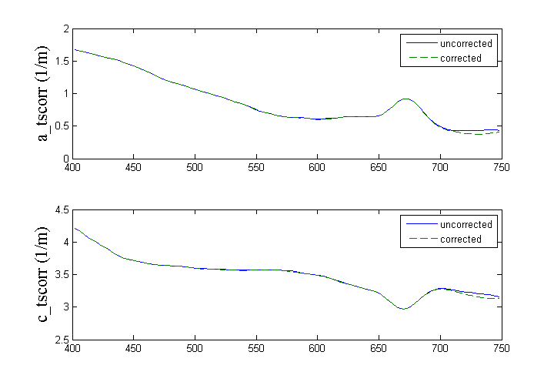
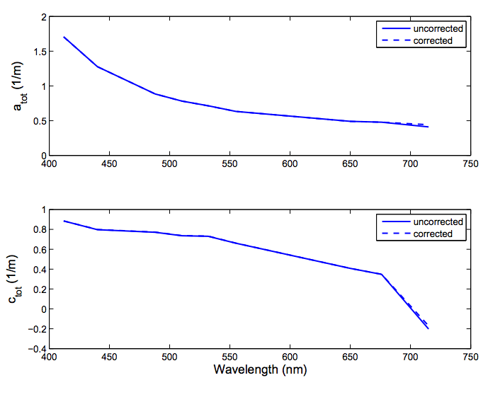
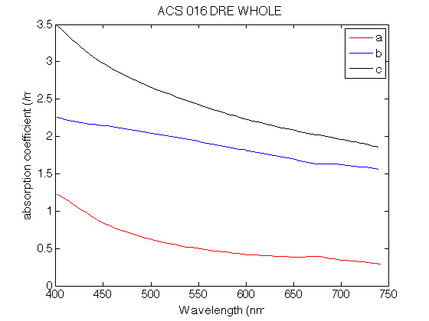
a,c temp corrected DRE and Culture
AC-S (25) - Culture
AC-9
AC-S (16) - DRE

Slide 4
a440 c440 after T and S correction
Sample | a440: AC-9 | a440: ACS (16) | a440: ACS (25)
DRE unfiltered | 1.2764 | 0.9038 | N/A
DRE filtered | 0.6683 | 0.3438 | N/A
Culture unfiltered | N/A | N/A | 1.5067
Culture filtered | N/A | N/A | 0.3759
Sample | c440: AC-9 | c440: ACS (16) | c440: ACS (25)
DRE unfiltered | 0.7984 | 3.0664 | N/A
DRE filtered | 0.7988 | 0.3890 | N/A
Culture unfiltered | N/A | N/A | 3.7856
Culture filtered | N/A | N/A | 0.4046

Slide 5

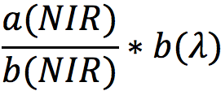
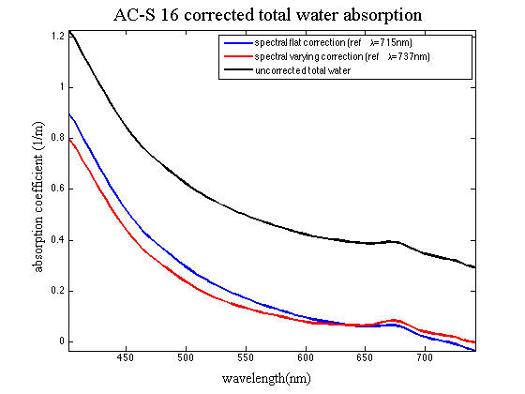
a,c scattered corrected
Method 1: spectrally flat correction (NIR absorption value subtraction)
Method 2: scattering constant correction
Notes:
D

Slide 6
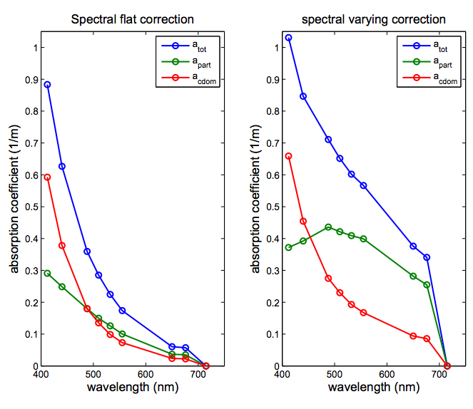
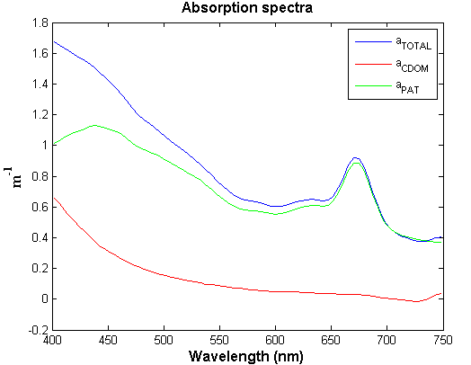
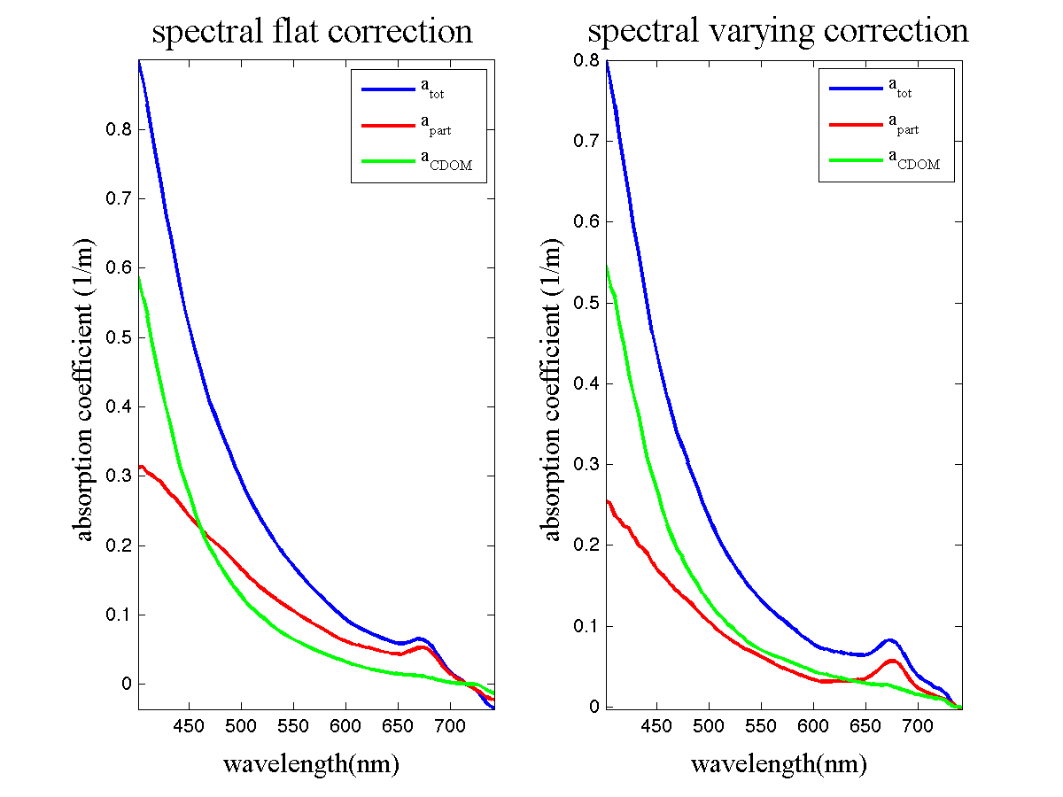
Comparisons of a breakdowns
AC-9 absorption
AC-S (25) absorption
Spectral Varying Correction
AC-S (16) absorption

Slide 7
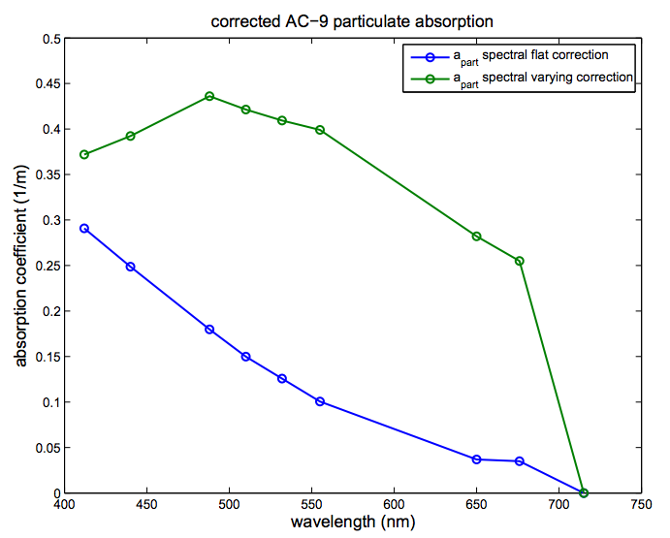
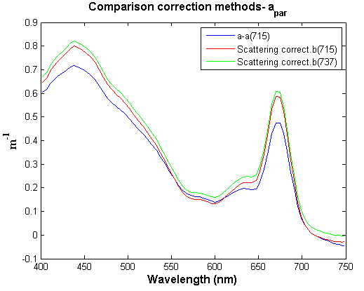
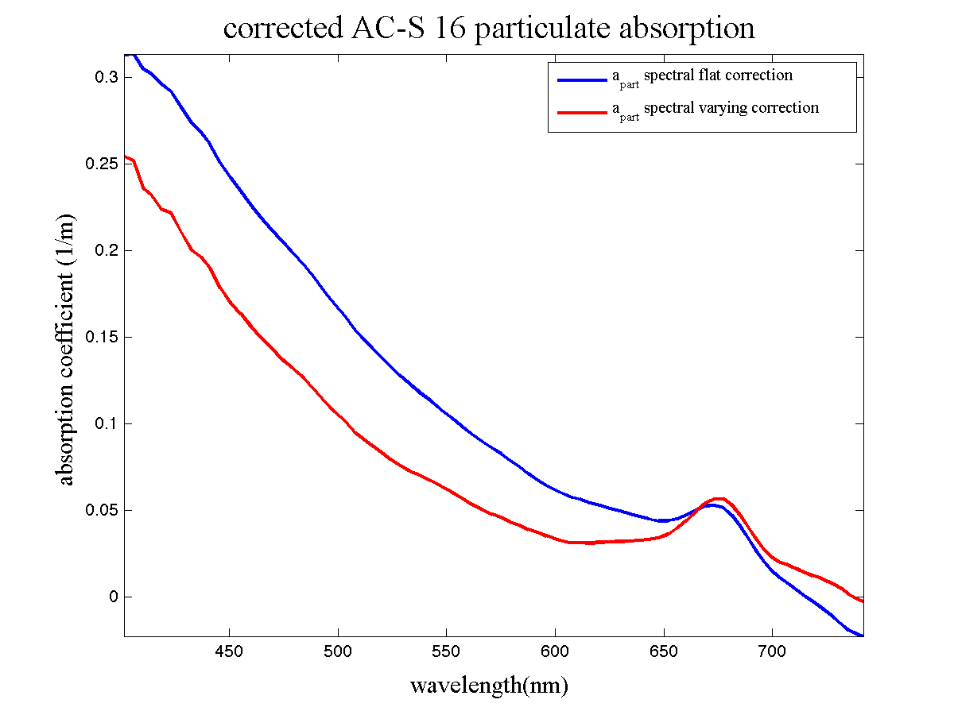
Comparison of methods for apart
AC-9
AC-S (25)
AC-S (16)

Slide 8
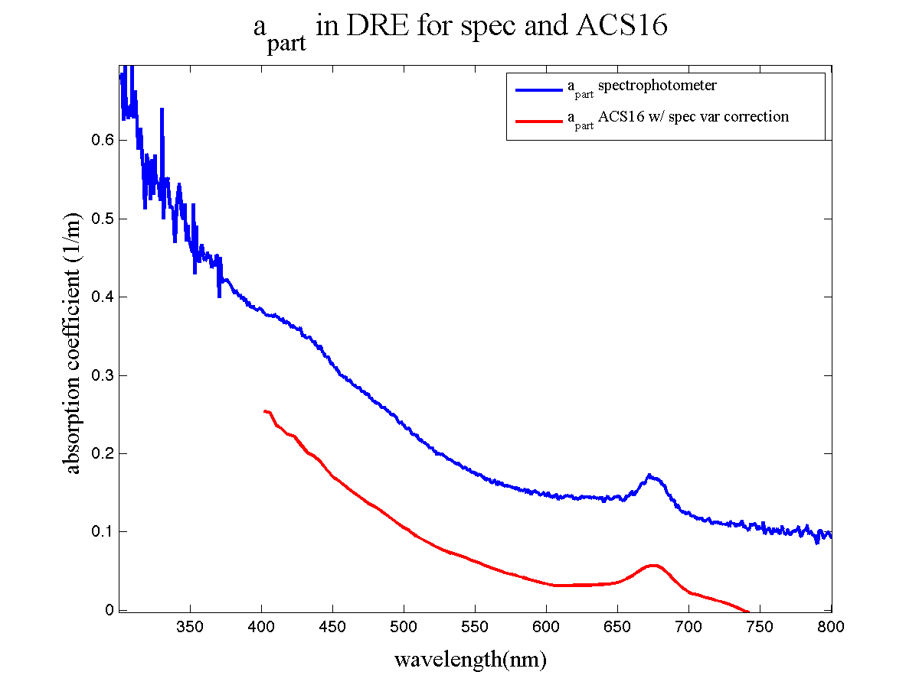
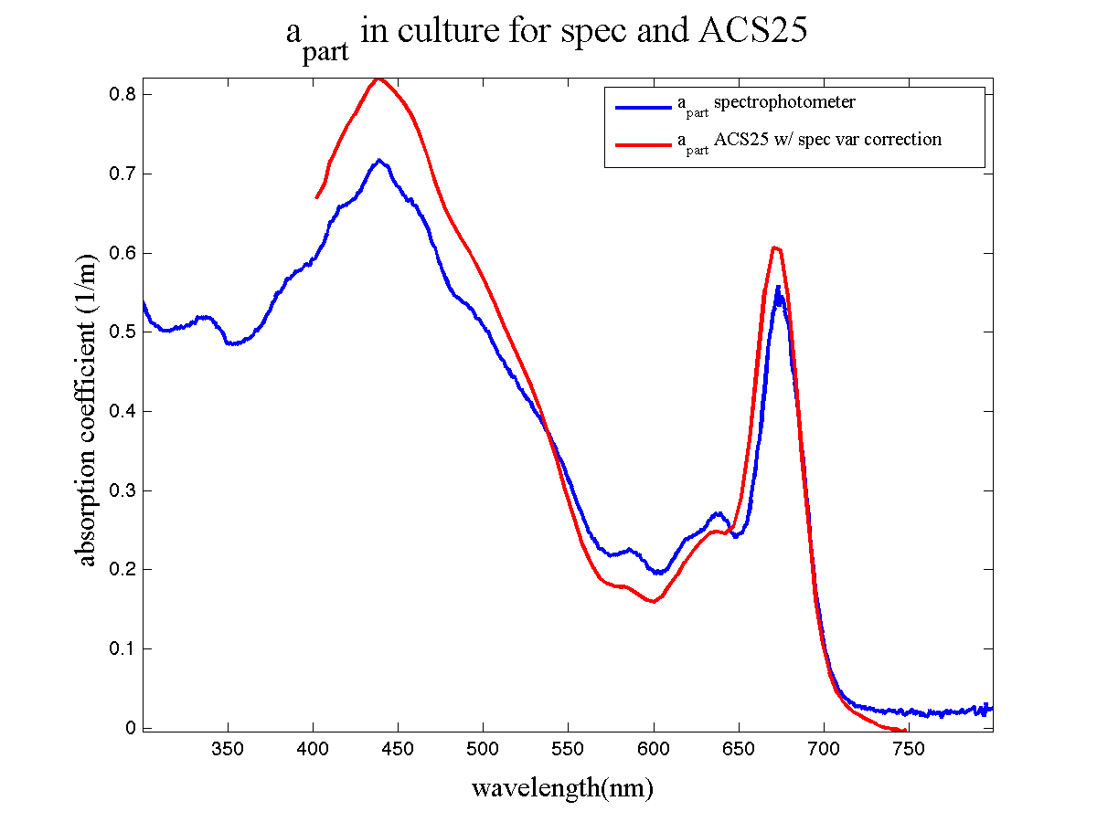
Particulate absorption comparison between spectrophotometer and AC

Slide 9
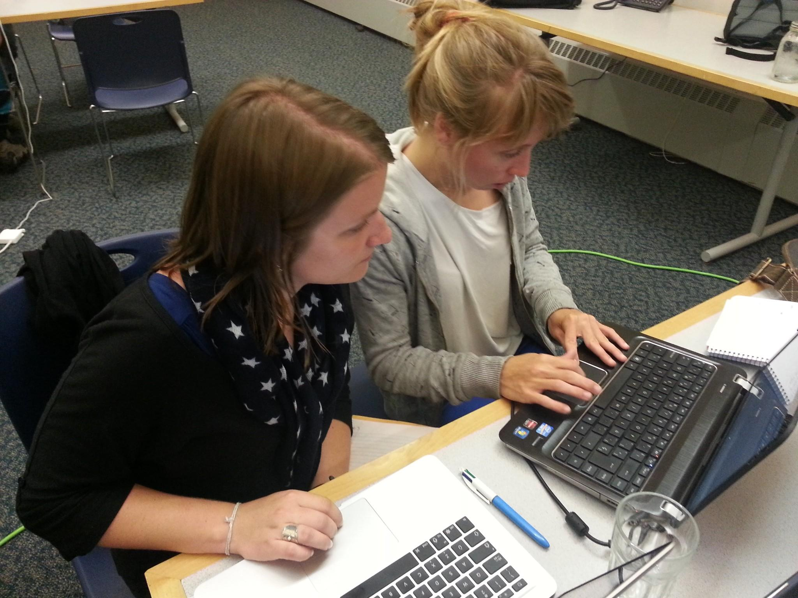

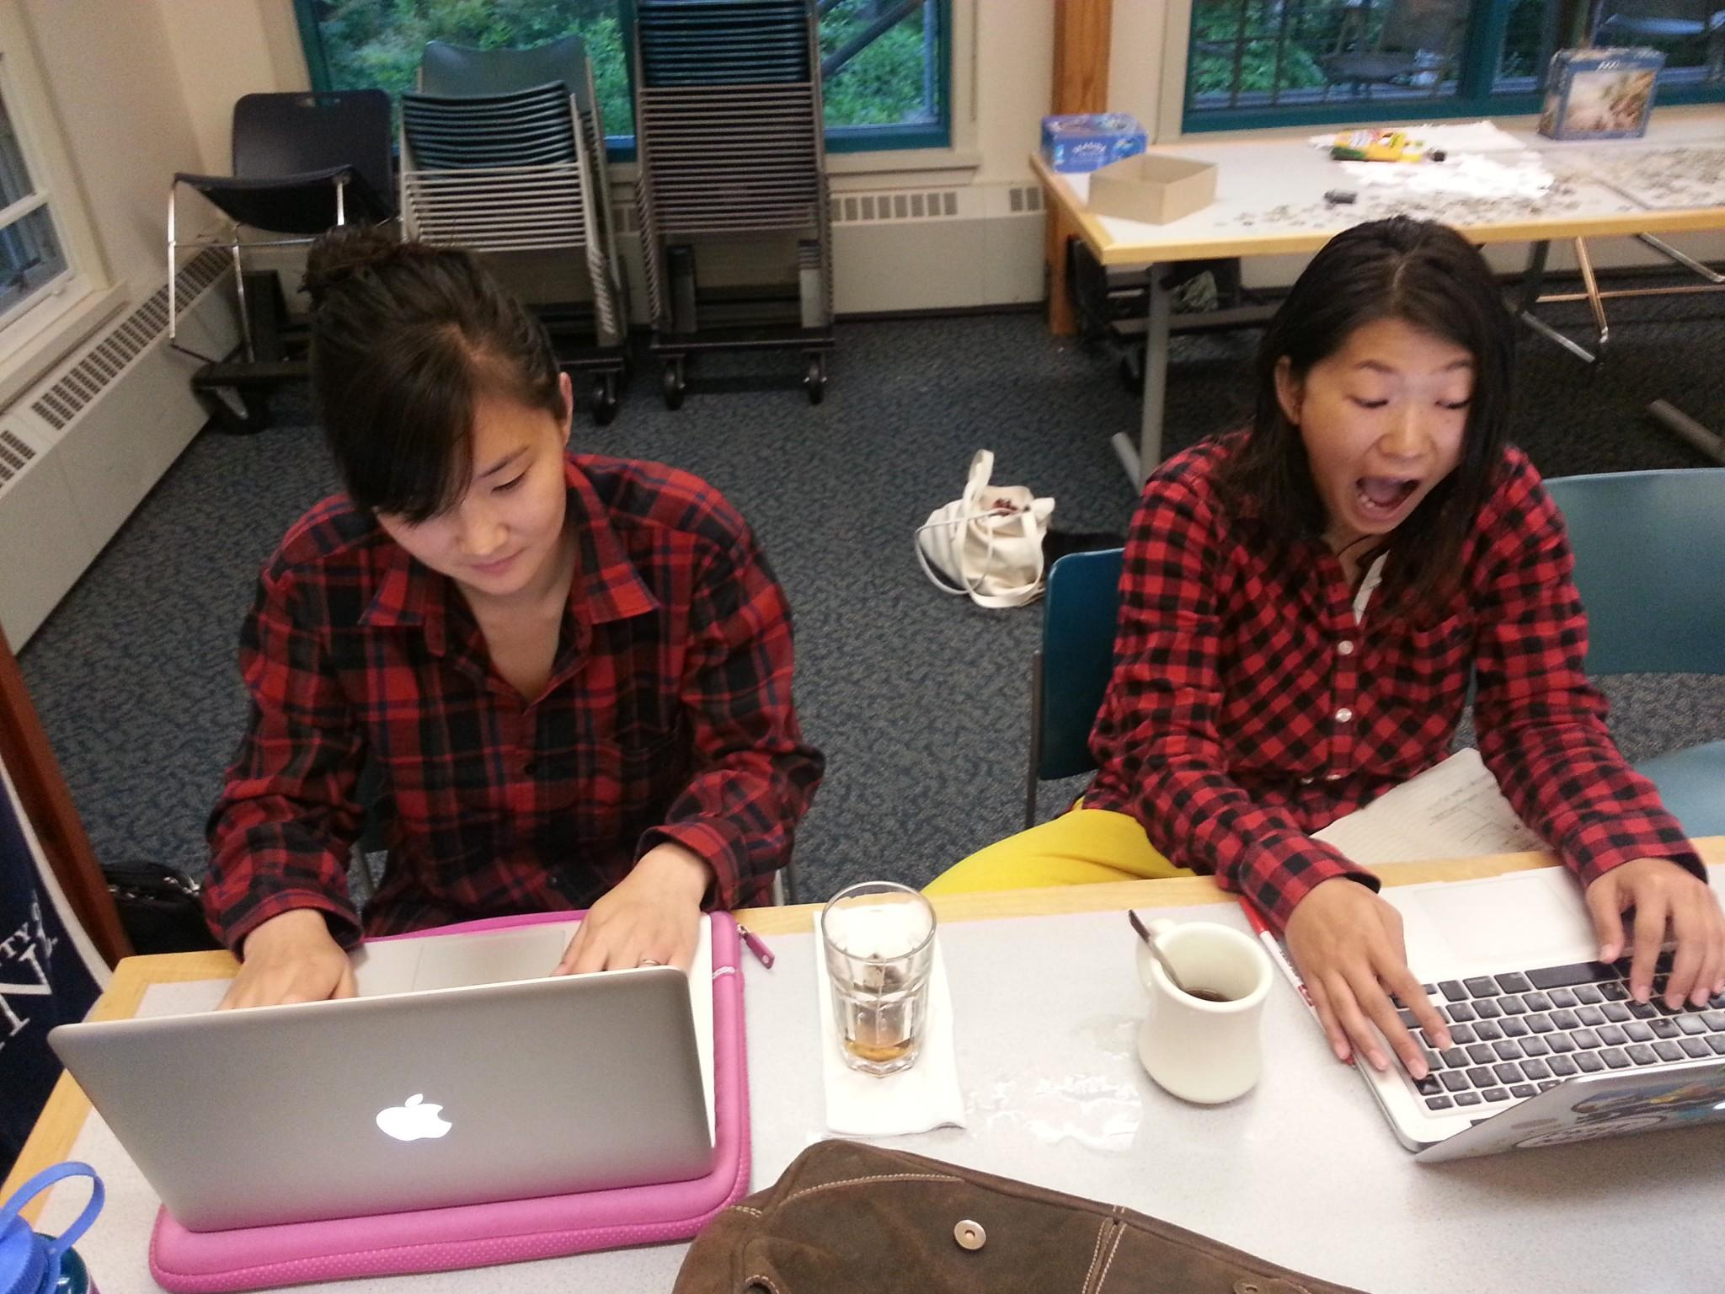
Thank you!

Slide 11
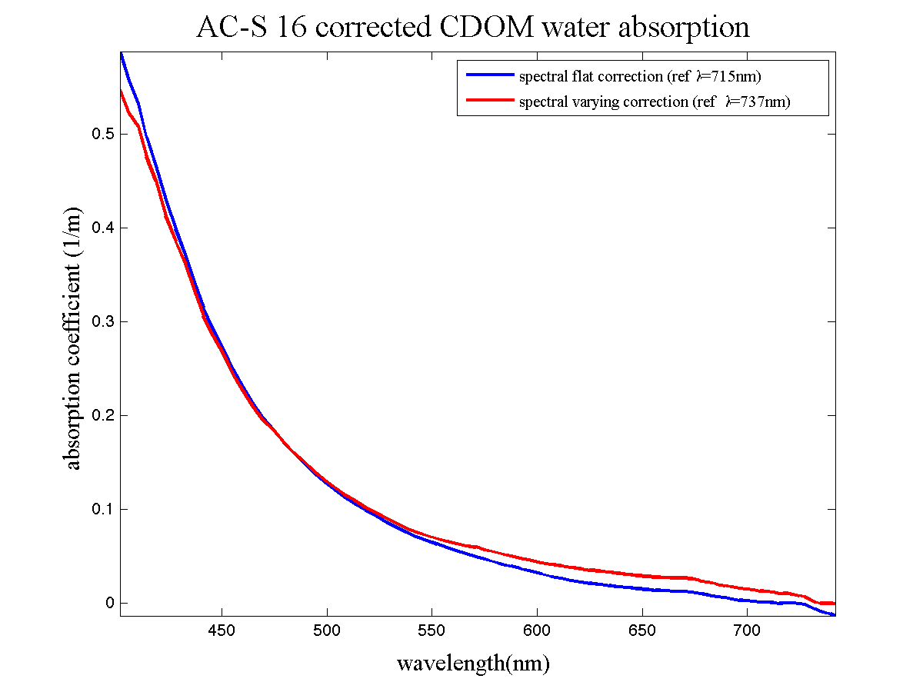
a,c scattered corrected
Method 1: spectrally flat correction (NIR absorption value subtraction)
Method 2: scattering constant correction
Notes:
D

