Slide 1
Lab 4
Scattering

Slide 2

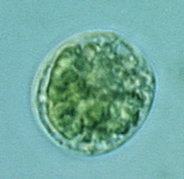
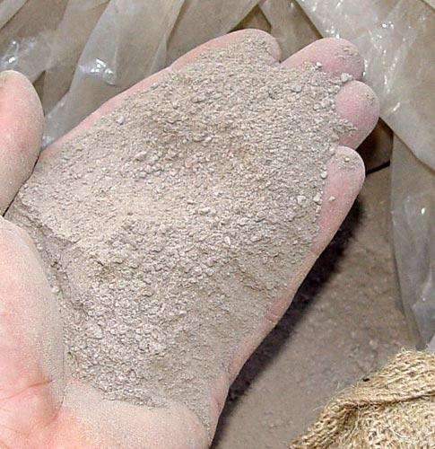
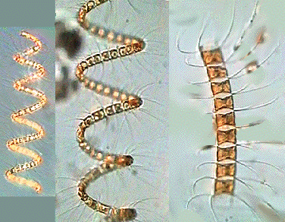
Samples:
Damariscotta River
Estuary
Platymonas*
Chaetoceros*
Arizona
'Dust'
*Wikipedia
Notes:
Lei: Platymonas: 2um; Chaetoceros: 20um but in chains, could be much bigger

Slide 3
METHODS

Slide 4
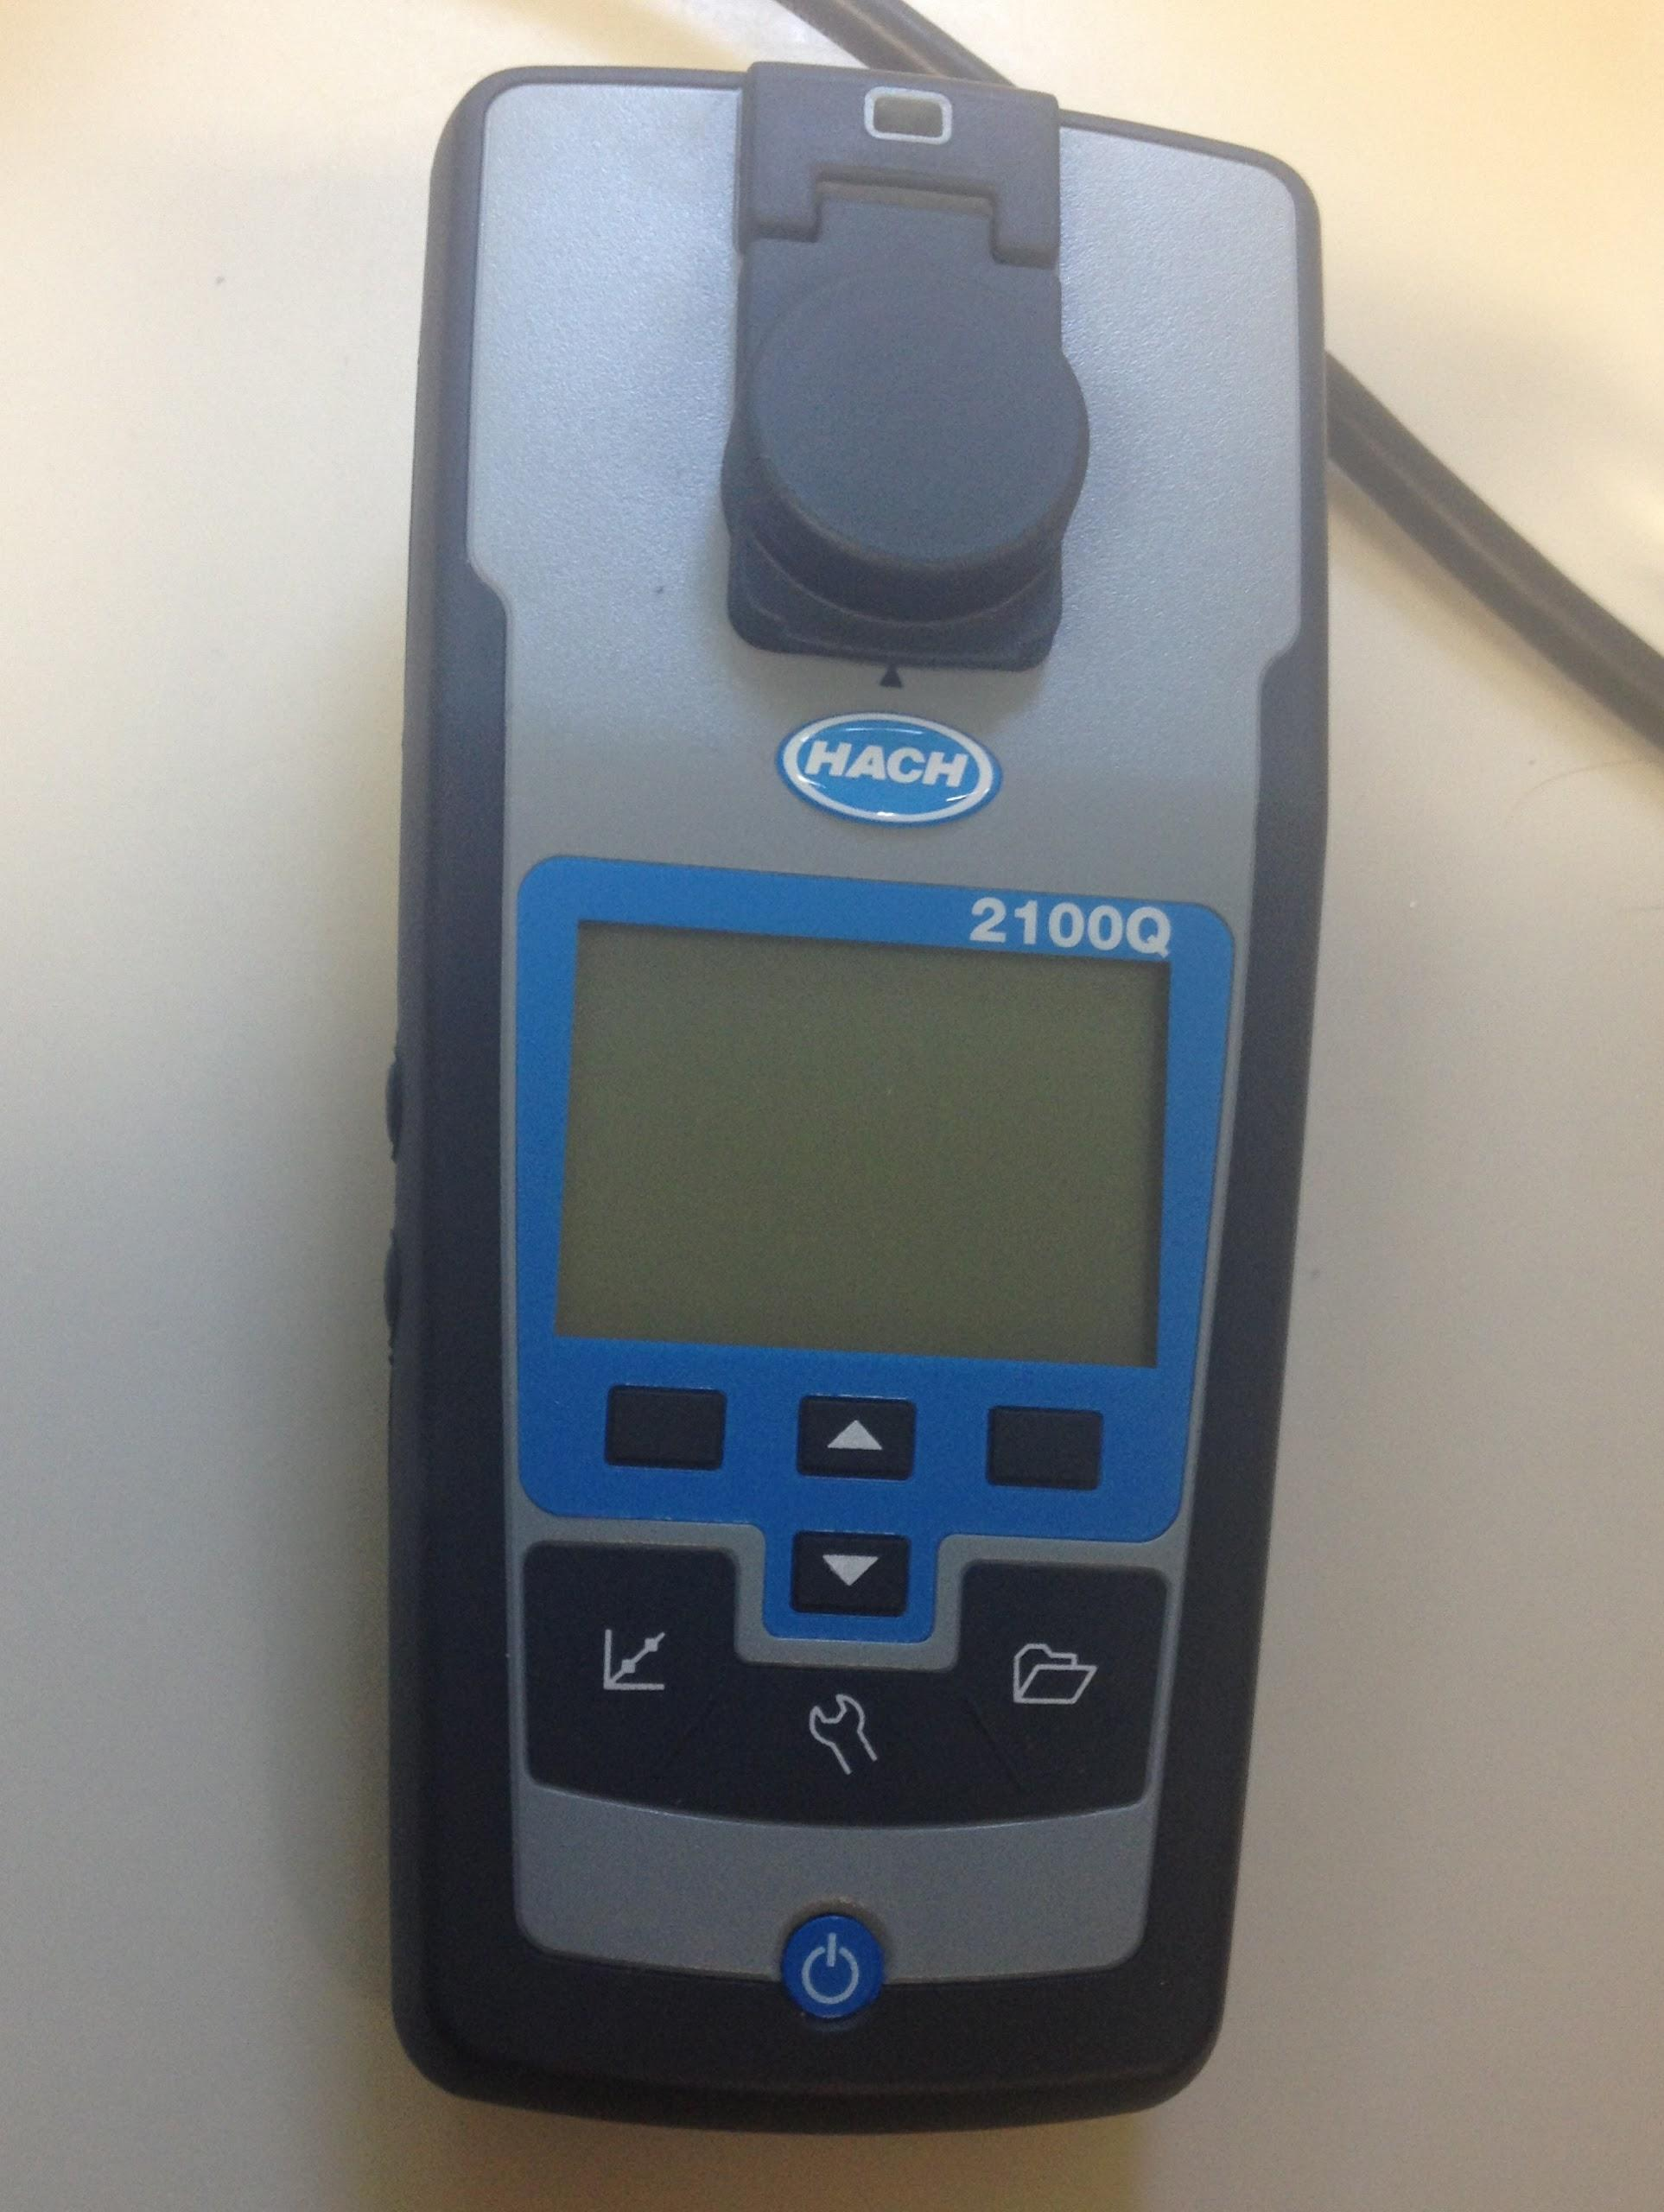
Turbidity Meter
Wavelength ~860 nm
Measures side-scattering
Range: 0 - 1000 NTU (related to nephelometer measurements of suspended particles)
Resolution: ~0.01 low range
Notes:
EB:

Slide 5
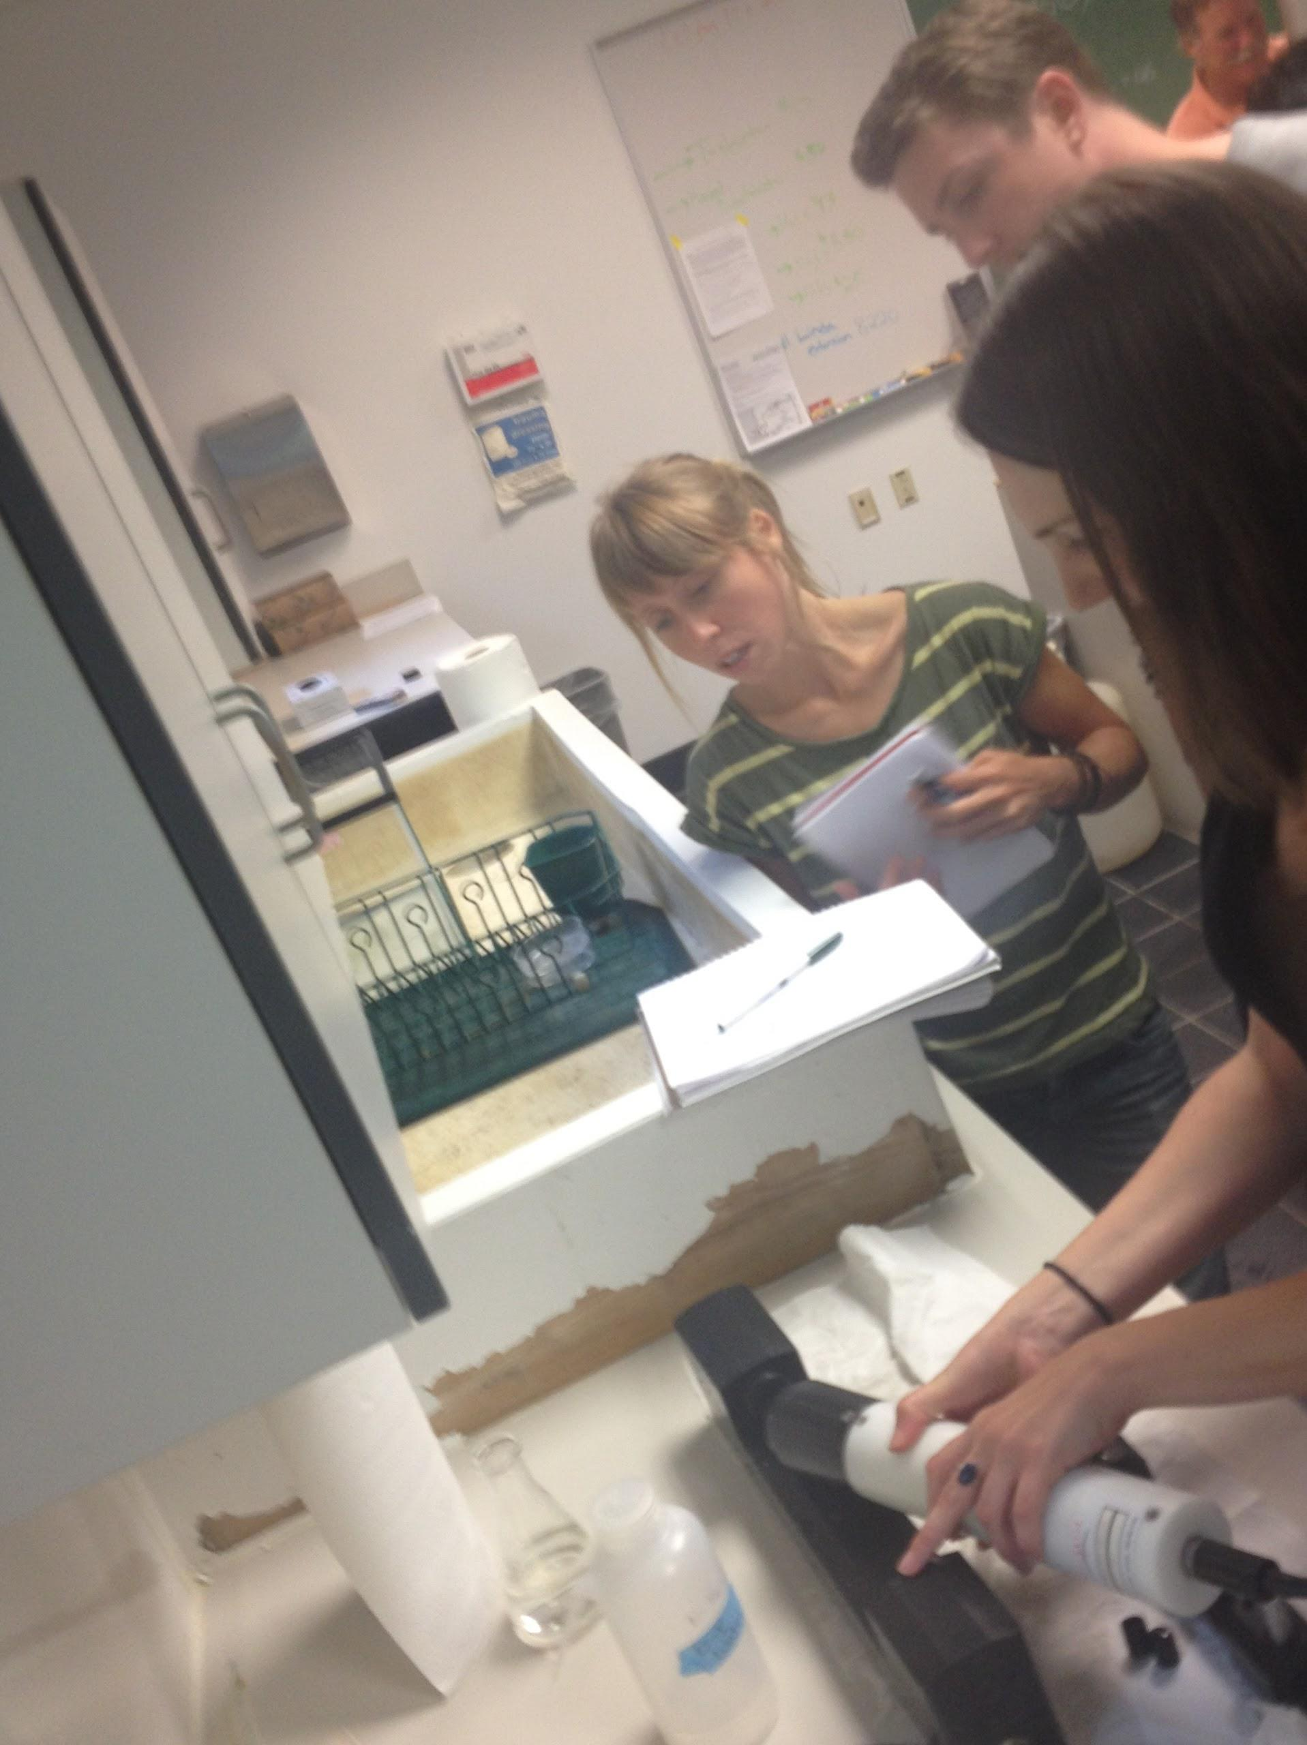
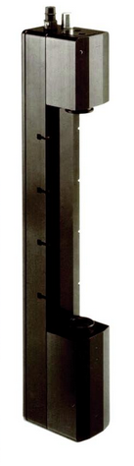

Transmissometer - C-Star
Pathlength: 25 cm
Wavelength: 652 nm
Bandwidth: ~20 nm
"c" tube
Notes:
EB:

Slide 6
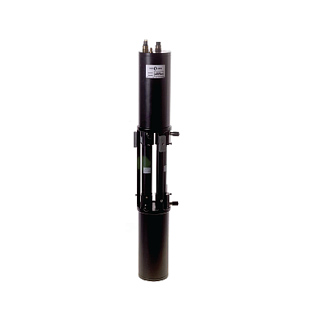
AC-9
Instrument design
Measures: absorption and attenuation
& scattering can be derived from c-a
& particulate scattering from whole-dissolved
Wavelengths: 9 from 412nm-715nm
c acceptance angle: 0.9328 degrees
Notes:
EB

Slide 7
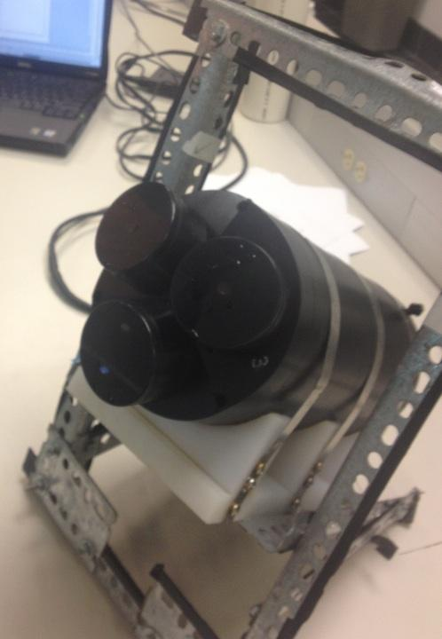
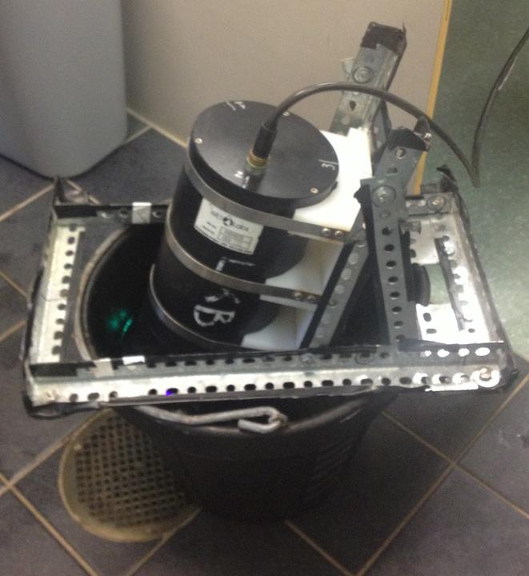
BB9
Measures the backscatter
Can be combined with AC-9 data
If so, can calculate b_{bp}/b_{p}
Uses 9 wavelengths
(412nm-880nm)
Uses 1 centroid angle
(117degrees)
No available corrections
for temperature effects
Notes:
Lei

Slide 8
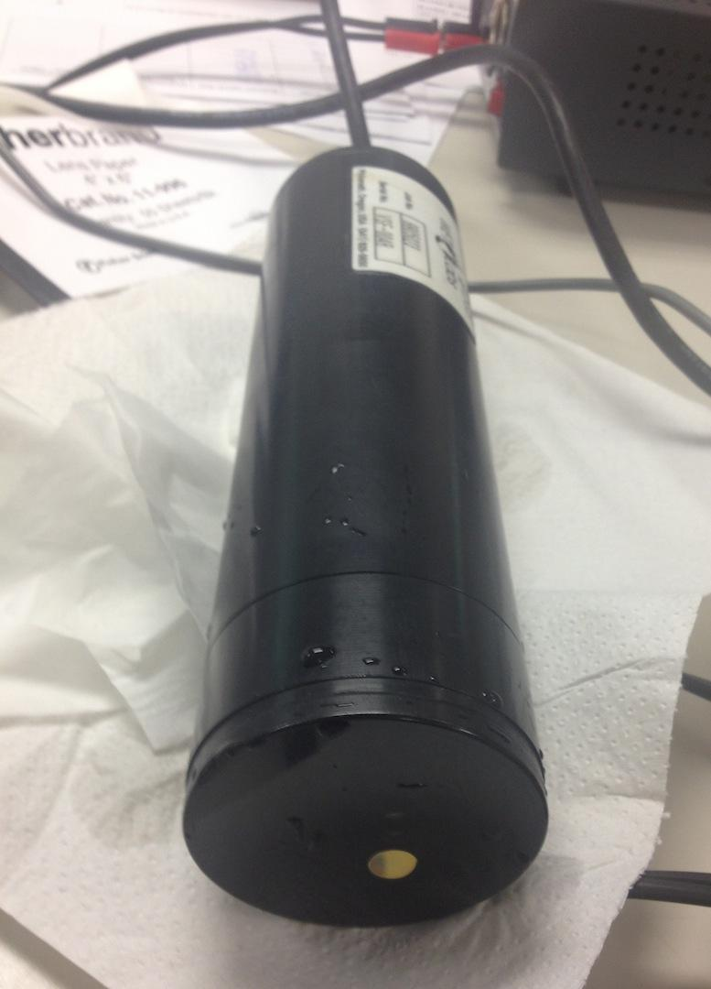
ECO-VSF
Measures optical scattering at 104, 130, and 151 degrees
Provides the shape of the Volume Scattering Function (VSF)
Measurements:
The three-angle measurement allows determination of specific angles of backscattering through interpolation
Total backscattering coefficient by integration and extrapolation from 90 to 180 degrees.
Notes:
Lei: The angular distribution of scattered radiation in the backward hemisphere is important in the interpretation of remote sensing measurements, investigations of particle shape, and models of visibility in seawater
Assumptions:
• Isotropic medium
• Unpolarized light

Slide 9
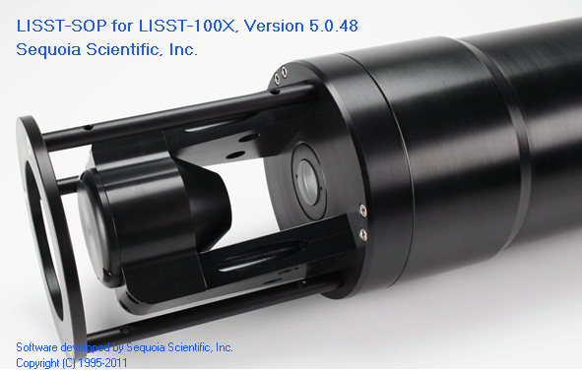
LISST 100X - Type B
LISST measures the angular scattering distribution over 32 ring-detectors which cover an angular range from 0.0017 to 0.34 radians.
The light source (a laser) operates at 670 nm.
Notes:
Lei

Slide 10
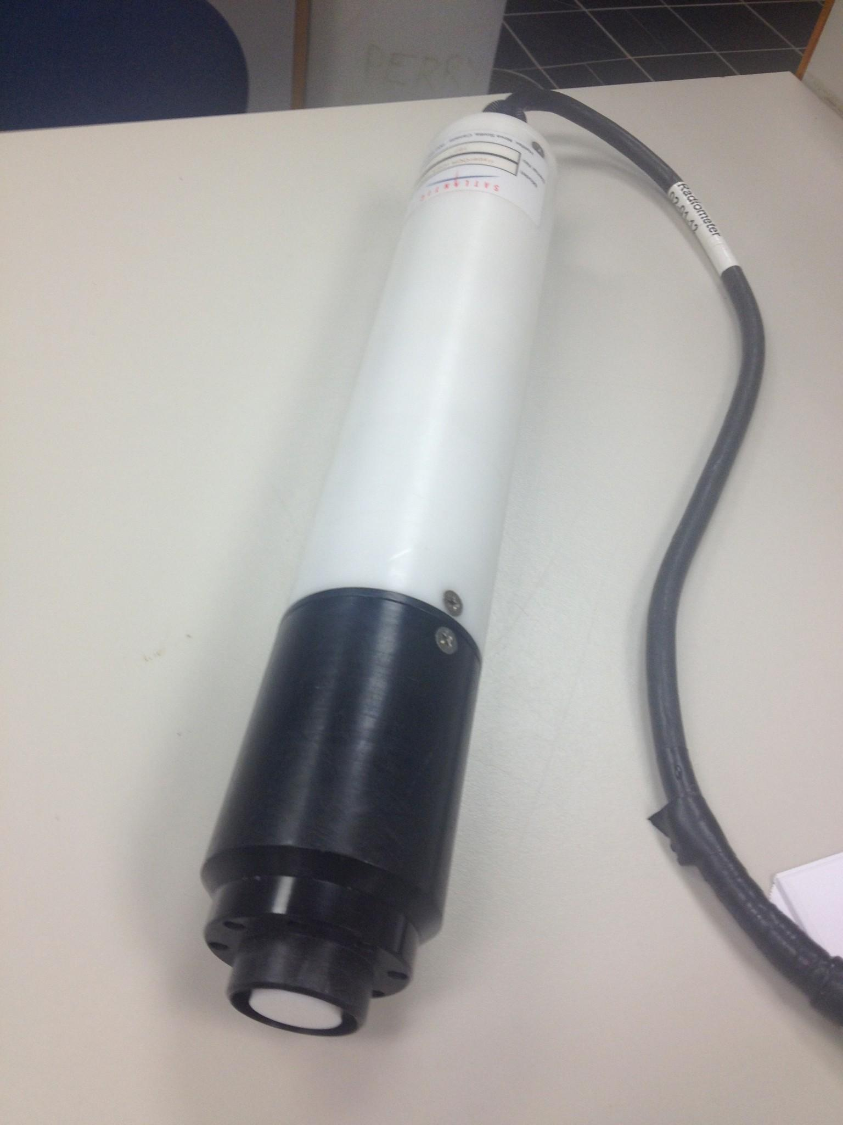
Instrument Radiometry
Radiometer measures emitted wavelength in other instruments for validation and data processing.
All tested instruments were within 5 nm of nominal value. Most were within 2.5 nm.
Notes:
EB

Slide 11
RESULTS

Slide 12
Instrument Radiometry
Instrument | Nominal Wave (nm) | Measured Wave (+/-1.5nm)
C-STAR | 650 | 652.1
ECO VSF | 660 | 655.4
BB9 | 412 | 408.8
BB9 | 440 | 442.1
BB9 | 488 | Not Measured
BB9 | 510 | 505.4
BB9 | 532 | 528.8
BB9 | 595 | 592.1
BB9 | 650 | 652.1
BB9 | 715 | 715.2
BB9 | 880 | Outside of Range
Notes:
EB

Slide 13
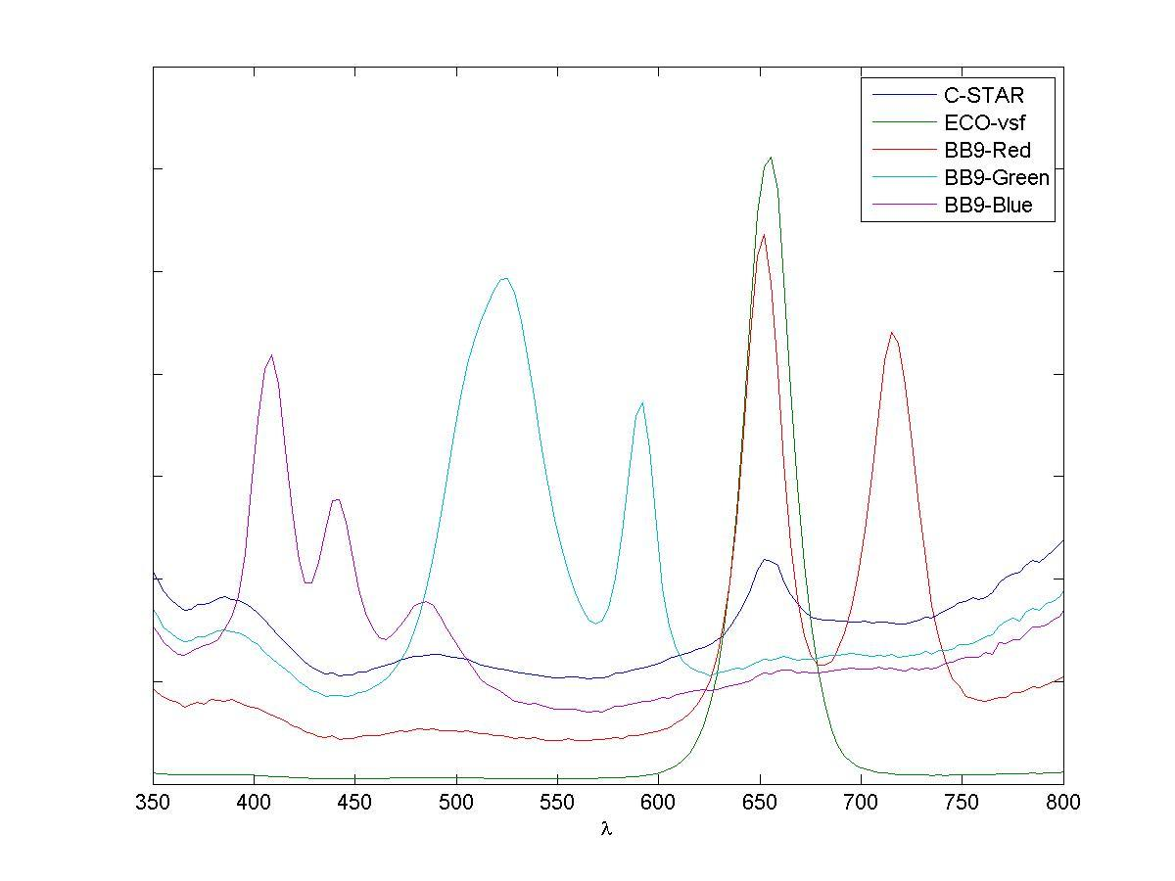
Instrument Radiometry
Notes:
EB: Note that the y-axis is not (and cannot be) calibrated because there were little to no controls between measurements. This plot can show you SHAPES but not MAGNITUDES. Also, BB3-Green has three peaks, including two that are very close together.

Slide 14
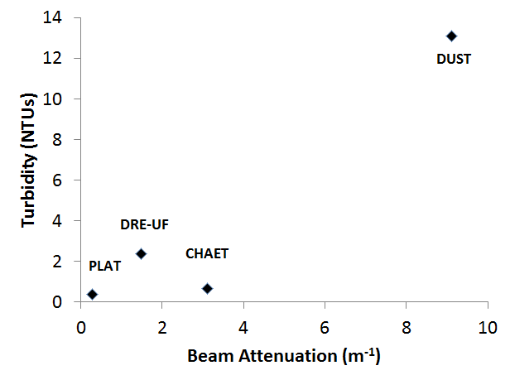
Turbidity and Beam Attenuation Results
SAMPLE | Turb [NTU] | c (652 nm) [m-1]
Arizona Dust | 13.1 | 9.1
Chaetoceros | 0.7 | 3.1
Platymonas | 0.4 | 0.3
DRE- Unfiltered | 2.4 | 1.5
Filtered Seawater | (0) 0.3 | (0) 4.2
DIW | (0) 0.5 | (0) 4.4
Notes:
Q1-EB: Culture samples hard to compare b/c of concentration differences, abundances of chloroplasts

Slide 15
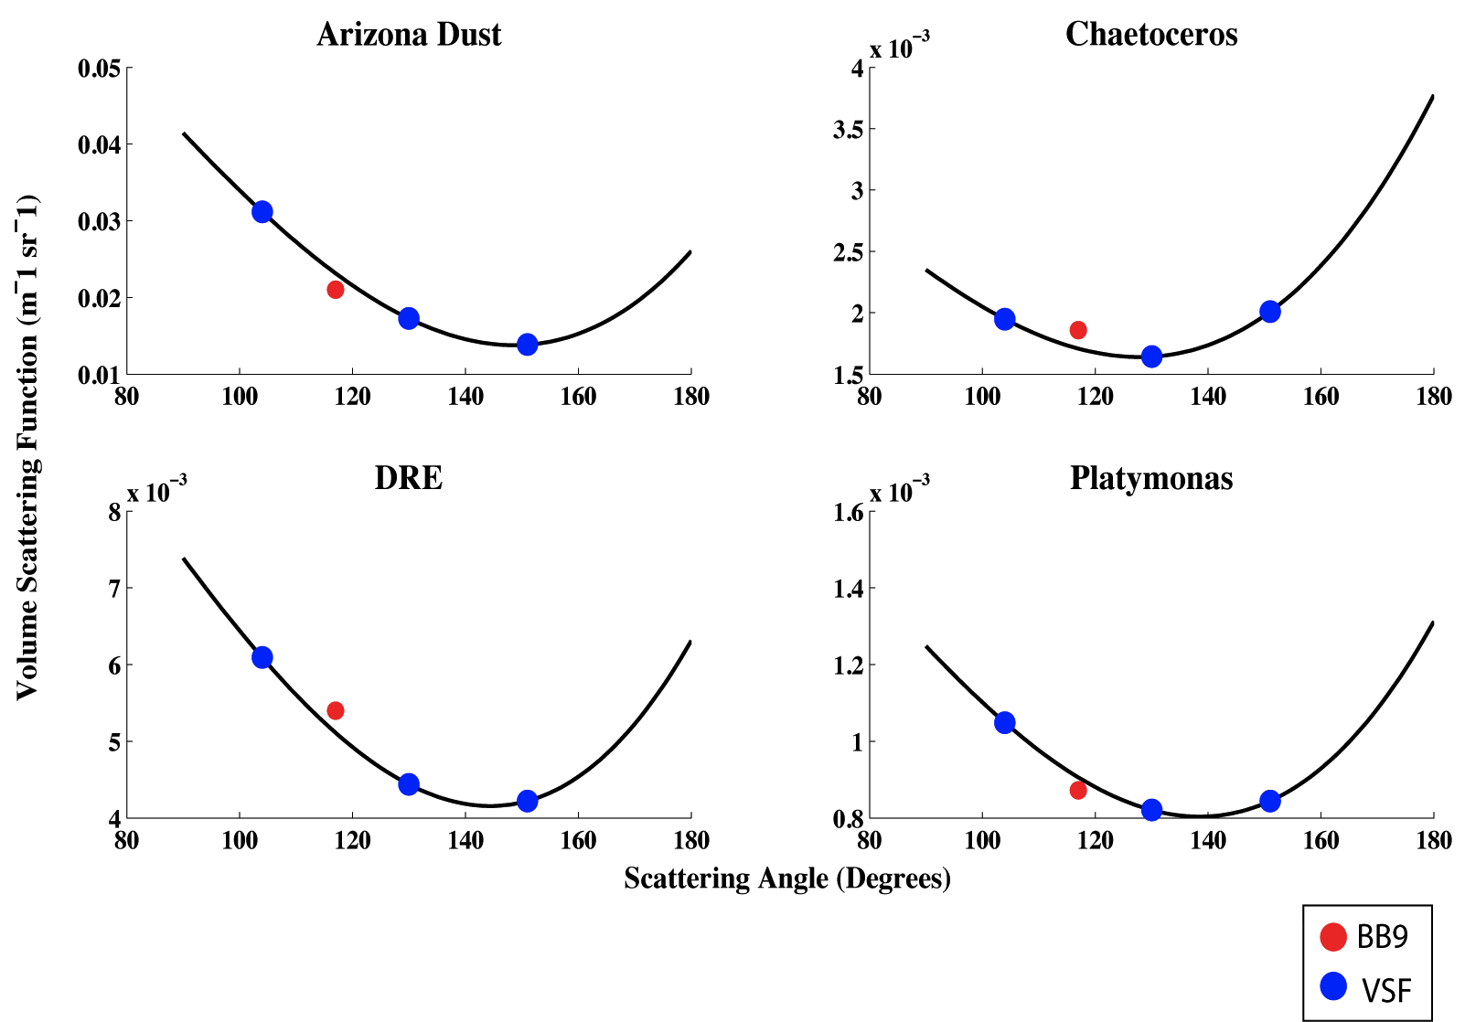
ECO-VSF: VSFs for Water Samples
• Uncertainties are small relative to our measurements
• Magnitudes correspond well with Petzold's data (Ocean Optics book)
• Matches 650 nm VSF measured by BB9– CLOSURE!
Notes:
Lei-Q4: For the bottom two graph, we observed very few backscattering. Limitation due to three points.
Points were fit in the model.
Comparison of BB9 and ECO-VSF derived VSF values at 650 nm shows excellent relationship. Only one point from BB9 (in red) because it only takes one measurement at 650nm. The ECO VSF takes 3 measurements at 650 nm (3 angles)
BLUE text is comments on the uncertainty of the ECO VSF measurements

Slide 16
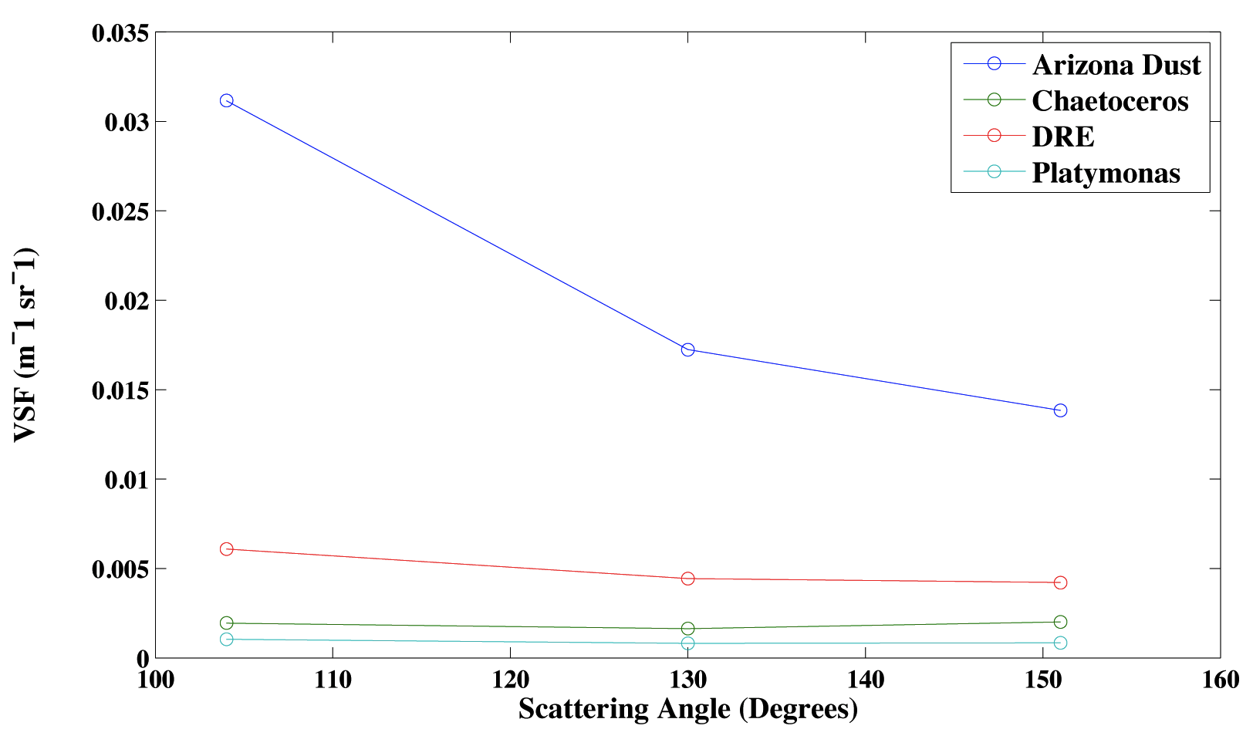
ECO VSF: Relative VSFs
Notes:
EB

Slide 17
ECO-VSF vs BB9 Derived b_{bp} Values
Water Type | b_{bp}at 650 (m⁻¹)
 | VSF | BB9
Arizona Dust | 0.1656 | 0.15
Chaetocerous | 0.0134 | 0.01
DRE | 0.0354 | 0.04
Platymonas | 0.0064 | 0.006
Check it out... CLOSURE!!!
Notes:
EB: CLOSURE!

Slide 18
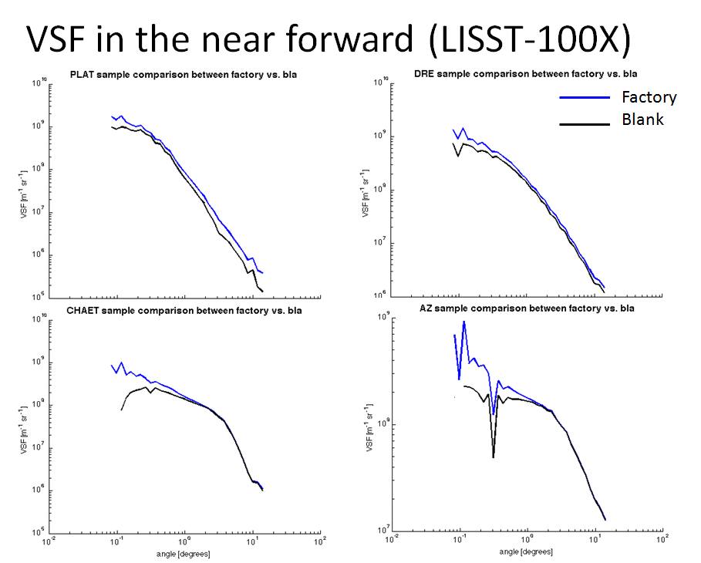

Slide 19


Particulate Composition: Backscatter to Scatter Ratio
The AC-9 and BB-9 data were combined to obtain the particulate backscattering ratio ( ):
~0.005 is related to organic particles
~0.02-0.03 is related to inorganic particles
References: Twardowski et al, 2001, Boss et al, 2004
Notes:
Lei-Q3-

Slide 20
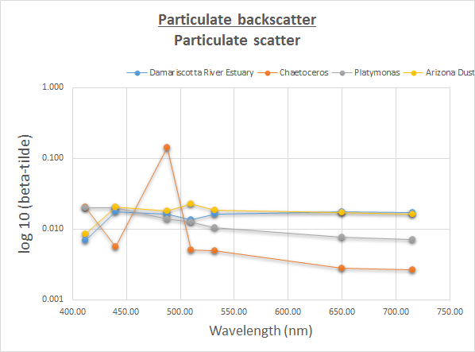
Particulate Composition: Backscatter to Scatter Ratio
Backscatter values were derived from BB-9 measurements and scatter values were calculated from AC-9 measurements.
Chaetoceros outlier was caused by sensor malfunction/oversaturation.
Notes:
-Q2: The DRE sample and Arizona dust sample had the highest particulate backscatter ratios. This indicates that there is more inorganic matter in those samples than in the culture samples, which is what we expected to see.
The values for Platymonas are slightly higher than expected..... Values are in a table at the END of the powerpoint show.

Slide 21
Beam Attenuation and Acceptance Angle
Beam attenuation is a function of acceptance angle (Boss et al., 2009).
Smaller acceptance angles provide larger attenuation values (Boss et al., 2009).
LISST is expected to have the largest attenuation relative to AC-9 and C-Star value since it has the smallest acceptance angle
Notes:
EB

Slide 22
Beam Attenuation and Acceptance Angle
Instrument | Acceptance Angle | DUST | CHAET | PLAT | DRE
LISST-B (670) | 0.0262 | 10.7 | 3.7 | 1.1 | 2.4
ac-9 (650) | 0.932 | 9.0 | 3.8 | 0.9 | 2.1
C-Star (652) | 1.1954 | 9.1 | 3.1 | 0.3 | 1.5
Notes:
EB

Slide 23
UNCERTAINTIES
Instrument | Uncertainty
C-Star (average difference) | ~0.017 (3%)
Turbitity meter | ~0.02
AC-9 | ~0.02 (plat)
Other sources of error
--Sensor orientation
--Cleanliness
--Different buckets
--BB9 red spectrum sensitive to time
--Discrepancy in instrument excitation wavelengths

Slide 24
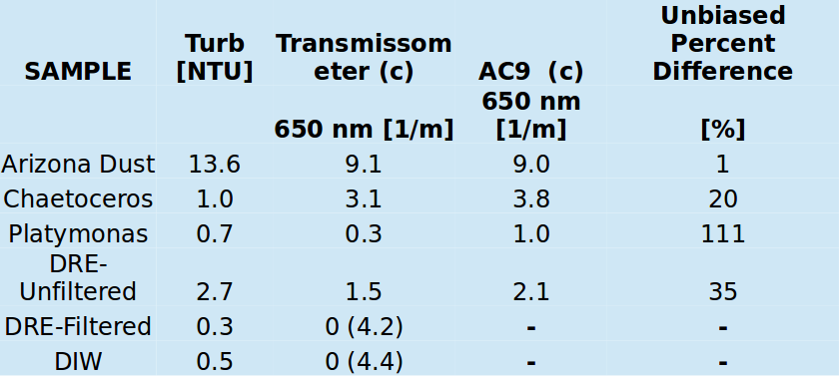
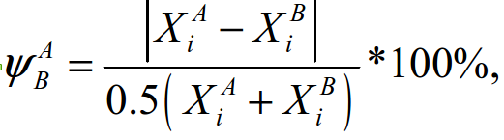

Notes:
EB

Slide 25
Previous Lab
Spectrophotomer

Slide 26
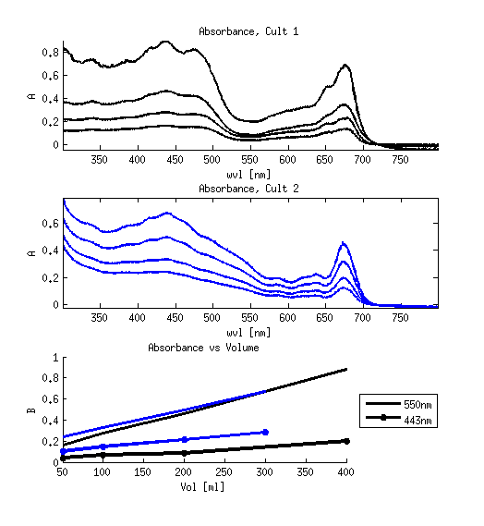
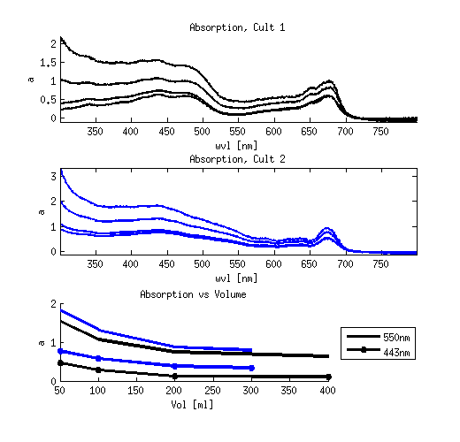
Absorption Lab--Spec
Still an issue. We have been unsuccessful with decoupling the reliance on path length (i.e. volume) from our spectro measurements.

Slide 27
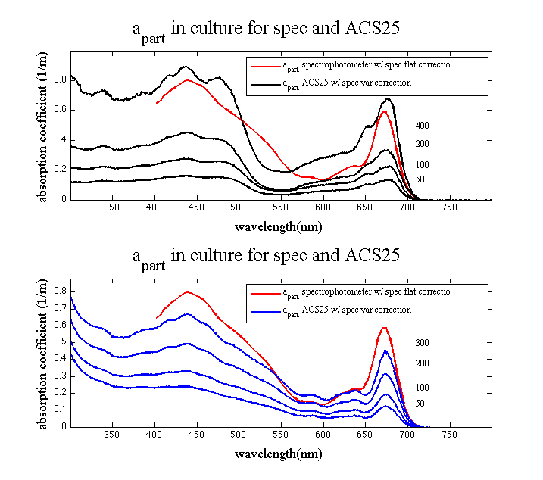
Absorption Lab--Spec compared to ACS25

Slide 28
 | Damariscotta River Estuary |  |  | Chaetoceros
wavelength | bbp (BB9) | bp (AC9) | b | bbp (BB9) | bp (AC9) | b
412.00 | 0.02 | 2.61 | 0.007 | 0.08 | 3.87 | 0.021
440.00 | 0.05 | 2.57 | 0.018 | 0.02 | 3.56 | 0.006
488.00 | 0.04 | 2.48 | 0.016 | 0.56 | 3.88 | 0.144
510.00 | 0.03 | 2.44 | 0.014 | 0.02 | 3.94 | 0.005
532.00 | 0.04 | 2.38 | 0.016 | 0.02 | 4.01 | 0.005
650.00 | 0.04 | 2.08 | 0.018 | 0.01 | 3.56 | 0.003
715.00 | 0.03 | 1.98 | 0.017 | 0.01 | 3.72 | 0.003
 | Platymonas |  |  | Arizona Dust
wavelength | bbp (BB9) | bp (AC9) | b | bbp (BB9) | bp (AC9) | b
412.00 | 0.00 | 0.20 | 0.020 | 0.08 | 9.63 | 0.009
440.00 | 0.01 | 0.40 | 0.020 | 0.20 | 9.59 | 0.021
488.00 | 0.01 | 0.57 | 0.014 | 0.17 | 9.51 | 0.018
510.00 | 0.01 | 0.72 | 0.013 | 0.21 | 9.47 | 0.022
532.00 | 0.01 | 0.85 | 0.011 | 0.17 | 9.41 | 0.018
650.00 | 0.01 | 0.78 | 0.008 | 0.15 | 8.97 | 0.017
715.00 | 0.01 | 0.99 | 0.007 | 0.14 | 8.79 | 0.016
Values

Slide 29
Thank you!!!!

