Slide 1
Previous Labs

Slide 2
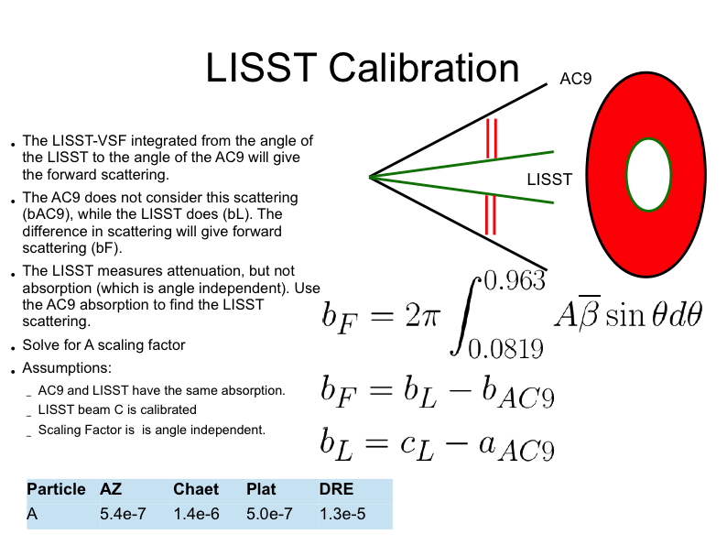

Slide 3
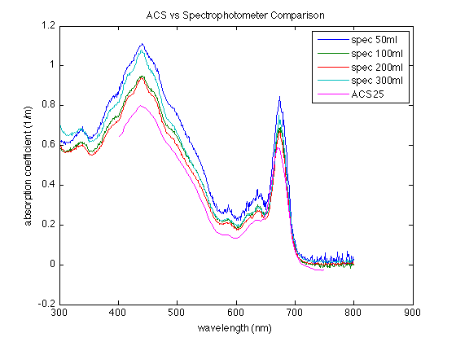
From Lab 2: sample absorption coefficient comparison between spec and ACS
Notes:
Magenta is ACS25, all others are different volumes of the culture filtered

Slide 4
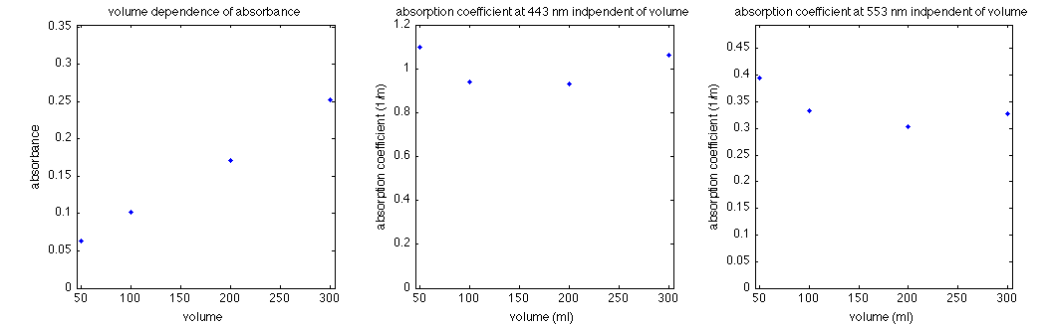
Volume Dependence Removed
Notes:
a_part not dependent of volume after corrections

Slide 5
Lab 5: Fluorescence
Notes:
Light absorbed by phytoplanton has 3 fates: photosynthesis, dissipation as heat, fluorescence

Slide 6
Lab 5: Fluorescence
F(λ) = E(λ) * C * Φ_{f}
E(λ)=spectral energy of excitation
C = concentration, a(λ)
Φ_{f}=quantum yield of F (photons
emitted/photons absorbed)

Slide 7
Chl Fluorometer Dark Counts
 | WETLab 1 | WETLab 2 | Percent difference
Condition | (Counts) | (Counts) | (%)
air_lights_on | 44 | 90 | 17.16
air_lights_off | 54 | 60 | 2.63
tape_air | 51 | 49 | 1.00
tape_DIW | 46 | 29 | 11.33
no_tape_DIW | 48 | 48 | 0.00
no_tape_tap | 50 | 50 | 0.00
no_tape_FilteredDRE | 68 | 65 | 1.13
 | Turner 1 | Turner 2 | Percent difference
Condition | (mv) | (mv) | (%)
air_lights_on | 0 | 0 | 0
air_lights_off | 0 | 0 | 0
DI water | 0 | 0 | 0
Tap water | 0 | 0 | 0
Filtered DRE water | 85 | 85 | 0
Meters agree between Turner groups; only the no tape measures agree between WetLabs groups
Variations could be due to meter position, wavelength detected by meter, ambient lighting, taping method, etc
No tape for the appropriate blank (DI or SW) appears the most consistent (keep in mind only 2 points)
Notes:
LC
#1 Compare the various approaches for dark values and blanks. How do you think a “blank” should be measured. How would you test for temperature effect? Pressure effect?

Slide 8
SCATTER AND CDOM FLUOROMETER
WETlab Fl | 1 – Bb counts | 2 – Bb counts
air_lights_on | 85 | 1400
air_lights_off | 100 | 1300
tape_air | 51 | 51
tape_DIW | 49 | 49
no_tape_DIW | 189 | 185
no_tape_tap | 185 | 630
no_tape_FilteredDRE | 145 | 300
CDOM Fl | 1 - mv | 2 - mv
Air with room lights on | 100 +/-20 | 60 +/-10
Air with room light off | 100 +/-15 | 200
DI water (no tape) | 160 +/-15 | 590 +/-20
Tap water (no tape) | 490 +/-15 | 1520 +/-20
Scatter: tape looks the best
CDOM Fl: shows high variability between groups, air blanks look the best
End Thoughts:
Using tape appears to provide the most consistent readings between groups (when possible to use tape) and between the four types of instruments
Variability between groups suggests we may need a better SOP (tape, output variability, etc) to distinguish instrument variance from procedure differences
Notes:
LC

Slide 9
Q1: T and P Effect Tests
Temperature Test
Remove bubbles
Fix sensor, larger bucket
Put bucket in recirculating bath. Use a standard with known fluorescence variations as a function of temperature (or perhaps use MQ water to see whether baseline counts change)
Increase temperature gradually, keeping internal T well-mixed
Make F measurements at discrete points after a standard amount of time to allow for equilibration
Pressure Test
Remove bubbles
Fix sensor in x-y, deep tank
Increase P by incrementally lowering the sensor and allowing for equilibration
Make fluor measurements to see if there are changes
Notes:
MM
If the tank is very large you might need to take into account temperature changes, could monitor temperature

Slide 10
Q2: Wall and Movement Effects
One group qualitatively tested putting the meter near the walls, no apparent change (variability in numbers already high)
Discussion: should it have an effect?
Moving sensor: effect would depend on how homogenous/mixed the sample and light field are is and if your arm can move at speeds close to light
Notes:
MM
Ishan tested this and said no change
Need to do a true test, collect the data

Slide 11
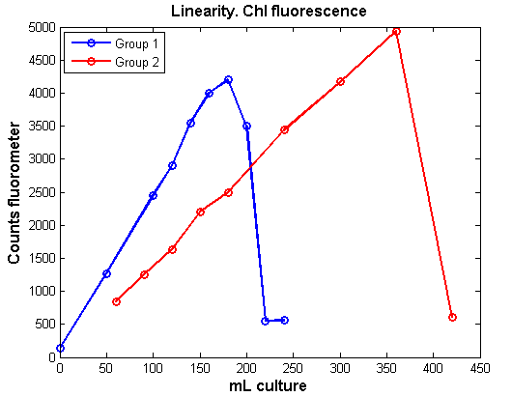
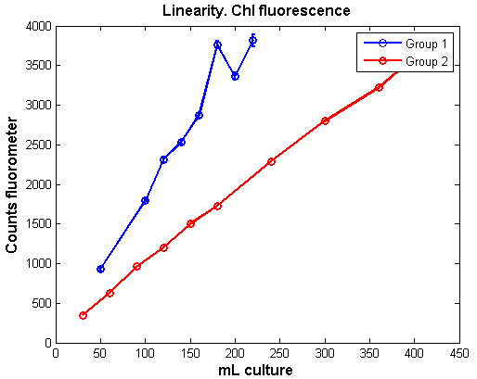
Chl Fluorescence vs Culture Concentration
Turner CYCLOPS-7
Wetlabs FLNTURT
Notes:
LM
#3 Plot various fluor readings vs vol of culture and cdom. Are the readings linear? Do they show saturation at higher volumes?
Chl Fluor, Wetlabs: Linear, then saturates

Slide 12
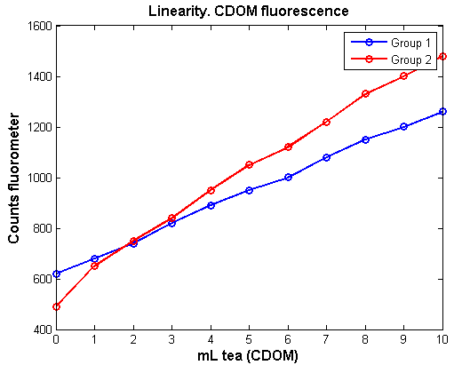
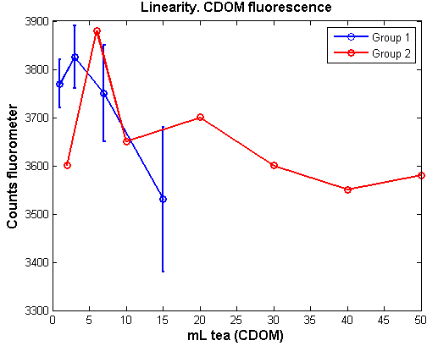
CYCLOPS-7: CDOM Fluor vs. Tea
Notes:
LM
#3 Plot various fluor readings vs vol of culture and cdom. Are the readings linear? Do they show saturation at higher volumes?
CDOM FLUOR: both are roughly linear, no saturation

Slide 13
CDOM Effect on Phytoplankton Fluorescence Signal
1
On the scale of figure 1, it seems that CDOM has negligible effect on phytoplankton fluorescent signal
When zoom in to scale of figure 2, it seems that adding CDOM overall decreases the signal
However signals were likely saturated and readings inaccurate: redo with lower phyto and/or higher CDOM conc
2
Notes:
MM
Q4

Slide 14
From the data we collected, we cannot conclude if adding phytoplankton has effects on CDOM fluorescent signal because of instrument uncertainties
However, phytoplankton scatters and absorbs at both excitation and emission wavelengths, which may affect detected CDOM fluorescent signal
Notes:
MM

Slide 15
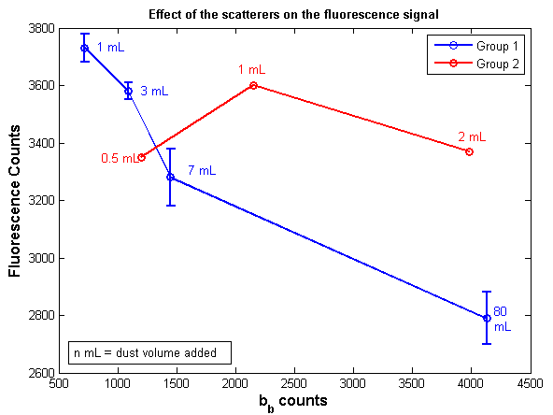
Q-5. Effect of the scatterers (dust) on the fluorescence signal (WetLabs sensor)
Notes:
LC
Different cultures, different fluorescence

Slide 16
Does natural light contaminate the signal ?
Turner Fluo. |  | F counts | Bb counts
Group 1 | Air - light on | 44 +- 5 | 85 +- 15
 | Air - light off | 54 +- 2 | 100 +- 1
Group 2 | Air - light on | 90 +- 20 | 1400
 | Air - light off | 60 +- 20 | 1300
Cyclops Fluo. (mV) | Group 1 | Group 2
Chl
Air - light on | 0 | 0
Air - light off | 0 | 0
CDOM
Air - light on | 100 | na
Air - light off | 100 | 60
• Wetlabs: there are differences between the values with the lights on/off
• Turner: no apparent differences
• Lights off if doing air cals, just to be sure
Notes:
MM
#6 Does natural sunlight (or other light sources) contaminate the signal?
WETLAB: differences between the values with the light on or off. It affects the signal!
FLUOROMETER: it seems there is no differences. The signal is not affected.
better to do the measurements with the light off to avoid any bias in the values.

Slide 17
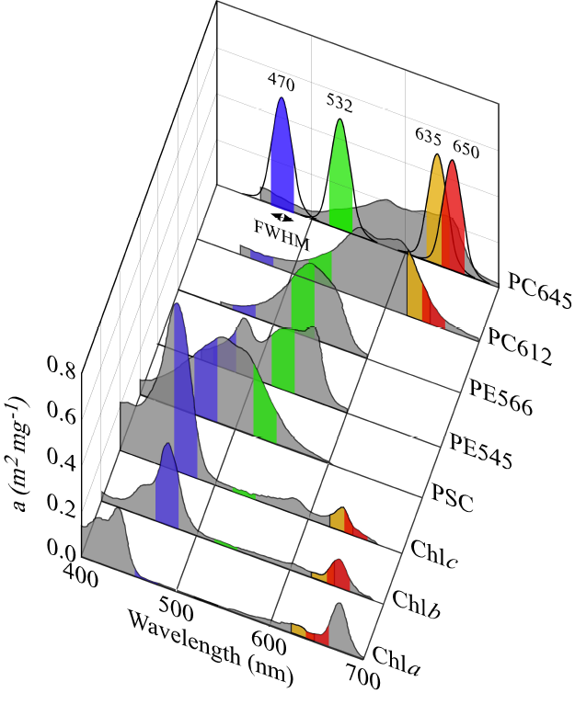
Wavelengths Advertised vs. Measured
Instrument | Max Peak | Advertised Value
Turner Chl | 462.05 | Not Advertised
Turner CDOM | 365.60 | Not Advertised
WetLabs | 465.38 | 470
Turner Manual listed the excitatory wavelengths as “visible” for Chlorophyll and “UV” for CDOM. No specific wavelength.
470nm preferentially excites accessory chlorophyll pigments (b and c), as well as photosynthetic carotenoids, not chl-a
(MacIntyre et al. 2010)

Slide 18
Solar Quenching: effects on measurements of chlorophyll fluorescence
Ratio of chl:chl fluorescence changes with variations in PAR
Expected: Increased PAR decreases chl fluorescence over sufficiently long exposure periods. Longer time series to see this?
There is a delay in acclimatization of the chl to the impact of increased PAR
This effect can be seen if a time series seems to have spikes in chlorophyll every night.
Notes:
LC
#8 PAR: note dips… clouds, someone walked over it

Slide 19
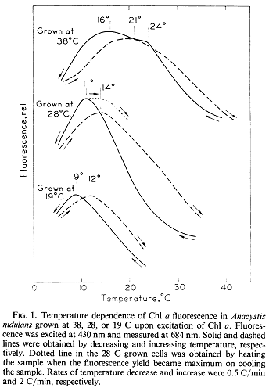
Temperature Effects
As temperature goes up, fluorescence goes down (generally)
Exact nature of the dependence is a functional of
  The speed of the T change
  The species of the algae
  The temperature at which the algae was grown
  The direction of the change (heating or cooling)
The samples were 6 degrees warmer than the controls at the end of the experiment
  It would be difficult to determine how the fluorescence of the samples is impacted by the changing temperature.
Figure: Murata & Fork (1975)
Notes:
LC
#8

Slide 20
 | Chl [μg/L] | Phaeo [μg/L]
Average | 2.41 | 0.82
Stdev | 0.82 | 1.78

Slide 21
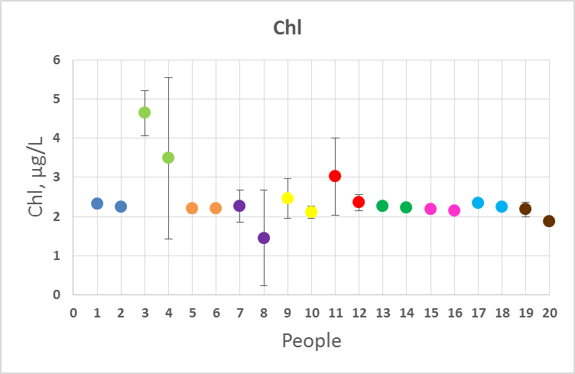

Slide 22
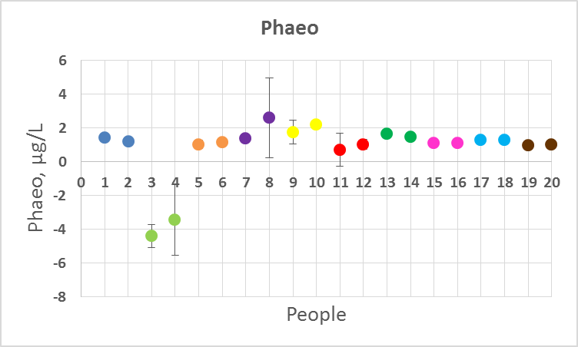
Notes:
Marta Sophie,

Slide 23
Confidence: Fluorometric Chl
F(λ) = E(λ) * C * Φ_{f}
E(λ)=spectral energy of excitation
C = concentration
Φ_{f}=quantum yield of F (photons
emitted/photons absorbed)
Notes:
Light absorbed by phytoplanton has 3 fates: photosynthesis, dissipation as heat, fluorescence

Slide 24
Confidence: Fluorometric Chl
F(λ) = E(λ) * C * Φ_{f}
F(λ) = E(λ) * C * Φ_{f}
E(λ)=spectral energy of excitation
C = concentration
Φ_{f}=quantum yield of F (photons
emitted/photons absorbed)
E(λ)=spectral energy of excitation
C = concentration, a(λ)
Φ_{f}=quantum yield of F (photons
emitted/photons absorbed)
• variance in blanks: to tape or not to tape?
• CDOM, high particulate concentration
• detection of sensor (how broad is the band?)
• human error (dark counts, readings, etc.)
comparing standard fluorimetric and HPLC methods for different areas demonstrated that the standard fluorimetric method generally underestimates chlorophyll-a concentrations by ~39%
  Trees et al., 1985
Notes:
Light absorbed by phytoplanton has 3 fates: photosynthesis, dissipation as heat, fluorescence

Slide 25
Confidence: Fluorometric Chl
F(λ) = E(λ) * C * Φ_{f}
F(λ) = E(λ) * C * Φ_{f}
E(λ)=spectral energy of excitation
C = concentration
Φ_{f}=quantum yield of F (photons
emitted/photons absorbed)
E(λ)=spectral energy of excitation
C = concentration, a(λ)
Φ_{f}=quantum yield of F (photons
emitted/photons absorbed)
• variance in blanks: to tape or not to tape?
• CDOM, high particulate concentration
• detection of sensor (how broad is the band?)
• human error (dark counts, readings, etc.)
• quenching
• accessory pigments
• pigment packaging
comparing standard fluorimetric and HPLC methods for different areas demonstrated that the standard fluorimetric method generally underestimates chlorophyll-a concentrations by ~39%
  Trees et al., 1985
Notes:
Light absorbed by phytoplanton has 3 fates: photosynthesis, dissipation as heat, fluorescence

Slide 26
