Slide 1
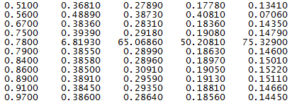
Exercise 5 Two Hypotheses: Problems causes by wrong backscatter number or “wrong” data input Backscatter changes don’t appear to help drop the hydrolight curve Editing out the anomalous data line appears to create the desired shape
Garbage In, Garbage Out???

