Slide 1
Lab 9
Hydrolight and Ecolight exercises

Slide 2
Ex. 1: Inputting measured Chl(z) data

Slide 3
Ex. 2: inputting IOPs from a, c, and b_{b} sensors

Slide 4
Ex. 3: simulating Case 2 water
Increased mineral concentration increases Rrs in the 550nm wavelengths.

Slide 5
Ex. 4: simulating optically shallow water

Slide 7
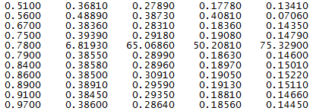
Exercise 5 Two Hypotheses: Problems causes by wrong backscatter number or “wrong” data input Backscatter changes don’t appear to help drop the hydrolight curve Editing out the anomalous data line appears to create the desired shape
Garbage In, Garbage Out???

