Slide 1
LISST calibration and measurements
Aya, Grace, Tom
Ocean Optics Summer 2013 Final Project
August 2nd, 2013

Slide 2
Outline
Calibration
Measurements
Lab
Cruise
Coccolithophore experiment
Instructional Video

Slide 3
Calibration: Methodology
Calibration relies on agreement between measured and modeled VSF of spherical particles
Notes:
Beta modeled, X_i is what we’re looking for, counts and zscat are values from machine

Slide 4
Calibration: Methodology
Methodology from Slade and Boss 2006, “Calibrated near-forward volume scattering function obtained from the LISST particle sizer”
Measure spherical beads of known size
(for our experiment, sizes were 1μm, 20μm, 50μm)
Only use runs in which the relative error of beam c is small
Select data from particular detector rings for different size classes
Exclude the first six rings for 1μm runs
Exclude rings 15 to 32 for 20μm runs
Exclude rings 11 to 32 for 50μm runs
Notes:
Relative error of beam c may be high when the laser power is weak.

Slide 5
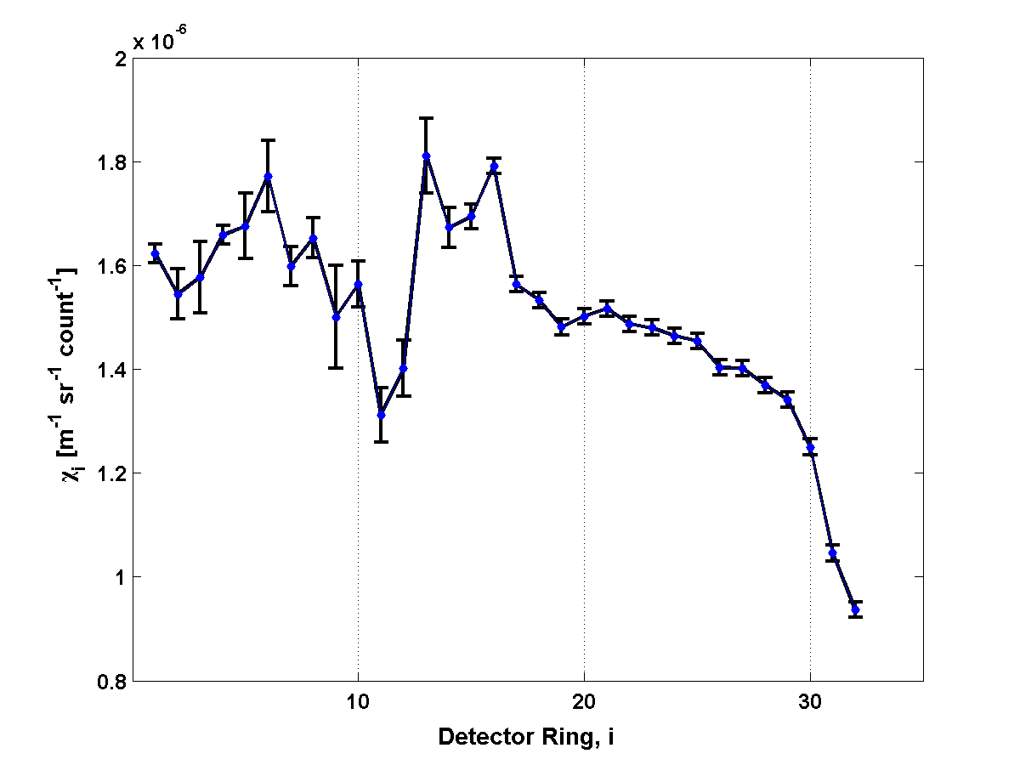
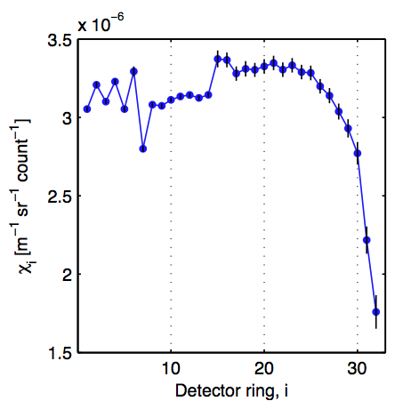
Calibration: Coefficients
Our bead calibration
From Slade and Boss 2006
Notes:
Same instrument; Should not match in magnitude because it has been factory calibrated since the paper was published

Slide 6
Calibration: Coefficients
Our bead calibration
Calibration experiments were done with expired beads after using vortex machine on the bottle
Expiration dates:
April 2007 for 1.0 micrometer
March 2012 for 20 micrometer
July 2007 for 50 micrometer
It still works!
Notes:
Same instrument; Should not match in magnitude because it has been factory calibrated since the paper was published
Read up on why there is a drop off in large rings, in paper
Error bars … maybe because of clumping?

Slide 7
Calibration: Coefficients
Recall…
Obtained by bead calibration
}
Output from LISST data

Slide 8
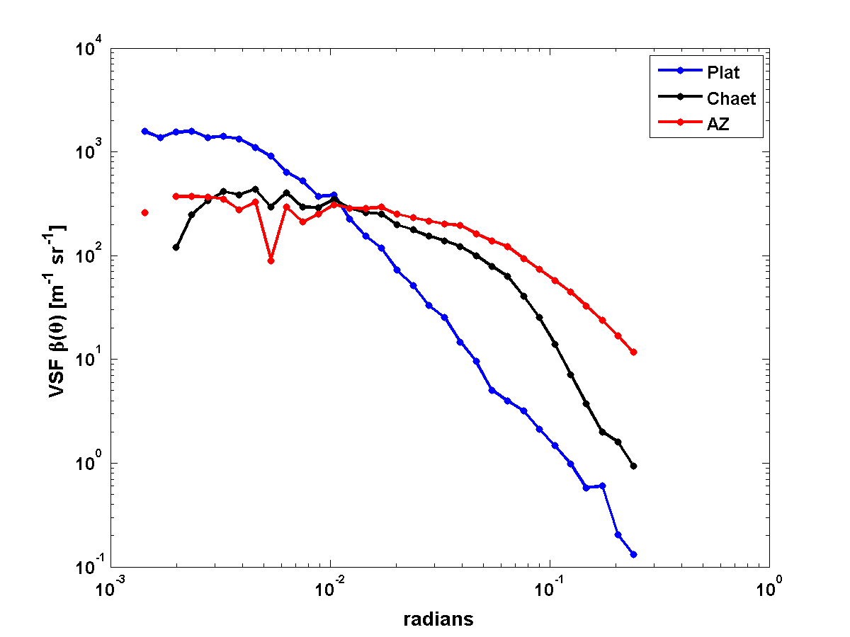
Measurements: from Lab
VSFs for lab measurements

Slide 9
PSD for lab measurements: Volume concentration
Notes:
Platy = spherical
Chaet = chains

Slide 10
Measurements: from Lab
PSD for lab measurements: Number frequency assuming spherical shape
Notes:
PSD

Slide 11
Measurements: Cruise

Slide 12
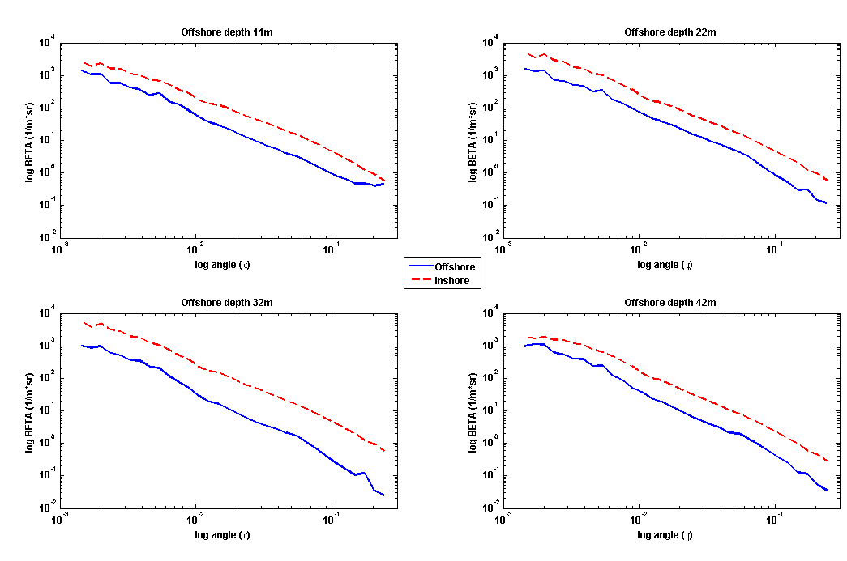
VSFs for cruise stations
depth = 11m
depth = 22m
beta (m⁻¹ sr⁻¹)
beta (m⁻¹ sr⁻¹)
angle (radians)
angle (radians)
depth = 32m
depth = 42m
beta (m⁻¹ sr⁻¹)
beta (m⁻¹ sr⁻¹)
angle (radians)
angle (radians)

Slide 13
Measurements: Cruise
PSDs for cruise stations: volume concentration

Slide 14
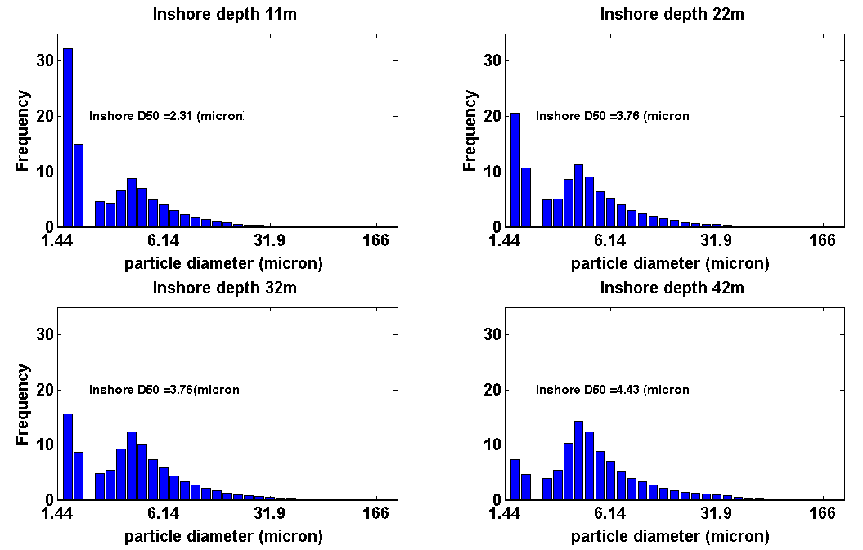
PSD for Damariscotta River Station: Number frequency assuming spherical shape

Slide 15
PSD for Ocean Station : Number frequency assuming spherical shape

Slide 16
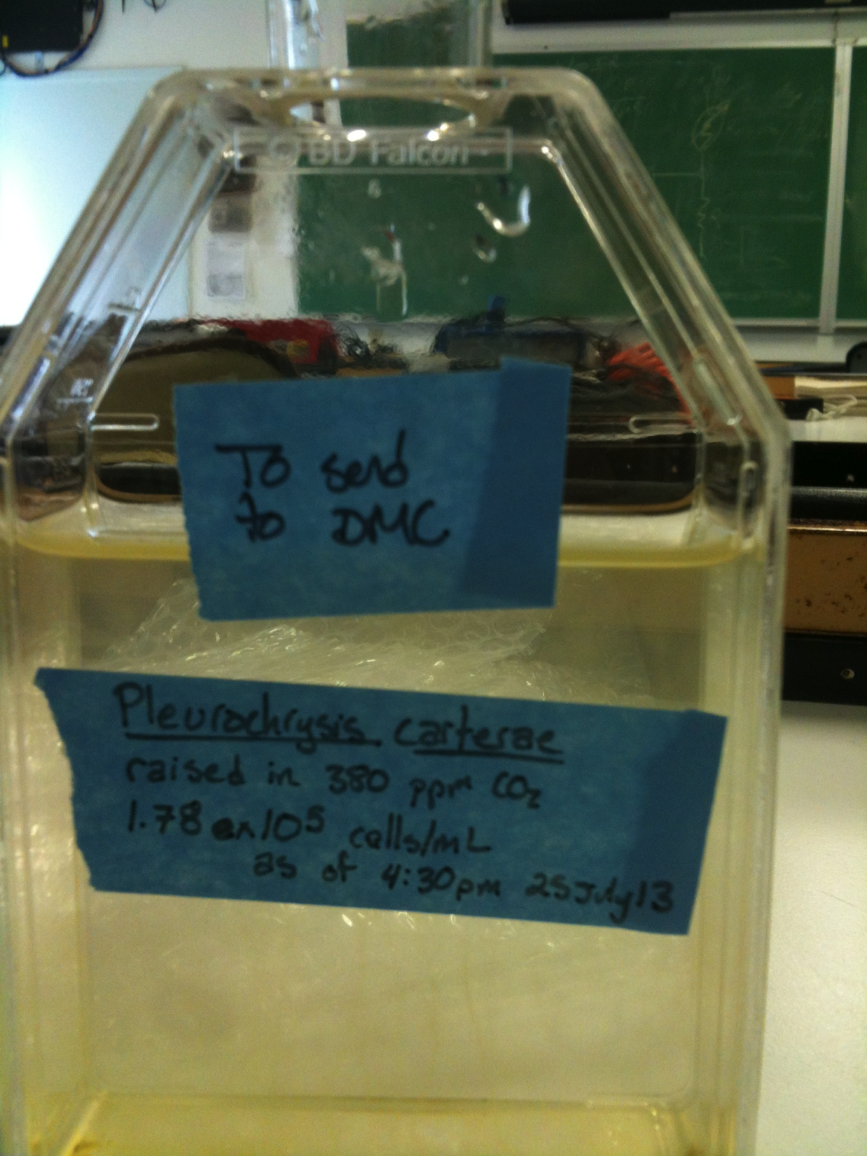
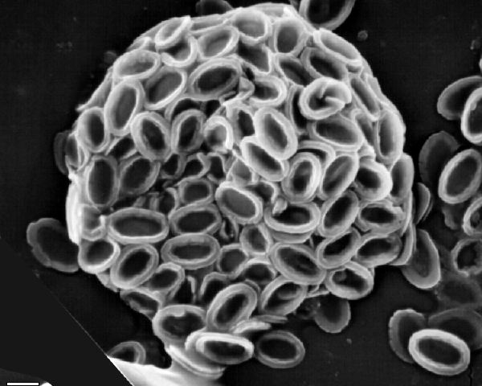
Measurements: Coccolithophores
Investigation of changes in river coccolithophore culture scattering and size distribution pre- and post- acidification
Pre-acidification: pH 9.0
Post-acidification: pH 4.5
http://ina.tmsoc.org/CODENET/GuideImages/COpleurocs/source/40-15.htm
Notes:
Acidified with acetic acid

Slide 17
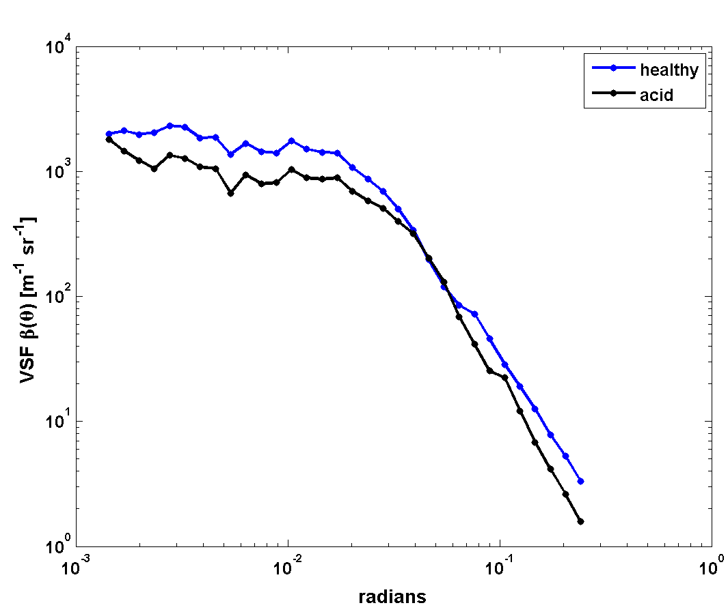
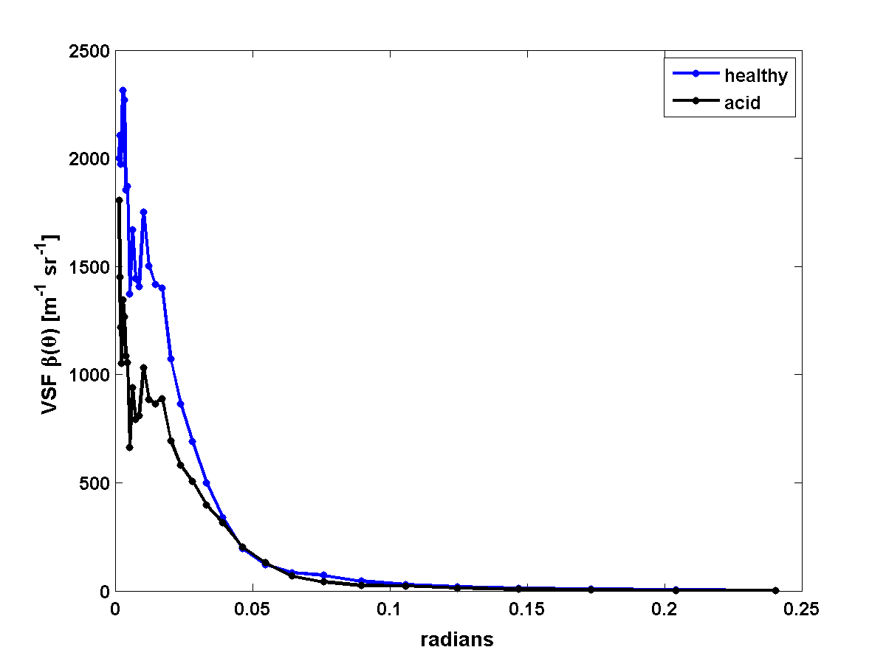
Measurements: Coccolithophores
Changes in VSF
log-log
linear
Notes:
VSF; note change in forward scatter power; particles are getting smaller

Slide 18
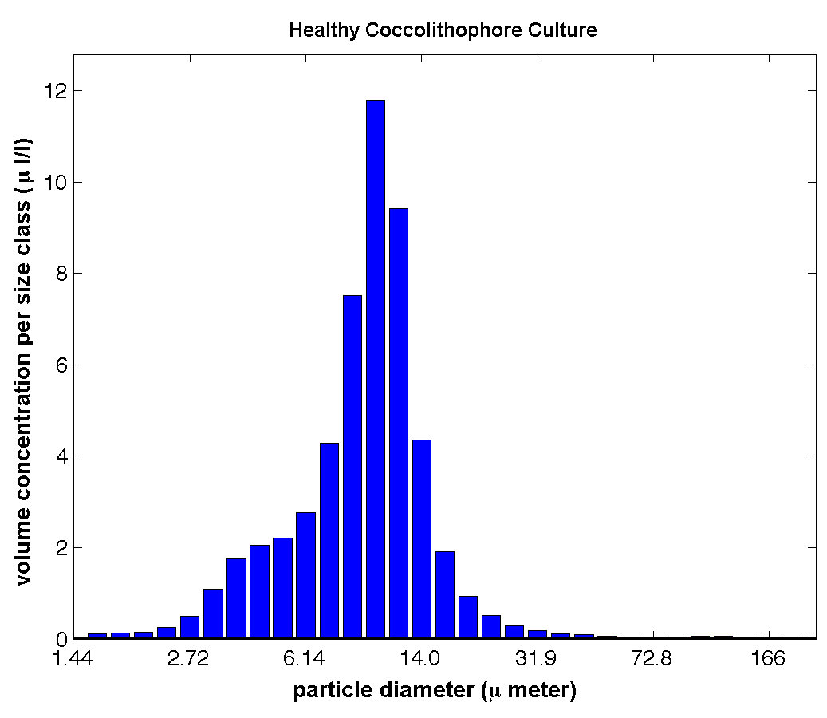
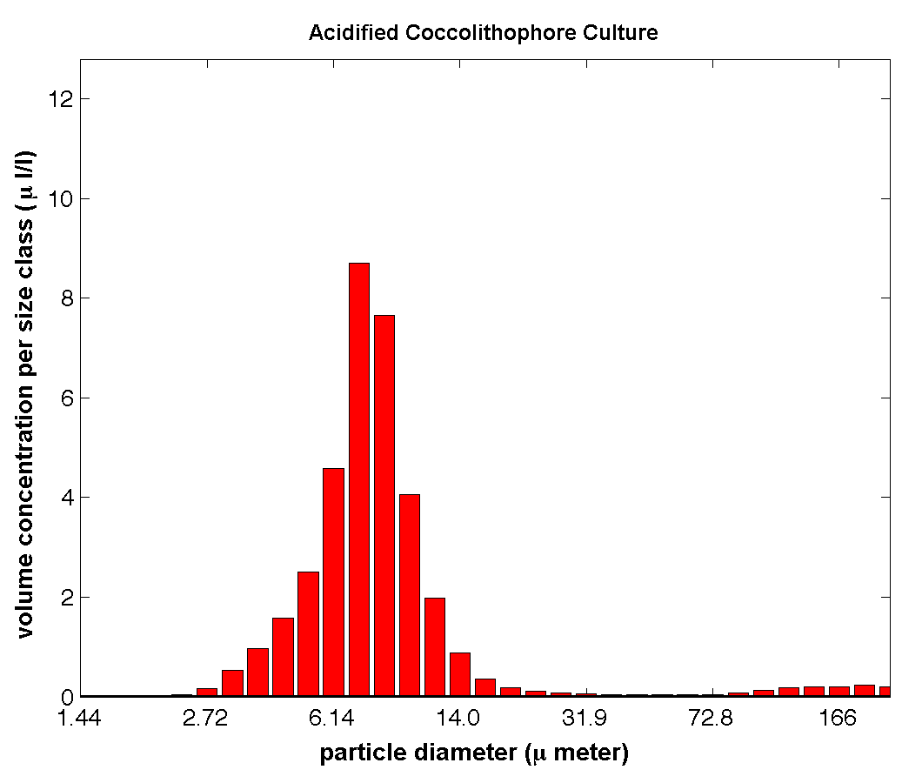
Measurements: Coccolithophores
Changes in PSD : volume concentration
Mean: 9μm
Mean: 8μm

Slide 19
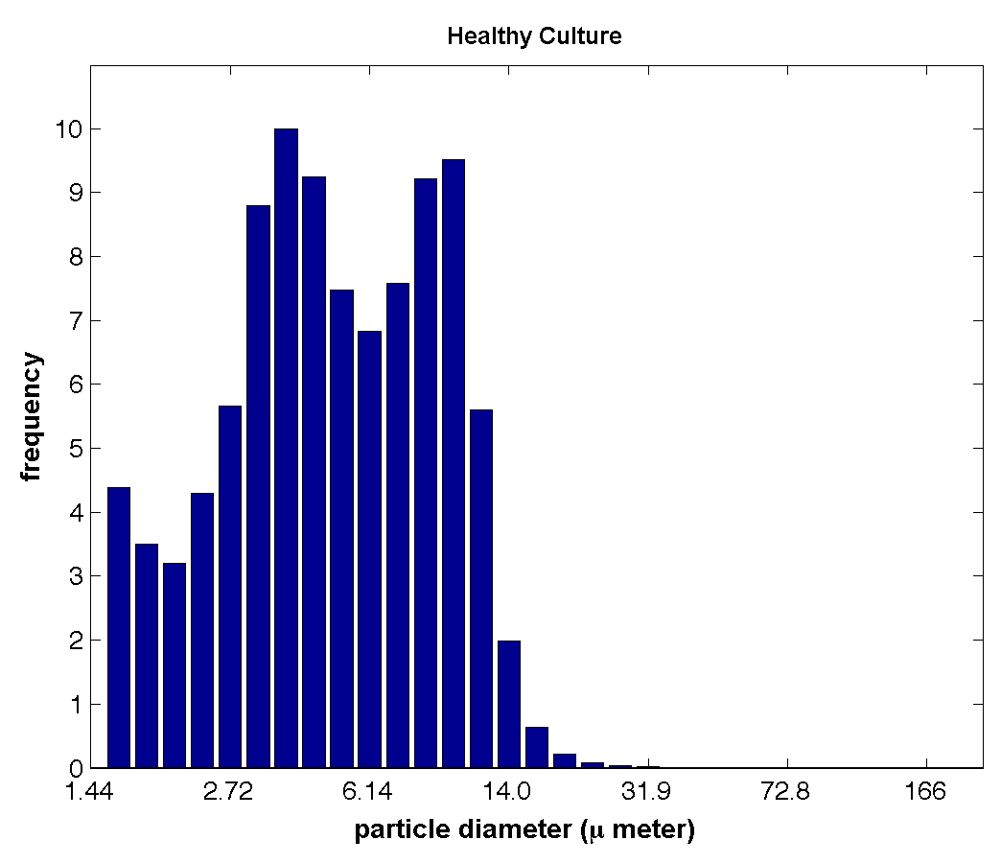
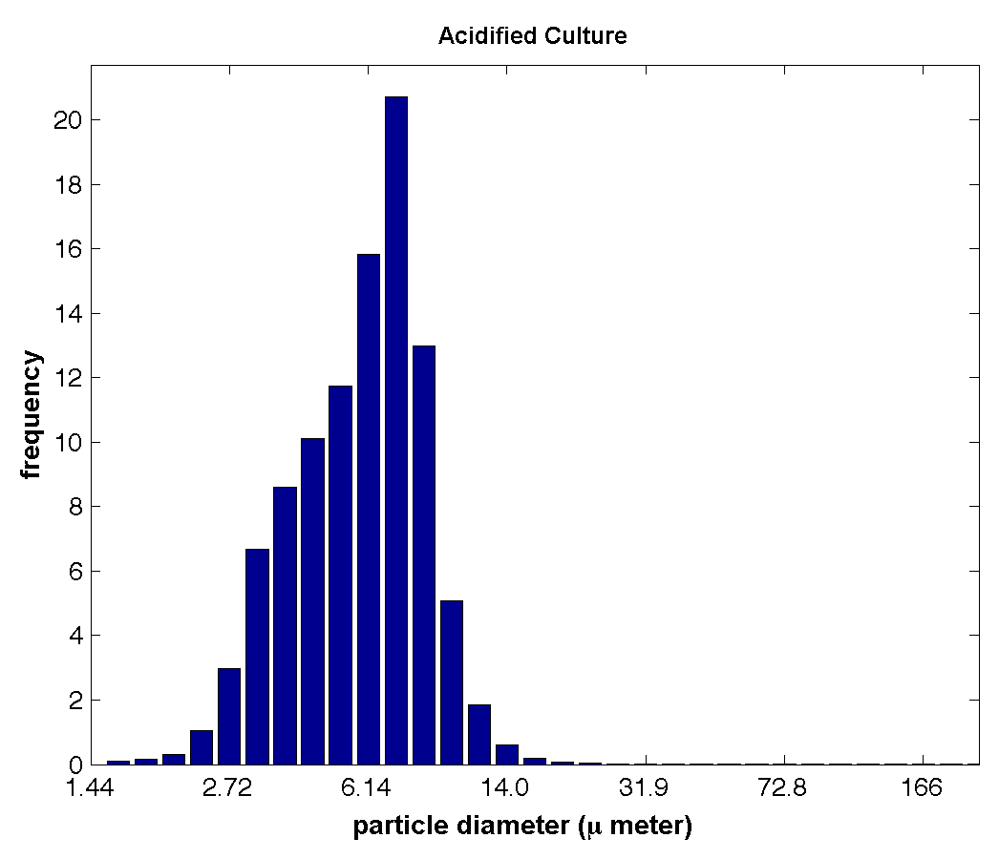
Measurements: Coccolithophores
Changes in PSD : number frequency assuming spherical shape
Median: 5.12 μm
Median: 6.14μm
Notes:
Healthy cultures shed plates, so there’s a bimodal distribution; The acidified culture has dissolved the smaller particles.

Slide 20
Video

Slide 21
Acknowledgements
For just the coccolithophore experiment:
Barney Balch, Meredith White, Dave Drapeau at Bigelow for the coccolithophore culture
Emmanuel Boss for the LISST instrument & instruction
Mary Jane Perry for instruction & supplies
Nathan Briggs for guidance
Larry Mayer for pH paper
Ken Voss for transporting the sample

