Slide 1
An Introduction to Radiometry:
Taking Measurements, Getting Closure, and Data Applications
Part I: Guide to Radiometric Measurements
(See Video)

Slide 2
An Introduction to Radiometry:
Taking Measurements, Getting Closure, and Data Applications
Part II: Data Processing and Analysis
(See animation)

Slide 3
An Introduction to Radiometry:
Taking Measurements, Getting Closure, and Data Applications
Part III: Closure and Application
(This powerpoint)

Slide 4
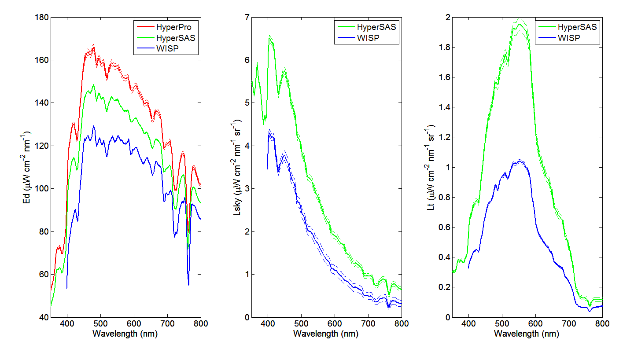
Dock Test, 07-27-13
The dock test is made on stable platform, and every measurements were strictly following protocols. Therefore, this dock test measurements are considered to be accurate.

Slide 5
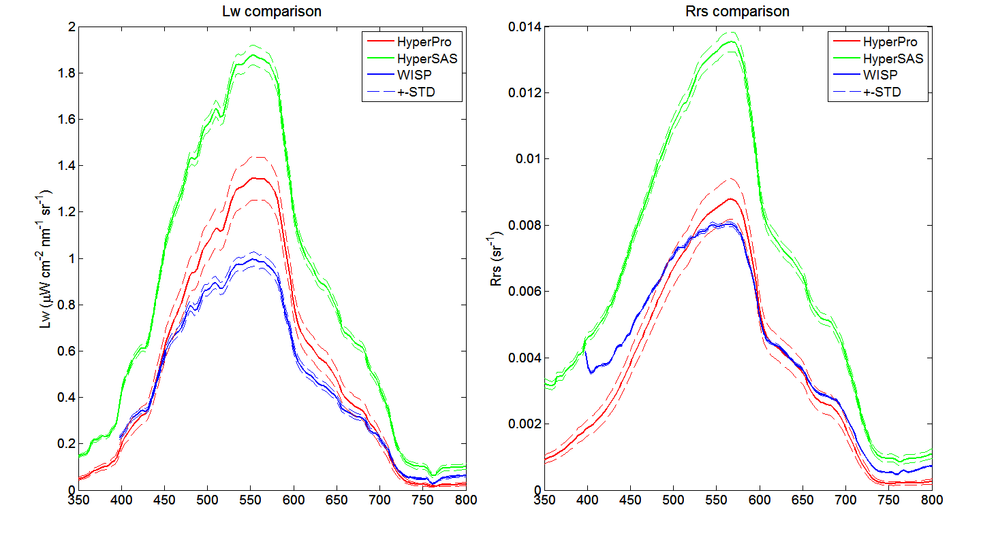
Dock Test, 07-27-13

Slide 6
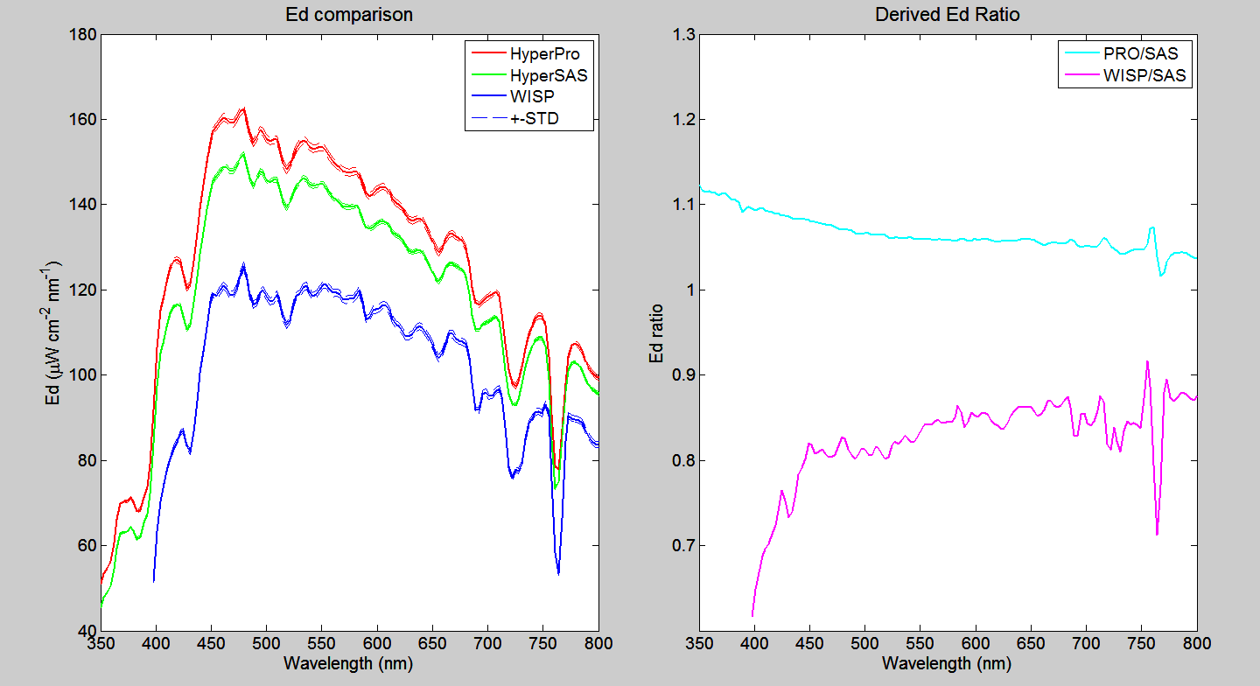
Dock Test, 07-27-13
Derived ratios between HyperPro and HyperSAS and between WISP and HyperSAS for each measured radiometric quantities. This shows ratios for Ed sensor.

Slide 7
WISP and HyperPro ‘Transformation’ to HyperSAS for inter-instrumental comparison
Assumed Dock Test was the most ‘ideal’ control conditions
Assumed HyperSAS was accurate enough to be the ‘right’ system
Used Dock Test spectra for SAS, Pro, and WISP to get ratios Pro/SAS and WISP/SAS for all wavelengths (3 nm bins)
Applied Dock Test ratios to transform cruise data
Assumed ρ_{sky}= 0.028

Slide 8
Cruise 1: River Station

Slide 11
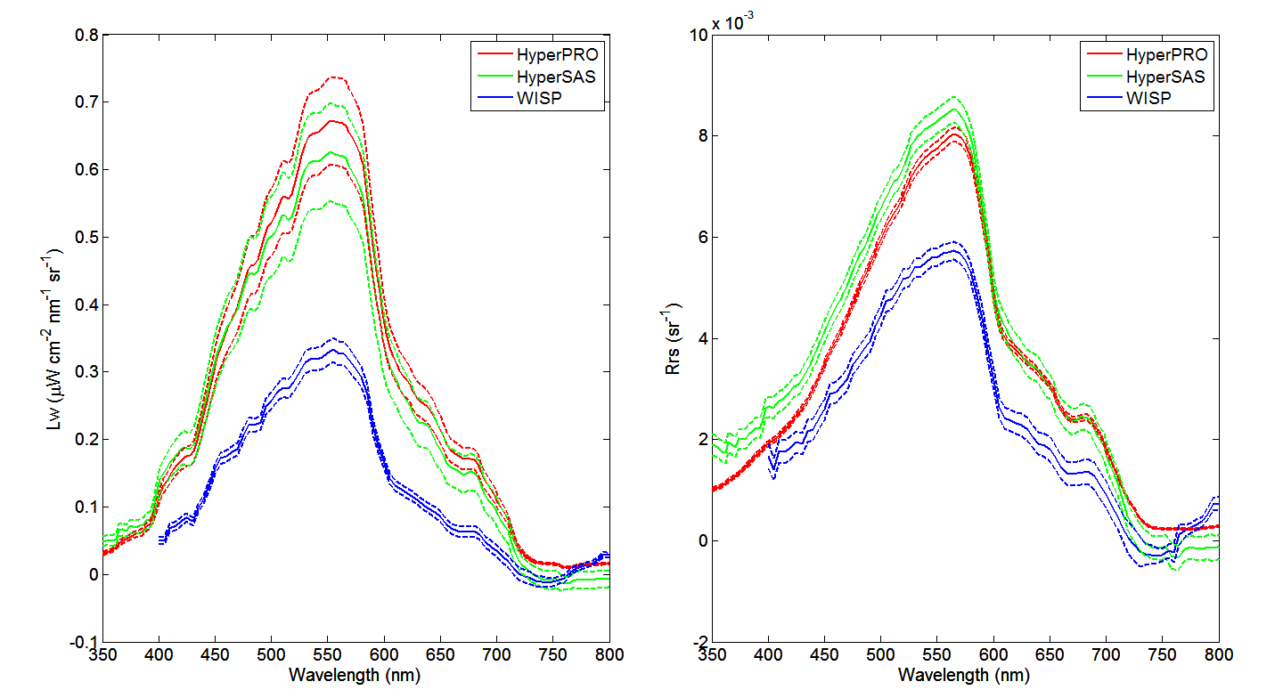
Before transformation

Slide 12
After transformation

Slide 13
After transformation

Slide 14
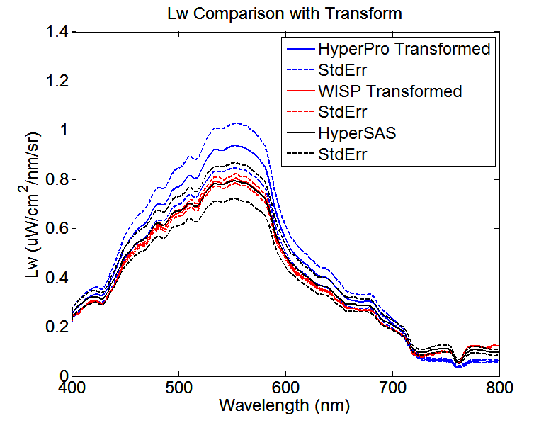
Three Lw’s can match if we use ρ_{sky}=0.021 instead of 0.028. Therefore, this means we overcorrected sky radiance initially (?).

Slide 15
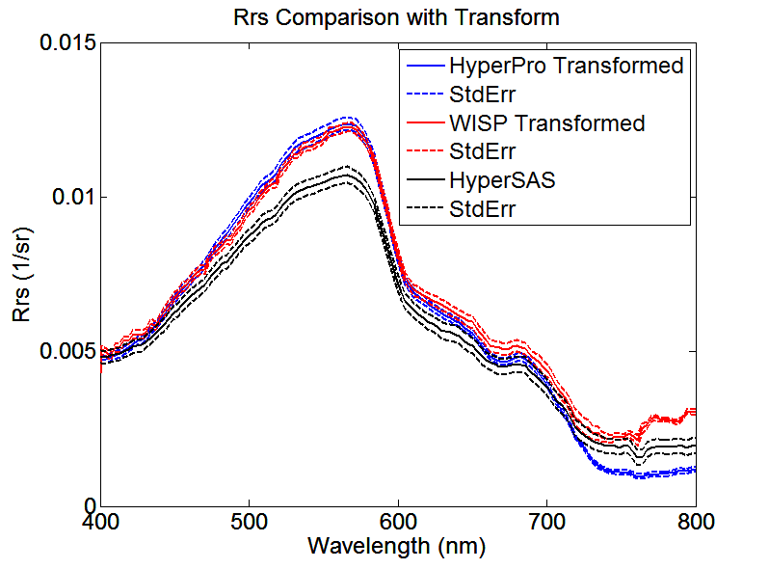
Three Rrs’s can match if we use ρ_{sky}=0.021 instead of 0.028. Therefore, this means we overcorrected sky radiance initially (?).

Slide 16
Cruise 1: Ocean Station

Slide 21
How do these comparisons suggest?
All three instruments work better under stable conditions. Especially, the two above-water instruments, HyperSAS and WISP may not ideal for wavy ocean surface.
Under stable condition, the offsets among instruments seem relatively constant. This may due to different calibration methods using for these instruments.
Therefore, derived Rrs, that Lw over Ed, is more reliable and comparable, but individual radiance and irradiance by a single instrument may not be trustable without providing sufficient calibration information.

Slide 22
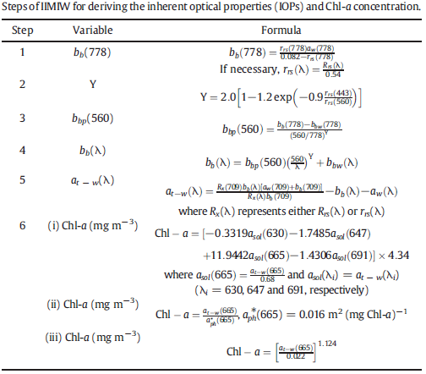
Inversion Application Example
Using algorithm developed by Li et al. (2013, RSE, Vol. 135, pp. 150–166).
The IOP Inversion
Model for Inland
Waters (IIMIW) is
specifically developed for
turbid lake, estuarine,
and coastal waters.
Validated and works
well for 8 sites all
over the world.

Slide 23
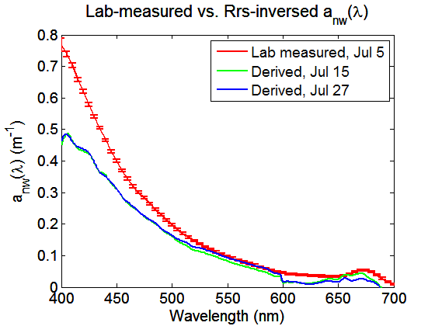
Inversion Application Example
R_{rs}(λ) a_{nw}(λ), b_{bp}(λ) Pigments
Chlorophyll (mg/m³)
Date | Lab | Inversed
Jul 15 | ~2.1 | 2.47
Jul 27 | ~2.2 | 1.88
Here we show the inversion results for dock test on July 15 and July 27. The interesting fact is that inversed results are always better when using WISP-measured R_{rs}(λ).
This may suggest WISP Rrs is more accurate than the other two instruments. However, it is not certain until further investigation. Measuring Rrs with more than one instruments, if possible, is still recommended.

Slide 24
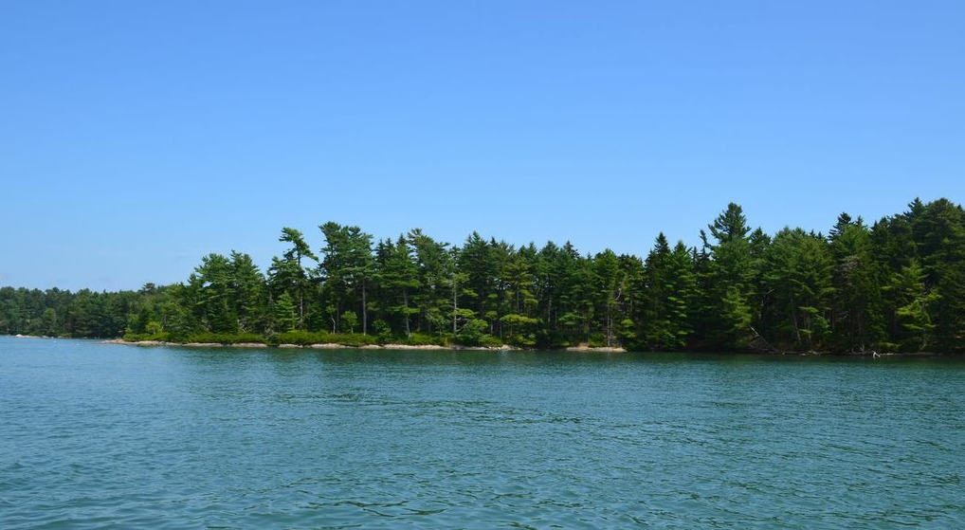
CLOSURE ANALYSIS

Slide 25
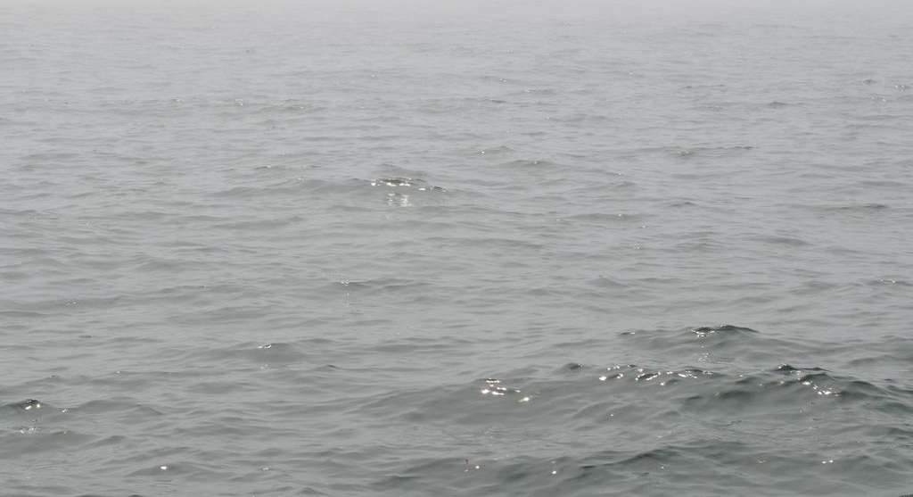
Differences between instruments’ response could be explained by:
Offsets between sensors,
Spatial variations during deployment,
Not accurate information about atmospheric conditions and sea level state,
Inappropriate angle corrections,
Handling errors (especially for WISP),
…
Due to the lack of more information, some of the corrections we can perform are only assumptions and we can’t justify them.
Incorrect values of sea-surface reflectance factor, ρ
Hydrolight model provides a very useful tool which can be used for this purpose.

Slide 26
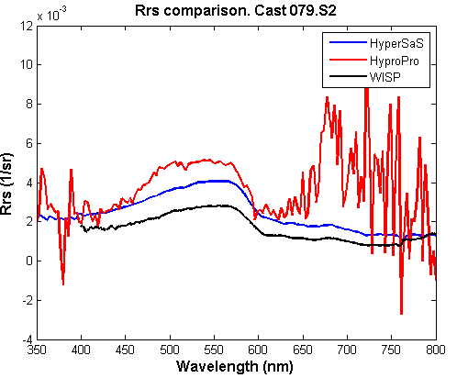
CRUISE 2- “OFFSHORE” STATION
HyperPRO, noisy and useless signal

Slide 27
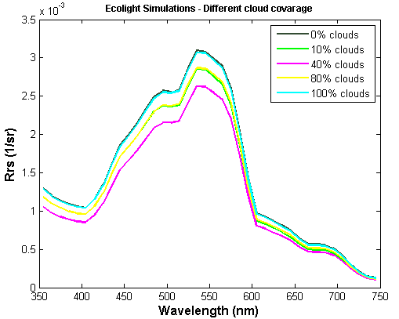
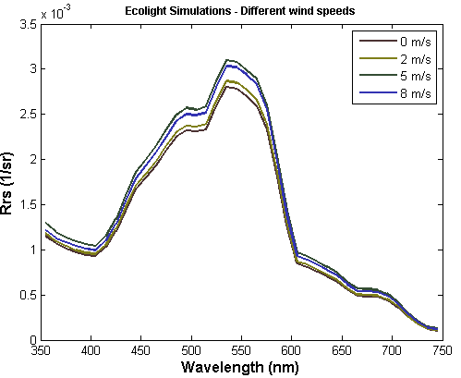
ECOLIGHT SIMULATIONS:
Inputs: IOPs (a_{P},b_{b},a_{CDOM})
10%
16%
Simulations under different cloud coverage and wind speeds

Slide 28
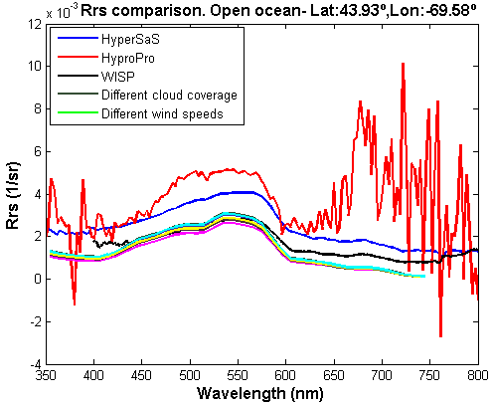
Same shape between spectra, different magnitude.
1) The measured Rrs at [720-750] significantly higher than zero → open ocean → “dark pixel” correction
2) Imprecise sky and measurement conditions, unknown → try with another rho values

Slide 29
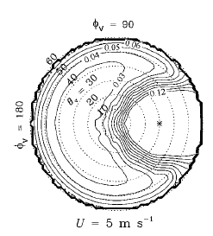
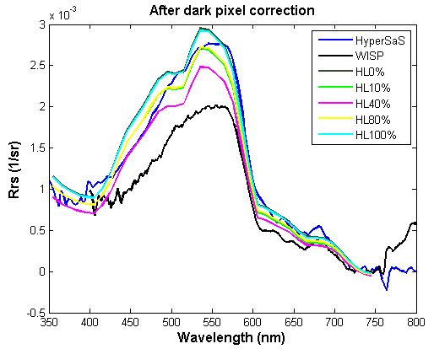
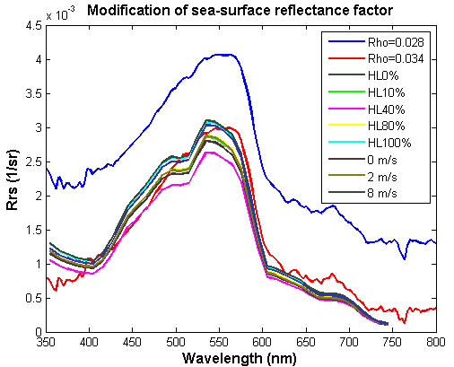
.
Mobley (1999)
ρ≈0.034 when φ ≈ 135º, θ ≈43º and U=5 m/s
 | EUCLIDEAN DISTANCE
Without corrections | 0.0076
Forcing Rrs_{[720-750]} = 0 | 8.05E-04
Sea-surface reflectance factor= 0.034 | 0.0014

Slide 30
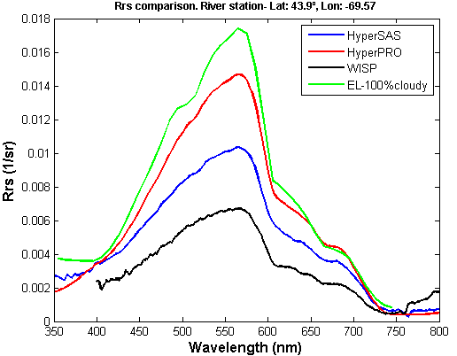
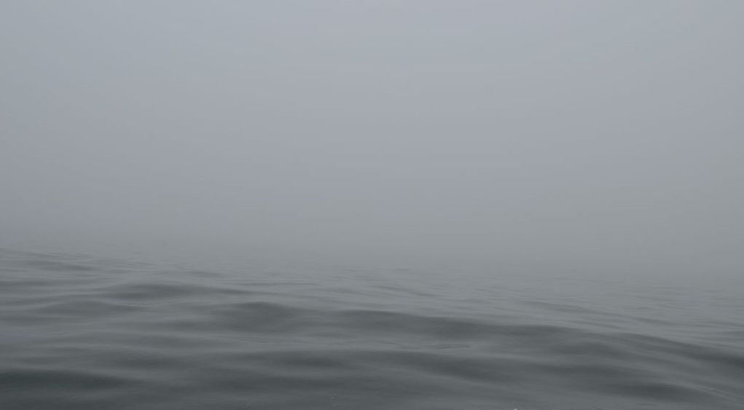
CRUISE 2- RIVER STATION
EUCL. DISTANCE | HyperSAS | HyperPRO | WISP | Ecolight
HyperSAS | 0 | 0.0138 | 0.0134 | 0.0215
HyperPRO | 0.0138 | 0 | 0.027 | 0.008
WISP | 0.0134 | 0.027 | 0 | 0.0346
Ecolight | 0.0215 | 0.008 | 0.0346 | 0
Full overcast (no “dark pixel” corrections nor change of sea-surface reflectance factor).

Slide 31
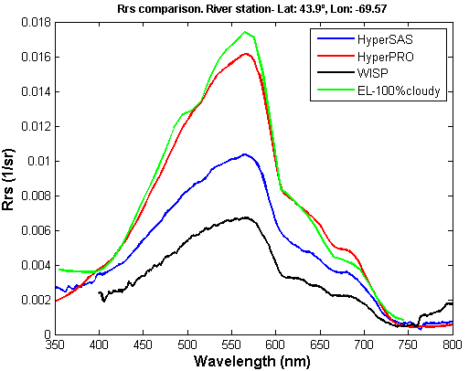
Euclidean_dist [Ecolight-HyperPRO]= 0.0036
Lab/ Dock test using the Ed sensors under the same light conditions → Ed_{PRO}= 1.1Ed _{SAS}

Slide 32
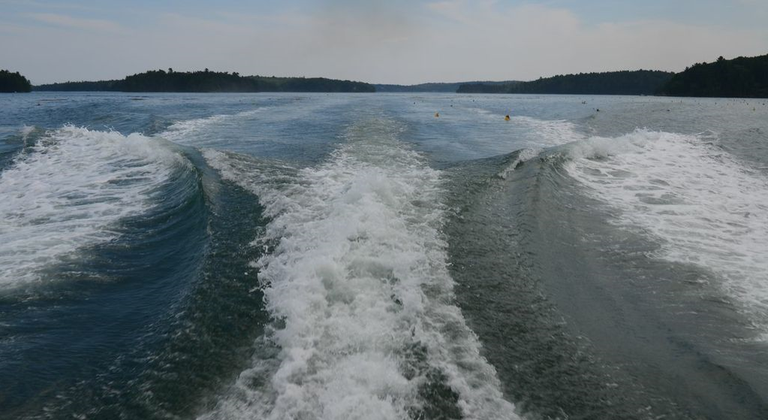
THANK
YOU!

Slide 33
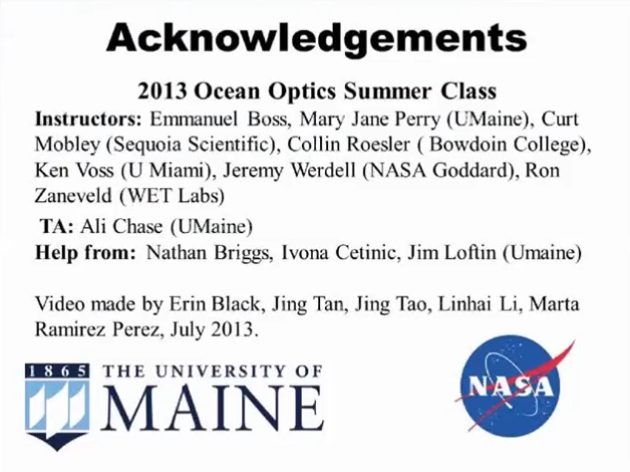

Slide 34
Contact information
If you have questions about the video, animation, or this PPT, please contact any of us.
Erin Black: eblack@whoi.edu
Jing Tan: tan30@purdue.edu
Jing Tao: jing.tao@dal.ca
Linhai Li: lil032@ucsd.edu
Marta Ramrez Perez: mramirez@icm.csic.es

