Slide 1
Scattering:
What is it? Who does it?
A few demos to get us going
Why should you care about it?
*includes materials by C. Roesler and C. Mobley

Slide 2
Scattering Measurement Theory
b = fractional scatterance
per unit distance
Φ_{b} Scattered Radiant Flux
Φ_{a}
Φ_{o}
Φ_{t}
b = (-1/x) ln [Φ_{t} /Φ_{o}] –
(-1/x) ln [Φ_{a} /Φ_{o}]
= c - a

Slide 3
Dimensionally, what should scattering dependent on?
When dealing with a single particles, presented as:
Ratio of optical cross section / Geometrical cross section (non-dimensional)
Size (cross-section, volume)
Index of refraction (difference with medium)
Wavelength (in medium)
To get back to scattering units [m⁻¹]:
Optical cross section x concentration of particles

Slide 4
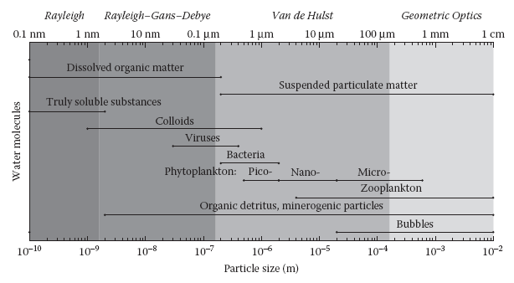
What physical properties determine the optical properties of particles?
Size, composition (refractive index), shape, internal structure.
These properties interact…

Slide 5
Small Particle Scattering follows Rayleigh Theory
Example for water
~ λ⁻⁴
β(θ)
b(λ)
VSF
0 30 60 90 120 150 180
θ
500 600 700
Wavelength (nm)
Similar results for viruses (Balch et al. 2000)

Slide 6
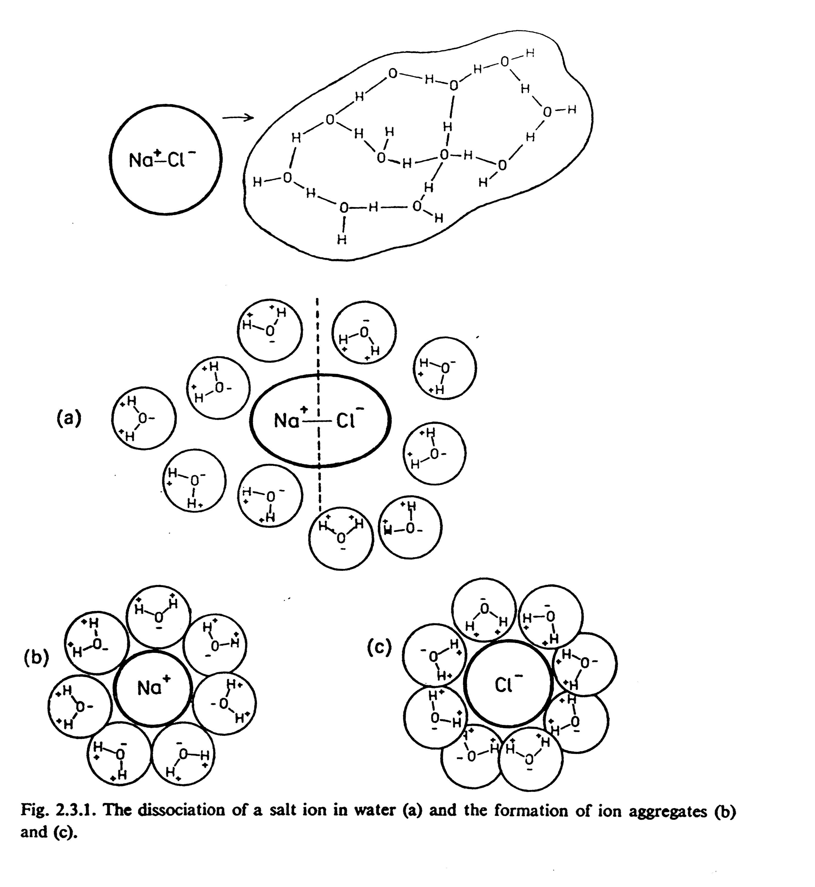
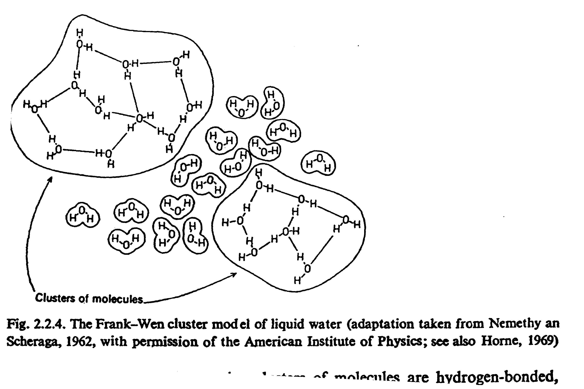
Scattering by water
Water clusters with salt
Density inhomogeneities:
Water clusters
Phase function: symmetric and similar
to Rayleigh (D<<λ):
Spectral dependence: Unlike Rayleigh ~ λ^{-4.32} (e.g. Morel, 1974)
Salts: increase scattering (~30% for 37psu).
Weaker dependence on Temperature and Pressure.
Latest works X. Zhang and co., Optics Express 2009.

Slide 7
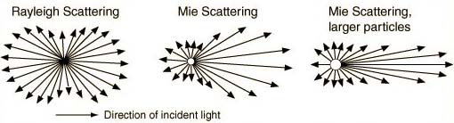
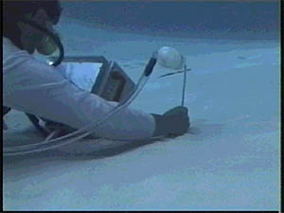
Scattering by CDOM:
Scattering by molecules whose D<<λ. Rayleigh scattering:
No evidence in the literature that scattering is significant (the only place I have ever found significant dissolved scattering (c_{g}>a_{g}) was in pore water).

Slide 8
Large Particle Scattering
Three effects: refraction, reflection and diffraction

Slide 9
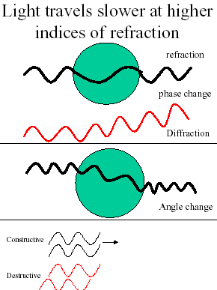
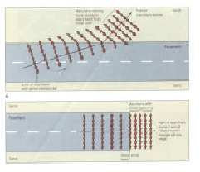
refraction
Changes the speed of propagation leading to directional changes and phase changes

Slide 10
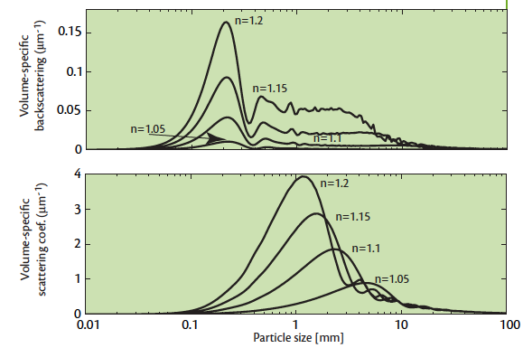
Backscattering and scattering sensitivity to size:
Boss et al., 2004, TOS
Based on Mie theory (homogeneous spheres)

Slide 11
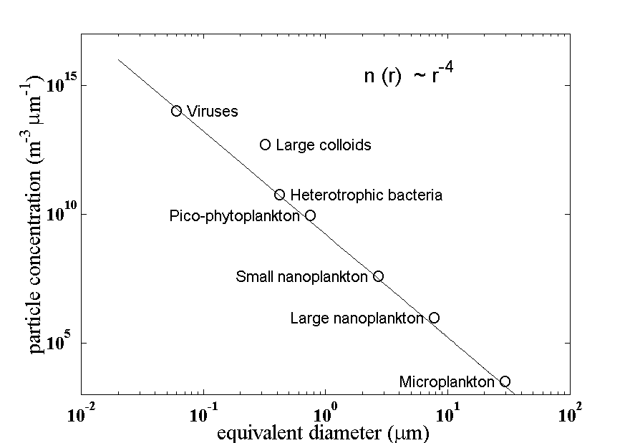
β(θ) response to particle size distribution
First let’s talk about particle size distributions
r⁻³
r⁻⁵
Stramski and Kiefer 1989

Slide 12
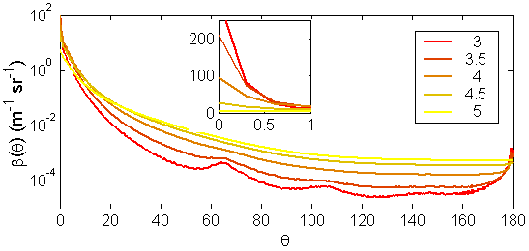
β(θ) and response to particle size distribution
β(θ) / V_{p}
Roesler and Boss, 2008

Slide 13
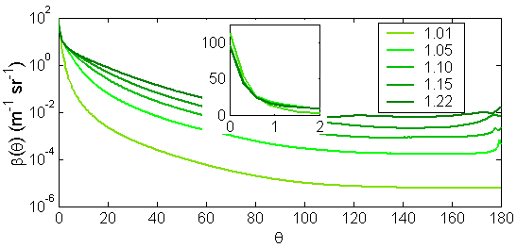
β(θ) response to index of refraction
β(θ) / V_{p}
Roesler and Boss, 2008

Slide 14
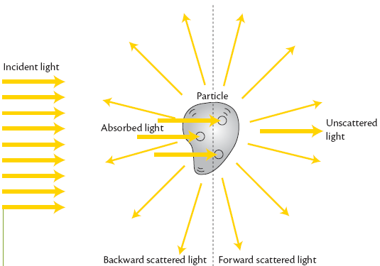
What scatters in the oceans:
Light within the ocean is scattered by:
H₂O+salts
Colloids
Inorganic particles
Organic particles (bacteria, phytoplankton)
bubbles

Slide 15
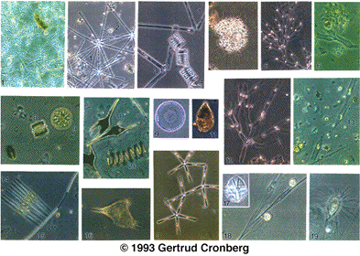
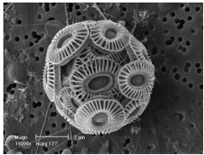
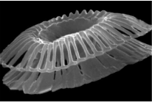
What particles scatter in the ocean?
Phytoplankton:
Variable in shape, size and pigment composition.
→ Variable in scattering and absorption properties

Slide 16
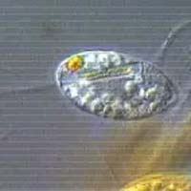
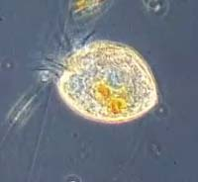
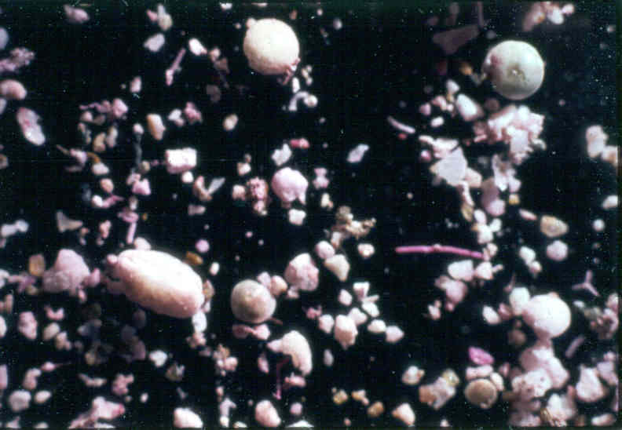
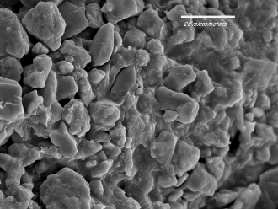
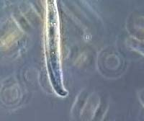
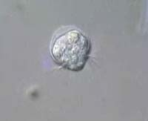
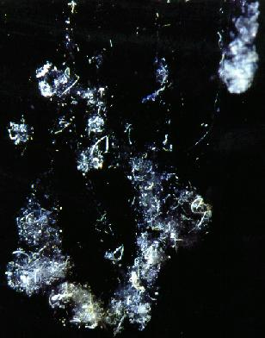
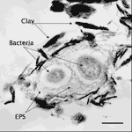
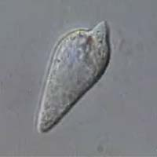
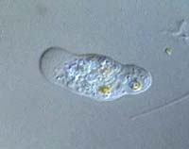
What particles scatter in the ocean?
Non-algal particles: Organic and inorganic.
Sand
Silt
clay
Aggregates:
Variable in scattering and absorption properties
http://www.aad.gov.au/default.asp

Slide 17
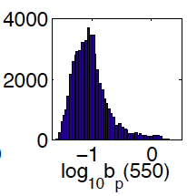
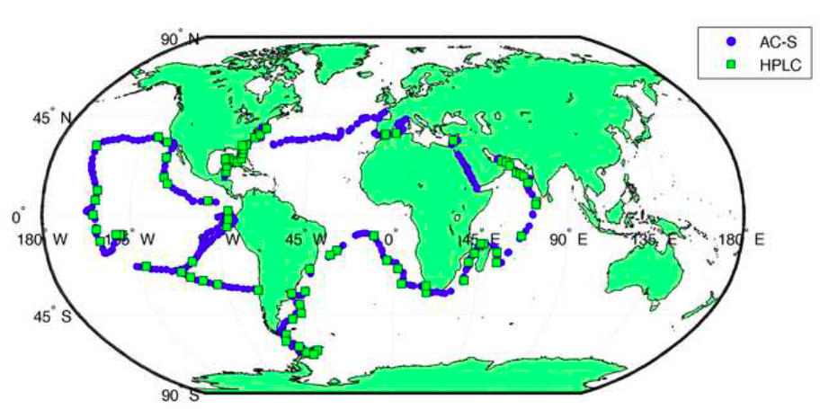
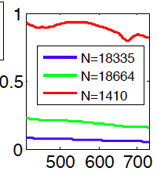
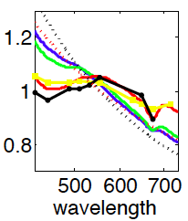
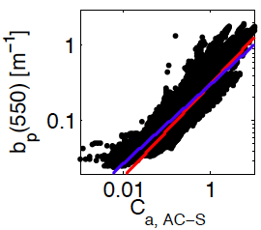
Scattering in the oceans (~60,000 1km² data):

Slide 18
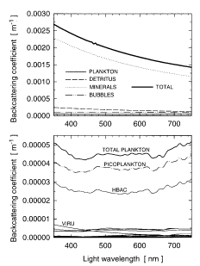
The b_{b} enigma:
Morel and Ahn, 1991: ‘Algal cells in open ocean, and to lesser extent small heterotrophs, dominate the scattering coefficients; …On the contrary, these organisms are definitely insignificant contributors to the backscattering coefficient.’
Stramski et al., 2001: simulating open-ocean (oligotrophic, 0.18mg Chl/m³) 2-3% of the backscattering coefficient is due to plankton. 50% from particles <0.2μm.
Stramski et al., 2001

Slide 19
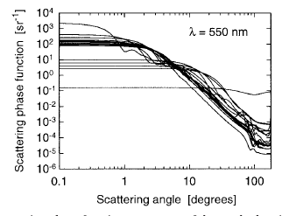
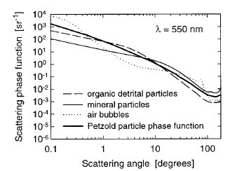
Phase functions:
Stramski et al., 2001

Slide 20
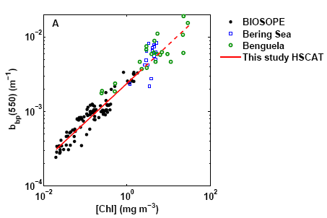
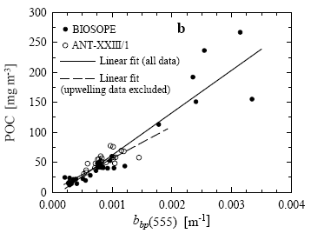
The b_{b} enigma (or paradox):
Based on Mie theory, backscattering should be dominated by inorganic particles and sub-micron particles (the least known of the bunch).
Yet b_{bp} correlates well with [chl] and POC (>0.7μm):
Huot et al., 2008
Stramski et al., 2008

Slide 21
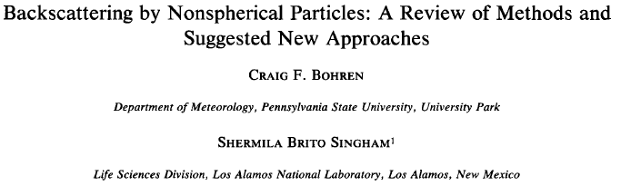
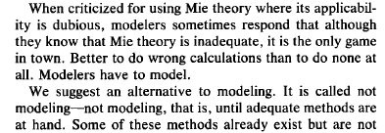
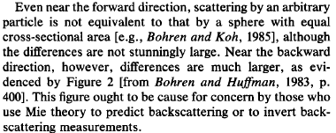
An important aside about modeling (using homogeneous O):

Slide 22
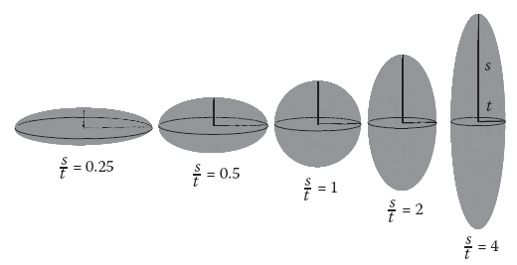
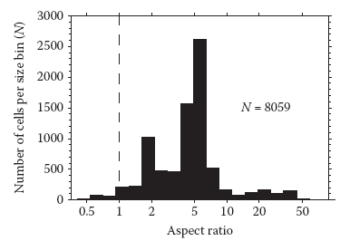
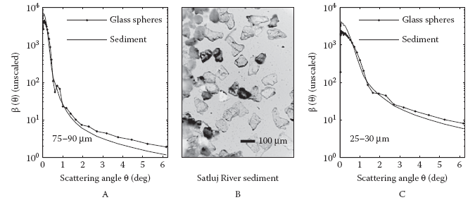
Shape matters:
VSF of large particles depends on <G>.
From Clavano et al., 2007

Slide 23
Shape approximations for light scattering calculations
Mie-Theory
T-matrix
Moderate Axis ratios (0.5<AR<2)
10
oblate
2
Size limit
1
Axis ratio
0.5
T-matrix
Axis ratios up to convergence limit
0.1
prolate
0.1
1
10
Particle radius (μm)
Slide From Volten

Slide 24
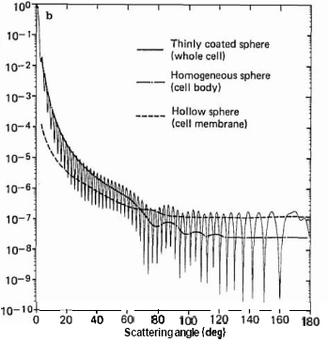
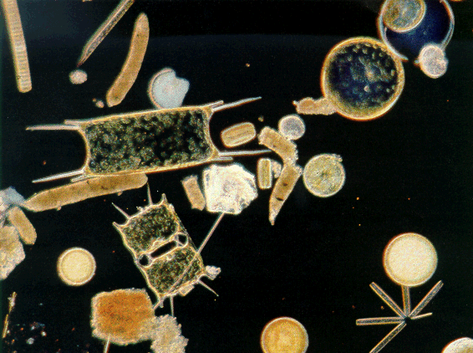
An other approach,
Coated spheres:
Relative intensity
Backscattering dominated by membrane.
Meyer, 1979

Slide 25
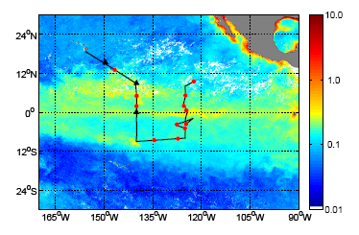
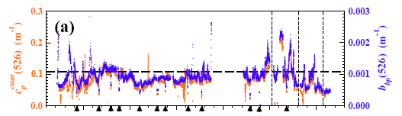
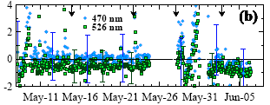

Measurements across the equatorial Pacific (Dall’olmo et al., 2009):
b_{bp} well correlated with c_{p}
b_{bp}(D<0.2mm)
<0.1
b_{bp}(D>0.2mm)
No filter effect visible
Uncertainty dominated by uncertainty in b_{b}(H₂O)

Slide 26
Angular scattering:
dΩ
Scattered
Radiance
L_{s}
θ
L_{o}
L_{t}
Incident
Radiance
Transmitted
Radiance
Volume scattering function [m⁻¹sr⁻¹]:
Δx
Most often assume azymuthal isotropy (only θ dependence).

Slide 27
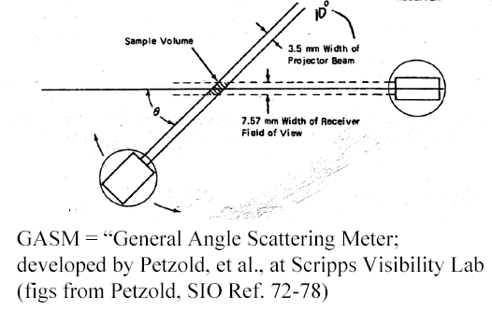
Volume Scattering Function (β)
β(θ) = (-1/x dΩ) ln[Φ_{b}(θ)/Φ_{o}]
detector
Φ_{b}/ΔΩ
source
Φ_{a}
Φ_{o}

Slide 28
Back-Scattering Measurements
β(θ) = (-1/x dΩ) ln[Φ_{b}(θ)/Φ_{o}]
Detected flux measurement must correct for attenuated flux along pathlength→ inner-filter effect x
Define shape of detection area
  Calibration with known substance
  mathematically
Φ_{o}
Φ_{b} (θ)
θ
source
detector

Slide 29
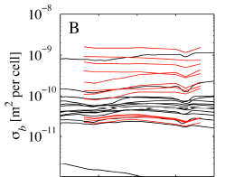
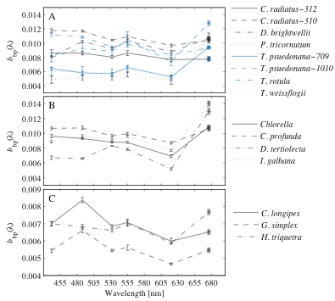
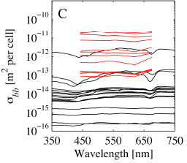
Scattering by phytoplankton
b_{b}+F_{chl}
In cultures (watch out for NAP)
Whitmire et al., 2010
Comparison with Mie theory of Stramski et al., 2001

Slide 30


Using one angle to infer backscattering
Consistency from 90->150degrees (except for one study…).
Sullivan and Twardowski (2009):

Slide 31

Another commercial design: Eco-VSF
Fit a 3rd order polynomial of βsin(θ) including at θ=π.
Integrate from π/2 to π.
Nominal angles: 104, 131, 151degrees

Slide 32


New designs to measure backscattering:
Independent of VSF !!!
Haubrich et al., 2011, Applied Optics
Gainusa-Bogdan and Boss, 2011

Slide 33

Whitmire et al. (2010):
Phytoplankton cultures (5 λ):

Slide 34


Scattering by bubbles:
Phase function of a population of bubbles:
Clean
With surfactant
Theory (clean)
Zhang et al., 2002, L&O

Slide 35

Scattering by aggregates (and what happen with handling)
Aggregates:
Boss et al., 2009
For particles with D>>λ:
When scattering centers are far enough, IOPs are additive.
Optical properties ∝ cross-sectional area, additive
Depends on aggregate packaging (‘fractal’ dimension).
Spectral dependence of scattering ∝ λ⁰

Slide 36
Summary:
Scattering measurements are useful but are not trivial.
Beware of models…
There still is no consensus about what dominates backscattering -> ocean color.

