Slide 1
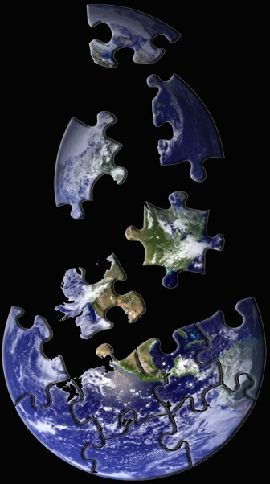
Quality
Assurance
Steven Ackleson
SA Ocean Services
www.saoceans.com
of Ocean
Optical
Data
Presented at: Ocean Optics Summer Course, University of Maine Darling Marine Center, July 31, 2013
Notes:
My aim this morning is to lead a discussion about data quality; how we assure ourselves that the data we collect is the highest quality possible and how we describe our data to the rest of the world.
Some of my comments will be directed at oceanographic data in general, others will be optics-specific.
Please treat this period as an open discussion; as questions when they occur, interject your own thoughts appropriately, and feel free to engage any of the instructors in the room regarding their views and experiences.
I understand that you all have been working hard on your individual projects and are deep into the data analysis phase, so make the most of this time – we are here to help!

Slide 2
Quality Assurance (QA):
The process of profiling data to discover inconsistencies and other anomalies and, if possible, making reasonable adjustments.
Performed by the observer or expert user
e.g., performing checks, assessing consistency, and assigning commentary
Quality Control (QC):
Determined by the user who may not be an expert
The process of controlling the usage of data of known quality for an application or a process
e.g., filtering data based on quality flags
Metadata:
Language that allows data producers to communicate with potential users
Data about data designed to make it discoverable and inform users
Reference: Marine Metadata Interoperability Project, marinemetadata.org
Notes:
When we talk about how to insure quality data, there are several terms that we need to understand.
The first, Quality Assurance, is designed to convince us that our observations are valid and meaningful. It consists of a systematic application of quality checks applied with a priori knowledge of how our sensors work and the expected scales of variability within the environment that they were deployed. It includes assigning commentary to individual observations or data sets designed to inform potential users. This is most often performed by the individual researcher responsible for collecting the data, but is increasingly being performed by other expert users interested in the data.
Another term is Quality Control and defines how the data user assesses the results of the QA process to make decisions about how to analyze the data.
Finally, Metadata (data about data) Metadata (‘data about data’) is data set level information critical for understanding the provenance (history) of the data. Metadata includes both human- and machine-readable information and includes descriptions of data, sensors, and processes, including any engineering
data that are generated during collection activities. They may also include
pointers to other data, such as auxiliary or coincident environmental observations, that are important for understanding the data (e.g., to support calibration of sensors at sea).

Slide 3
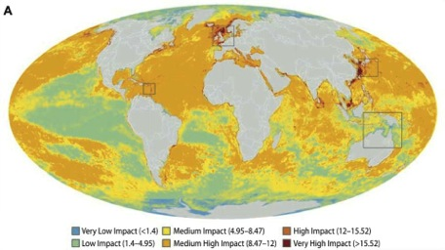
An Age of Unprecedented Global Change
Increasing pCO₂
Increasing Heat Content
Decreasing Sea Ice Coverage
Rising Sea Level
Decreasing Ocean pH
Decreasing Fishery Biomass
Increasing Plastic Concentration
Increasing Sound Levels
Cumulative Impact:
Notes:
Last year global population passed 7 billion people and is increasing at a rate of a billion people every 15 years. Thus, it is likely that our children, certainly our grandchildren, will live in a world of 10 billion people, all requiring food and demanding the energy necessary to live in a modern society. According to projections by the Intergovernmental Panel on Climate Change, global energy consumption, primarily the burning of fossil fuels, is expected to increase by at least 50% by the end of the century. The resulting increase in atmospheric CO₂ will have profound effects, not only on global temperature and sea level rise, but is expected to drive fundamental changes in ocean carbonate chemistry, producing a more acidic marine environment. Combine these projections with human reliance on marine sources for animal protein and it doesn’t take a genius to predict serious societal consequences of global proportion.
Some of the most important marine services are related to or impacted by biogeochemical properties and processes that have optical signatures; e.g., pollution and sediment transport, harmful algal blooms, factors related to the ocean carbon cycle, and biological responses to ocean acidification.
Thus, the data that you collect will have societal importance beyond your individual interests. Insuring and communicating high quality data benefits everyone.

Slide 4
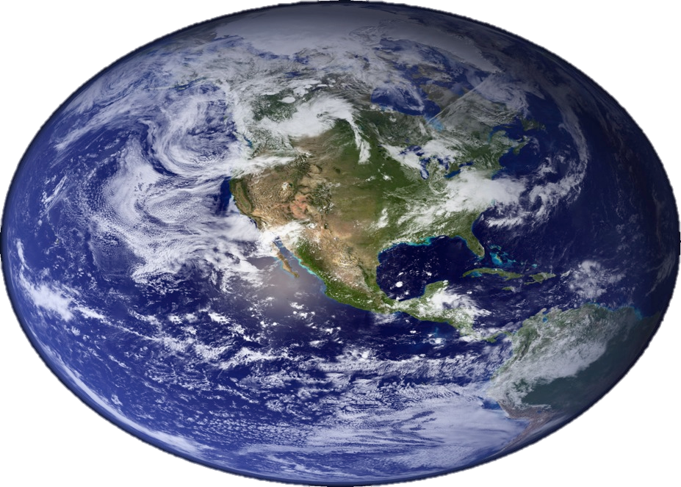
GEOSS
GOOS
CalCoFi
ARGO
NEPTUNE
IOOS
OceanSITES
Coordination
Connectivity
Standards
US Coastal Ocean Observing Systems
HOTS
OOI
EuroSITES
EU Ocean Observing Systems
TAO
MARS
IMOS
BATS
Satellites
Notes:
In order to understand changes in the global environment, ocean observing systems have been steadily increasing in number and complexity.
While the early efforts were conceived as individual efforts, developers quickly realize that no data stream can be completely understood in isolation and that there are many common problems related to data quality assurance and management.
What we have seen is a natural coalescing of activities at local, regional, and global scales based on common goals, geography, and available resources.
The driving needs at all scales are better connectivity of data streams, better coordination of resources, and global standards that will ensure data compatibility no matter then or where it is collected.

Slide 5
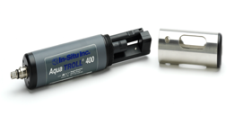
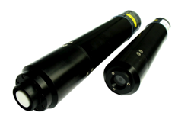
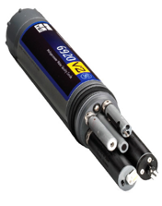
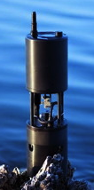
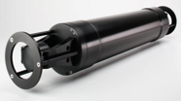
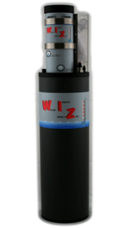
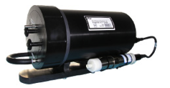
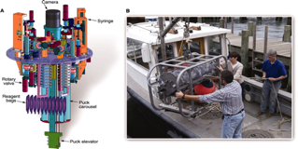
Optical & Biogeochemical Sensors
OPTICS
pH
DISSOLVED OXYGEN
pCO₂
NUTRIENTS
PARTICLES
Notes:
Our optical and biogeochemical sensing capabilities have advanced significantly over the past decade. Modern ocean observatories around the world deployed these sensors in various combinations and are making data streams available in near-real time. Likewise, nay of these sensors are being incorporated into mobile platforms such as gliders and profiling floats.

Slide 6
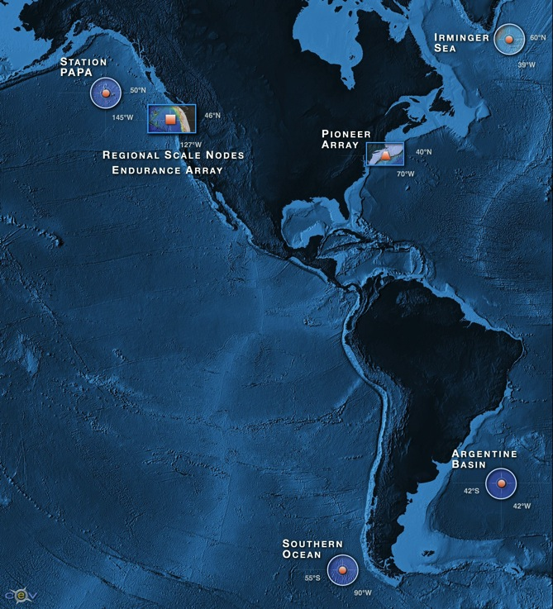
Ocean
Observatories
Initiative
O&M Cost: $50-65M
6
48
764
Regional Arrays
Instrument Types
Instruments
Notes:
One of the most ambitions observing efforts is the U.S. Ocean Observatories Initiative; a $400M construction project funded by the National Science Foundation.
When it comes on line in 2015 it will consist of 6 regional arrays sporting a total of 764 instruments. Sensing arrays on the east and west costs of the U.S. will permit process studies in Case I and II coastal, shelf, and pelagic waters. Four global arrays will monitor deep ocean processes within the North Atlantic in the Irminger Sea, the NE Pacific at Ocean Station PAPA, the South Atlantic in the Argentine Basin, and the SE Pacific off the coast of southern Chile. The NSF is committed to 25 years of support, ensuring free access to near-real time observations that will add to knowledge of ocean variability and long-term change associated with climate.

Slide 7
OOI Core Parameters
a(λ)
c(λ)
b_{b}(λ)
PAR
E_{d}(λ)
E_{s}(λ)
Chlorophyll (fluorescence)
CDOM (fluorescence)
Dissolved Oxygen
pCO₂
pH
Nutrients (NO₂, NO₃, PO₄, SiO₄)
Temperature
Salinity
Current Velocity
Turbulence
Surface Waves
Surface Wind Velocity
Long-wave Radiation
CO₂
Optical:
Biogeochemical:
Physical:
Meteorological:
Notes:
This is the list of core OOI measurements pertaining to ocean color science.
As you can see, the list is rather impressive and includes optical, biogeochemical, physical, and meteorological observations. However, the most interesting aspect of the OOI will be the ability of individual researchers to add additional sensors to the various arrays and, depending on the location and mode of communication, be able to receive that data along with all of the core data fairly rapidly, often with latencies of just a few minutes.

Slide 8
Climate Quality Data:
Time series of observations of sufficient length, consistency, continuity, and accuracy to reveal meaningful climate variability and change.
Notes:
The goal is to collect and distribute complete, interdisciplinary data sets that are of climate quality.

Slide 9
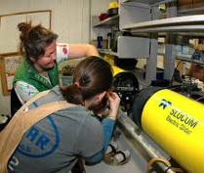
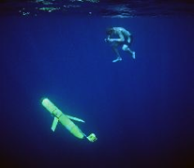
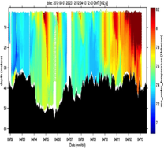
Prepare
Acquire
Analyze
Report
Notes:
High quality data is the result of an end-to-end process ...

Slide 10
Pre-Deployment Preparations
Are all of the sensors recently calibrated and operating properly?
Are the sensors position to avoid interference?
For flow-through sensors, is the plumbing configured to eliminate bubbles and minimize disruption of fragile particles?
Are science team roles and responsibilities well defined?
Is the sensor suite configured to sample the expected scales of variability?

Slide 11
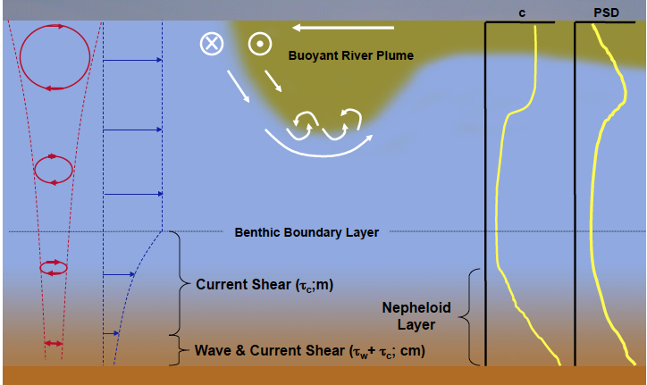
Understand Expected Scales of Variability
<1 m
1 m
10 m
1 m
Notes:
Data quality starts with understanding the temporal and spatial scales scales of variability

Slide 12
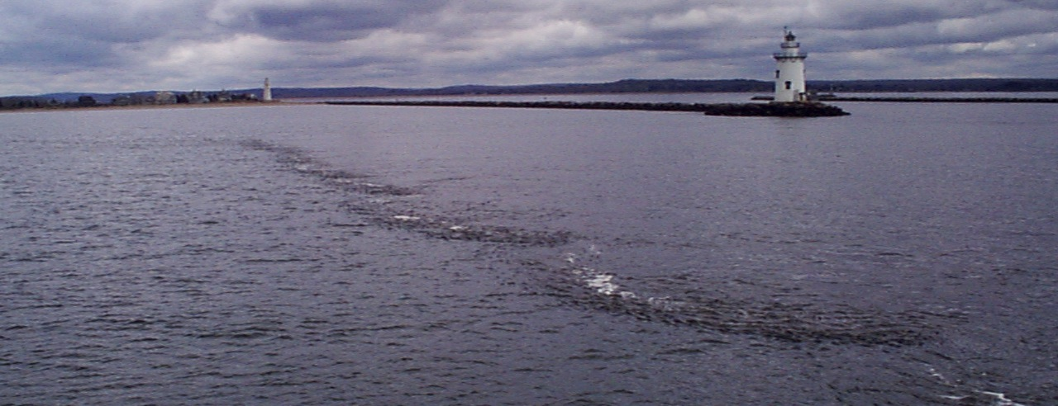
Small-Scale Variability Across the Connecticut River Plume Boundary

Slide 13
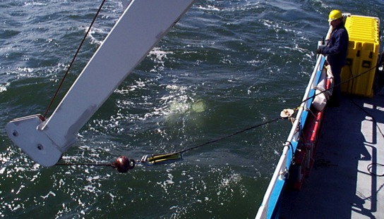
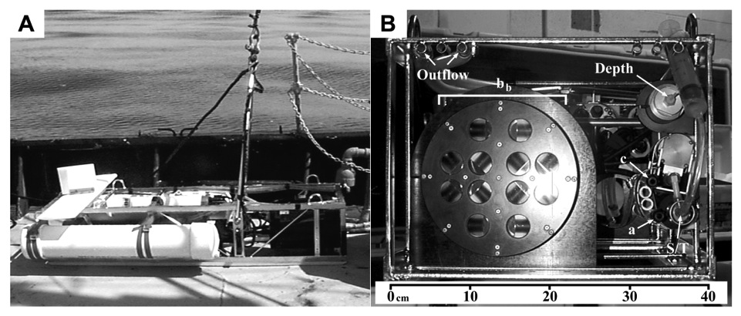
Instrument
Configuration

Slide 14
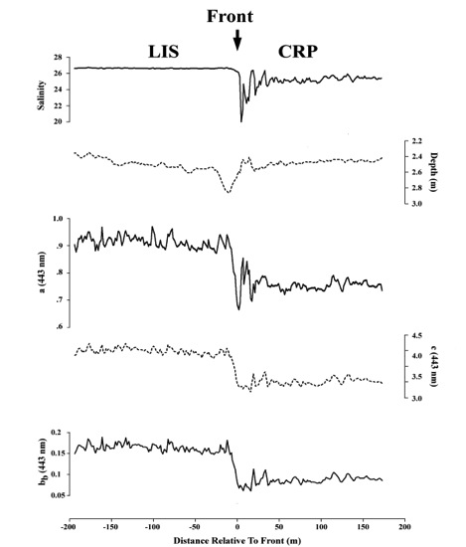
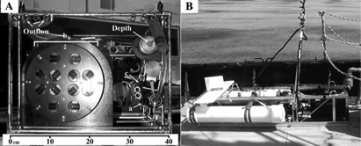
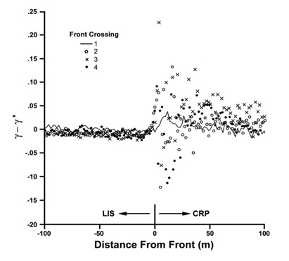
Scales of Variability In The Connecticut River Plume
Ackleson, S. G., and J. O'Donnell. 2011. J. Geophys. Res., doi:10.1029/2011JC007053.
O'Donnell, J., S. G. Ackleson, and E. R. Levine. 2008. J. Geophys. Res., doi:10.1029/2007JC004440.
Ackleson, S. G. 2006. J. Geophys. Res., doi:10.1029/2005JC003214.

Slide 15
Pre-Deployment Preparations
Are all of the sensors recently calibrated and operating properly?
Are the sensors position to avoid interference?
For flow-through sensors, is the plumbing configured to eliminate bubbles and minimize disruption of fragile particles?
Are science team roles and responsibilities well defined?
Is the sensor suite configured to sample the expected scales of variability?
Do you have a strategy to mitigate biofouling?

Slide 16
Over 4000 marine organisms have been identified associated with fouling problems!
Yebra, D.M., Kiil, S., Dam-Johansen, K., Review – Antifouling technology – past, present and future steps towards efficient and environmentally friendly antifouling coatings, Progress in organic Coatings, 50 , 75-104, 2004.
Timeline
Seconds
Hours
Days
Weeks
Organic/Inorganic Macromolecule Adsorption
Microbial Cell Transport to Surface
Microalgae, detritus, and Sediment Deposition
Invertebrate & Macro-algae
Attachment
The rate and type of fouling depends on the local physical and biogeochemical environment. Thus, optimum mitigation approaches require local knowledge.
Delauney, L. et al. 2013. Biofouling protection for marine underwater observatory sensors. Oceans 2009 – Europe,

Slide 17
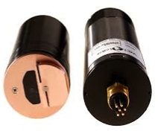
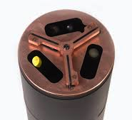
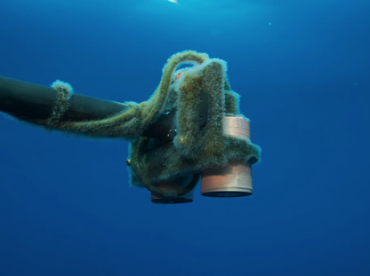
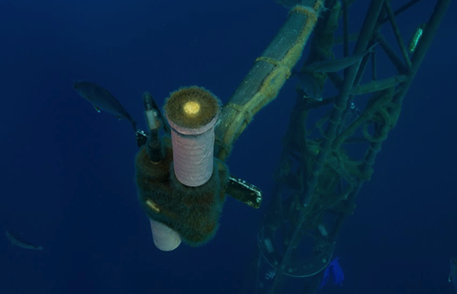
BIOFOULING MITIGATION
Copper Components
Copper Tape
Scrapers
Coatings
BIOFOULING EXAMPLES (BOUSSOLE)

Slide 18
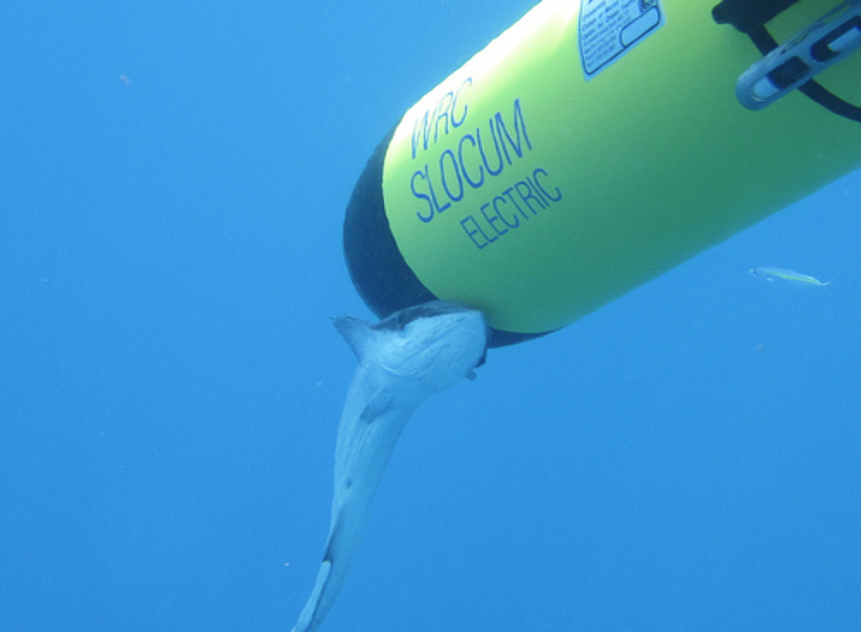

Slide 19
Common QA Checks
Stuck Value: Is the sensor operating and producing data?
Range: Does the data fall within expected minima and maxima?
Spike: Is a value realistic compared with surrounding data?

Slide 20
Spike Detection
Noise or meaningful observation?
Pass = not spike
–
[ P_{i} – P ] < Nσ
Fail = spike
Notes:
This is the approach used by QARTOD; N is left up to the individual researcher/operator. Spikes are replaced by the running average of data on either side of the spike.

Slide 21
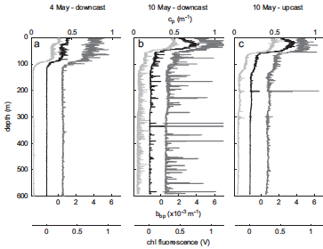
Deep Sea Research I, 58 (2011)

Slide 22
Common QA Checks
Stuck Value: Is the sensor operating and producing data?
Range: Does the data fall within expected minima and maxima?
Spike: Is a value realistic compared with surrounding data?
Gradient: Are values systematically changing with time in a way that cannot be explained by expected environmental variability?

Slide 23
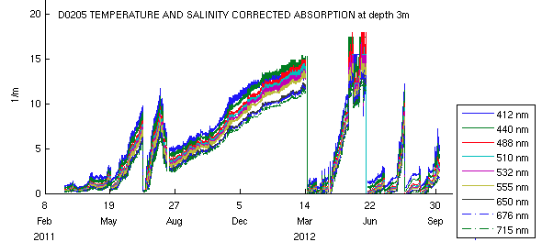
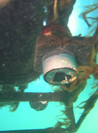
Temporal Gradients
Instrument Drift (frequent absolute & vicarious calibration)
Biofouling (frequent cleaning, multi-parameter comparison)
Roesler, C., Bowdoine College, ME

Slide 24
Common QA Checks
Stuck Value: Is the sensor operating and producing data?
Range: Does the data fall within expected minima and maxima?
Spike: Is a value realistic compared with surrounding data?
Gradient: Are values systematically changing with time in a way that cannot be explained by expected environmental variability?
Multi-Parameter Consistency: Are parameter magnitudes and variability reasonable compared with other coincident observations?

Slide 25
Multi-Parameter Consistency
Realistic magnitude relative to other parameters
e.g., a < c
Covariance between similar or related parameters
e.g., b (c-a) vs. b_{b}
Expected progression of magnitude
e.g., db_{b} / dλ ≤ 0

Slide 26
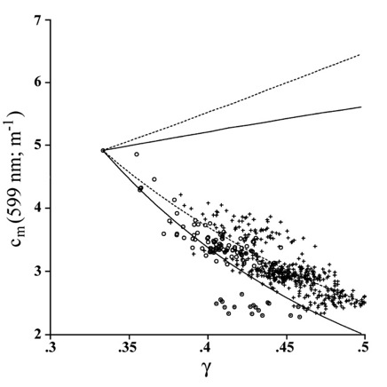
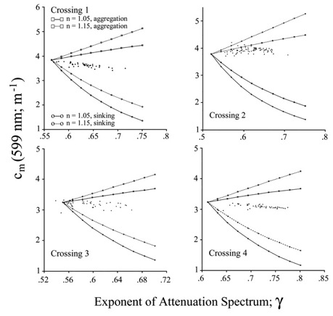
Tests of Closure
Observations Vs. Model
Benthic Nepheloid Layer
Connecticut River Plume
o, o,
: Nepheloid Layer
: Overlying water column
: n = 1.05
: n = 1.15
+
Aggregation
Dominated
c_{p} (599 nm; m⁻¹)
c_{p} (599 nm; m⁻¹)
Sinking
Dominated
γ
Ackleson, S. G. 2006. J. Geophys. Res., doi:10.1029/2005JC003214.

Slide 27
Automated QA/QC
Valid
Signal
Yes/No
Sensor
Flag
Raw Data
Sensor
Calibration
Range
Test
Yes/No
Flag
Spike
Test
Yes/No
Flag
Gradient
Test
Yes/No
Flag
Archive
(Seadas)

Slide 28
Data Quality Flags
Argo Program • British Oceanographic Data Centre • European Sea Level Service • Global Temperature and Salinity Profile Program • Ocean Data View Software • PANGAEA • Quality Assurance of Real-Time Oceanographic Data (QARTOD) • SeaDataNet • Swedish Meteorological and Hydrological Institute (SMHI) • WOCE CTD/Bottle Samples • World Ocean Database
http://library.oceanteacher.org
Data Record n : T, S, Z, ..., flag
0 - No QC was performed
1 - Good data
2 - Probably good data
3 - Probably bad data that are potentially correctable
4 - Bad data
5 - Value changed
8 - Interpolated value
9 - Missing value
e.g., Argo

Slide 29
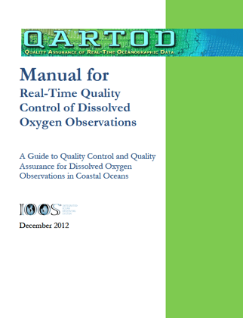
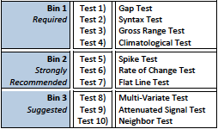
www.ioos.noaa.gov/qartod/

Slide 30
Joint workshop: April, 2013
- International Oceanographic Data and Information Exchange (IODE)
- Joint WMO-IOC Technical Commission for Oceanography and Marine Meteorology (JCOMM).
Suggested a 2-level quality flagging scheme.

Slide 31
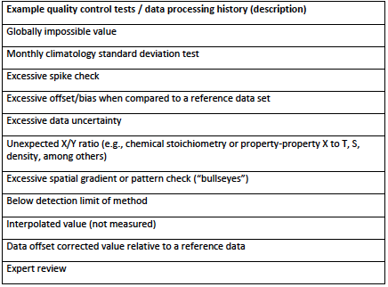
Primary Level:
1. Good
2. Not evaluated, not available, or Unknown
3. Questionable or suspect
4. Bad
5. Missing data
Secondary Level:
Compliments Primary Level by reporting the results of specific QA tests performed.
Can be sensor, project, or platform specific.
Notes:
This is the template use by QARTOD.

Slide 32
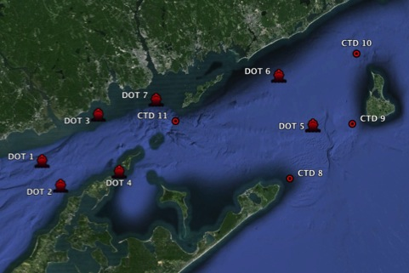
Example: Sediment Transport Study
Objective: Establish a better understanding of sediment transport in Eastern Long Island Sound and Block Island Sound in support of dredge spoil site decisions.
Ship Surveys:
a(l, z)
c(λ, z)
b_{b}(λ, z)
PSD (z)
CHLFL (z)
CDOMFL (z)
CTD (z)
SPM (z; bottle samples)
POC (z, bottle samples)
Bottom Sensors:
b_{b}(λ, t, bottom)
c (660 nm, t, bottom)
ADCP (t, bottom)
CTD (t, bottom)
Derived Parameters:
SPM (c, b_{b})
γ (c_{p} spectral slope)
a_{chl} (absorption line height)
POC (b_{b}/b)

Slide 33
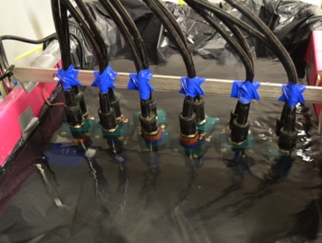
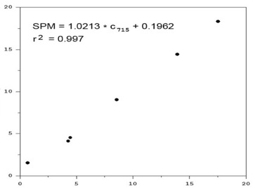
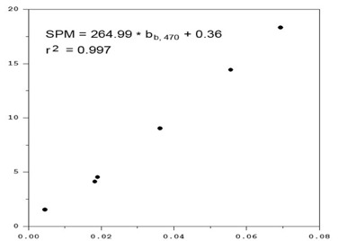
Suspended Particulate Matter Calibration
Calibration Chamber
SPM (mg m⁻³)
c (715 nm; m⁻¹)
SPM = <Parameter> A + B
*
Parameter A B r²
c₄₁₂
c₄₄₀
c₄₈₈
c₅₁₀
c₅₃₂
c₆₅₀
c₆₇₆
c₇₁₅
b_{b,470}
b_{b,532}*
b_{b,660}**
0.7275
0.7527
0.7991
0.8193
0.8421
0.8639
0.9582
0.9836
1.0213
264.99
189.32
112.22
0.4074
0.2220
0.0732
0.0056
0.0377
0.0609
0.1500
0.1649
0.1962
0.36
0.04
0.24
0.996
0.996
0.996
0.997
0.997
0..997
0.997
0.997
0.997
0.997
0.993
0.971
*
**
Saturated for SPM > 18.3 mg m⁻³
Saturated for SMP > 14.4 mg m⁻³
b_{b} (470 nm; m⁻¹)

Slide 34
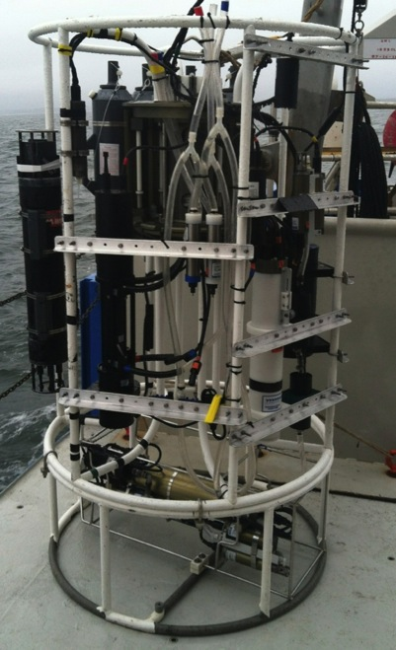
Niskin
Water
Samplers
Eco
Triplet
CTD
Sensors
Interrogation
Layer
(Δz = 0.25 m)
LIST 100
ac-9
Intake
Rosette
CTD

Slide 35
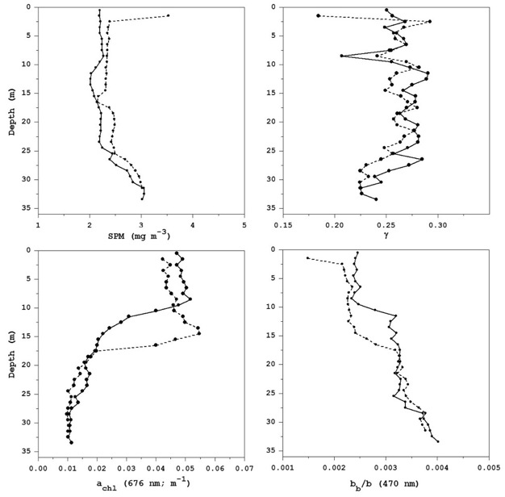
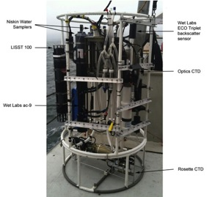
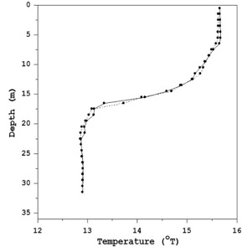
Do the data make physical sense?
Low SPM High
Large PSD Small
0.35
High POC Low

Slide 36
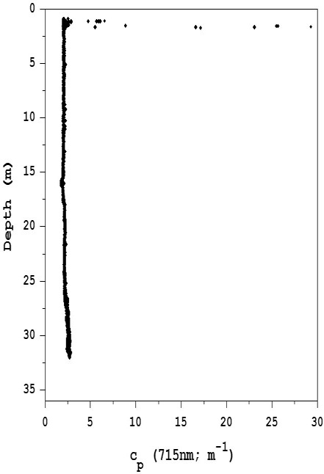
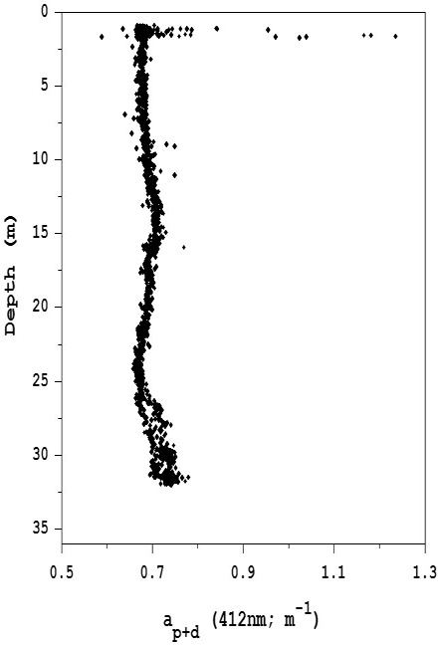
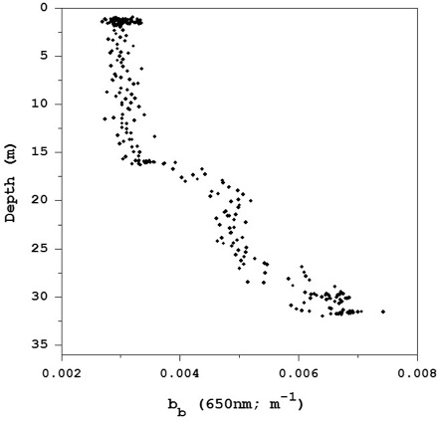
Consistent with
bubble contamination

Slide 37
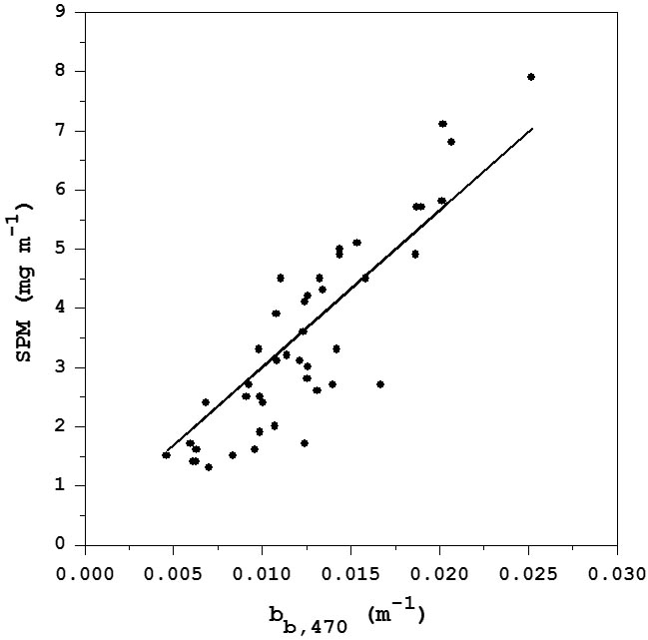
Measured Vs. Derived SPM
MAE = 0.67 mg m⁻³
Laboratory Calibration:
SPM = 264.99 b_{b,470} + 0.36

Slide 38
Quality Flags
For each record:
ac-9: time, depth, a412, a440, , QF1, QF2, QF3, QF4
•
•
•
QF1: Negative Value (0=pass; 1=fail)
QF2: Range
QF3: a < c
QF4: Spike
b_{b}-3: time, depth, b_{b}470, b_{b}532, , QF5, QF6, QF7, QF8
•
•
•
QF5: Negative Value
QF6: Range
QF7: bb470 > bb532 > bb650
QF8: Spike
•
•
•
For each data set:
Σ QF / N_{QF}
1 = pass if < 0.1
Q (Overall Quality) =
Σ QF / N_{QF}
2 = suspect if 0.1 < < 0.4
Σ QF / N_{QF}
3 = fail if > 0.4

Slide 39
Data Set Structure
"DOT – 1" : Station ID
12/06/2013 : Date
13:00 : Local Time
-43.5824 : Latitude
72.0548 : Longitude
43 : Water Depth
1 : Data Quality
'time (s)', 'depth (m)', 'a412', 'a440', . . . , 'QFn' : Data Headers
0.5, 1.2, 0.5032, 0.4938, . . . , 0 : Data Record 1
205.3, 40.2, 0.3103, 0.3087, . . . , 0 : Data Record n
•
•
•
All data distributed as either *.csv or NetCDF formatted files

Slide 40
Summary
Standardized data quality assurance and control procedures are necessary because your data has importance beyond the specific project for which it was collected.
QA/QC is an end-to-end process, starting with understanding the study environment and how instrument operate in it and ending with clear documentation of the data and the processing procedures applied.
- Instrument preparation
- Sensor deployment with knowledge of scales of variability
- Systematic application of data quality checks, ranging from instrument diagnostics to multi-parameter comparisons and tests of closure
- Annotation with quality flags
- Distribution with appropriate metadata

Slide 41
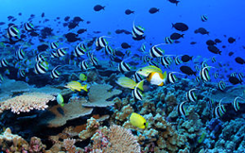
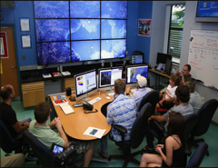
Future marine management strategies will require science-based, ecosystem approaches requiring accurate, climate quality observations.
1875
to
1890
Ecosystem
Based
Management
Now

Slide 42
