Slide 1
Landsat-8 for coastal and inland water applications
Quinten Vanhellemont
RBINS/DO Nature
Presented at Ocean Optics Summer Course
DMC, Maine 15 July 2015
http://odnature.naturalsciences.be/remsem/

Slide 2
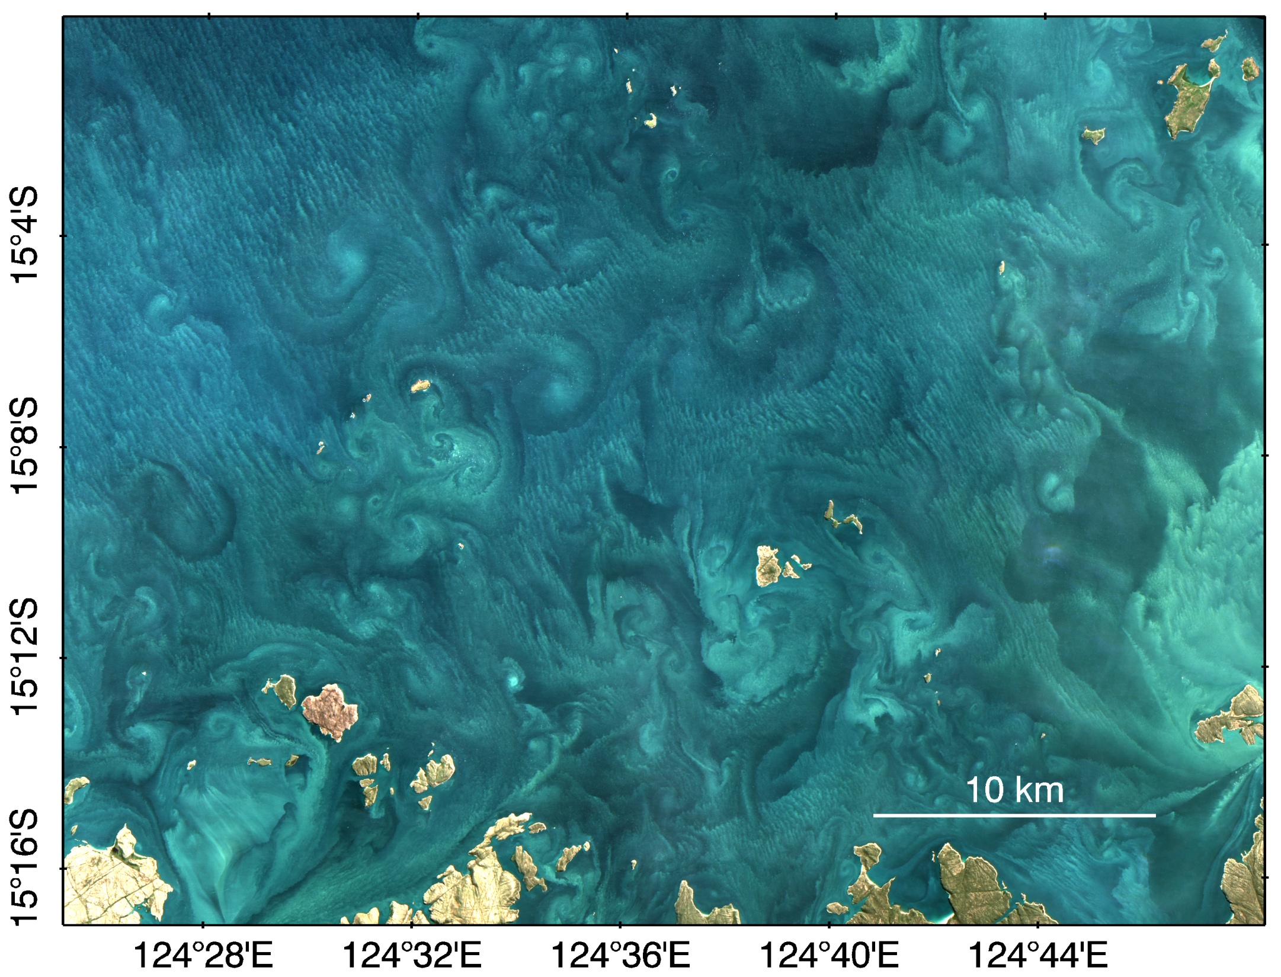
NW Australia – 2013-05-26
Landsat-8 / RBINS processing

Slide 3
Landsat-8 for coastal research
European directives (MSFD, WFD) require member states to monitor inland and coastal waters, with a focus on the first nautical mile
impossible with traditional ocean colour sensors
Landsat-8, launched in 2013, Sentinel-2 launched 23rd June 2015
data is FREE
L8/OLI-S2/MSI have a spatial resolution (30/10-60m) at which “new” processes can be observed:
small scale sediment transport
human impacts (shipping, offshore construction, dredging)
glint, waves, foam are spatially resolved (processing challenge)
EU-FP7/HIGHROC project is developing atmospheric correction algorithms and processing software for OLI/MSI
TW atmospheric correction needed for many coastal waters
operational processor: ACOLITE
collaboration with SeaDAS developers (OLI processing as of v7.2)

Slide 4
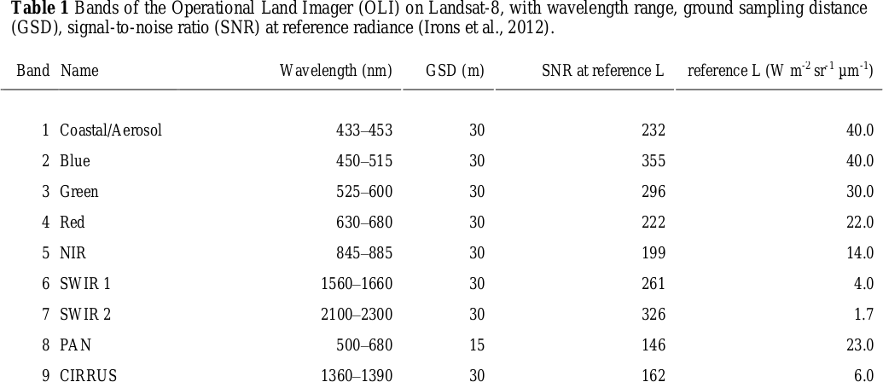
Landsat-8 / OLI
The Operational Land Imager (OLI) on Landsat-8 is a push-broom scanner with 8 relatively narrow 30 m bands and one 15 m panchromatic band.
OLI swath width is 185 km, and Landsat-8 is in a polar orbit with 16-day track repeat, with overlapping tracks at higher latitudes

Slide 5
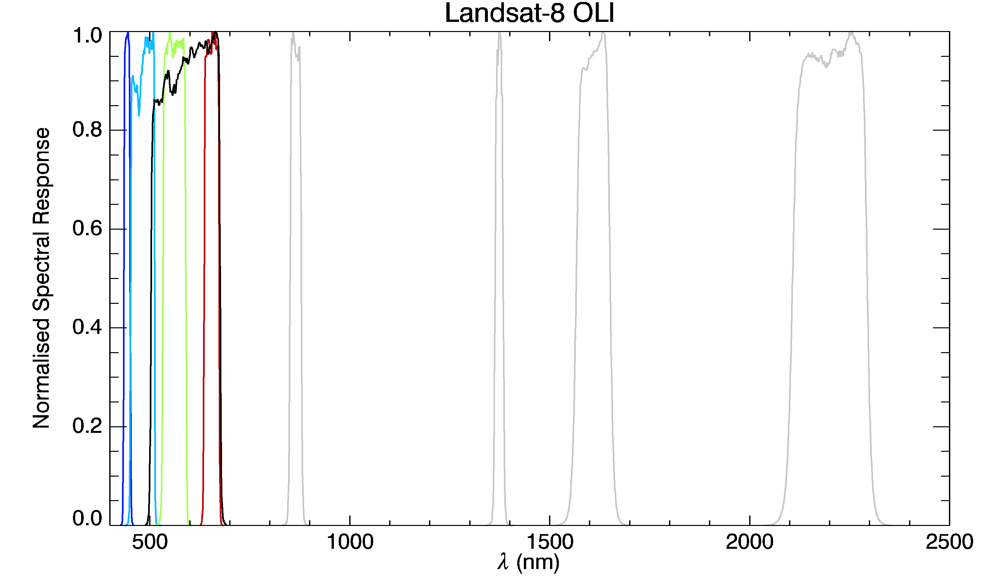
4 VIS bands
NIR
cirrus
SWIR1
SWIR2
PAN

Slide 6
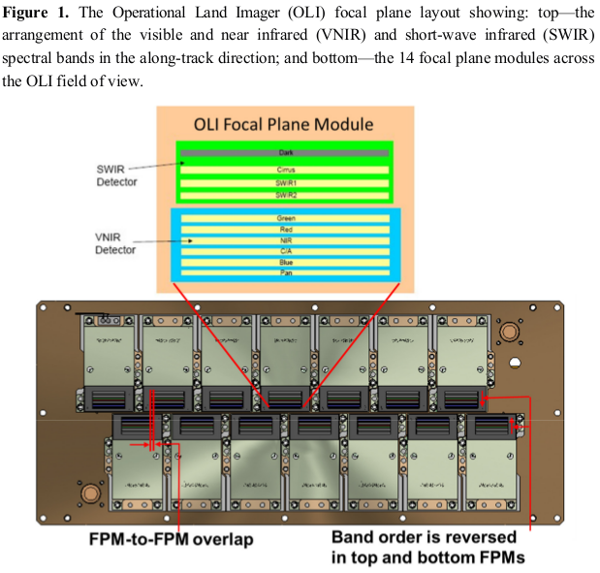
∼7000 detectors in 8 bands
(x4 in panchromatic band)
Storey, et al. 2014 "Landsat 8 Operational Land Imager on-orbit geometric calibration and performance." Remote Sensing

Slide 7
(USGS provides both calibrated${ L}_{TOA} and ρ_{TOA}$)
Top of Atmosphere Radiance (W m⁻² sr⁻¹ μm⁻¹)
$$ρ_{TOA}=\frac{π⋅L_{TOA}⋅d^{2}}{F_{0}⋅cosθ_{0}}$$
Top Of Atmosphere Reflectance (dimensionless)
= L_{TOA} normalised to extraterrestrial solar irradiance

Slide 8
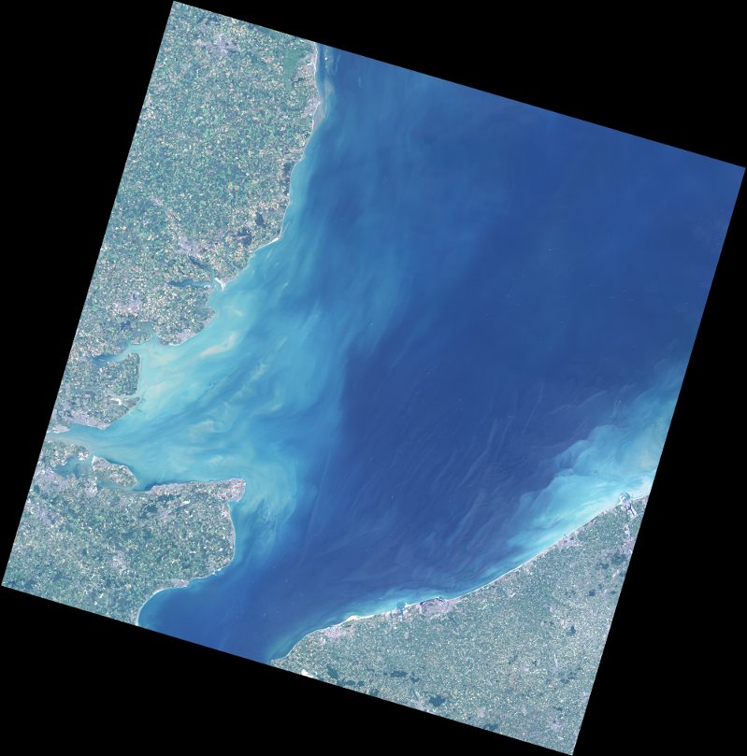
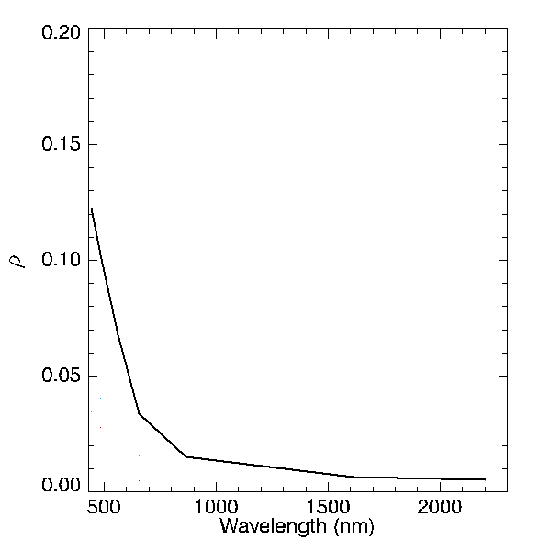
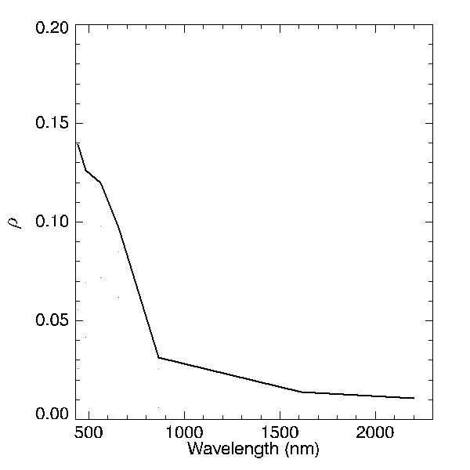
Landsat-8/OLI
2015-06-30 – TOA
RGB (655/561/483)
clear(ish)
$$ρ_{TOA}$$
bands 1-7
UK
Thames Estuary
turbid
$$ρ_{TOA}$$
BE
Zeebrugge
∼185 km
FR

Slide 9
(USGS provides both calibrated${ L}_{TOA} and ρ_{TOA}$)
Top of Atmosphere Radiance (W m⁻² sr⁻¹ μm⁻¹)
$$ρ_{TOA}=\frac{π⋅L_{TOA}⋅d^{2}}{F_{0}⋅cosθ_{0}}$$
Top Of Atmosphere Reflectance (dimensionless)
= L_{TOA} normalised to extraterrestrial solar irradiance
$ρ_{TOA}=ρ_{a}+ρ_{r}+{t⋅ρ}_{f}+{T⋅ ρ}_{g}+t⋅ρ_{w}^{0+}$
aerosol
Rayleigh
foam
glint
water

Slide 10
Atmospheric correction: simplified
Rayleigh reflectance:
air molecules, ∼λ⁻⁴
LUT + geometry
(atm. pressure)
Top Of Atmosphere
water-leaving radiance
reflectance or
marine reflectance
$ρ_{TOA}=ρ_{a}+ρ_{r}+t⋅ρ_{w}^{0+}$
two-way diffuse
atmospheric transmittance
Aerosol reflectance:
particles in the atmosphere
variable in space, time, and composition
Rayleigh-corrected reflectance
$ρ_{c}=ρ_{TOA}−ρ_{r}=ρ_{a}+t⋅ρ_{w}^{0+}$

Slide 11
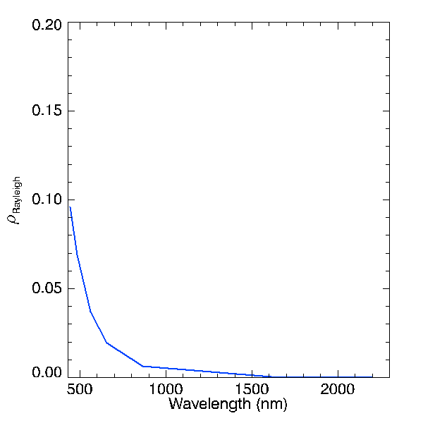
clear(ish)
$$ρ_{TOA}$$
Rayleigh reflectance ∼λ⁻⁴
θ sun and sensor, rel. φ
precomputed LUT
turbid
$$ρ_{TOA}$$

Slide 12
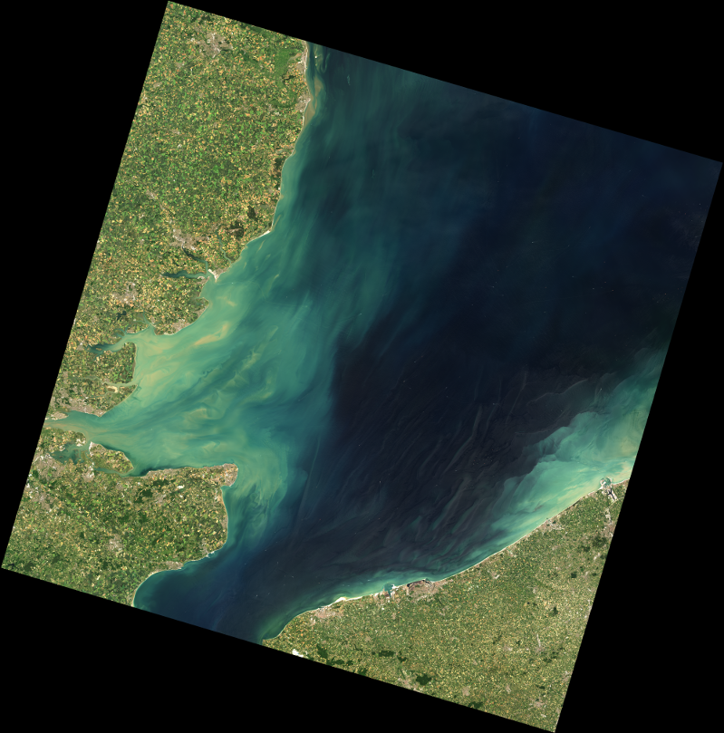
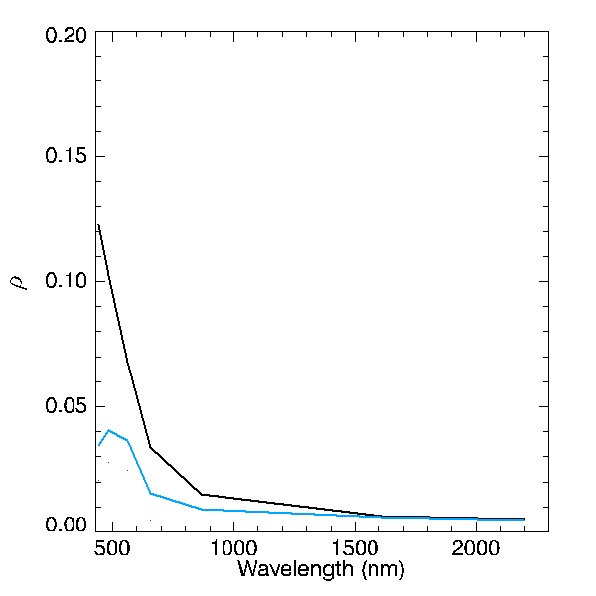
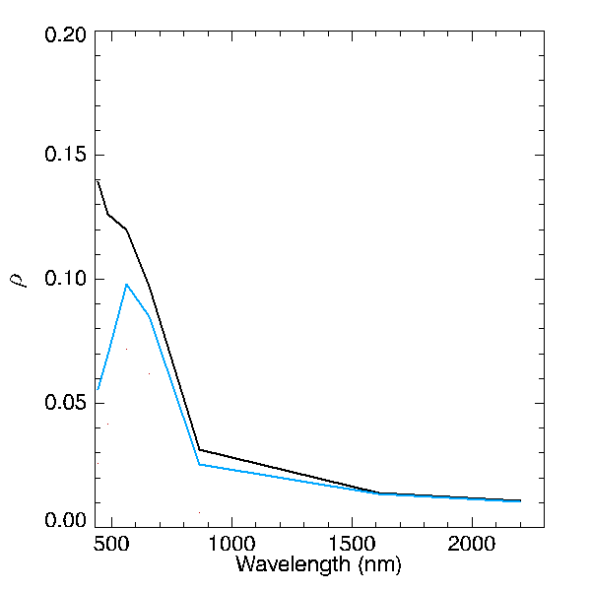
Landsat-8/OLI
2015-06-30 – RCO
RGB (655/561/483)
clear(ish)
$$ρ_{TOA}$$
$$ρ_{c}$$
UK
Thames Estuary
turbid
$$ρ_{TOA}$$
$$ρ_{c}$$
BE
Zeebrugge
∼185 km
FR

Slide 13
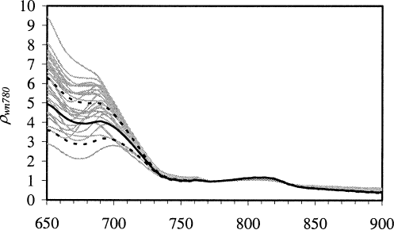
Aerosol correction?
$ρ_{c}=ρ_{TOA}−ρ_{r}=ρ_{a}+t⋅ρ_{w}^{0+}$
$ρ_{c}=ρ_{a}$
where
$$ρ_{w}^{0+}=0$$
(Ruddick et al. 2006, Similarity Spectrum)
red + NIR bands (4,5)
$$ρ_{c}^{4}=ρ_{a}^{4}+t^{4}ρ_{w}^{4}$$
$$ρ_{c}^{5}=ρ_{a}^{5}+t^{5}ρ_{w}^{5}$$
clear waters
$\frac{ρ_{c}^{4}}{ρ_{c}^{5}}=\frac{ρ_{a}^{4}}{ρ_{a}^{5}}$= $ε^{4,5}$
assume fixed aerosol type over (sub)scene
$\frac{ρ_{w}^{4}}{ρ_{w}^{5}}=8.7$= α
fixed ratio between red+NIR water reflectance
$$ρ_{w}^{4}=\frac{α{(ρ}_{c}^{4}−ε^{4,5}ρ_{c}^{5})}{t^{5}(γα−ε)}$$
(see algebra in Ruddick et al., 2000)

Slide 14
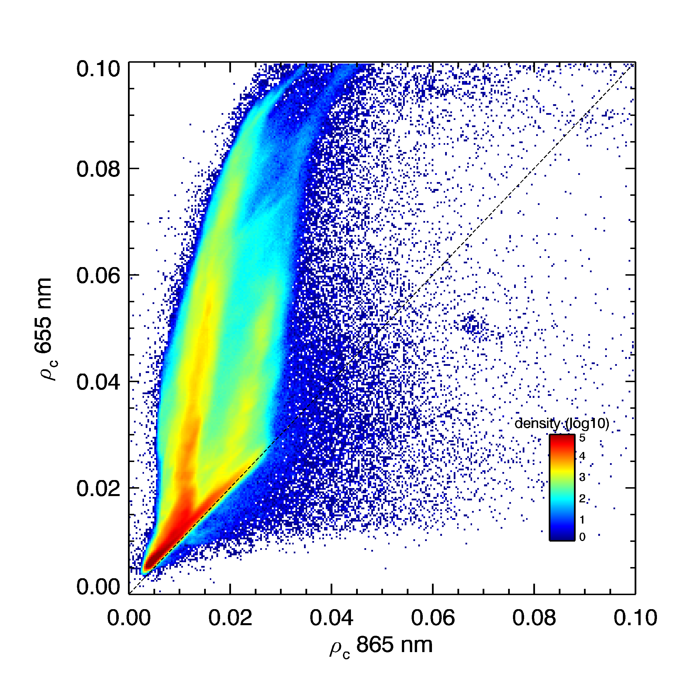
Rayleigh-corrected reflectance in red and NIR bands
turbid water (+aerosol)
clear water + aerosol

Slide 15
Aerosol correction?
$ρ_{c}=ρ_{TOA}−ρ_{r}=ρ_{a}+t⋅ρ_{w}^{0+}$
$ρ_{c}=ρ_{a}$
where
$$ρ_{w}^{0+}=0$$
NIR + SWIR bands (5,6/5,7)
SWIR + SWIR bands (6,7)
$$ρ_{c}^{5}=ρ_{a}^{5}+t^{5}ρ_{w}^{5}$$
$ρ_{c}^{6}=ρ_{a}^{6}$ ($ρ_{w}^{6}=0$)
$ρ_{c}^{L}=ρ_{a}^{L}$ ($ρ_{w}^{L}=0$)
$ρ_{c}^{7}=ρ_{a}^{7}$ ($ρ_{w}^{7}=0$)
clear waters
$\frac{ρ_{c}^{5}}{ρ_{c}^{L}}=\frac{ρ_{a}^{5}}{ρ_{a}^{L}}$= $ε^{5,L}$
$\frac{ρ_{c}^{6}}{ρ_{c}^{7}}=\frac{ρ_{a}^{6}}{ρ_{a}^{7}}$= $ε^{6,7}$
assume
constant
per pixel
or fixed
$ρ_{w}^{5}=\frac{1}{t^{5}}(ρ_{c}^{5}−ε^{5,L}ρ_{c}^{L})$
$ρ_{w}^{5}=\frac{1}{t^{5}}(ρ_{c}^{5}−ε^{5,7}ρ_{c}^{7})$
No assumption on water reflectances! (other than $ρ_{w}^{}$ SWIR = 0)

Slide 16
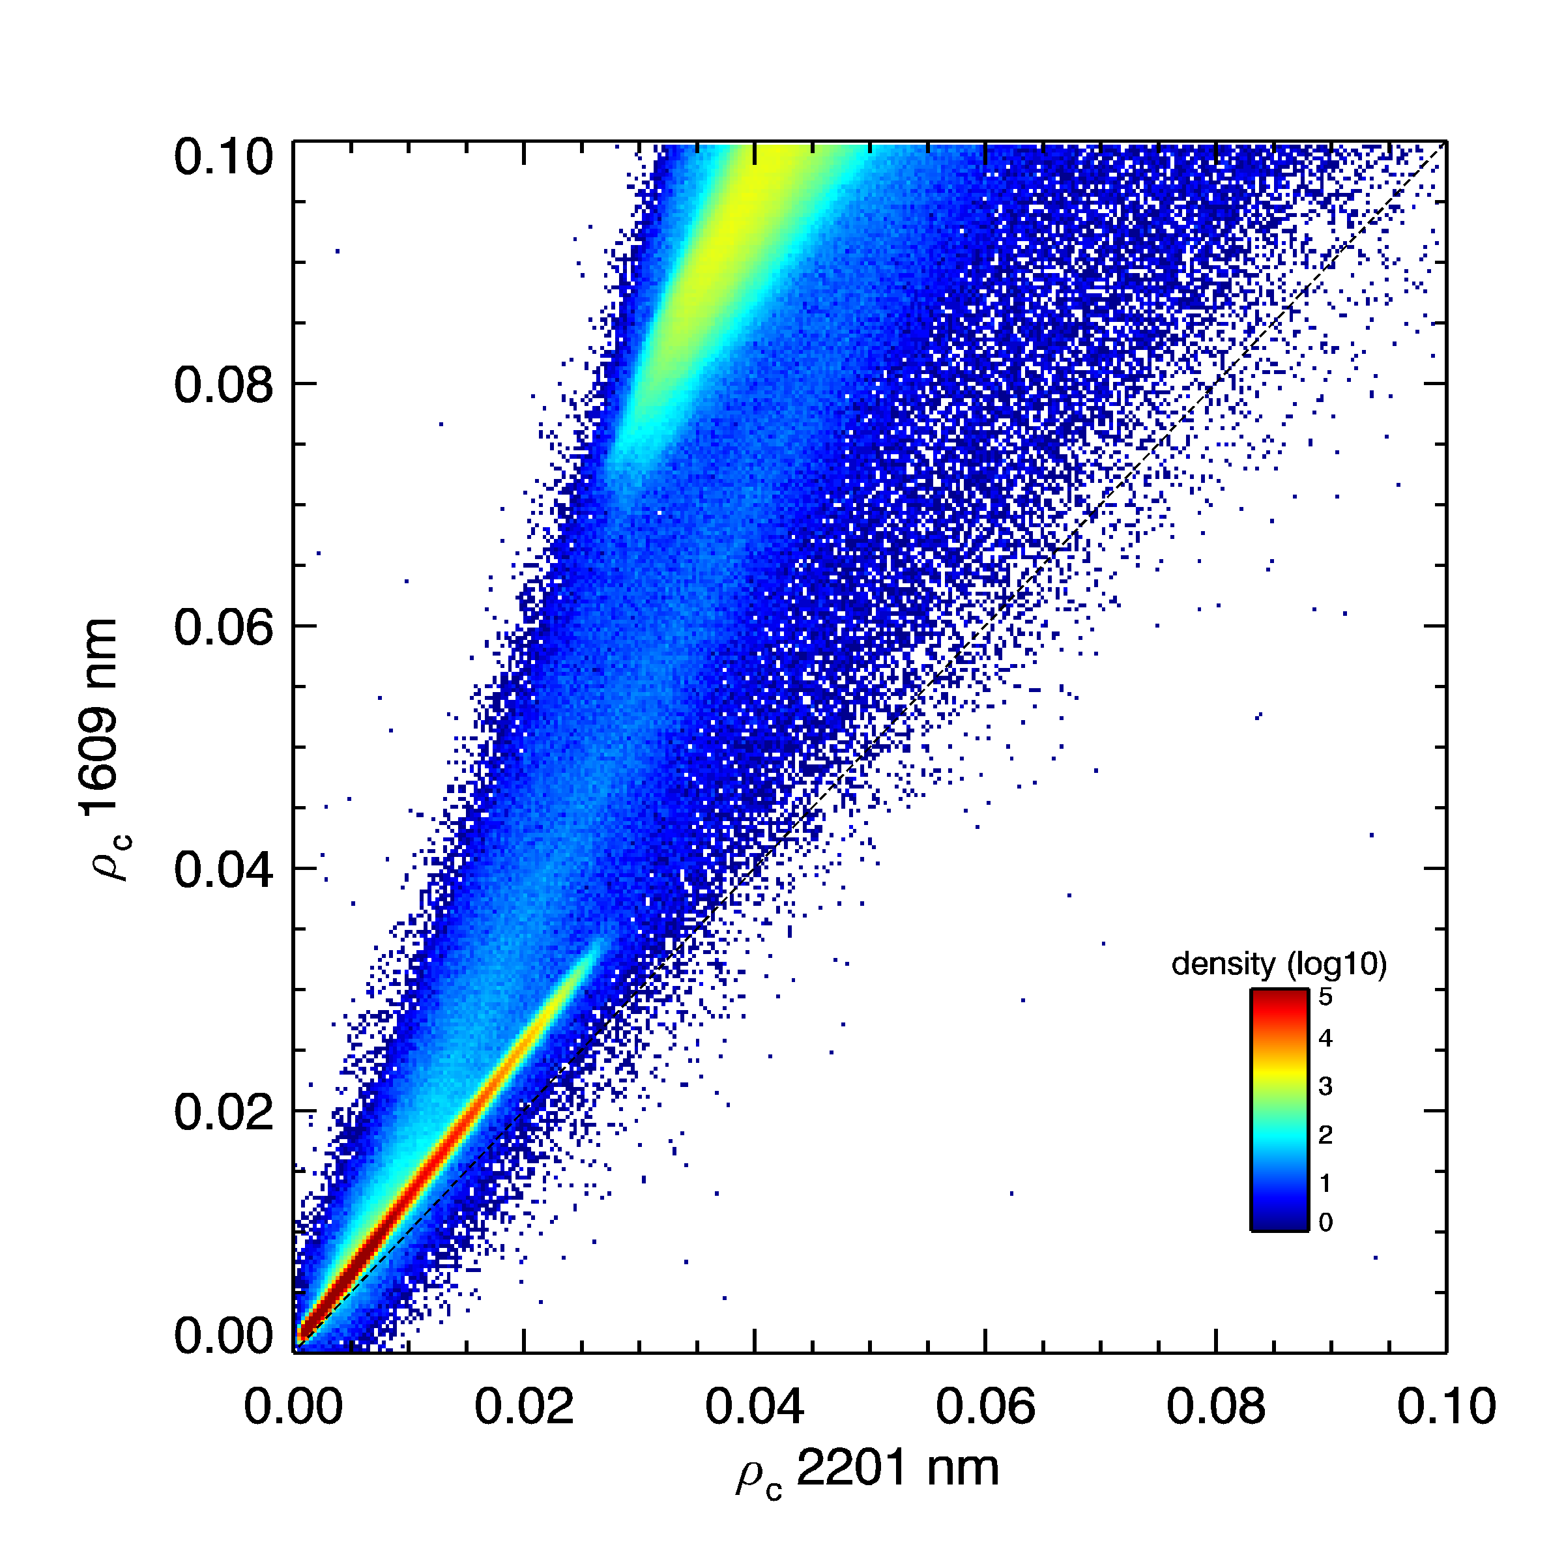
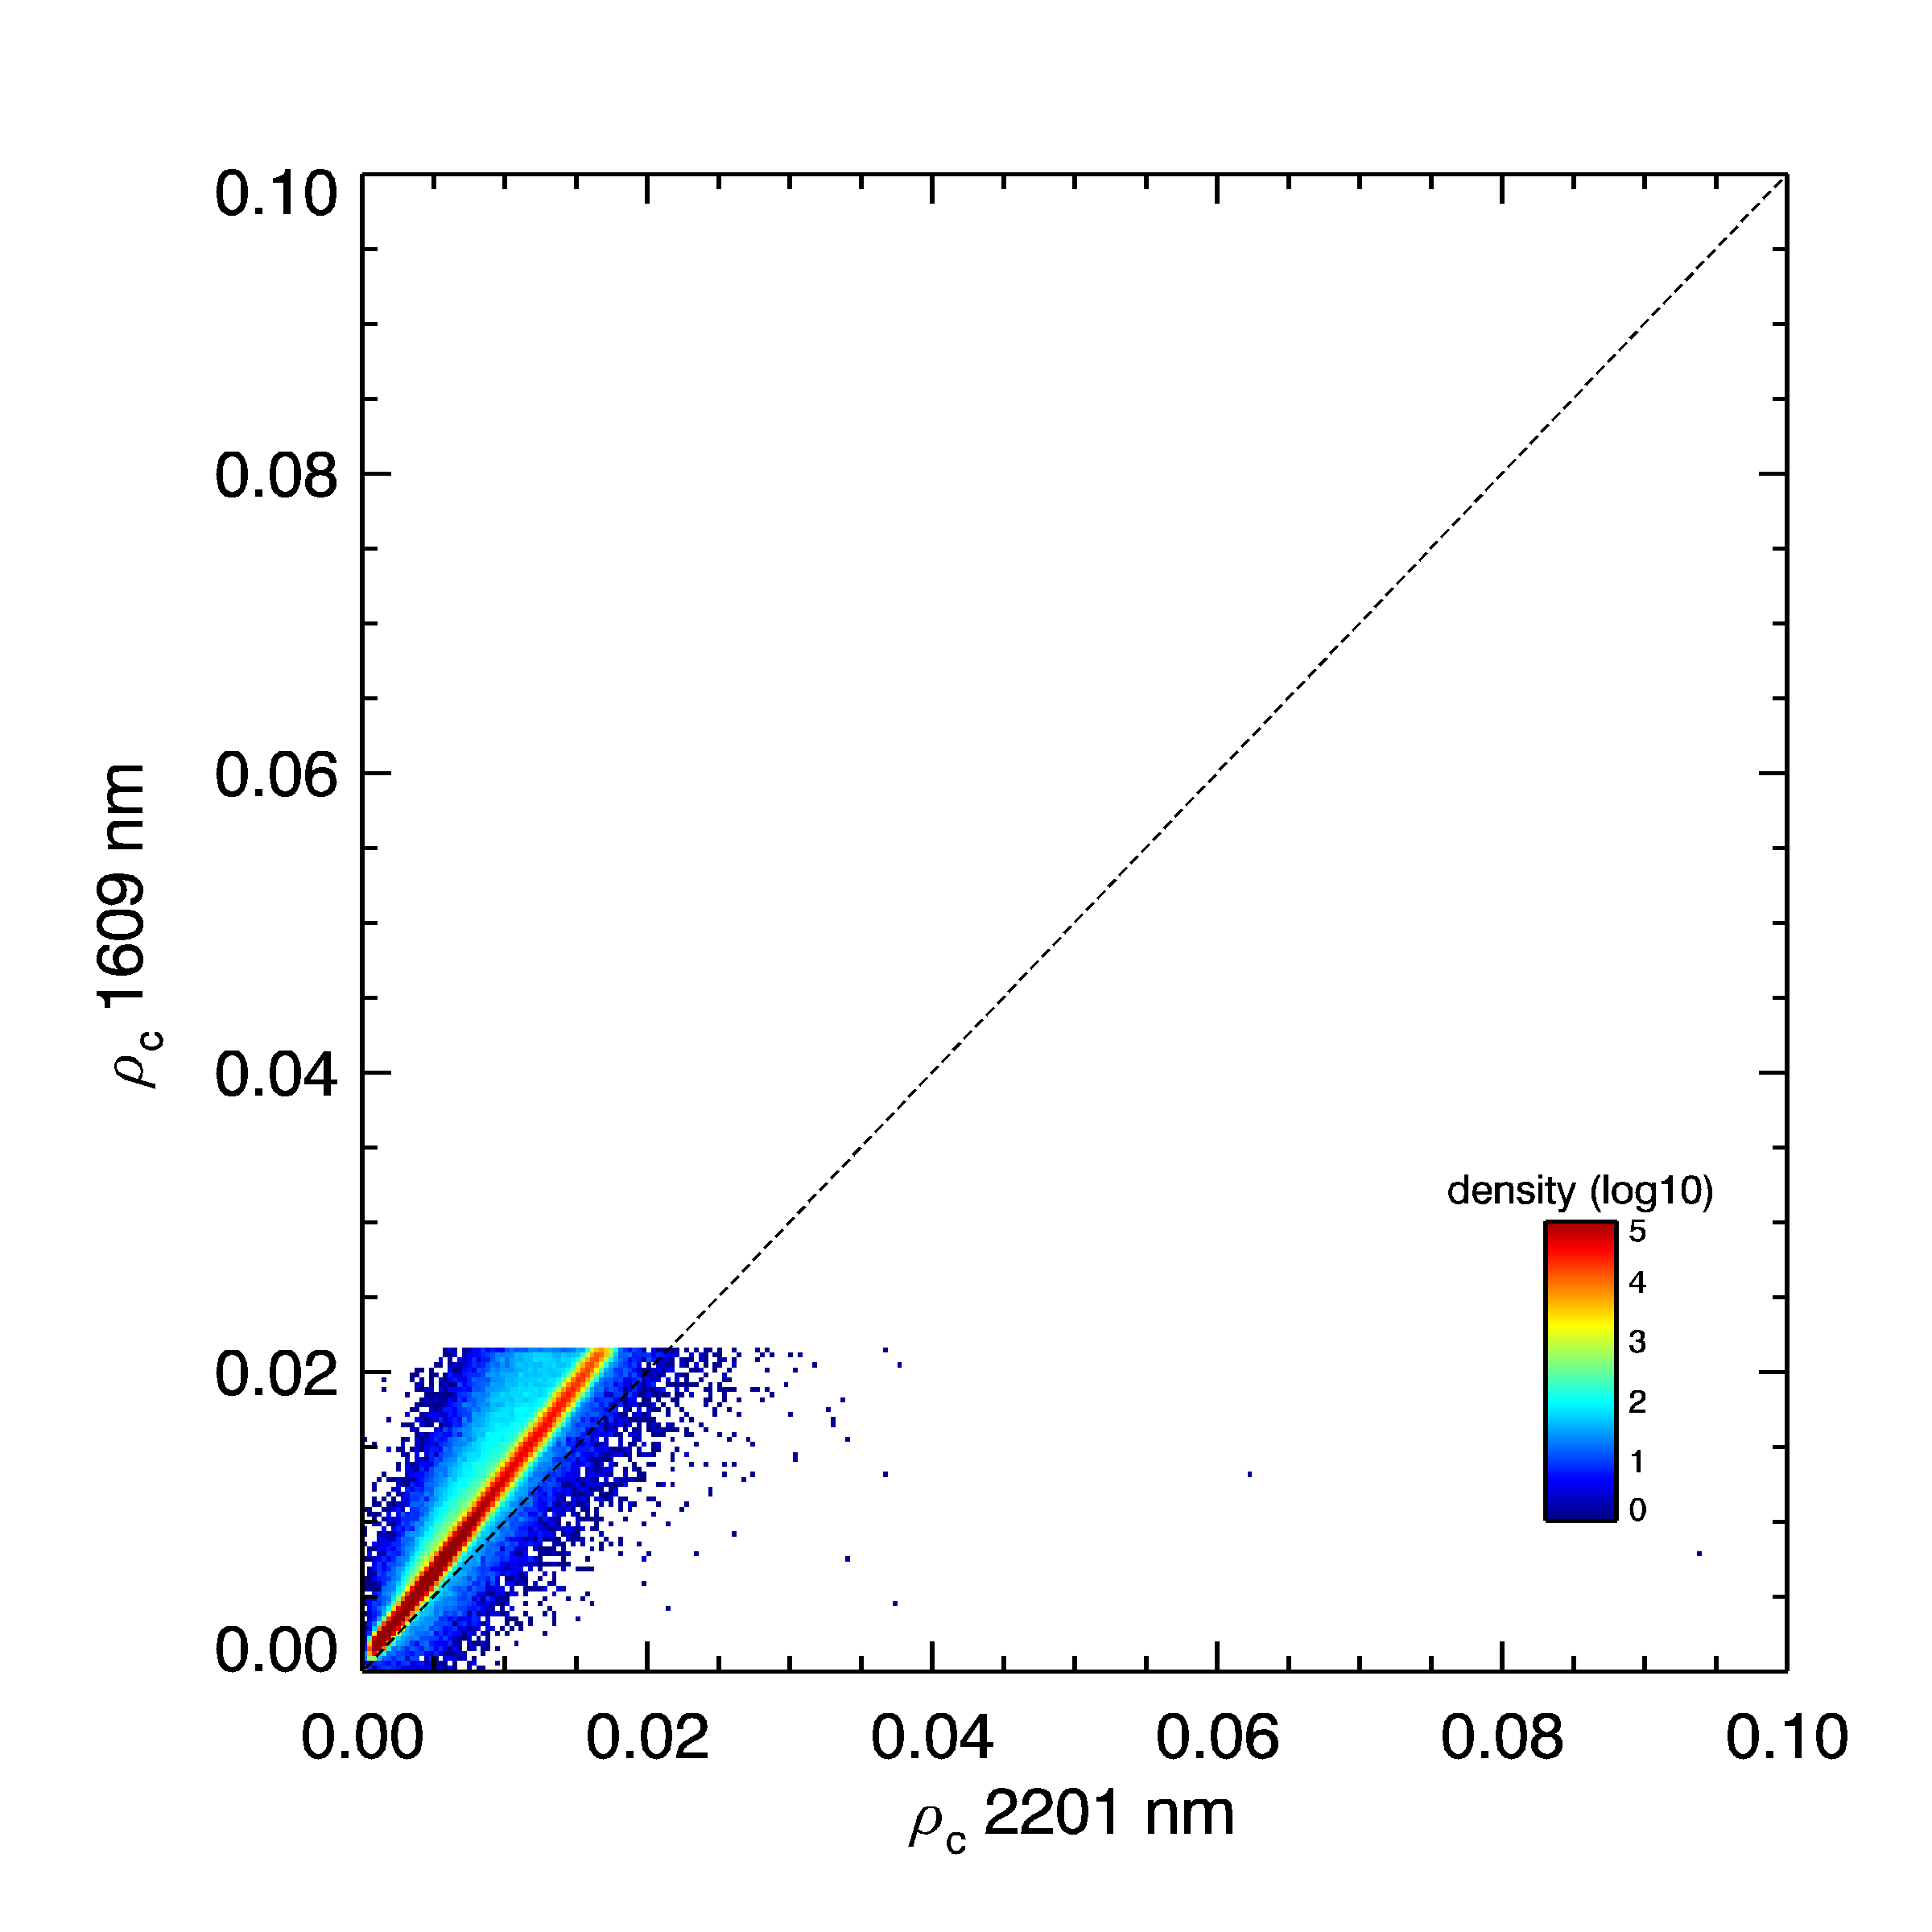
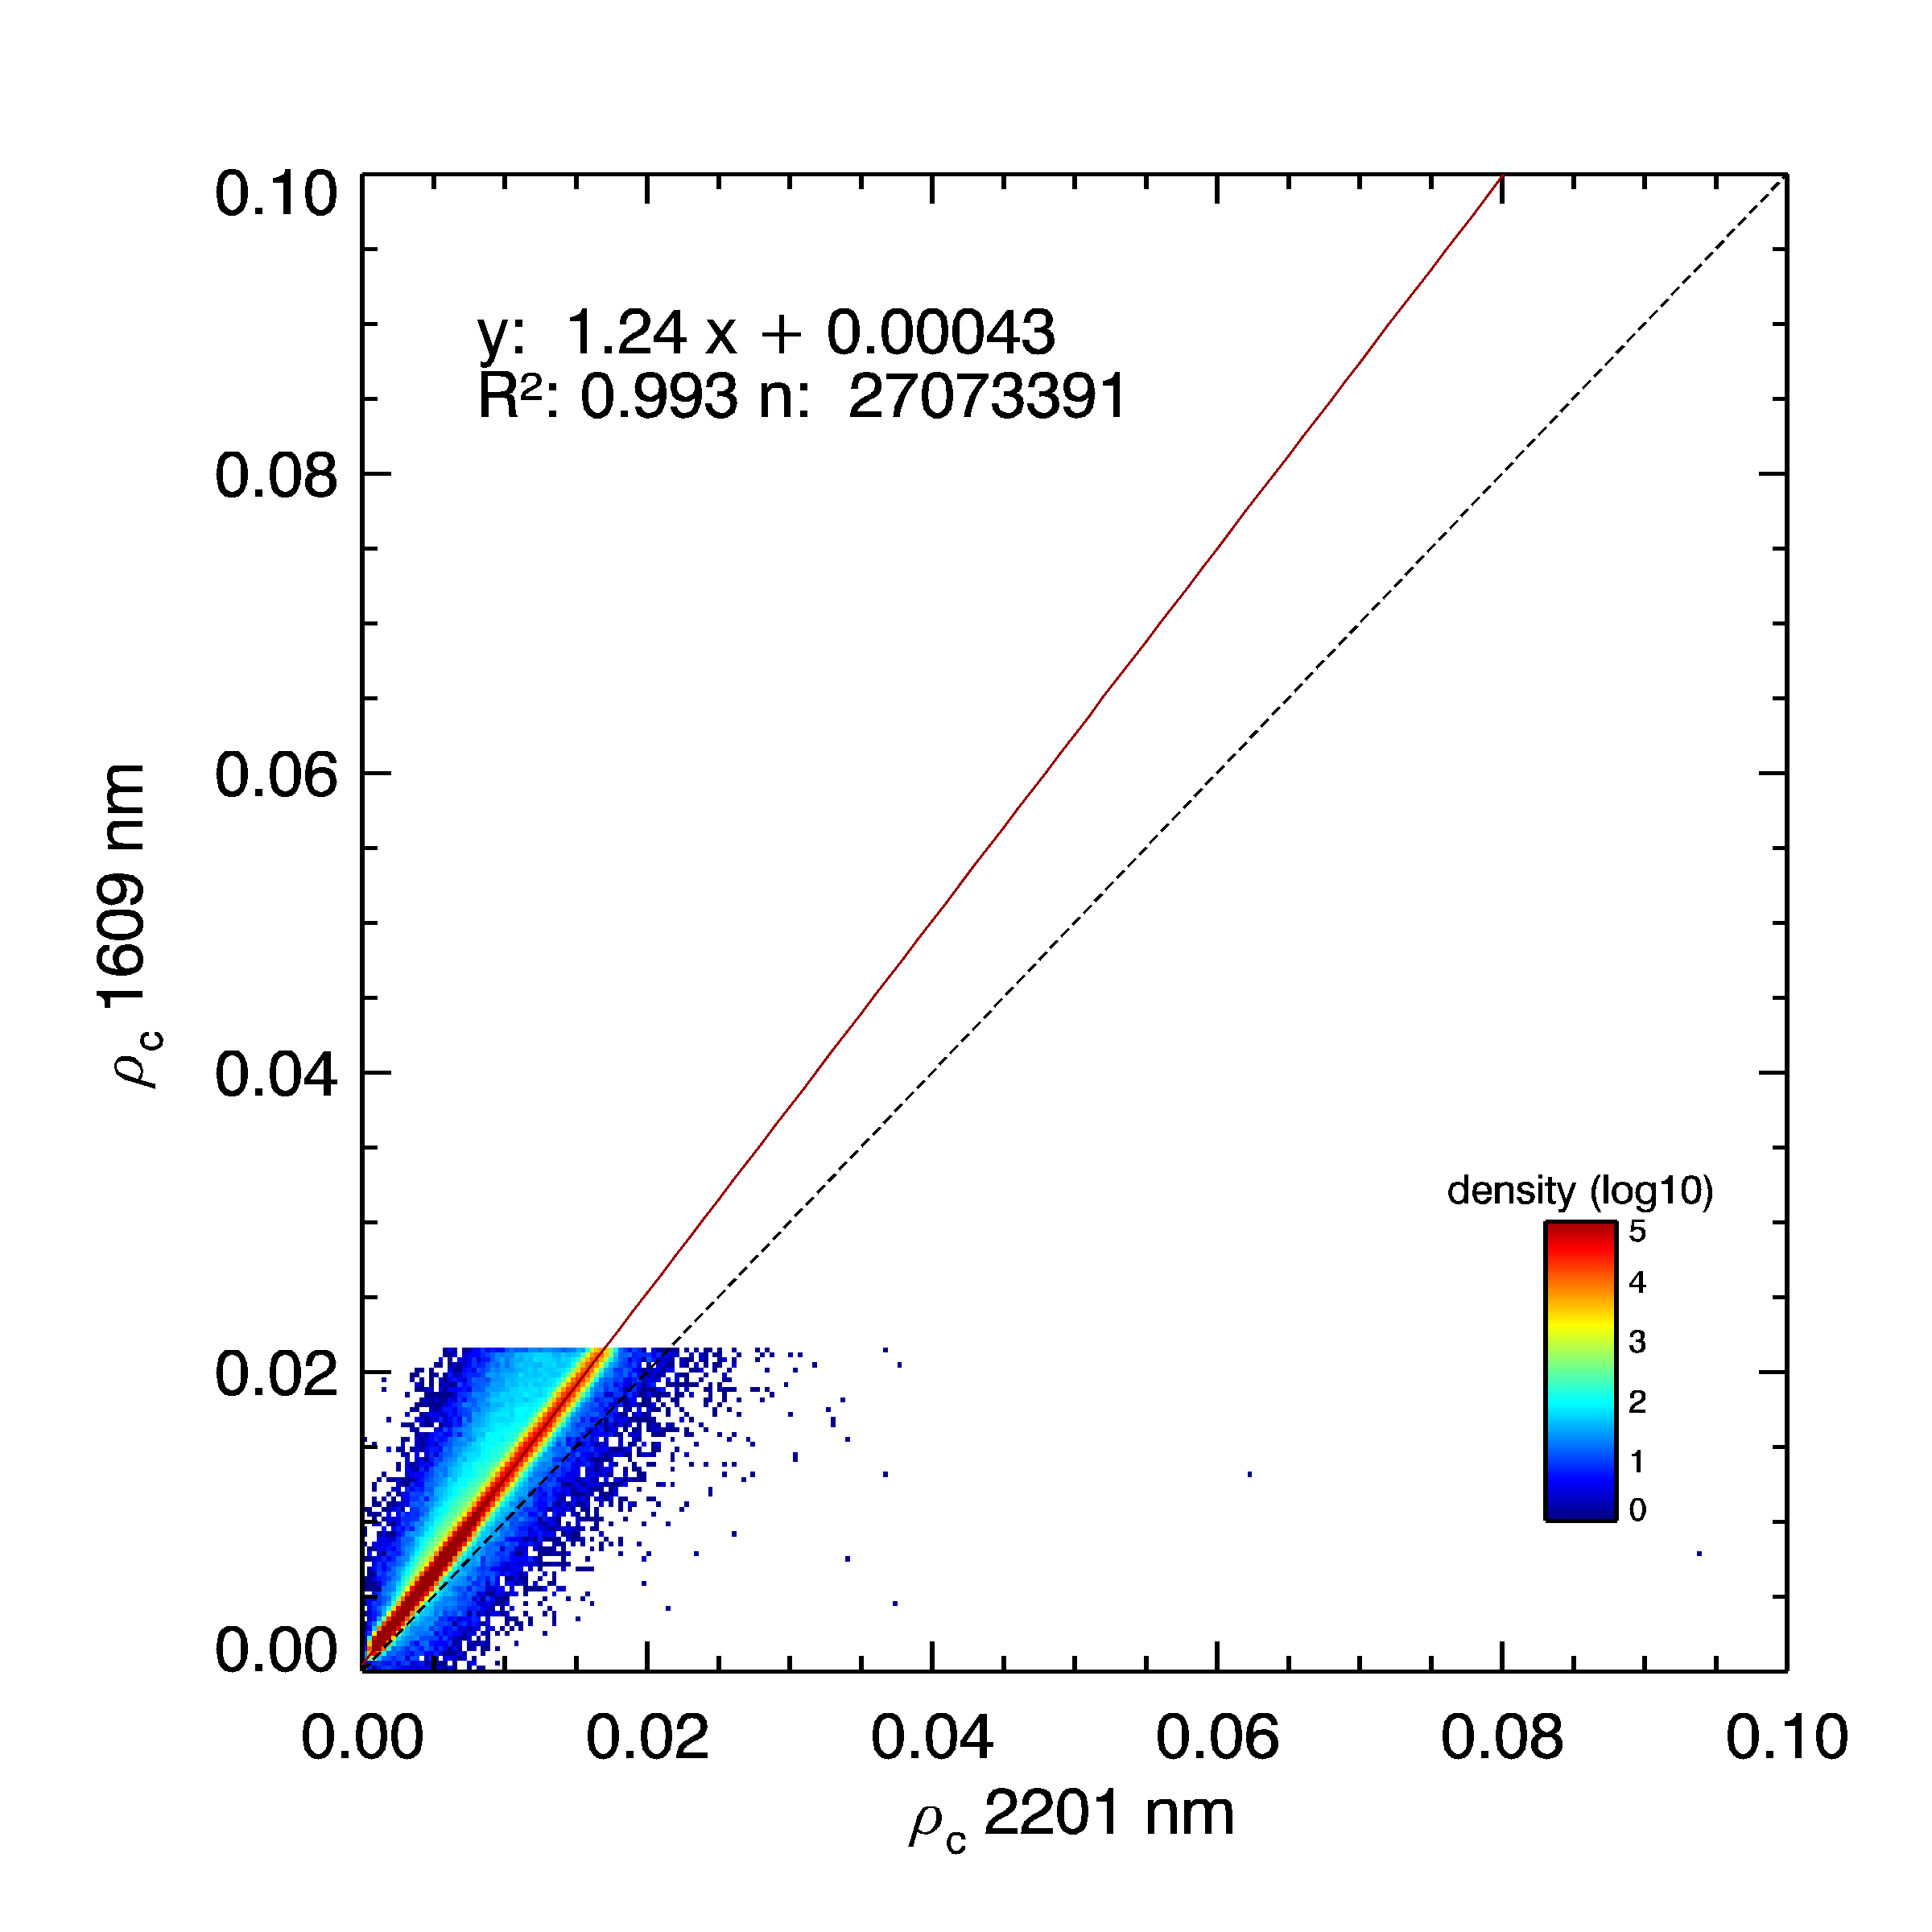
Rayleigh-corrected reflectance in SWIR bands
all water pixels + aerosol
“non water” mask
>2.15% at 1,6µm

Slide 17
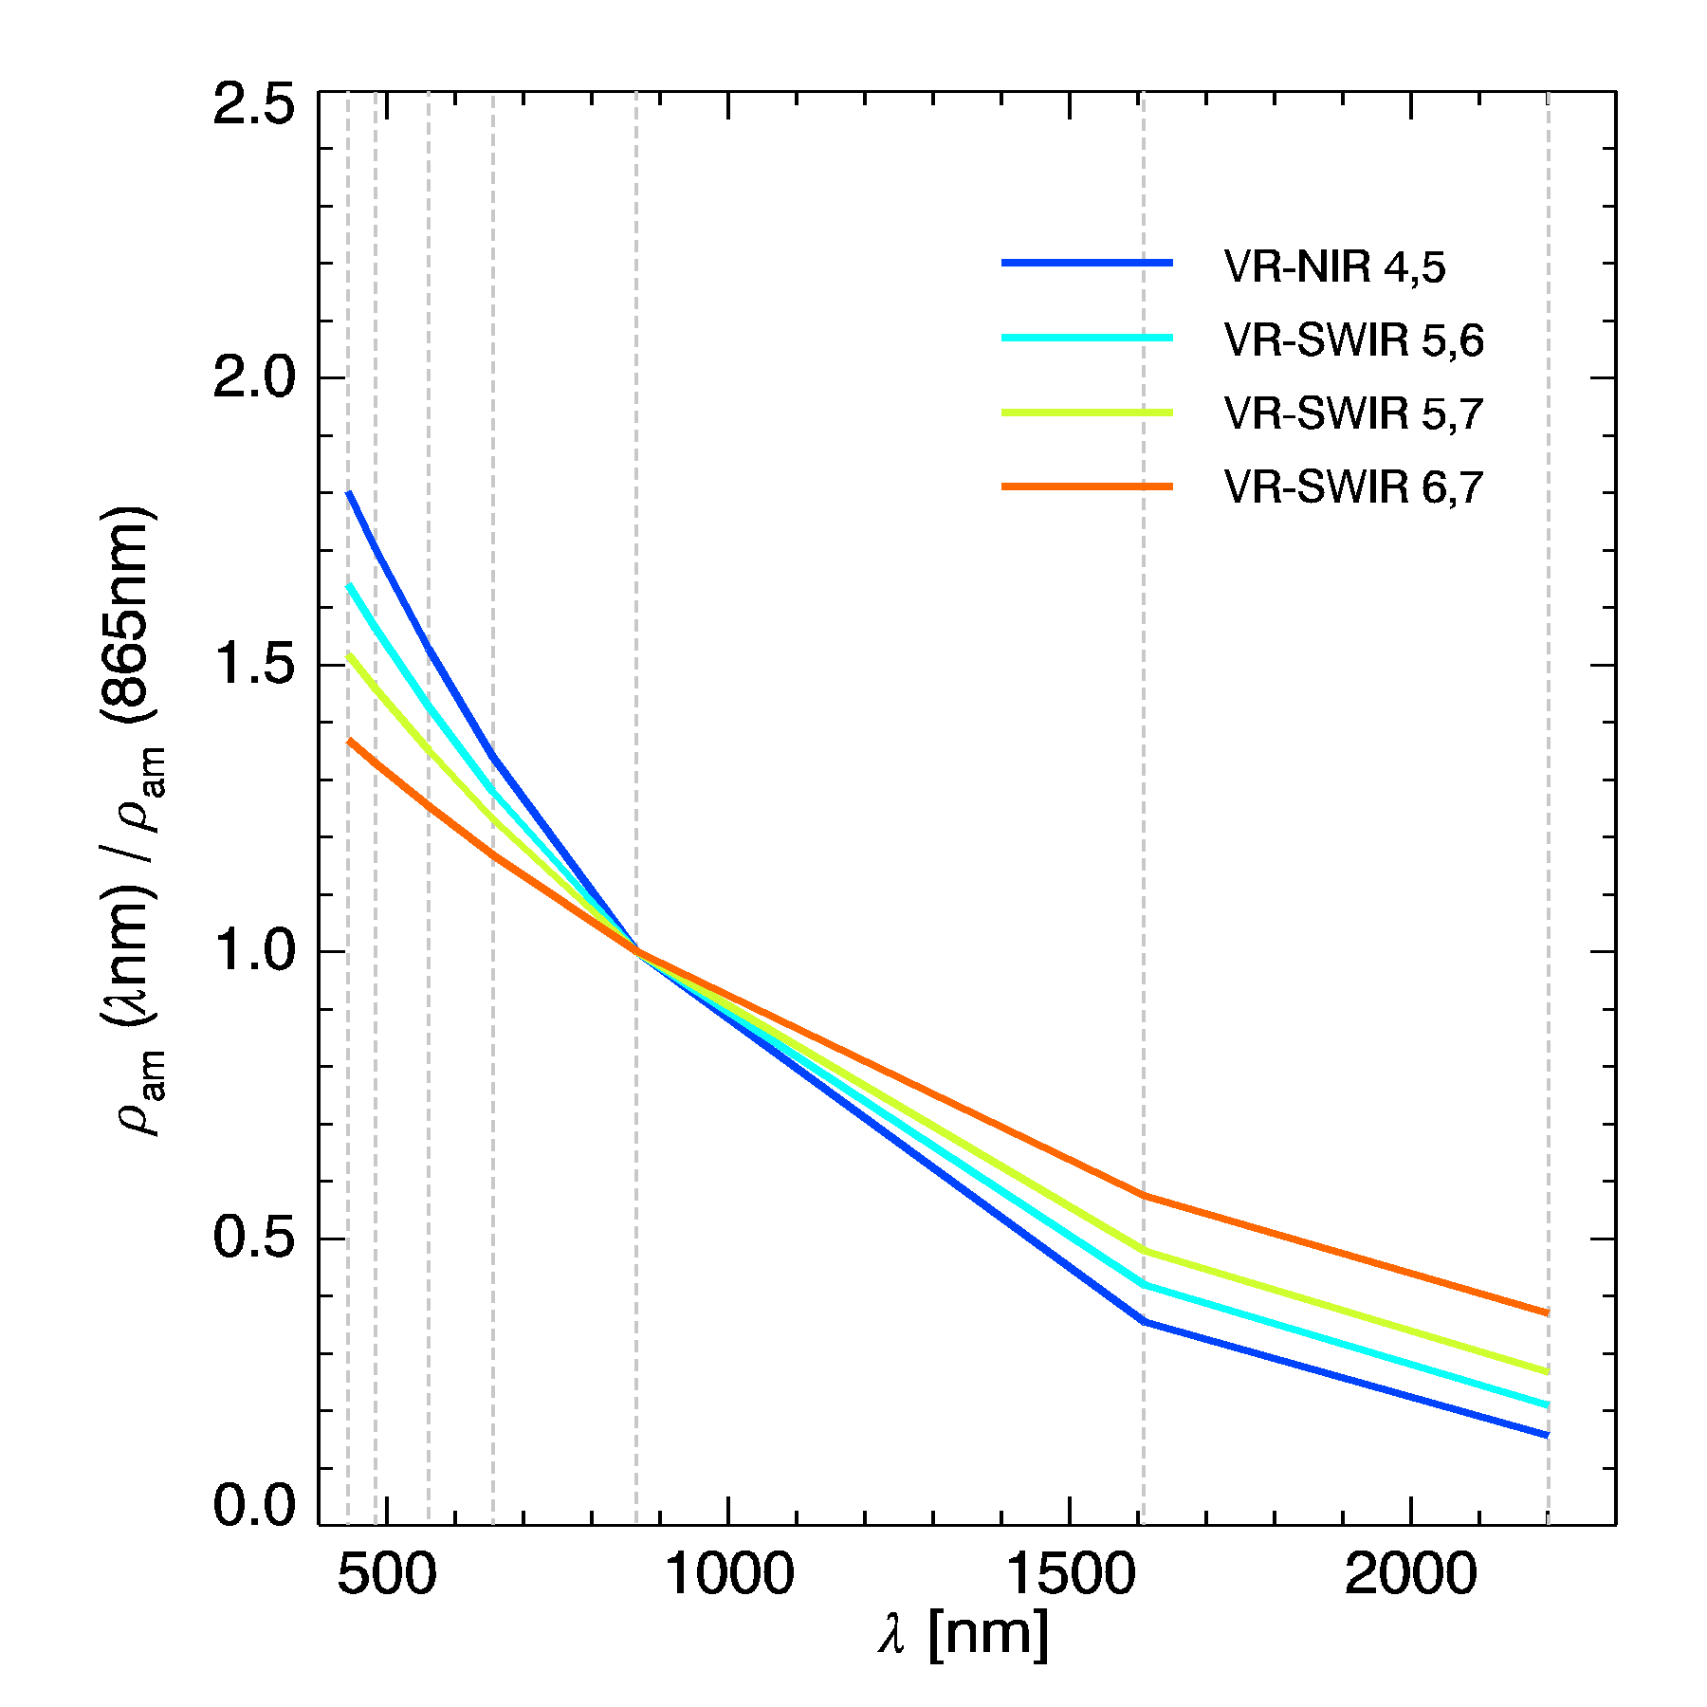
Aerosol extrapolation from long wavelengths (NIR/SWIR) to visible bands
SeaDAS: uses tabulated aerosol models, ACOLITE: uses exponential extrapolation
$$ε^{i,L}={\left(ε^{S,L}\right)}^{δi}$$
$$δi=\frac{λ_{L}−λ_{i}}{λ_{L}−λ_{S}}$$
$$ρ_{w}^{i} = \frac{1}{t^{i}}\left(ρ_{c}^{i}{−ε}^{i,L}{⋅ρ}_{am}^{L}\right)$$
i: target band
S: shortest band in aerosol correction
(655, 865, or 1609 nm)
L: longest band in aerosol correction
(865, 1609, or 2201 nm)

Slide 18
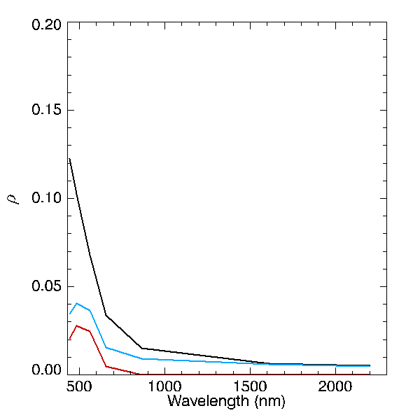
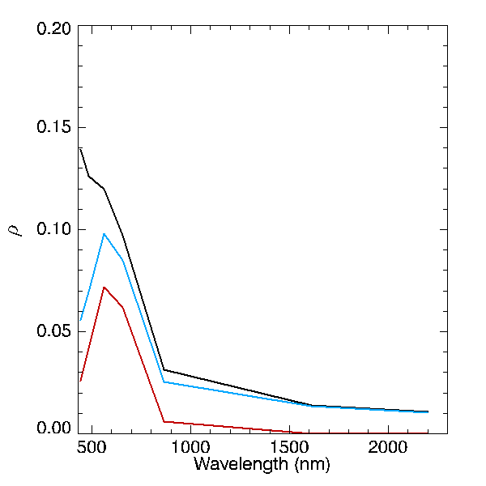
Landsat-8/OLI
2015-06-30 – RCO
RGB (655/561/483)
clear(ish)
$$ρ_{TOA}$$
$$ρ_{c}$$
$$ρ_{w}$$
UK
Thames Estuary
turbid
$$ρ_{TOA}$$
$$ρ_{c}$$
$$ρ_{w}$$
BE
Zeebrugge
∼185 km
FR

Slide 19
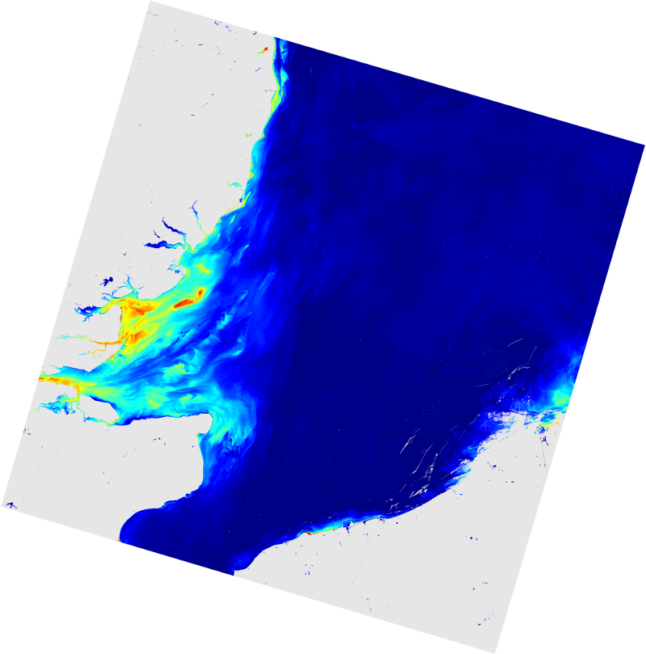
London Array
ρ_{w} < 0 ☹
surface effects (glint)
Landsat-8/OLI
2015-06-30
∼185 km

Slide 20
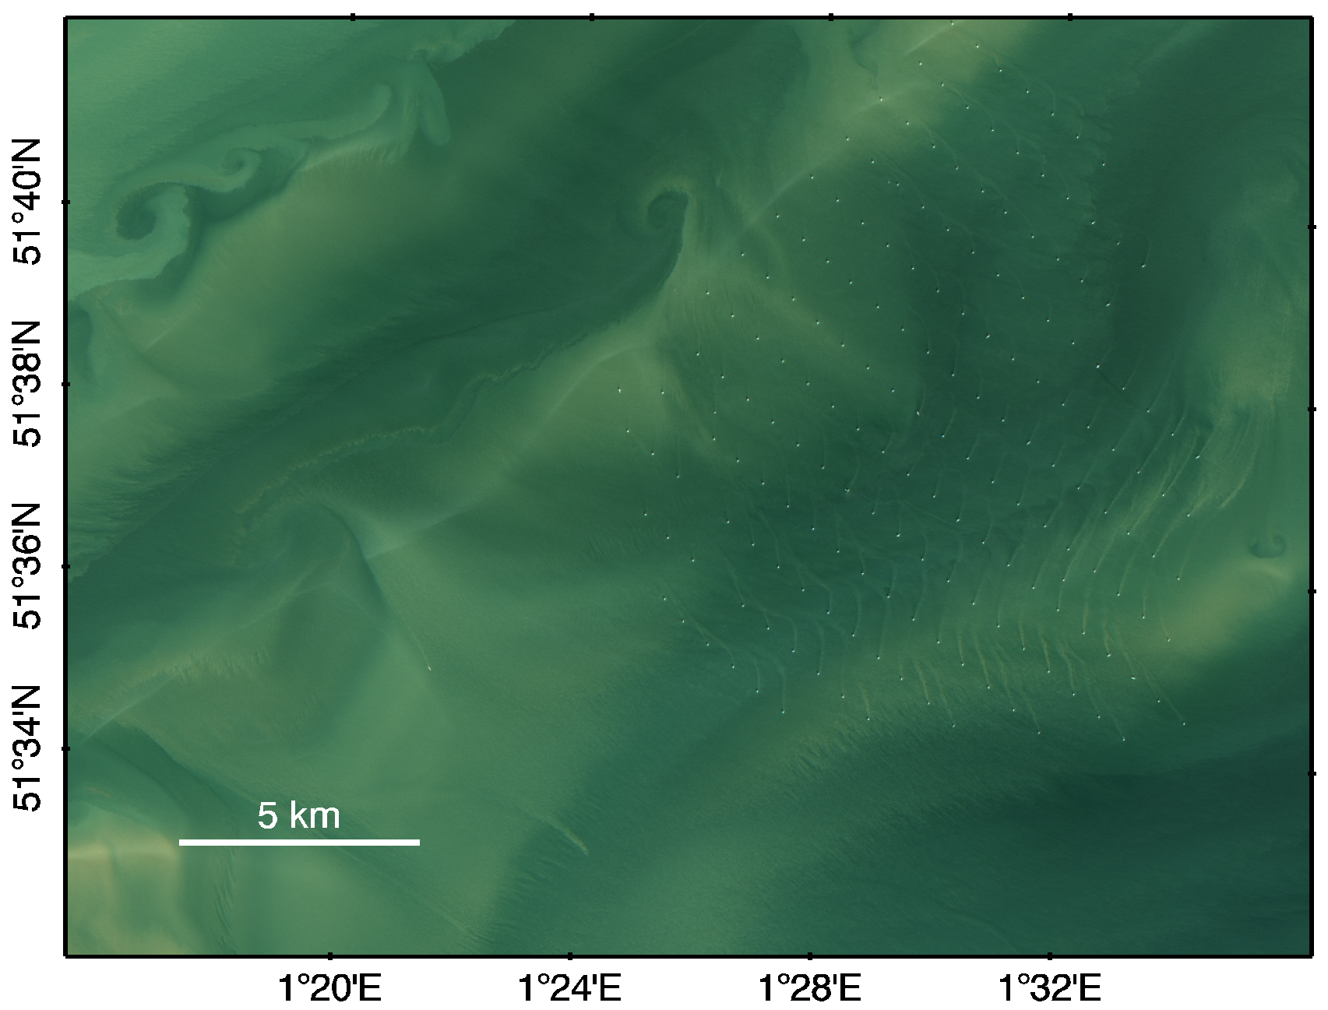
L8/OLI 2015-06-30 RGB RCO
see also Vanhellemont & Ruddick (2014)
London Array
Offshore Wind Farm

Slide 21
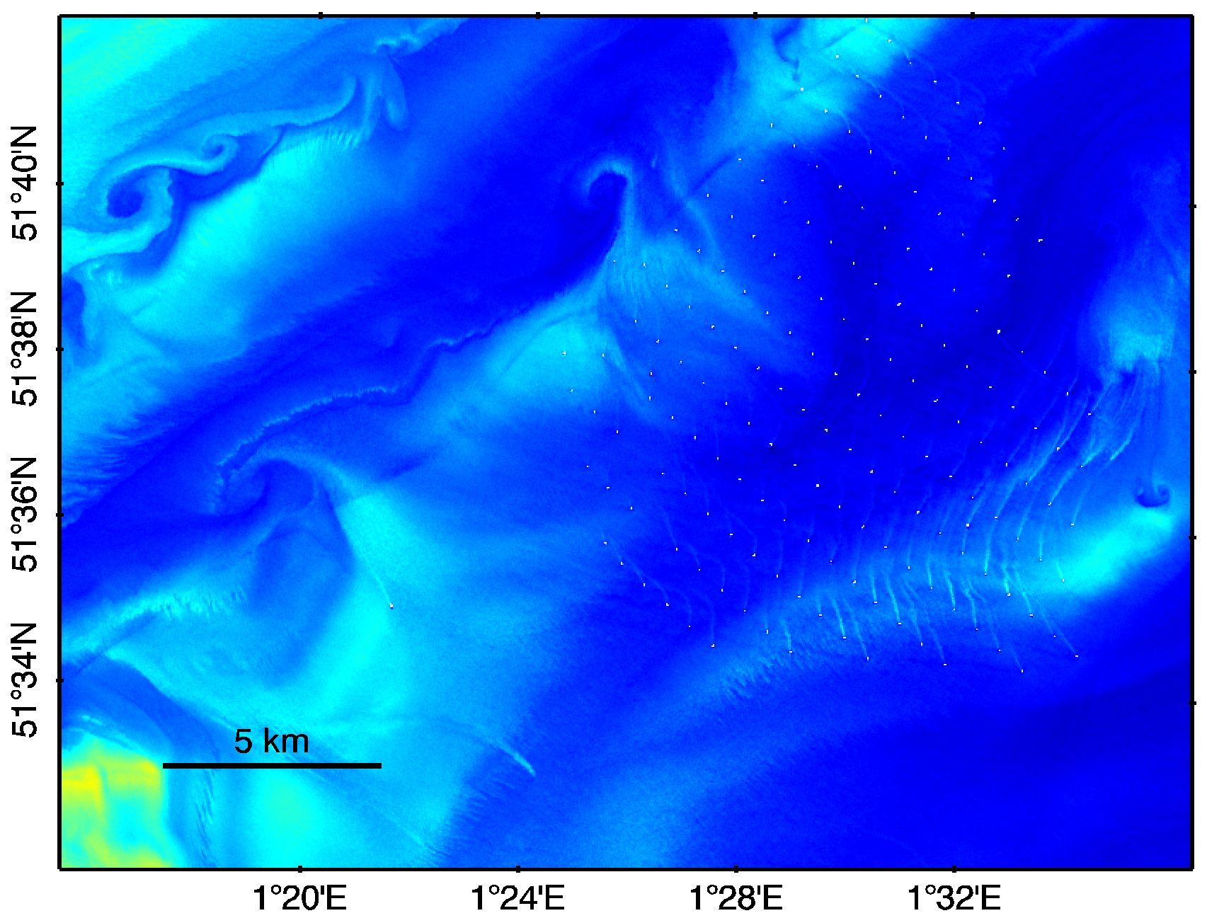
L8/OLI 2015-06-30
ρ_{w} 655 nm
for ρ_{w} 655:
A=289.29 (gm⁻³)
C=0.1686
Nechad et al. (2010)
London Array
Offshore Wind Farm

Slide 22
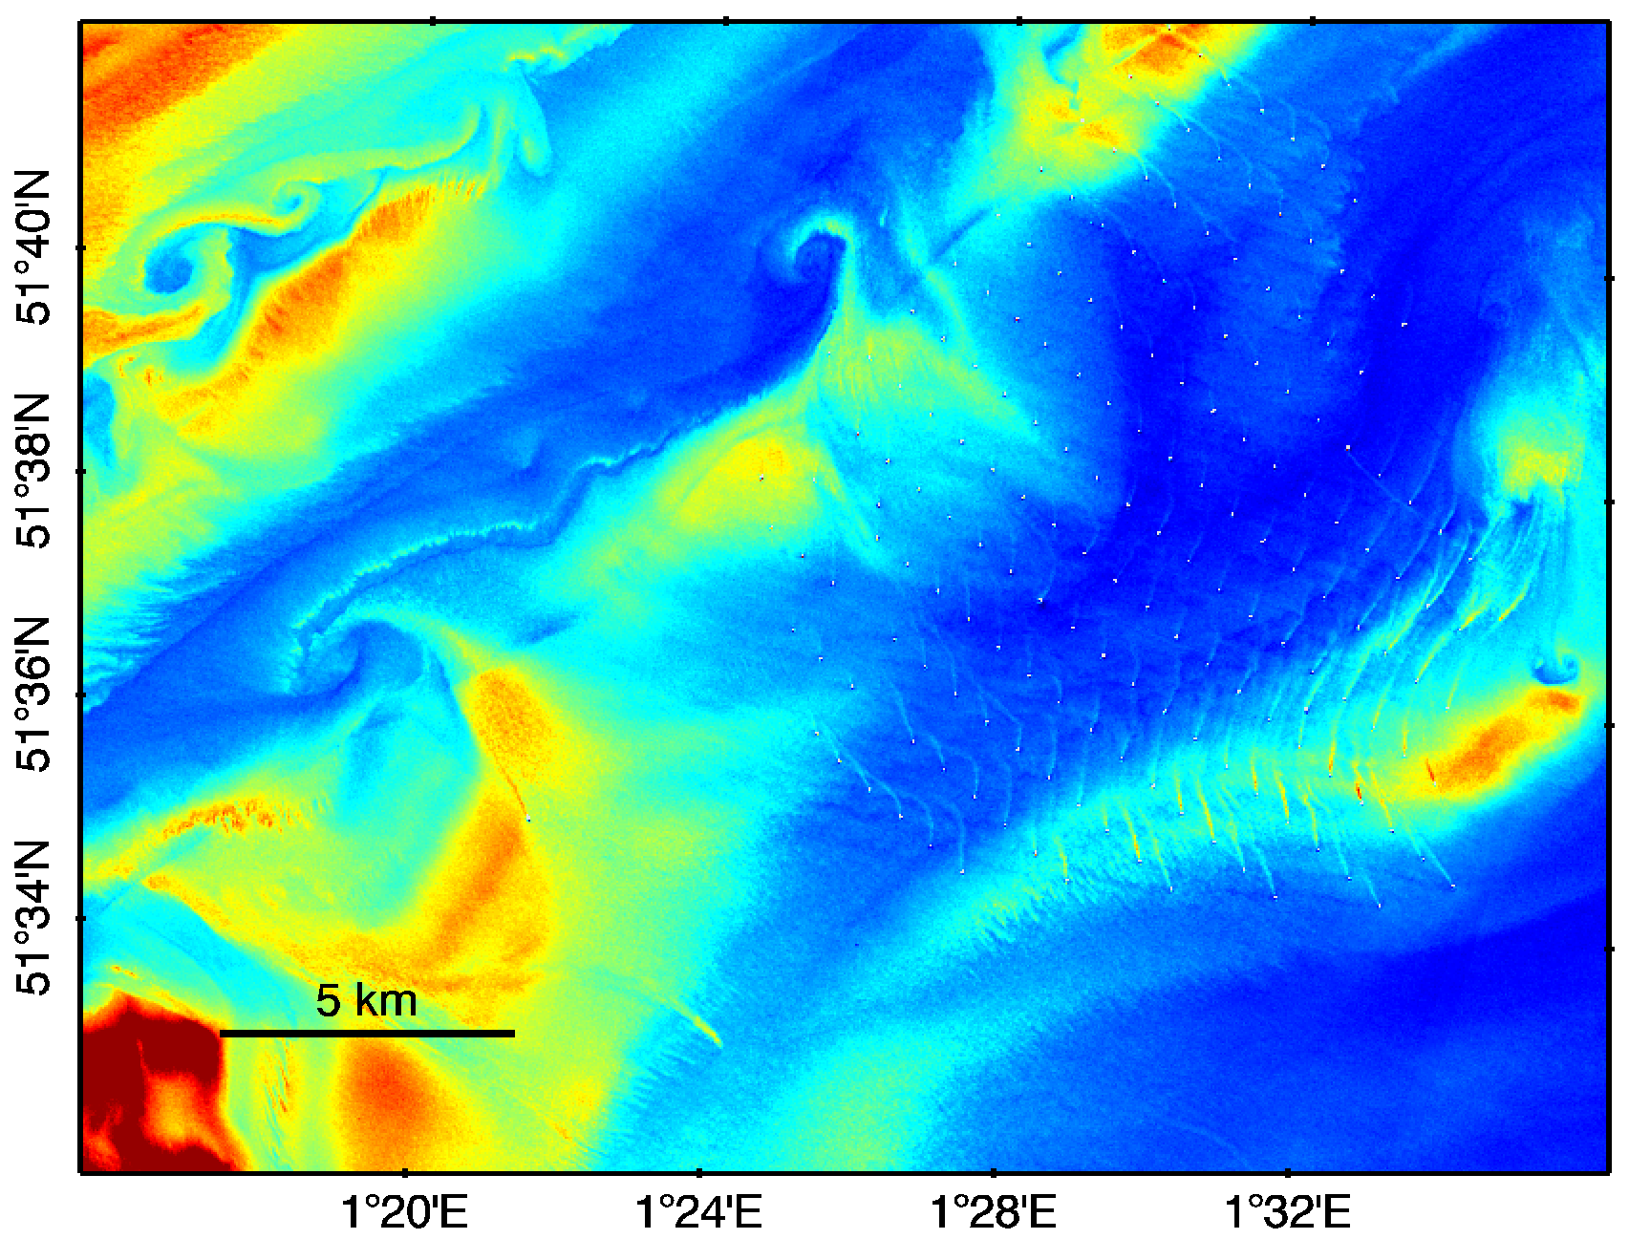
L8/OLI 2015-06-30
SPM
London Array
Offshore Wind Farm

Slide 23
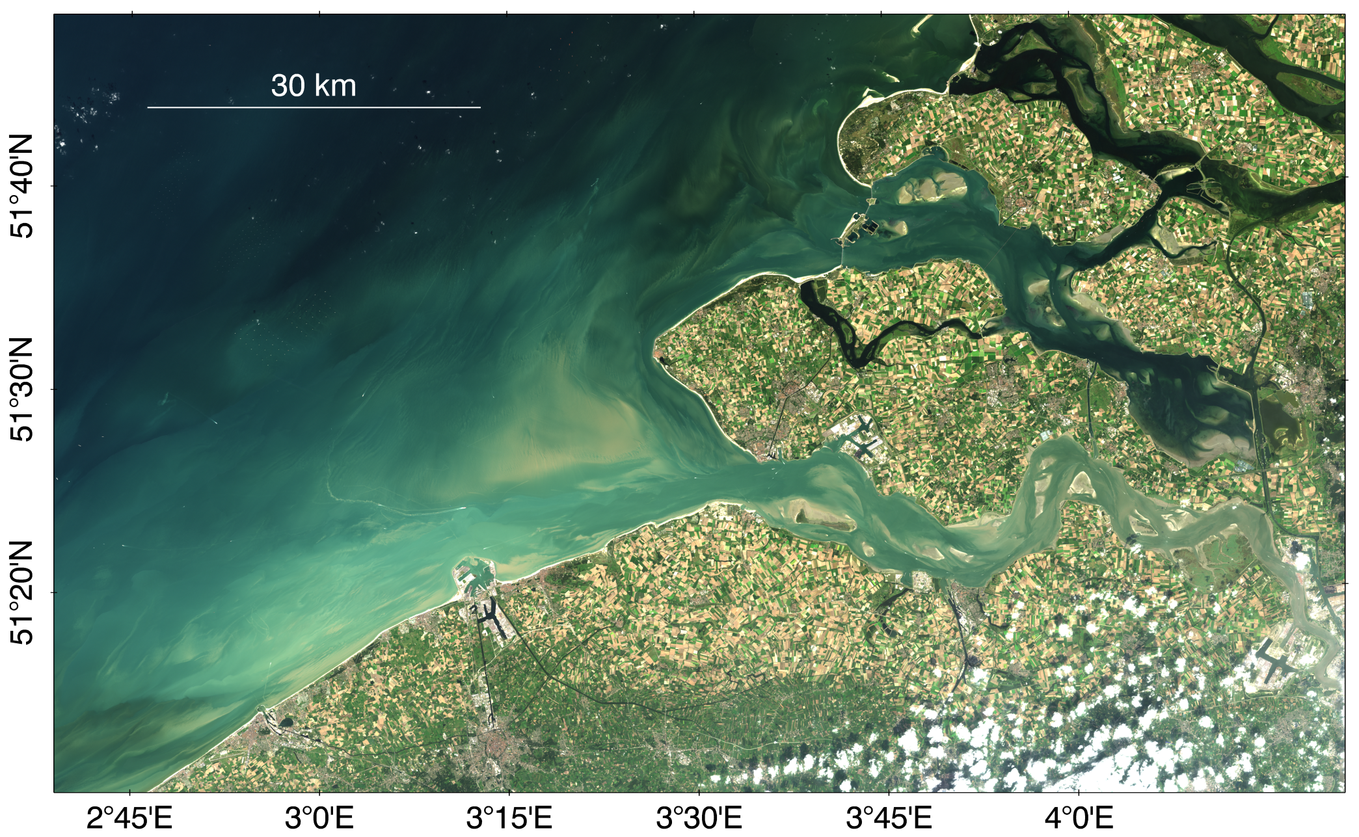
Belgian/Dutch coastal zone and Western Scheldt Estuary
wind farms
Zeebrugge
Antwerpen
2nd biggest EU port
190M tonnes int. freight, ~15k ships
Landsat-8/OLI Rayleigh corrected RGB 2014-09-08

Slide 24
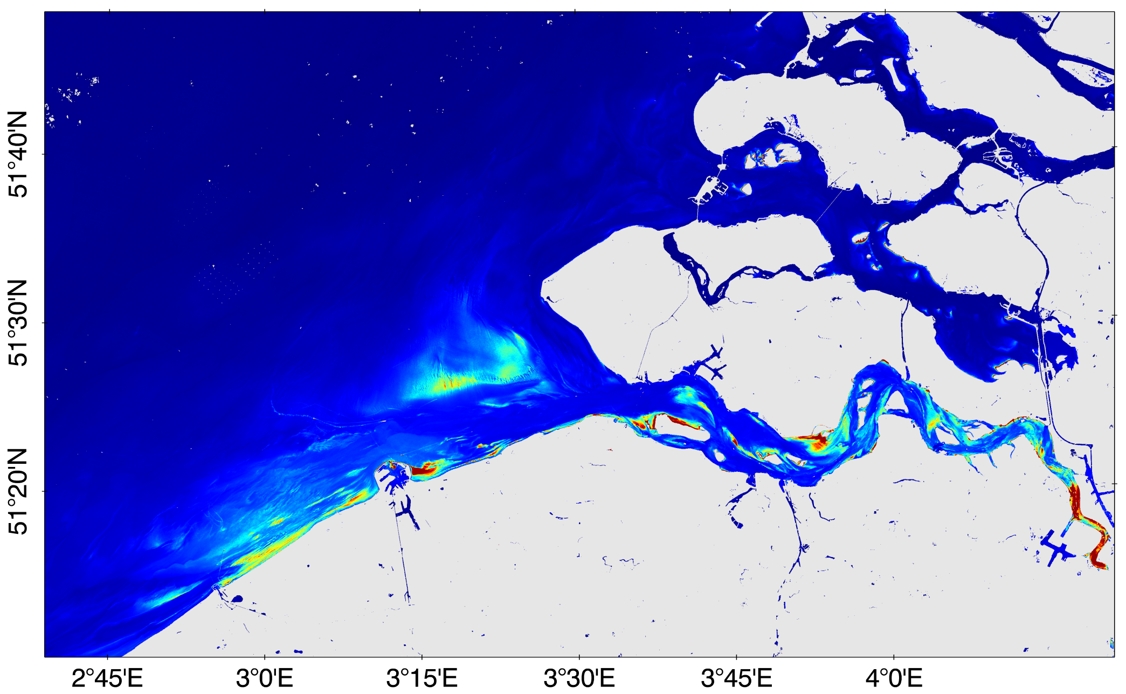
Zeebrugge
Antwerpen
2nd biggest EU port
190M tonnes int. freight, ~15k ships
Landsat-8/OLI Turbidity (V2015+D2015) 2014-09-08

Slide 25
sediment transport into the port
MOW1
dredger
Landsat-8/OLI Turbidity (V2015+D2015) 2014-09-08

Slide 26
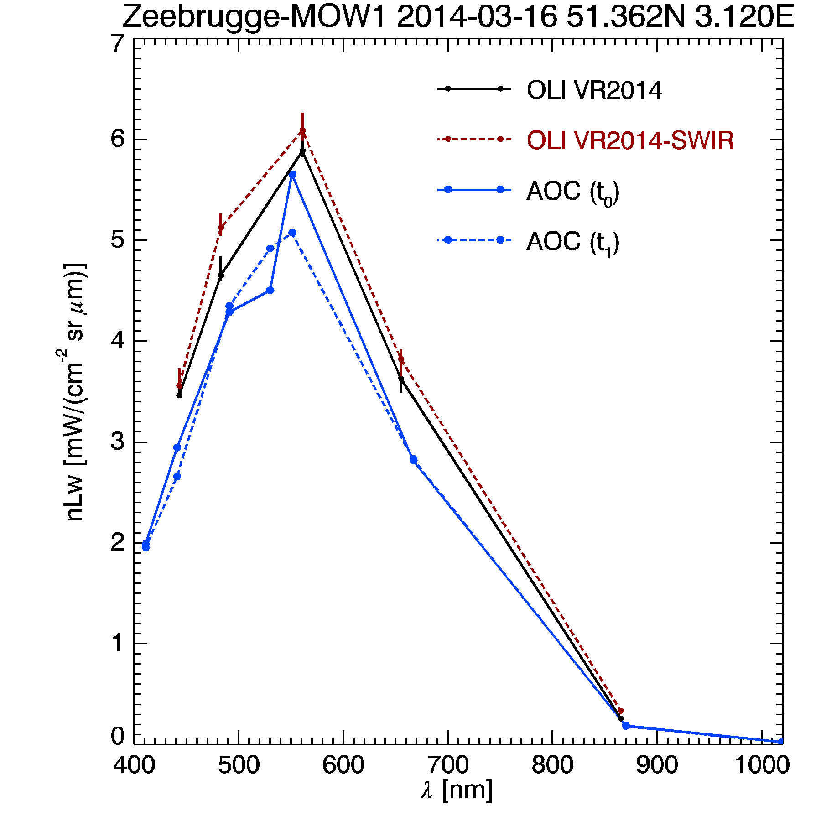
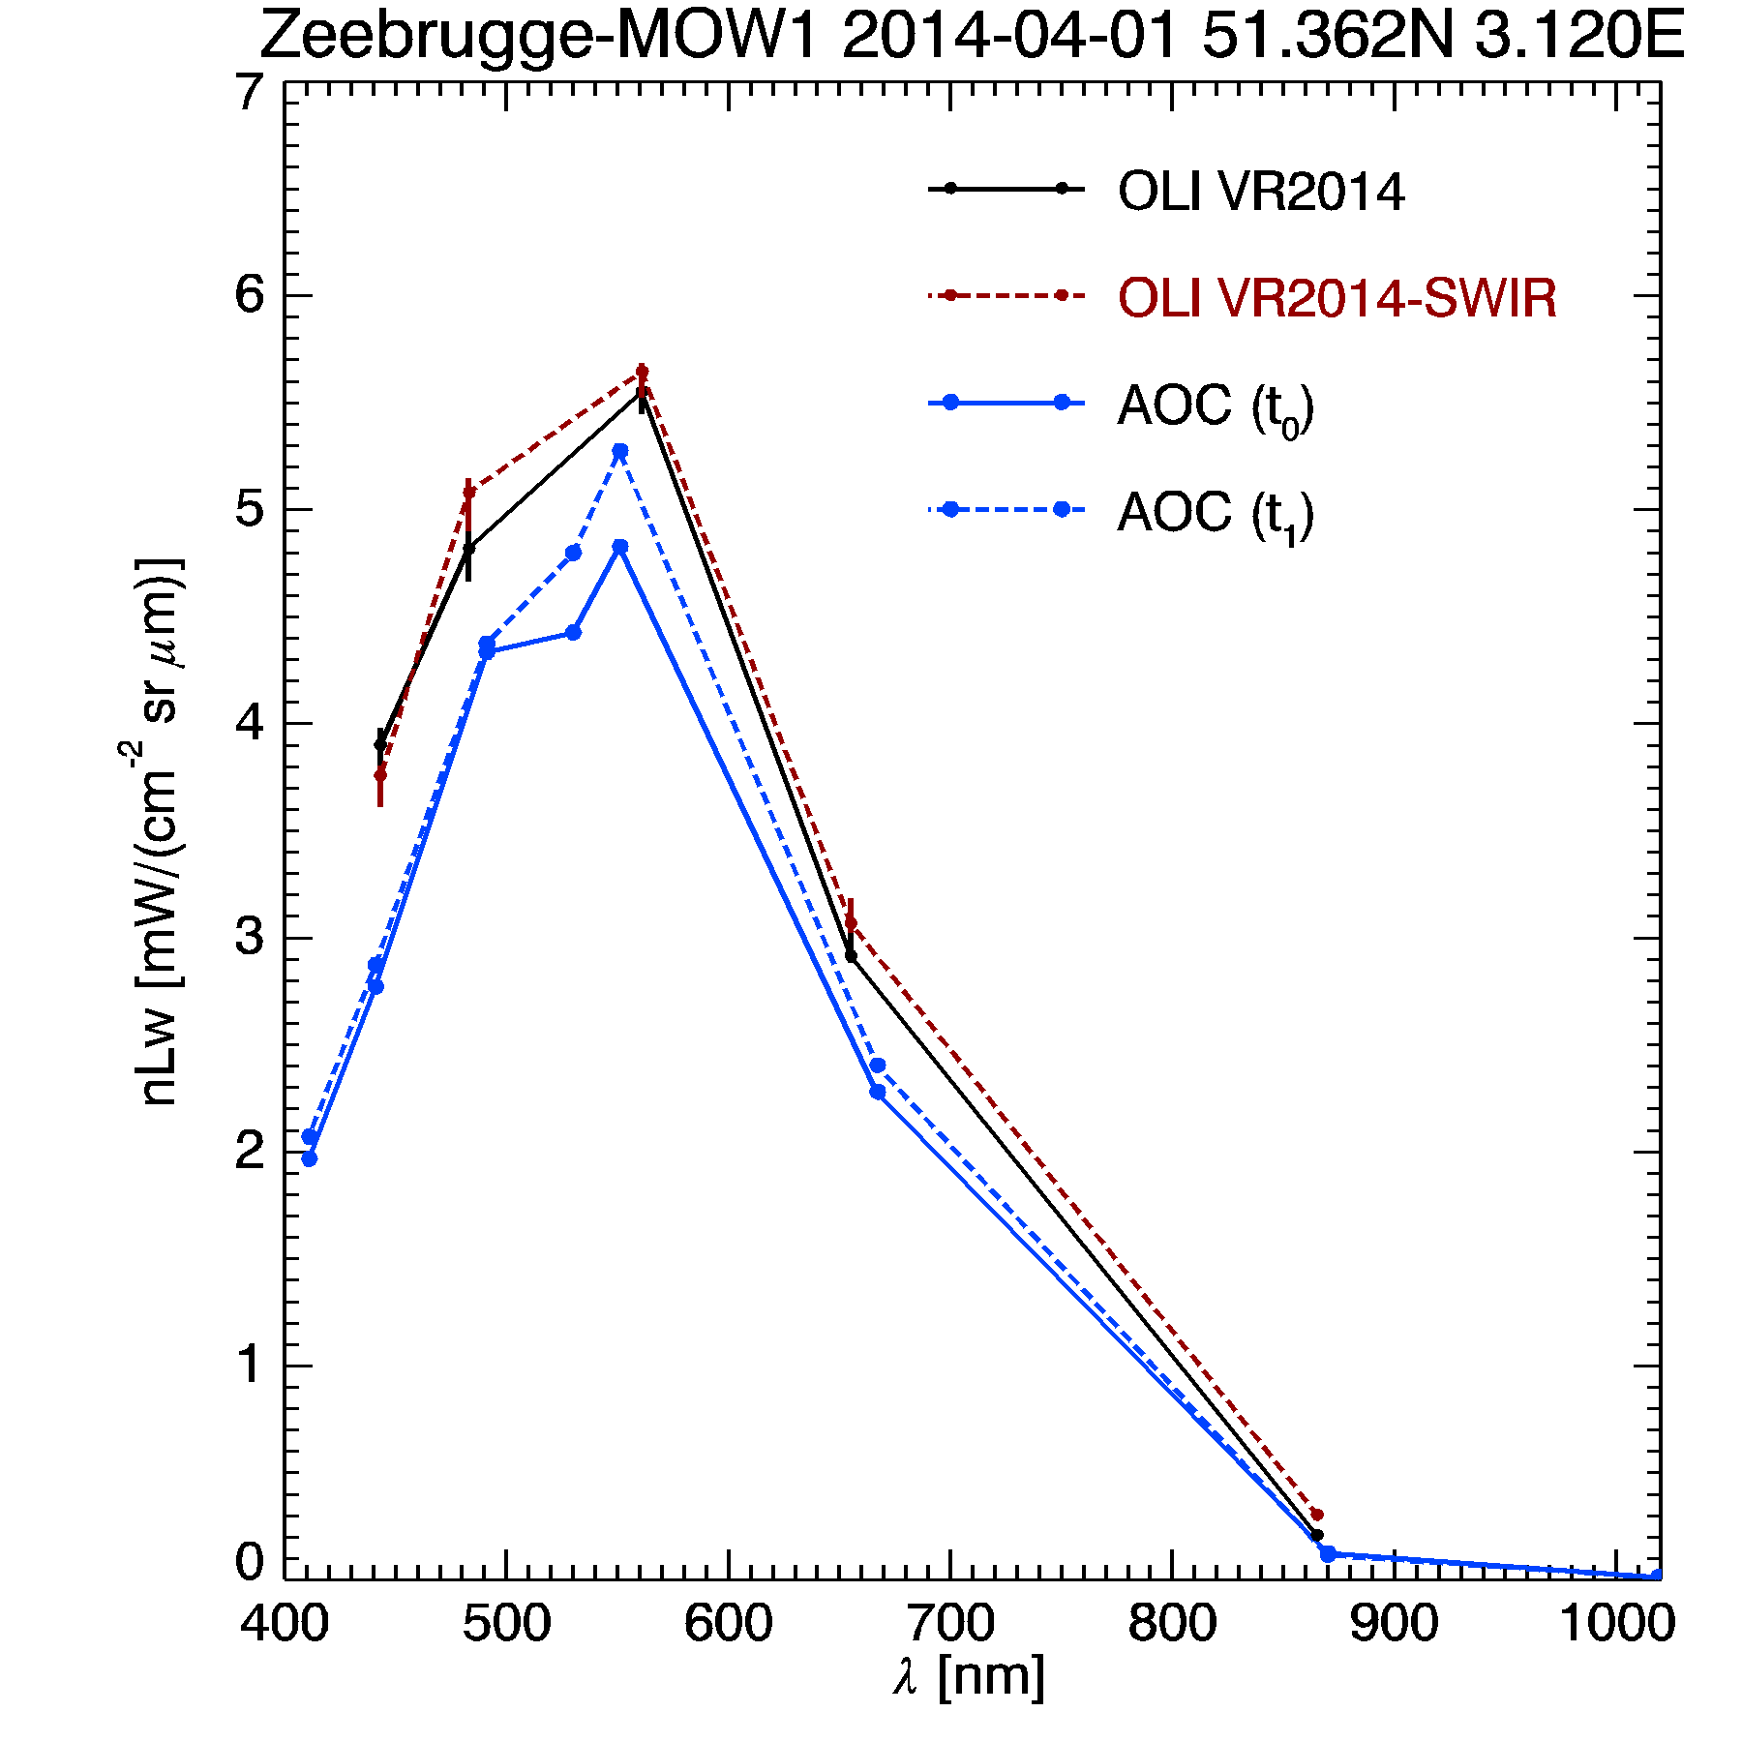
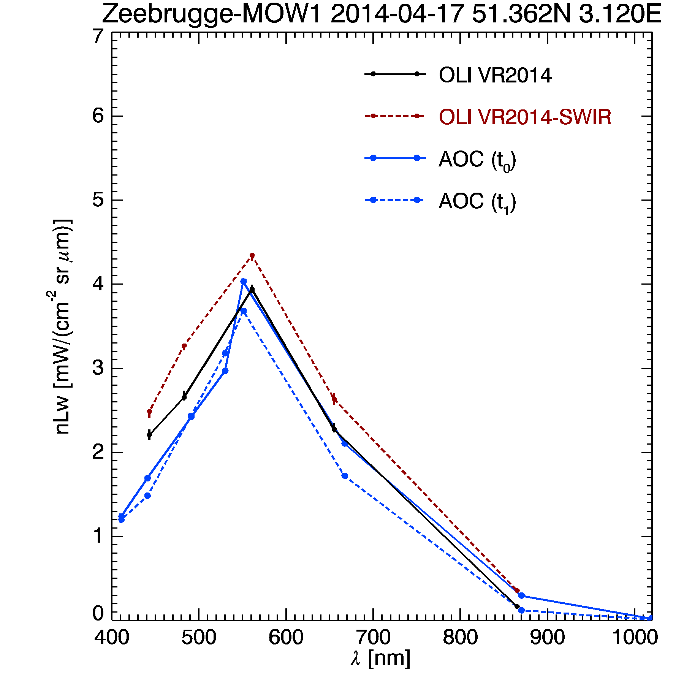
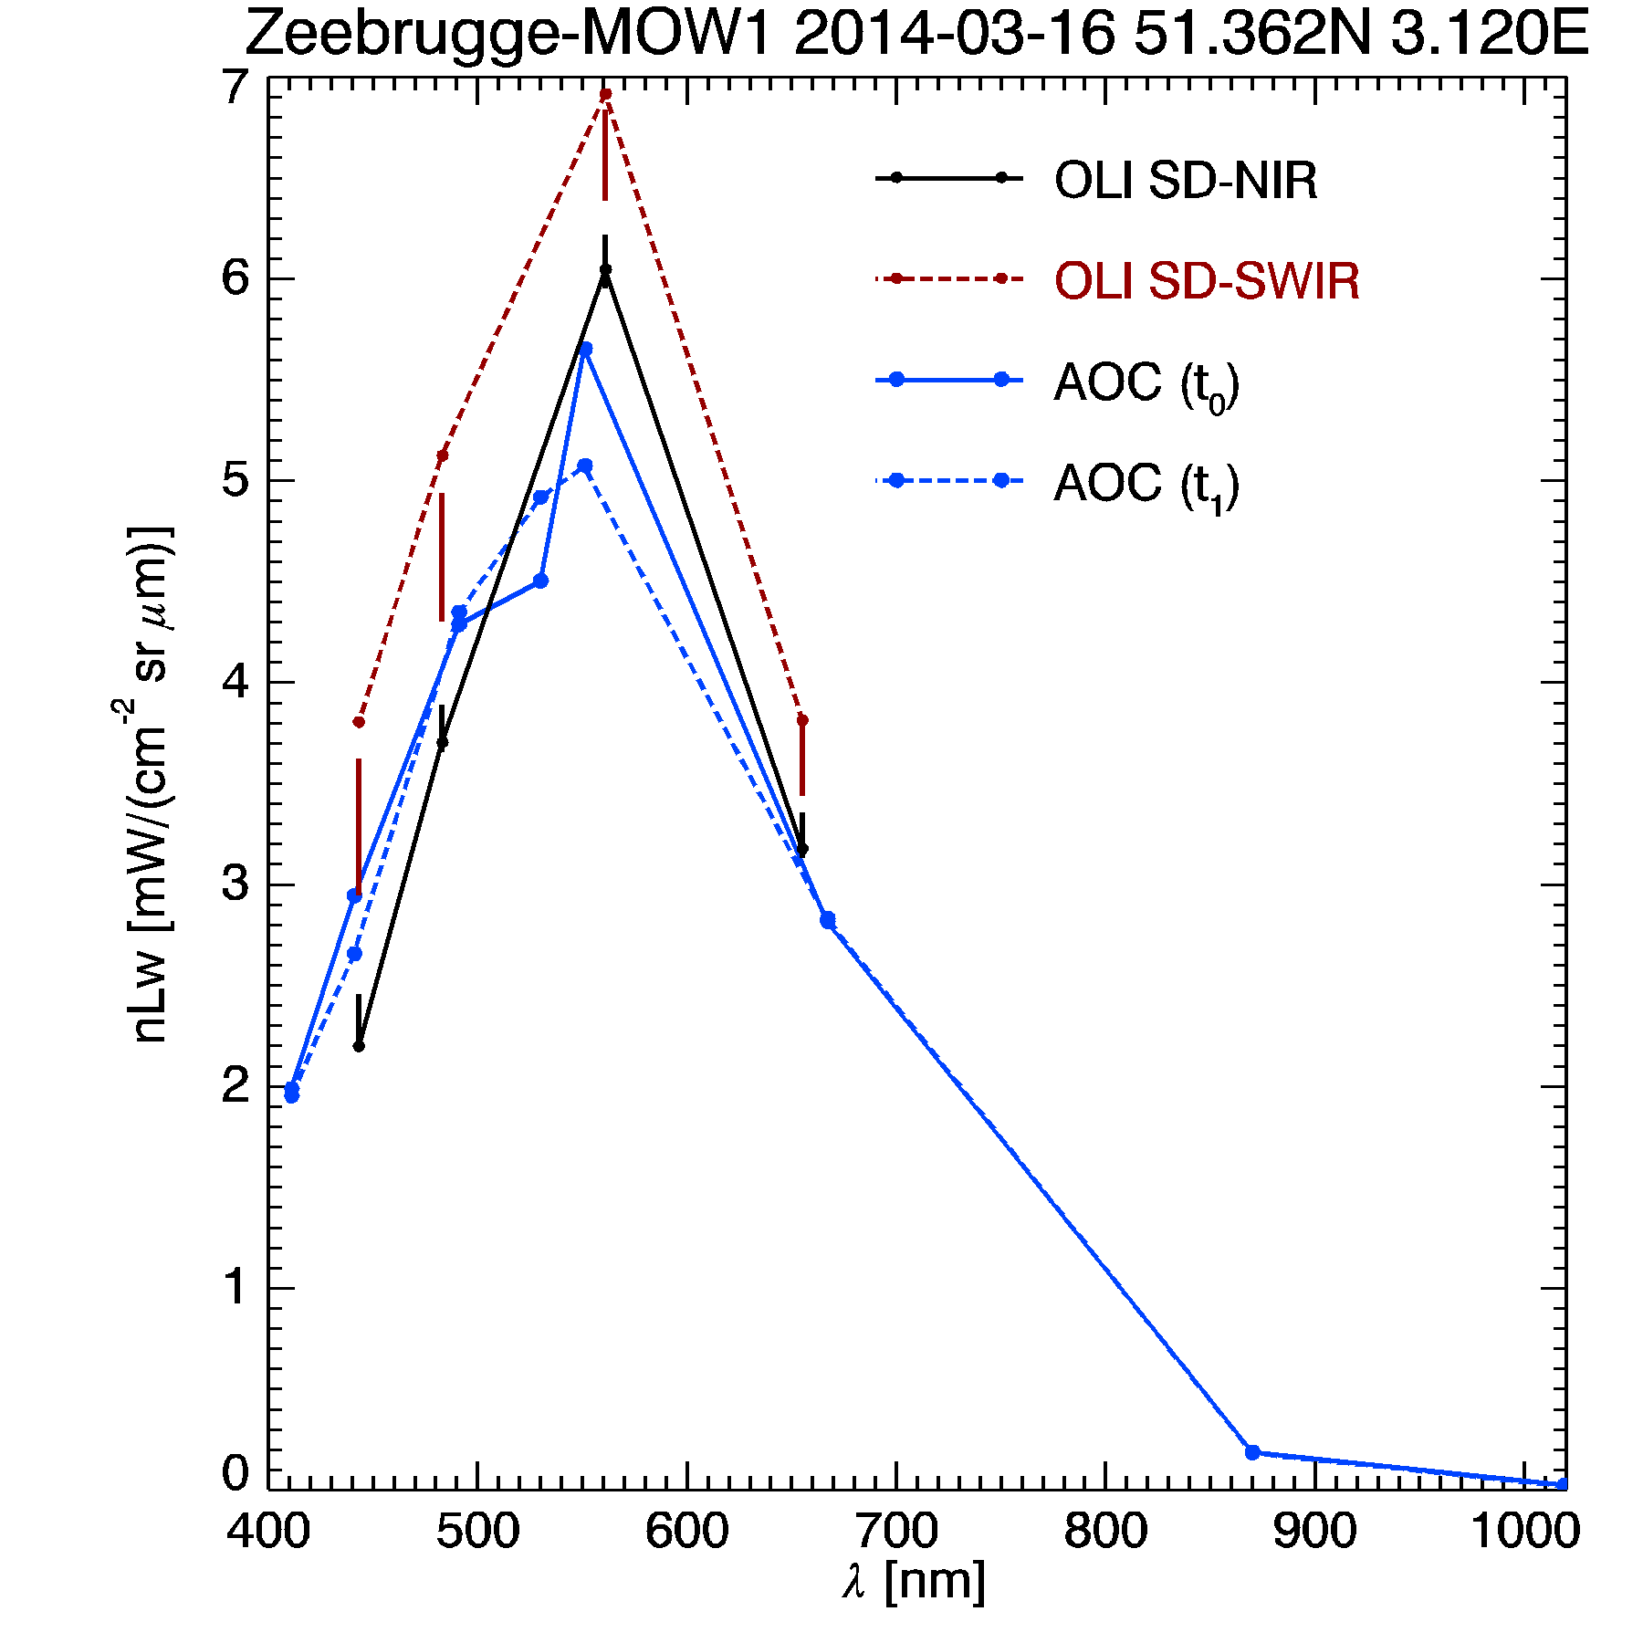
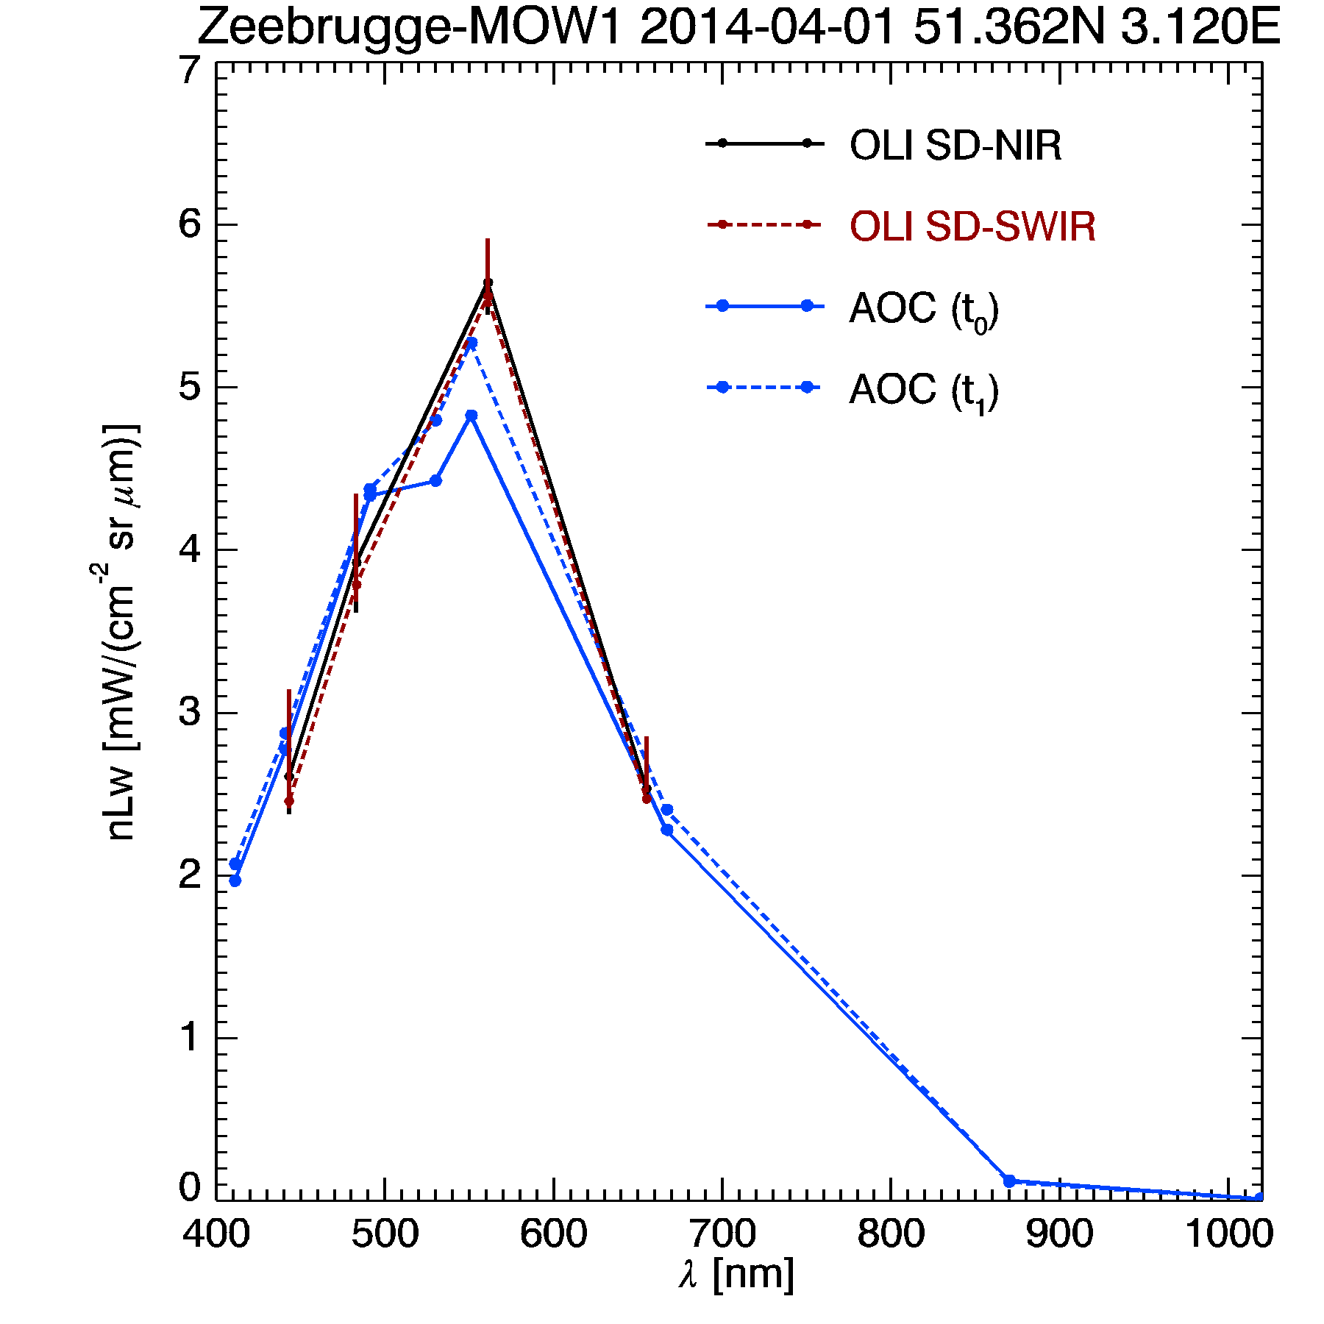
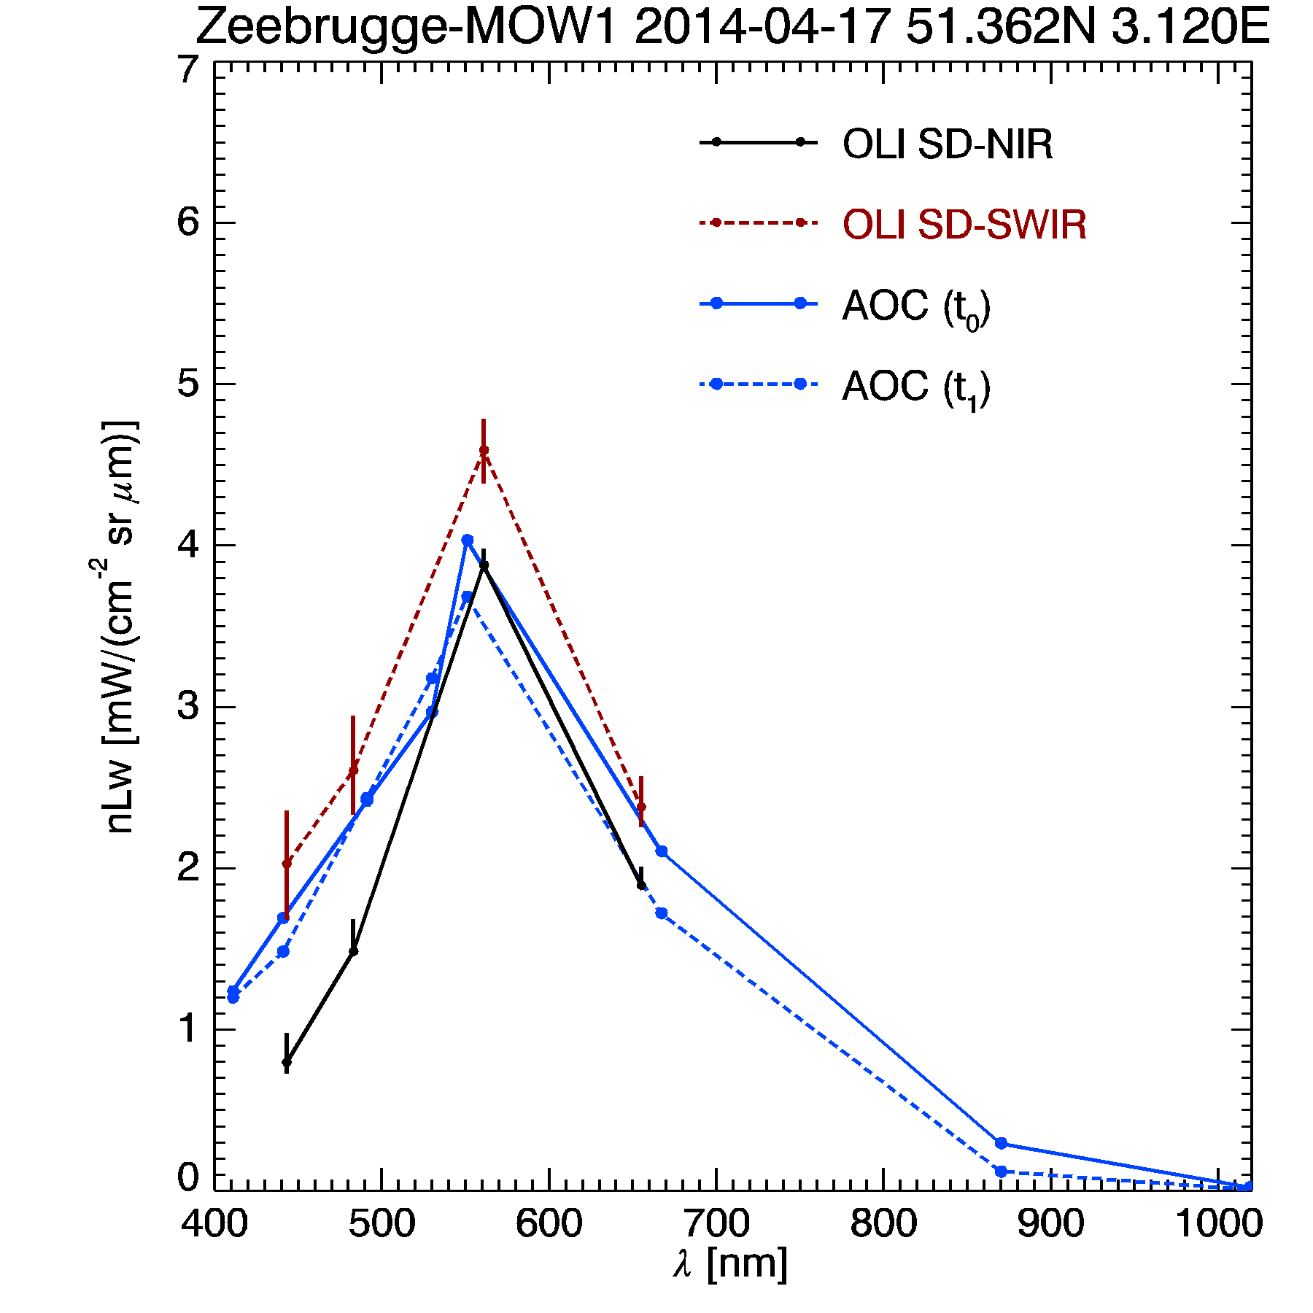
Zeebrugge Aeronet-OC (L1.5 no QC)
ACOLITE
ACOLITE
ACOLITE
SeaDAS
SeaDAS
SeaDAS
Vanhellemont Q. & Bailey S. & Franz B. & Shea D., 2014, Atmospheric Correction of Landsat-8 Imagery Using SeaDAS Proceedings of the Sentinel-2 for Science Workshop.

Slide 27
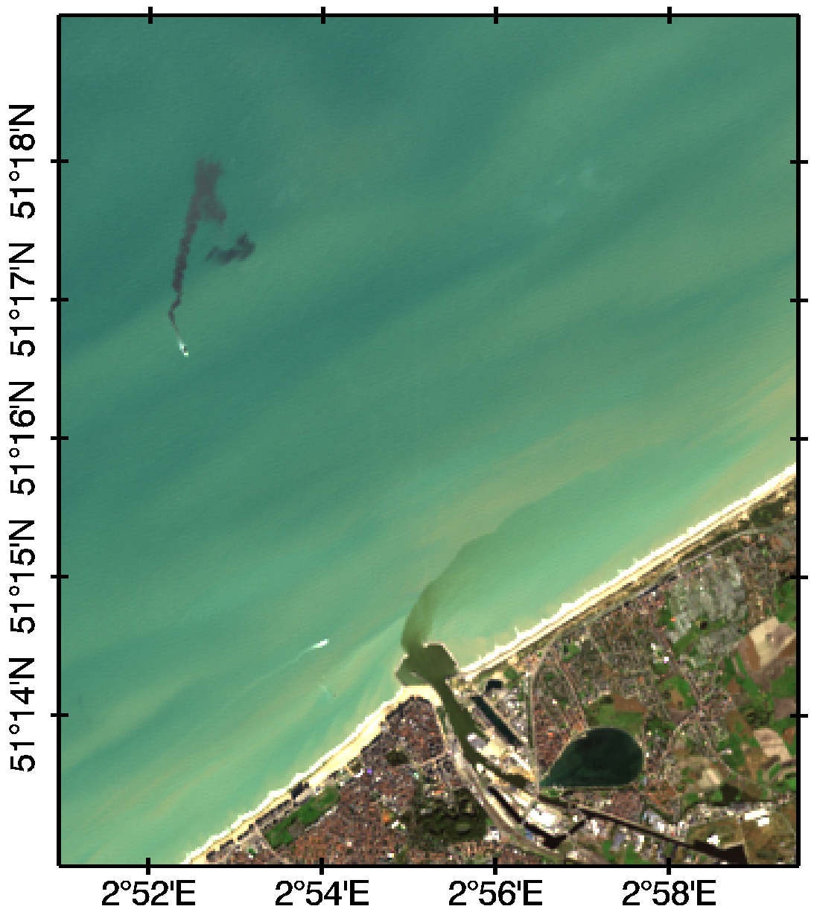
Landsat-8/OLI 2013-10-30
Rayleigh corrected RGB
dumped dredged
sediments
ship
port discharge
Oostende
Spuikom
J.P. Vogt (RBINS) 2014-01-24
Vanhellemont, Q., Ruddick, K., 2014b. Landsat-8 as a Precursor to Sentinel-2: Observations of Human Impacts in Coastal Waters., in: ESA Special Publication SP-726.

Slide 28
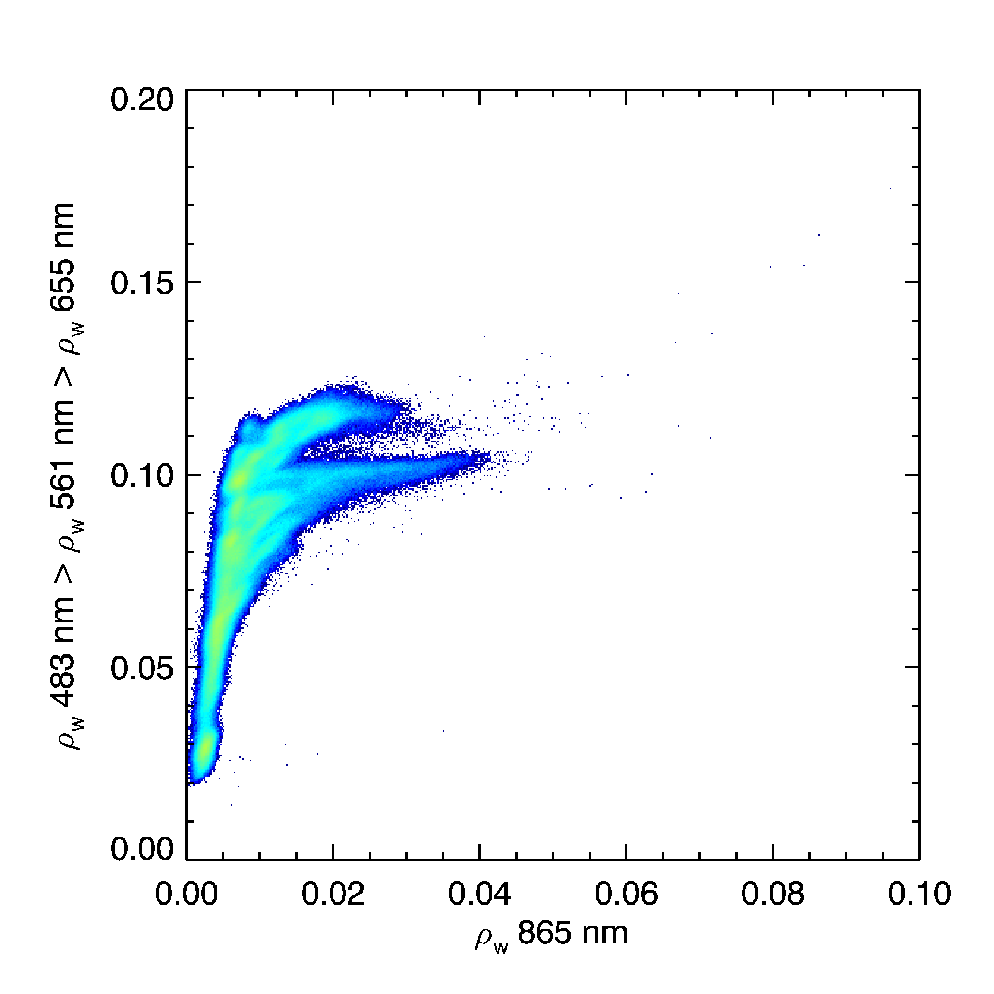
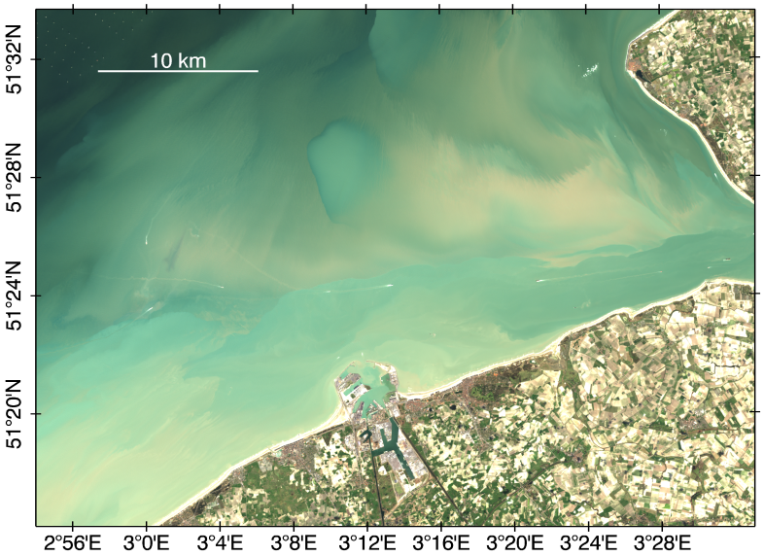
Simple detection algorithm for high concentrations of absorbing sediments
the NIR marine reflectance is greater than a threshold for turbid waters:
$ρ_{w}^{5}$ > 0.01
the maximum marine reflectance in three visible bands is low for this turbidity:
$max(ρ_{w}^{2},ρ_{w}^{3},ρ_{w}^{4})$ < 0.07
NIR-VISMAX
absorbing sediment flag
L8/OLI 2014-03-16
Vanhellemont, Q., Ruddick, K., (2015). Advantages of high quality SWIR bands for ocean colour processing: examples from Landsat-8. http://dx.doi.org/10.1016/j.rse.2015.02.007

Slide 29
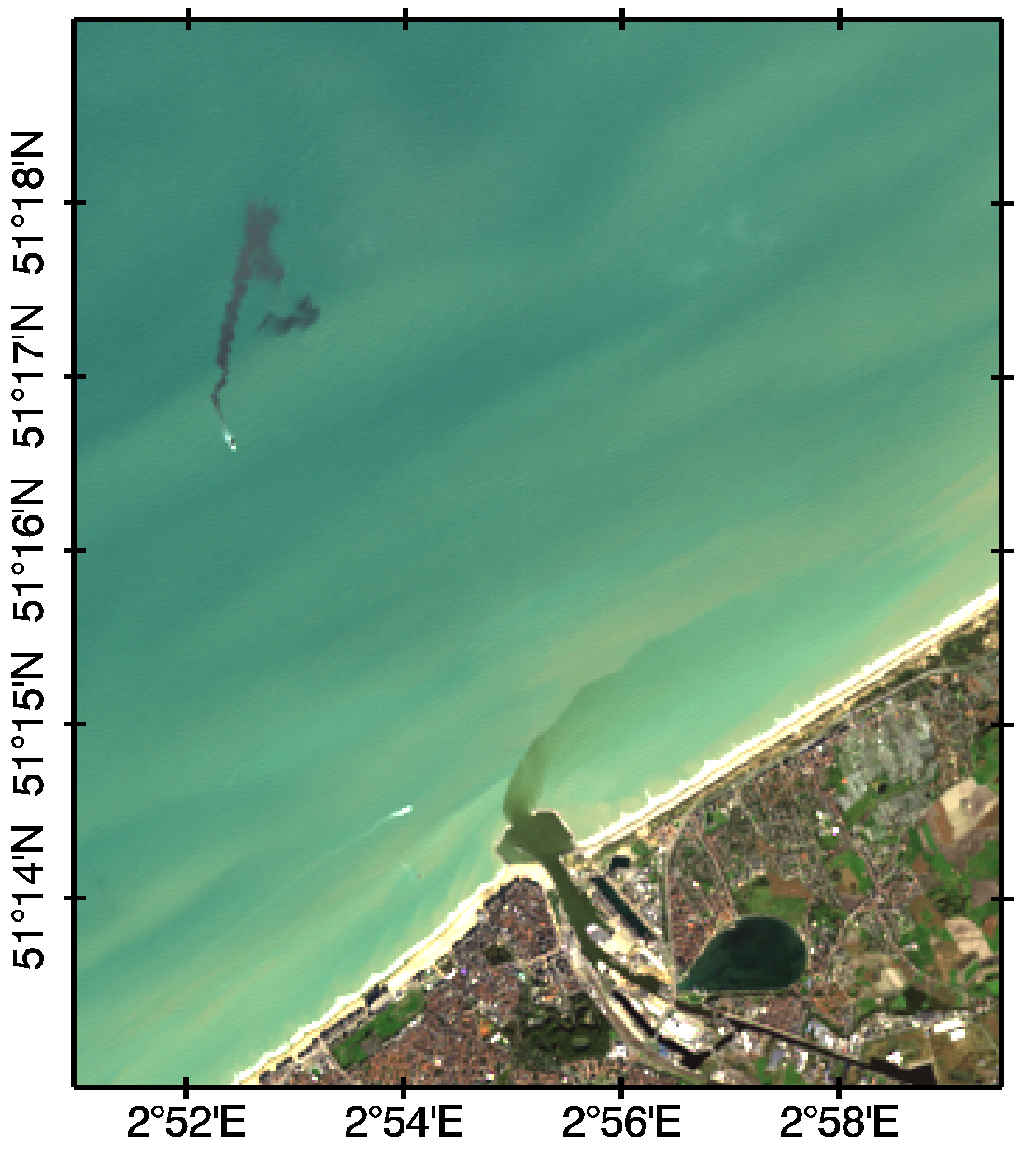
Landsat-8/OLI 2013-10-30
Vanhellemont, Q., Ruddick, K., (2015). Advantages of high quality SWIR bands for ocean colour processing: examples from Landsat-8. http://dx.doi.org/10.1016/j.rse.2015.02.007

Slide 30
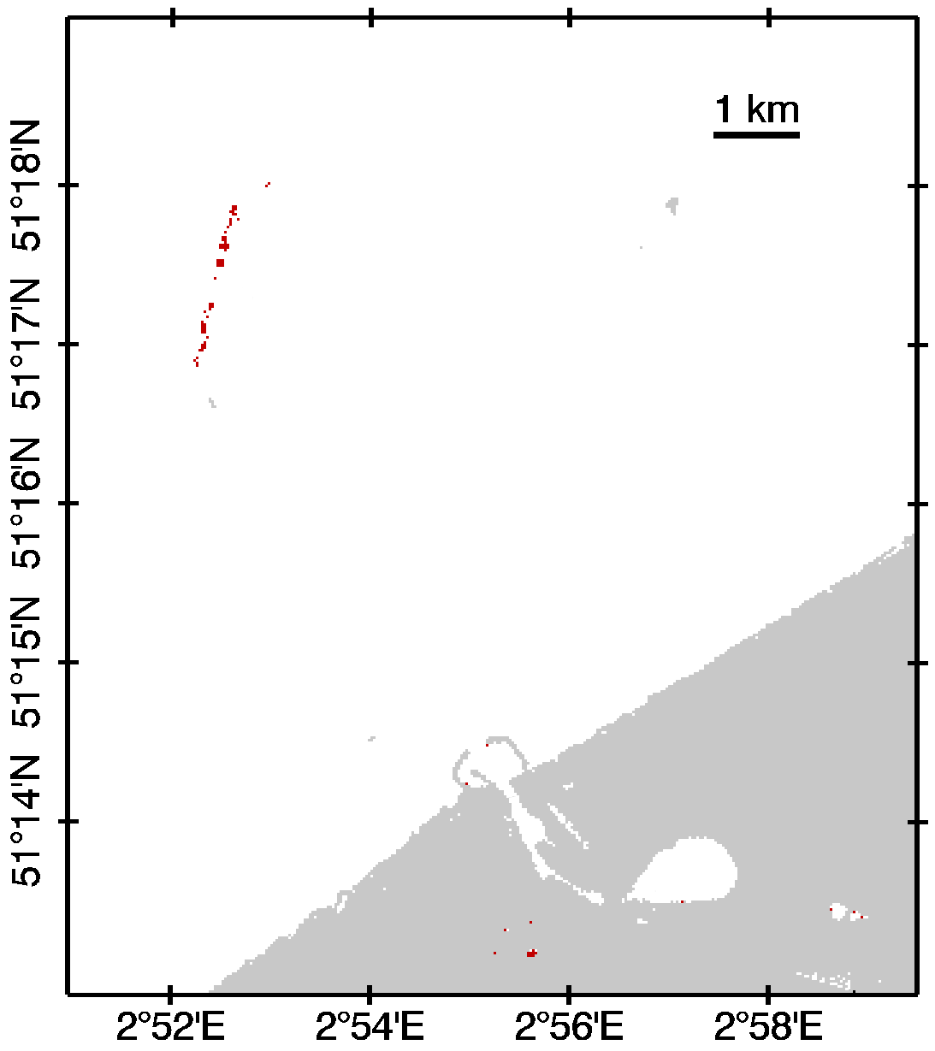
Landsat-8/OLI 2013-10-30
$ρ_{w}^{5}$ > 0.01
$max(ρ_{w}^{2},ρ_{w}^{3},ρ_{w}^{4})$ < 0.07
dredger plume
Vanhellemont, Q., Ruddick, K., (2015). Advantages of high quality SWIR bands for ocean colour processing: examples from Landsat-8. http://dx.doi.org/10.1016/j.rse.2015.02.007

Slide 31
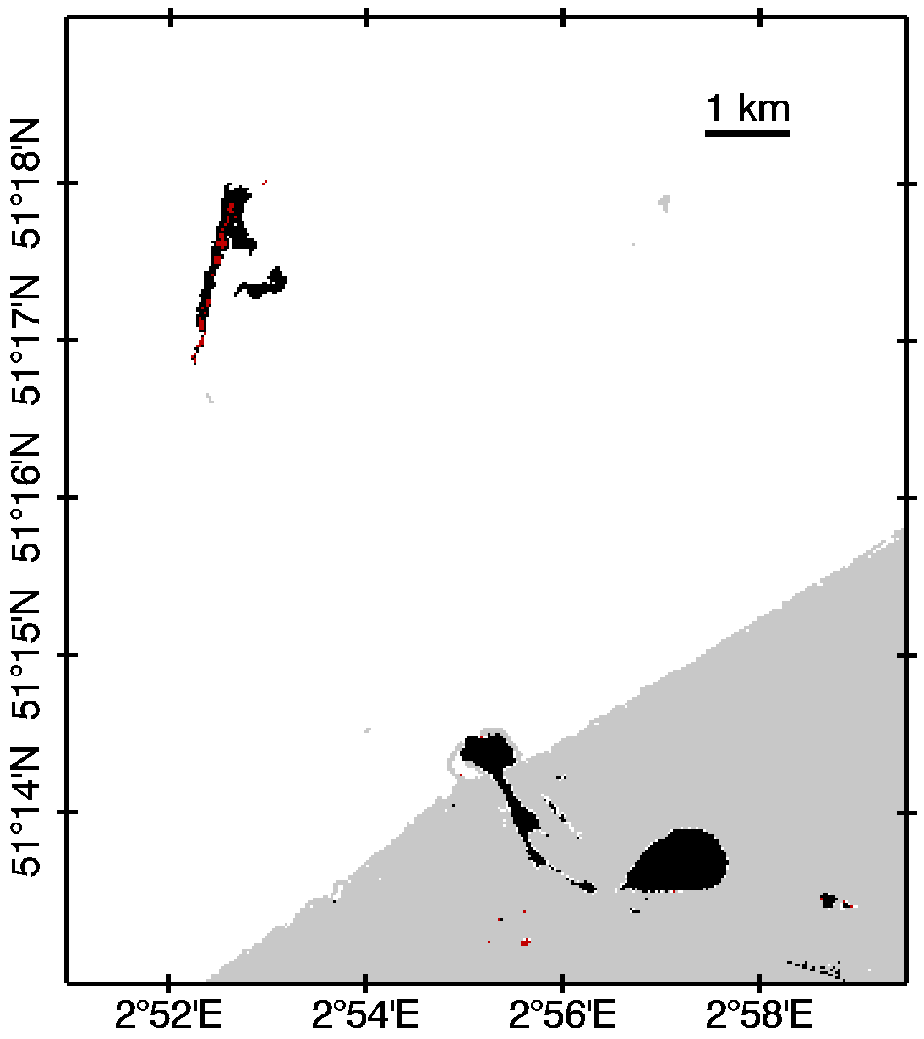
Landsat-8/OLI 2013-10-30
$ρ_{w}^{5}$ > 0.01
$max(ρ_{w}^{2},ρ_{w}^{3},ρ_{w}^{4})$ < 0.07
low VIS, background NIR
dredger plume
$ρ_{w}^{5}$ > 0.001 ≈ ambient
$max(ρ_{w}^{2},ρ_{w}^{3},ρ_{w}^{4})$ < 0.07
Vanhellemont, Q., Ruddick, K., (2015). Advantages of high quality SWIR bands for ocean colour processing: examples from Landsat-8. http://dx.doi.org/10.1016/j.rse.2015.02.007

Slide 32
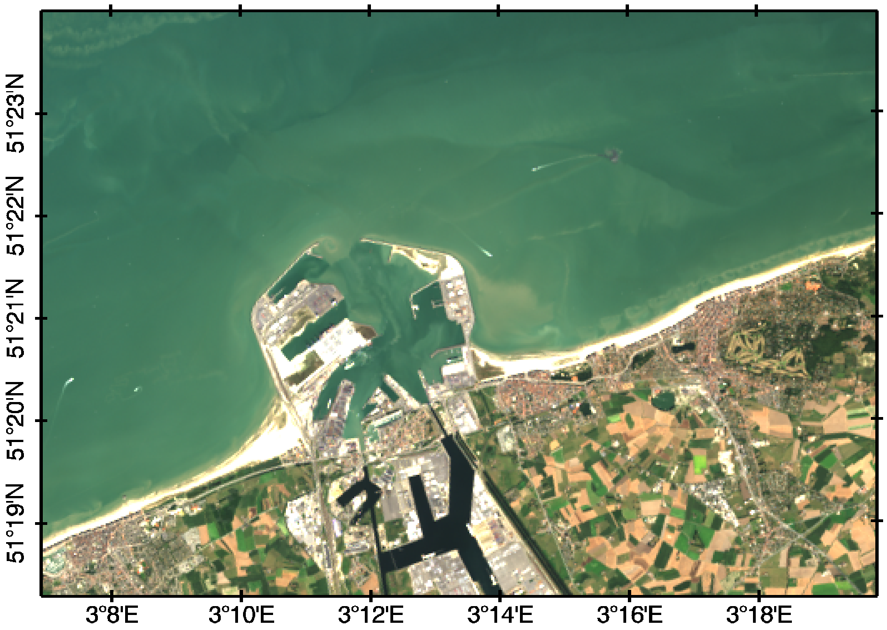
Landsat-8/OLI 2013-09-05
dredger plume
Vanhellemont, Q., Ruddick, K., (2015). Advantages of high quality SWIR bands for ocean colour processing: examples from Landsat-8. http://dx.doi.org/10.1016/j.rse.2015.02.007

Slide 33
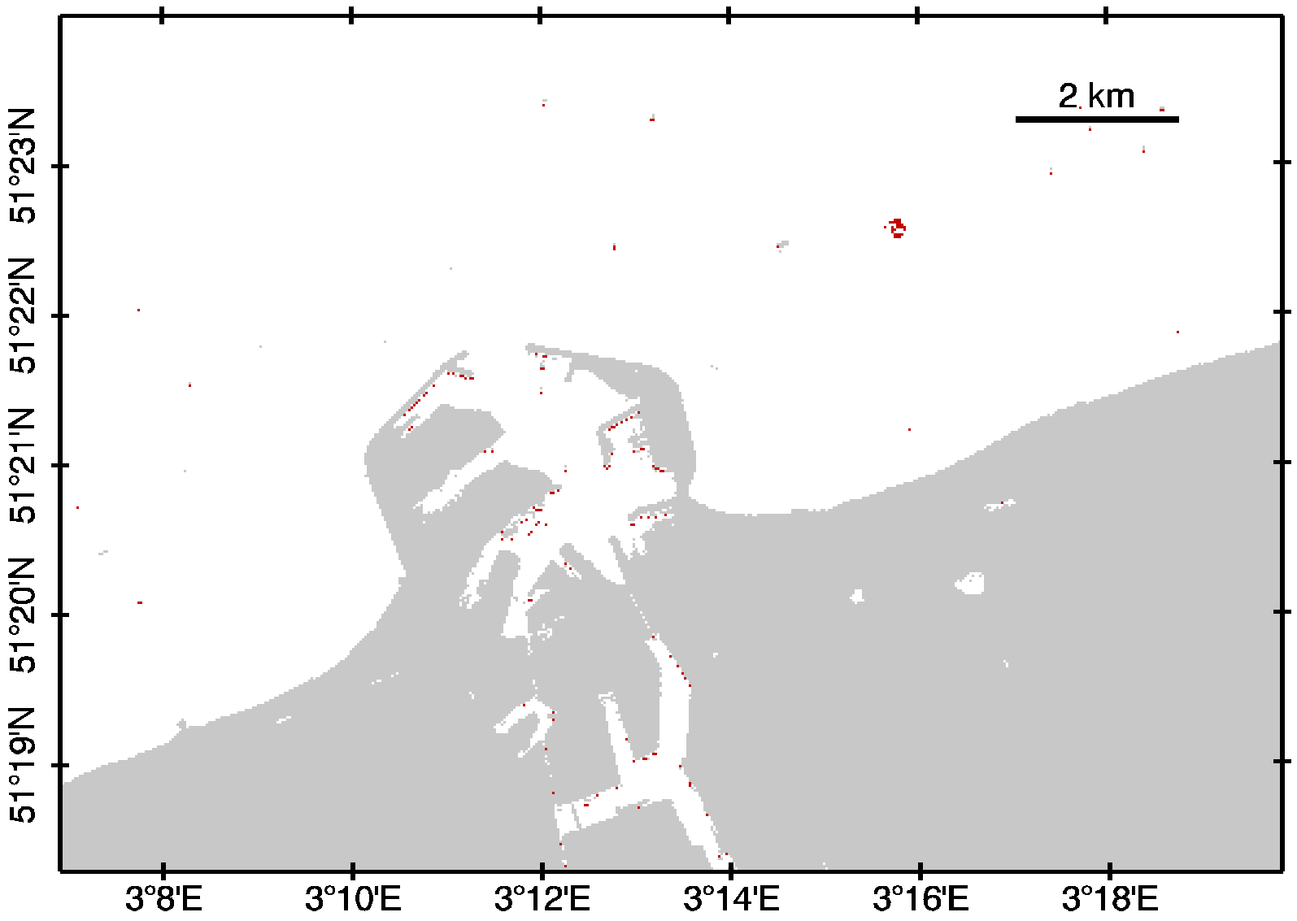
Landsat-8/OLI 2013-09-05
dredger plume
Vanhellemont, Q., Ruddick, K., (2015). Advantages of high quality SWIR bands for ocean colour processing: examples from Landsat-8. http://dx.doi.org/10.1016/j.rse.2015.02.007

Slide 34
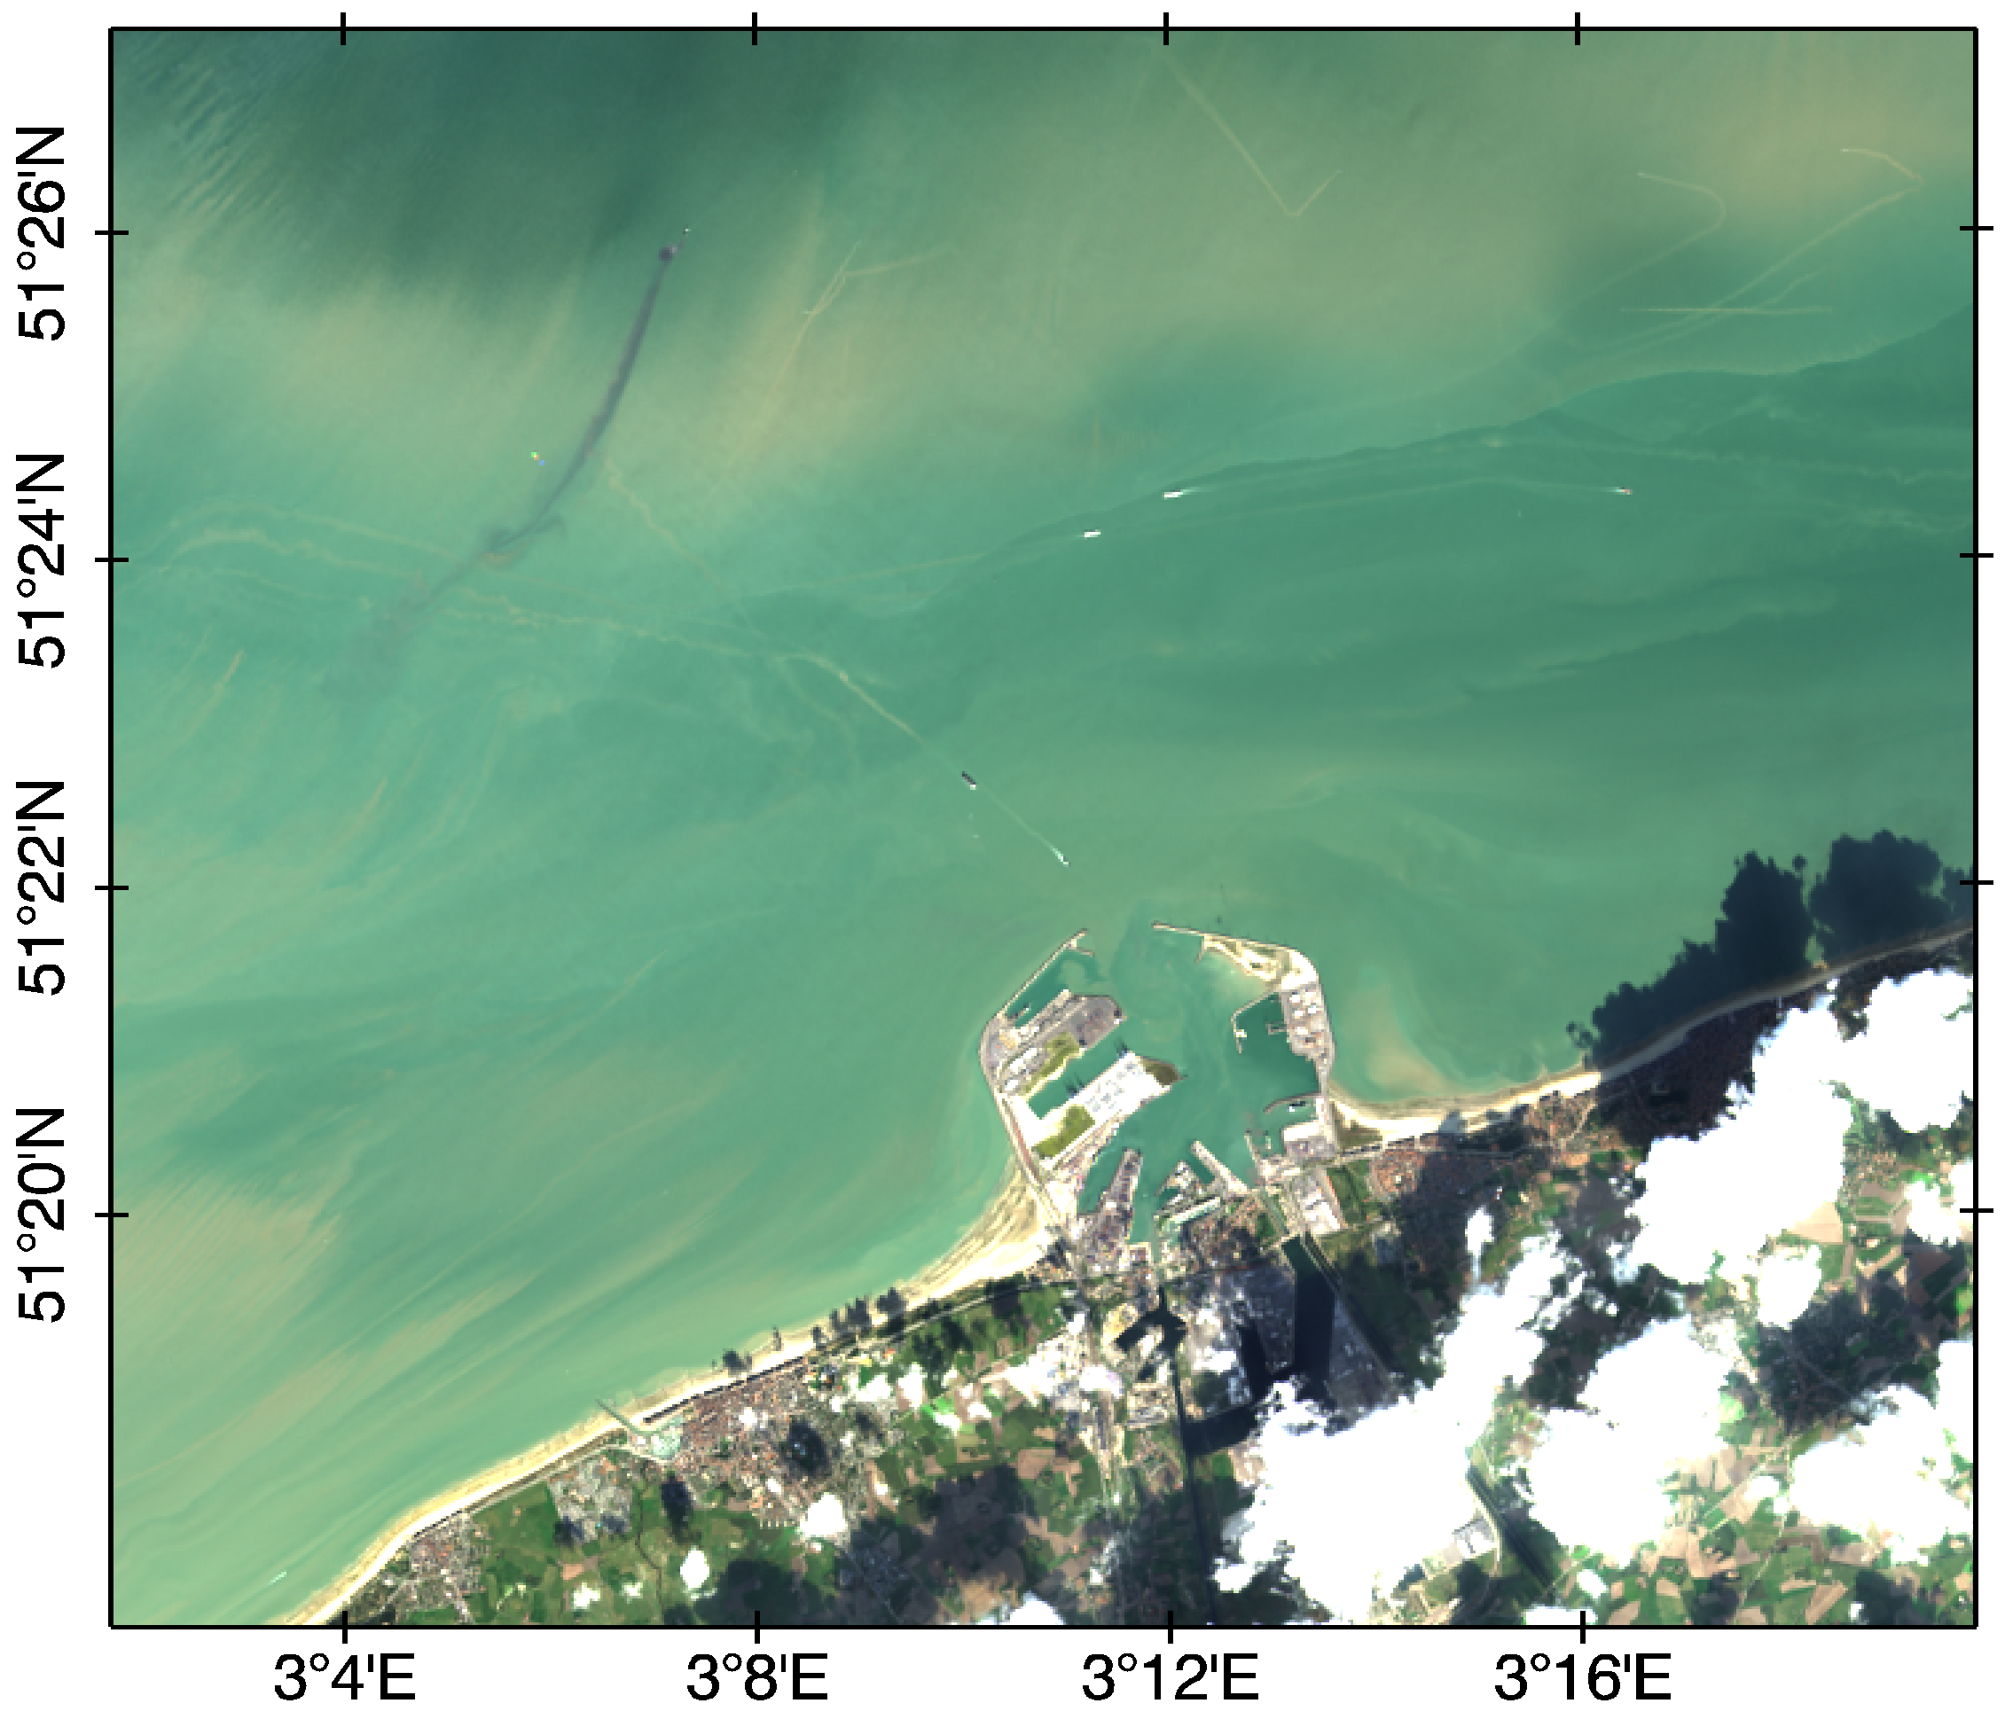
Landsat-8/OLI 2013-10-07
Vanhellemont, Q., Ruddick, K., (2015). Advantages of high quality SWIR bands for ocean colour processing: examples from Landsat-8. http://dx.doi.org/10.1016/j.rse.2015.02.007

Slide 35
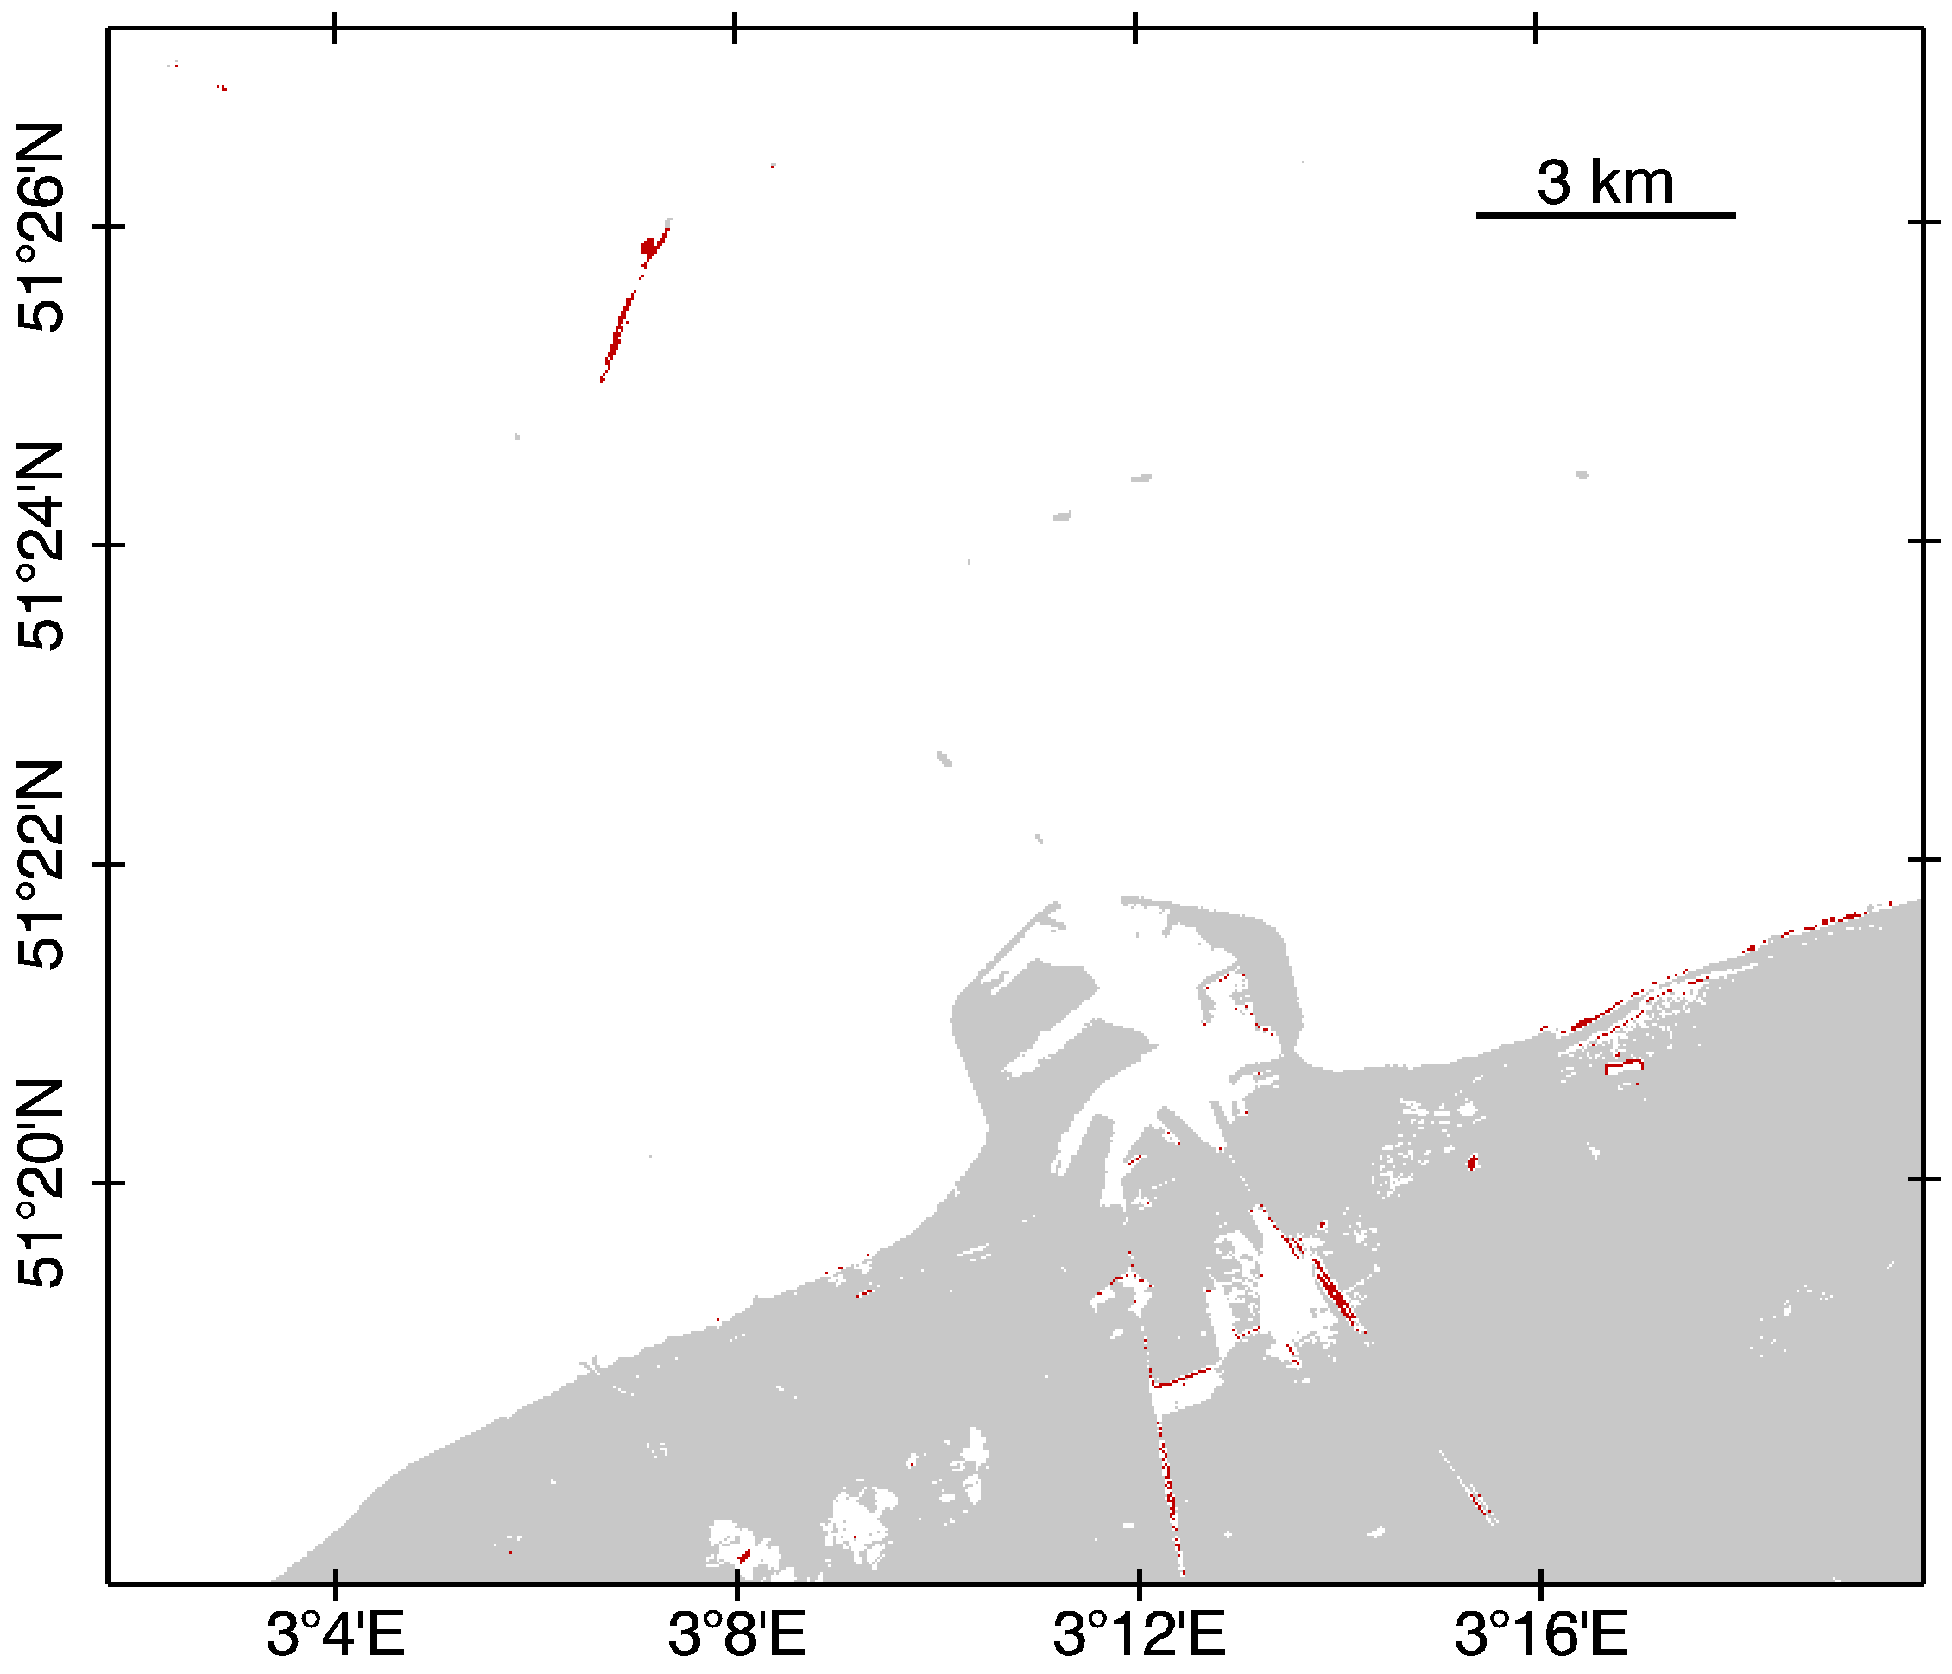
dredger plume
cloud shadow
problems
Vanhellemont, Q., Ruddick, K., (2015). Advantages of high quality SWIR bands for ocean colour processing: examples from Landsat-8. http://dx.doi.org/10.1016/j.rse.2015.02.007

Slide 36
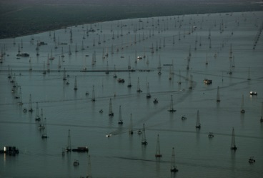
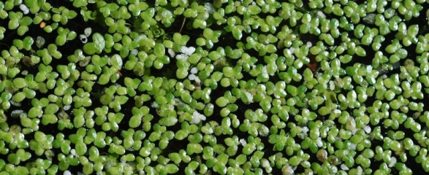
Venezuela/Lake Maracaibo– 2014-02-27
Landsat-8 / RBINS processing

Slide 37
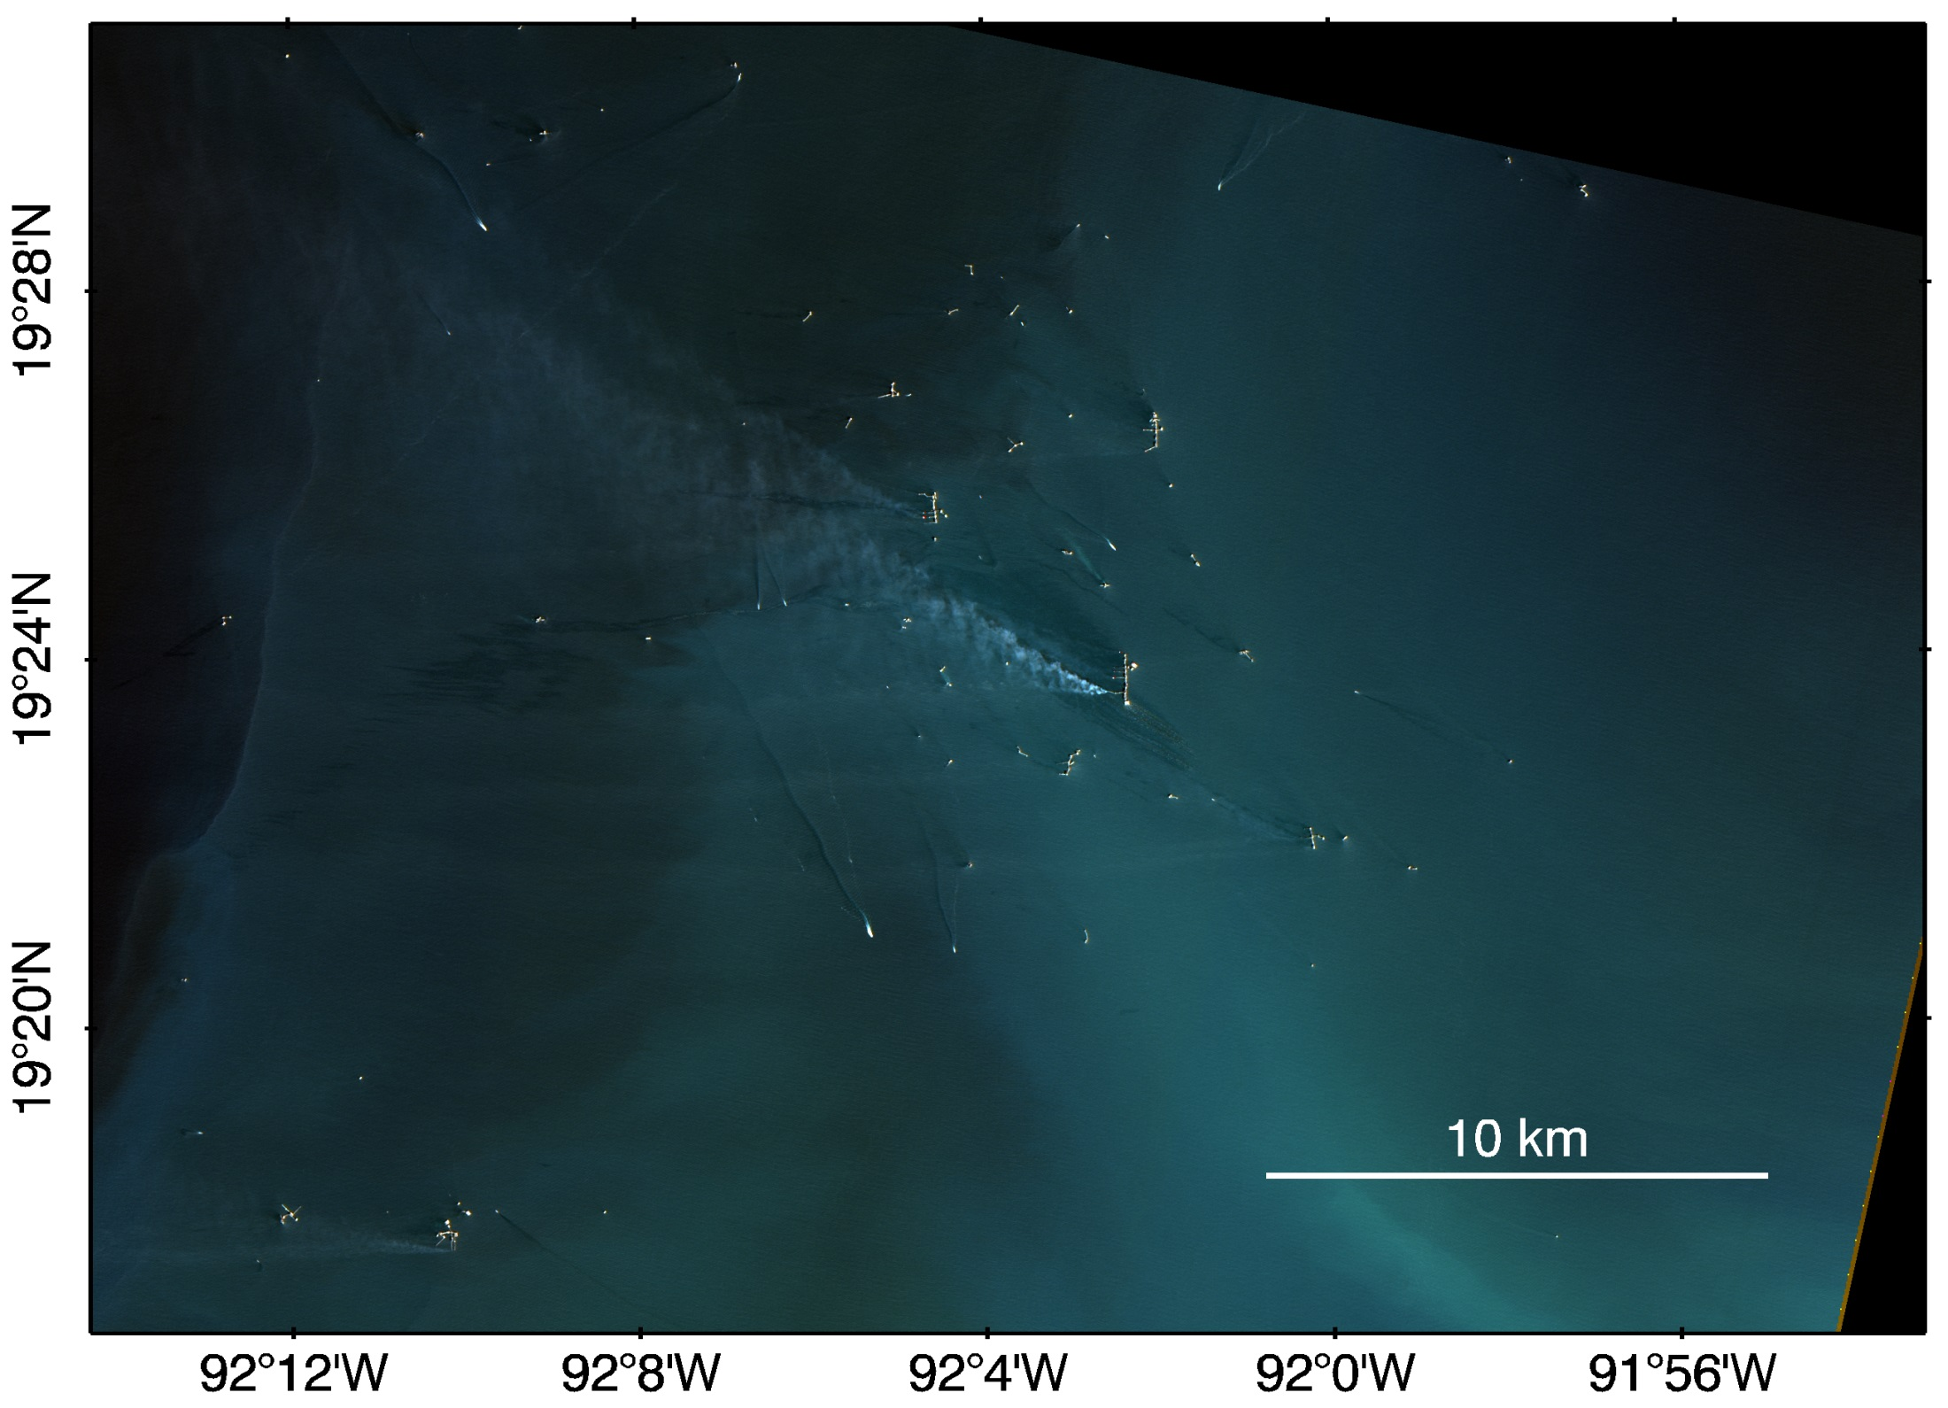
Gulf of Mexico Oil Rigs - 2015-02-23
Landsat-8 / RBINS processing
gas flares
turbid/surface wakes
smoke
oil slicks?

Slide 38
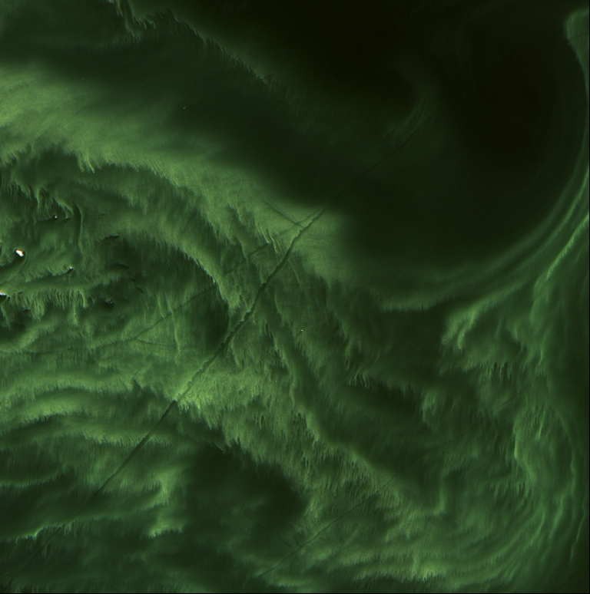
Sweden/AOC Gustav Dalen – 2014-07-21
Landsat-8 / RBINS processing
Aeronet-OC Gustav Dalen

Slide 39
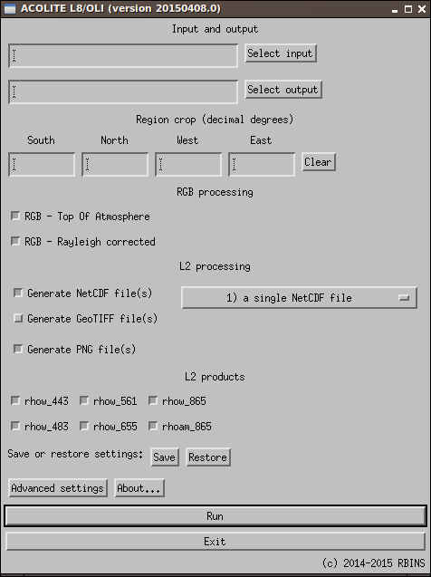
ACOLITE
Fast L8 image processing
full tile or cropped to region
batch mode option
Makes RGB images
TOA or Rayleigh corrected
Pan-sharpening
V&R NIR or SWIR atmospheric correction
Output in NetCDF / GeoTIFF / PNG
Possible outputs:
marine reflectance
aerosol reflectance
extra: rtoa, rrc, spm, t, chl_oc, fai, ndvi …
Tweakable AC settings
http://odnature.naturalsciences.be/remsem/acolite-forum/

