Slide 1
Lab 3
Part 2
Particle Absorption
And Pigments
Ocean Optics 2017

Slide 2
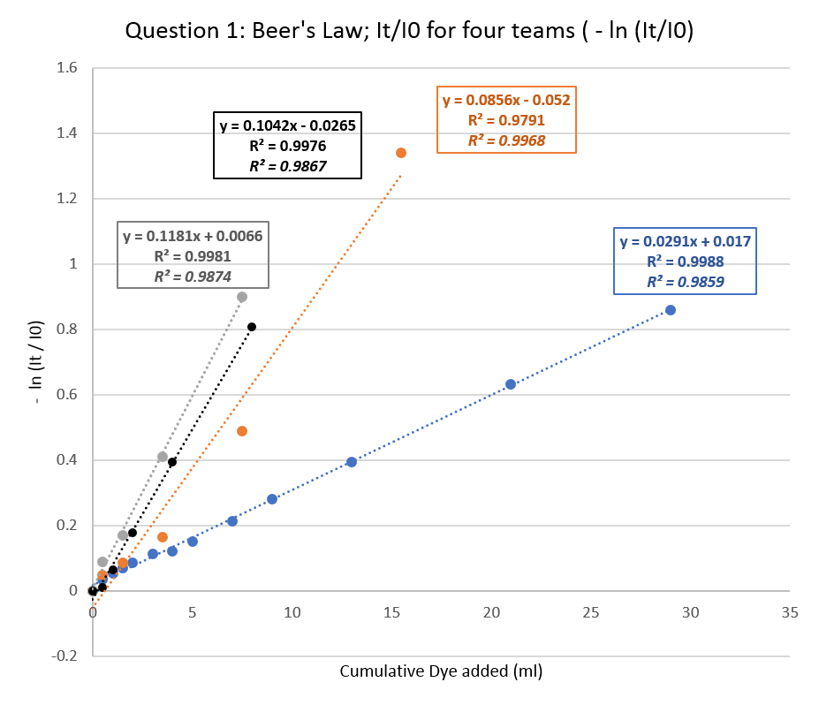
Revisiting tank and dye Transmittance from Lab 1
Notes:
You would expect a factor of 2 maximum slope change
R_Sq depends on dynamic range so it’s not really useful statistics … add median difference, average difference….
We still have no sense what’s the average deviation of this line

Slide 3
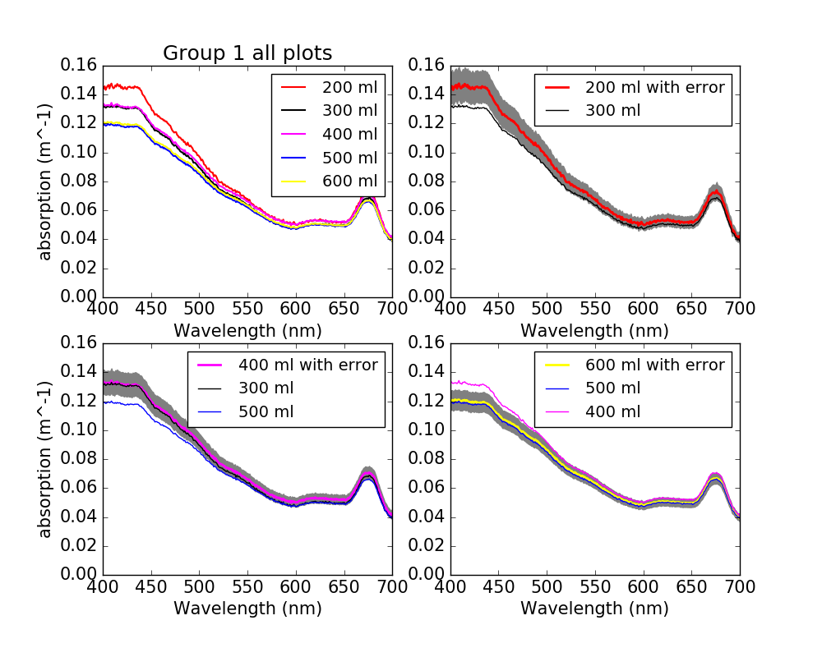
Revisiting error propagation from path length correction in converting Absorption to absorbance

Slide 4
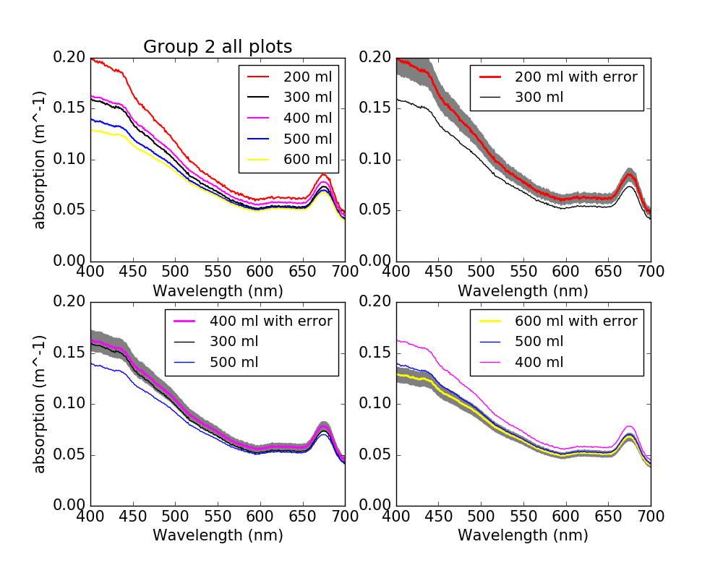
Revisiting error propagation from path length correction in converting Absorption to absorbance
Notes:
Difference depends on the volume of filter
Replication between the groups shows a difference - another source of error (due to DEGRADATION!)
Largest error is in NOT MIXING THE SAMPLE
Higher V samples will have less absorbing matter - type of error we cannot quantify!
300 and 400 were poured at the same time - 2nd set
500 and 600 - 3rd set
Thus the match between each of those 2 sets! Voila’! :-)

Slide 5
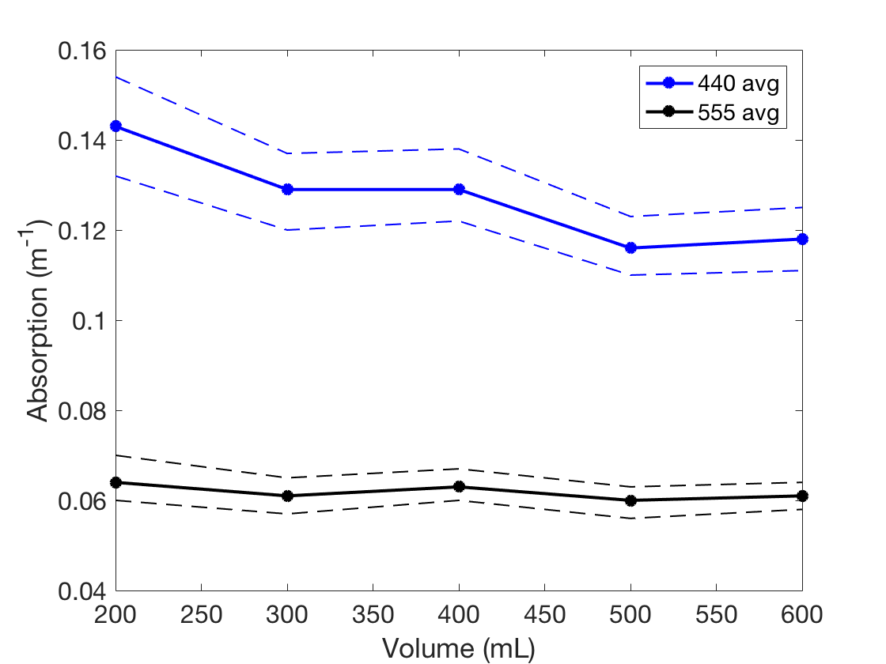
Revisiting error propagation from path length correction in converting Absorption to absorbance.
D=+/- 0.5 mm
V=+/- 5 mL
Notes:
Error in terms of filtration - looks the previous slide. The change isn’t due to the correction from absorption to absorbance, it is something else.

Slide 6
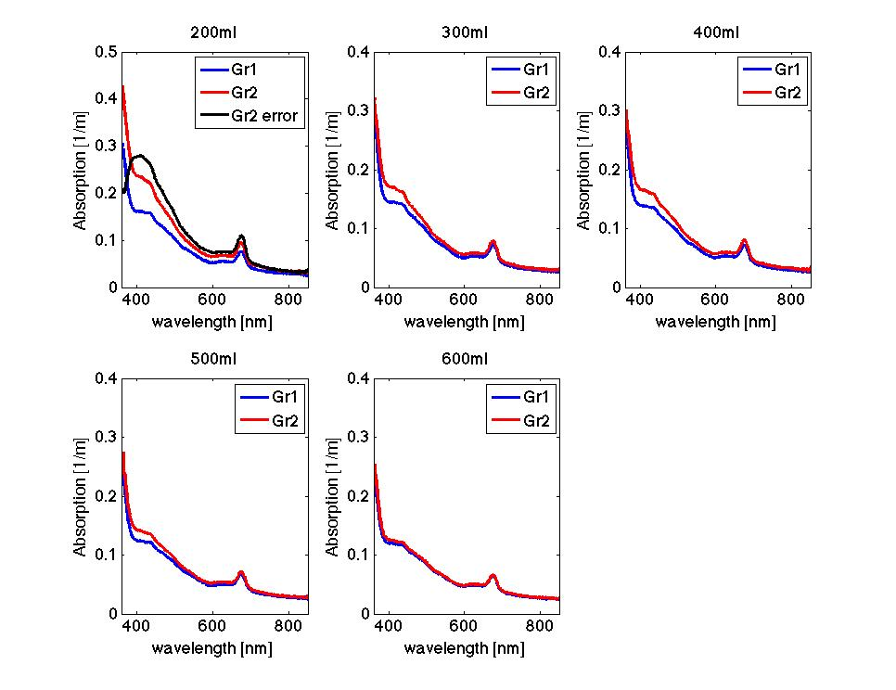
Notes:
Revisiting differences between different volumes of filtered sea water.
Data from yesterday

Slide 7
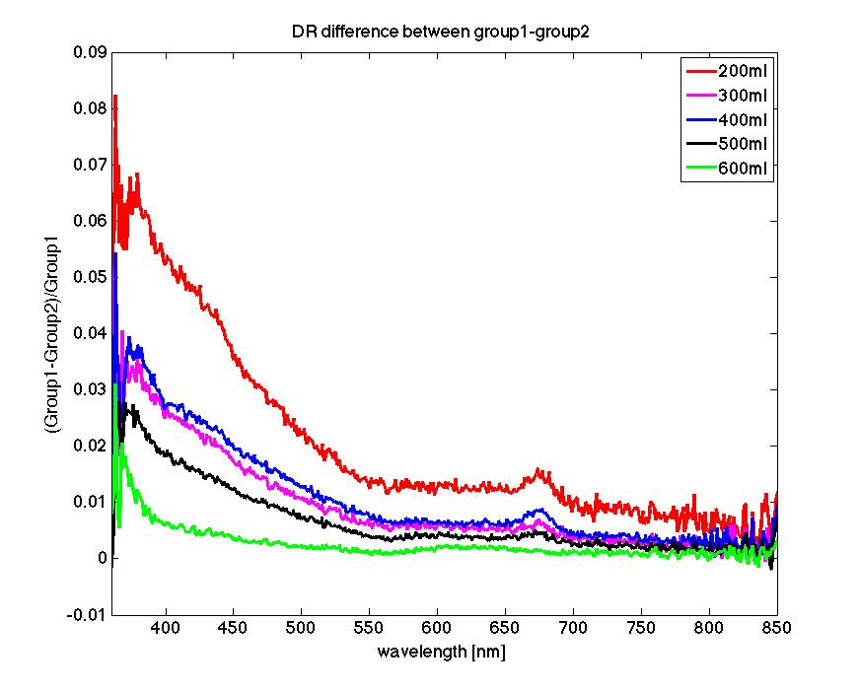
Notes:
Difference proportional to the signal. Collin thinks it looks like a NAP curve with a peak in the red . Phaeophytin absorbs at 676, thus the blob?

Slide 8
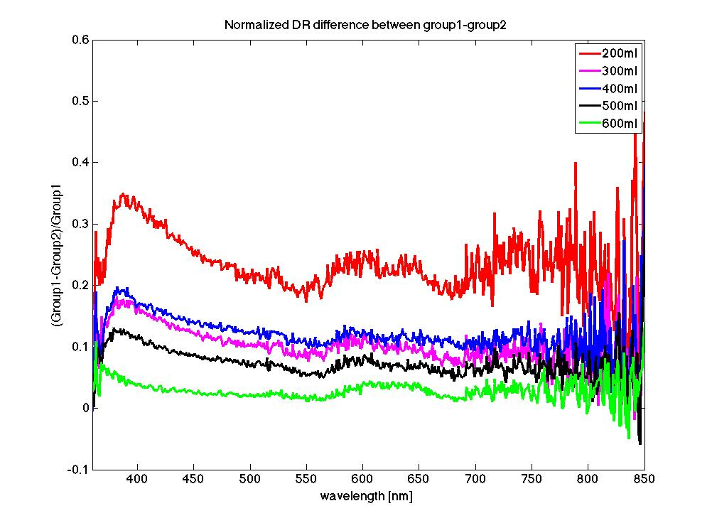
Notes:
It’s more or less of the same stuff
Treat your samples carefully and run them quickly! The difference is due to degradation - at 600 ml you could have a lot of self shading thus the abs lowers with larger volume? Is that correct?
Features of salt? -- between 600-650nm?

Slide 9
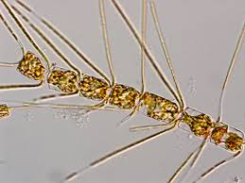
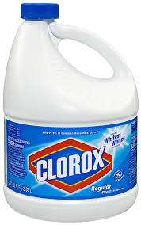
Cary Spec Testing
vs
Notes:
Effect of bleaching of the sample

Slide 10
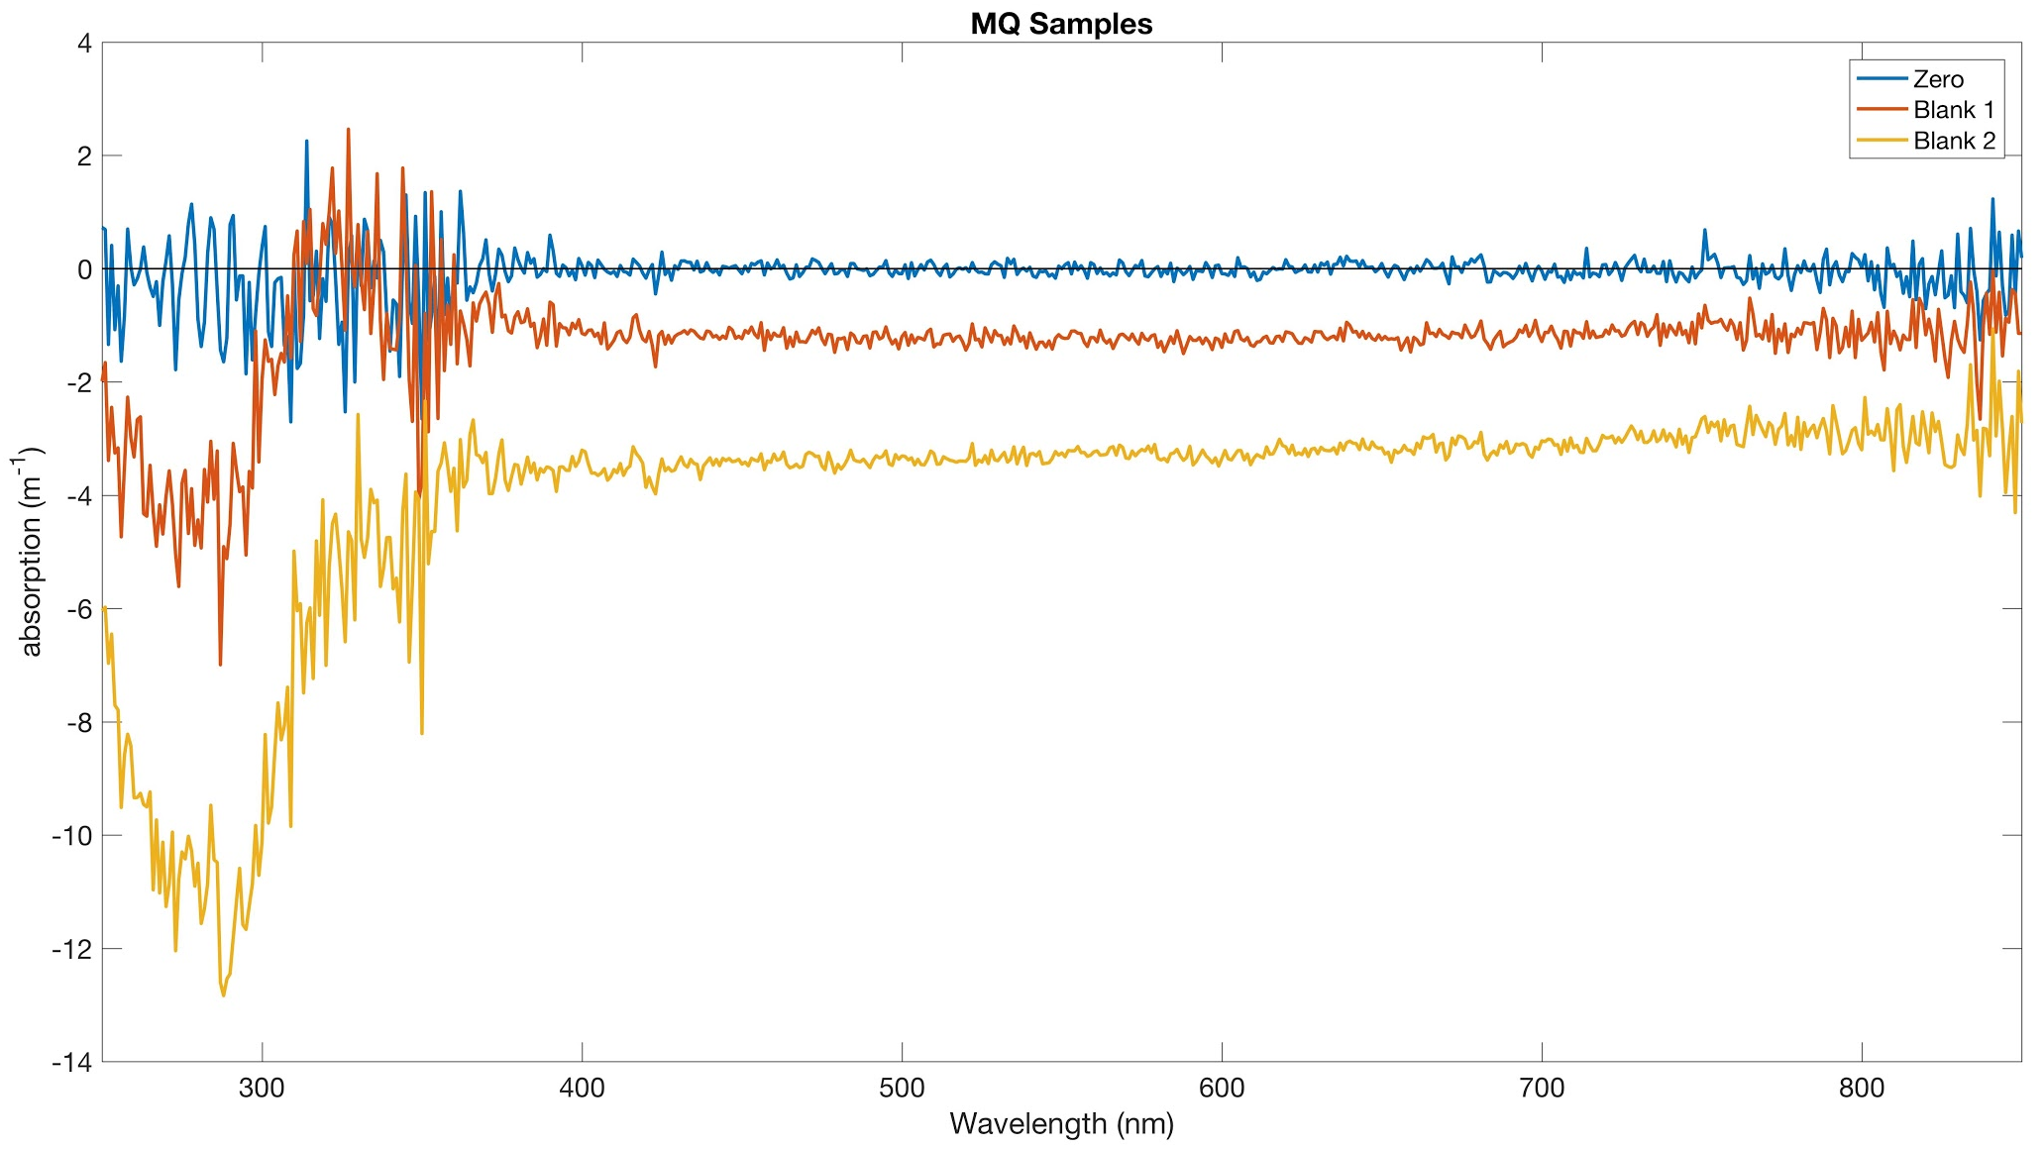
Milli-Q drift on Cary Spec
Notes:
Spectrophotometer gave craaaaazy values in the near UV - drift of he instrument
Uncertainty here is like 2, which is high for Milli-Q
How much can the subtracted vary with different Milli-Q measurements

Slide 11
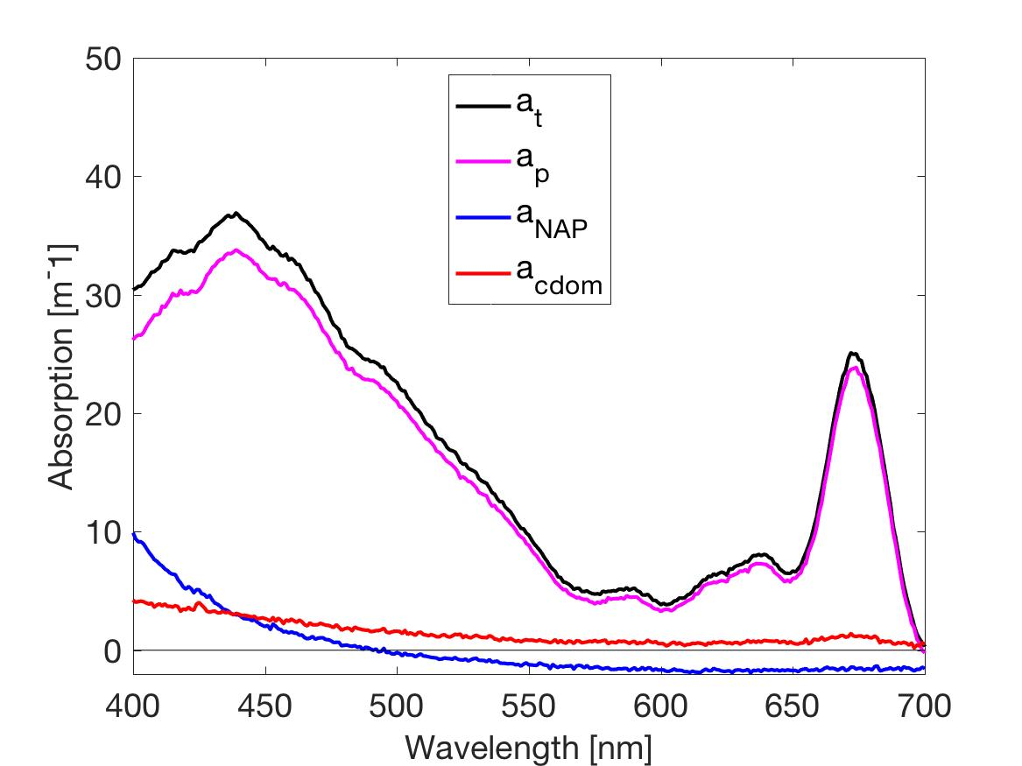
IOP’s not corrected by equipment drift
Notes:
The uncertainty compared
0.1-0.4 in a 1cm couvette needs a lot of stuff inside .
The integrating sphere is really only made for cultures and filter pads, which have really high absorption. Natural waters don’t do so great, which is why you don’t compare the spec to the Cary.

Slide 12
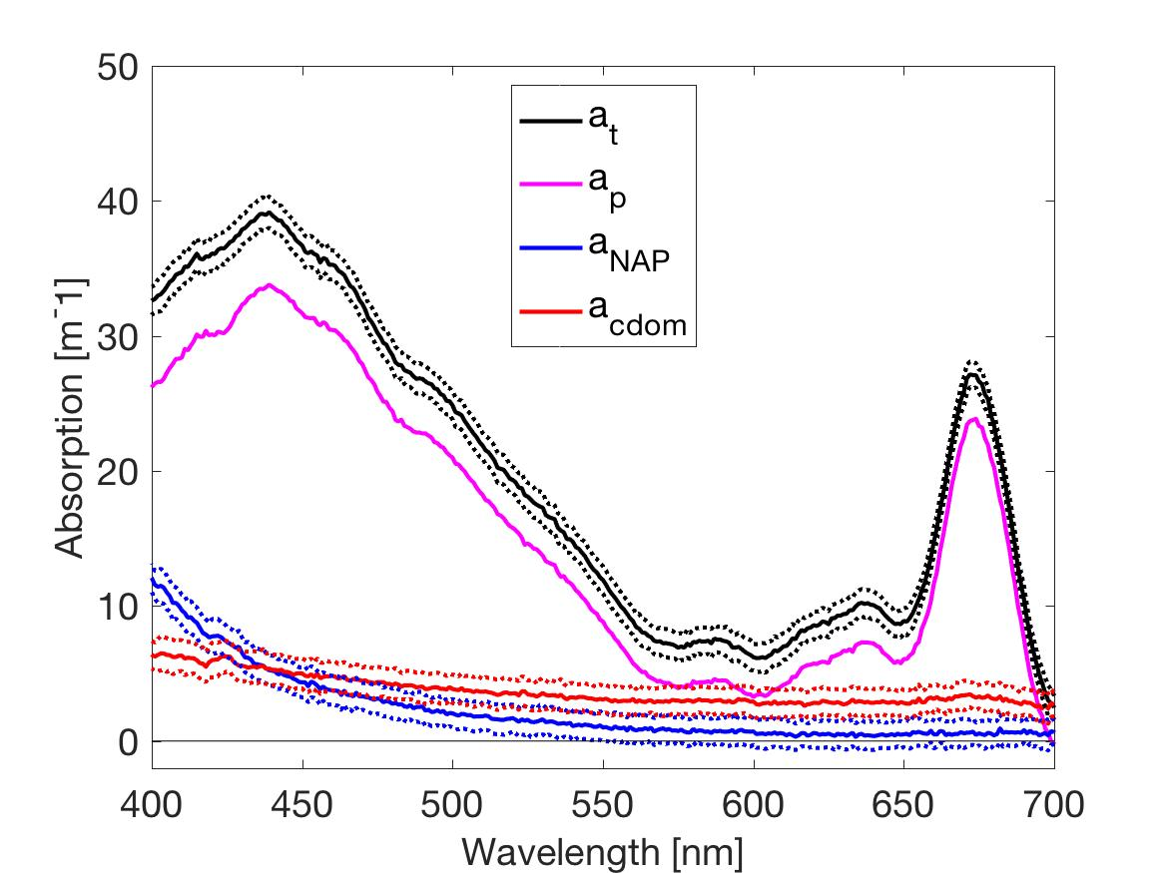
Drift Corrected IOP’s

Slide 13
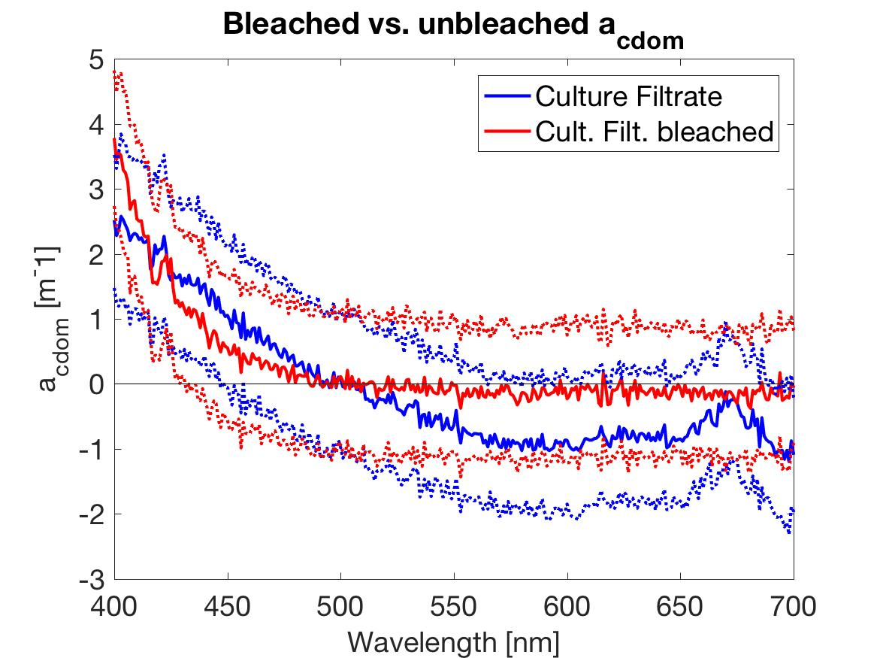
Notes:
Solid lines - blue before the bleaching, red after. Bleaching boosts the absorption signals

Slide 14
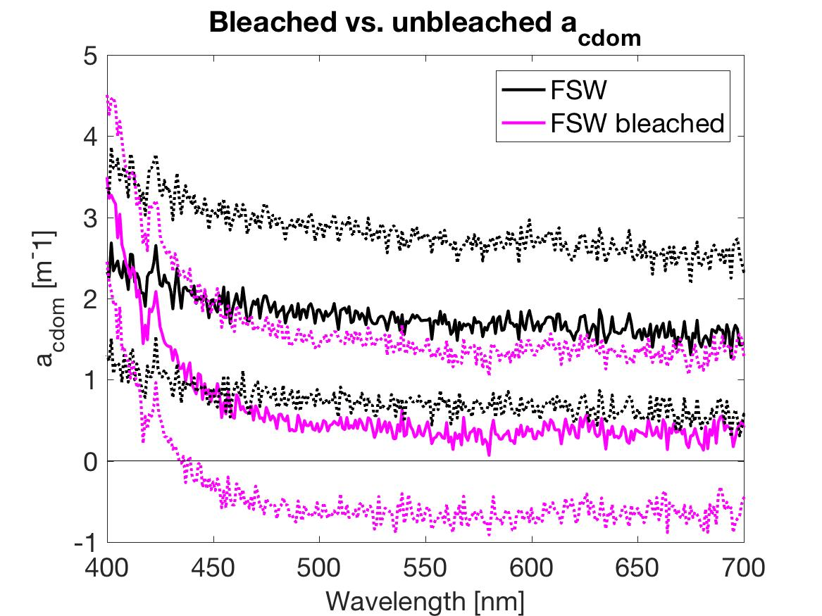

Slide 15
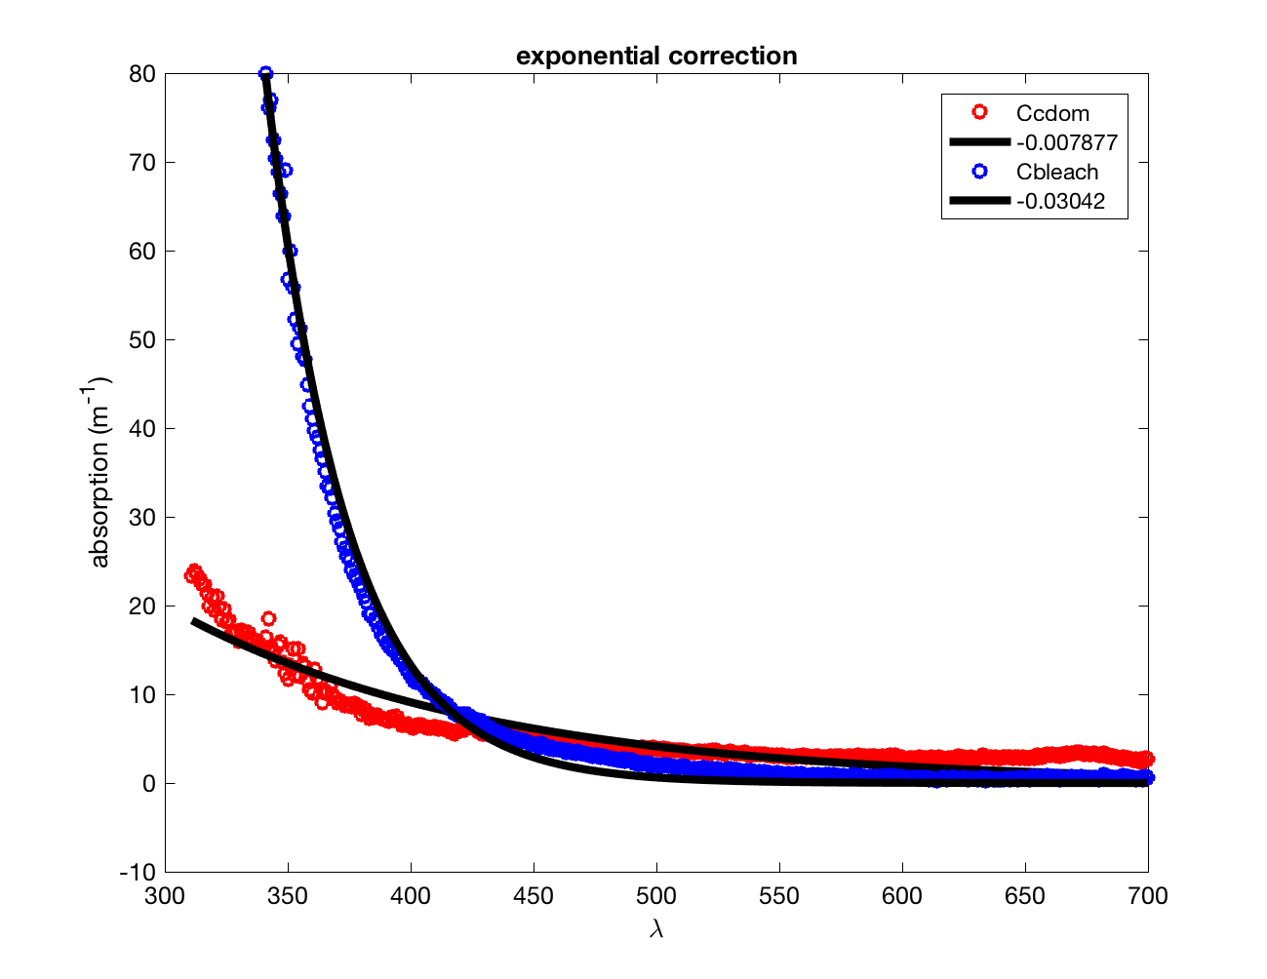
Exponential fit for CDOM
Notes:
We should fit with an OFFSET!
The red CDOM curve doesn’t go to 0. If you add a constant if will fit your exponential

Slide 16
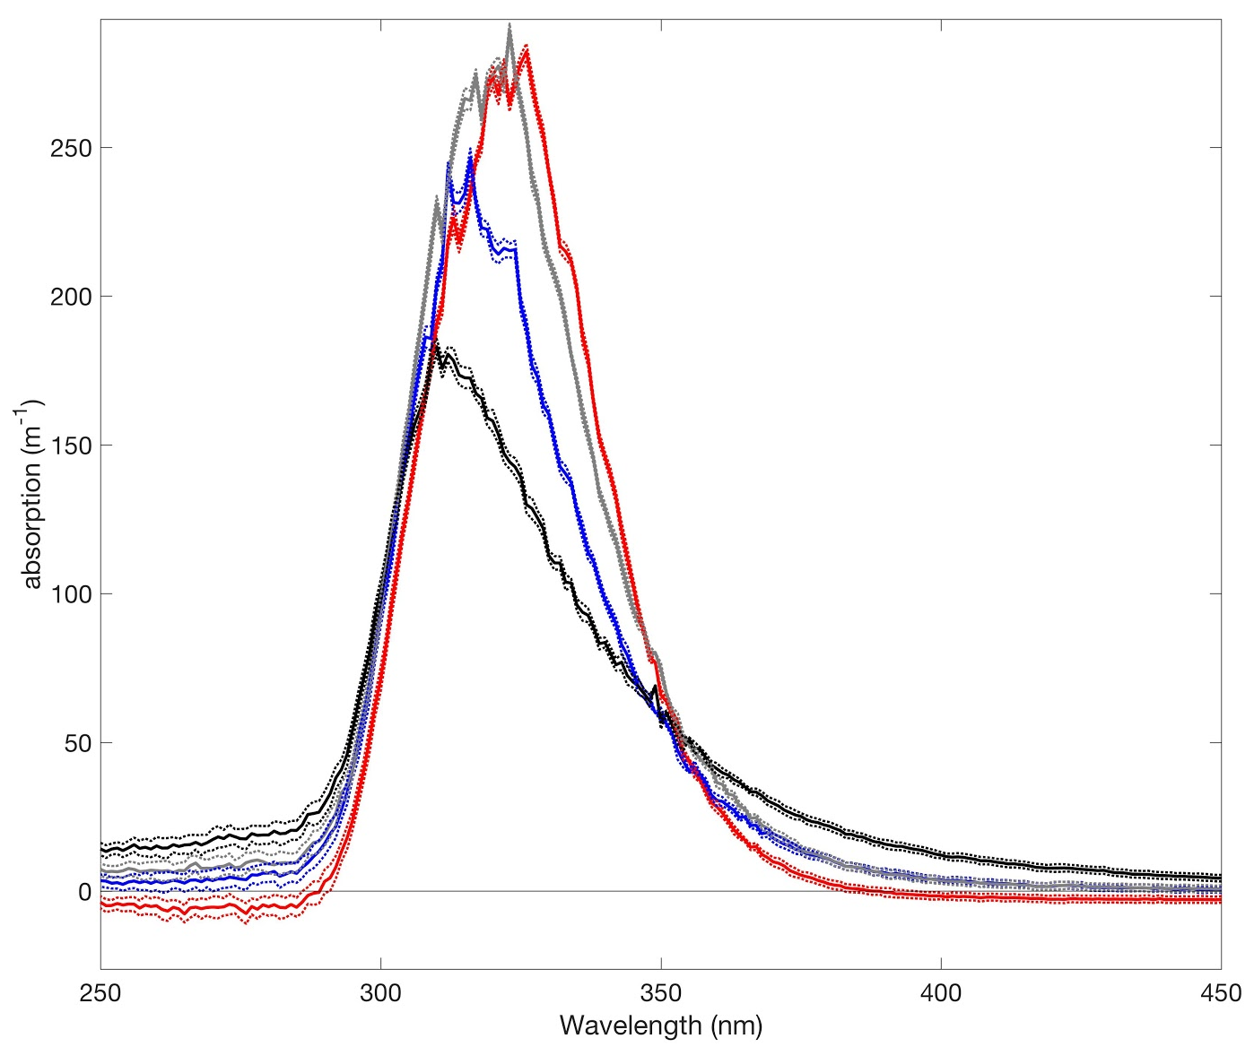
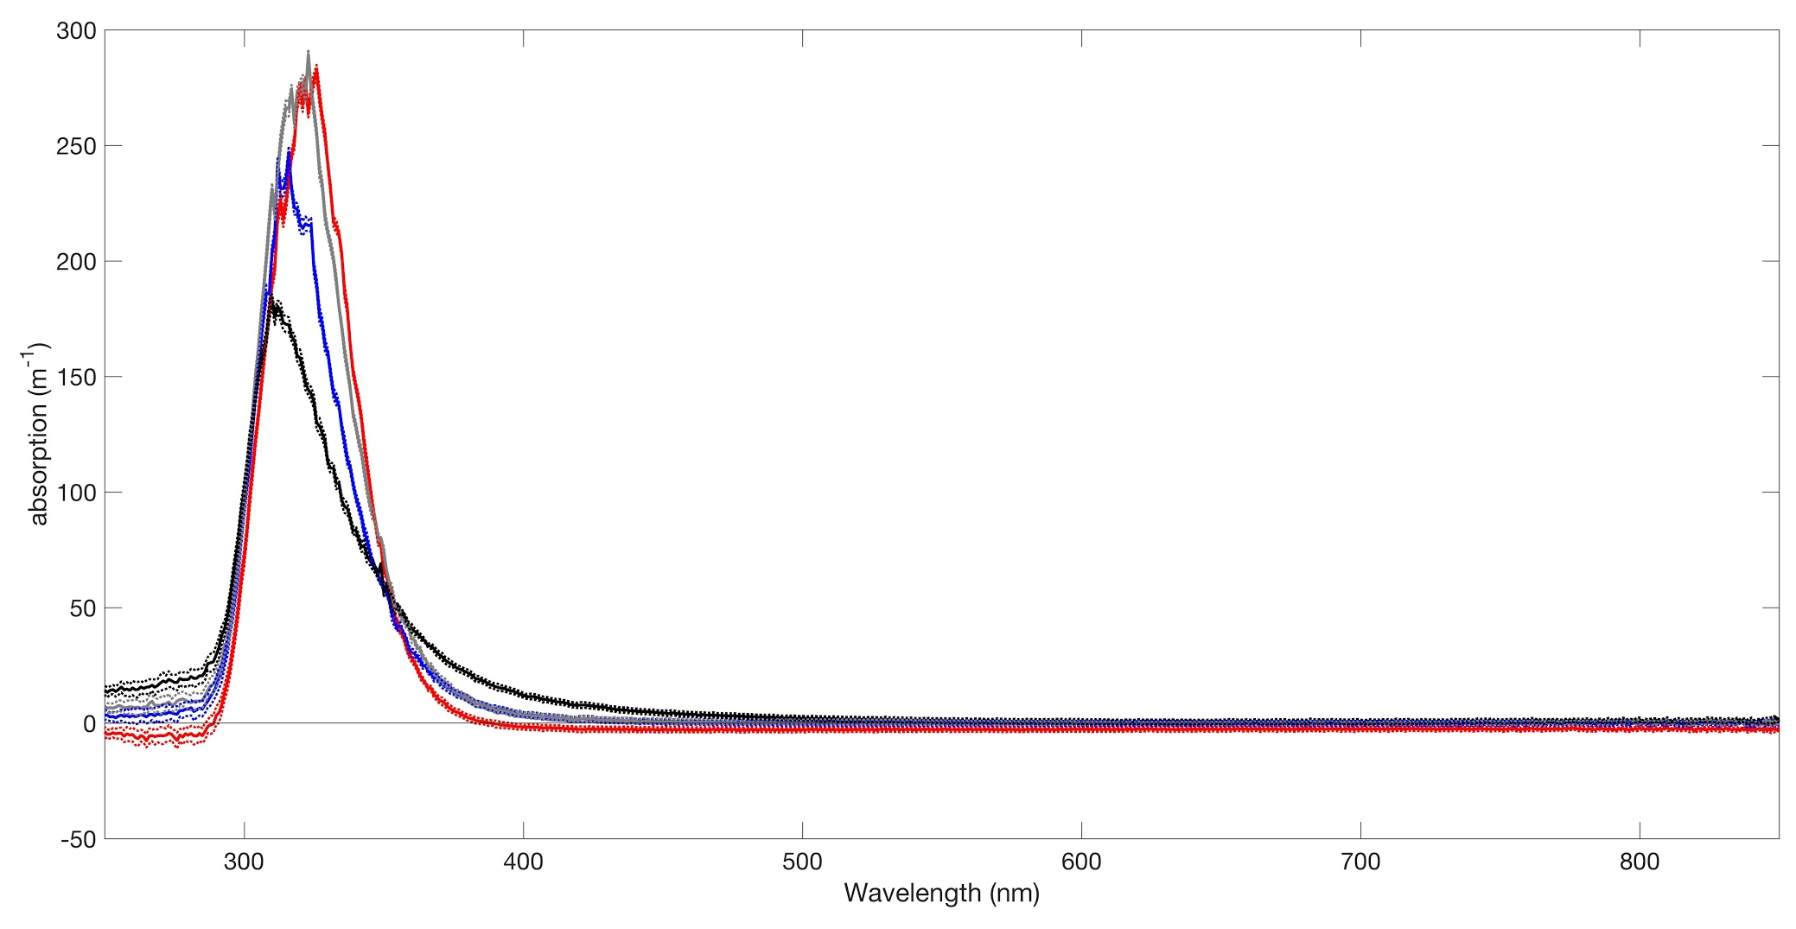
Bleach
In the UV
DRE water, filtered bleached
BLEACH!
Filtered culture, bleached
Total Culture,
bleached
Notes:
Looks relatively flat in the optical and NIR
Getting absorbance peaks in the UV
We know we have to interpret that cautiously because the UV is where we saw the biggest drift,
But when we zoom in, we see something really interesting
Antimicrobial properties denatures bacteria
As salts of a weak acid, hypochlorous acid, hypochlorites ionize water to produce hydroxide anions, thus increasing pH:
Ph of bleach is 12.6, DRE ph = 8.4
COMMENTS:
From 250-350 were added
ABS in the UV
lowest abs slope = total culture;
higher abs slope = filtered culture,
bleached, even higher;
DRE water, filtered, bleached = highest
DO THE DIFFERENCE SPECTRUM
Subtract each of the samples from the bleach and see what does spectra look like between 350
Red curve - absorption spectra of the bleach
In organic bleach produces COLOR in different regions

Slide 17
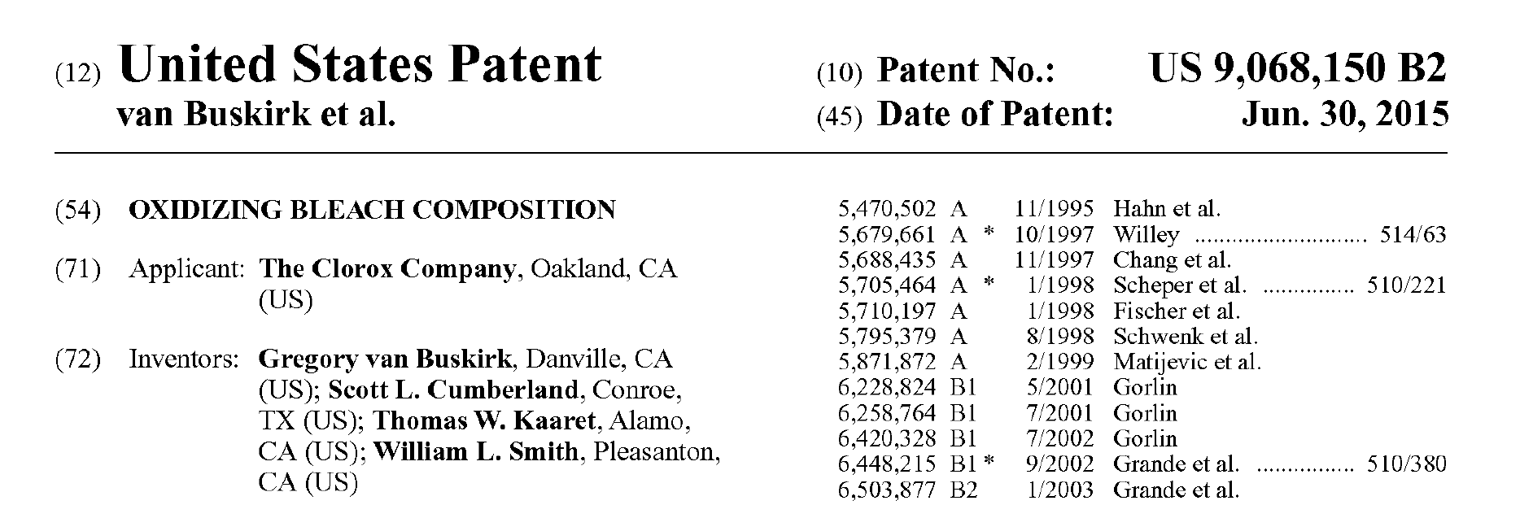
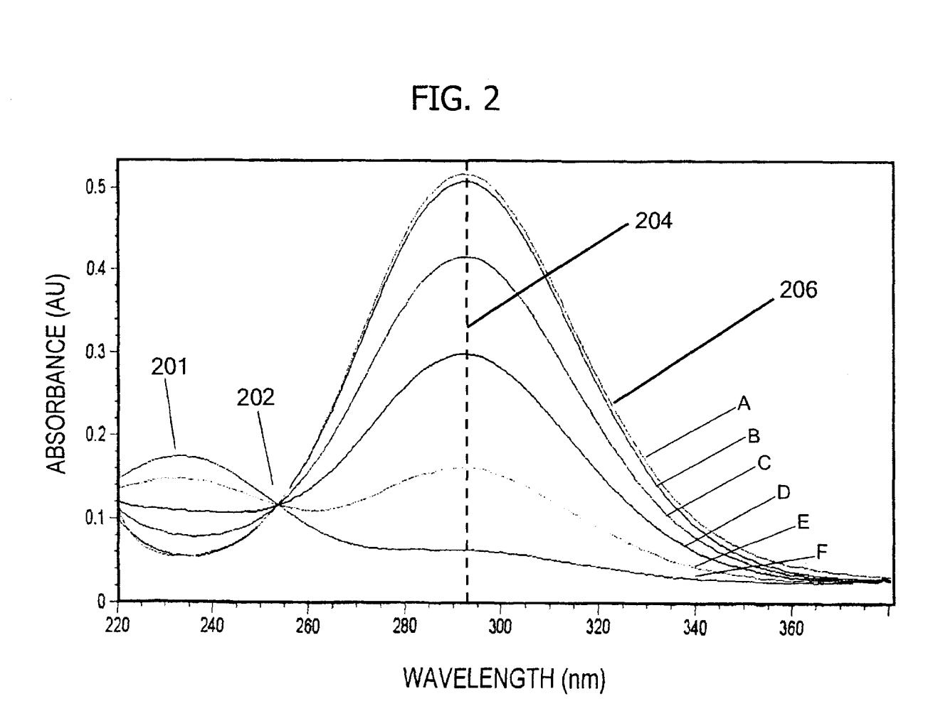
Bleach Absorbs!
Peak around 290
Notes:
Sodium hypochlorite NA Cl O
Sodium, chloride, oxygen
Some things we could check
response to pH change
There is a peak 296 nm ??
The change in the slope is due to the cut of the molecules … longer molecules absorb more in the UV.
You “chop” molecules into smaller ones
We guess we don’t want to use bleach :-)
We COULD use bleach to tell us something more about the organic composition (shorter vs. longer molecules) ?

Slide 18
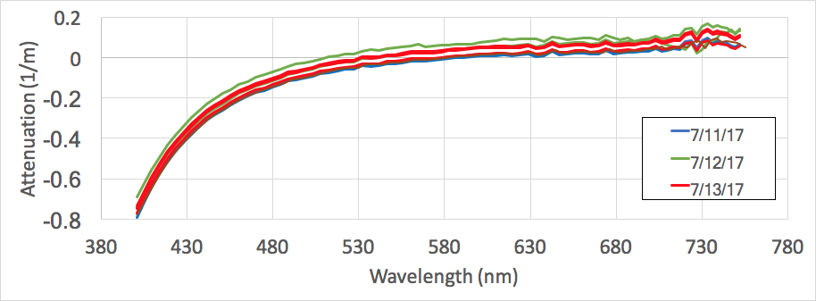
ACS - 017 Calibration

Slide 19
ACS - 022 Calibration

Slide 20
AC9 Calibration

Slide 21
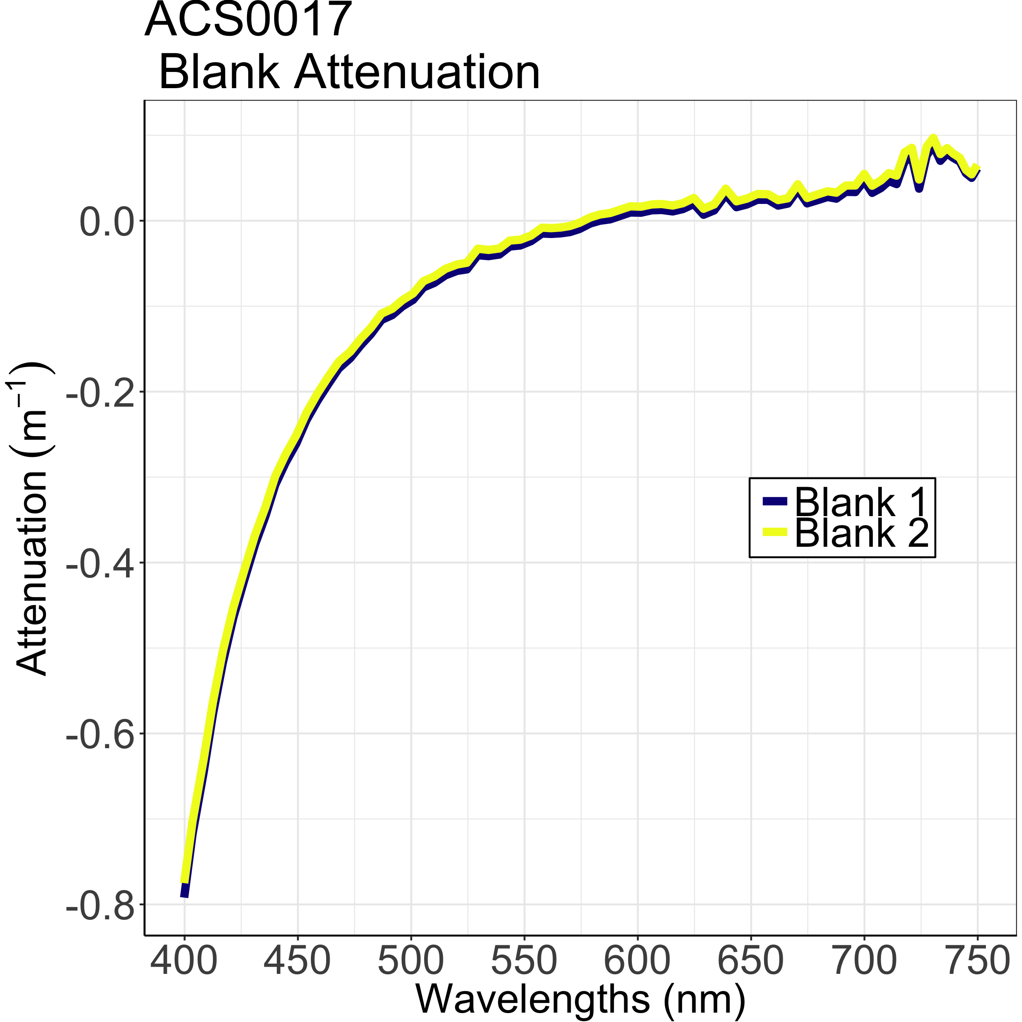
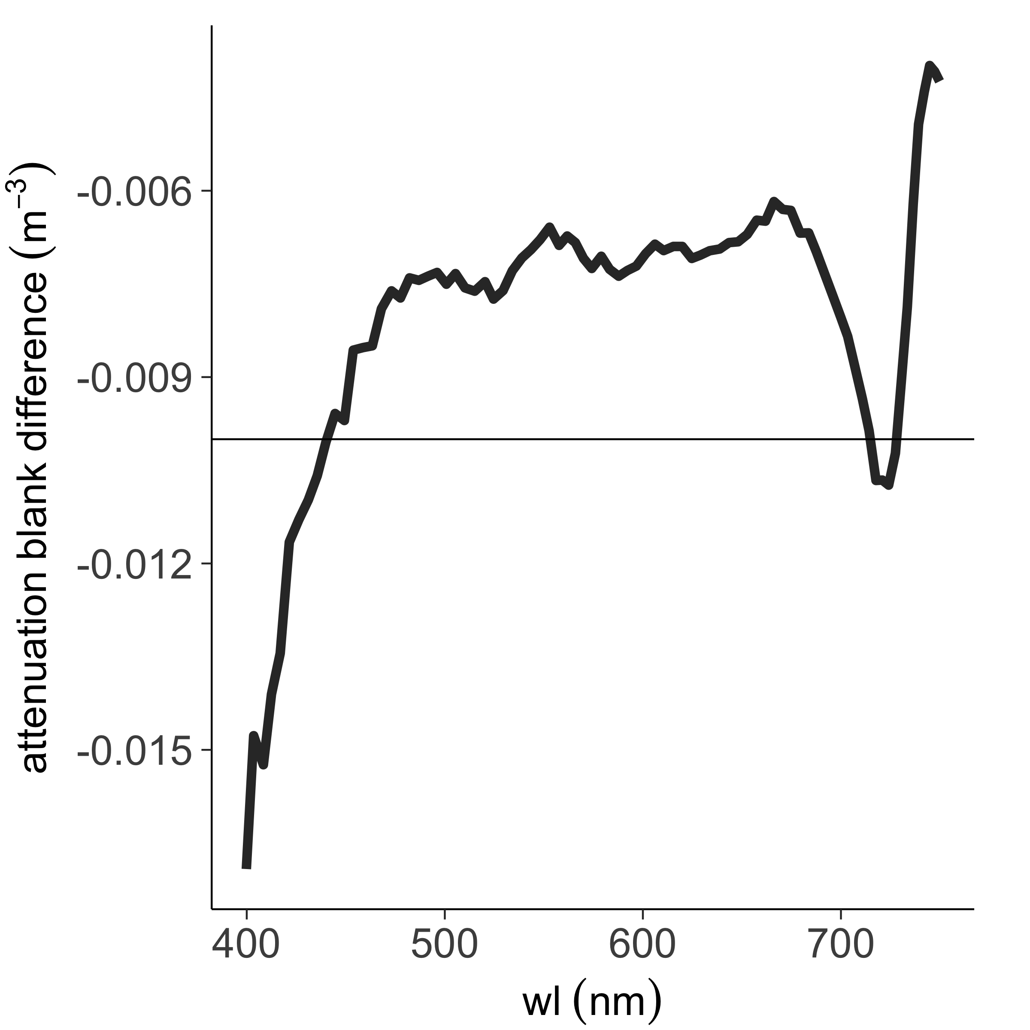
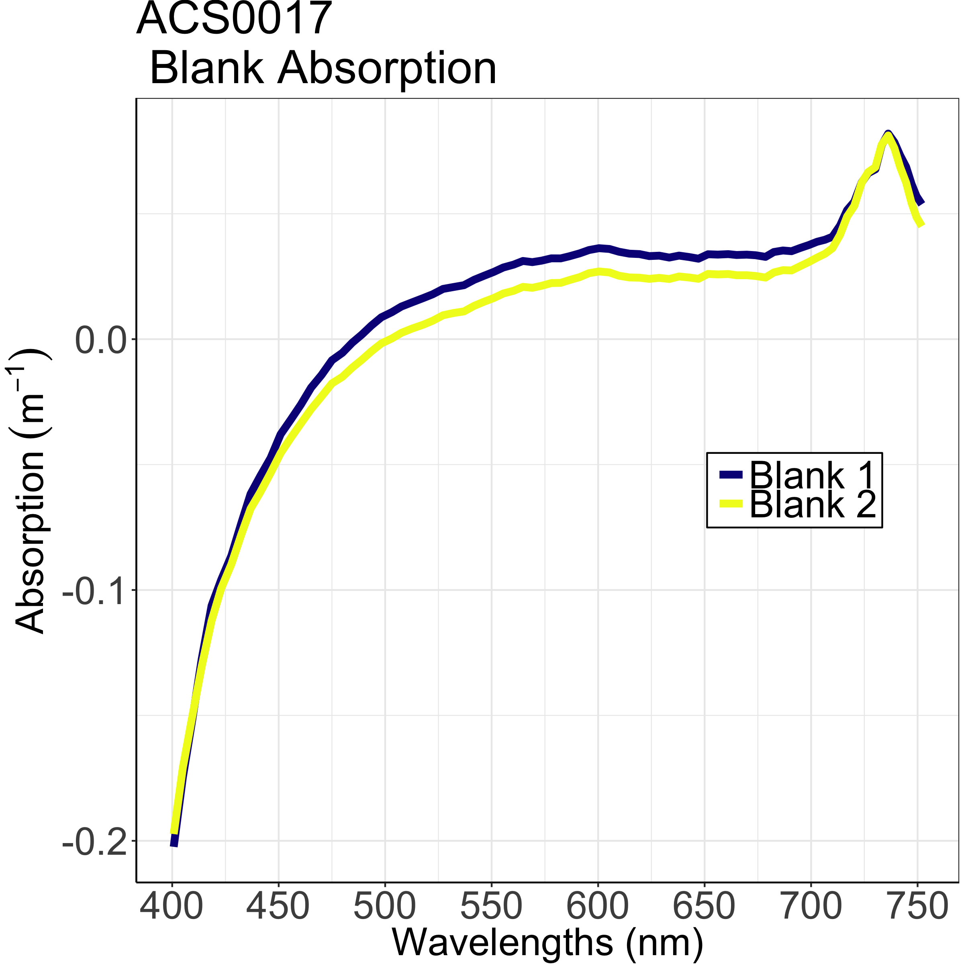
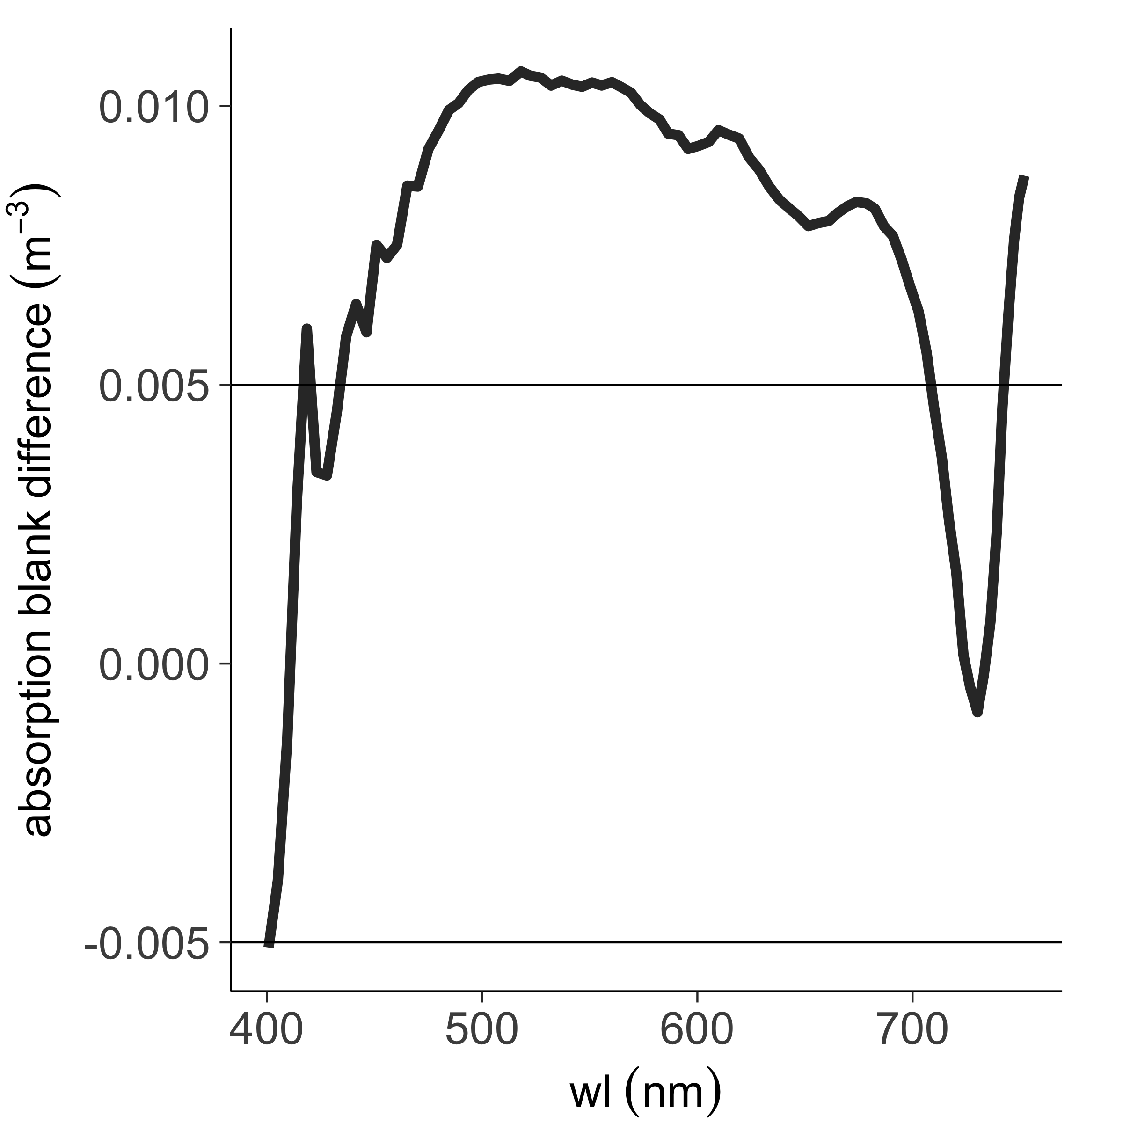
Difference in blanks ACS
Difference between
Calibrations
Should be within
0.01 m-1 for the attenuation
It is not in the blue !
Should be within 0.005 m-1 for the absorption
It is not in the green !
Notes:
Error will be higher in the (a) tube below 450 there is uncertainty in the light source.
You can see the temperature correction - we are getting better at our correction

Slide 22
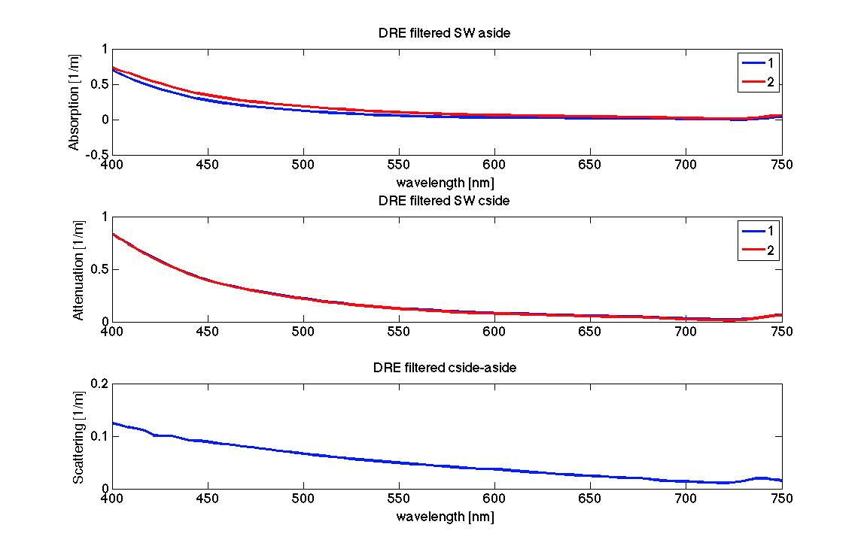
CDOM Scattering
Notes:
They did a better job of getting a c-side down to zero, but you still see a signal in the near IR
This is the samples that we thought had bubbles from yesterday. You can see there is still some scattering in the ~700 range. The scattering is flat (isotropic) which means it is probably small particles.
Empirically the scattering in the 700 range should be zero, but here we see there is a signal even though this is just the CDOM. Some papers suggest particles can reform after you filter, so EB thinks that maybe marine gels are reforming into particles. It could be gelation, it could be CDOM scattering.
The literature shows that CDOM doesn’t scatter significantly enough for us to observe with our instruments.
The scatter here makes up 10-20% of your signal.
EB says you should filter close to the time you measure, but filtering also could entrain bubbles.
Constant reminder: You can’t get closure for particles and dissolved, you need to capture the <0.2, <0.7, >0.7 size ranges

Slide 23
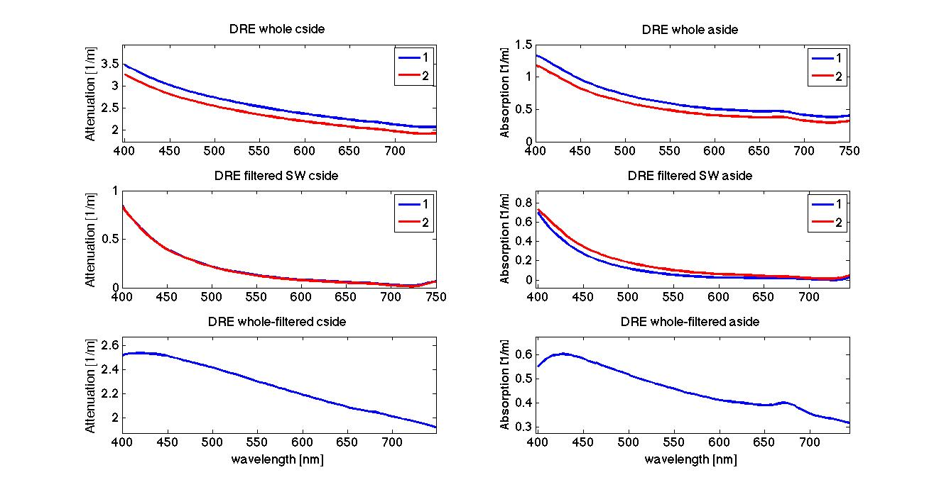
Particle Absorption
Particle
attenuation
Notes:
Scattering + absorption of the particles in bottom left. The NIR is offset because it’s interpreting backscatter as absorption. Here we are very biased, because we can’t capture the backscatter!!

Slide 24
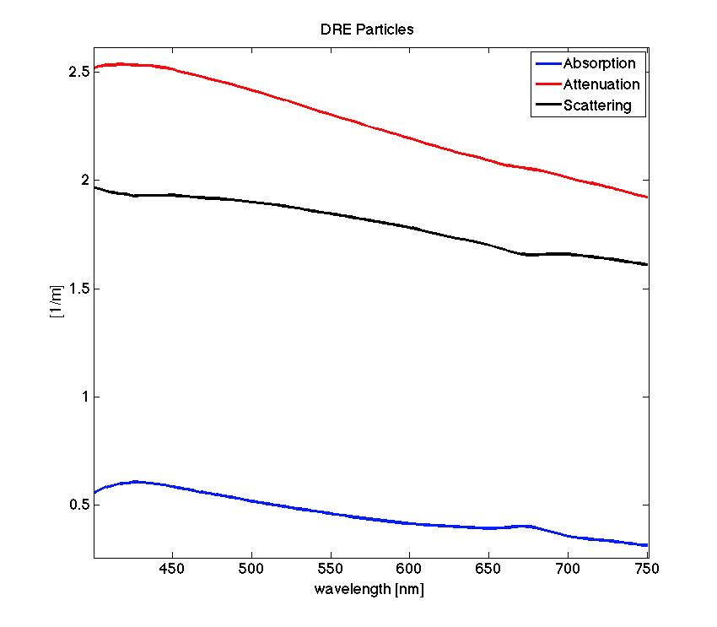
Notes:
Particulate Absorption = whole DRE - filtered DRE
If you fit a slope to the attenuation curve you will get particle size.

Slide 25
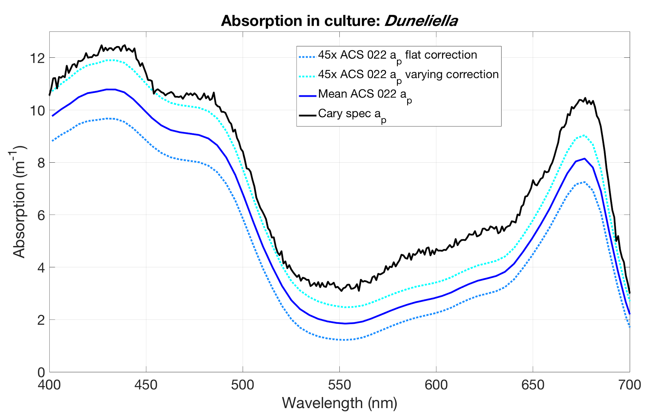
Spectrophotometer / AC-S comparison
Notes:
This can go at the very end if necessary!

Slide 26
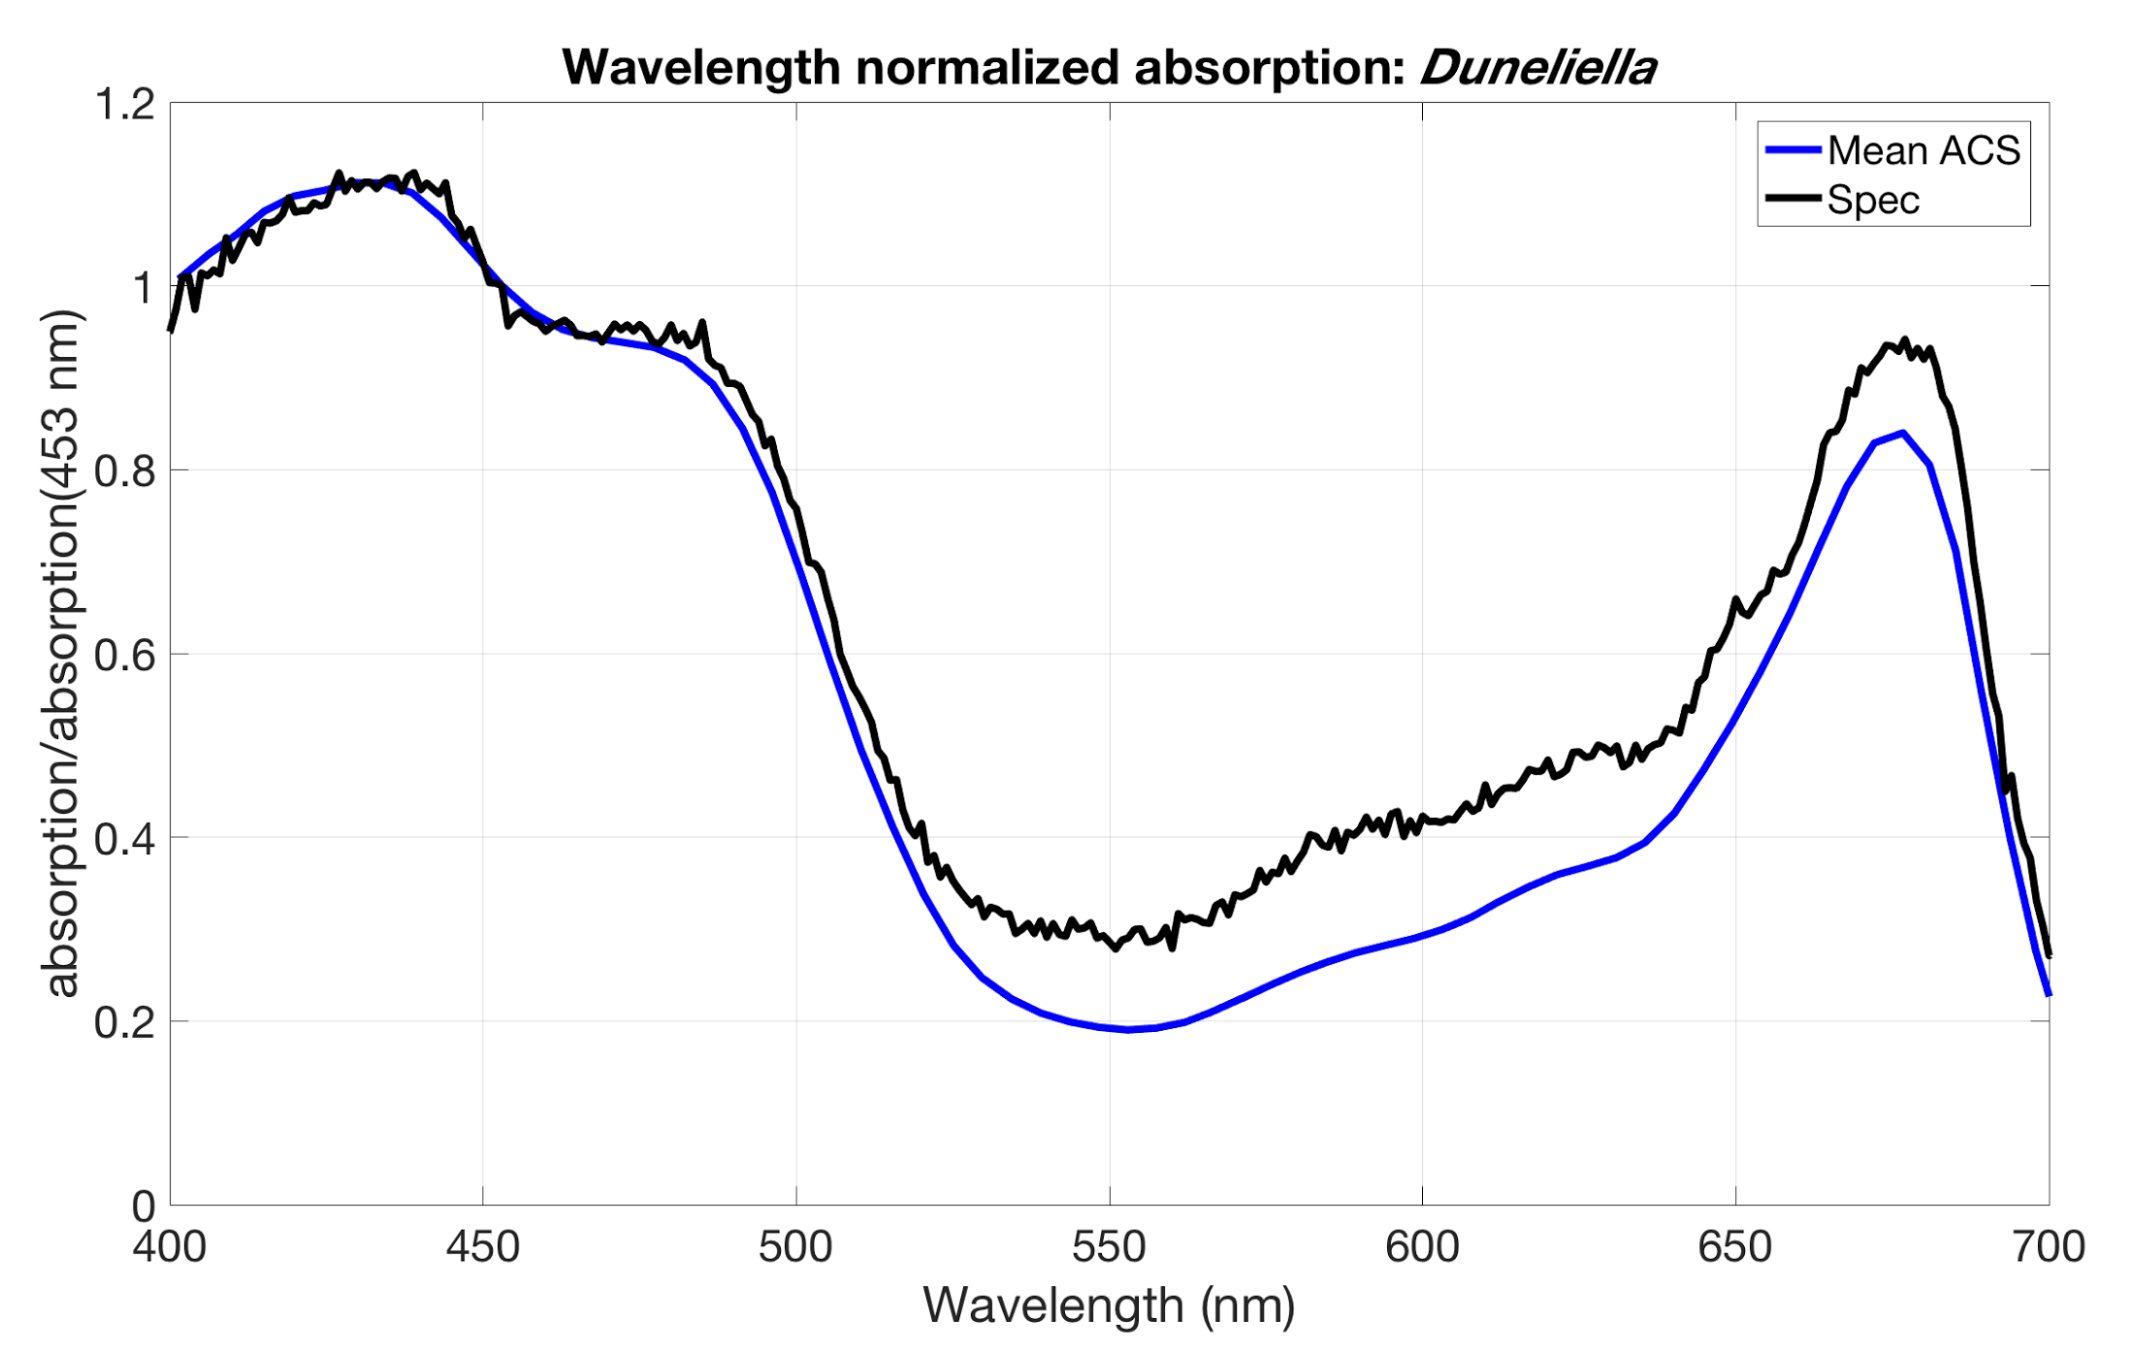

Slide 27
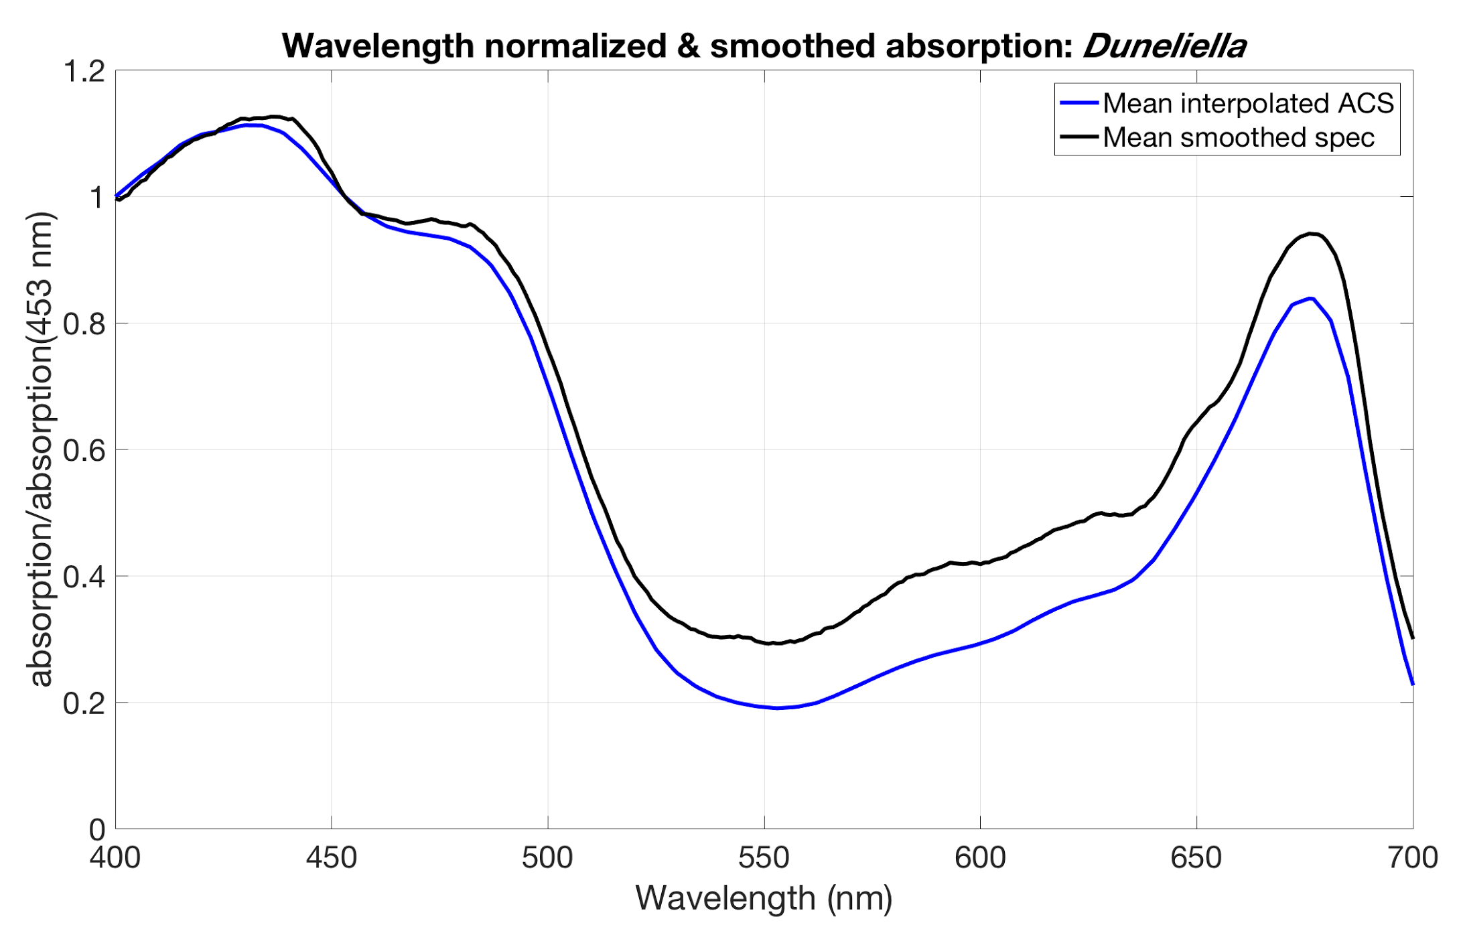
Notes:
Interpolate ACS data for the spectrophotometer wavelengths

Slide 28
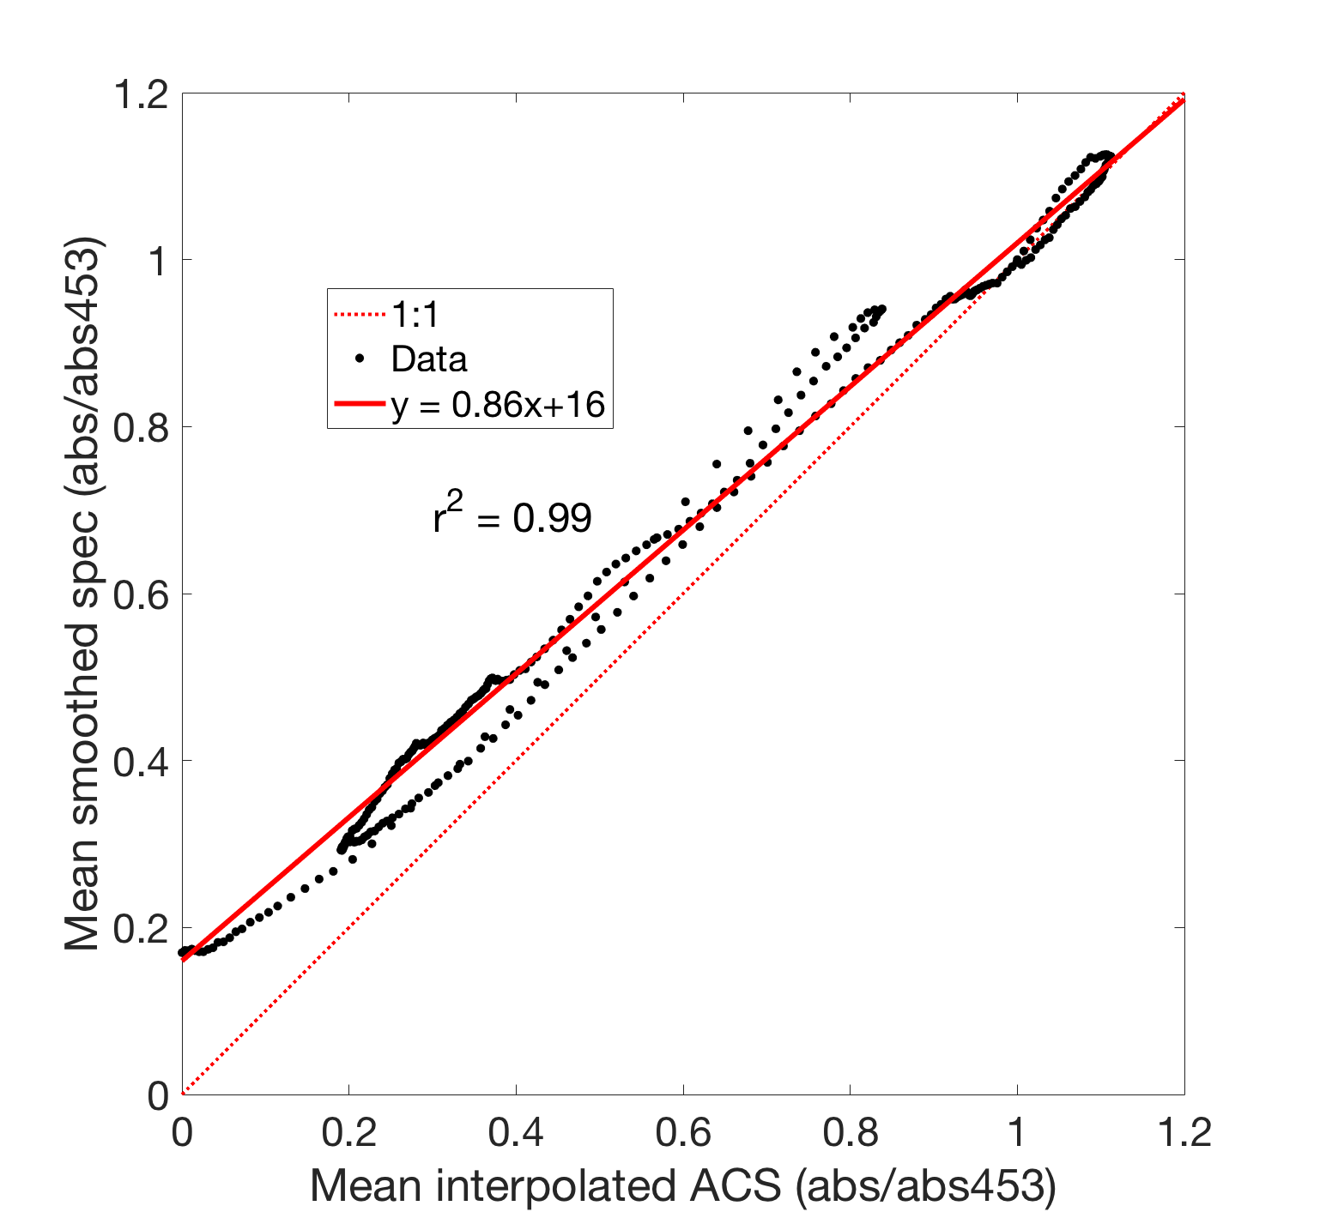
Notes:
Couvette spec has an offset

Slide 29
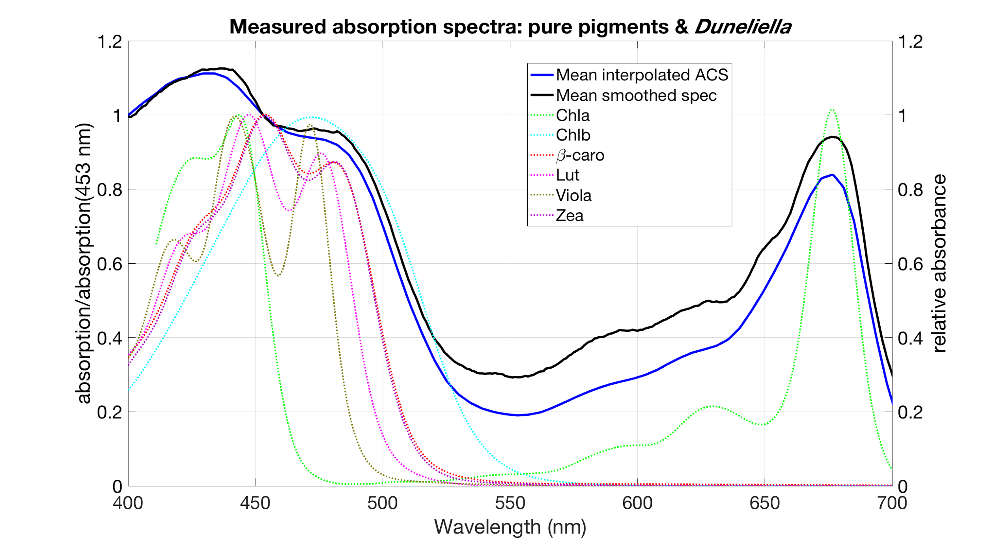
Pigment spectra from Thrane et al 2015
Notes:
Pigment absorption is measured in a solved and not in a cell, thus a shift in the peak
You can take the ratio and observe the degree of packaging
Heidi Dierrsen: cool paper about packaging (molecular - chloroplast - cell level)

Slide 30
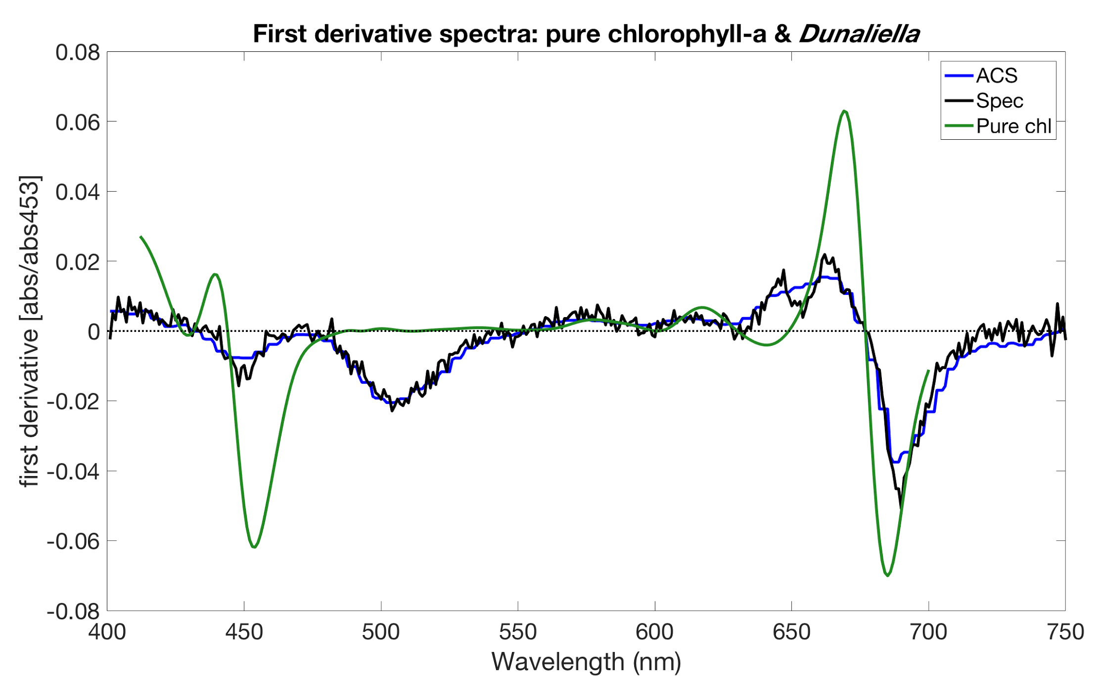
Notes:
To detect pigments
Around 650: spec resolves chl a and b, ACS is smeared betwee
COFFEEE :)

