Slide 1
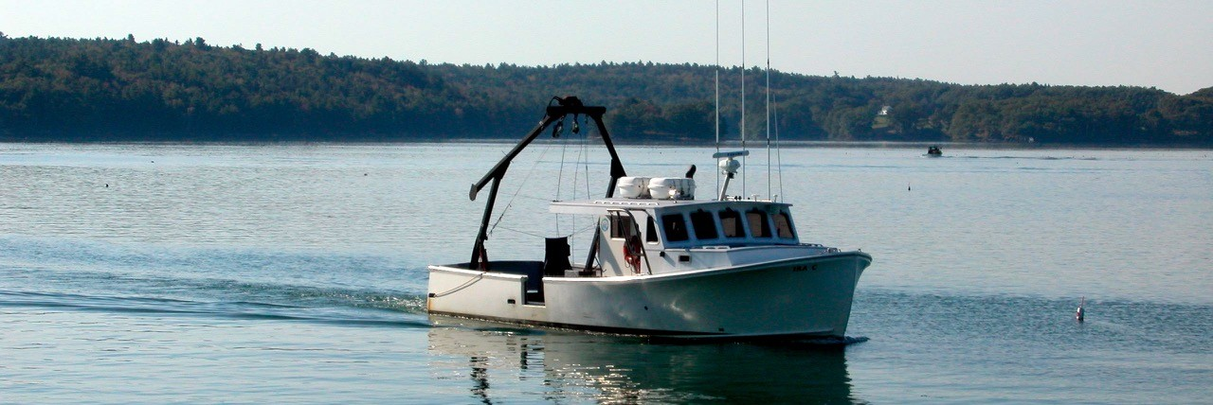
Preliminary Cruise Results from 7/25/17 and 7/26/17

Slide 2
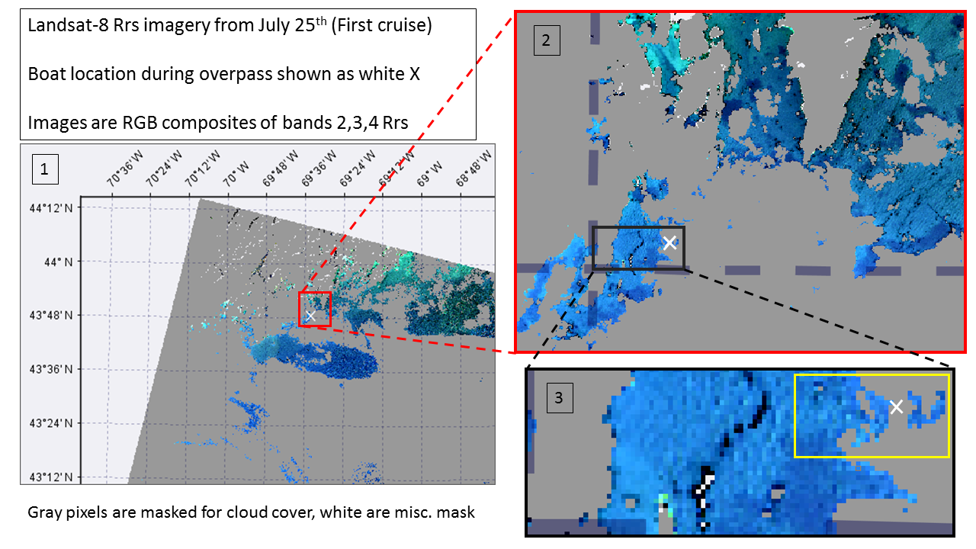

Slide 3
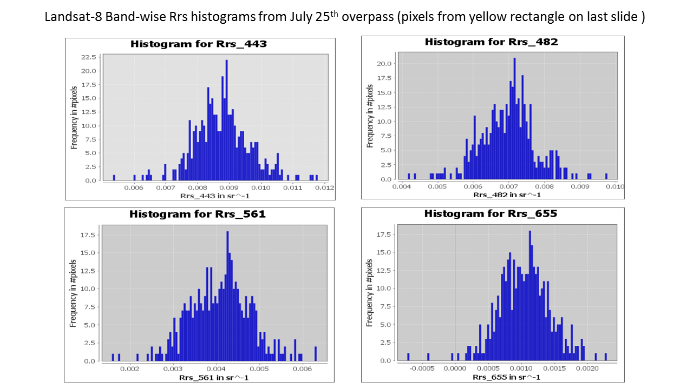

Slide 4
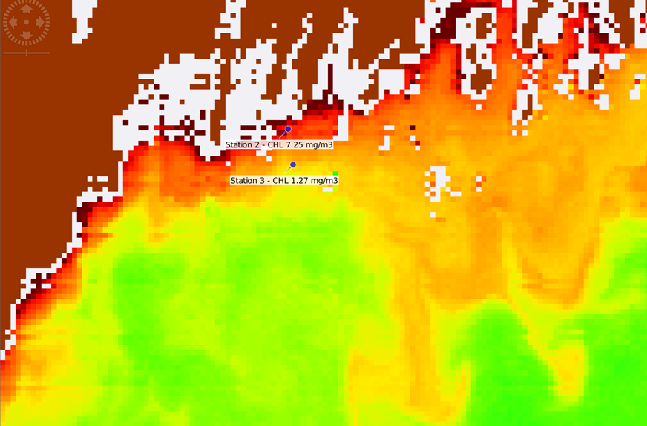
MODIS Aqua Overpass - July 26, 2017
NASA OCx Chlorophyll a

Slide 5
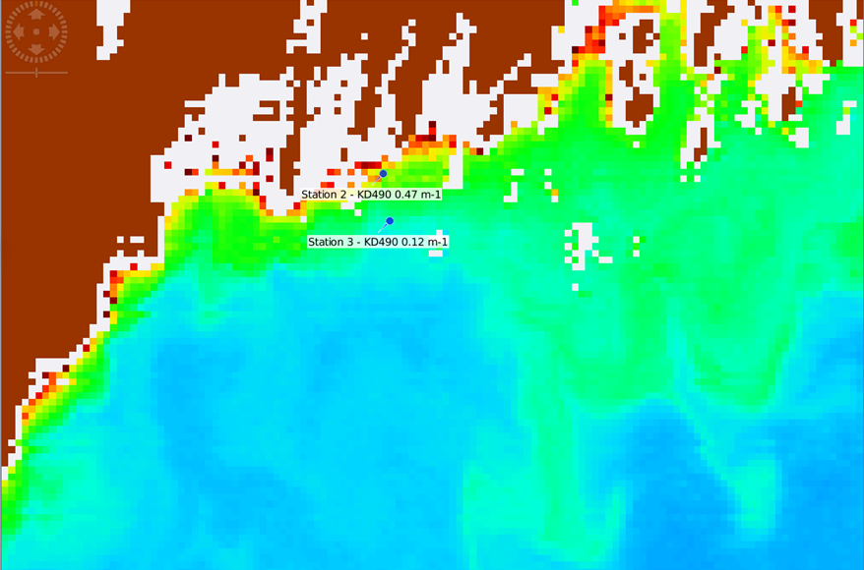
MODIS Aqua Overpass - July 26, 2017
NASA KD490

Slide 6
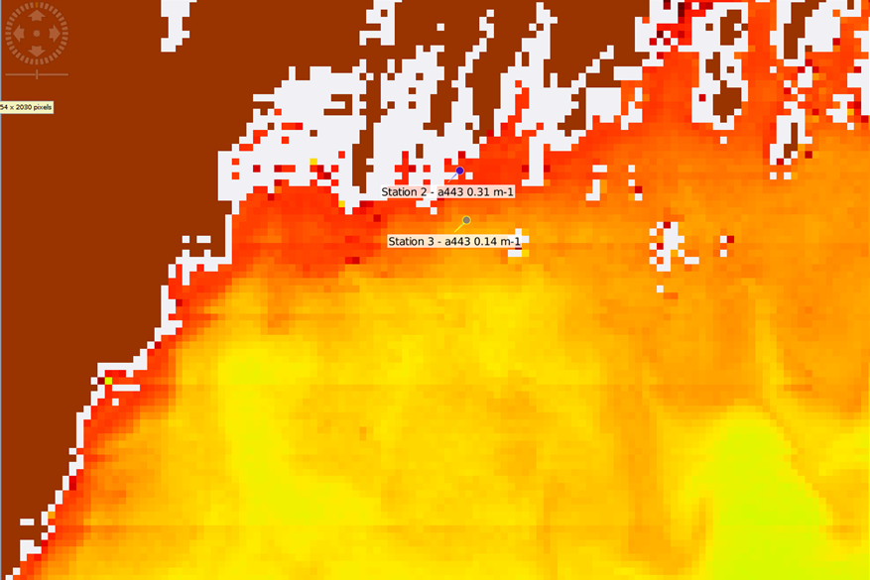
MODIS Aqua Overpass - July 26, 2017
GIOP a443

Slide 7
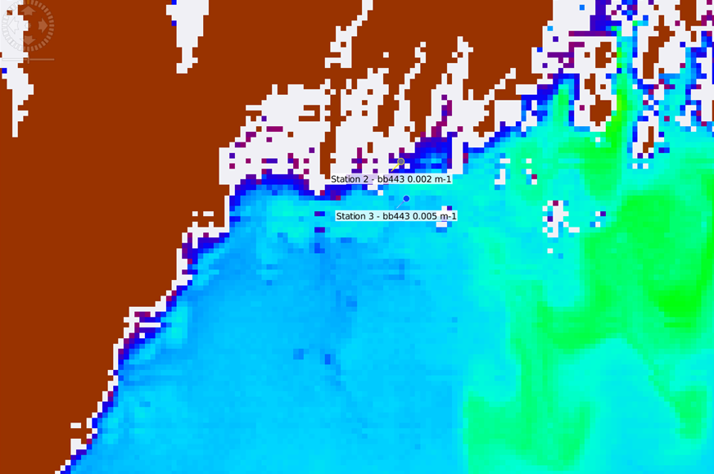
MODIS Aqua Overpass - July 26, 2017
GIOP bb443

Slide 8
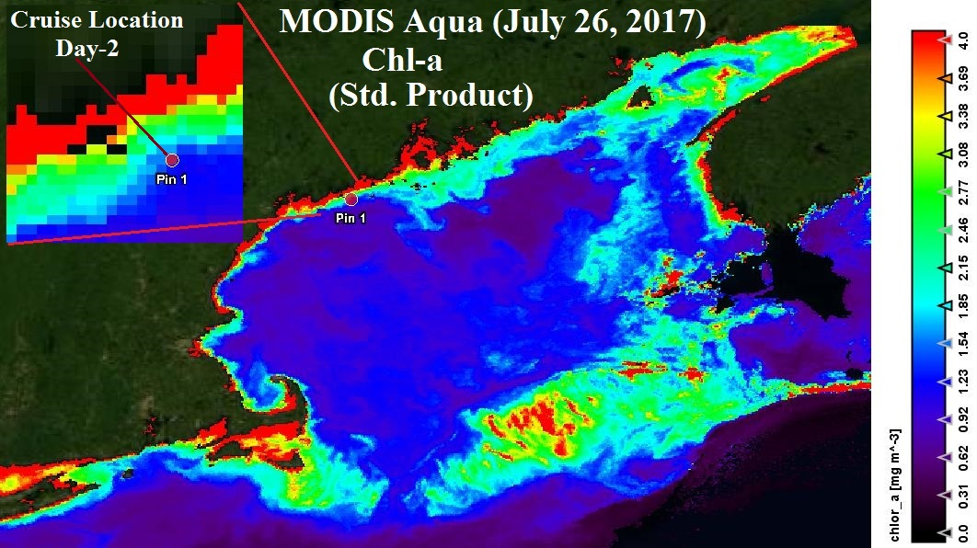
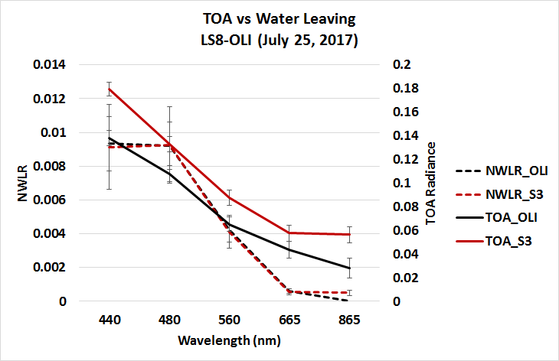
Sentinel-3 Vs LS-8 OLI (July 25, 2017)

Slide 9
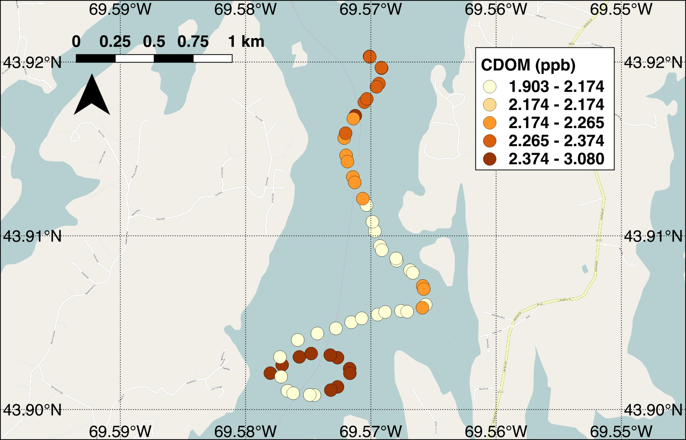
Drifter 2 - CDOM Fluorescence (QSE)

Slide 10
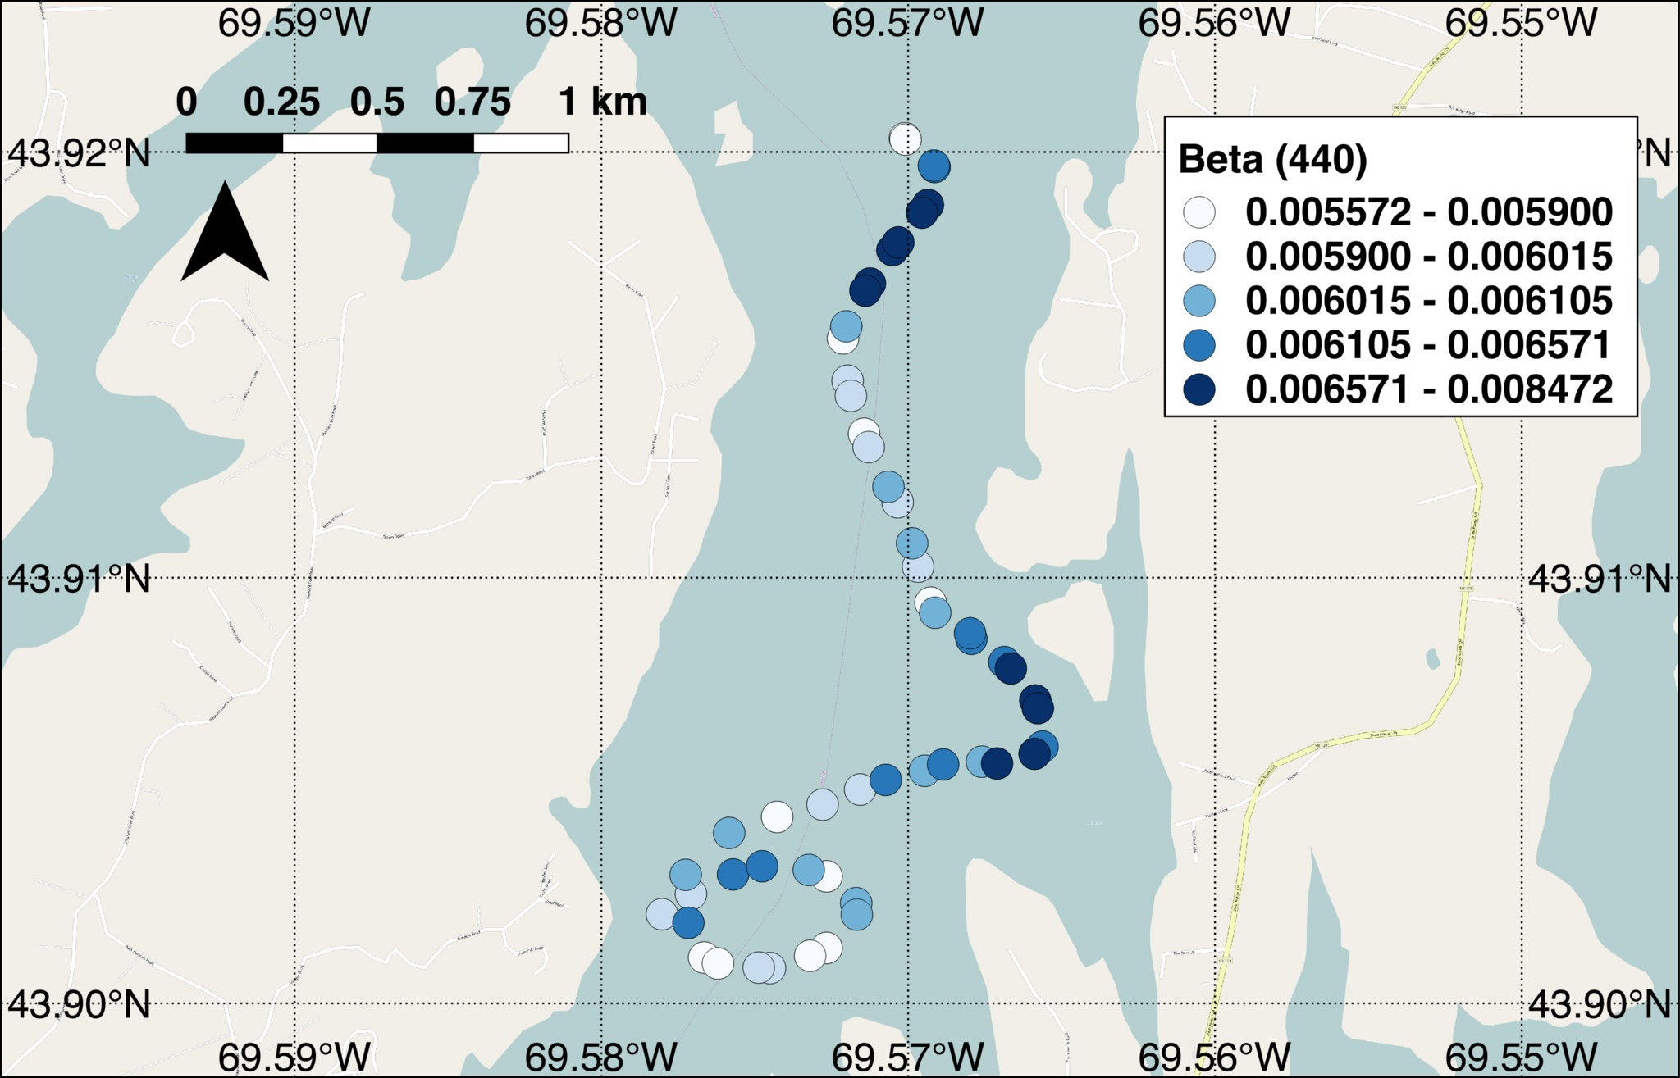
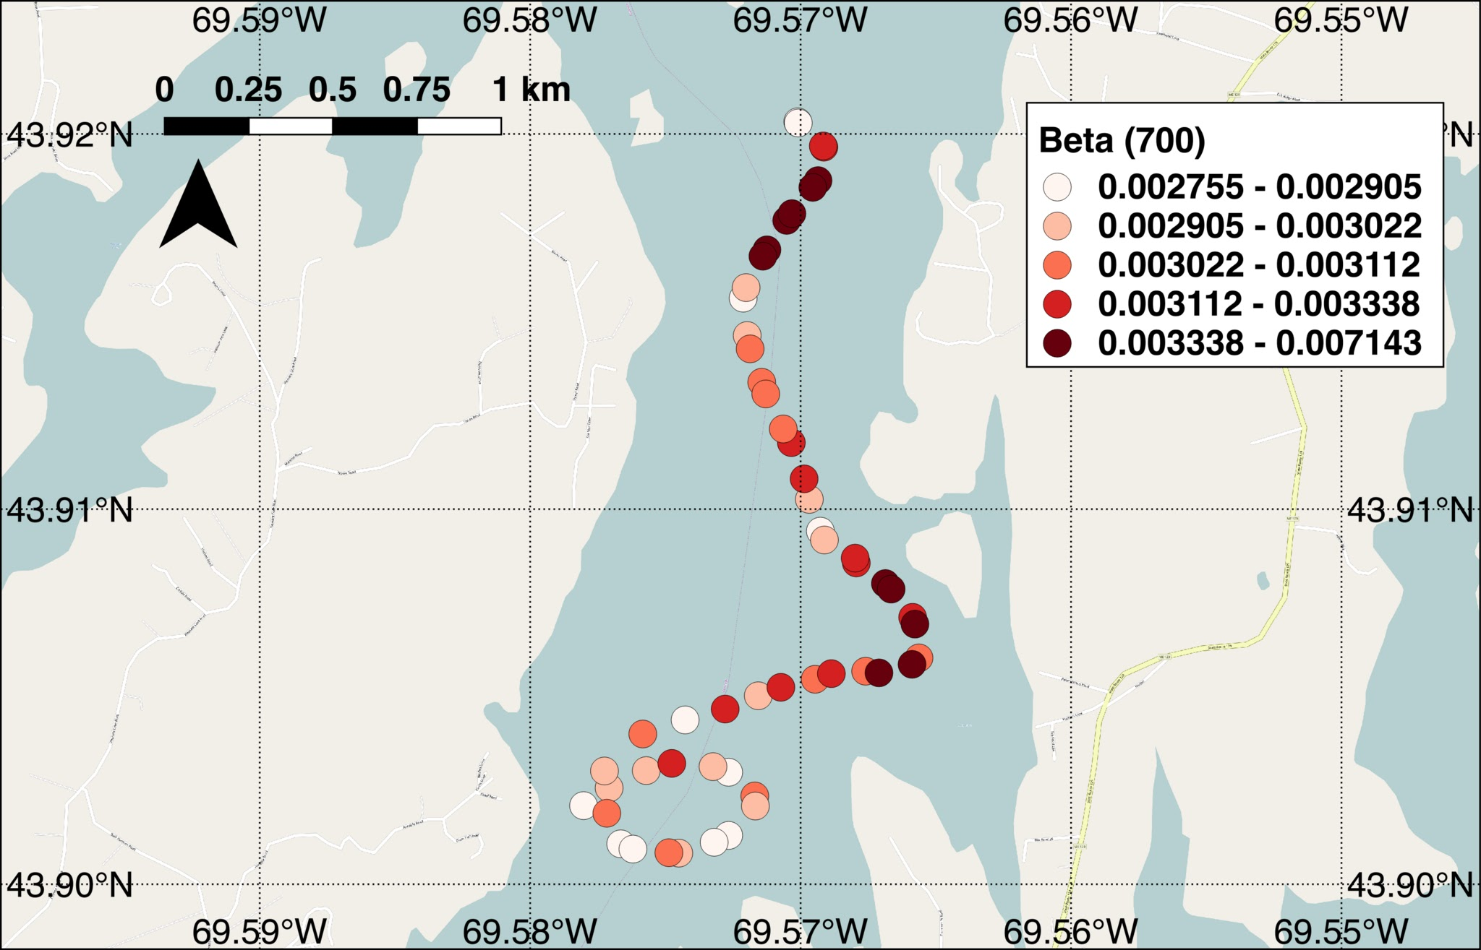
Drifter 2 - β (440 nm) & β (700 nm)
Notes:
This is total VSF. We need to know the instrument angle (120 degrees?). We need to convert from total VSF to particulate VSF by subtracting out seawater and then to particulate backscattering (bb) at a single angleusing Emmanuals Chi correction

Slide 11
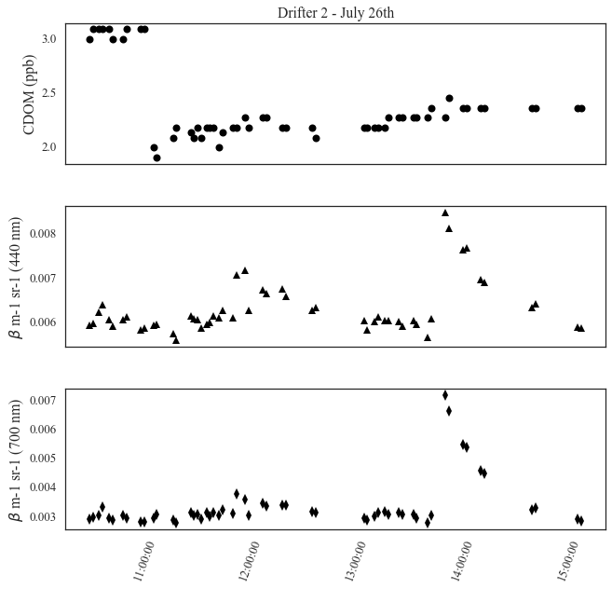
?
Drifter data as a time series
Drop off
Pick Up
Notes:
We need to know the instrument angle (120 degrees?). We need to convert from total VSF to particulate VSF by subtracting out seawater and then to particulate backscattering (bb) at a single angleusing Emmanuals Chi correction
Use the original high temporal dataset to see the variability with time

Slide 12
Drifter data as a time series
?
Drop off
Pick Up

Slide 13
Drifter data as a time series
?
Drop off
Pick Up

Slide 14
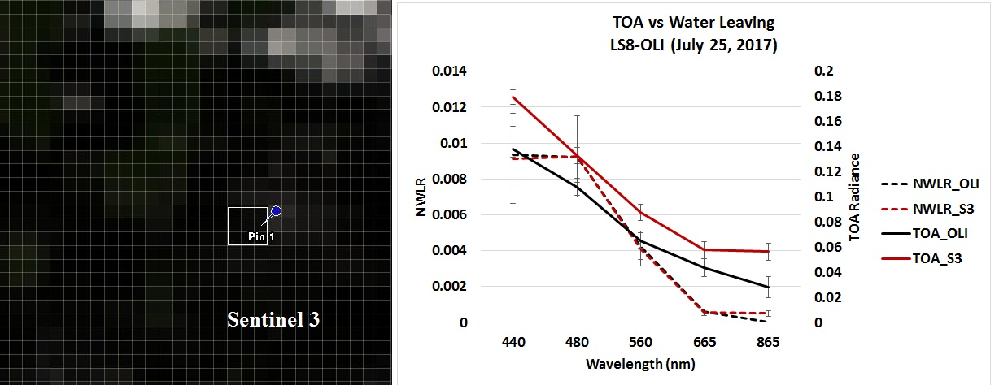
Sentinel 3 vs LS8-OLI (July 25, 2017)

Slide 15
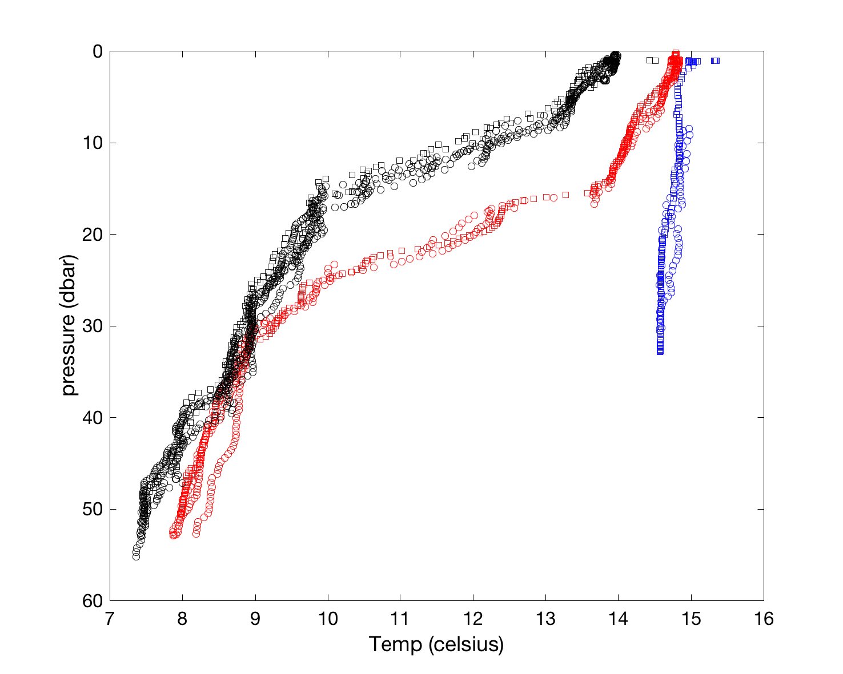
Temperature depth profiles

