Slide 1
Lab 2: CDOM Absorption
By: The Best Ocean Optics Class Yet

Slide 2
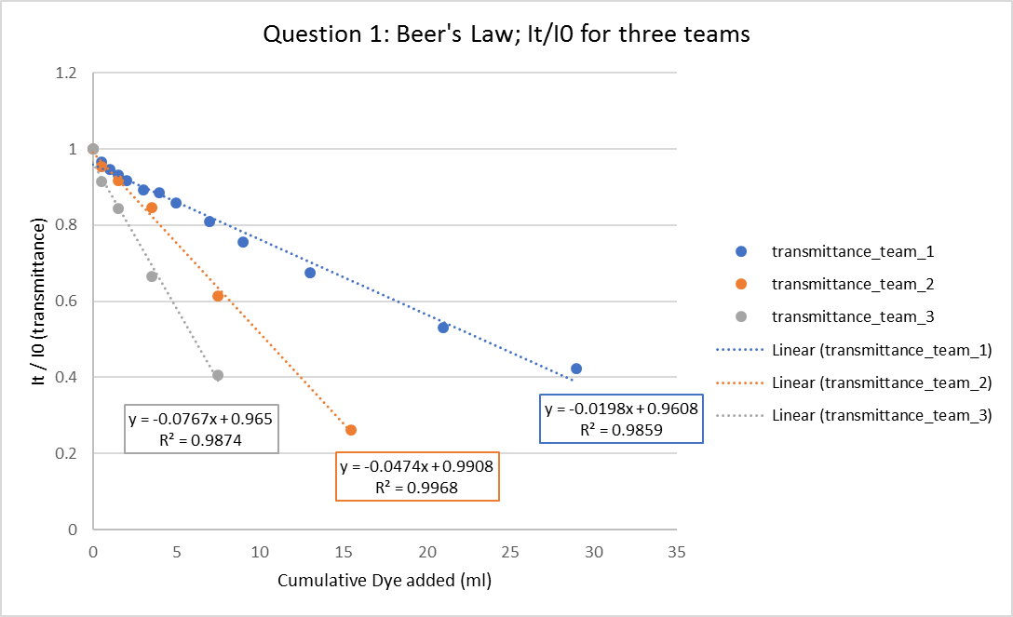
Beer’s Law: Concentration

Slide 3
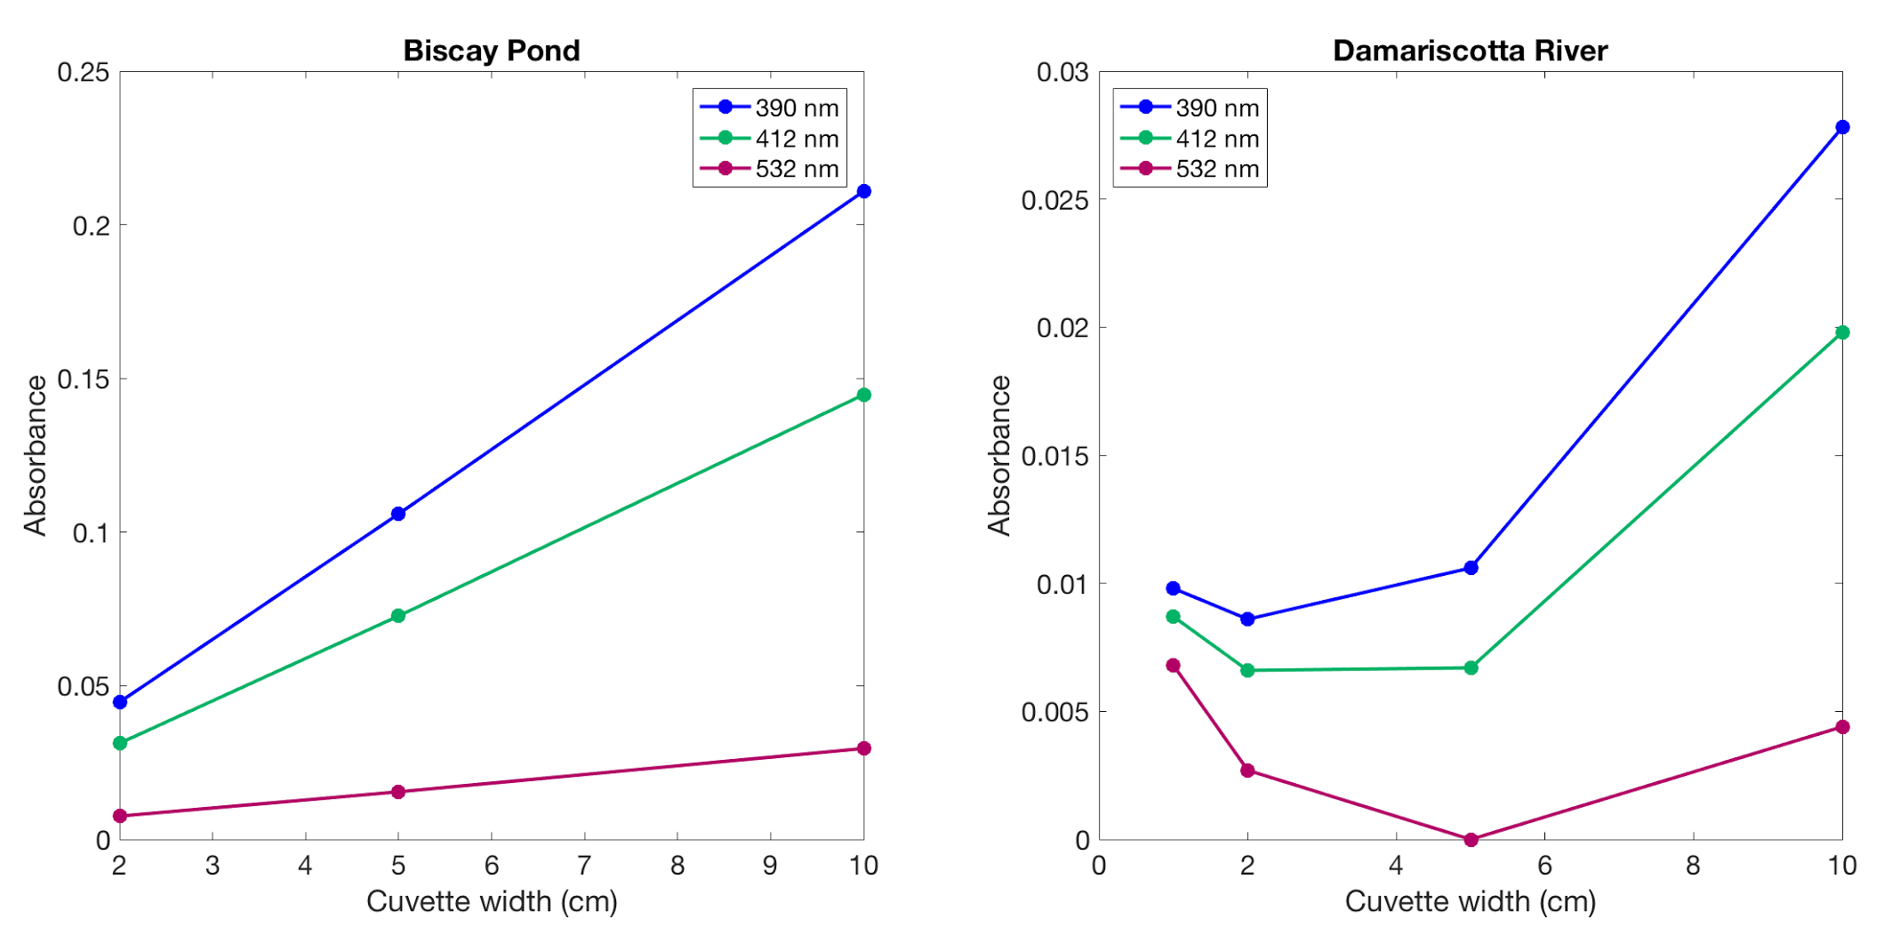
Beer’s Law: Pathlength

Slide 4
Beer’s Law: Pathlength

Slide 5
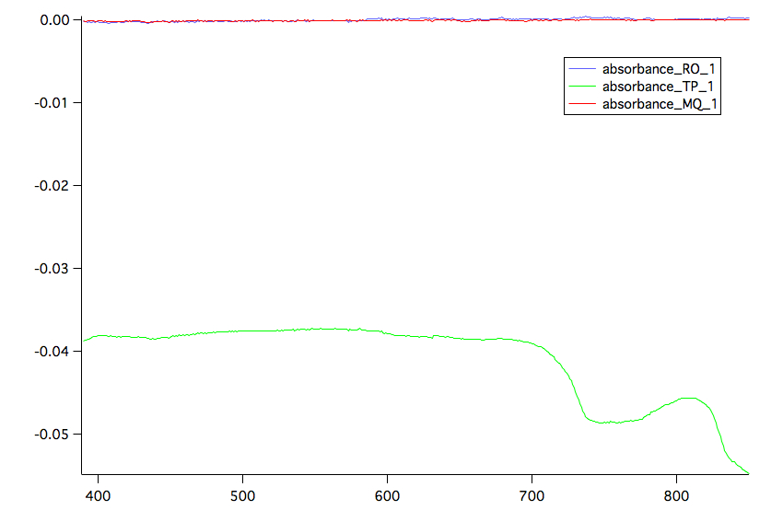
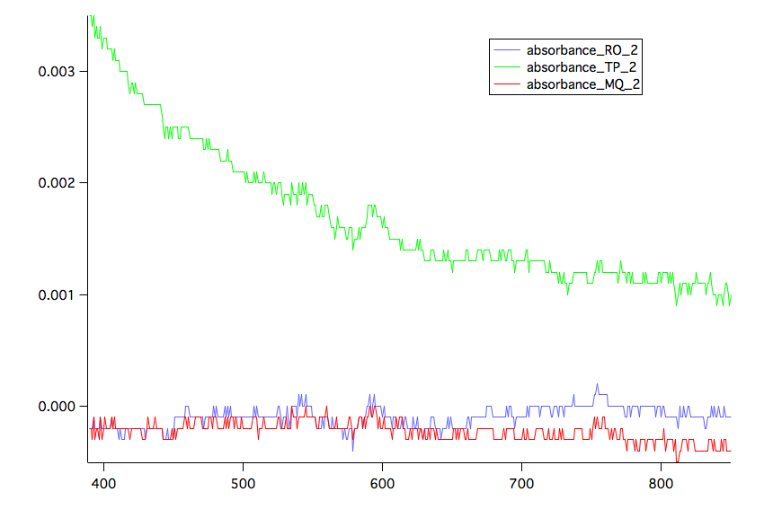
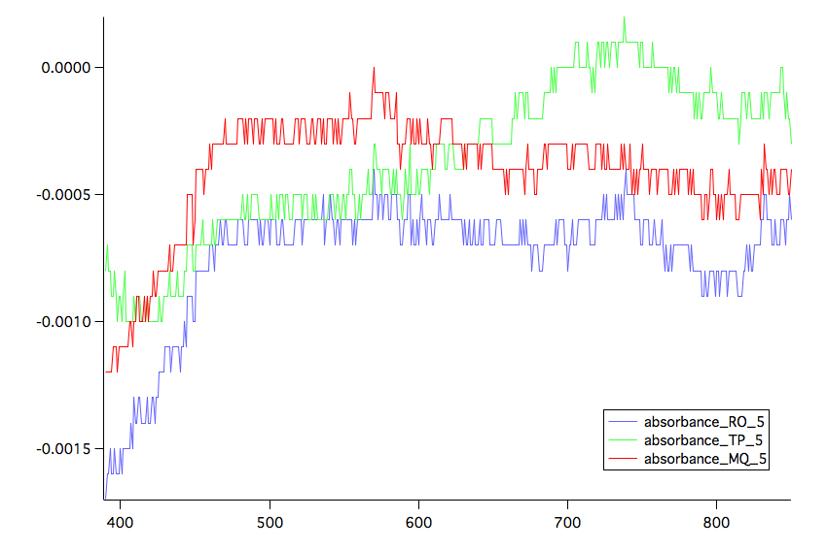
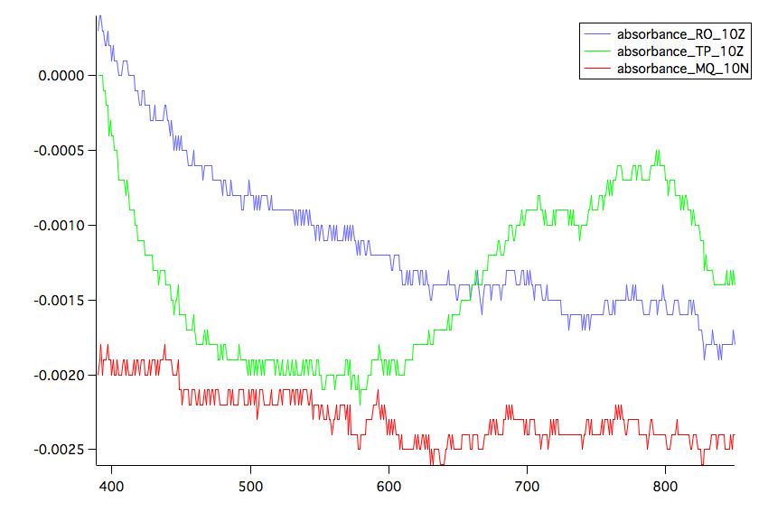
Comparison of RO and Tap Water Spectra
1 cm 2 cm
5 cm 10 cm

Slide 6
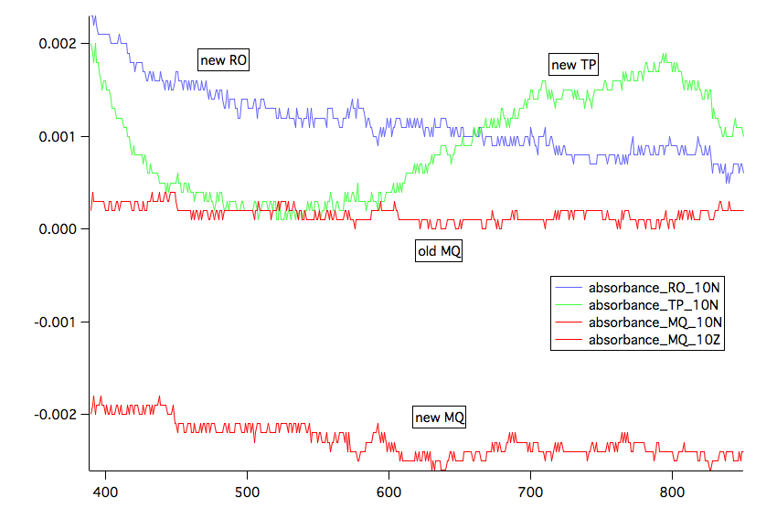
Cuvette 10 cm Post-Correction

Slide 7
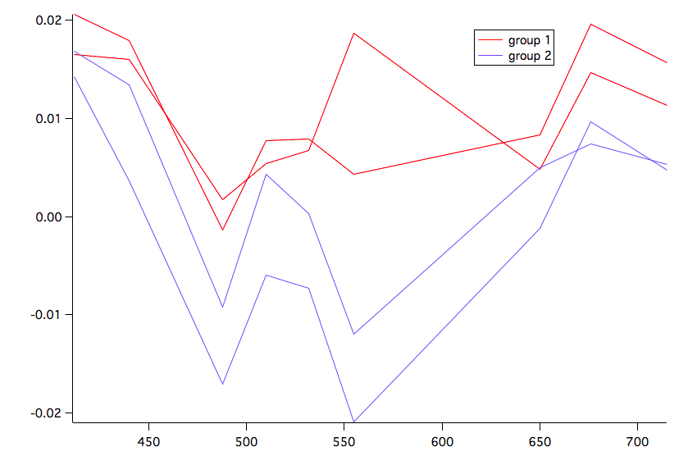
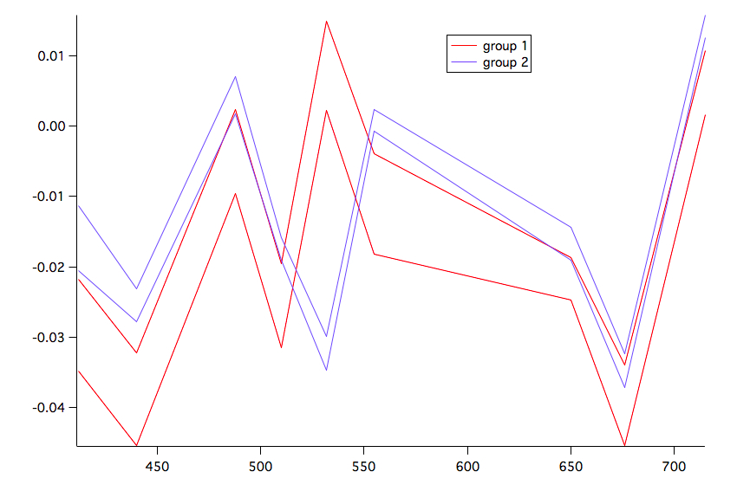
Pure Water Measurements: ac9
Absorption
Largest variation in green
Most wl measurements are within 0.005
Attenuation
Inversion at 532 nm

Slide 8
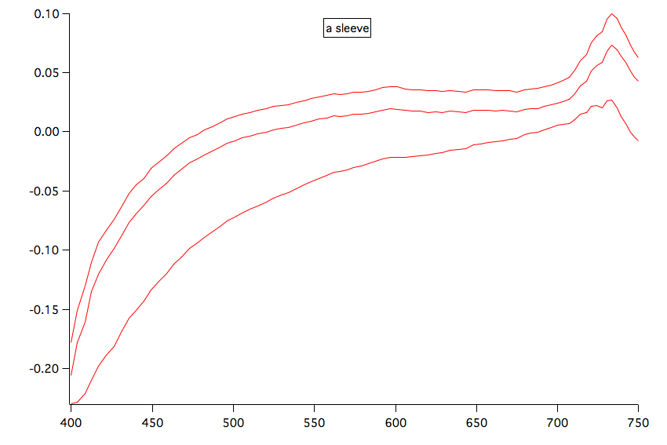
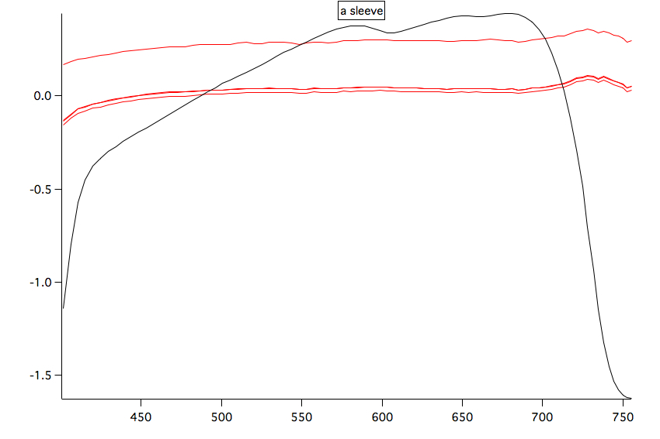
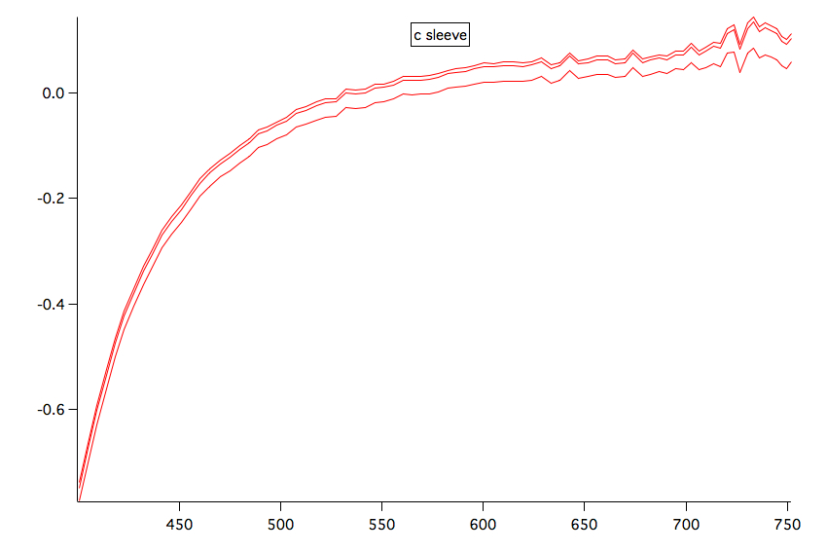
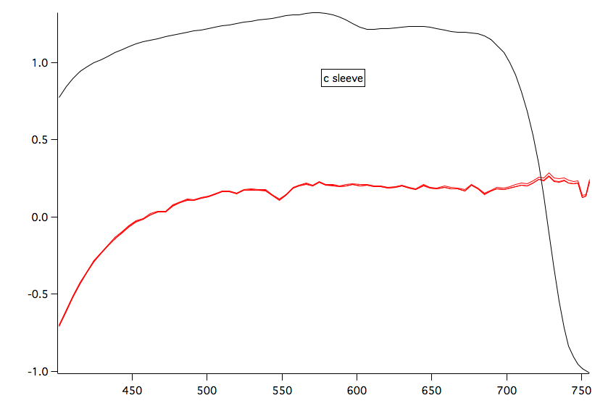
acs1 acs2
a
c

Slide 9
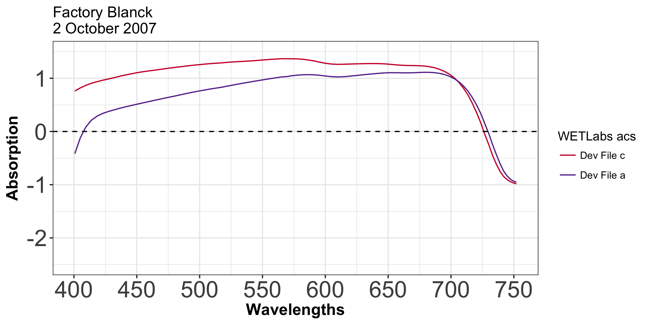
Spectrometer Blanks (2) - Factory coefficients

Slide 10
Calibration Discussion
Blanks signals are not similar to the device files ones
Sensor drift during travel, storage, over time
Temperature differences, ours 3-4 degs C warmer
Possible presence of bubbles
Differences in quality of water sample (MiliQ vs RO)
Beyond… environment temperature is outside of usable instrument range, light leakage, dirty or scratched sensors

Slide 11
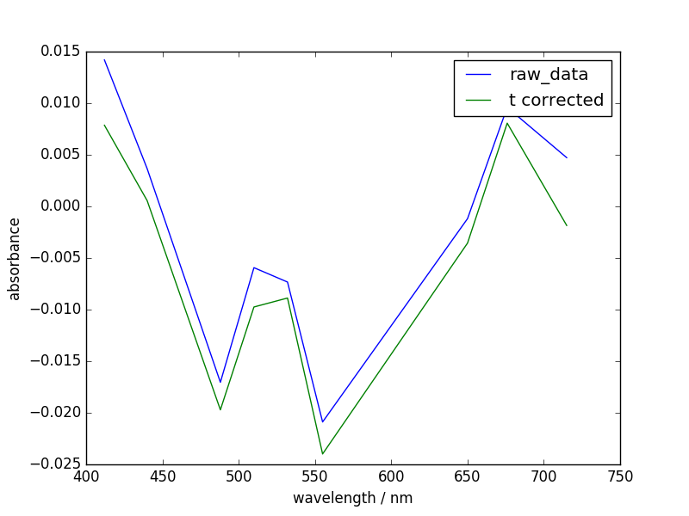
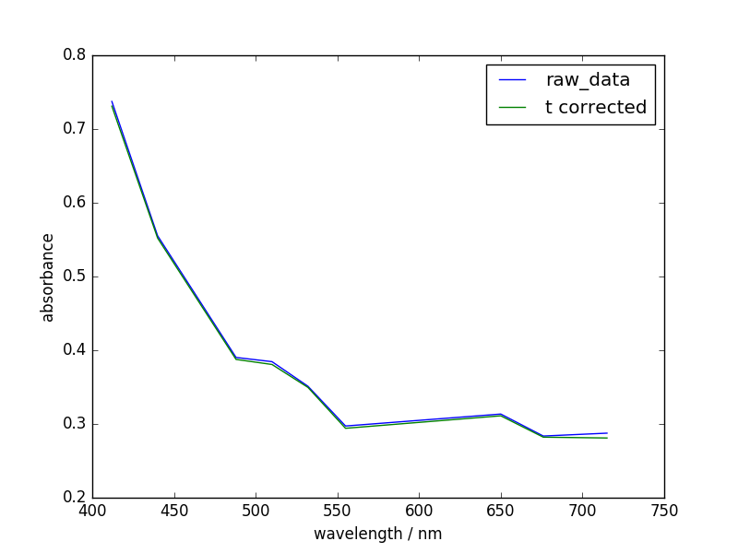
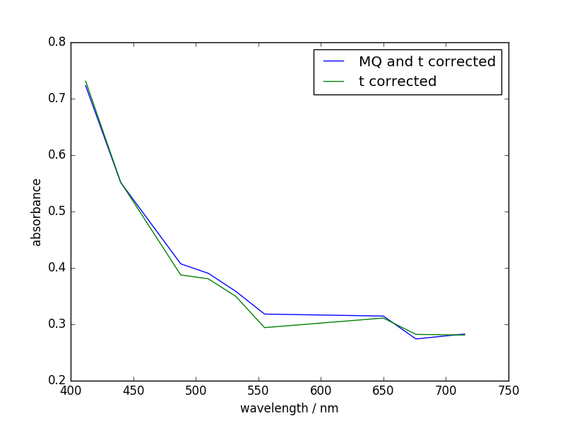
Temperature Effect: ac-9 (a tube)
DMC Dock
Milli-Q
Sample
Sample Reference Corrected

Slide 12
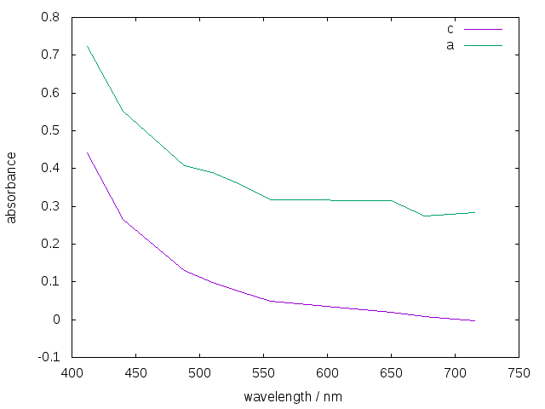
Comparison of A and C Tube

Slide 13
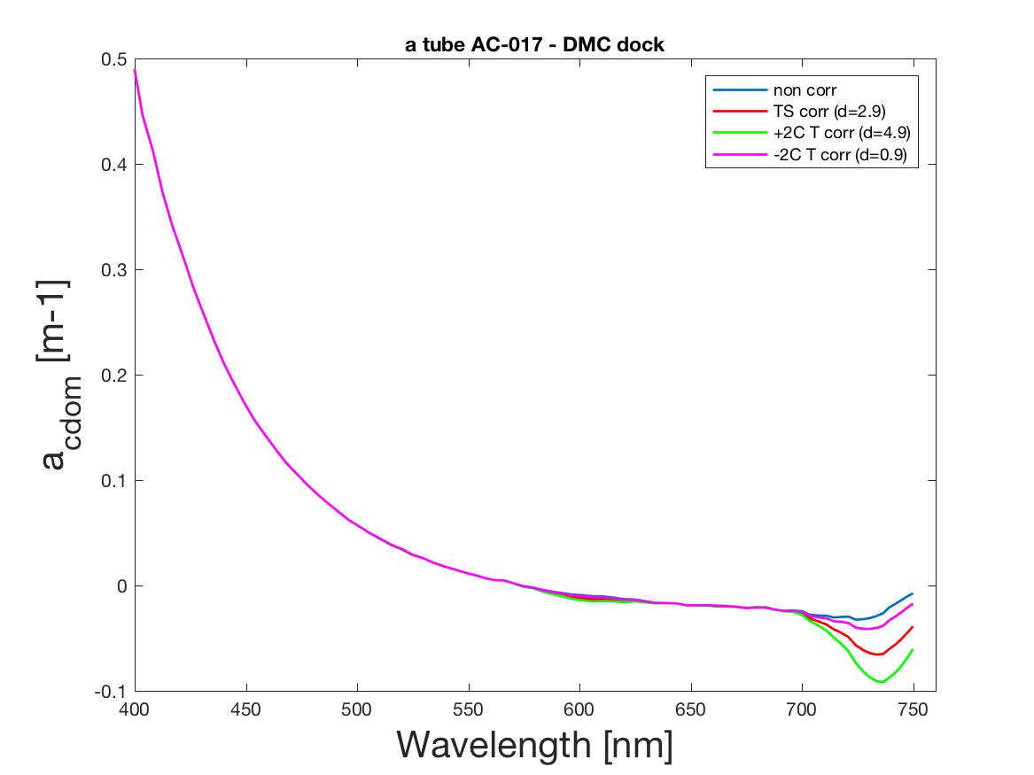
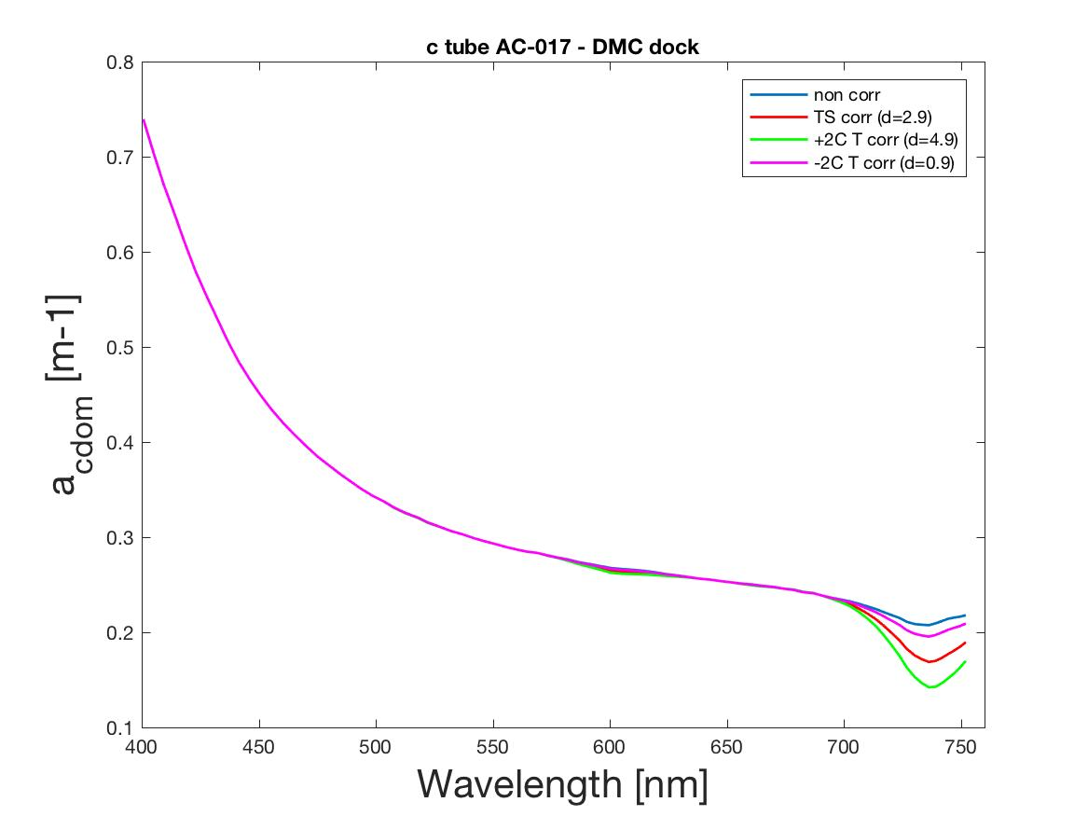
Temperature Effect on DMC dock sample: ac-S

Slide 14
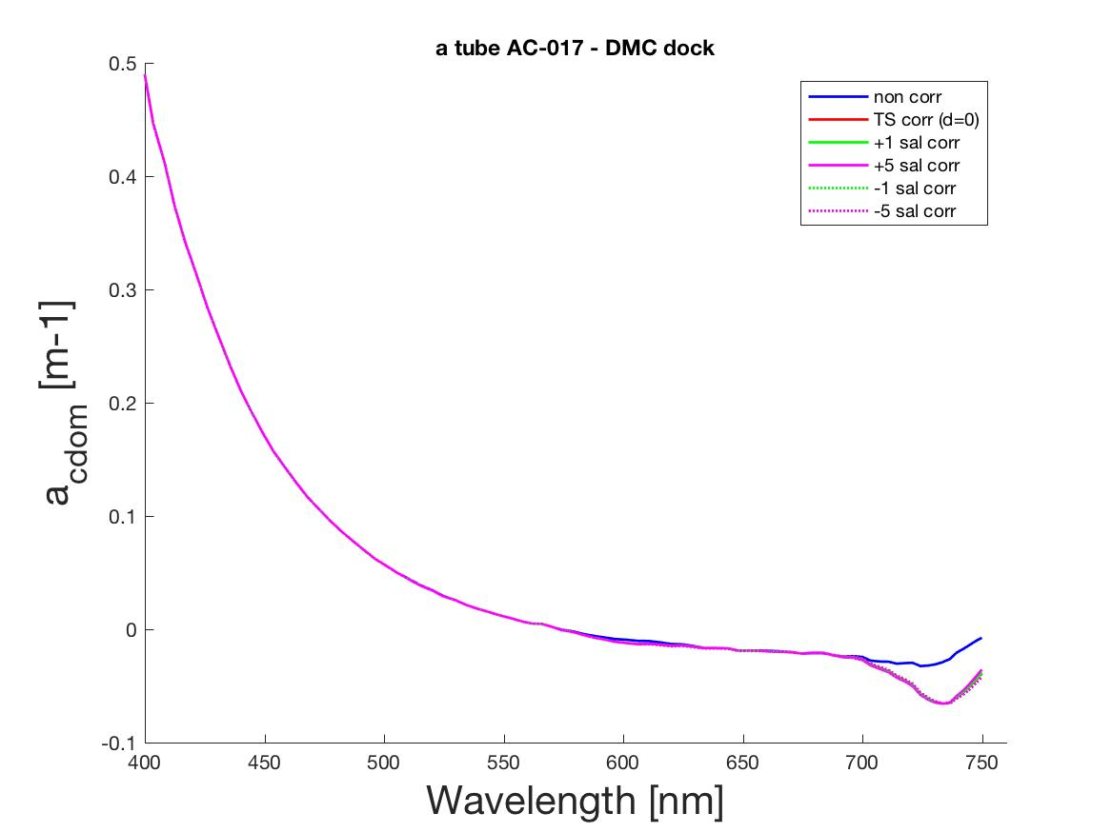
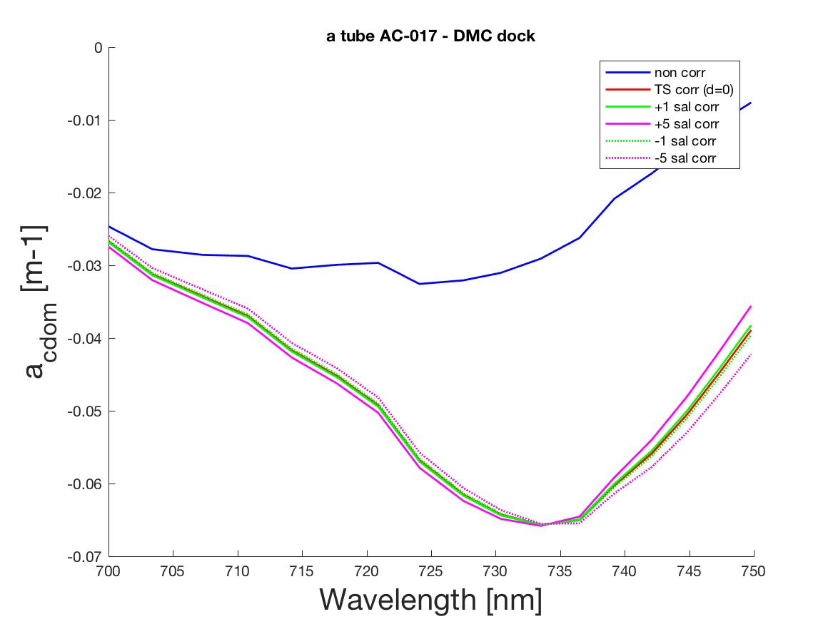
Salinity Correction on DMC dock sample: ac-S

Slide 15
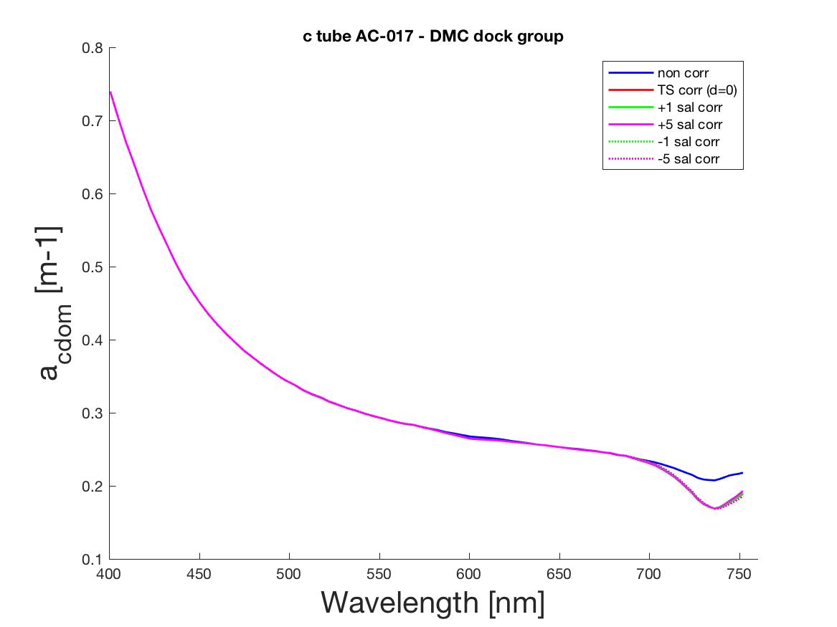
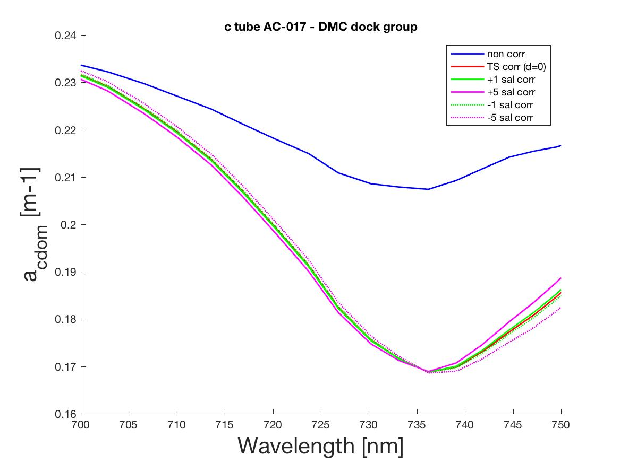
Salinity Correction on DMC dock sample: ac-S

Slide 16
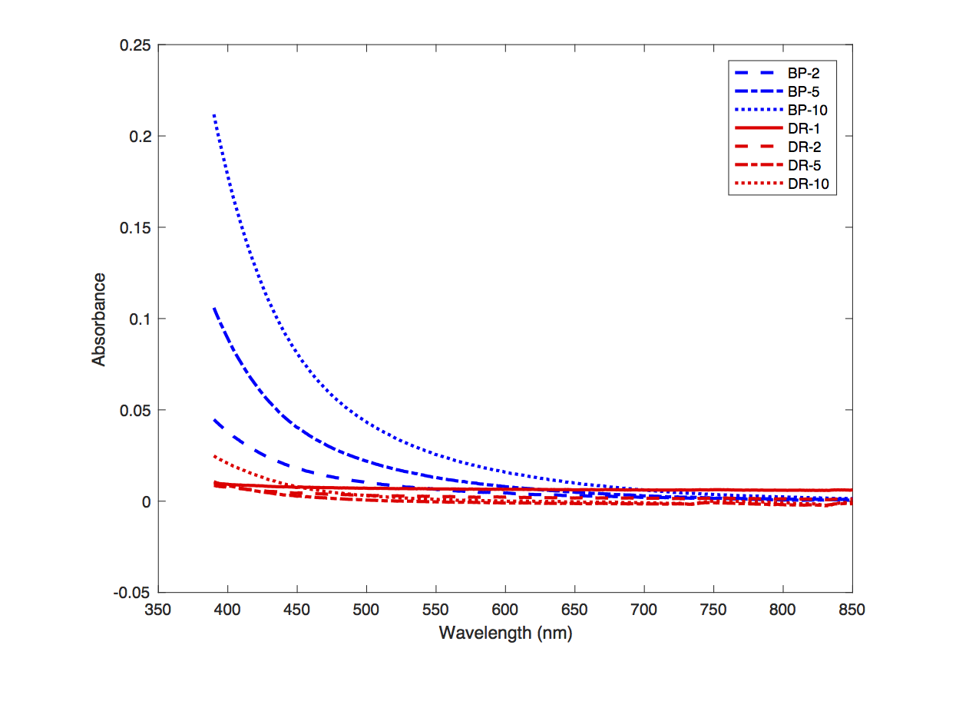
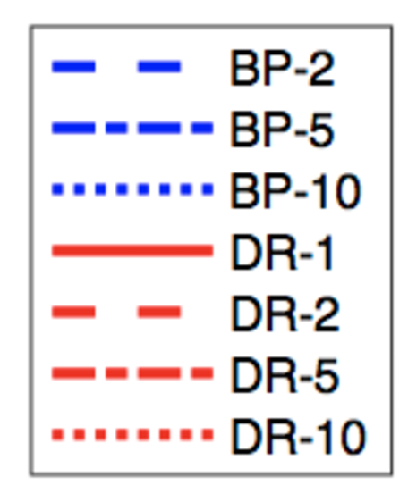
Absorbance Plots By Site
Absorbance
Wavelength (nm)
Notes:
Curves look exponential, as they should for CDOM
Difference in magnitude between sites with the pond showing a much higher absorbance than the estuary
Higher absorbance for a lower pathlength in the estuary

Slide 17
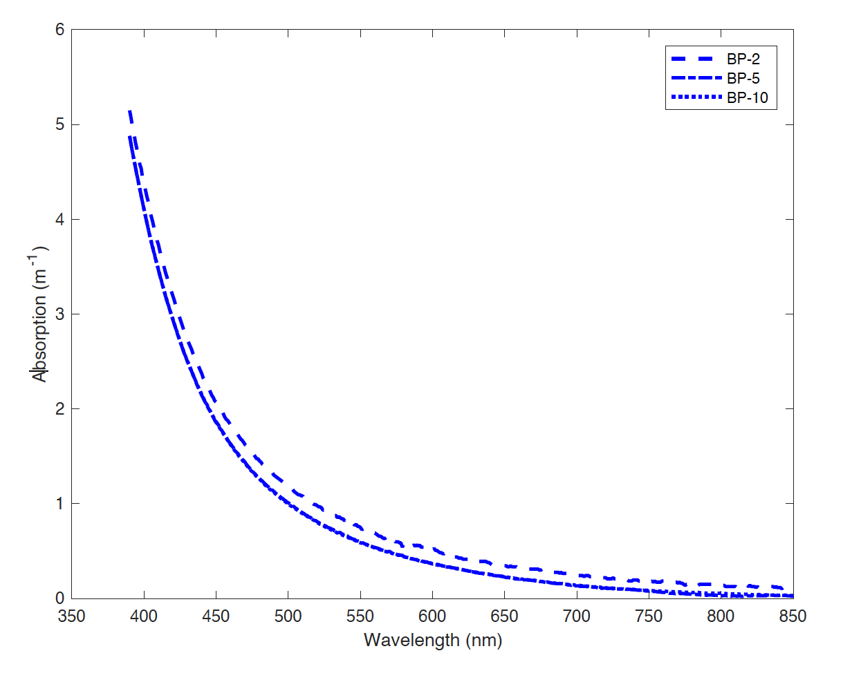
Absorption Plots -Biscay Pond
Absorption (m⁻¹)
Wavelength (nm)

Slide 18
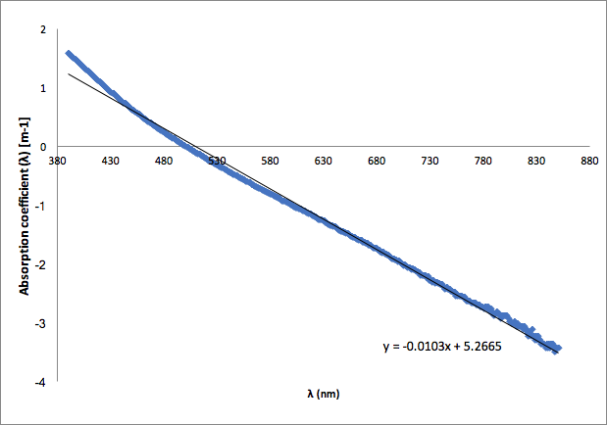
Spectral slopes (all wavelengths)
Notes:
Spectral slope is on the low end
Average range in Roesler et al 1989 - .016/.017

Slide 19
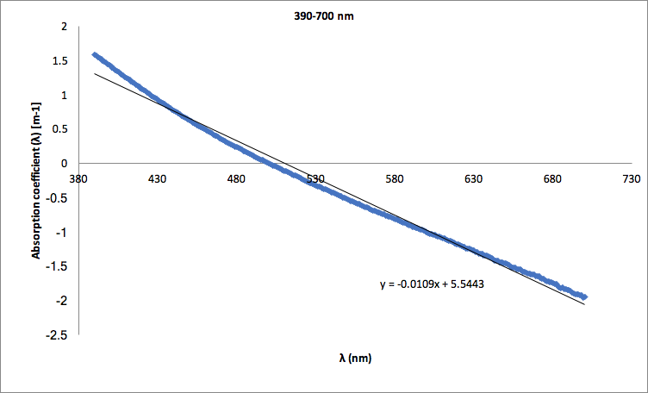
Spectral slopes (390-700 nm)

Slide 20
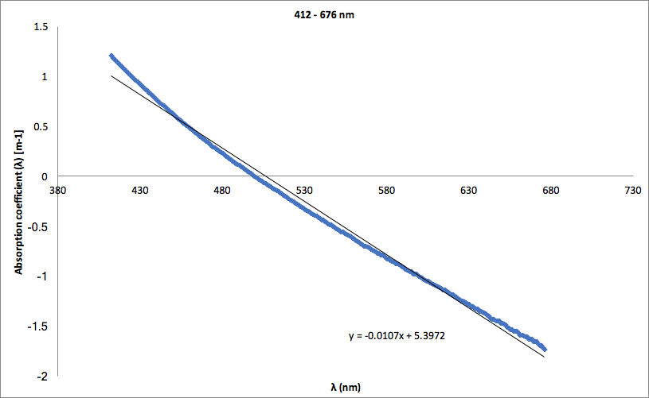
Spectral slopes (412-676 nm)

Slide 21
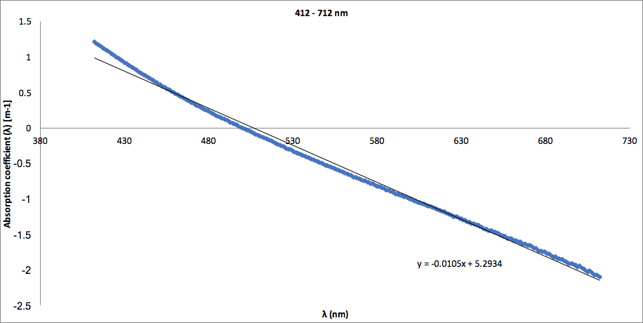
Spectral slopes (412-712 nm)

Slide 22
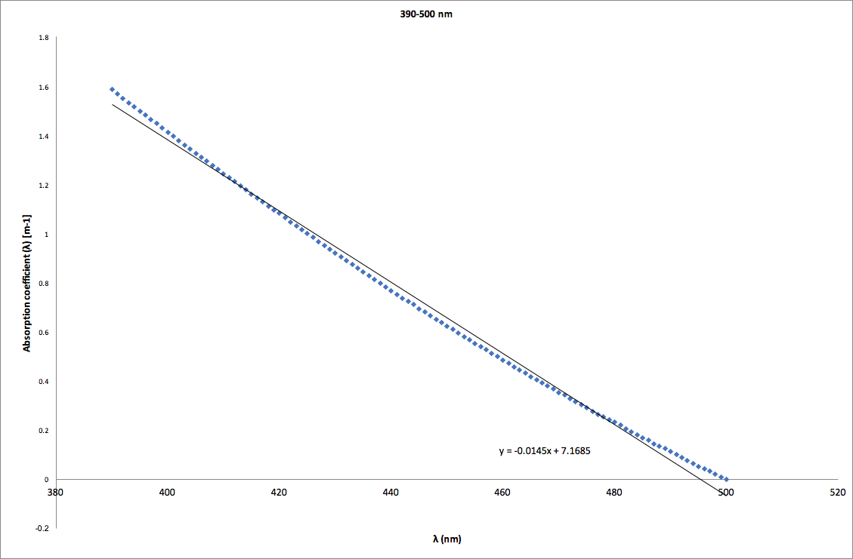
Spectral slopes (300-500 nm)
Notes:
Bumps us into lowest range of uncertainty (Roesler et al 1989)

Slide 23
