Slide 1
Lab 4: Scattering, back scatter, and beam attenuation

Slide 2
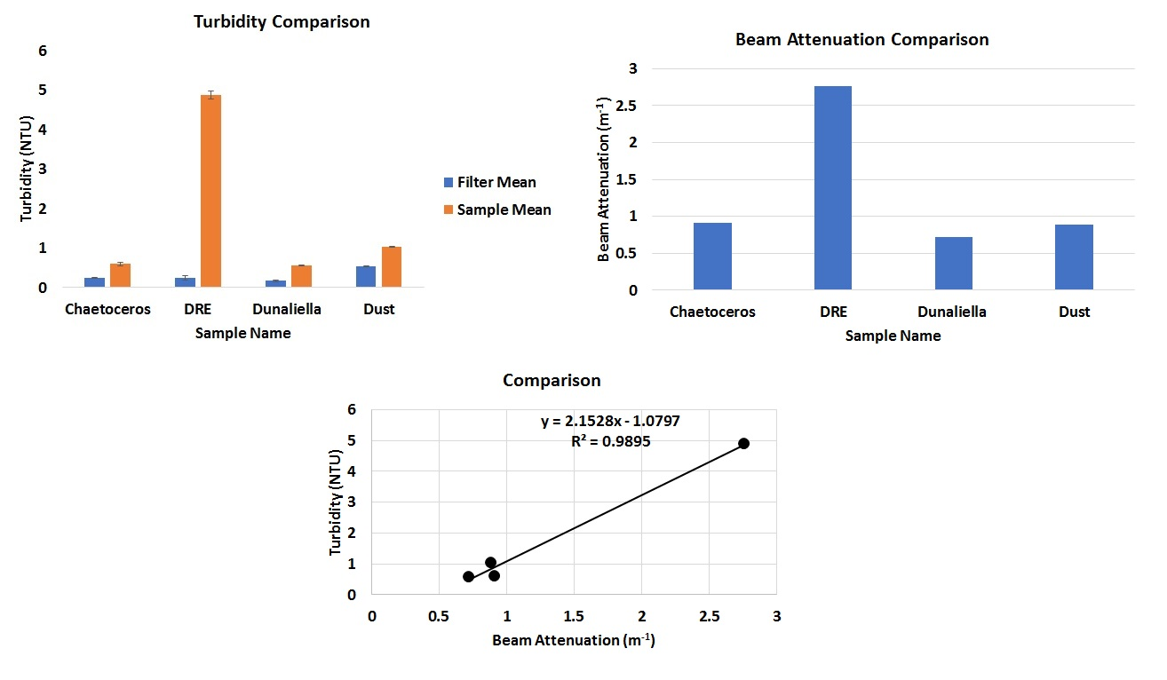
Transmissometer
Notes:
If you measure it in the lab it can vary by a factor of 2
Good regression, but NEVER trust only R^2!!! In this example, the regression is driven by the higher point.
Try calculating c using filtered sample as reference

Slide 3
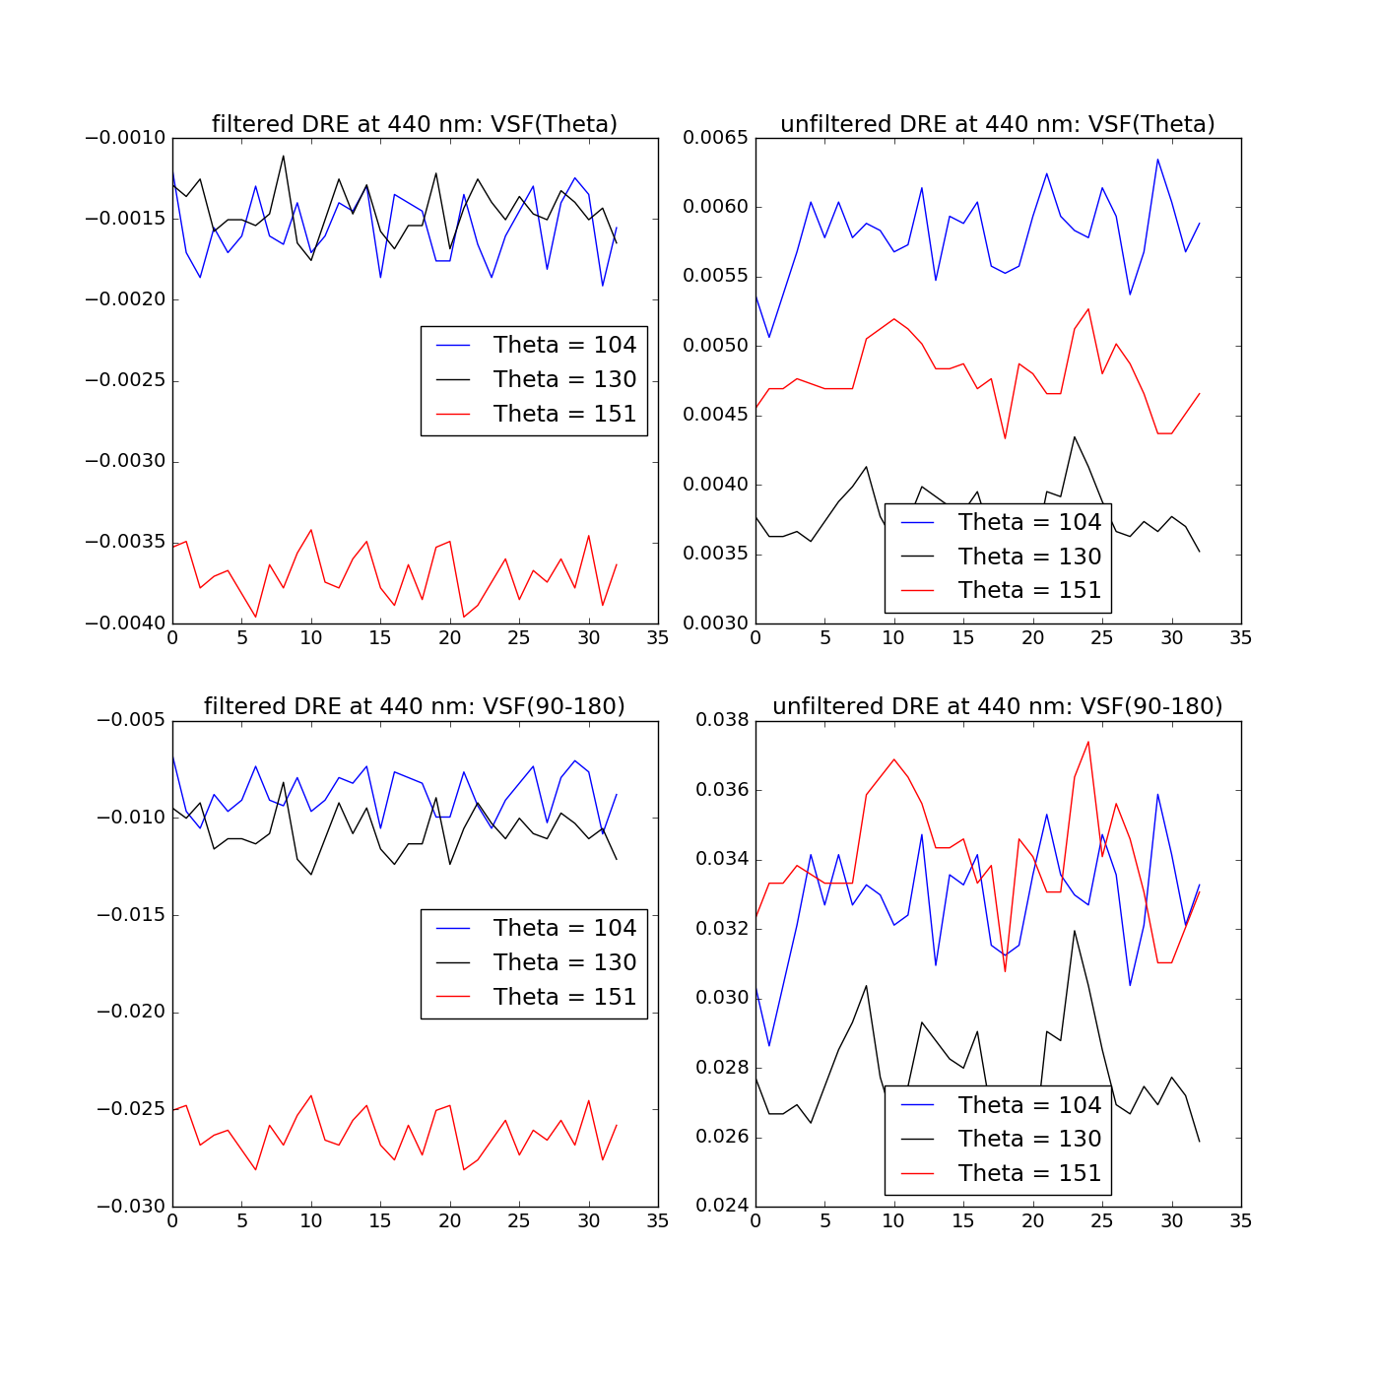
BB3 data plotted at a single wavelength (440 nm) for a single group. Data has been: 1. Converted to Beta
2. Salt water corrected
3. Path length corrected
4. 90-180 degree VSF integration
Future work: performing these corrections on all data (all groups, red wavelength)
Notes:
Go to dark - slope factor is done in DI water
Particulate backscattering - contribution of water + salts
By using one angle you can have uncertainties of ca 15%
Use the paper Sullivan et al., 2013
Three sensors - each looks at a different part of water so that’s why we have different patterns
Std error of the mean = stdev/sqrt(mean_value)
VSF gives you digital counts from 50 to 4096 (very clear water vs turbid - different range of signal adjustment)
Procedure:
Beta(theta, lambda) = slope(counts_signal - counts_dark)
Beta_p (theta, lambda) = beta(theta, lambda) - beta_sw(theta, lambda, P, S, T) VSF for the particulate (p is for pressure)
b_bp(lambda) = 2*pi X_p(theta) . beta_p ; 2pi due to azimuthal symmetry

Slide 4
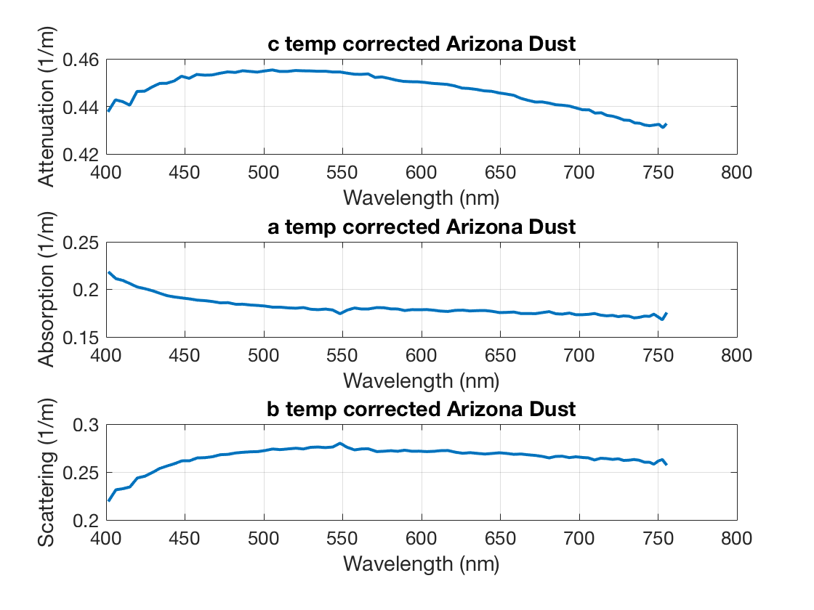
TS corrected ACS (sample - reference)
Notes:
To be corrected for absorption - Rud correction type???’ Who wrote this, what is Rud??
Rud Rottgers (2013)- spectrally varying scattering correction apply to Dust
Something wrong since dust doesn’t absorb as much as it scatters!!

Slide 5
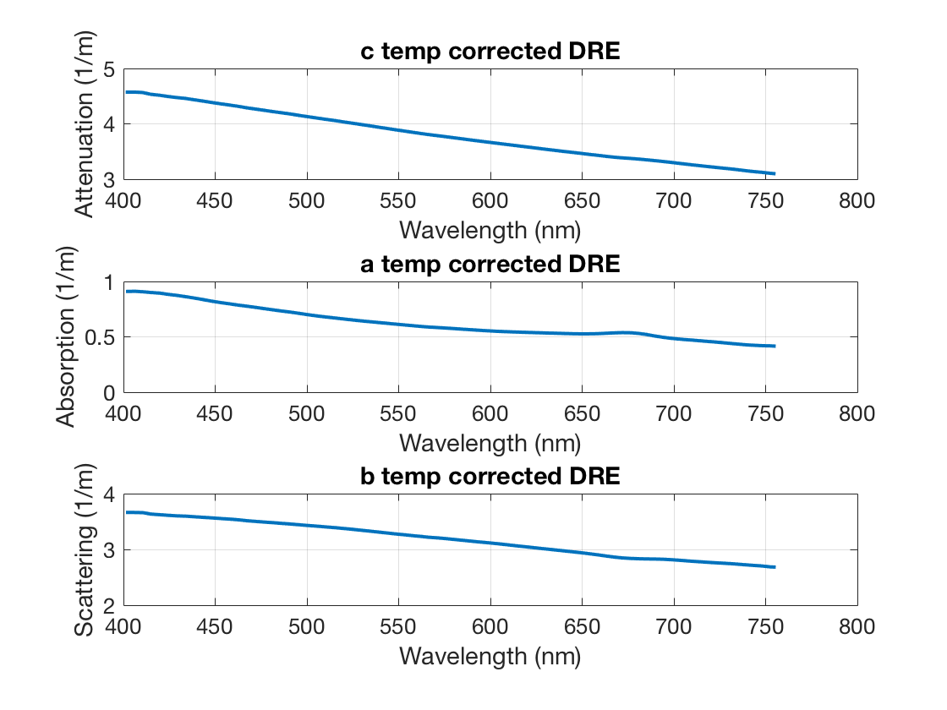

Slide 6
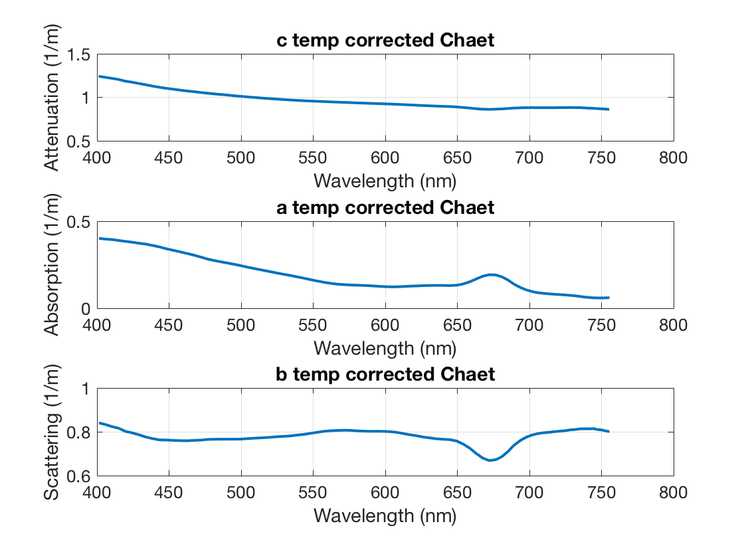
Notes:
Apply spectrally flat correction by subtracting a(715) offset from a(wl)
Refer to

Slide 7
Notes:
Apply spectrally flat correction by subtracting a(715) offset from a(wl)
For this culture, you may want to correct using flat correction since you don’t expect NAP to be strong at 715

Slide 8
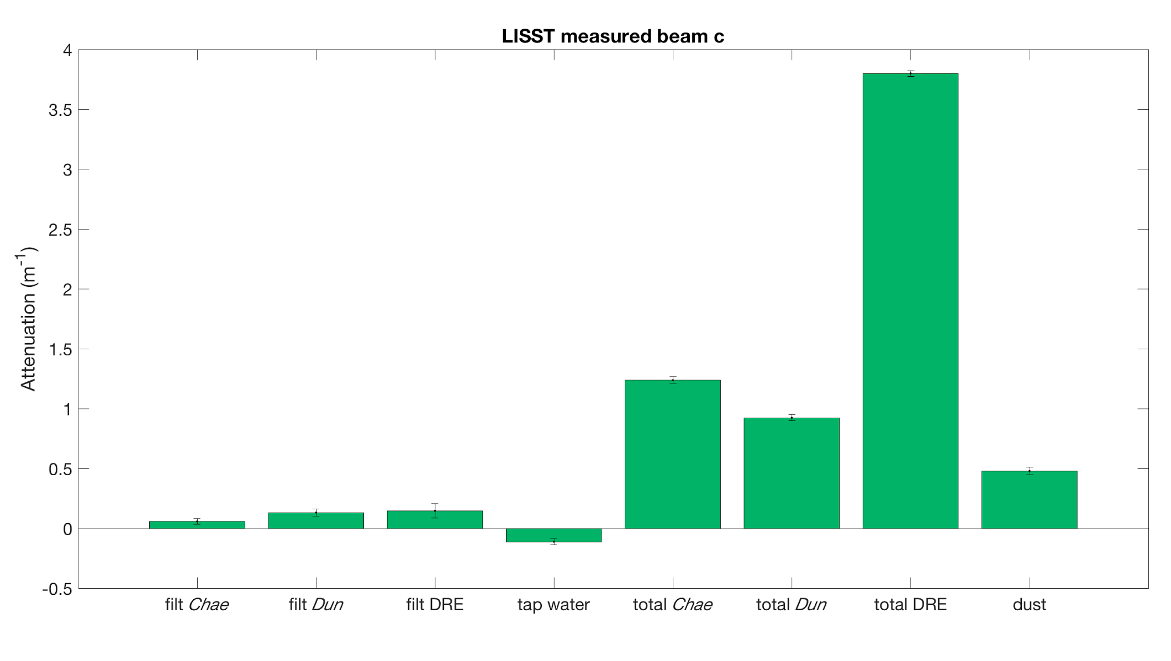
LISST beam attenuation
Notes:
Tap water - instrument noise? Negative values ...

Slide 9
Beam c: Instrument Comparisons
Notes:
Uncertainties of AC meter - largest source: you measure BLANK
Highest acceptance angle - lower attenuation ?

Slide 10
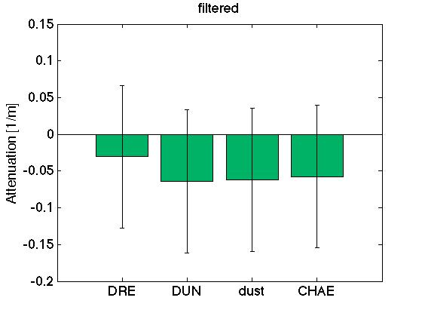
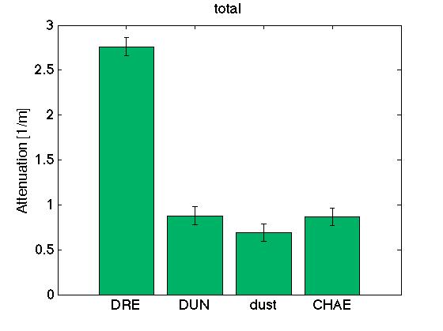

Slide 11
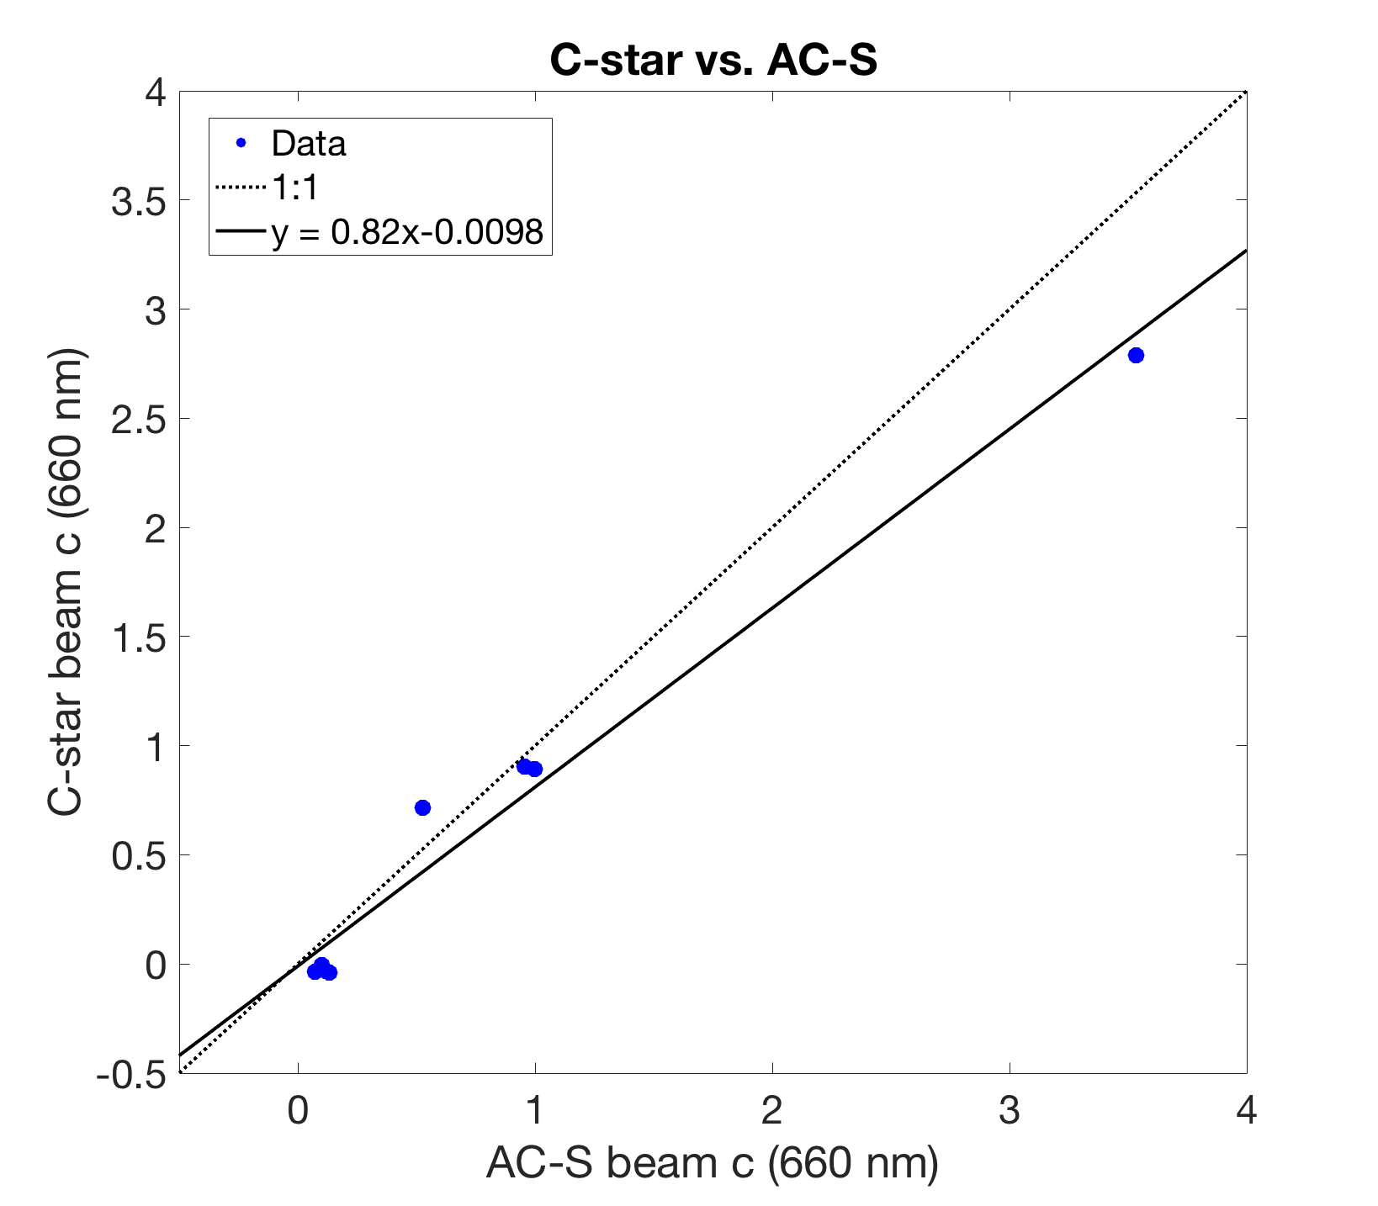
Beam c: Instrument Comparisons
r² = 0.9744

Slide 12
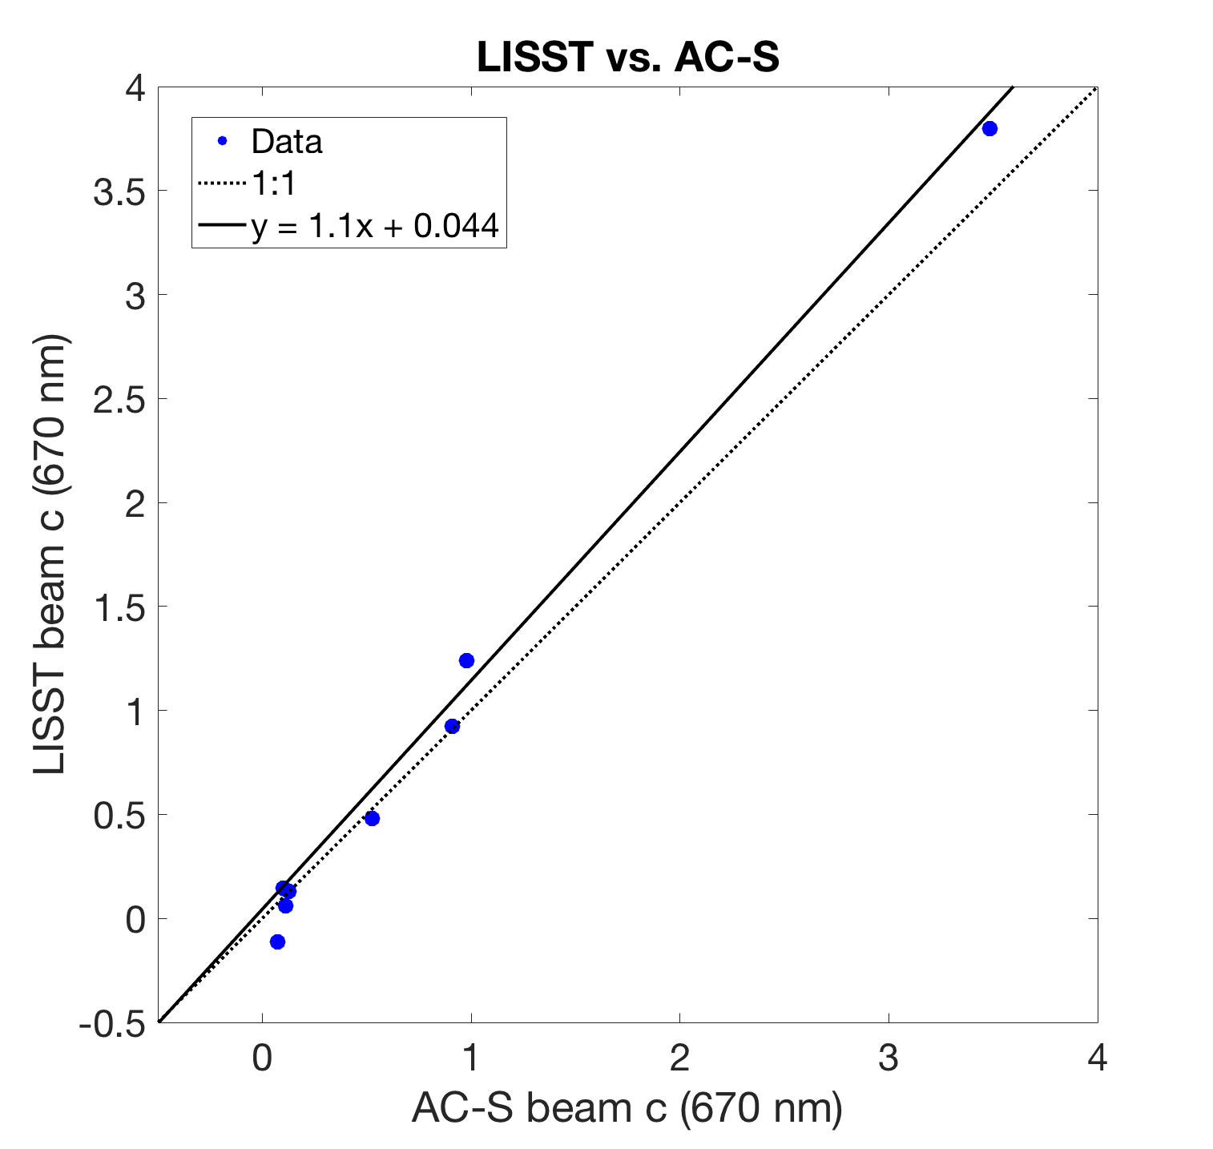
Beam c: Instrument Comparisons
r² = 0.9936

Slide 13
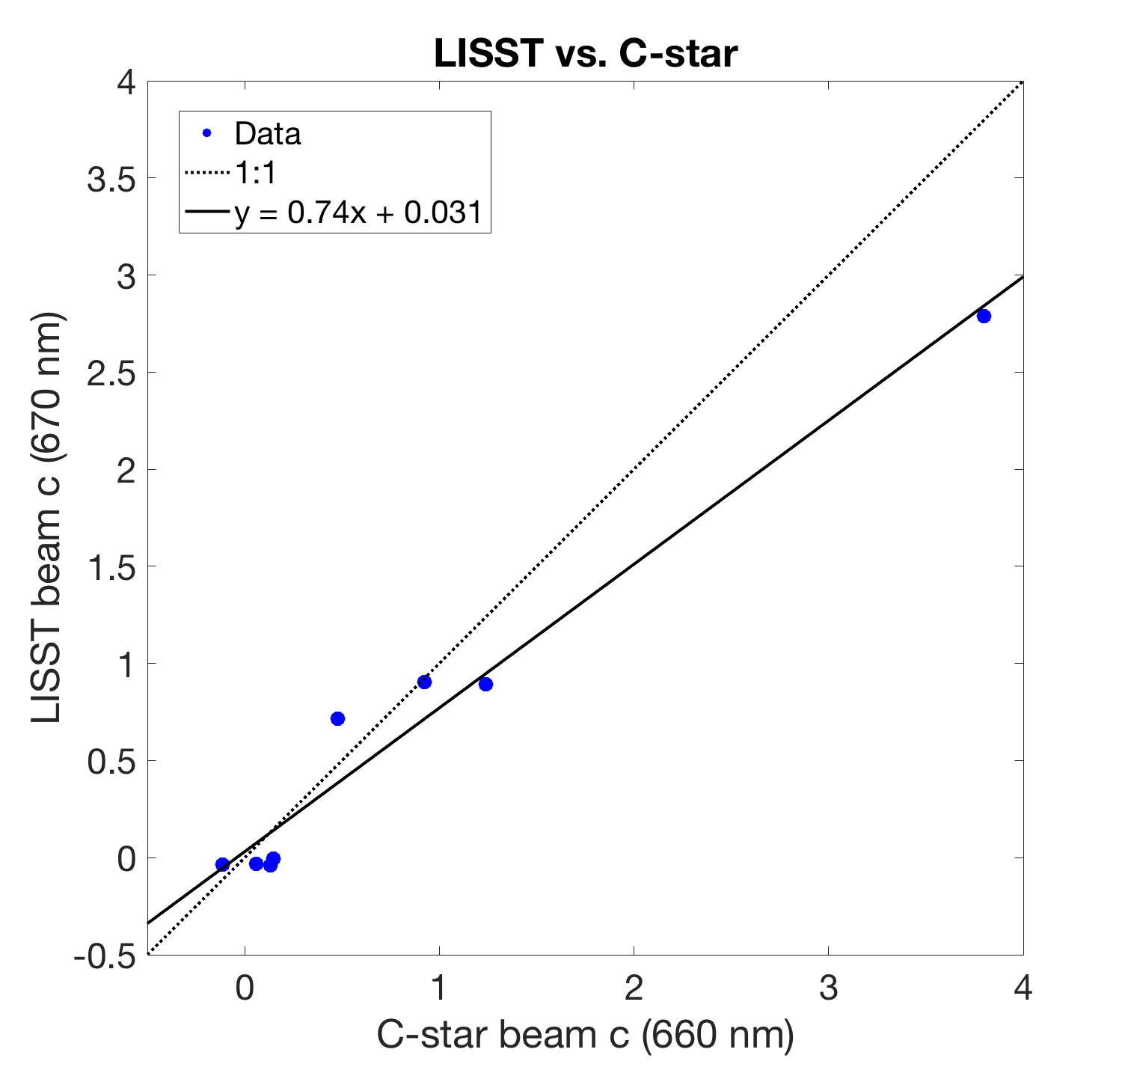
Beam c: Instrument Comparisons
r² = 0.9675
Notes:
Subtract: sample - filtered!!!!

