Slide 1
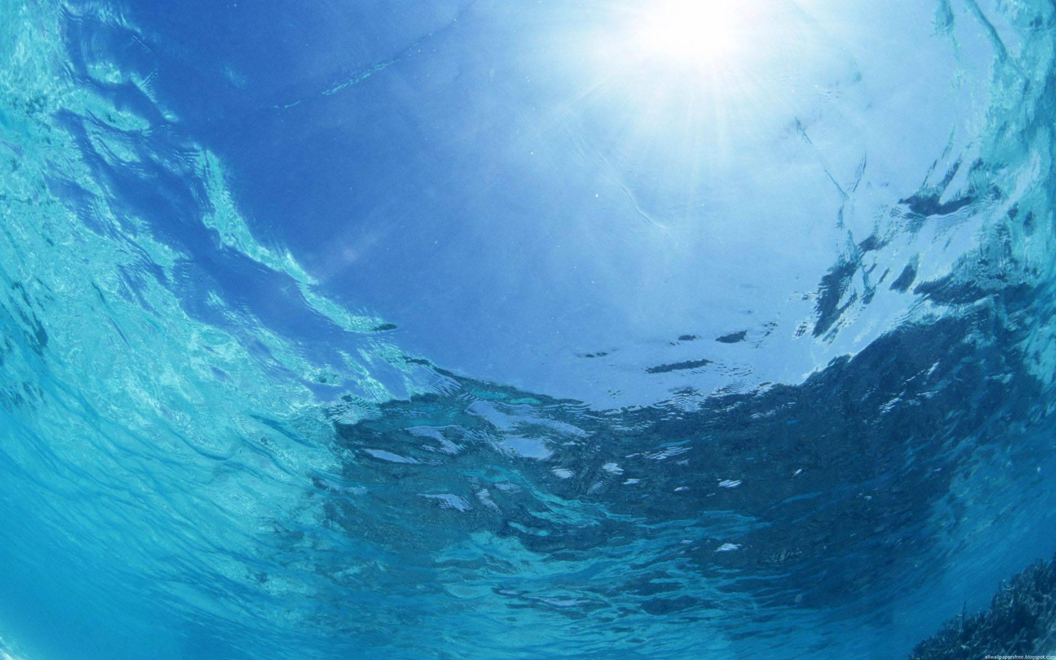
Lab 4: Scattering, Backscattering, and the Beam Attenuation (Revisited)

Slide 2
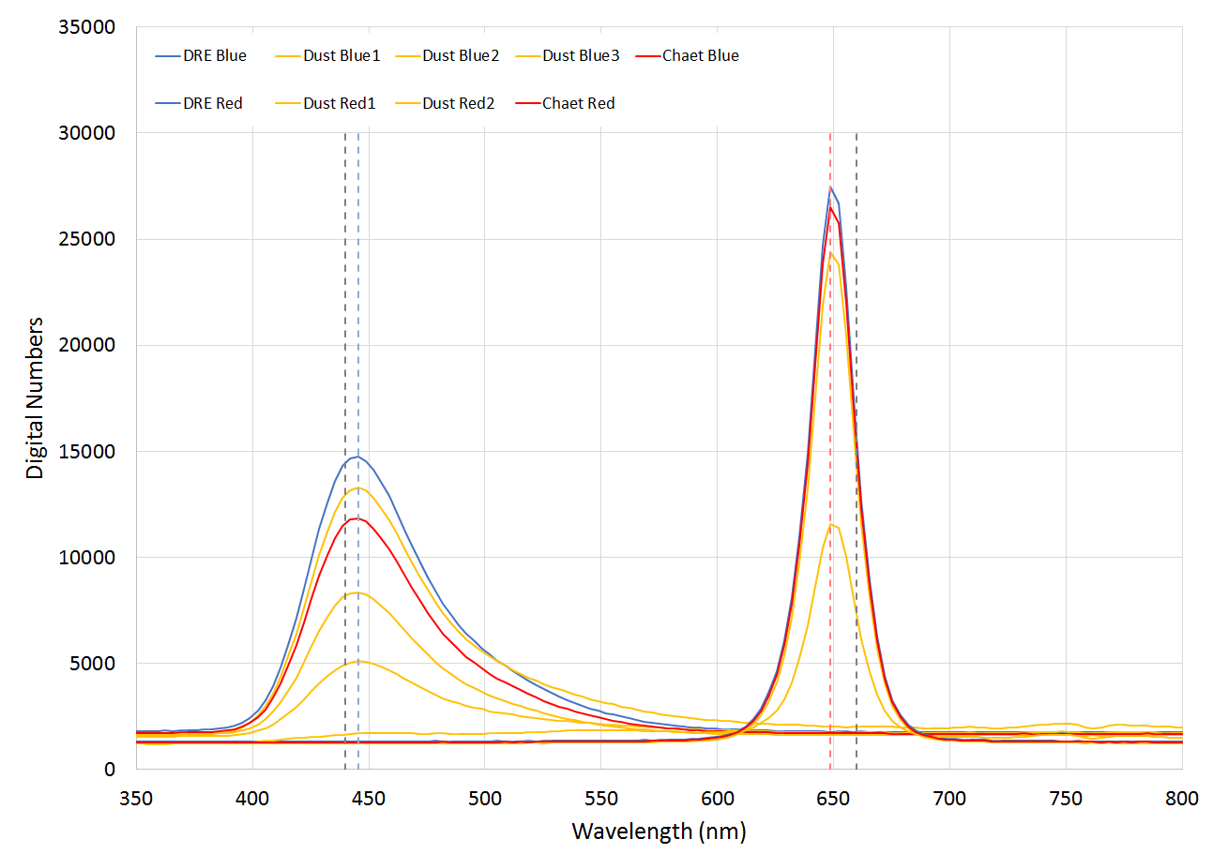
5.4 nm
11.3 nm
FWHM
Blue ~70 nm
Red = ~23 nm
Notes:
Question 6
Bandwidth = the width of frequency range where less than half the signal’s power is attenuated
Calibration of the VSF - plotting the readings from the radiometer to the red and blue channel. We can find out the bandwidth form that.
How does the device file compare with that bandwidth
We compute our MAX and there is an offset of 5 nm from the device file report (445 instead of 440)
BLUE - larger deviation (around 11 nm)
All measurements (of all samples had peaks at the same wavelengths - that’s pretty cool :-)
Just digital numbers, no calibration (KV), which means that if toward the blue is going to raise the digital numbers due to increasing sensitivity.
(EB) What else do you need to know about the spectral response? The s.r. Of the DETECTOR!!
Always check the info about the instrumentation!!
The red should capture also the fluorescence that is emitted from the blue as well, thus a source of error. (EB) says that the proportion is supposedly negligible. You can add (DCMU???) to stop the fluorescence
Angle distribution of the fluorescence check: fluorescence is way lower than inelastic scattering (KV)

Slide 3
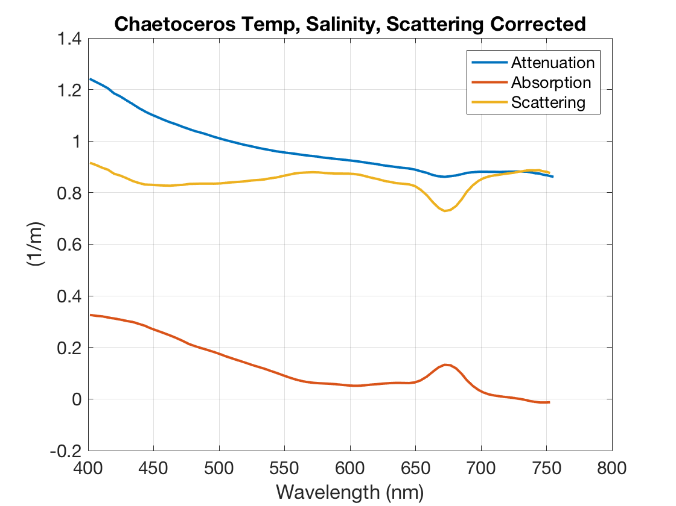
Revisited ACS Attenuation, Absorption, Scattering
Notes:
ACS T, S, b, corrected
Ok for the cultures - a reaches 0 towards the red. Abs peak at 676-ish nm (Q-peak)

Slide 4
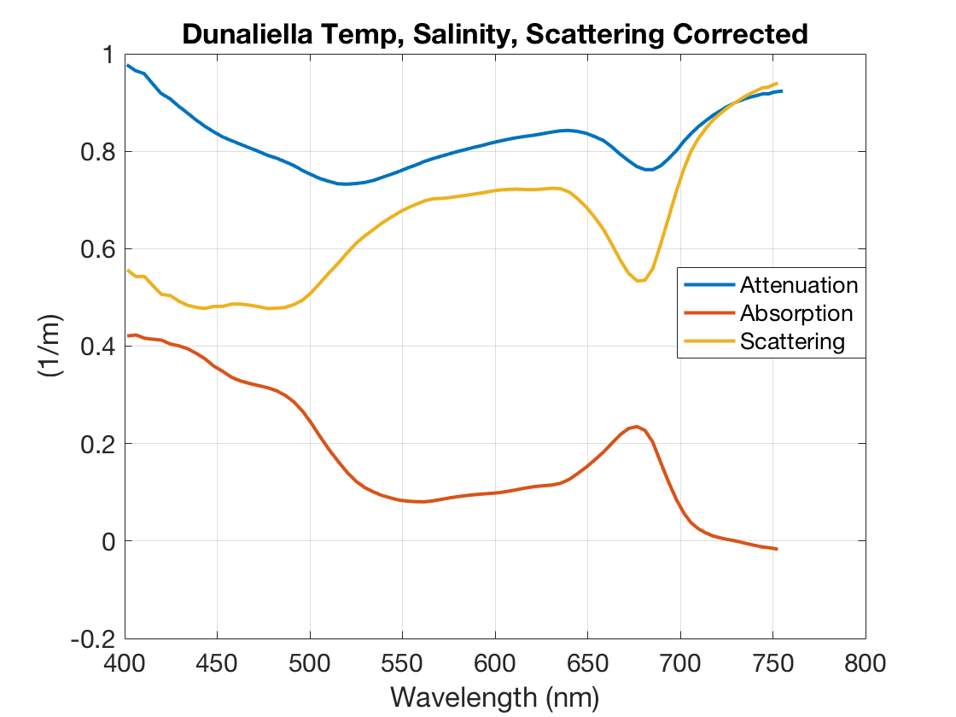
Notes:
Brian wasn’t sure why there was an absorption signal in the red, but EB says that for a culture, it doesn’t necessarily have to follow a power law.

Slide 5
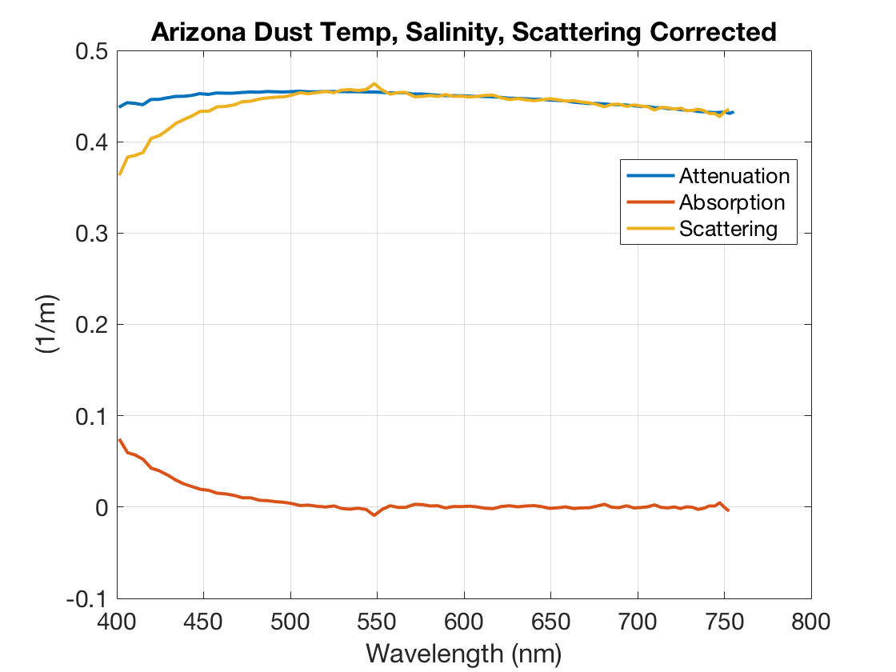
Notes:
Inorganics like iron oxides can absorb in the red. Depends on the composition of the dust. EB says this curve looks great.

Slide 6
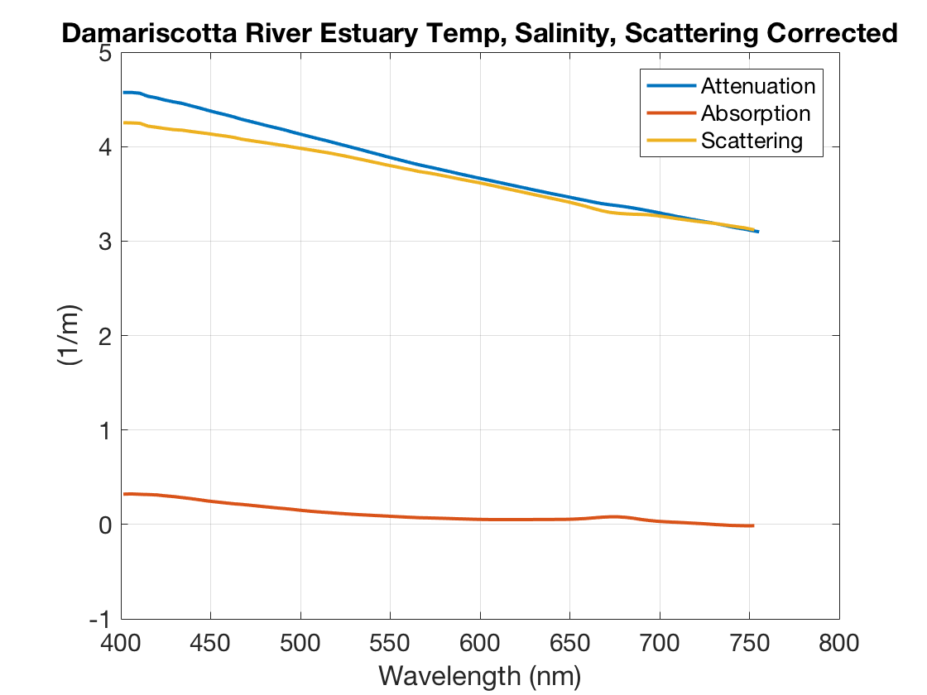
Notes:
They think they are slightly overcompensating in the red.
Ratio of abs vs attenuation - low … if you compare it with the one of the cultures in terms of absorption
The abs of particles contribution - NAP!!!!
Non-algal particles are contributing to the lack of features in the blue (the cultures have that bump in the blue, this doesn’t).

Slide 7
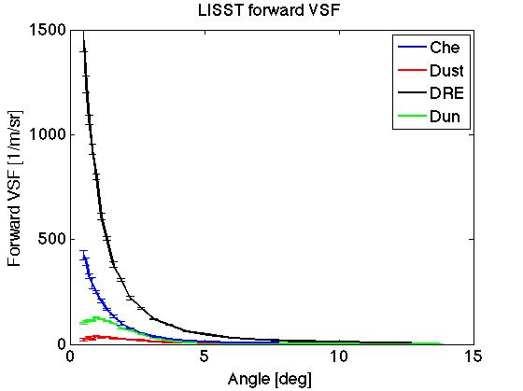
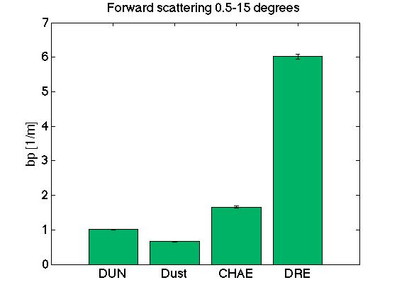
VSF obtained from LISST
Notes:
Problems with small angles, so they start with 0.5 deg

Slide 8
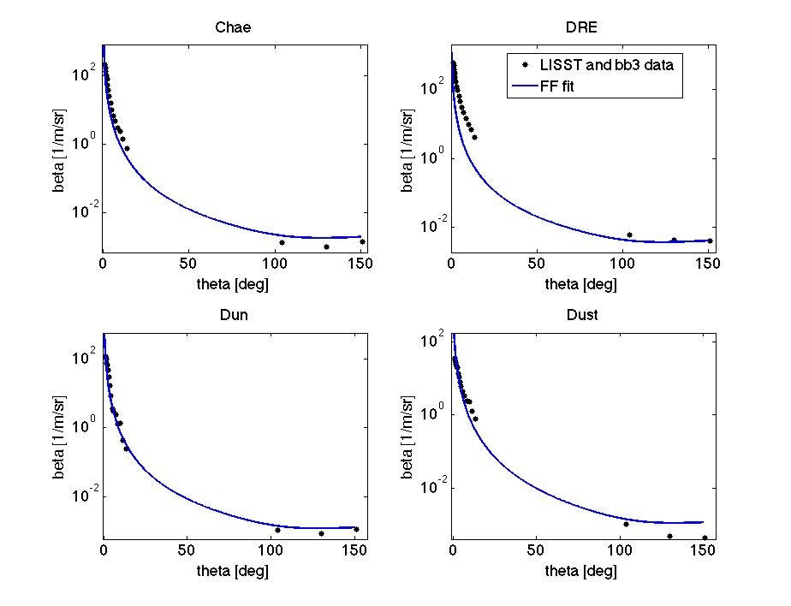
Notes:
Adding measurements from BBS - Fournier-Fourand fit function
How did we weigh our angles when we did the fit? It fits only in the back direction - DRE fit problems?
Manual adjustment of the fit did not help. Minimization of squared differences - angle by angle -- this is tricky because at small angles you’ll have a huge error -- you should do a RELATIVE error
Big numbers totally dominate the fit compared to small angles so how to fit well big vs small particles.
Take the backscatter ratio and get the right number for the FF fit!!! HOMEWORK :-)

Slide 9
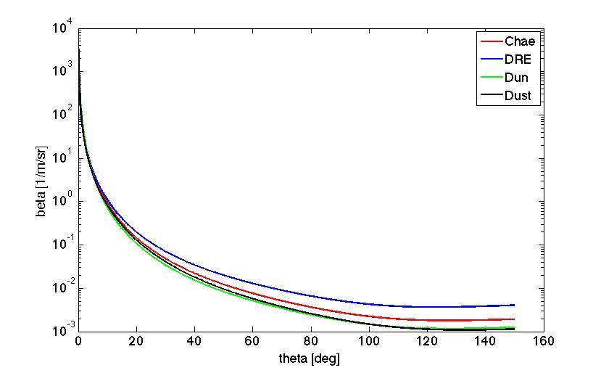

Slide 10
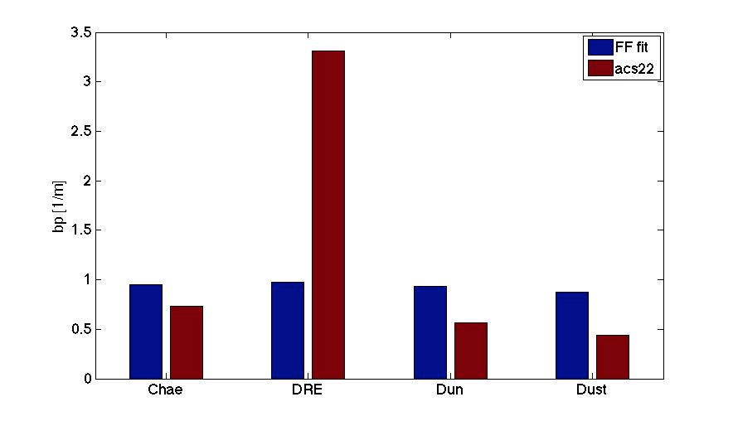

Slide 11
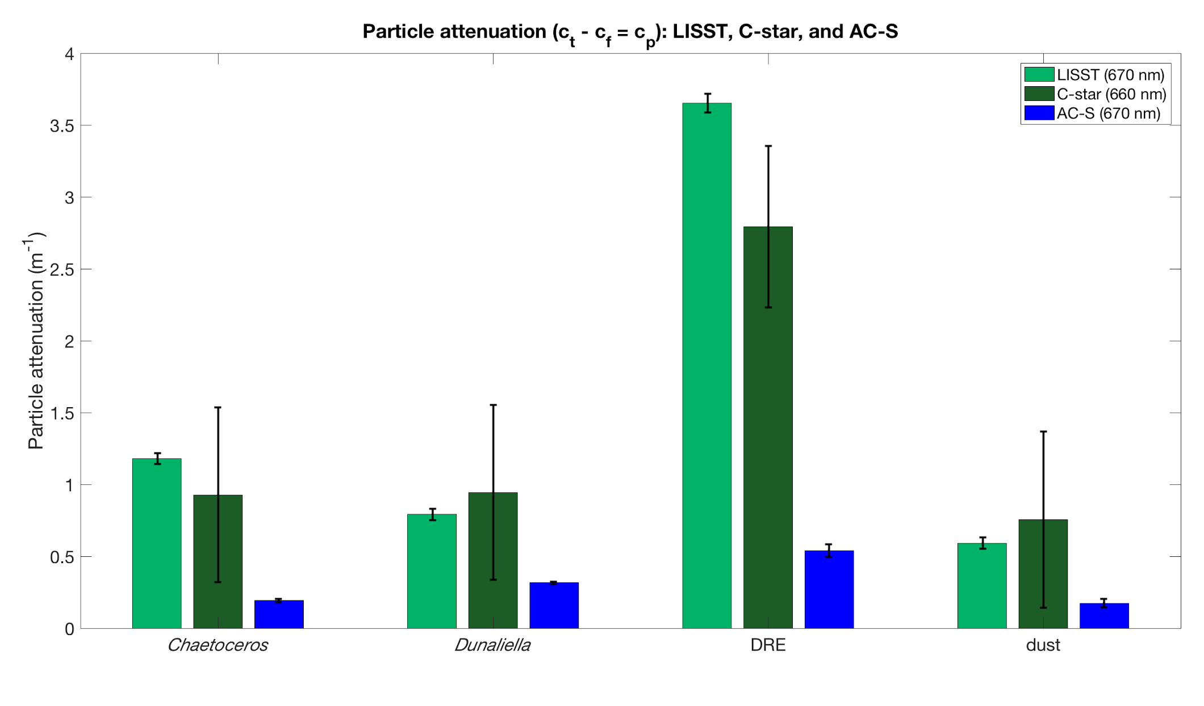
Particulate attenuation comparison
Notes:
ReviTotal-filtered → particulate
Applying the new AC-S corr lowers the acs attenuation values slightly, but the trend between the samples remains the same.
In the new correction, they used Milli-Q water. THey also didn’t take the mean of all the values, but instead took the mean of the middle of the run once the instrument reading stabilized.
The two cultures don’t settle down that quickly. If the a spectrum changes with time then you know you have bubbles.

Slide 12
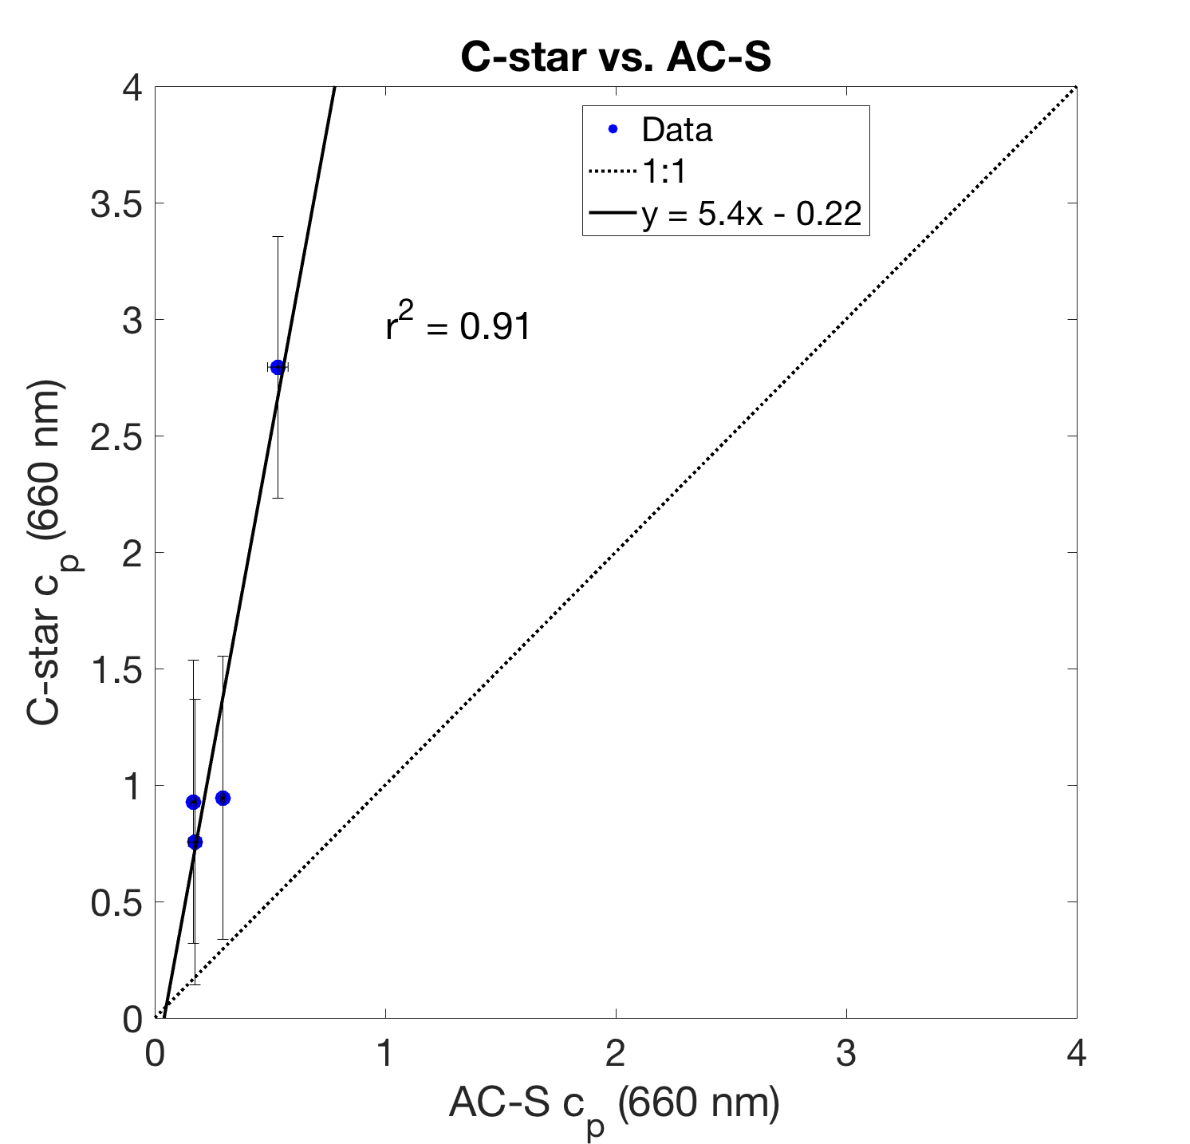
Notes:
Huge difference , contradictorily expected from the theory! The C-star should have had lower attenuation because it has a wider acceptance angle, but instead it has 5 times the attenuation. Totally WEIRD :)

Slide 13
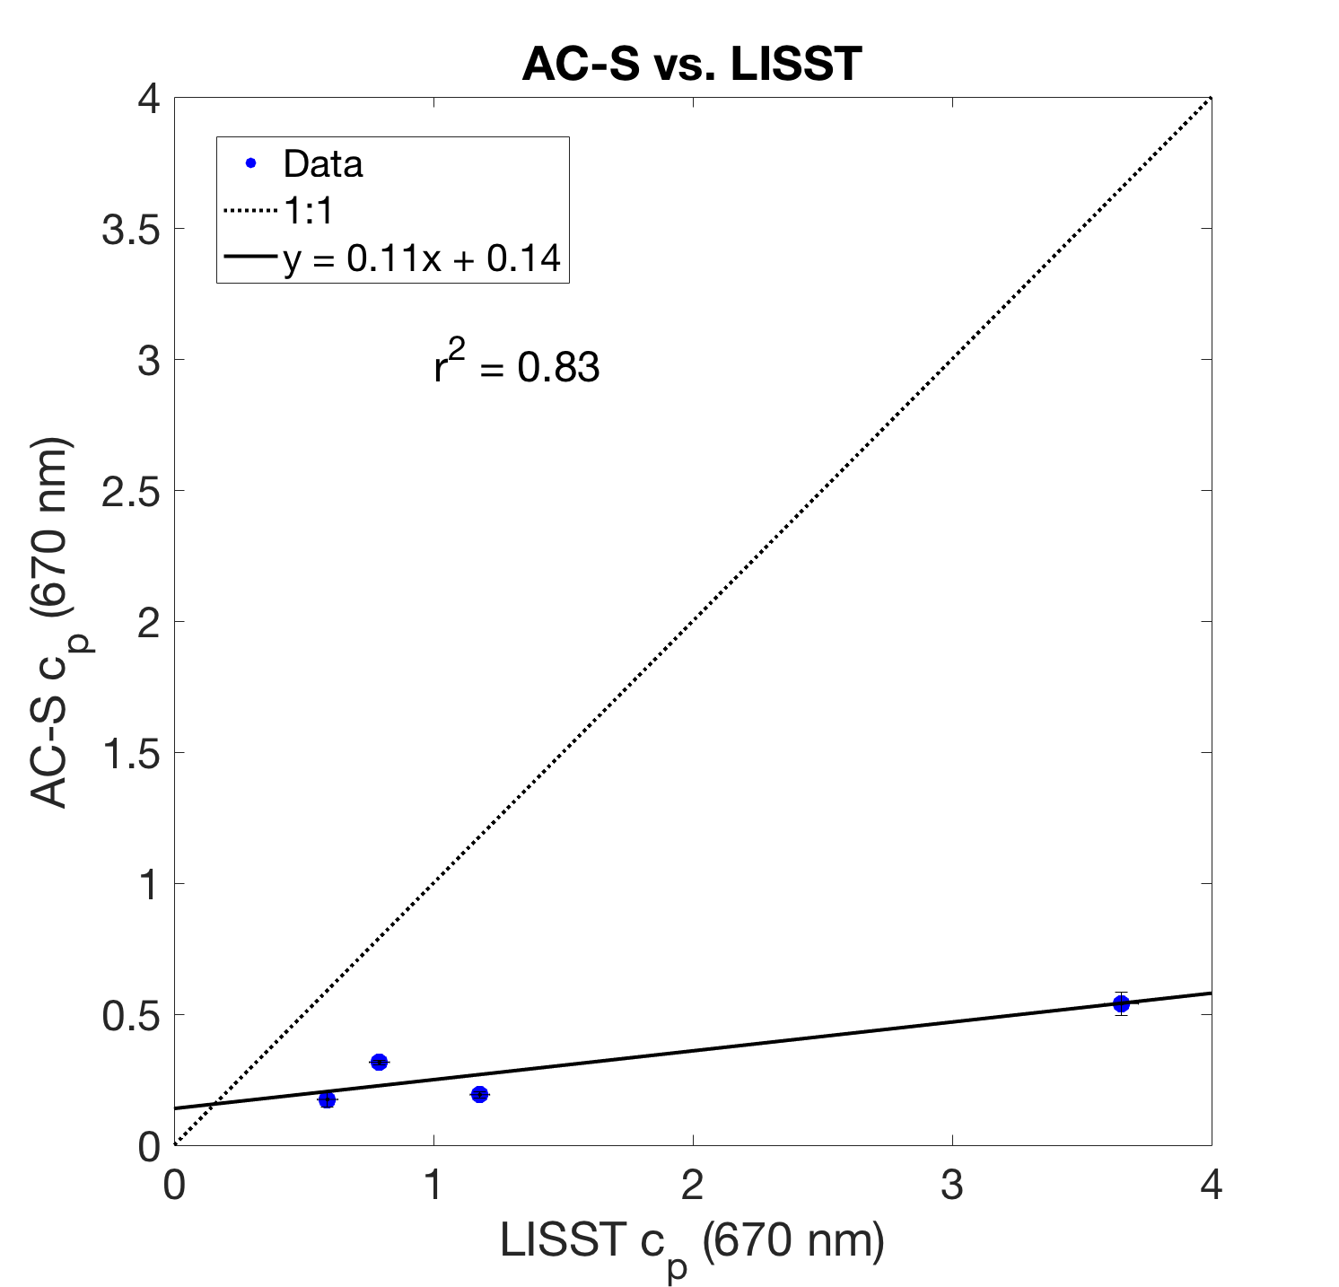
Notes:
Small error bars

Slide 14
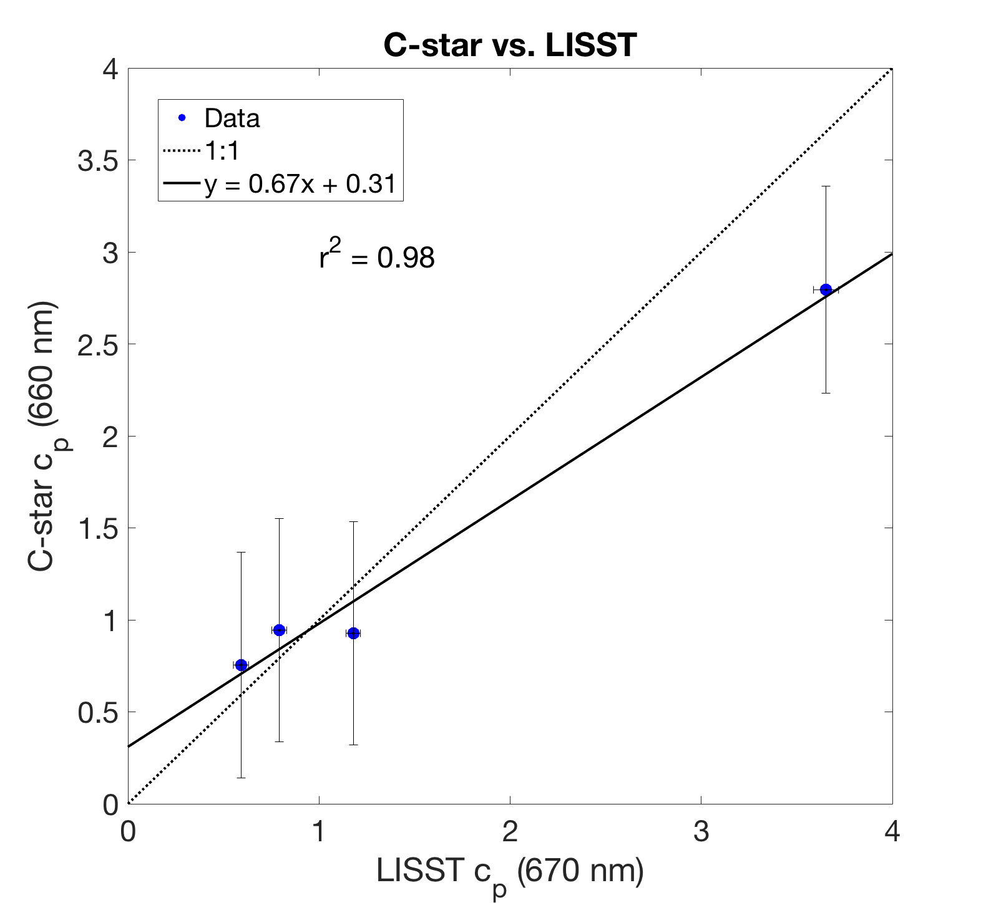

Slide 15
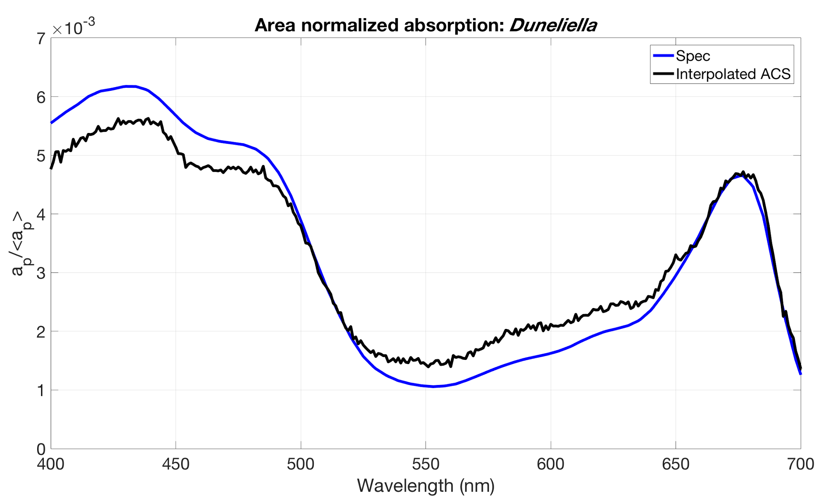
Revisited particle absorption spectra comparisons
AC-S spectra interpolated before normalizing to area under the curve
Notes:
Interpolation of the AC-S BEFORE the normalization!! Makes the curve improve significantly.

Slide 16
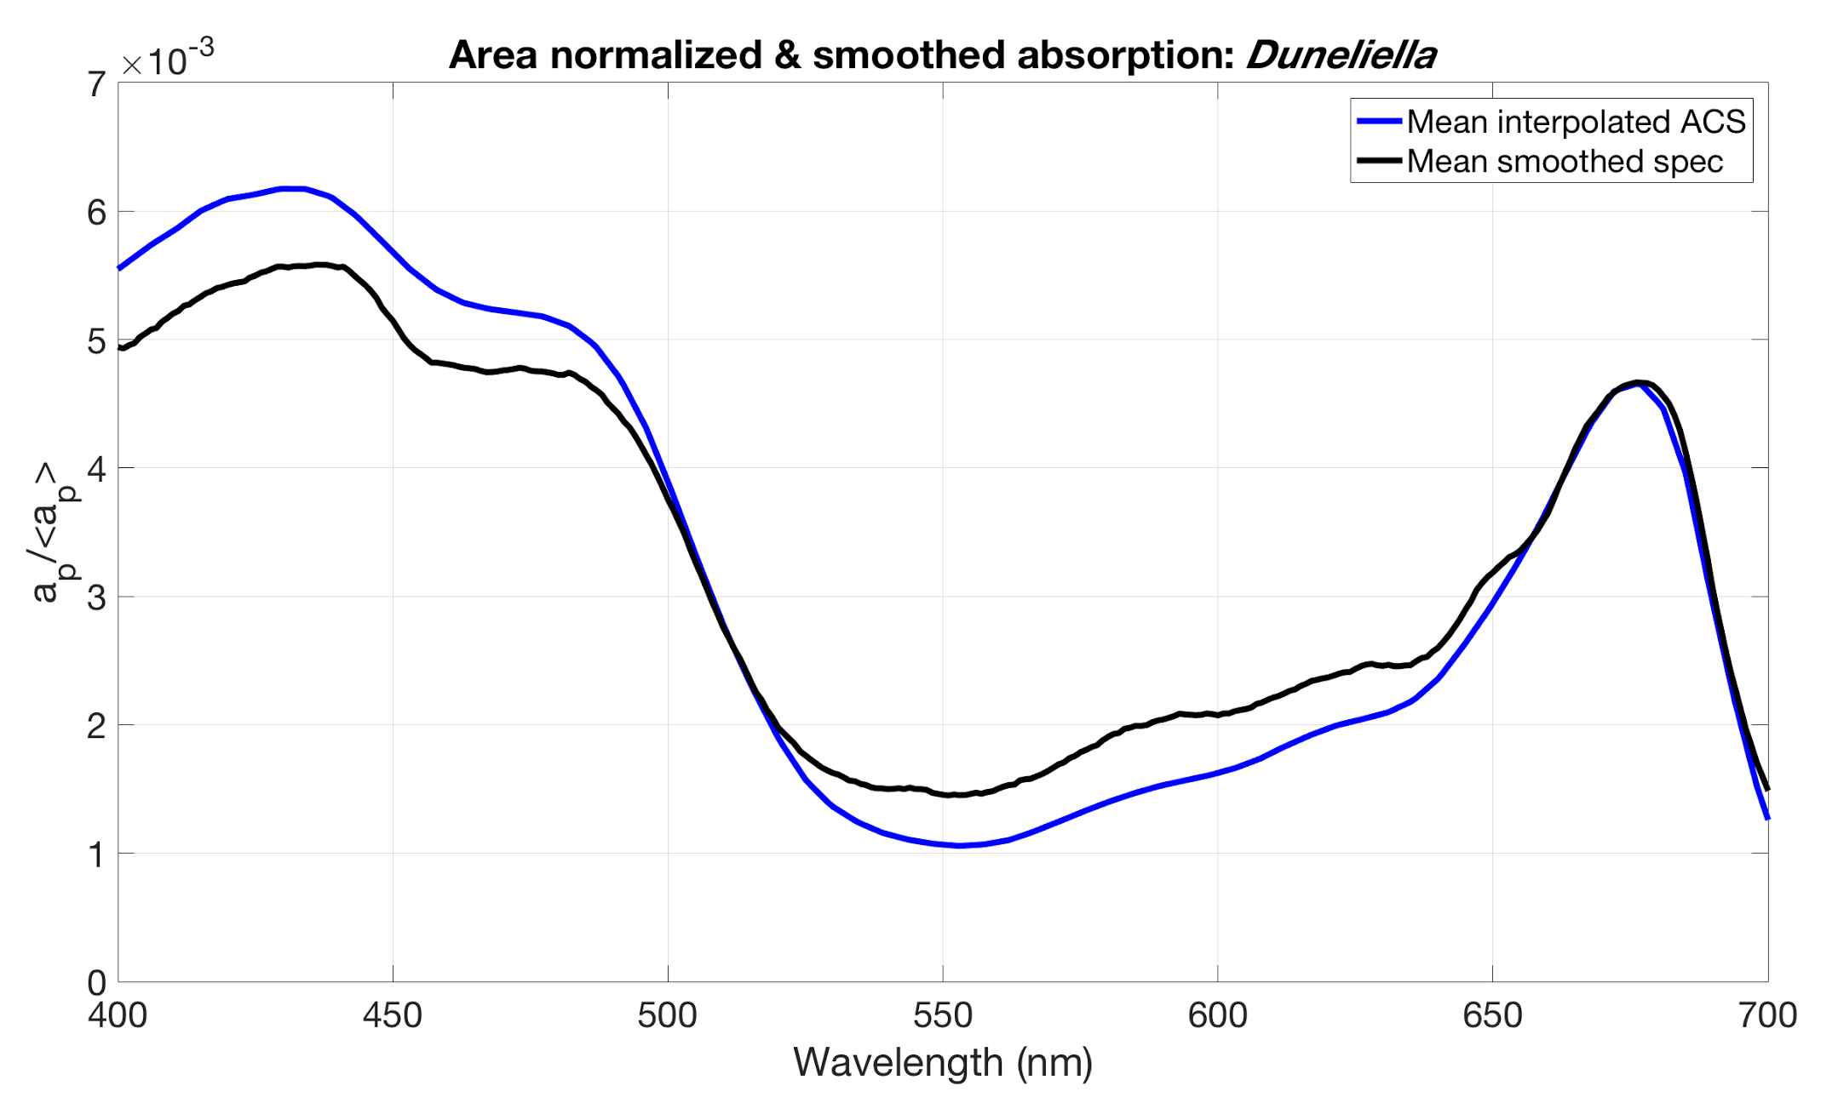

Slide 17
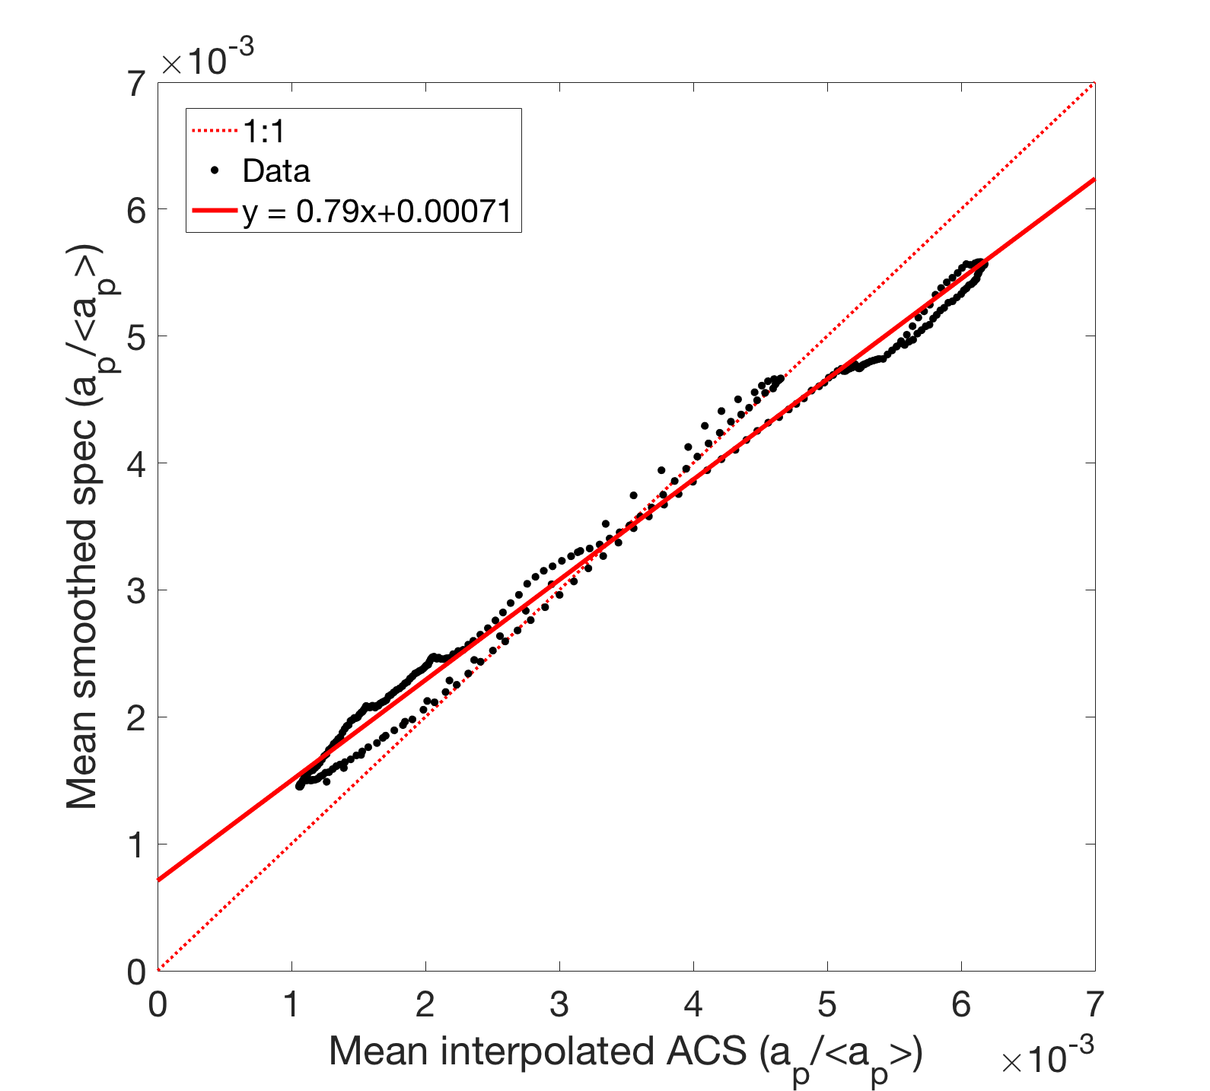

Slide 18
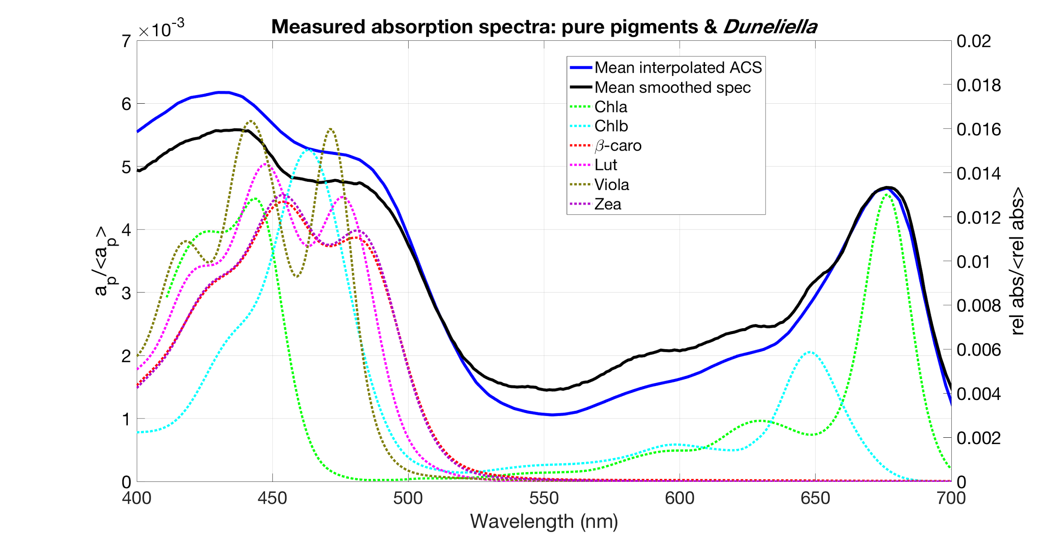
Notes:
(EB) Which one seems to be more corrected in terms of scattering? It seems you have more abs in the blue
If you had applied only the proportional correction you would lower the curve down
DUN has small particles - more scattering in the blue??

Slide 19
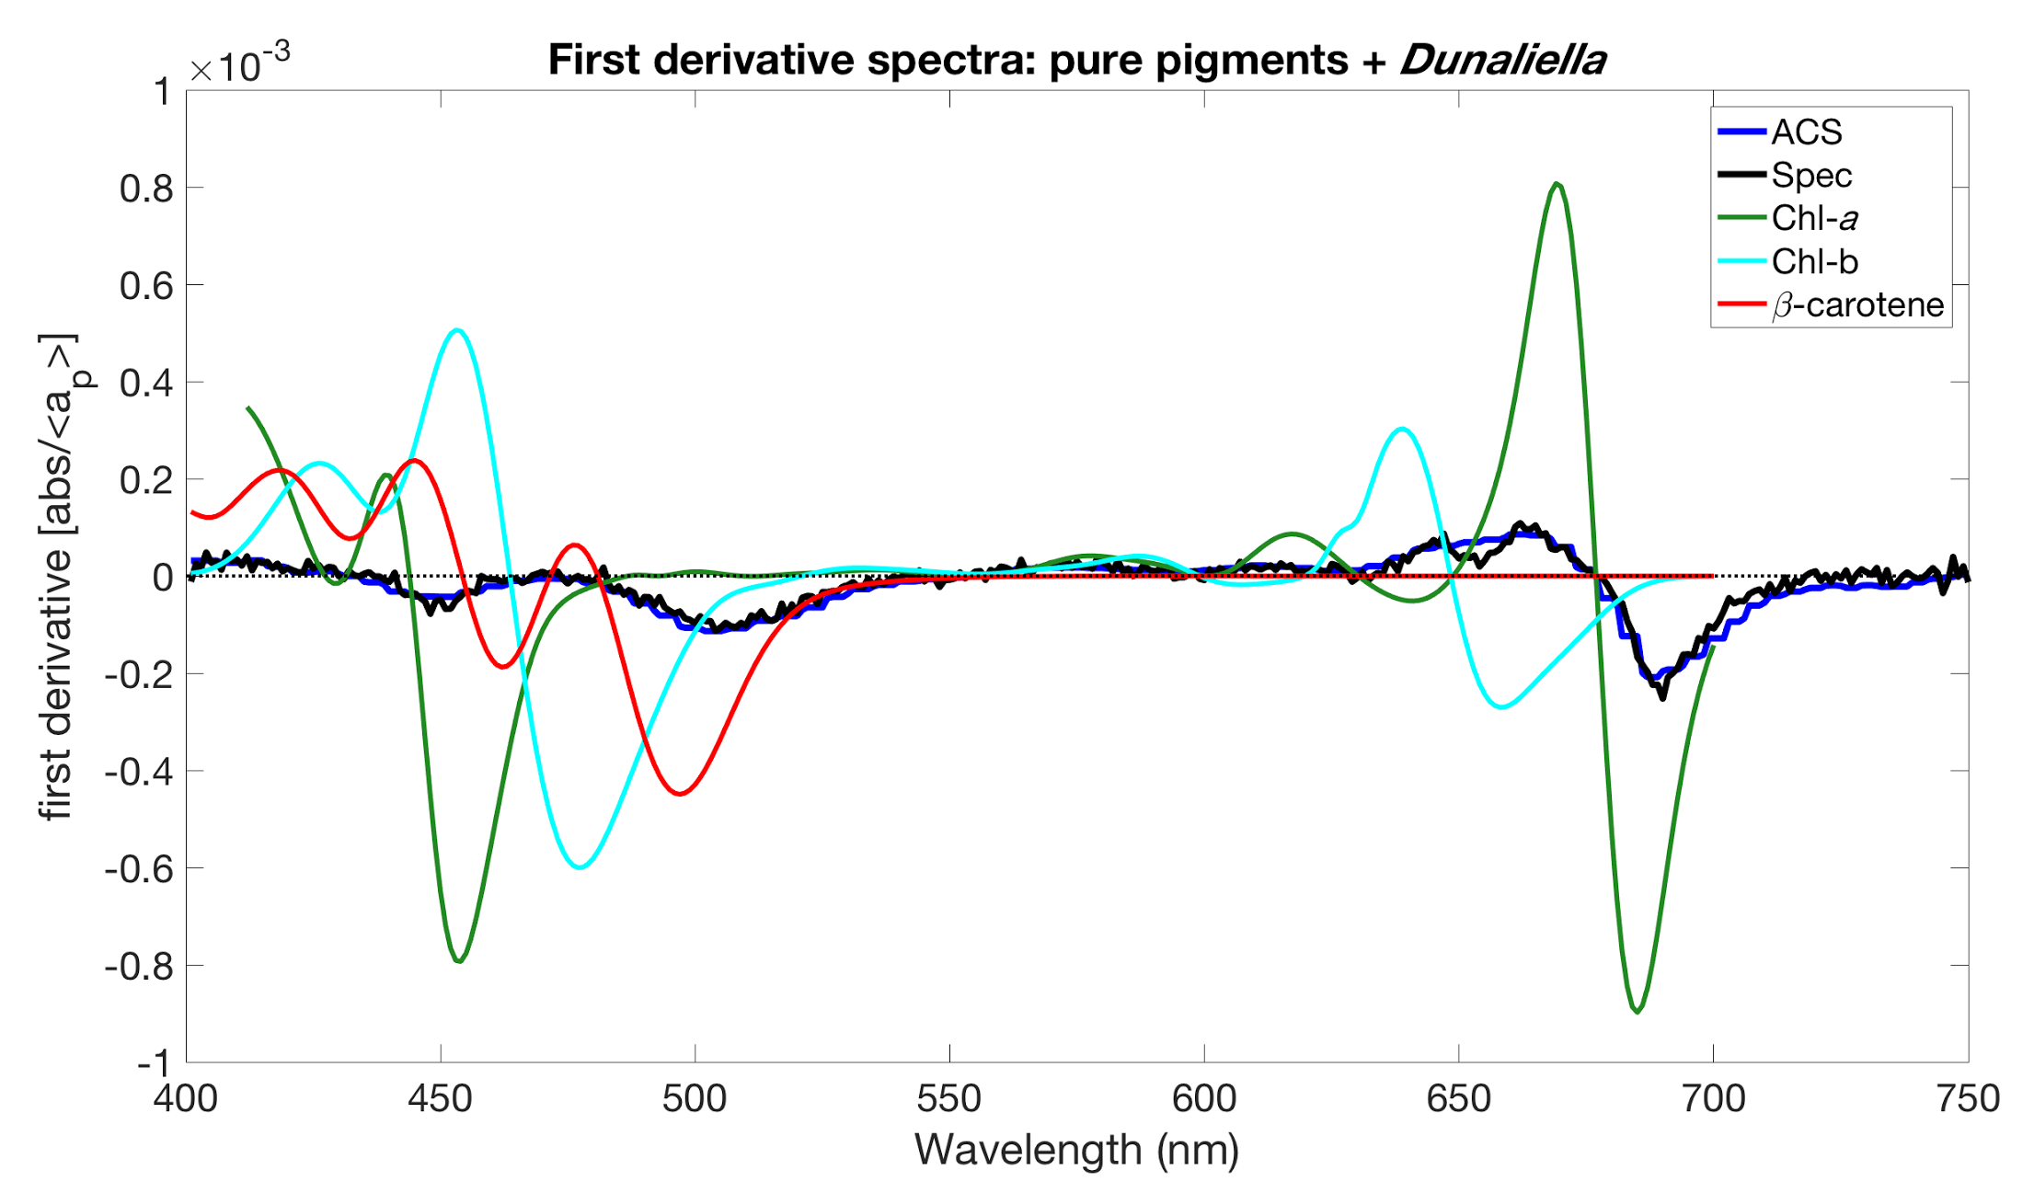
Notes:
Looking for other pigments using the first derivative spectra
They used the mean of the flat and varying scattering correction.
Derivative spectra to see the features. Chl looks fine

Slide 20
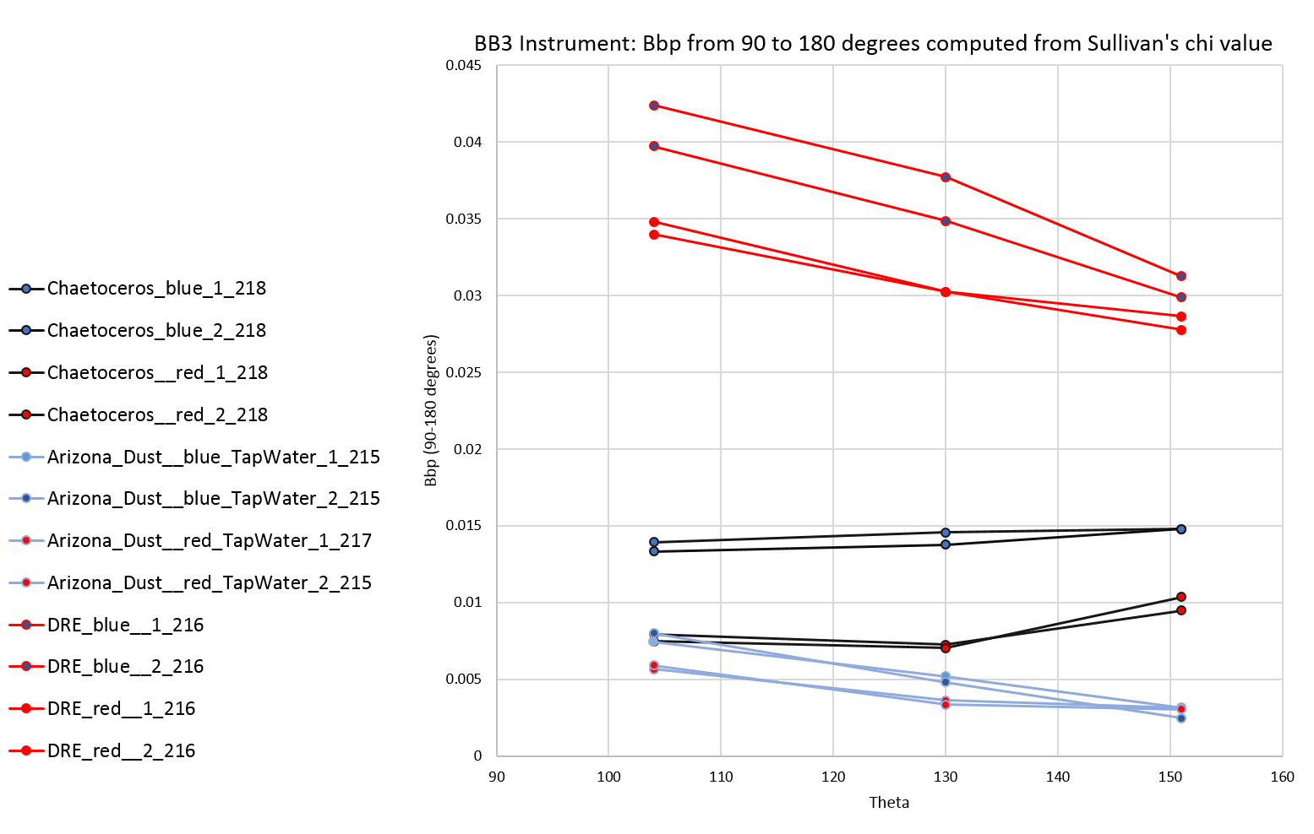
Notes:
Bbp coeff as you were measuring only one angle. You’re seeing the flat line only for the chaetoceros - flat line.
We can compare them to each other because it depends on the concentration. To compare samples we need to use the ratio. If you had a higher conc. Of dust you will get more backscatter.

Slide 21
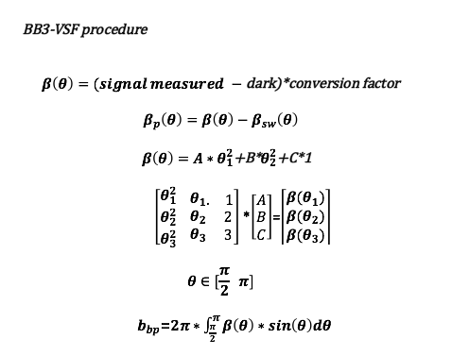

Slide 22
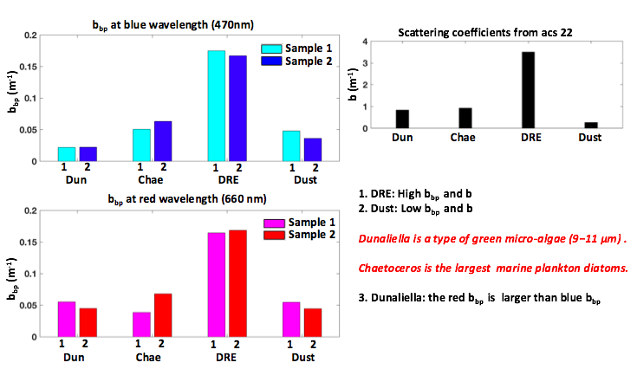
Notes:
This slide is comparing Bb derived from Sullivan’s empirical chi’s and from integrating under the curve. Bingqing’s method shows about three times higher backscattering, which EB thinks might be a factor of 3.14 higher so it could be an algebra mistake.
What else affects backscattering. Light incident to a particle, enters the particle - it can be absorbed! You could see a reduction in the blue for DUN and CHAE.
There’s a factor of PI of difference between the outputs of Bingqing and ours. CHECK!!!! Probably a problem in the integration process - this is what (EB) suspects it might be an error

Slide 23
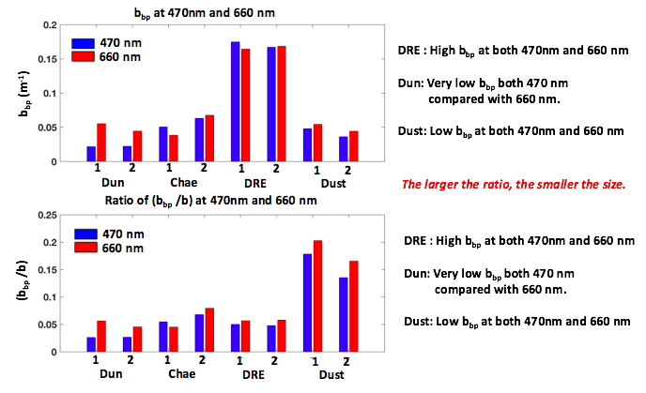
Notes:
Bbp high, but the ratio is low for DRE → smaller particles!
Composition impacts as well!!!
DUN and CHAE both phytopl, lower n, absorb
DUST - high n, small particles…
Steep population w small particles - biggest sensitivity for size
Larger particles - larger sensitivity on composition(refraction index n)
TWARDOWSKI paper!
Phytopl backscattering ratio: 0.5% 10x lower of what we get
Inorganic particles bbp/bb = 2-5% 10x higher
Brian values are more consistent

Slide 24
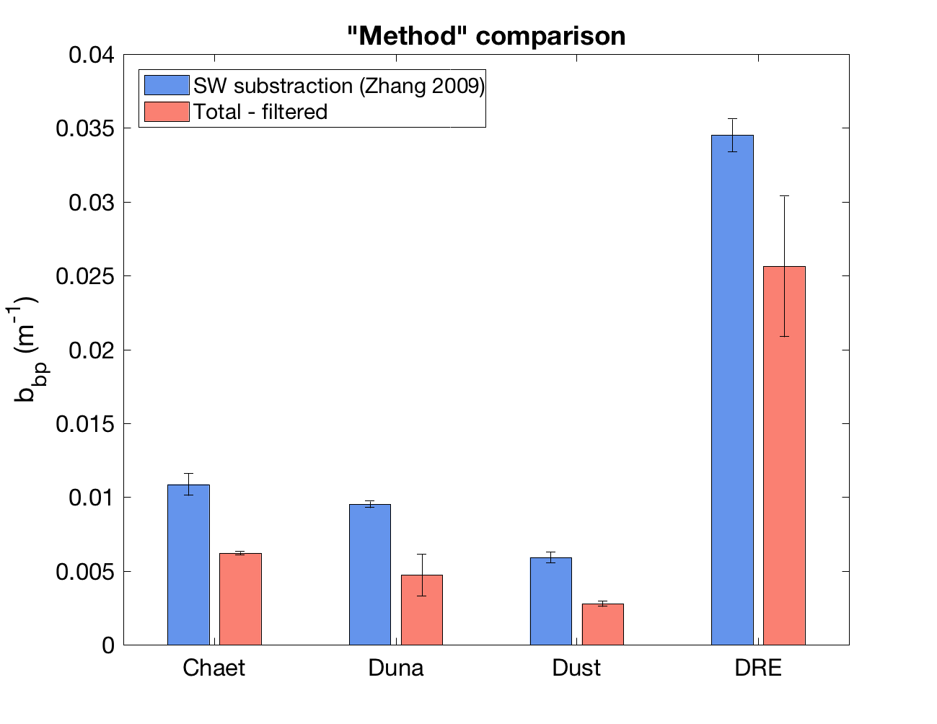
bbp from FLNTU
Notes:
SW correction vs Total-Filtered
Pure SW backscattering model from Morel’s measurements from 1973 - matched very well, but accounted only for water and salt. The ZHANG method doesn’t account for the range of particles between 0.2 and 0.7 micrones.
Filter size of the POC 0.7 micrones
The filtered is lower because you’re subtracting more stuff :)
Three comparisons:
Zhang method (salt correction),
subtract 0.2 filtrate AND
then also the filtrate 0.7 (filter above which you’re measuring POC)

Slide 25
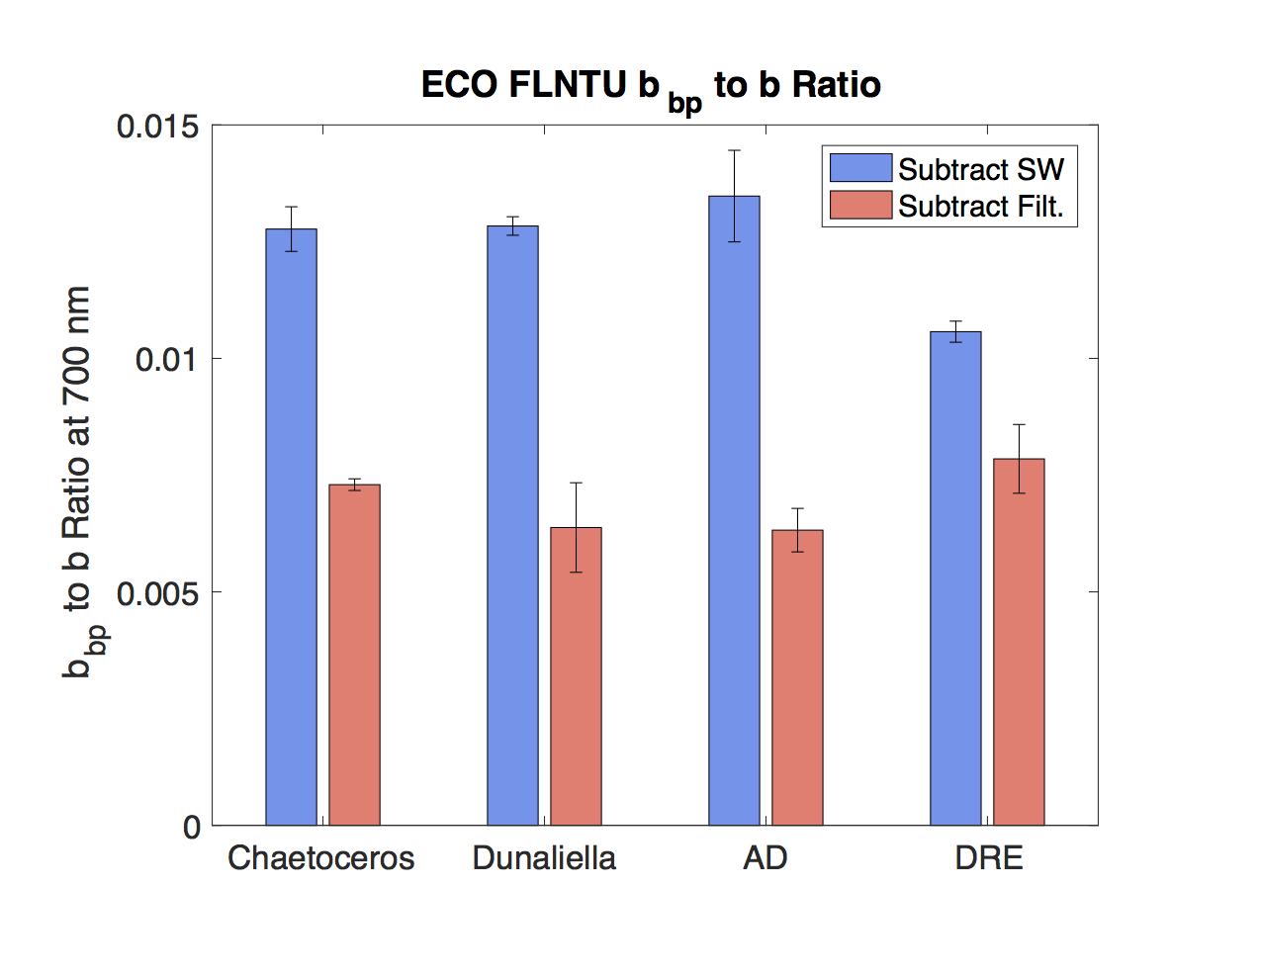
Notes:
Magnitudes are off by a factor of pi
No variability between samples (red bars) - pretty weird. AD and DUN are the same - doesn’t make sense
bbp/bp - CORRECT IT! Not bbp/b
There might be some variability in the sample (AD) - turbidity changed for a factor of 2.5 before and after mixing.

Slide 26
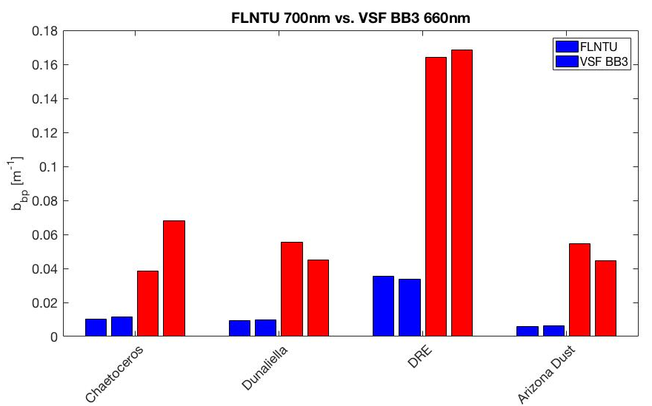
Notes:
BINQING data- correct it to Brian’s

Slide 27
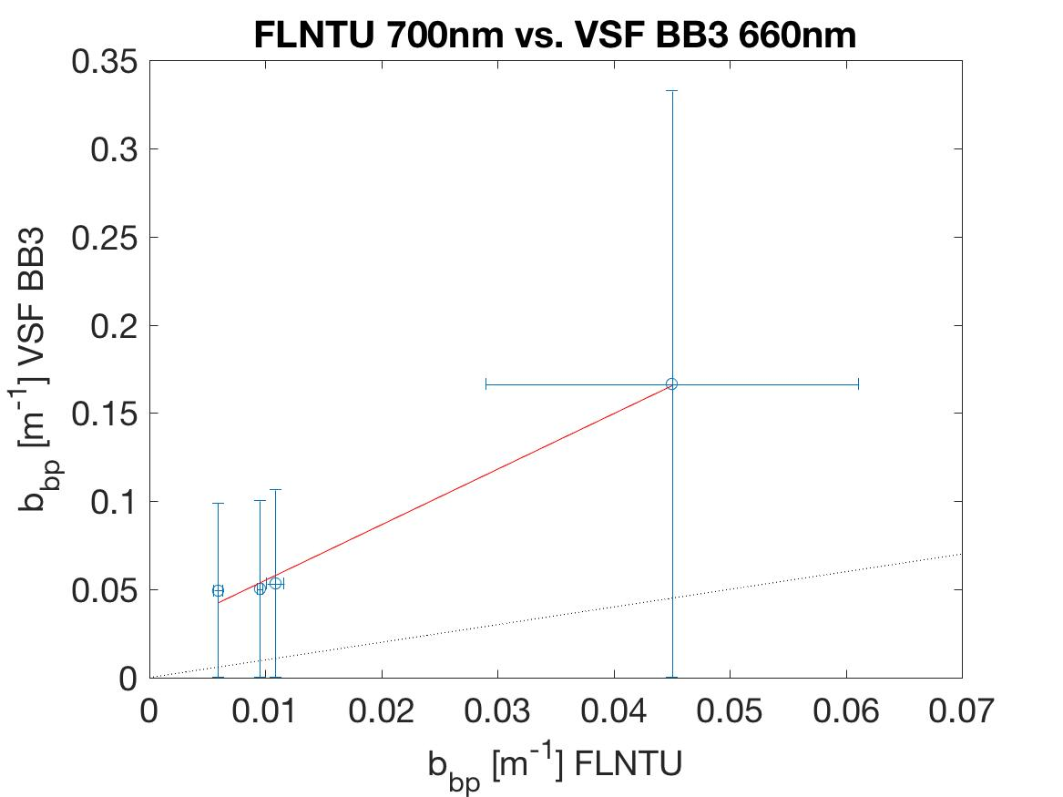
BB3=0.0236 + 3.15*FLNTU
R²=0.98
DRE
Dust
Dunal.
Chaet.
Notes:
Again, correct it - look at slide 26.

