Slide 1
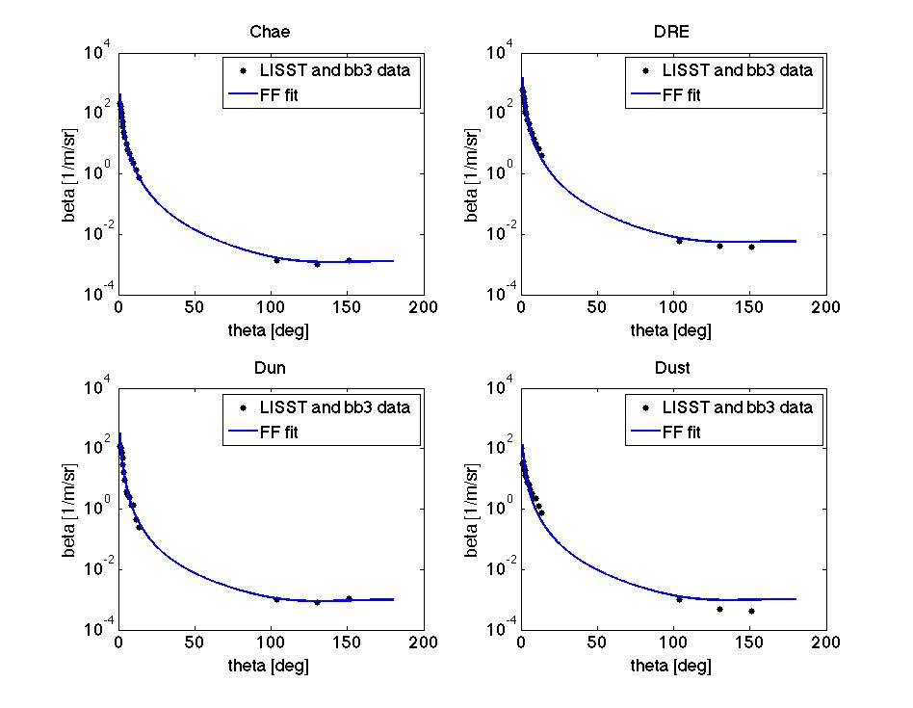
Lab 4 revisited
Notes:
The problem from last time; last presentation, this fit didn’t work at all. They redid the phase function and improved the fit. Curt says those fits are shockingly good and thinks this is good work.
They fit a fournier fournand phase function here. This is beta, not the phase function.
Fit using 3 parameters: N, nu, b?

Slide 2
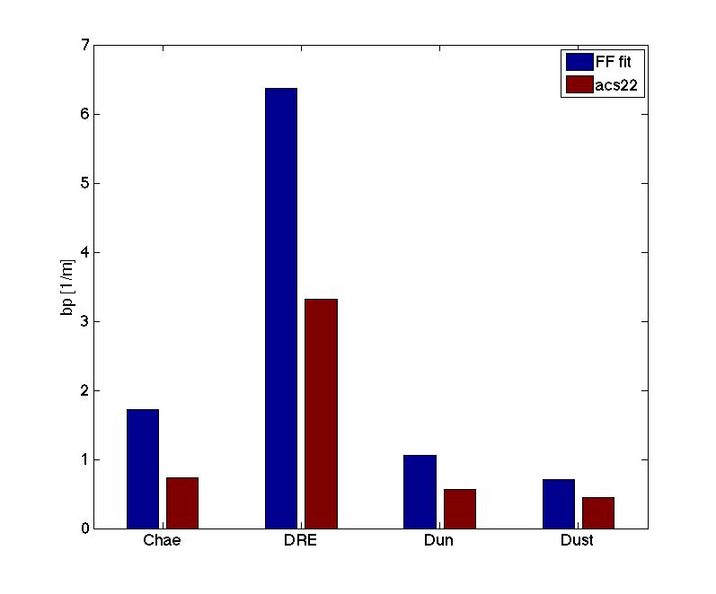
Notes:
The nominal angle is 93. The mismatch between instruments could be shrunk by changing the angle they integrated over but that would just be overfitting their data. Is he saying “Beads” or “bs”? Like known materials (beads?) or knwon scattering numbers (b)? I guess the latter makes more sense

Slide 3
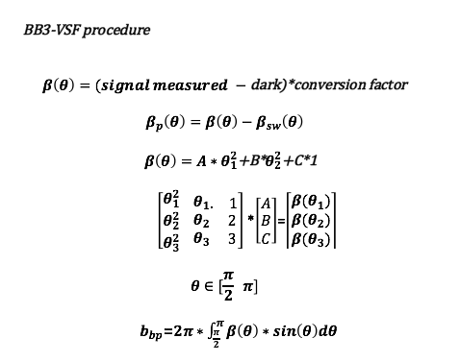

Slide 4
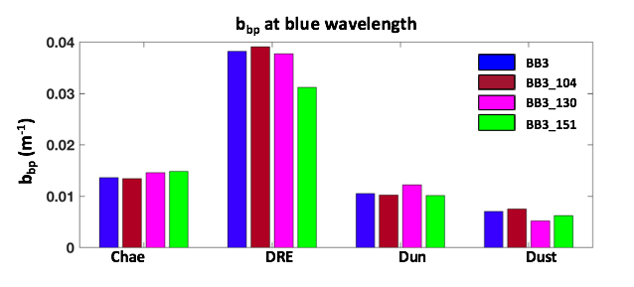
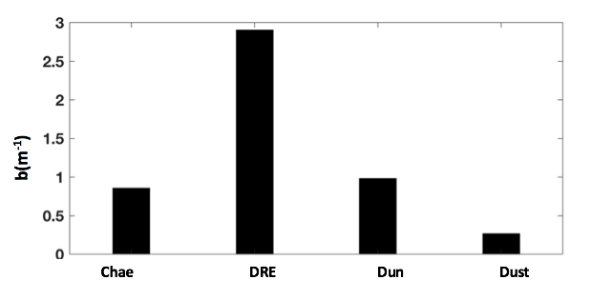
Notes:
Ratio of bbp/b tells us something on the composition. In absolute values we cannot say anything about the size distr.
She shouldn’t have used the total backscattering here. Instead, we should look at the ratio.

Slide 5
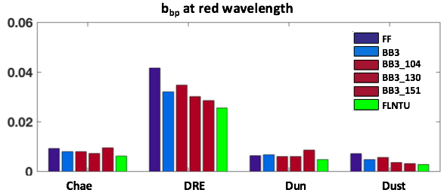

Slide 6
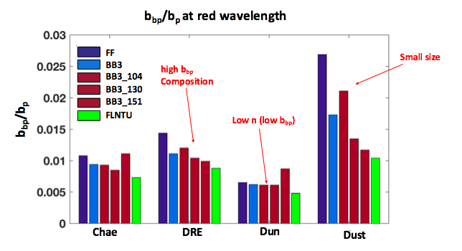
The smaller the size is, the larger the backscattering is.
Notes:
The smaller the size the larger the backscattering fraction is because the bbs is determined by the composition. The ratio shows you the sensitivity to size and index of refraction. The larger the index of refraction the higher the backscattering ratio. What is the maximum backscattering ratio you could possible observe? 0.5 is your absolute max for the kind of materials we are dealing with.
Then you consider the size.

Slide 7
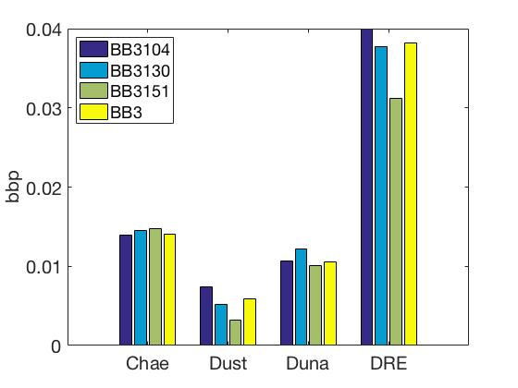
Bb3 at blue wavelength

Slide 8
Lab 5: Radiometry

Slide 9
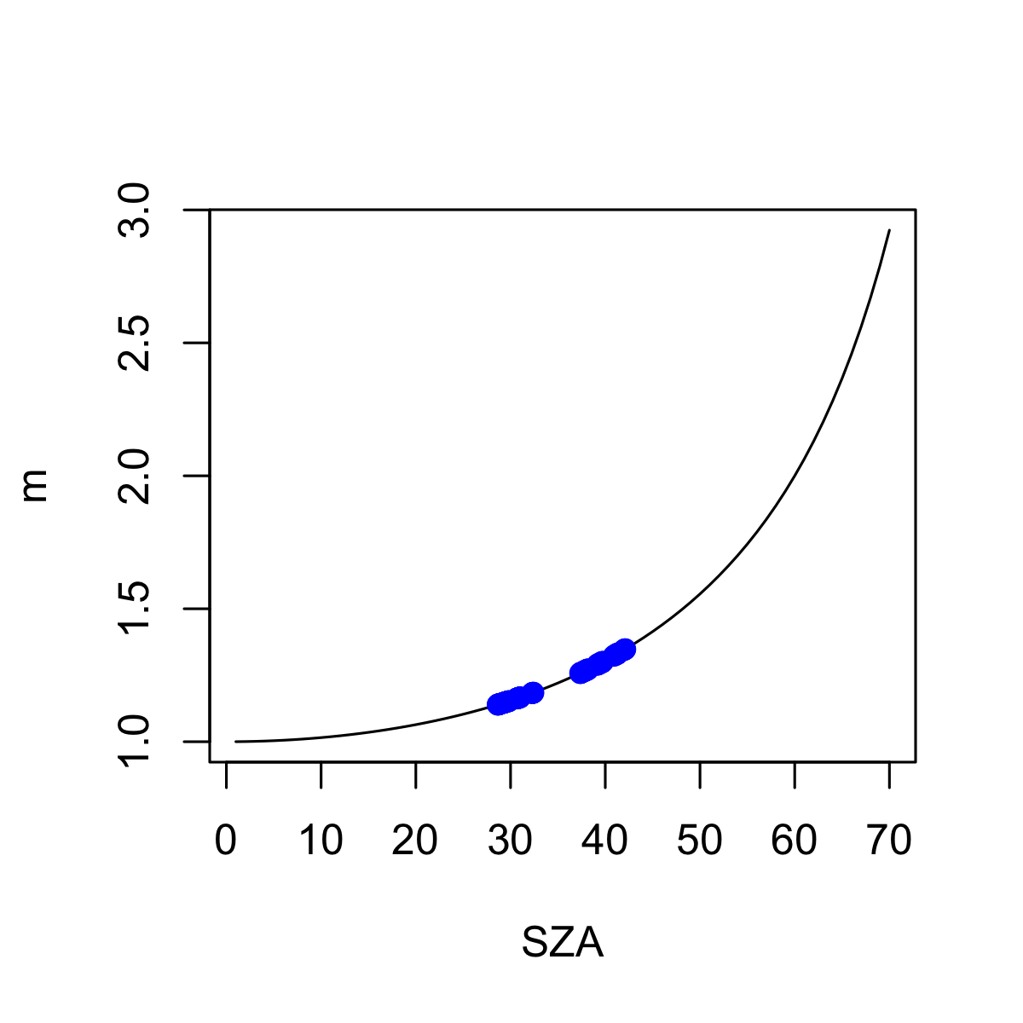
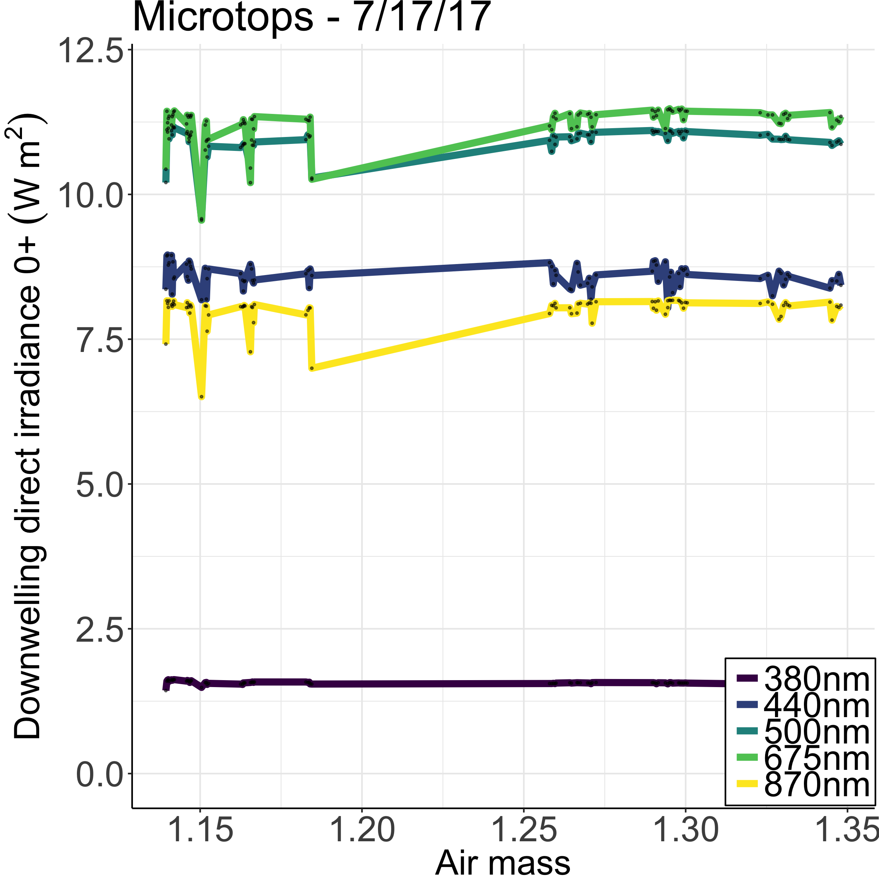
Sunphotometer
The path length increases as the sun follows its course towards the horizon.
On the plot, we do not see any decrease in the downwelling irradiance above surface, even if the air mass increases.
What happens past 70°?
Notes:
You can see variability in sun-pointing differences.
Known: The solar radiation at short UV wavelengths decreases rapidly with increasing air mass
They usually measure aerosols. We took measurements between 30 and 40 sun zenith angle.
Longer pathlength, more air mass
Past 70 deg you use some fancier equation :-)
Plot airmass vs time.: you don’t need to take many measurements. Like one every 30 min

Slide 10
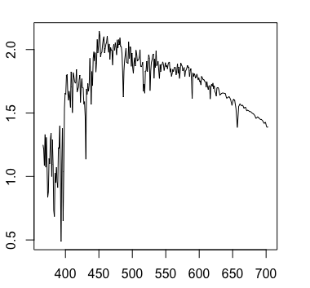
Something went wrong !
Irradiance [W/m2 ] = signal [mV] * cal_factor [W/m2 /mV]
Cal_factor yielded values higher than the Extraterrestrial irradiance

Slide 11
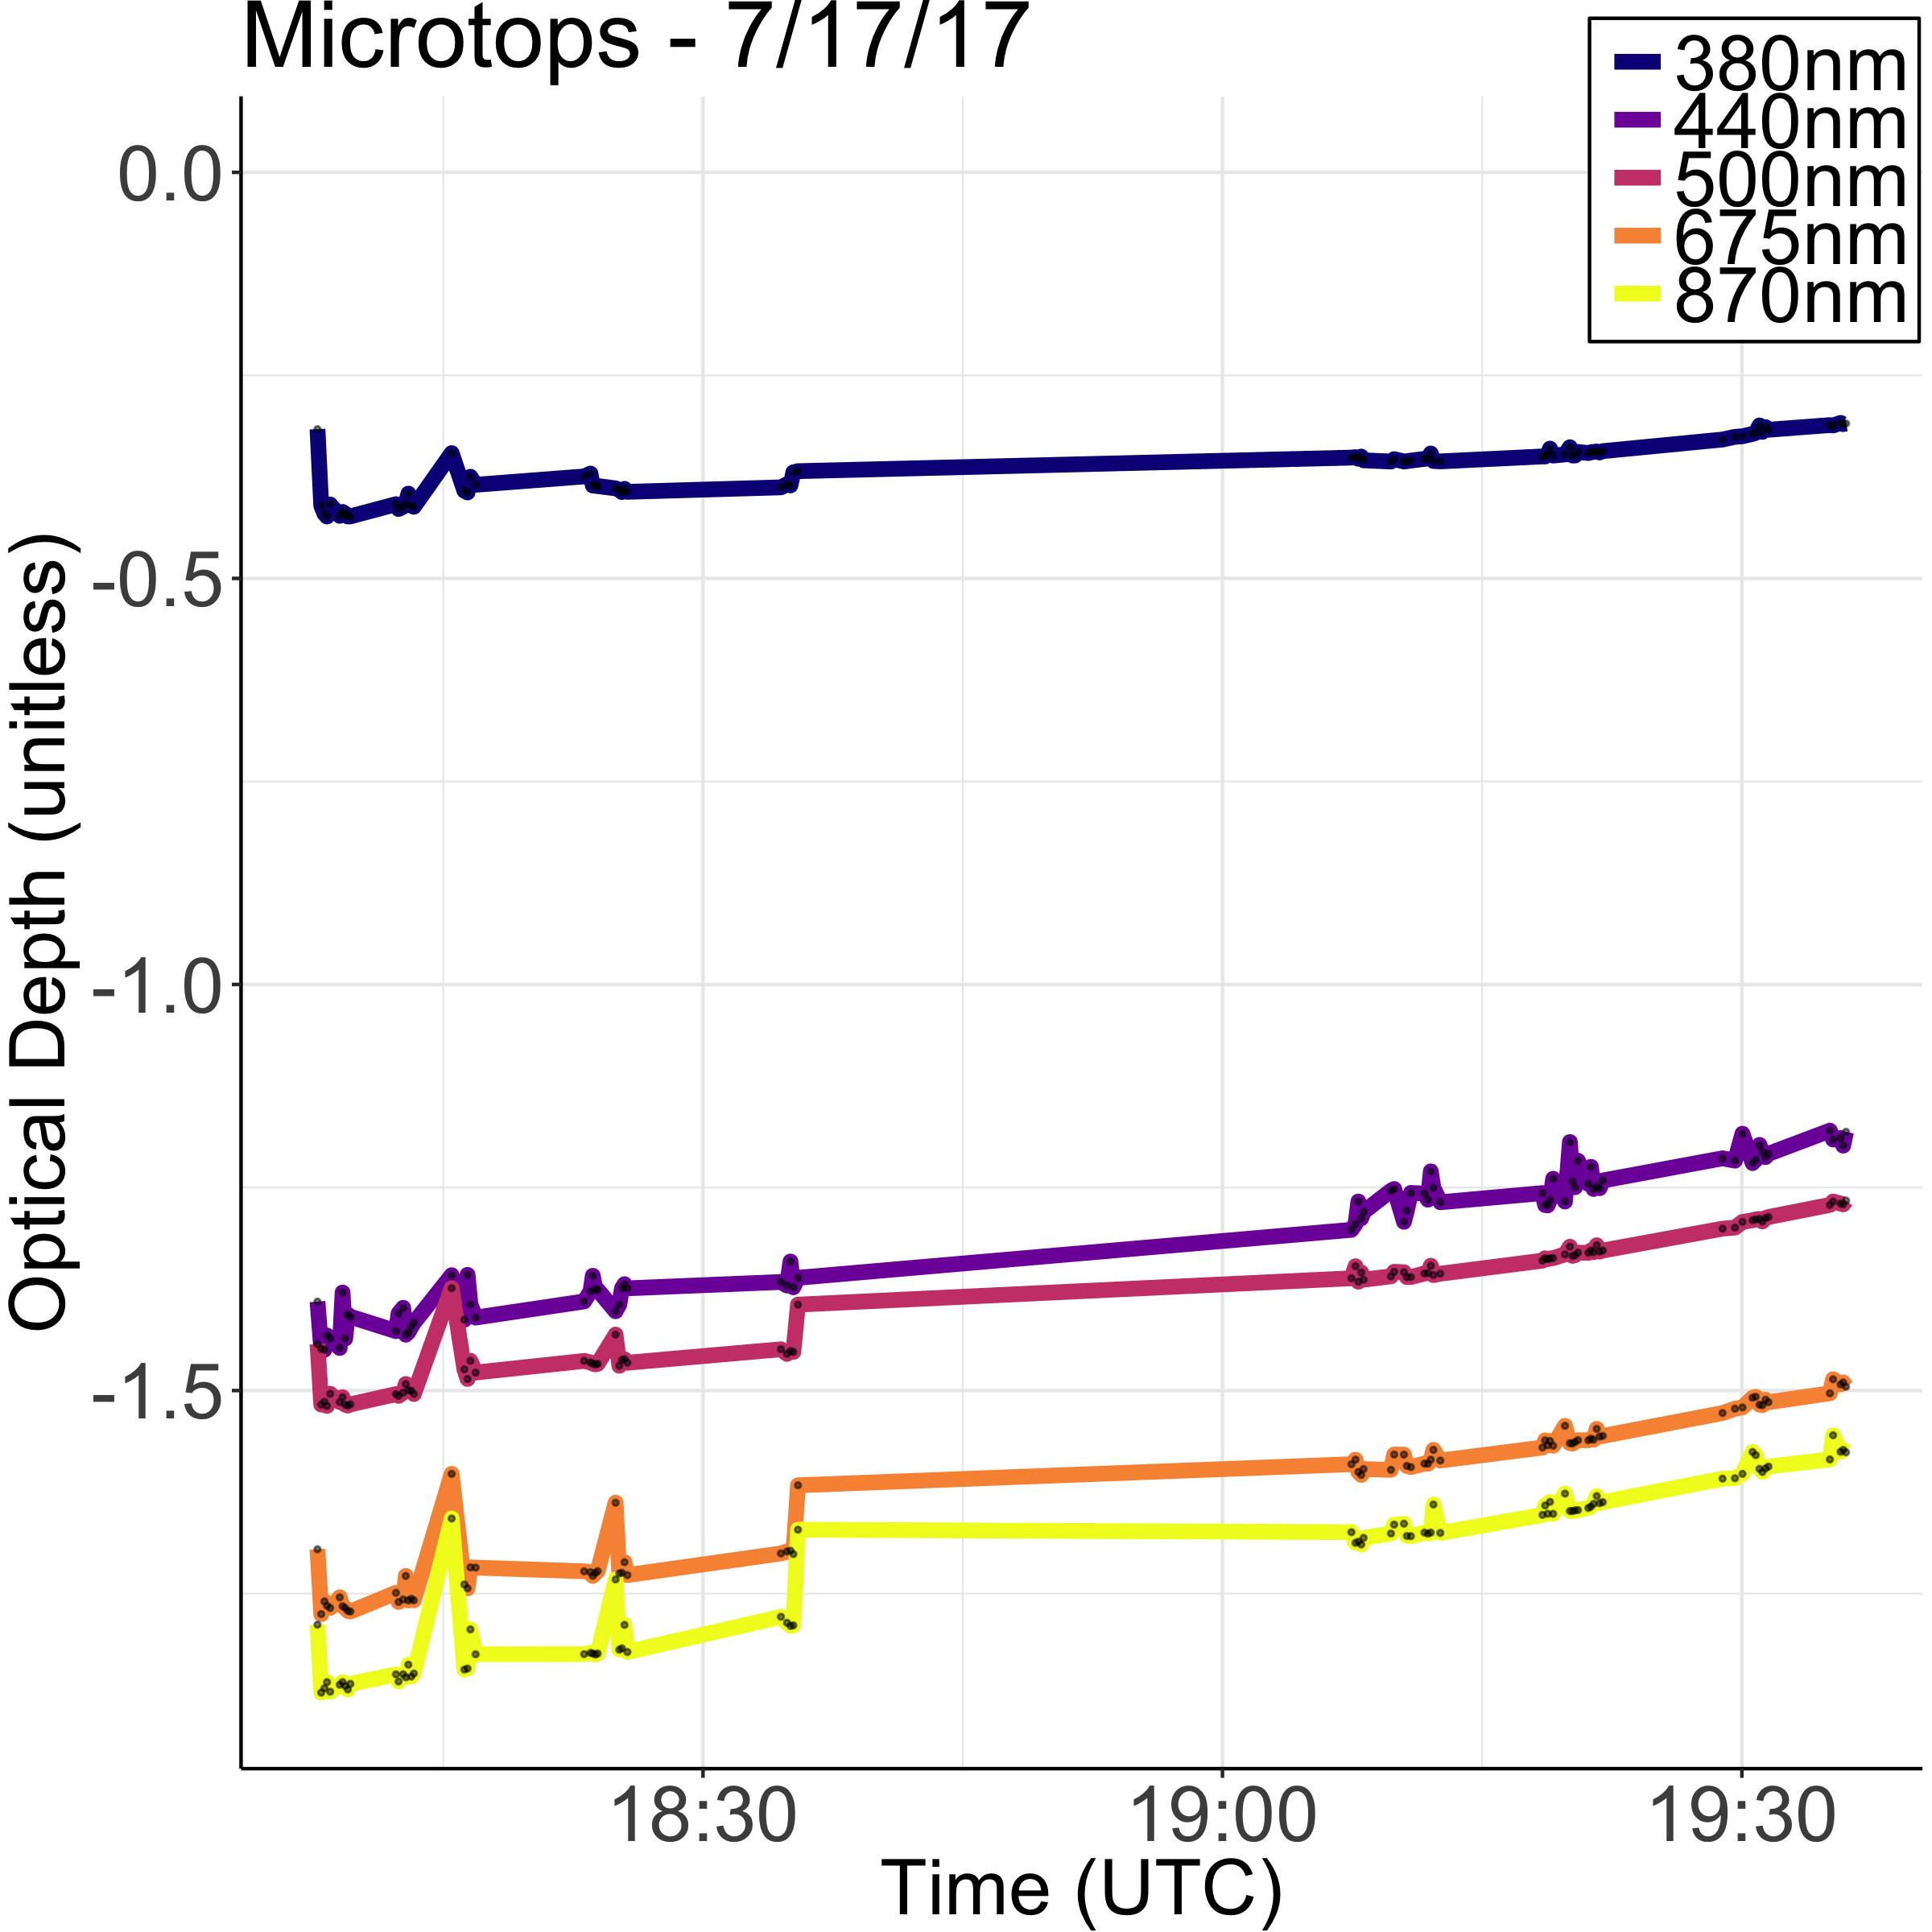
Sunphotometer
Isolating Optical Depth:
E = E0 exp(-Tau m)
E / E0 = exp(-Tau m)
ln(E/E0) = -Tau m
-ln(E/E0)/m = Tau
Where E0=E_{mean} * orbex
As seen on the plot, the optical depth magnitude decreases with time, as opposed to what we would expect.
Notes:
Optical depth is dimensionless, and in particular is not a length, though it is a monotonically increasing function of path length, and approaches zero as the path length approaches zero.

Slide 12
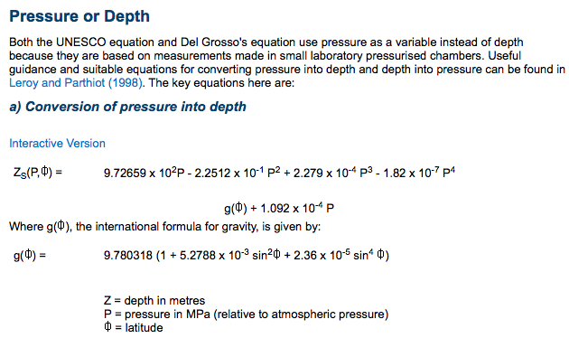
Hyper PRO profile data
Pressure → Depth (UNESCO procedure)
Leroy and Parthiot (1998)

Slide 13
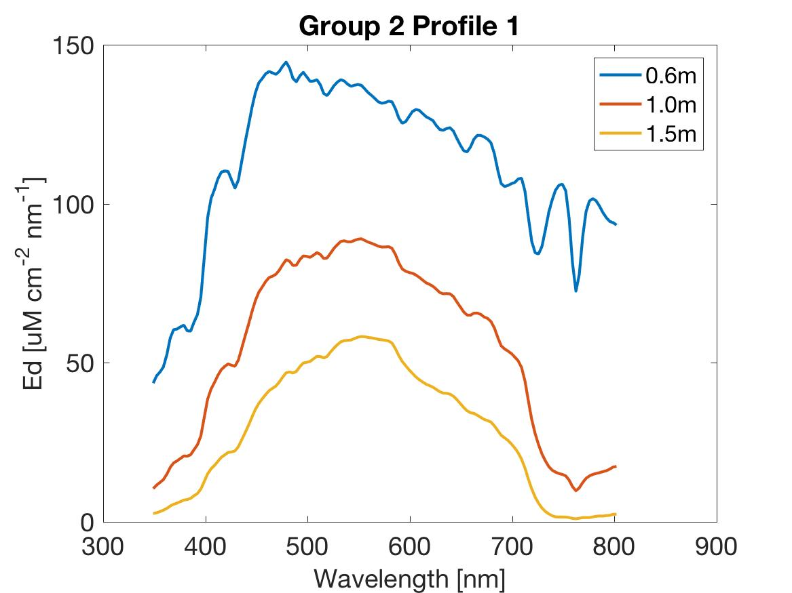
Notes:
Change unit!!! uW not uM

Slide 14
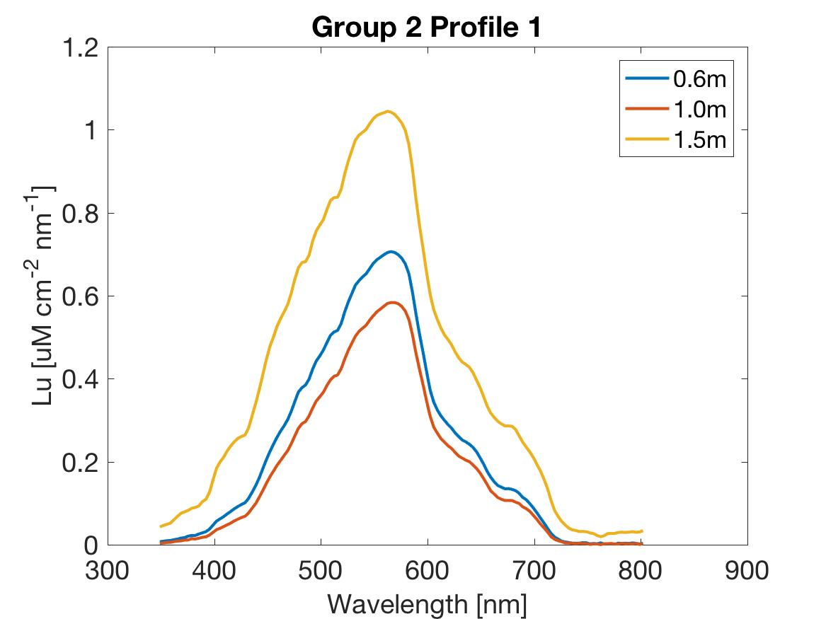
Notes:
Change unit!!! uW not uM, add sr-1 to unit

Slide 15
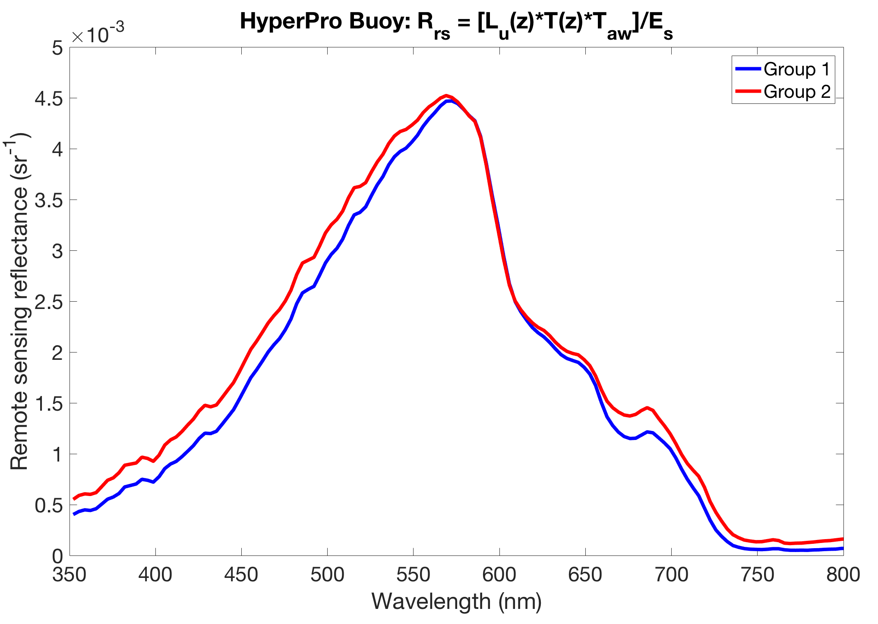
HyperPro Rrs spectra
Notes:
Phytoplankton absorption feature at 676 ish nm

Slide 16
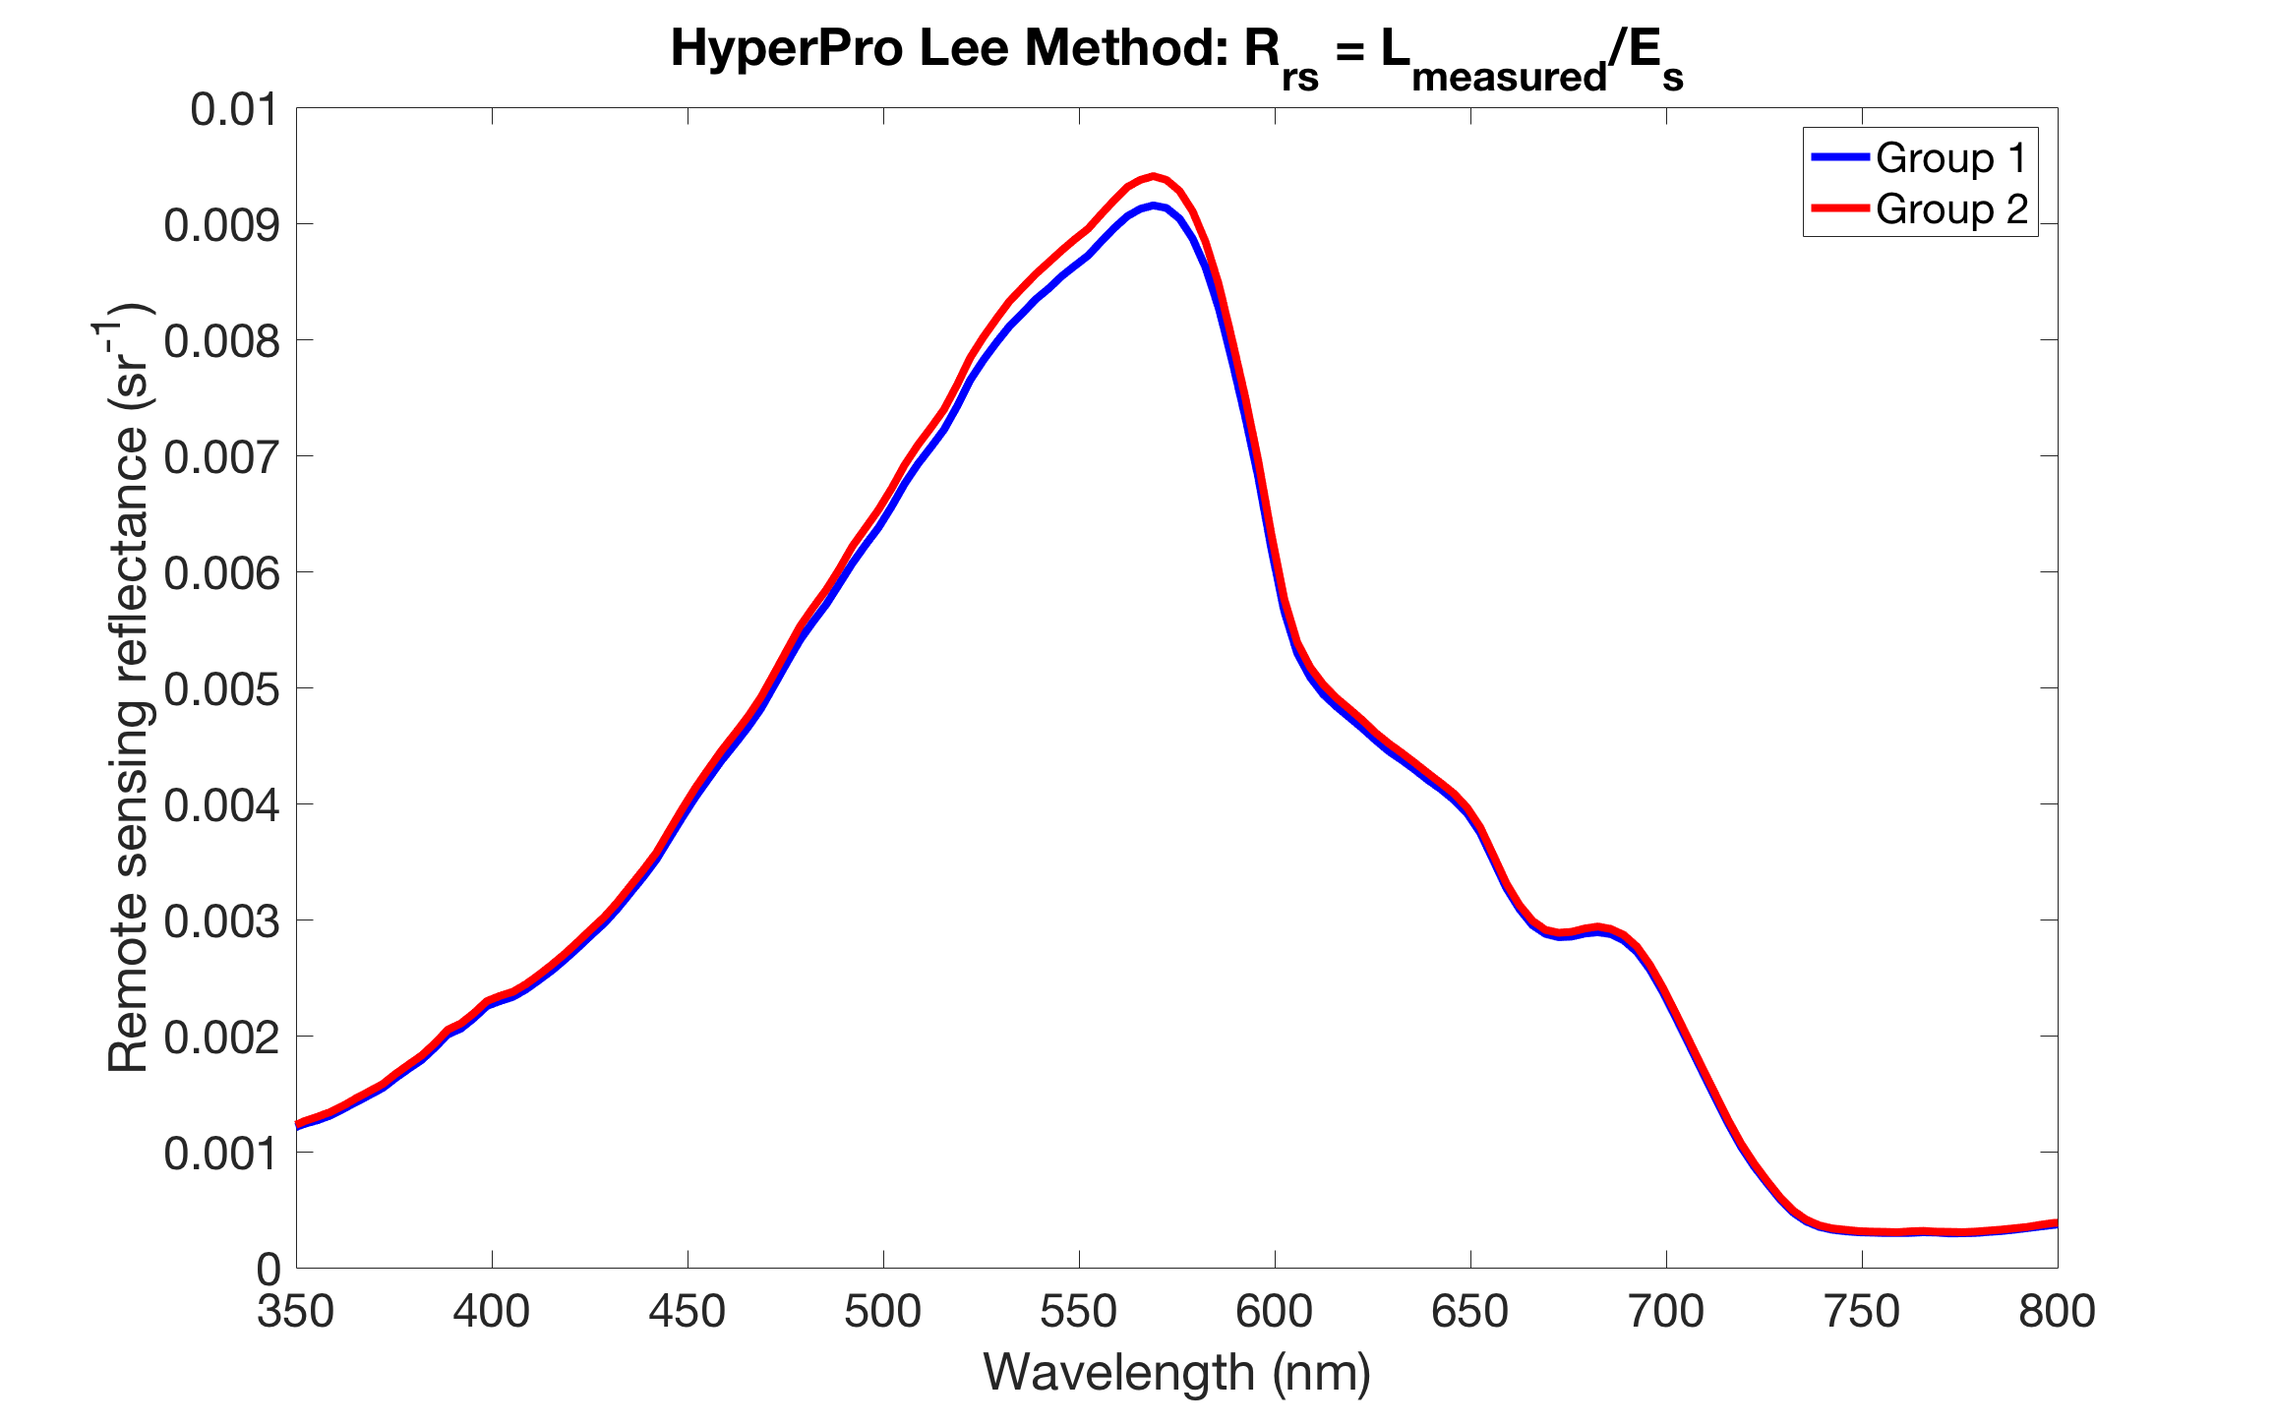
Notes:
Plot Lee method on buoy method

Slide 17
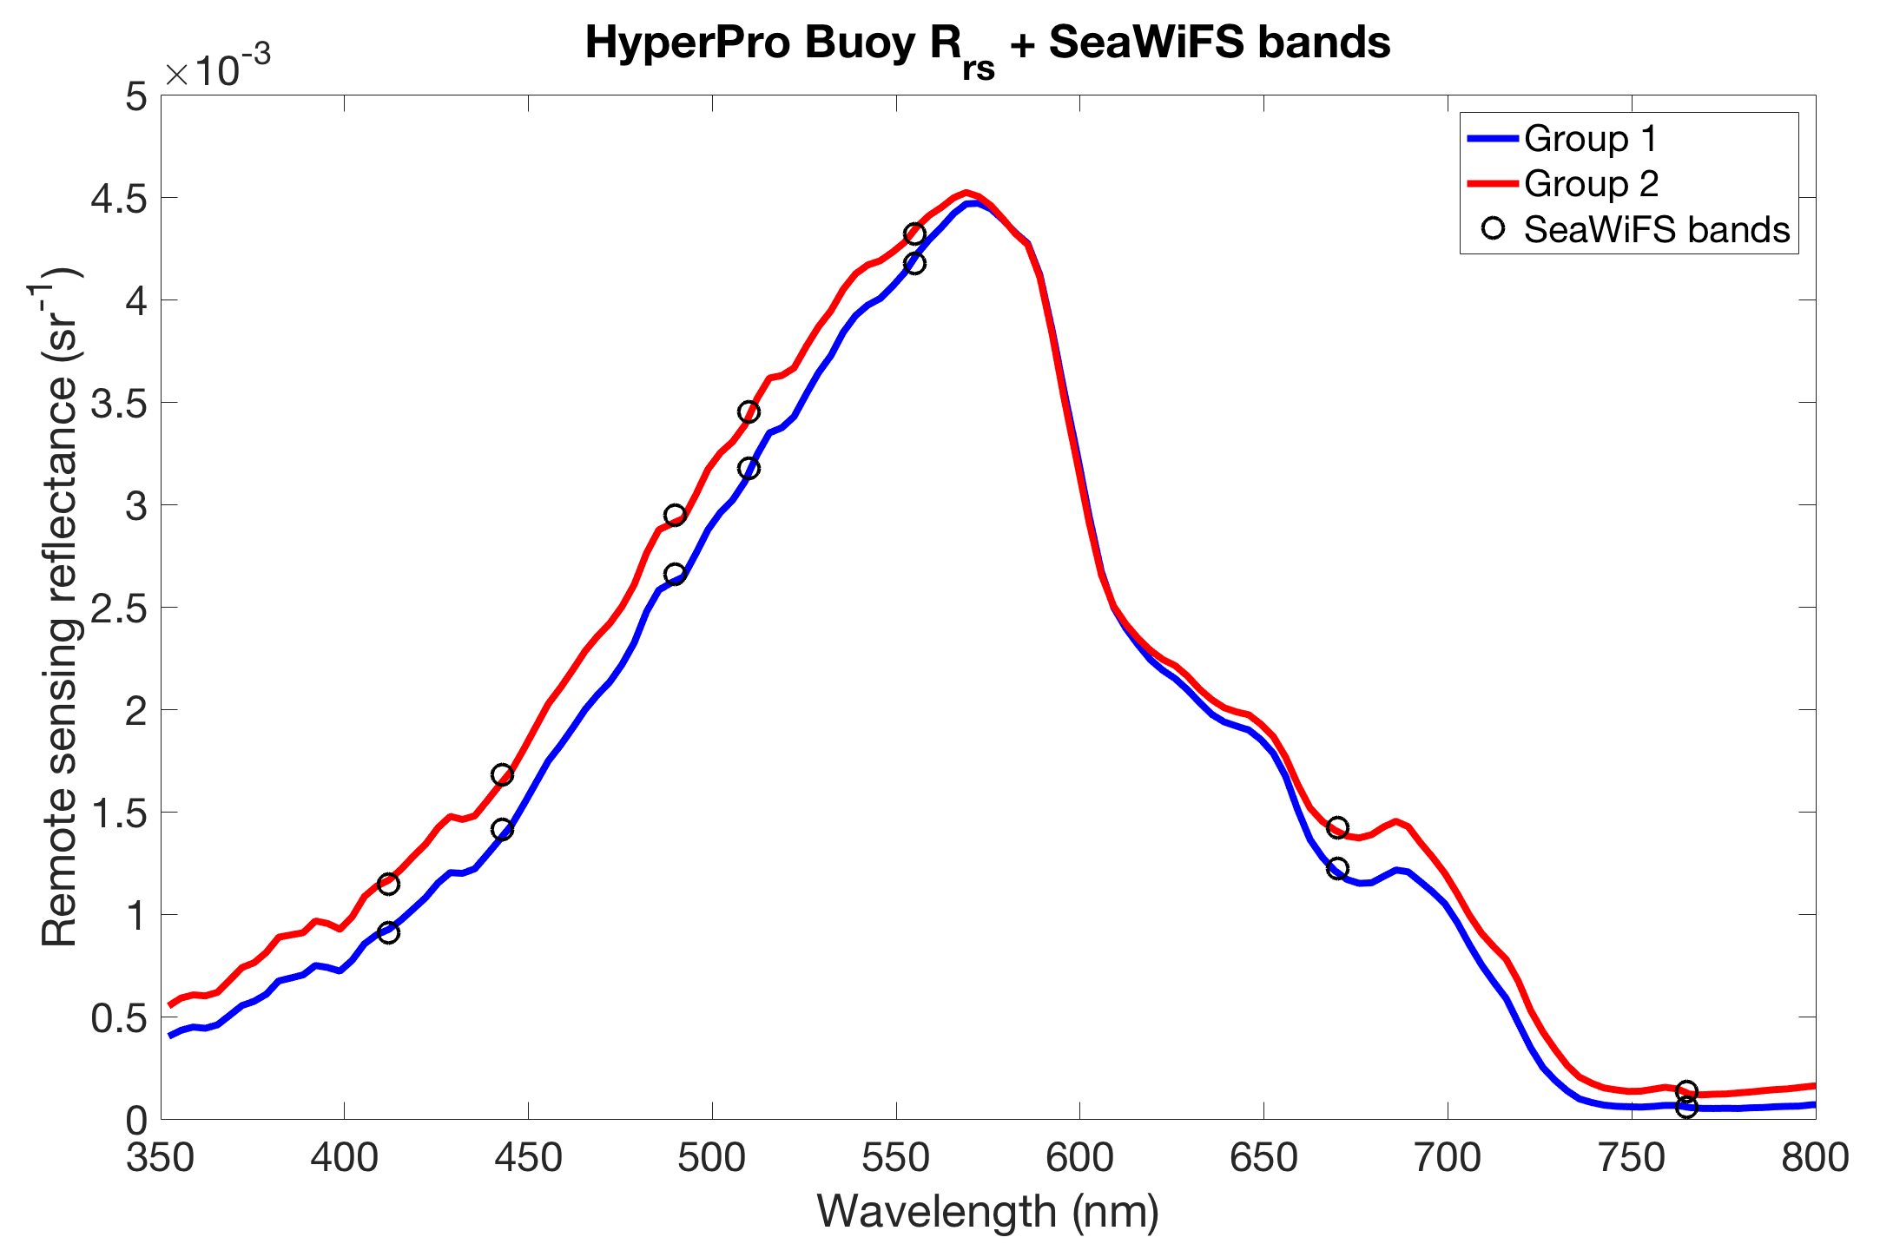
Notes:
Buoy problems with the immersion coefficient?

Slide 18
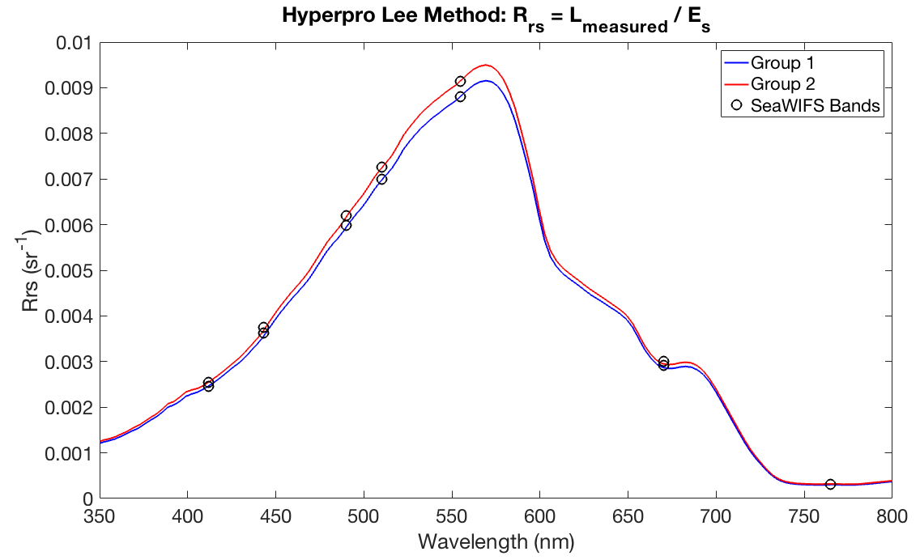
Notes:
Lee is higher for a factor of two

Slide 19
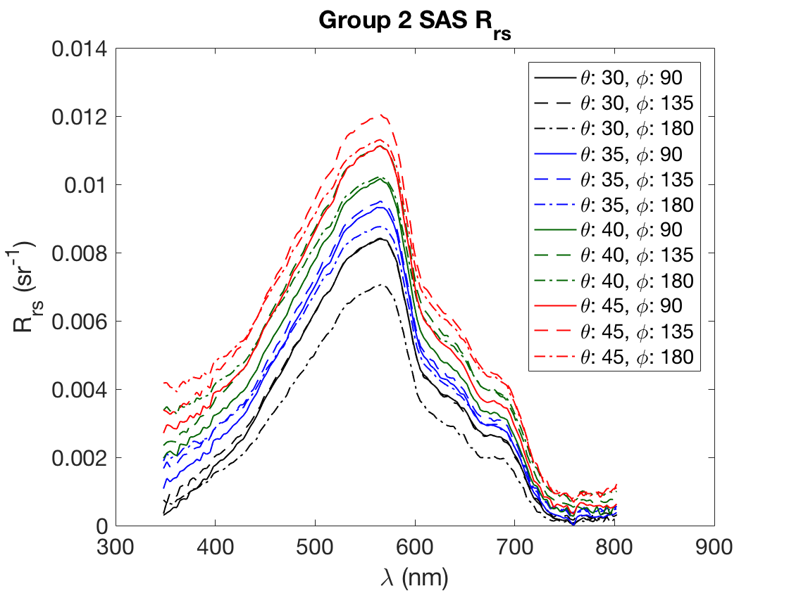
Notes:
Change reflection according to zenith angles (45deg has more reflectance than 30deg). Correction of wind speed in Mobley paper (lookup table). (Rho table AO 1999 - this is the file name of the lookup table)

Slide 20
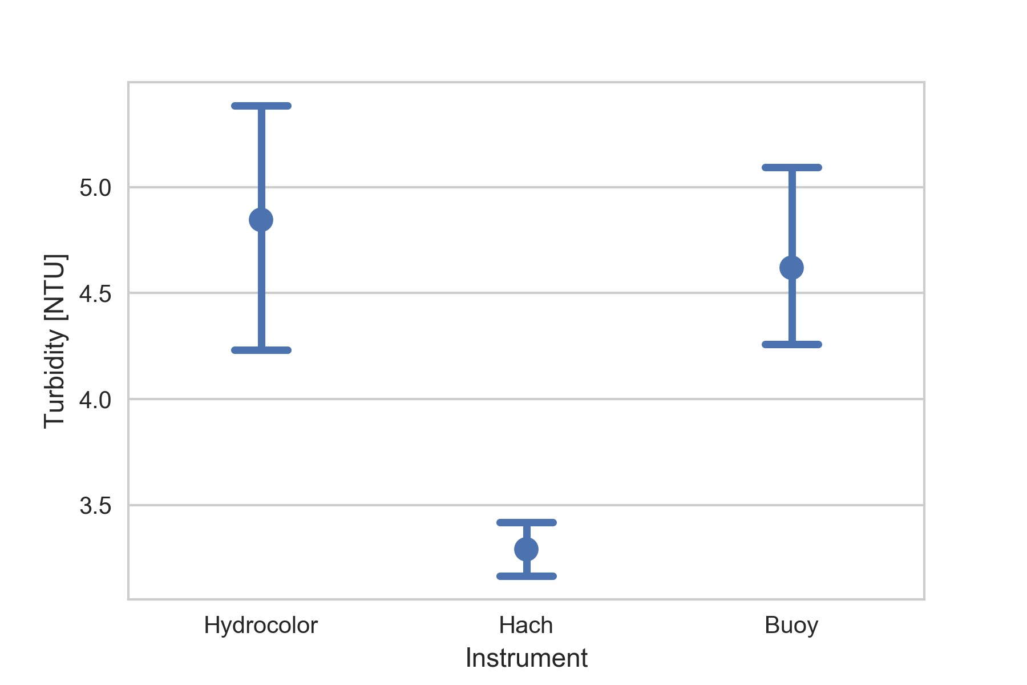
Hydrocolor Turbidity
N =
No. of readings 13 11 4

Slide 21
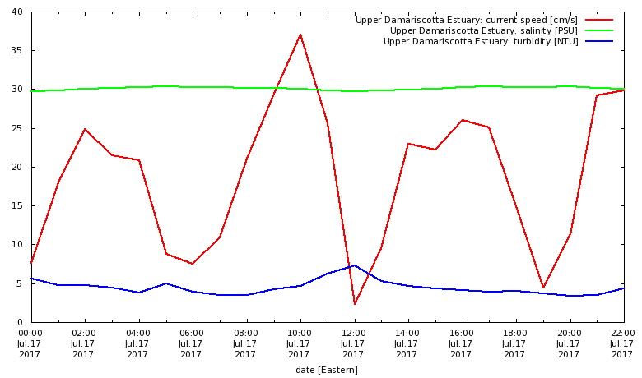
Turbidity Minimum @ Low Tide

Slide 22
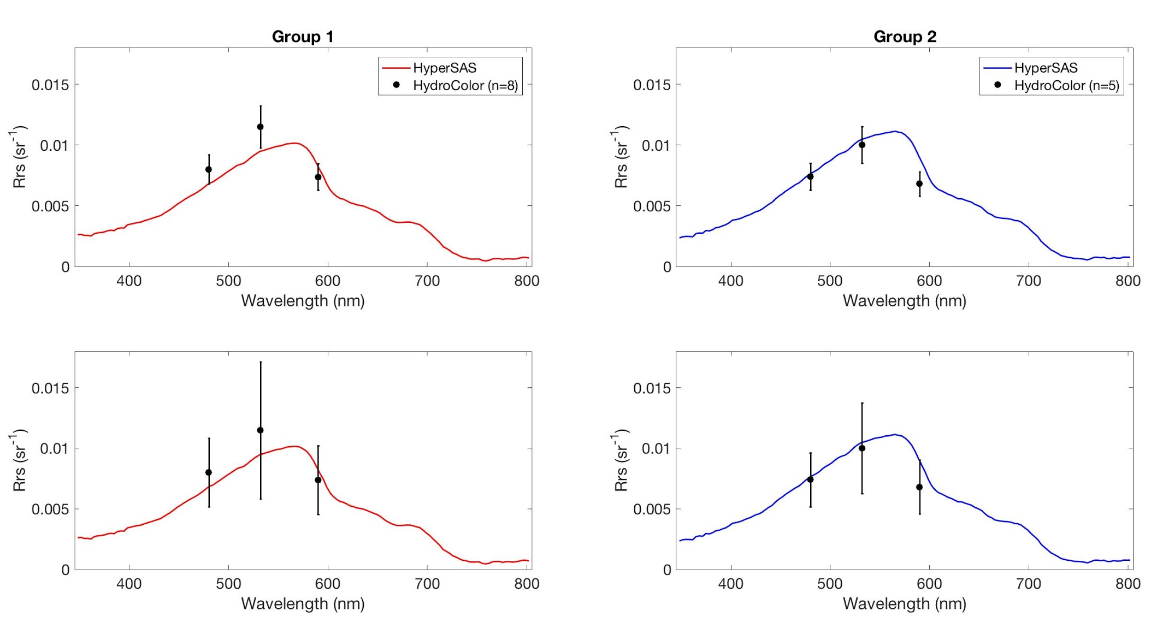
Reflectance: HydroColor vs. HyperSAS
Top panels: ±15% mean absolute relative error for all channels derived by HydroColor
Bottom panels: Error for each observation propagated to consider uncertainty between people
*HyperSAS reflectance spectrums for 40 deg. zenith and 135 deg. azimuth
Notes:
Was it the Lee method or the buoy method more consistent with Hydrocolor?

Slide 23
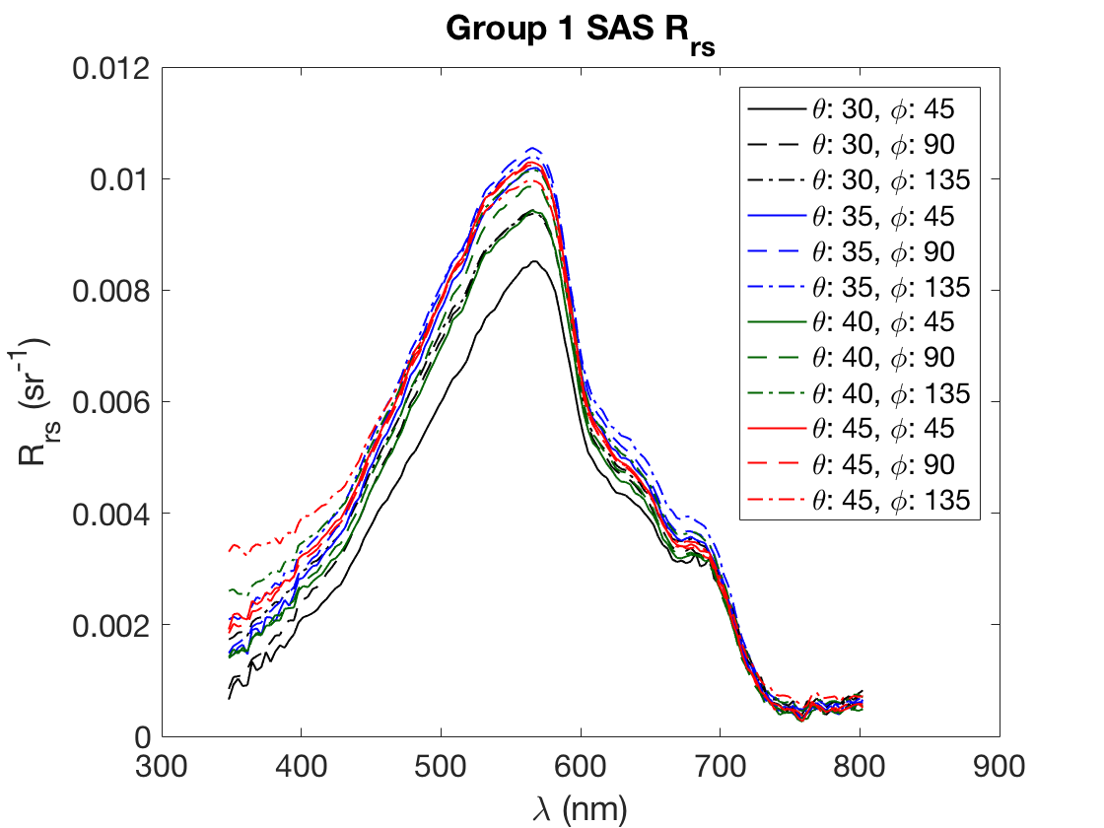

Slide 24
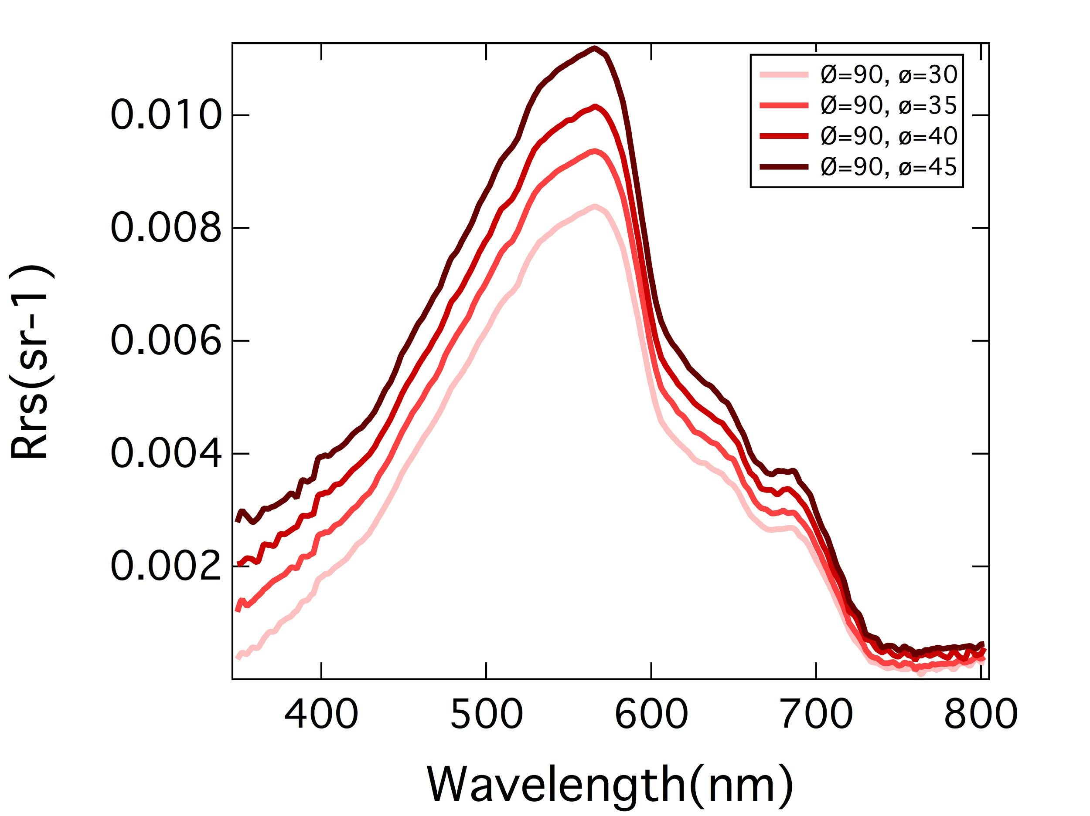
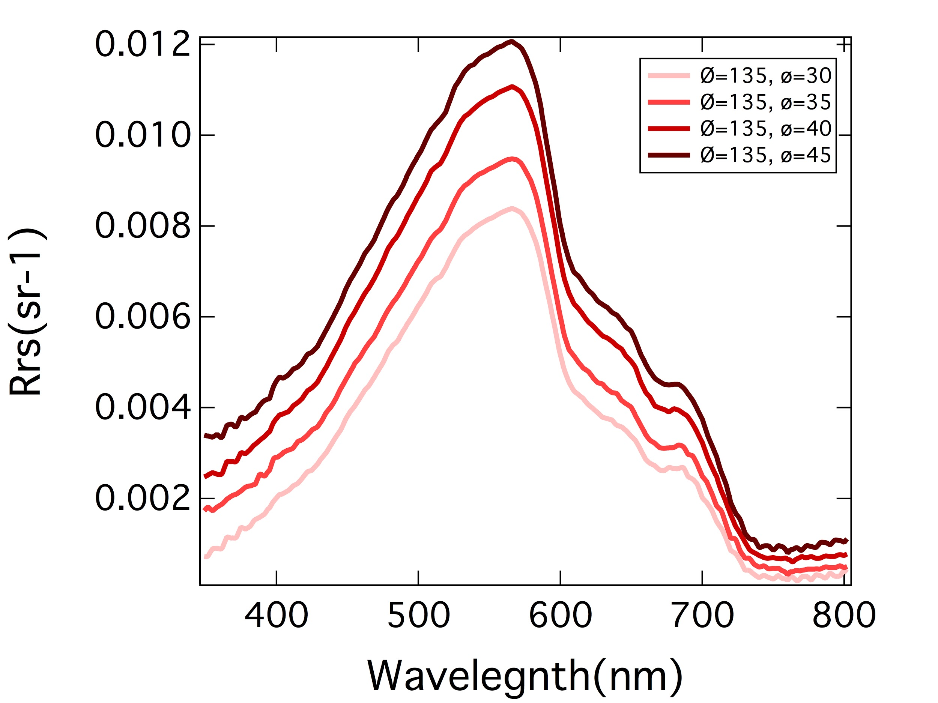
Group2 HyperSAS
Azimuth = 90° Azimuth = 135°
Notes:
Darker color = increase in azimuth angle = larger reflectance
Not really … differences are small - compare the 2 plots!
It has to do more with the zenith range …. Right???
In the past, people removed the infrared contamination to all the spectrum. This may still be valid for case-1 waters !

Slide 25
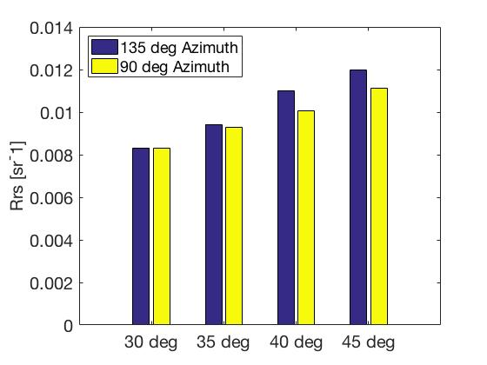
Comparison of Rrs between 135 and 90 azimuth at 560 nm
Notes:
Comparison of different azimuth angles = 45 degrees has the highest reflectance

Slide 26
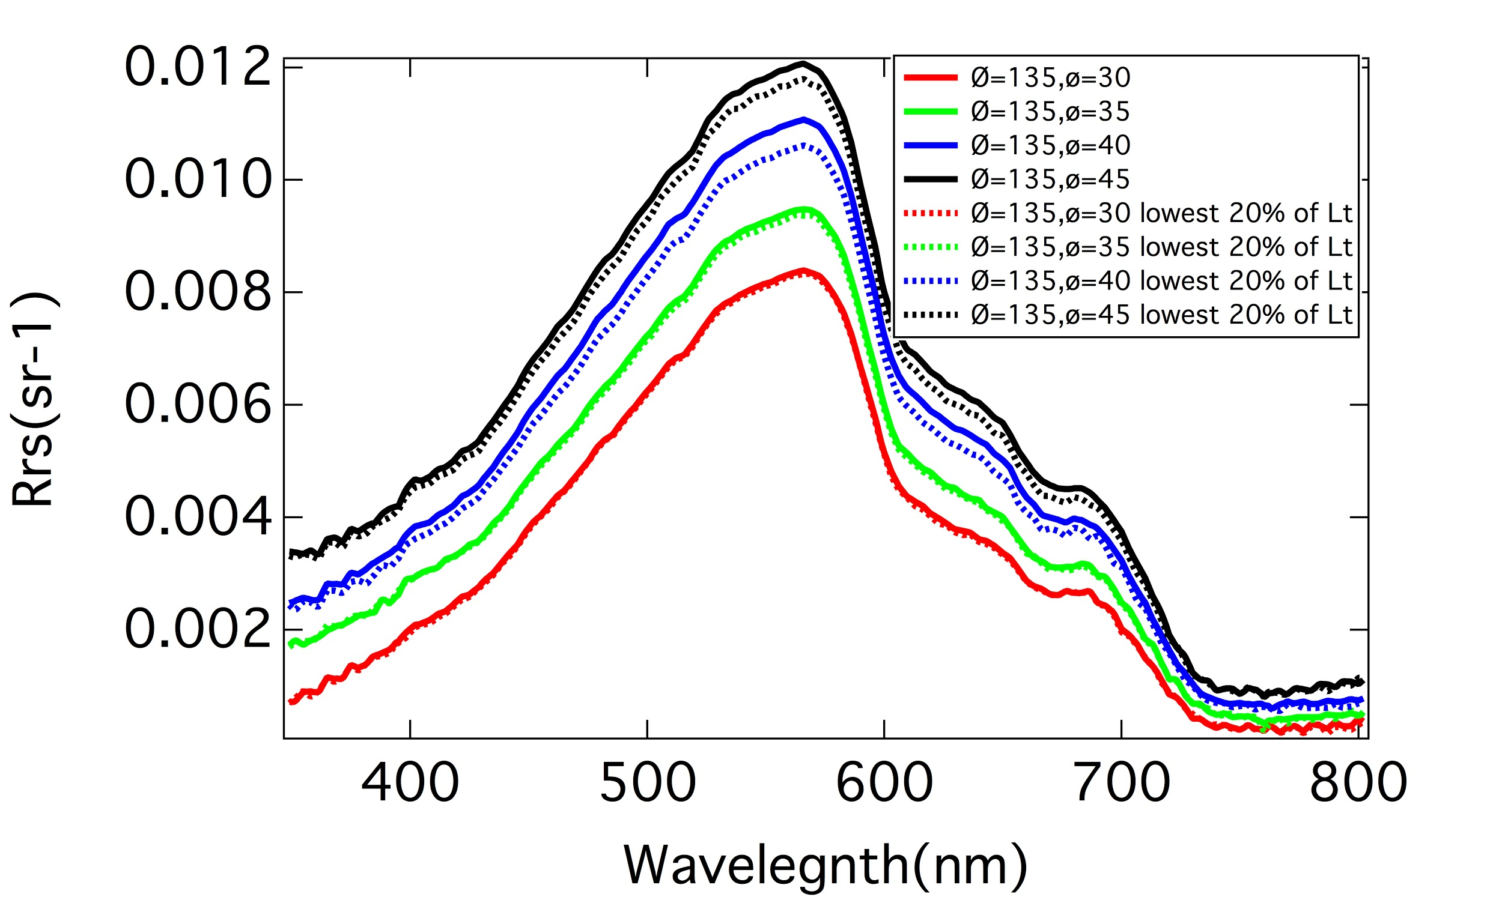
Comparison between the lowest 20% of Lt and the total measurement at azimuth 135°
Notes:
When the zenith angle is lower there is a smaller difference between the lowest 20% and the rest, when the angle is larger the difference between them is the largest.This difference is also NOT spectrally dependent as the offset doesn’t seem to vary across wavelengths.
Some people would chose the angle that would get you the closest to zero in the NIR. This is dangerous in the coastal env. Though because you can’t assume there is no reflectance in the NIR because coastal waters are turbid.

Slide 27
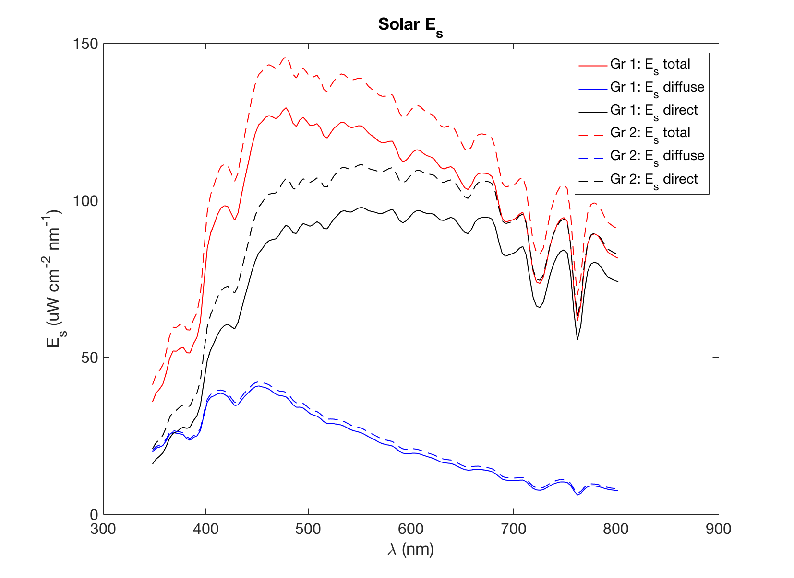
Notes:
How much of those features make it in the water?
Features of the atm gas abs make it into water and how they are filled up due to inelastic scattering

Slide 28
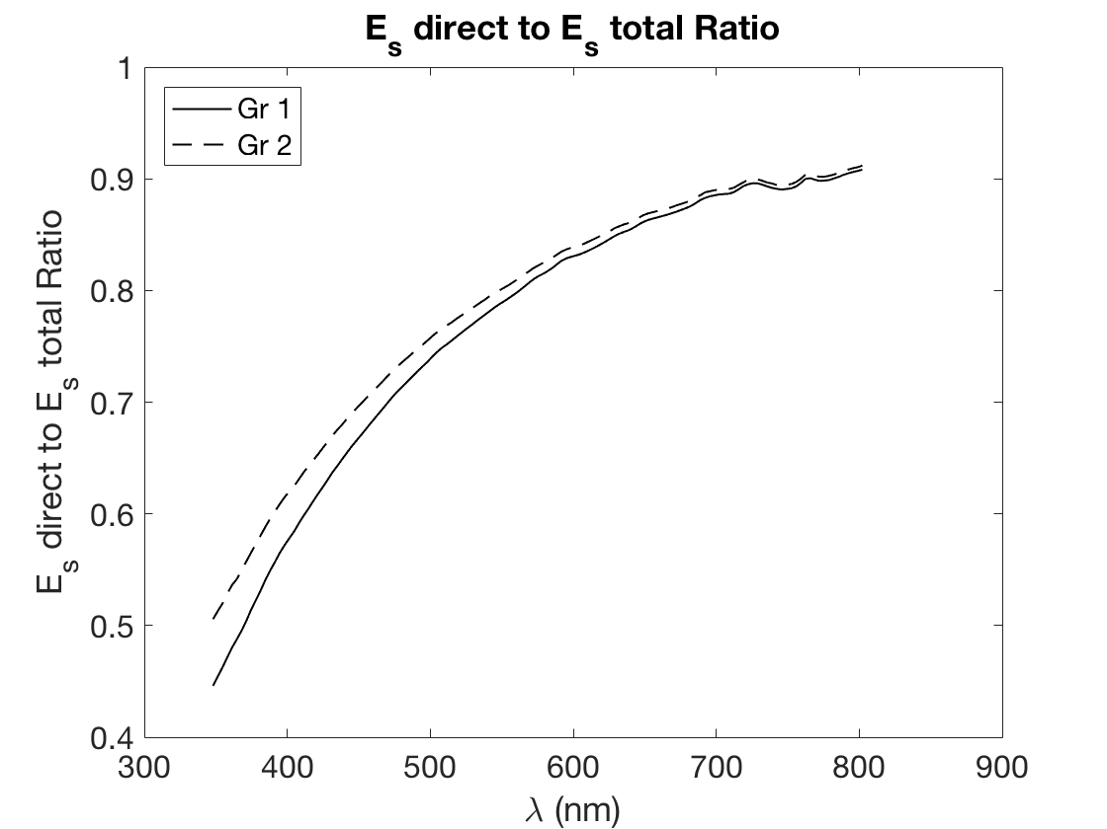
Notes:
What causes the shape
Diffuse comes from the sunlight - rayleigh scattering. Slope could tell us something about the aerosol in the air.

Slide 29
THE END
Notes:
Discussion of PAR:
Curt M PAR rand; PAR needs to be in numbers of photons per square meter per second NOT in watts and other crap.
You can calculate PAR with ED because you have the cosine factor which is a problem. People do this in ecosystem models and THIS IS JUST NOT RIGHT. You need to use scalar irradiance not plane irradiance and do it in photons NOT watts.

