Slide 1
Lab 5b Wrap-Up

Slide 2
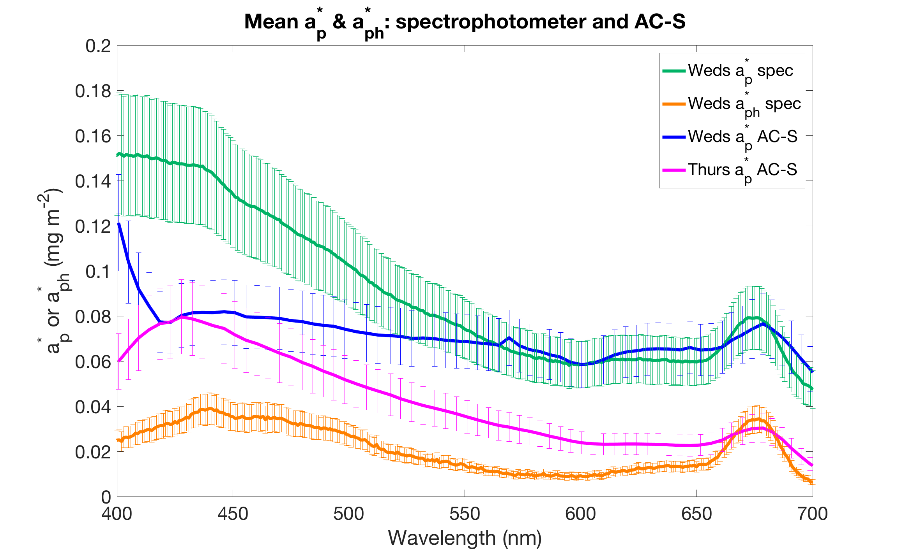
Notes:
spectrally varying correction
if it drops that much down there’s residual T
AC peak is shifted (Ac-17 had a largest uncertainty in the calibration)

Slide 3
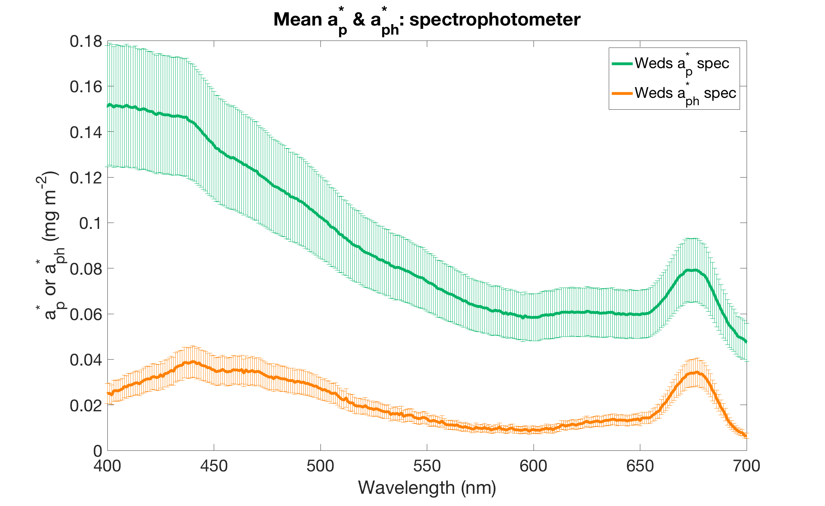
Notes:
No Chl b peak
a factor of 2 too high

Slide 4
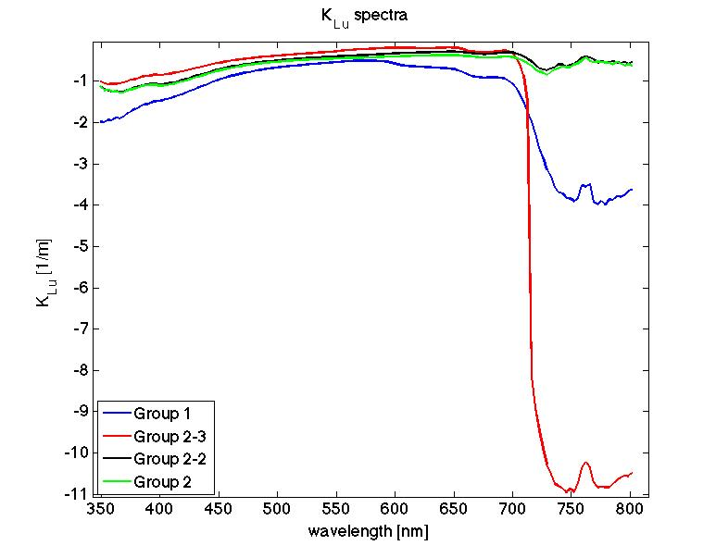
Notes:
use only downcast for data analysis - remove bad data with high tilt angle
plot KLu with absorption profiles (+ pure water spectra) to help explain the pattern of K
it might be bottom reflectance - yesterday we noticed Lu was higher near bottom
What is the peak between 750-800? Raman scat? atmospheric feature?
Plot Lu 750nm for each cast to compare magnitudes

Slide 5
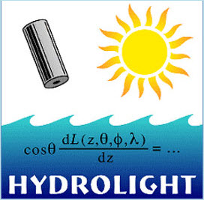
Lab 6: HydroLight
Introduction to HydroLight and Guided Simulations (simple and veeery cool simulations :-) )

Slide 6
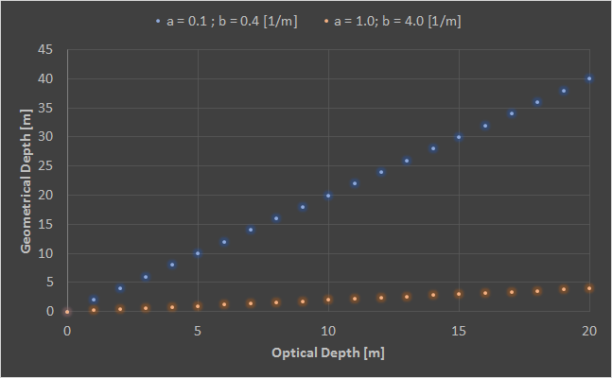
Exercise 1: OPTICAL DEPTH
Notes:
ceta = c * z

Slide 7
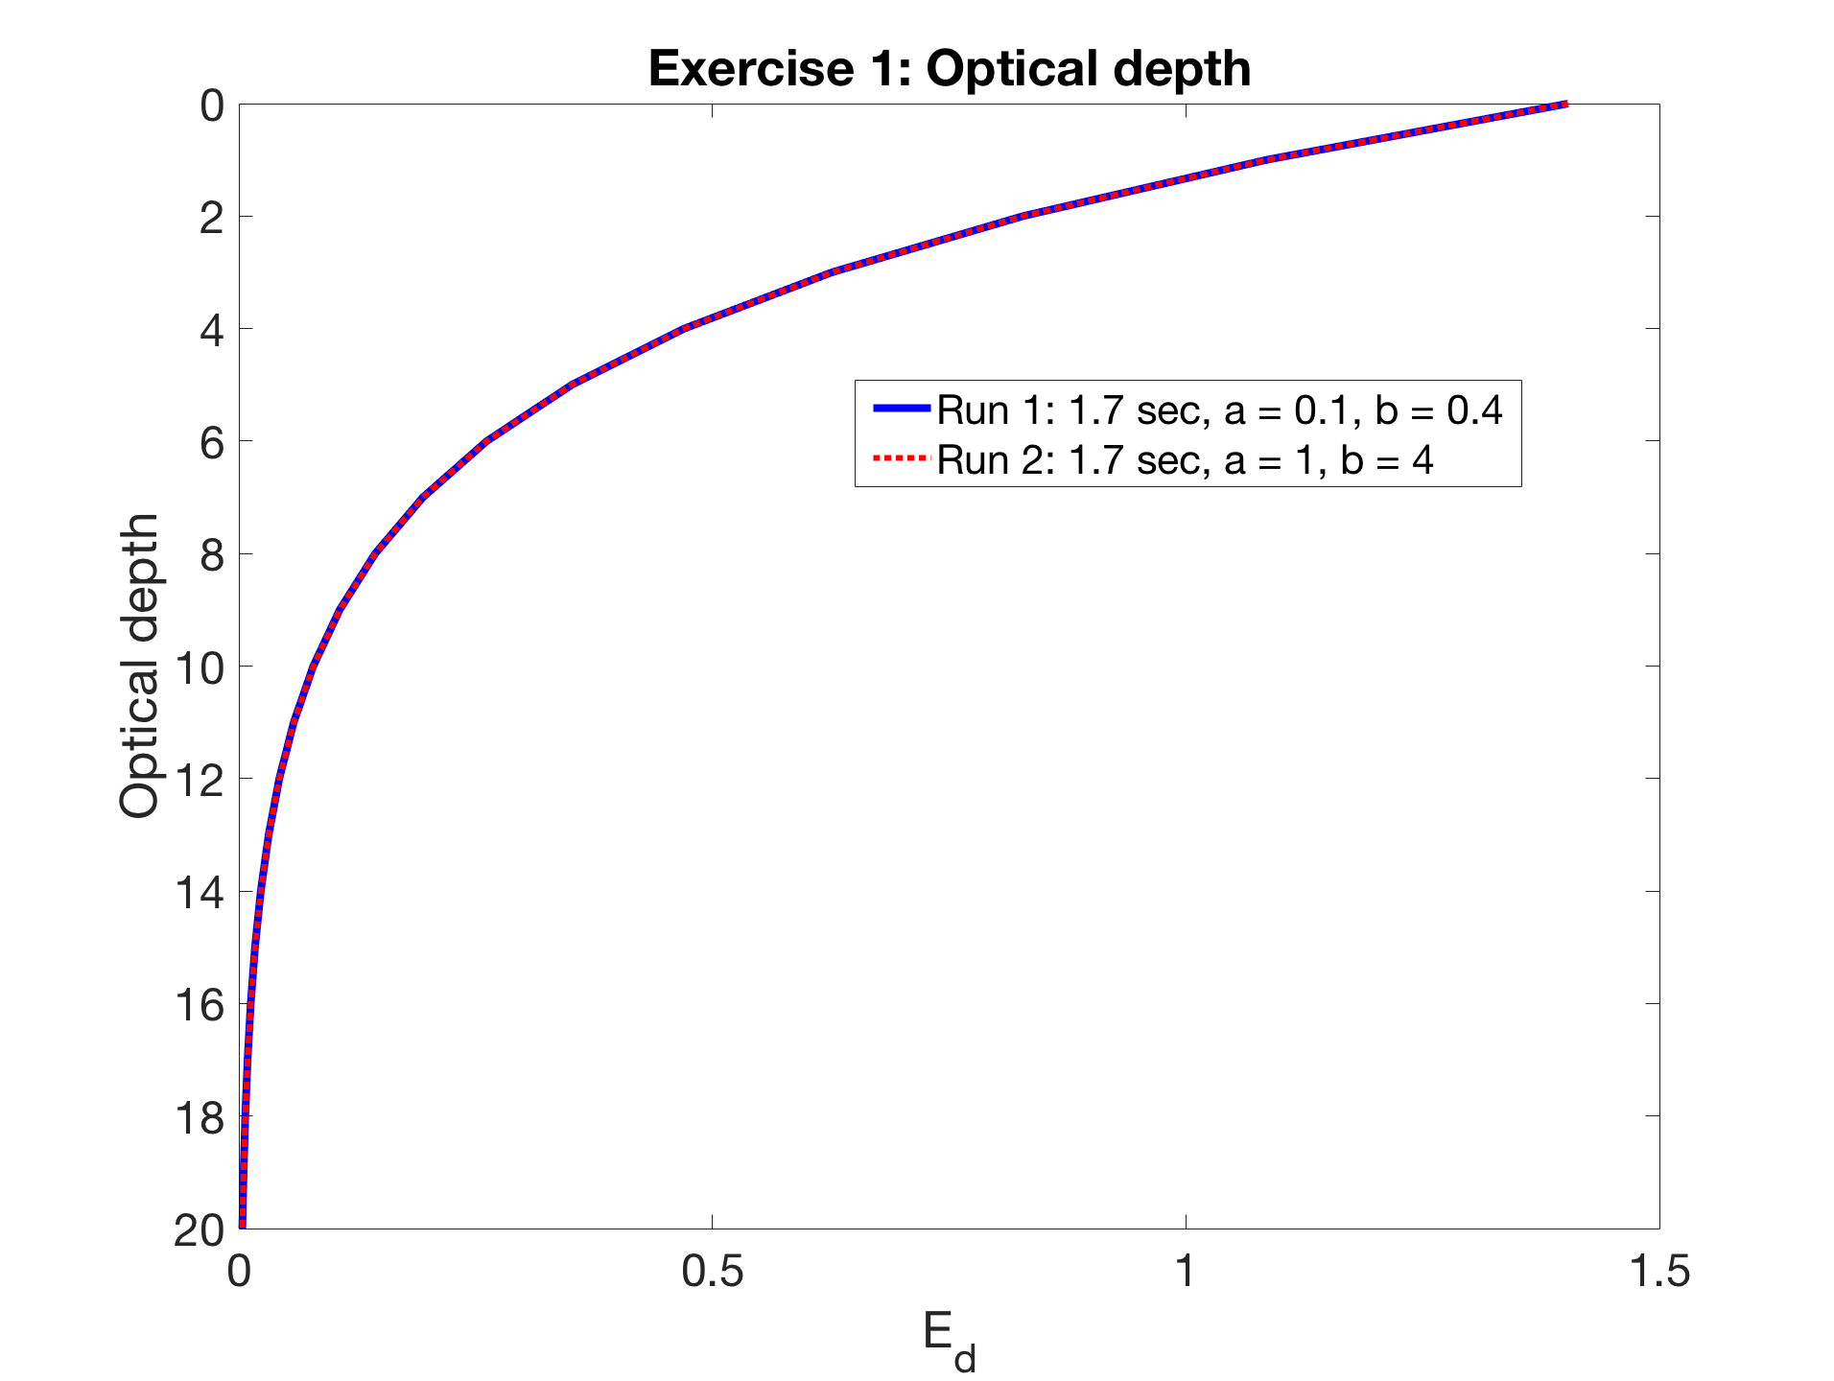

Slide 8
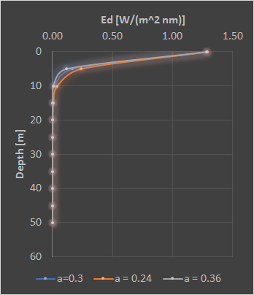
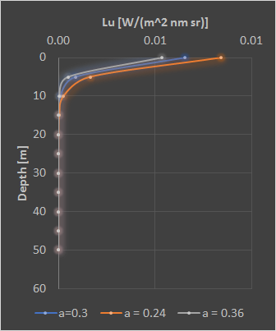
Exercise 2: IOP error effects on computed light fields

Slide 9
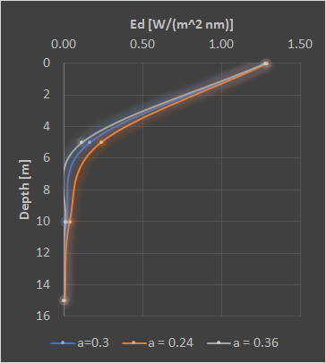
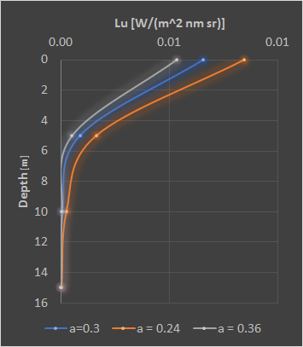
Exercise 2: IOP error effects on computed light fields

Slide 10
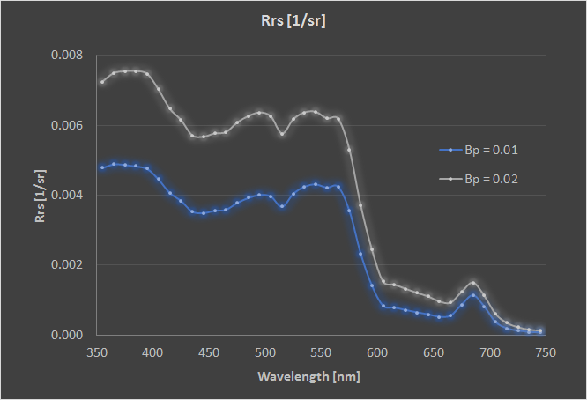
Exercise 3: Rrs dependence on backscatter

Slide 11
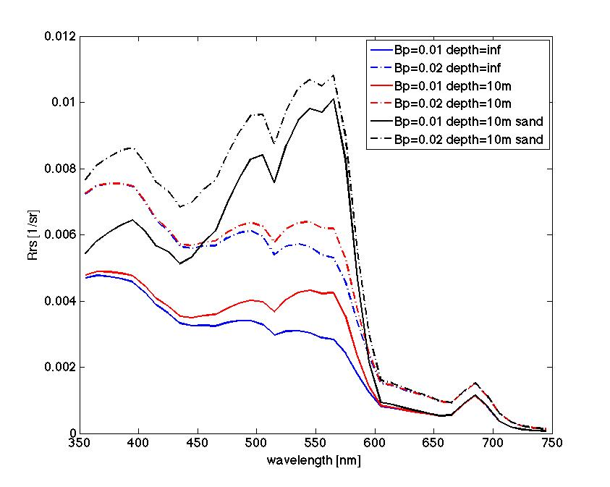

Slide 12
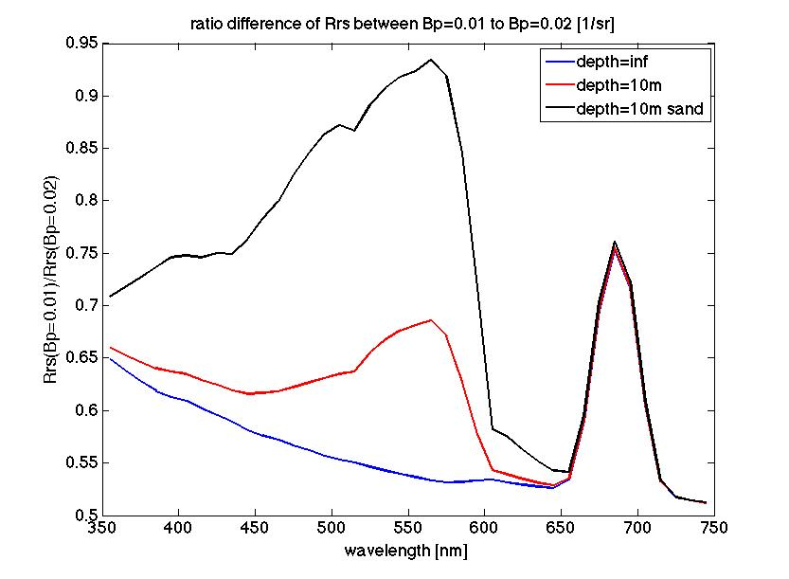
Notes:
Fluorescence Line Height (FLH) is quenched in Rrs signals, so you have to do a quenching correction to get chlorophyll-a concentration.
Type of bottom (e.g. seagrass) can produce fluorescence signal, if water is clear and local depth is low

Slide 13
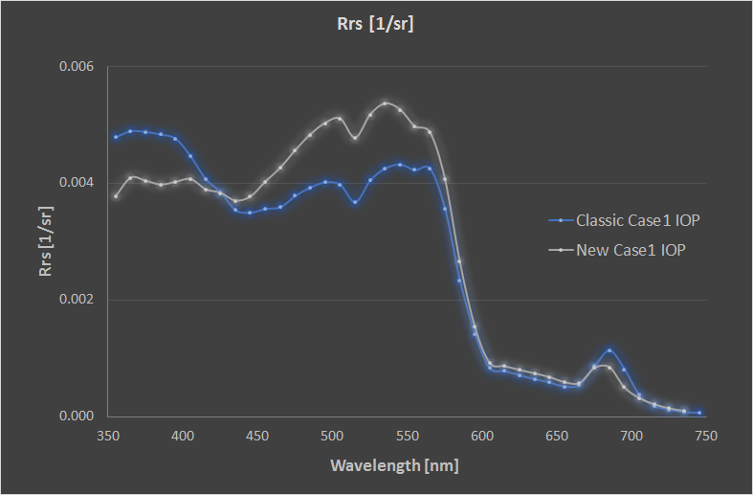
Exercise 4: Comparison of the “classic” and “new” Case 1 IOP water
Notes:
For high chlorophyll the bb will be flat

Slide 14
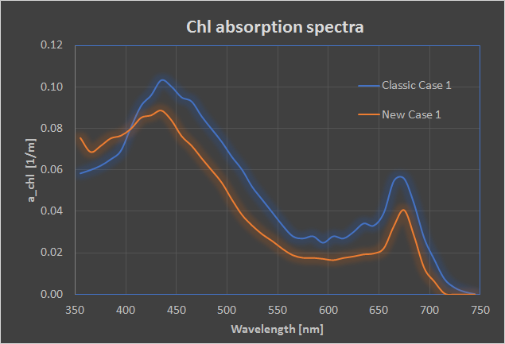
Exercise 4: Comparison of the “classic” and “new” Case 1 IOP water

Slide 15
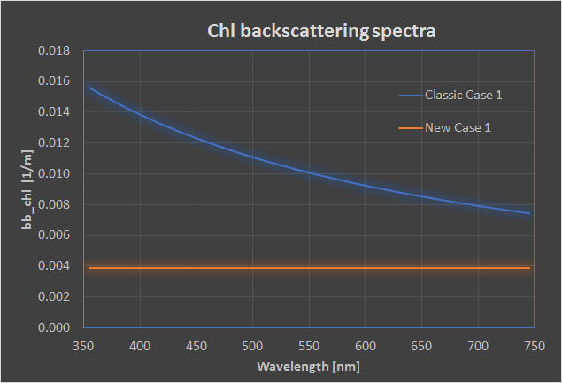
Exercise 4: Comparison of the “classic” and “new” Case 1 IOP water
Notes:
Try to plot for different chl, some levels have bigger differences than others between the two models

Slide 16
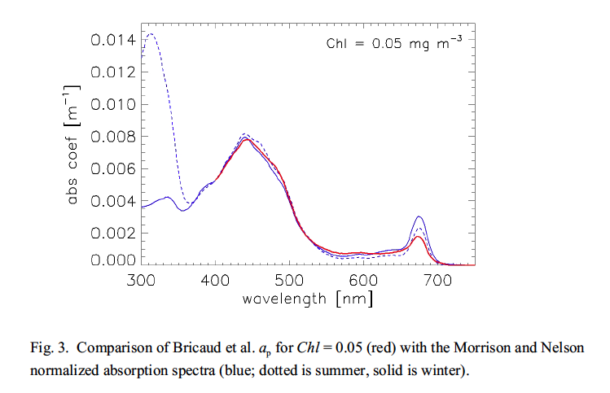
Exercise 4: New Case 1- Chlorophyll Specific Absorption Options
High
Mycosporine like amino acids
Low
Notes:
ap = summer and winter (dotted versus summer) = Mycosporine is a metabolite that acts like sunscreen. It absorbs UV - you can see it in the summer when there is high heat. You can also see it in ice algae because they are also exposed to high UV
Stramski : it’s really hard to do repeated absorption measurements in the UV - still a very active area of research.
The light that phytoplankton experiences depends on the MLD (summer - stratified, winter - vertical mixing)
Likely to have higher abs during summer

Slide 17
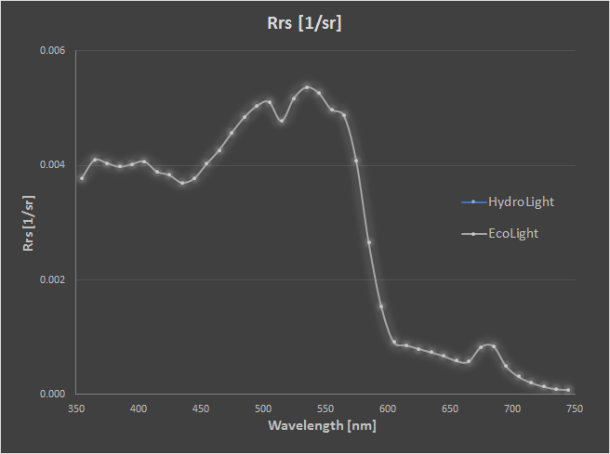
Exercise 5: HydroLight vs. EcoLight
EcoLight Total (wall clock) run time = 4.4 sec
HydroLight Total (wall clock) run time = 54.5 sec
Notes:
EcoLight = INTEGRATED over azimuth! :-)

Slide 18
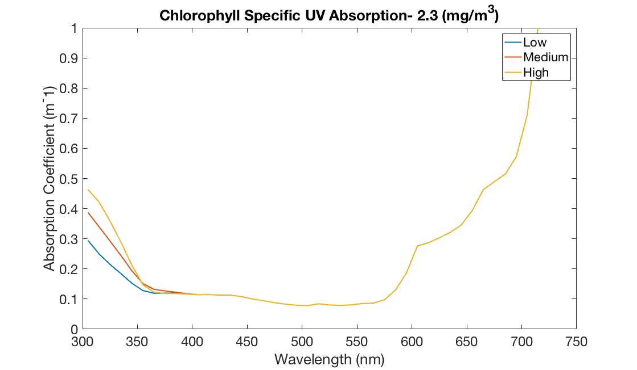
Exercise 4: New Case 1- Chlorophyll Specific Absorption Options
Notes:
A lot of the modelled IOPs are good from 400 - 700 but lower and higher than that it gets really flakey
If you generate reflectances for these absorption you might see Raman scattering.

