Slide 1
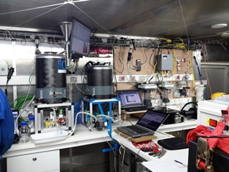
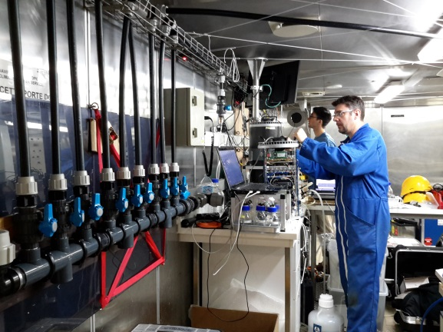
Phytoplankton high spatial-temporal resolution: Automated flow cytometry on the surface continuum.
M Thyssen, G. Grégori, D. Lefèvre, T. Wagener, O. Grosso, L. Chirurgien, J. Uitz, C. Guieu....others to complete the surface continuum participation team ?

Slide 2
Cytosense measures up to 5 cm³ every hour: 630 recorded samples
Automated system, coupled with the CYTOPRO (G. Grégori) for heterotrophic bacteria staining and also phytoplankton
Synechococcus/Picoeukaryotes/nanoeukaryotes/cryptophytes/microphytoplankton
Pictures not collected (focus out of field, easy to modify but need time and training)
Bad resolution of Prochloroccocus although expected, surely due to impact of light on pigments and overused cytometer.

Slide 3
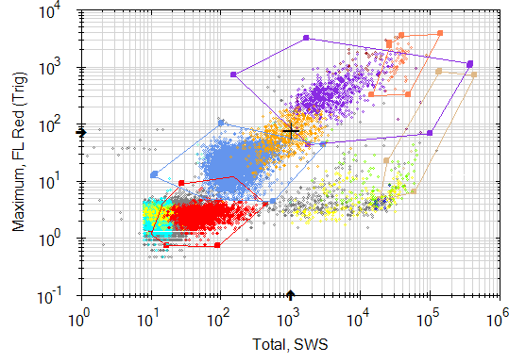
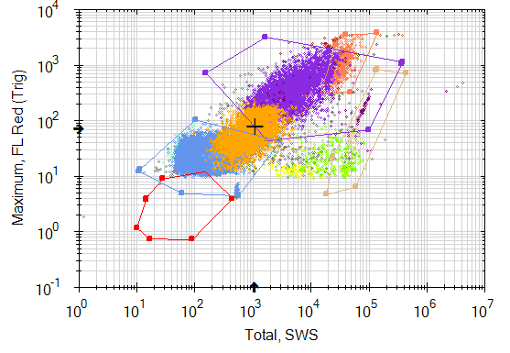
Prochlorococcus (but not always well resolved because surface population evidence
tiny fluorescence+optical shift in the sensor)
Synechococcus
Picoeukaryotes
Nanophytoplankton 1
Nanophytoplankton 2
Coccolithophorideae like
Cryptophytes like

