Slide 1


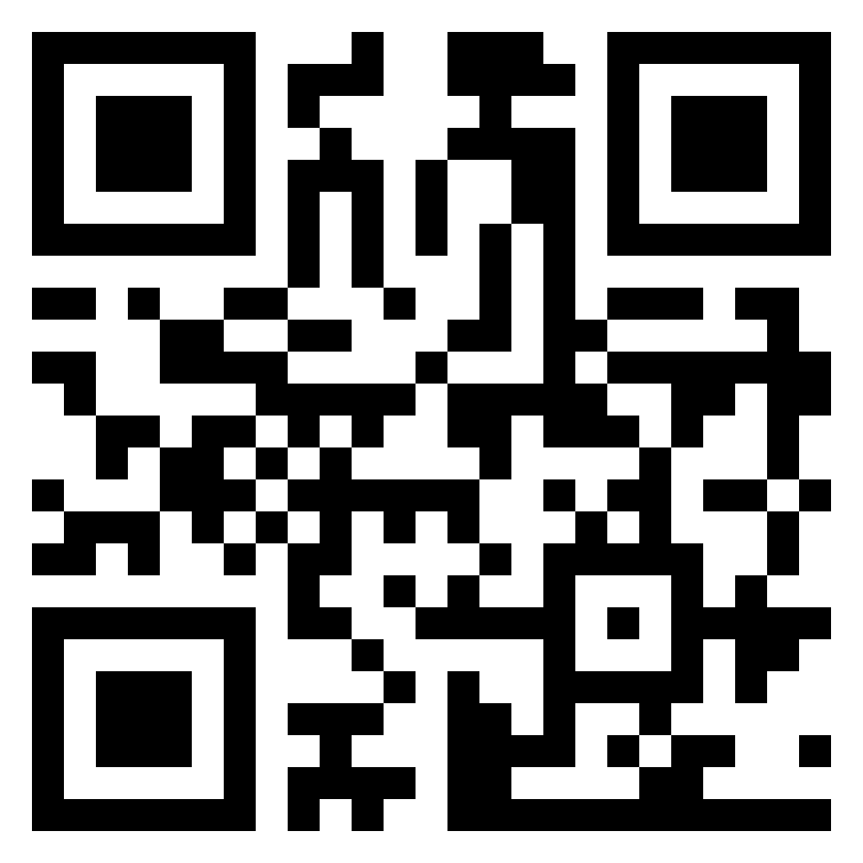
 |  | LOG-METADATA
 |  |  |  | YYYY | YYYY |  | MM | DD |  |  |  | # | # | #
LOG_SAMPLES_ |  |  |  |  |  |  |  |  |  | _STATION- |  |  |  |  |  | _METADATA
LATITUDE LONGITUDE
 | BATHYMETRY | OPERATOR(S)
Depth |  | SALINITY | SALINITY (from TSG U-Lab) |  | SEAWATER TEMPERATURE (from TSG in U-Lab ; °C) | SEAWATER TEMPERATURE °C (from TSG in U-Lab) |  | TURBIDITY (1 = open ocean; 2 = coastal; 3 = estuary) |  | TURBIDITY (1 = open ocean; 2 = coastal; 3 = estuary) | TURBIDITY DATA (from S-Lab ; FNU) | TURBIDITY DATA FNU (from S-Lab) | FLUORESCENCE (from fluoroprobe in U-Lab ; µg.L⁻¹) | FLUORESCENCE (from fluoroprobe in U-Lab ; µg.L⁻¹) | FLUORESCENCE µg.L⁻¹ (from fluoroprobe in U-Lab)
[1] Z= m |  |  |  |  |  |  |  | 1 [ ] 2 [ ] 3 [ ] |  | 1 [ ] 2 [ ] 3 [ ]
[2] Z= m |  |  |  |  |  |  |  | 1 [ ] 2 [ ] 3 [ ] |  | 1 [ ] 2 [ ] 3 [ ]
[3] Z= m |  |  |  |  |  |  |  | 1 [ ] 2 [ ] 3 [ ] |  | 1 [ ] 2 [ ] 3 [ ]
START UTC HH:MM
END UTC HH:MM
STATION NAME
COMMENTS
LISTS OF DEPLOYMENTS BY STATION:
NORMAL SITE
SERVICE SITE
ROSETTE
A20 PUMP FOR OMICS
A20 PUMP FOR DECKNET 5 µM
A40 PUMP FOR DECKNET 20 µM
ASM
NET 200 µM
NET 680 µM
BOW POLE
MERCURY
LOG-METADATA_recto_V22032023

Slide 2
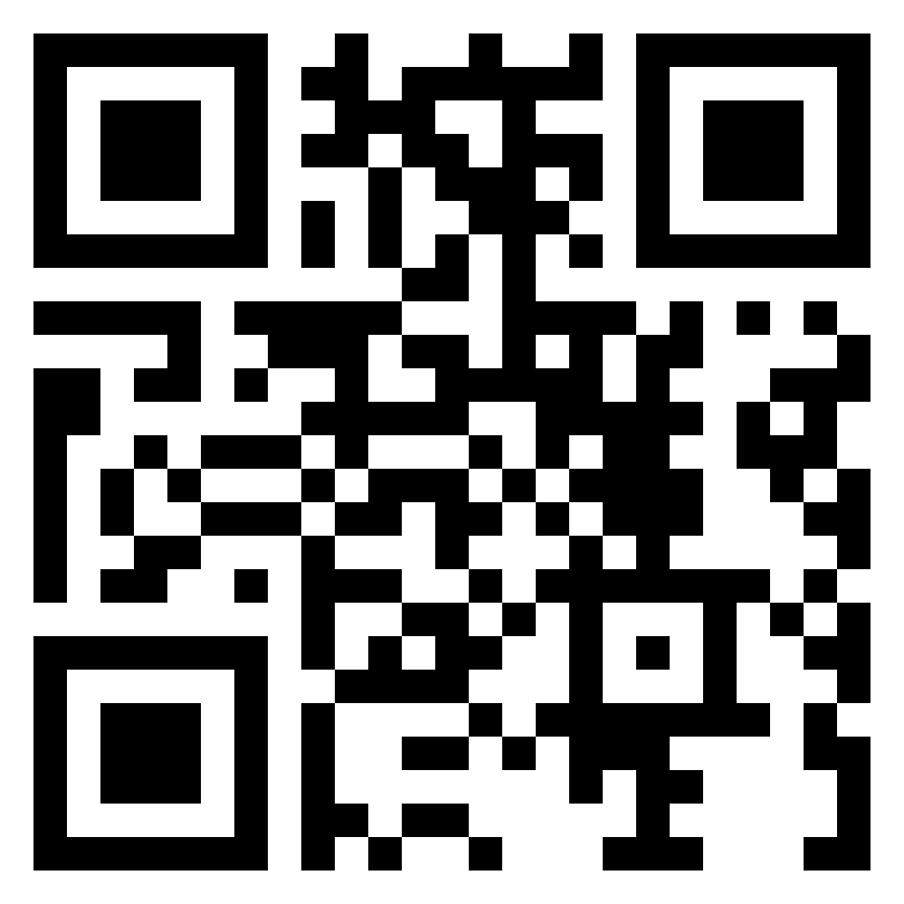
 |  | LOG-METADATA
 |  | COMMENTS
LOG-METADATA_verso _V22032023

Slide 3
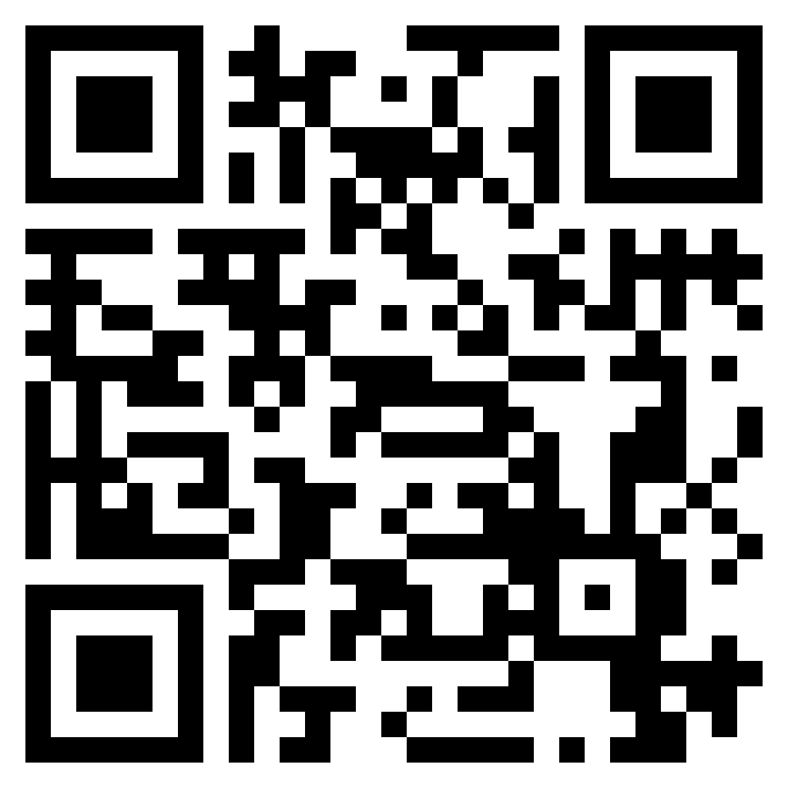
 |  | LOG-EVENT_ROSETTE
STATION |  |  |  | CAST #
NORMAL SITE SERVICE SITE
[ UTC ] | YYYY | MM | DD |  | HH | MM
START | 20
END | 20
OPERATORS INITIALS
DECIMAL DEGREE (+/- XX.XXXX)
DECIMAL DEGREE (+/- XX.XXXX)
•
•
•
•
CABLE OUT (m) |  |  | SOUNDER IN (m) |  |  | WIND SPEED (kn)
SCANMAR (m) |  |  | SOUNDER OUT (m) |  |  | WIND DIRECTION
PLACE NAME |  |  |  |  |  | SEASTATE START
CTD raw file name |  |  |  |  |  | SEASTATE END
UVP raw file name |  |  |  |  |  | Other information
Bottle # | 1 | 2 | 3 | 4 | 5 | 6 | 7 | 8 | 9 | 10 | 11 | 12
Bottle Volume (L) | 8 | 8 | 12 | 12 | 12 | 8 | 8 | 12 | 12 | 8 | 8 | 8
Depth Label | Z | Z | Z | Z | Z | Z | Z | Z | Z | Z | Z | Z
Target Depth (m)
CTD Depth (m)
LOG-EVENT_ROSETTE_recto_V3
LOG-EVENT_ROSETTE_recto_V22032023

Slide 4
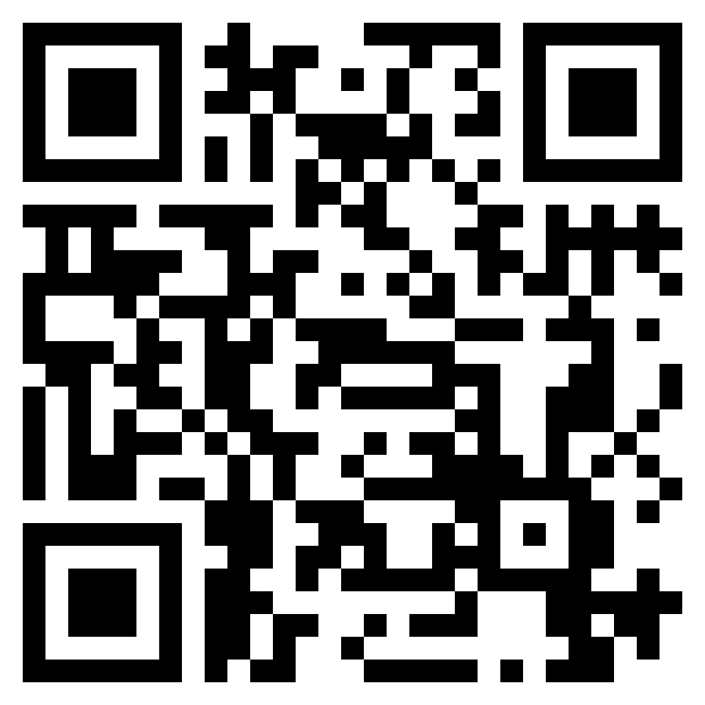
 |  | LOG-EVENT_ROSETTE
LOG-EVENT_ROSETTE_verso_V22032023

Slide 5

 |  | LOG-EVENT_NET
STATION
NORMAL SITE SERVICE SITE
[ UTC ] | YYYY | MM | DD |  | HH | MM
START | 20
END | 20
INVESTIGATOR(S) |  |  |  |  |  |  | DAY |  |  |  | NIGHT
DECIMAL DEGREE (+/- XX.XXXX)
DECIMAL DEGREE (+/- XX.XXXX)
•
•
•
•
SOUNDER IN (m) |  |  | CABLE OUT (m) |  |  | SEASTATE START
SOUNDER OUT (m) |  |  | SCANMAR (m) |  |  | SEASTATE END
NET TYPE | Decknet 20* | WPII 200 | Regent 680 | Decknet 5
NET TOW TYPE | Horizontal | Oblique
NET DEPTH (m) | MIN |  | MAX
NET FLOWMETER | START |  | END
NET COD-END 680 | ZooScan | S680-L
COMMENTS
/VOLUMETER in L for 20-µM
*volumeter always in litres
LOG-EVENT_NET_recto_V22032023
Notes:
Ajouter case decknet débitcompteur

Slide 6
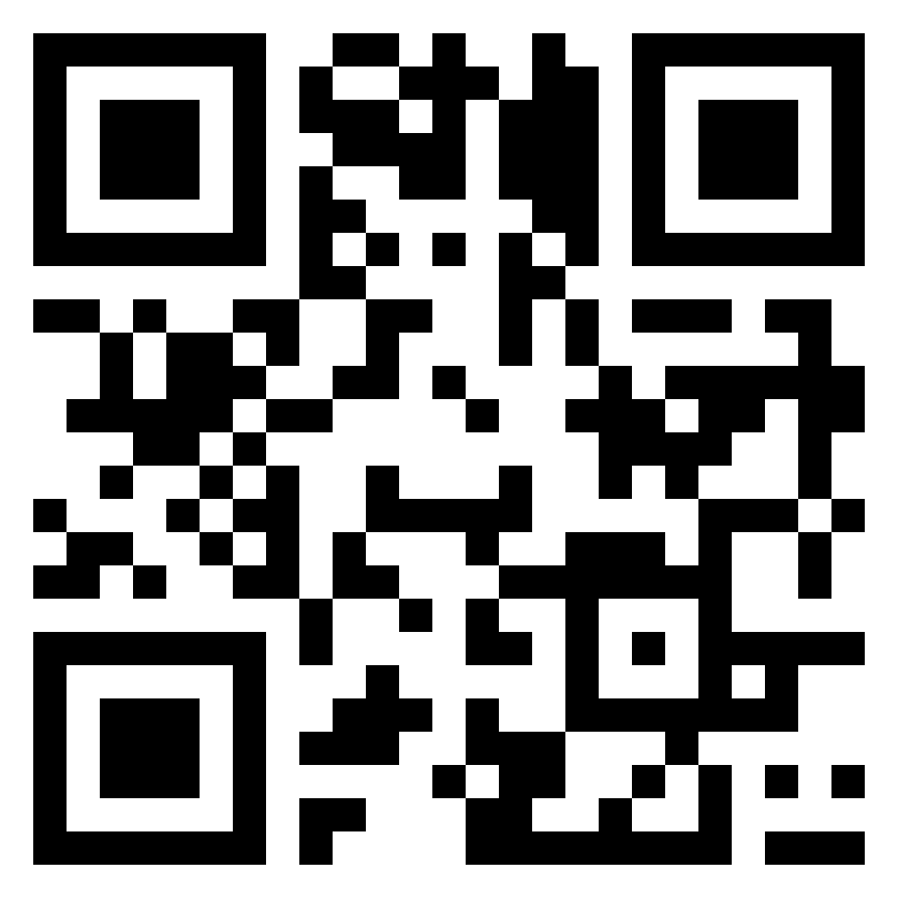
 |  | LOG-EVENT_NET
LOG-EVENT_NET_verso_V22032023

Slide 7
 |  | LOG-EVENT_NET
STATION
NORMAL SITE SERVICE SITE
[ UTC ] | YYYY | MM | DD |  | HH | MM
START | 20
END | 20
INVESTIGATOR(S) |  |  |  |  |  |  | DAY |  |  |  | NIGHT
DECIMAL DEGREE (+/- XX.XXXX)
DECIMAL DEGREE (+/- XX.XXXX)
•
•
•
•
SOUNDER IN (m) |  |  | CABLE OUT (m) |  |  | SEASTATE START
SOUNDER OUT (m) |  |  | SCANMAR (m) |  |  | SEASTATE END
NET TYPE | Decknet 20* | WPII 200 | Regent 680 | Decknet 5
NET TOW TYPE | Horizontal | Oblique
NET DEPTH (m) | MIN |  | MAX
NET FLOWMETER | START |  | END
NET COD-END 680 | ZooScan | S680-L
COMMENTS
/VOLUMETER in L for 20-µM
*volumeter always in litres
LOG-EVENT_NET_recto_V22032023
Notes:
Ajouter case decknet débitcompteur

Slide 8
 |  | LOG-EVENT_NET
LOG-EVENT_NET_verso_V22032023

Slide 9
 |  | LOG-EVENT_NET
STATION
NORMAL SITE SERVICE SITE
[ UTC ] | YYYY | MM | DD |  | HH | MM
START | 20
END | 20
INVESTIGATOR(S) |  |  |  |  |  |  | DAY |  |  |  | NIGHT
DECIMAL DEGREE (+/- XX.XXXX)
DECIMAL DEGREE (+/- XX.XXXX)
•
•
•
•
SOUNDER IN (m) |  |  | CABLE OUT (m) |  |  | SEASTATE START
SOUNDER OUT (m) |  |  | SCANMAR (m) |  |  | SEASTATE END
NET TYPE | Decknet 20* | WPII 200 | Regent 680 | Decknet 5
NET TOW TYPE | Horizontal | Oblique
NET DEPTH (m) | MIN |  | MAX
NET FLOWMETER | START |  | END
NET COD-END 680 | ZooScan | S680-L
COMMENTS
/VOLUMETER in L for 20-µM
*volumeter always in litres
LOG-EVENT_NET_recto_V22032023
Notes:
Ajouter case decknet débitcompteur

Slide 10
 |  | LOG-EVENT_NET
LOG-EVENT_NET_verso_V22032023

Slide 11
 |  | LOG-EVENT_NET
STATION
NORMAL SITE SERVICE SITE
[ UTC ] | YYYY | MM | DD |  | HH | MM
START | 20
END | 20
INVESTIGATOR(S) |  |  |  |  |  |  | DAY |  |  |  | NIGHT
DECIMAL DEGREE (+/- XX.XXXX)
DECIMAL DEGREE (+/- XX.XXXX)
•
•
•
•
SOUNDER IN (m) |  |  | CABLE OUT (m) |  |  | SEASTATE START
SOUNDER OUT (m) |  |  | SCANMAR (m) |  |  | SEASTATE END
NET TYPE | Decknet 20* | WPII 200 | Regent 680 | Decknet 5
NET TOW TYPE | Horizontal | Oblique
NET DEPTH (m) | MIN |  | MAX
NET FLOWMETER | START |  | END
NET COD-END 680 | ZooScan | S680-L
COMMENTS
/VOLUMETER in L for 20-µM
*volumeter always in litres
LOG-EVENT_NET_recto_V22032023
Notes:
Ajouter case decknet débitcompteur

Slide 12
 |  | LOG-EVENT_NET
LOG-EVENT_NET_verso_V22032023

Slide 13
 |  | LOG-EVENT_NET
STATION
NORMAL SITE SERVICE SITE
[ UTC ] | YYYY | MM | DD |  | HH | MM
START | 20
END | 20
INVESTIGATOR(S) |  |  |  |  |  |  | DAY |  |  |  | NIGHT
DECIMAL DEGREE (+/- XX.XXXX)
DECIMAL DEGREE (+/- XX.XXXX)
•
•
•
•
SOUNDER IN (m) |  |  | CABLE OUT (m) |  |  | SEASTATE START
SOUNDER OUT (m) |  |  | SCANMAR (m) |  |  | SEASTATE END
NET TYPE | Decknet 20* | WPII 200 | Regent 680 | Decknet 5
NET TOW TYPE | Horizontal | Oblique
NET DEPTH (m) | MIN |  | MAX
NET FLOWMETER | START |  | END
NET COD-END 680 | ZooScan | S680-L
COMMENTS
/VOLUMETER in L for 20-µM
*volumeter always in litres
LOG-EVENT_NET_recto_V22032023
Notes:
Ajouter case decknet débitcompteur

Slide 14
 |  | LOG-EVENT_NET
LOG-EVENT_NET_verso_V22032023

Slide 15
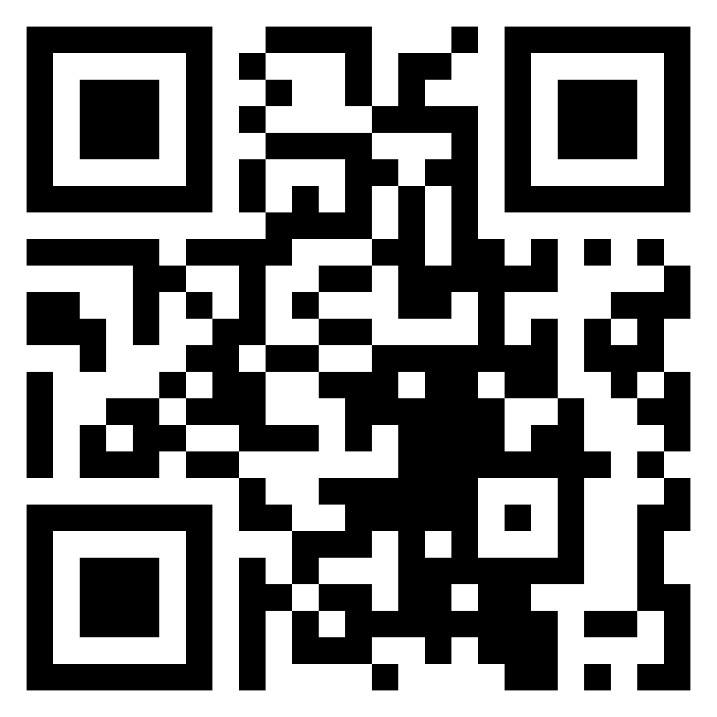
 |  | LOG-EVENT_OTHER
NORMAL SITE SERVICE SITE
STATION
[ UTC ] | YYYY | MM | DD |  | HH | MM
START | 20
END | 20
INVESTIGATOR(S)
DECIMAL DEGREE (+/- XX.XXXX)
DECIMAL DEGREE (+/- XX.XXXX)
•
•
•
•
EVENT TYPE | SML | MICROTOPS | BOW POLE | hTSRB
 | A20 PUMP | A40 PUMP | ASM Normal site | ASM Service site
 | Aliens in ports
eDNA
COMMENTS / PROTOCOL NAMES
T-HG
Vial-40mL
RT >10°C
###
T-HG-1
###
T-HG-2
MTE-BP
Bottle-125mL
RT >10°C
###
MTE-S-1
###
MTE-S-2
ASM
Whirl-Pak
FRZ -20°C
###
ASM-1
###
ASM-2
###
ASM-3
###
ASM-4
###
ASM-5
###
ASM-6
LOG-EVENT_OTHER_recto_V22032023

Slide 16
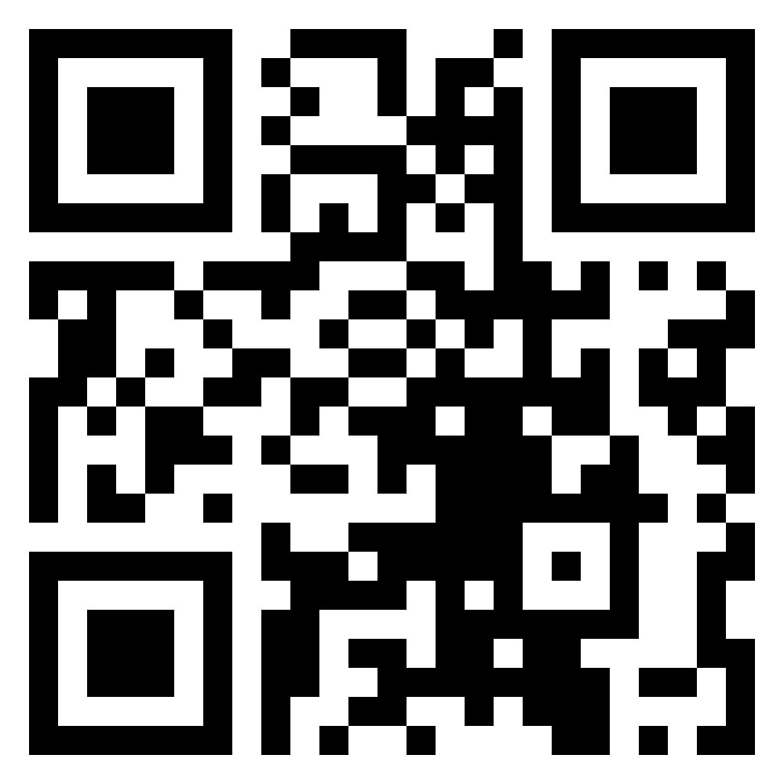
 |  | LOG-EVENT_OTHER
LOG-EVENT_OTHER_verso_V22032023

Slide 17
 |  | LOG-EVENT_OTHER
NORMAL SITE SERVICE SITE
STATION
[ UTC ] | YYYY | MM | DD |  | HH | MM
START | 20
END | 20
INVESTIGATOR(S)
DECIMAL DEGREE (+/- XX.XXXX)
DECIMAL DEGREE (+/- XX.XXXX)
•
•
•
•
EVENT TYPE | SML | MICROTOPS | BOW POLE | hTSRB
 | A20 PUMP | A40 PUMP | ASM Normal site | ASM Service site
 | Aliens in ports
eDNA
COMMENTS / PROTOCOL NAMES
T-HG
Vial-40mL
RT >10°C
###
T-HG-1
###
T-HG-2
MTE-BP
Bottle-125mL
RT >10°C
###
MTE-S-1
###
MTE-S-2
ASM
Whirl-Pak
FRZ -20°C
###
ASM-1
###
ASM-2
###
ASM-3
###
ASM-4
###
ASM-5
###
ASM-6
LOG-EVENT_OTHER_recto_V22032023

Slide 18
 |  | LOG-EVENT_OTHER
LOG-EVENT_OTHER_verso_V22032023

Slide 19
 |  | LOG-EVENT_OTHER
NORMAL SITE SERVICE SITE
STATION
[ UTC ] | YYYY | MM | DD |  | HH | MM
START | 20
END | 20
INVESTIGATOR(S)
DECIMAL DEGREE (+/- XX.XXXX)
DECIMAL DEGREE (+/- XX.XXXX)
•
•
•
•
EVENT TYPE | SML | MICROTOPS | BOW POLE | hTSRB
 | A20 PUMP | A40 PUMP | ASM Normal site | ASM Service site
 | Aliens in ports
eDNA
COMMENTS / PROTOCOL NAMES
T-HG
Vial-40mL
RT >10°C
###
T-HG-1
###
T-HG-2
MTE-BP
Bottle-125mL
RT >10°C
###
MTE-S-1
###
MTE-S-2
ASM
Whirl-Pak
FRZ -20°C
###
ASM-1
###
ASM-2
###
ASM-3
###
ASM-4
###
ASM-5
###
ASM-6
LOG-EVENT_OTHER_recto_V22032023

Slide 20
 |  | LOG-EVENT_OTHER
LOG-EVENT_OTHER_verso_V22032023

Slide 21
 |  | LOG-EVENT_OTHER
NORMAL SITE SERVICE SITE
STATION
[ UTC ] | YYYY | MM | DD |  | HH | MM
START | 20
END | 20
INVESTIGATOR(S)
DECIMAL DEGREE (+/- XX.XXXX)
DECIMAL DEGREE (+/- XX.XXXX)
•
•
•
•
EVENT TYPE | SML | MICROTOPS | BOW POLE | hTSRB
 | A20 PUMP | A40 PUMP | ASM Normal site | ASM Service site
 | Aliens in ports
eDNA
COMMENTS / PROTOCOL NAMES
T-HG
Vial-40mL
RT >10°C
###
T-HG-1
###
T-HG-2
MTE-BP
Bottle-125mL
RT >10°C
###
MTE-S-1
###
MTE-S-2
ASM
Whirl-Pak
FRZ -20°C
###
ASM-1
###
ASM-2
###
ASM-3
###
ASM-4
###
ASM-5
###
ASM-6
LOG-EVENT_OTHER_recto_V22032023

Slide 22
 |  | LOG-EVENT_OTHER
LOG-EVENT_OTHER_verso_V22032023

