Slide 1



 |  | LOG-SAMPLES_MERCURY |  | B4
 |  | YYYY | MM | DD |  |  | # | # |  | #
LOG_SAMPLES_ |  |  |  |  | _STATION- |  |  |  |  |  | _MERCURY
 | OPERATOR(S)
Depth | p.MeHg Glass fiber filter FRZ -20°C | Filter code |  | Filtration Volume (mL) |  | Filtration time (min) |  |  | f.MeHg 125-mL PETG bottle FRG +4°C
Z00 m | ###-Z00 p.MeHg |  |  |  |  |  |  |  | ###-Z00 f.MeHg
Z02 m | ###-Z02 p.MeHg |  |  |  |  |  |  |  | ###-Z02 f.MeHg
Depth | p.THg Glass fiber filter FRZ -20°C | Filter code |  | Filtration Volume (mL) |  | Filtration time (min) |  |  | f.THg 40-mL glass bottle FRG +4°C
Z00 m | ###-Z00 p.THg |  |  |  |  |  |  |  | ###-Z00 f.THg
Z02 m | ###-Z02 p.THg |  |  |  |  |  |  |  | ###-Z02 f.THg
Depth | uf.THg 40-mL glass bottle RT
Z00 m | ###-Z00 uf.THg
Z02 m | ###-Z02 uf.THg
LOG-SAMPLES_MERCURY_recto_V03032024

Slide 2
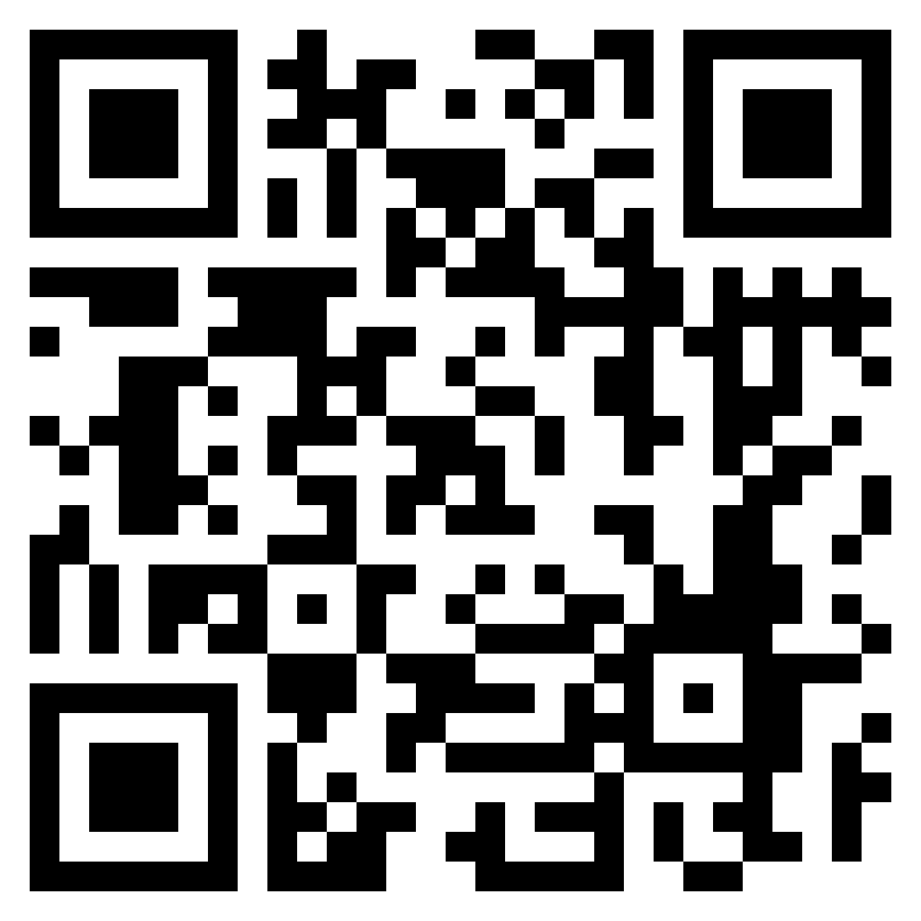
 |  | LOG-SAMPLES_MERCURY |  | B4
Depth | COMMENTS |  |  | COMMENTS MB320
Z00 m
LOG-SAMPLES_MERCURY_verso_V03032024

