Slide 1


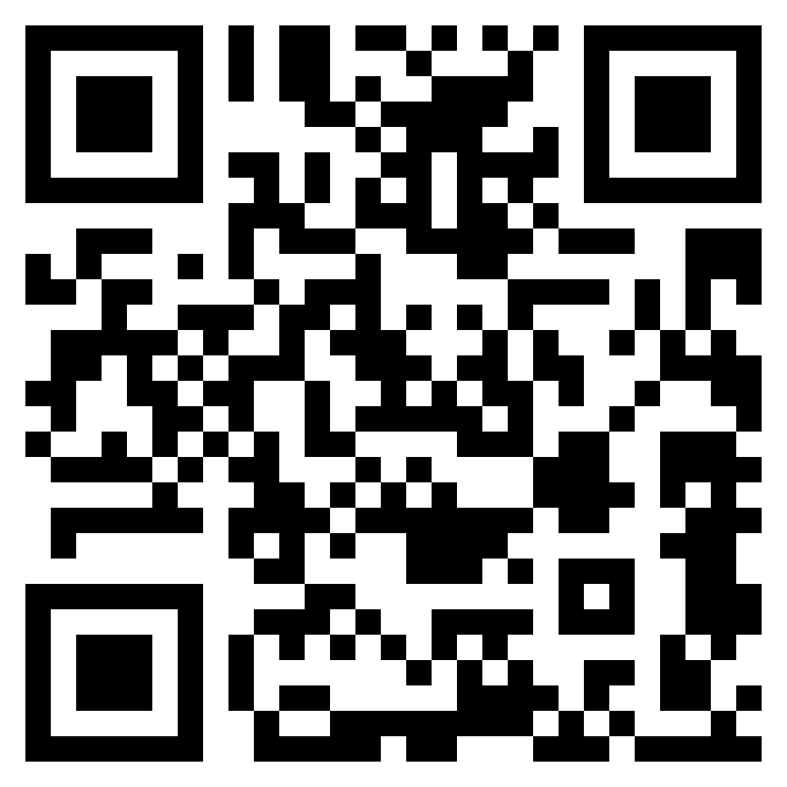
 |  | LOG-SAMPLES_W-LAB-142-SERVICE-SITE-1 |  | C2
 |  | YYYY | MM | DD |  |  | # | # |  | #
LOG_SAMPLES_ |  |  |  |  | _STATION- |  |  |  |  |  | _W-LAB-142-SS-1
 | OPERATOR(S)
Depth Replicate | S02-2K Cryo-5mL LN2 #1 | Filtration Volume (Litres) |  | Filtration Duration (minutes)
Z00 R01 m | ###-Z00 S02-2K-1 | 15L |  | 15’ |  | 80 L : Collect filtrate for SS protocols onland : VV<0.2, qPCR<0.2 .
 |  | L |  | min.
Z00 R02 m | ###-Z00 S02-2K-2 | 15L |  | 15’
 |  | L |  | min.
Depth Replicate | < 3 µm
Z00 m | For onland protocols |  |  |  |  | 50 L : Collect filtrate for SS protocols onland : V<3, RBM<3, VV<3, VV<3bis
LOG-SAMPLES_W-LAB-142-SERVICE-SITE-1_recto_V19012024

Slide 2
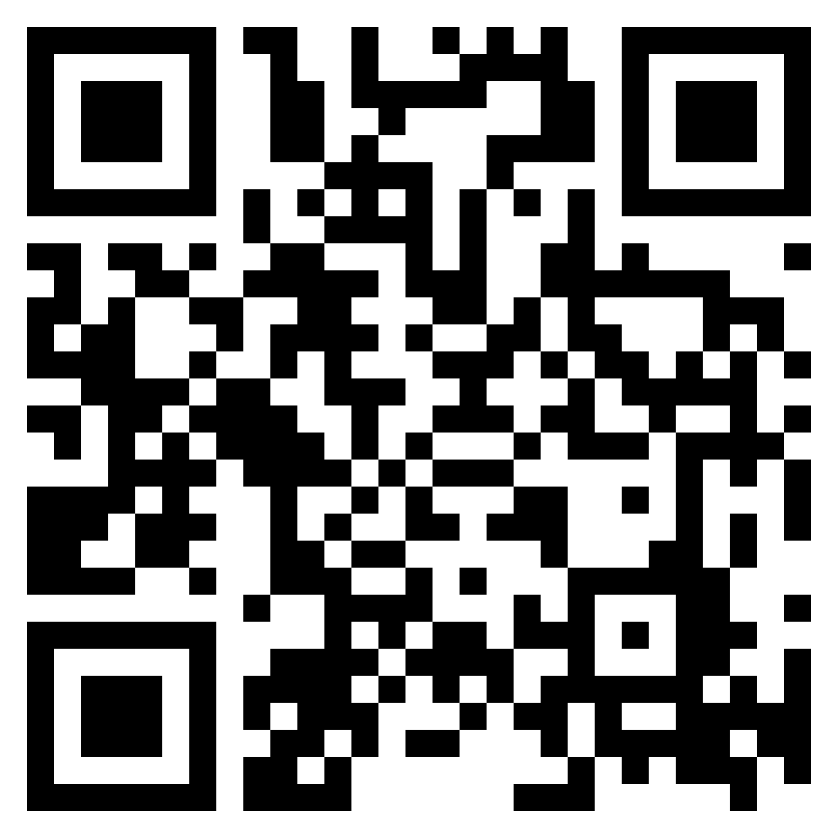
 |  | LOG-SAMPLES_W-LAB-142-SERVICE-SITE-1 |  | C2
Depth Replicate |  |  |  | COMMENTS S02-2K
Z00 R01 m
Z00 R02 m
Depth Replicate |  |  |  | COMMENTS < 3 µm
Z00 m
LOG-SAMPLES_W-LAB-142-SERVICE-SITE-1_verso_V19012024

